Slide 1
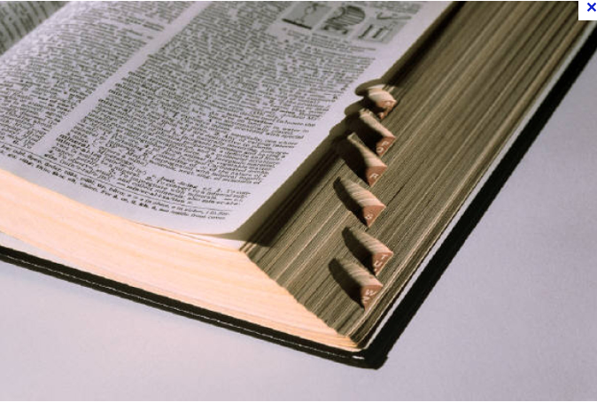
The role of the lexicon in regular sound change
William Labov
University of Pennsylvania
NWAV41 Bloomington Oct 26, 2012

Slide 2
www.ling.upenn.edu/~labov

Slide 3
The Neogrammarian viewpoint
Every sound change, inasmuch as it occurs mechanically, takes place according to laws that admit no exception. --Ostoff and Brugmann 1878
Sound-change is merely a change in the speakers’ manner of producing phonemes and accordingly, affects a phoneme at every occurrence, regardless of the nature of any particular linguistic form in which the phoneme happens to occur. . .
The whole assumption can be briefly put into the words: phonemes change. --Bloomfield 1933:353-4

Slide 4
Lexical diffusion
The phonetic law does not affect all items at the same time: some are designed to develop quickly, others remain behind, some offer strong resistance and succeed in turning back any effort at transformation.
--Gauchat (cited in Dauzat 1922)
We hold that words change their pronunciations by discrete, perceptual increments (i.e., phonetically abrupt) but severally at a time (i.e., lexically gradual) --Wang and Chen 1977:150.
The lexically gradual view of sound change is incompatible, in principle, with the structuralist way of looking at sound change. --Chen and Wang 1957:257.

Slide 5
Resolving the Neogrammarian Controversy (Labov 1981)
Regular sound change is the result of a gradual transformation of a single phonetic feature of a phoneme in a continuous phonetic space.
Lexical diffusion is the result of the abrupt substitution of one phoneme for another in words that contain that phoneme.

Slide 6
Reports of lexical diffusion, 1970-1997
1970
Cheng, Chin-Chuan, and Wang, Wm. S-Y. 1970. Phonological change of Middle Chinese initials. University of California (Berkeley) Dept. of Linguistics. Project on Linguistic Analysis, Second Series, 10 CW1 - CW69.
1973
Sherman, D. 1973. Noun-verb stress alternation: an example of the lexical diffusion of sound change in English. Project on Linguistic Analysis, Reports, Second Series, 17: 46-81.
1976
Barrack, C. M. 1976. Lexical diffusion and the High German consonant shift. Lingua 40:151-75.
Toon, Thomas E. 1976. The variationist analysis of Early Old English manuscript data. In W. M. Christie Jr. (ed.), Proceedings of the Second International Conference on Historical Linguistics. Amsterdam: North Holland. Pp. 71-81.
Toon, Thomas E.. 1976. The actuation and implementation of an Old English sound change. In R. J. Di Pietro & E. L. Blansitt (eds.), The Third Lacus Forum. Pp. 614-622. Columbia, SC: Hornbeam Press, Inc.
1977
Cheng, Chin-chuan and William S.-Y. Wang. 1977. Tone change in Chaozhou Chinese: a study of lexical diffusion. In W. S-Y. Wang (ed),The Lexicon in Phonological Change. The Hague: Mouton Pp. 86-100.
Wang, William S.-Y. and C.-C. Cheng. 1977. Implementation of phonological change: the Shaungfeng Chinese case. In W. S-Y. Wang (ed.),The lexicon in phonological change. The Hague: Mouton.

Slide 7
Reports of lexical diffusion, 1977-1982
1977
Janson, Tore. 1977. Reversed lexical diffusion and lexical split: Loss of -d in Stockholm. In Wang (ed.), The Lexicon in Phonological Change. The Hague: Mouton. Pp. 252-65.
Lyovin, Anatole. 1977. Sound change, homophony, and lexical diffusion. In W. Wang (ed.), The Lexicon in Phonological Change. The Hague: Mouton. Pp. 120-32.
1978
Krishnamurti, Bh. 1978. Areal and lexical diffusion of sound change. Language 54. 1-20.
Toon, Tomas E. 1978. Lexical diffusion in Old English. CLS. Papers from the Parasessions on the Lexicon.
1979
Wang, William S.-Y. 1979. Language change--a lexical perspective. Ann. Rev. Anthropol. 8:353-71.
1980
Milroy, James. 1980. Lexical alternation and the history of English: evidence from an urban vernacular. In E. Traugott et al. (ed., Papers from the 4th International Conference on Historical Linguistics. Amsterdam: John Benjamins.
Phillips, B. S. 1980. Lexical diffusion and Southern Tune, Duke, News. American Speech 56:72-78.
1981
Wallace, Rex. 1981. The variable deletion of final s in Latin. Ohio State M.A. Thesis.
Bauer, Robert S. 1982. Cantonese sociolinguistic patterns: correlating social characteristics of speakers with phonological variables in Hong Kong Cantonese. U. of California Berkeley dissertation.

Slide 8
Reports of lexical diffusion, 1982-1987
1982
Li, Paul Jen-Kuei . 1982. Linguistic variations of different age groups in the Atayalic dialects. The Tsing Hua Journal of Chinese Studies, new series, 14:167-191.
Chan, Marjorie K. M. 1983. Lexical diffusion and two Chinese case studies re-analyzed. Acta Orientalia 44:117-52.
1983
Phillips, Betty S. 1983. Middle English diphthongization, phonetic analogy, and lexical diffusion. WORD 34.1: 11-23. April 1983.
1984
Phillips, B. S. 1984. Word frequency and the actuation of sound change. Language 60:320-42.
Wallace, Rex. 1984. Variable deletion of -s in Latin: Its consequences for Romance. In Baldi, P. (ed), Papers from the XIIth Linguistic Symposium on Romance Languages. Philadelphia: J., Benjamins. Pp. 565-577.
1985
Fagan, D. S. 1985. Competing sound change via lexical diffusion in a Portuguese dialect. Sezione Romanza 27:263-92.,.
1986
Bauer, Robert S. 1986. The microhistory of a sound change in progress in Hong Kong Cantonese. Journal of Chinese Linguistics 14:1-41.
1987
Lien, Chinfa. 1987. Coexistent tone systems in Chinese dialects. Berkeley: University of California dissertation.

Slide 9
Reports of lexical diffusion, 1987-1991
1987
Gamble, G. 1987. Nootkan glottalized resonsants in Nitinat: a case of lexical diffusion. In W. Wang (ed.), The Lexicon in Phonological Change. The Hague: Mouton. Pp. 266-278.
Ogura, Mieko. 1987. Historical English Phonology: A Lexical Perspective. Tokyo: Kenkyusha.
1989
Harris, John. 1989. Towards a lexical analysis of sound change in progress. Journal of Linguistics 25:35-56.
Labov, William. 1989. The exact description of the speech community: short a in Philadelphia. In R. Fasold & D. Schiffrin (eds.),Language Change and Variation. Washington, Georgetown U.P. Pp. 1-57.
Phillips, Betty S. 1989. The Diffusion of a Borrowed Sound Change. JENGL 22.2, October
1990
Shen, Zhongwei. 1990. Lexical diffusion: a population perspective and a numerical model. Journal of Chinese Linguistics 18:159-200.
1991
Ogura, Mieko, William S.-Y. Wang and L. L. Cavalli-Sforza. 1991. The development of ME i in England: a study in dynamic dialectology. In P. Eckert (ed.), New Ways of Analyzing Sound Change. New York: Academic Press, pp. 63-106.
.

Slide 10
Reports of lexical diffusion, 1993-2006
1993
Wang, William S.-Y. and Chinfa Lien 1993. Bidirectional diffusion in sound change. In Charles Jones (ed.), Historical Linguistics: Problems and Perspectives. London: Longman Ltd. Pp. 345-400.
1997
Krishnamurti, Bh. 1997. Regularity of sound change through lexical diffusion (A study of s > h > zero in Gondi dialects. Paper presented to the Panel on Lexical Diffusion at the 16th International Congress of Linguists, Paris, July 21.
1998
Krishnamurti, Bh. 1998. Regularity of sound change through lexical diffusion: A study of s > h > 0 in Gondi dialects. Language Variation and Change 10:193-220.
2006
Phillips, Betty S. 2006. Word frequency and lexical diffusion. New York: Palgrave Macmillan.

Slide 11
Lexical diffusion of /s -> h -> 0/ in Gondi dialects
Proto-Gondi | Meaning | Adi. | Yeo. | Bet. | Chi. | Man. | Cha. | Mur. | Sur. | N. | Mar. | Koi
*satta | 'shoulder' | s | - | s | s | s | h | h | h | 0 | 0 | 0
*sanai | 'son-in-law' | s | s | s | s | s | h | h | h | -- | 0 | --
*sari | 'way' | s | s | s | s | s | h | h/0 | -- | h | 0 | 0
*sar- | 'tear' | s | -- | s | s | s | h | h | h/0 | -- | 0 | --
*sarung | 'six' | s | s | s | s | s | s | h | -- | h | 0 | 0
*sur | 'go' | s | s | s/h | s/h | s/h | h | h | h | 0 | 0 | --
*son | 'see' | s | s | h | -- | h | -- | h | h | h | 0 | --
*sille | 'not' | s | s | -- | -- | h | -- | -- | h/0 | -- | 0 | 0

Slide 12
Words floating on the surface of sound change Fronting of /ow/ for words before /l/ and others for North America and the Southeast
Words selected by regression analysis at p <.001 level as ahead of phonological prediction, light blue; behind, yellow

Slide 13
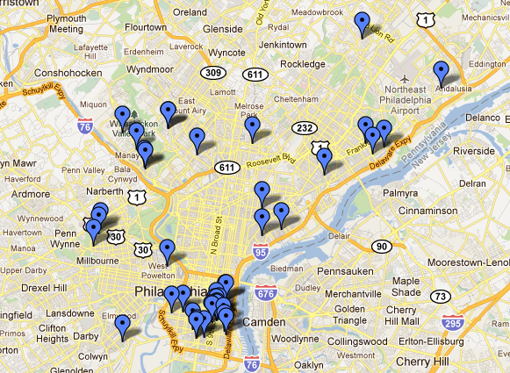
Locations of LING560 Studies, 1972-2010, transcribed and analyzed to form the Philadelphia Neighborhood Corpus

Slide 14
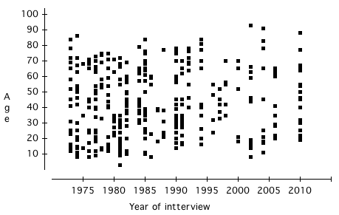
PNC subjects analyzed as of September 2012 by Age and Year of Interview
Year of Interview

Slide 15
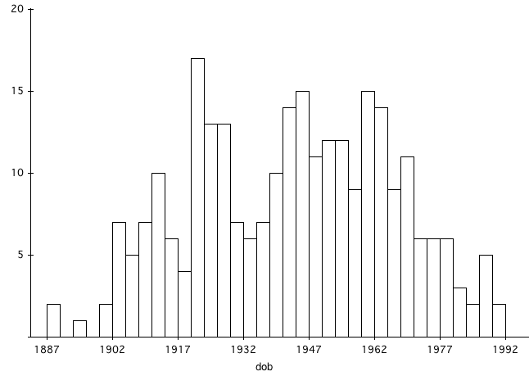
Distribution of Dates of Birth in Philadelphia Neighborhood Corpus, 1887 - 1991

Slide 16
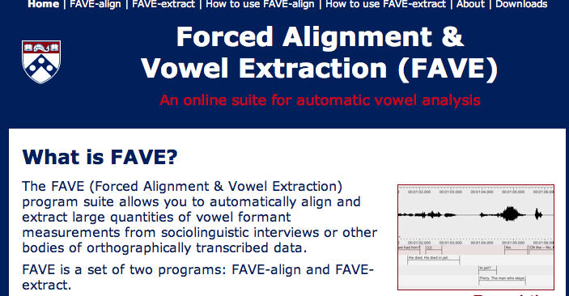
The FAVE web site fave.ling.upenn.edu

Slide 17
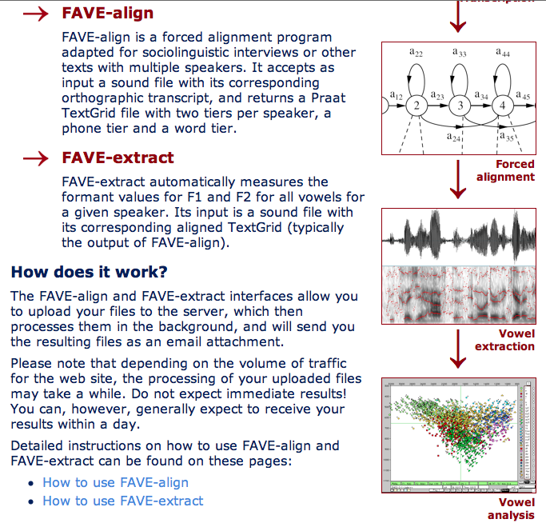

Slide 18
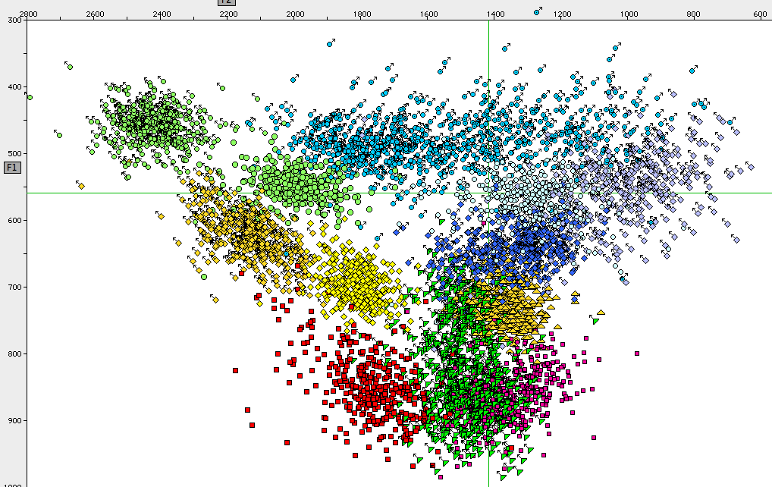
Mean values of 14 vowels of 388 speakers in the Philadelphia Neighborhood Corpus
/iyC/
/eyC/

Slide 19
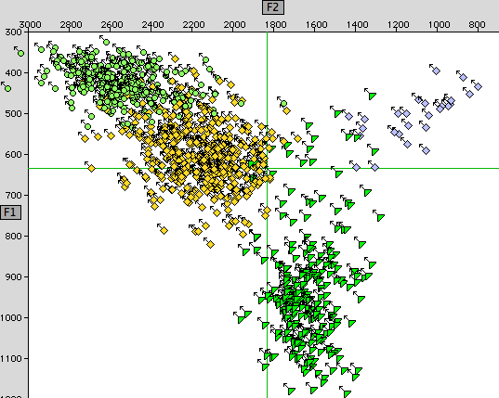
Front upgliding vowels of Mary C., 63 [1972], Daley St. PH73-5-1
/iyC/
/oy/
/eyC/
/ayv/

Slide 20
Raising along the front diagonal (F2 – 2 * F1) of /eyC/ in made, pain, etc. vs. stability of /eyF/ in may, mayor, male, etc. by Date of Birth for white adults [N=293]
Mary C.

Slide 21
Increasing height of /eyC/ in made, pain, etc. by Date of birth and by Sex
by Higher Education

Slide 22
Regression coefficients with p < .0001 for raising of /ey/ on the front diagonal, N = 56748
Date of birth | 2.582
Frequency | 0.015
Female | 20
Italian | 29
Jewish | -53
Onset
velar | 147
palatal | 142
none | 129
/w/ | -132
lateral | -141
stop/liquid | -170
Coda
complex | 44
velar | -88
lateral | -107
nasal | -127
none | -355
Stress
tertiary | 97
Duration | -0.760

Slide 23
Regression coefficients with p < .0001 for raising of /ey/ on the front diagonal, N = 56748
Date of birth | 2.582
Frequency | 0.015
Female | 20
Italian | 29
Jewish | -53
Onset
velar | 147
palatal | 142
none | 129
/w/ | -132
lateral | -141
stop/liquid | -170
Coda
complex | 44
velar | -88
lateral | -107
nasal | -127
none | -355
Stress
tertiary | 97
Duration | -0.760
hate | 224
stay | 145
gave | 111
came | 111
pay | 107
eight | 82
name | 70
days | 55
way | 45
day | 41
say | 38
make | -40

Slide 24
Phonetic constraints on raising of /ey/ with and without random effect of lexicon
- Lexicon
+ Lexicon
- Lexicon
+ Lexicon

Slide 25
A model of lexical diffusion: selection of eight words over time
First half: time 1-15
Second half: time 16-30

Slide 26
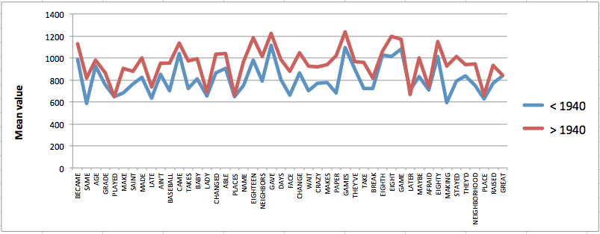
Mean front diagonal values for 47 most common words with checked /eyC/ for speakers in the Philadelphia Neighborhood Corpus born before and after 1940. r² = .83

Slide 27
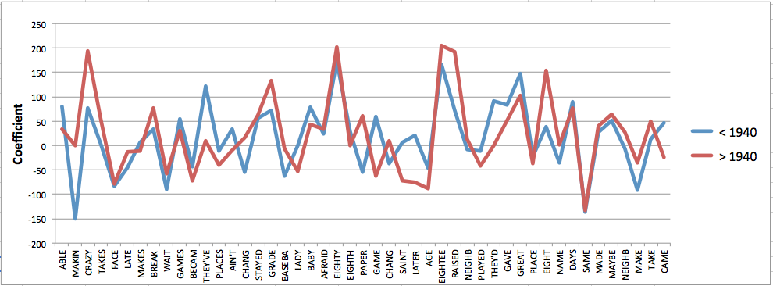
Figure 2. Front diagonal coefficients for 47 most common words with checked /eyC/ for speakers in the Philadelphia Neighborhood Corpus born before and after 1940. r² = .66.

Slide 28
days
change
made
gave
take
make
hate
name
came
eight

Slide 29
days
change
gave
made
take
hate
make
name
came
eight
a
pay
stay
say
day
way

Slide 30
grade
great
break
place

Slide 31
Classic exceptions to sound change: consonant/liquid onsets
/i:/ mite
/u:/ mouth
/e:/ meet
/o:/ moot
/ɛ:/ meat
great break
drain
/ɔ:/ moat
broad
/æ:/ mate
[ai]
[au]

Slide 32
Conclusion
Although significant lexical effects can be found in the course of a regular sound change, all words in which the phoneme occurs are selected to participate in the change in accordance with the phonetic factors that define the change.
Sound-change is merely a change in the speakers’ manner of producing phonemes and accordingly, affects a phoneme at every occurrence, regardless of the nature of any particular linguistic form in which the phoneme happens to occur. . . The whole assumption can be briefly put into the words: phonemes change. --Bloomfield 1933:353-4

