Slide 1

Cognitive Capacities of the Sociolinguistic Monitor
William Labov,
University of Pennsylvania
SS17 March 20, 2008

Slide 2
How is sociolinguistic information perceived and where is it stored?
www.ling.upenn.edu/~labov

Slide 3
The Sociolinguistic Monitor: some critical parameters
    Temporal window: Over what span of time do listeners modify their sociolinguistic judgments?
    Sensitivity: What is the just noticeable difference in frequencies that the SLM can detect?
      Does this sensitivity vary with age, region, social class?
    Linearity: Is the impact of successive instances of the variable constant or does it vary over time?

Slide 4
(ING)
The stable sociolinguistic variable (ING)
-ing vs. -in’
He’s working vs. He’s working.

Slide 5
Social and stylistic stratification of (ing) in the random sample of the Lower East Side of New York City adults [N=81]
Source: Labov 1966

Slide 6
Social and stylistic stratification of (ing) in the random sample of the Lower East Side of New York City adults [N=81]
Source: Labov 1966

Slide 7
Social stratification of (ing) in the random sample of the Lower East Side of New York City adults [N=81]
Source: Labov 1966

Slide 8
Stylistic stratification of (ing) in the random sample of the Lower East Side of New York City adults [N=81]
Source: Labov 1966

Slide 9
The social and stylistic stratification of (ing): a linear model
(ING) = a + b * SEC + c * ATS
where SEC = socio-economic class and ATS = attention paid to speech,
This implies but does not state the independence of SEC and ATS.
Equally true in the more general logistic expression used in sociolinguistic analysis today:

Slide 10
The variable (ING)
Definition: The alternation of /in/ and /iN/ in unstressed syllables
Not only in working, swimming, interesting, during,
but also something, nothing
Characteristics of production
High frequency
Regular stylistic and social stratification
Uniform across most English speech communities
Characteristics of social evaluation
A stereotype (“dropping the g”)
Overtly and accurately associated with informality

Slide 11
GRAMMATICAL AND STYLISTIC CONSTRAINTS
ON (ING) FOR A KING-OF-PRUSSIA FAMILY
Curt & Kay C., David, 7
parents son
STYLE
less formal (narrative) .72 .69
more formal (other) .38 .38
GRAMMATICAL FORM
progressive (I’m working on it) .61 .73
participle (A man working for you) .43 .30
nominal (Working is bad for you) .17 .20

Slide 12
Experiment 1: Philadelphia
Site: University of Pennsylvania, Philadelphia
Experimenter: W. Labov
Subjects: U of Penn undergraduates
Speaker: SA [White, female, Chicago]

Slide 13
Experiment 1: The Newscast trial
A young woman from Philadelphia has been studying to be a newscaster, and has applied for a job with a local radio station. Here are seven versions of a trial newscast that she read to submit with her job application. Would you please rate each one on the following scale by putting a check in one box:
TRIAL ONE
Perfectly Try another
professional . line of work
1 2 3 4 5 6 7
/ ______ / ______ / _____ / ______ / ______ / ______ / _______ /
. . .

Slide 14

The text for the Newscast experiment
SA
50% /in/
    President Bush announced tonight that he was putting all available White House resources into support for the new tax cut bill.
    Democratic leaders of the House and Senate are preparing compromise legislation.
    Republican spokespersons predicted that record numbers of working-class Americans would be receiving tax refund checks before the end of the year.
    Senator Edward Kennedy’s staff announced that the tax cuts are creating a new elite who are excused from paying their fair share of the cost of government.
    At the Office of Management of the Budget, officials are trying to estimate the size of the deficit that will be produced by the new legislation.
    Federal Reserve Board chairman Alan Greenspan stated that he was not confirming that tax cuts would lead to a change in prime interest rates, nor was he denying it.
    The Washington Post is publishing today a list of all members of Congress who will receive tax refunds greater than $1,000 as a result of the proposed tax cuts.
SA
70% /in/
AH
50% /in/

Slide 15
Mean ratings for Newscast Experiment 1.
Site = Philadelphia. Speaker: SA. N=23
prob block effect: = .066

Slide 16
Logarithmic fit to data of Experiment 1
0 30 50 70 100
Percent apical /in/

Slide 17
Another view of the results of Experiment 1
0 30 50 70 100
Percent apical /in/

Slide 18
Mean ratings of Newscast Experiment 2.
Speaker: SA. Site: Philadelphia. N=36
0 10 20 30 50 70 100
Percent apical /in/

Slide 19
Logarithmic relationship in Newscast Experiment 2. Site: Philadelphia. Speaker: SA. N=36.
0 10 20 30 50 70 100
Percent apical /in/

Slide 20
Results of Newscast Experiment 2 by Gender
Male N = 11; Female N = 25
0 10 20 30 50 70 100
Percent apical /in/

Slide 21
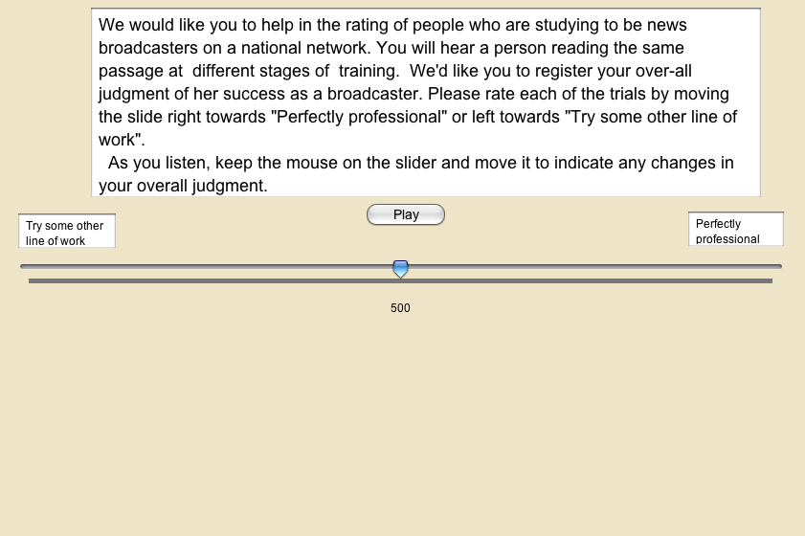
Instructions for individual administration of Newscast Experiment 2

Slide 22
Mean ratings for individual subjects on Newscast experiment 2.
Speaker: AH. Site: Philadelphia [N=56]
0 10 20 30 50 70 100
percent apical /in/

Slide 23
Experiment 3: Regional comparison I
Site: University of South Carolina, Columbia
Experimenter: Prof. Tracey Weldon
Subjects: U.S.C. students
Speaker: SA [White, female, Chicago]

Slide 24
Experiment 3: Regional comparison I
Site: University of South Carolina, Columbia
Experimenter: Prof. Tracey Weldon
Subjects: U.S.C. students
Speaker: SA [White, female, Chicago]

Slide 25
Results of Newscast Experiment 3.
Site: Columbia. Speaker = SA. N=55.
0 10 20 30 50 70 100
Percent apical /in/

Slide 26
Mean ratings of (ING) in Newscast experiments 2 and 3 by Philadelphia and Columbia subjects. Speaker: SA.
0 10 20 30 50 70 100
Percent apical /in/
90 80 70 50 30 0
Percent velar /ing/

Slide 27
Experiment 4: Regional comparison II
Site: University of South Carolina, Columbia
Experimenter: Prof. Tracey Weldon
Subjects: U.S.C. students
Regional speaker: JB (50%)

Slide 28
Results for Newscast Experiment 4: evaluation of use of (ING) by Columbia speaker JB by Columbia subjects. N=54 .
0 10 20 30 50 70 100
Percent apical /in/

Slide 29
Mean ratings for Newscast Experiments 3 and 4: Comparison of evaluation of speakers JB and SA by Columbia subjects
JB
(JB)
0 10 20 30 50 70 100
Percent apical /in/

Slide 30
Experiment 2: Regional comparison II
Site: University of New Hampshire, Durham
Experimenter: Prof. Naomi Nagy
Subjects: U. of NH students
Speaker: SA

Slide 31
Results for Newscast experiment 2: New England, Feb 2005
Speaker: SA. Site: U. of New Hampshire [N=51]
0 10 20 30 50 70 100
Percent apical /in/

Slide 32
Replication of Newscast experiment 2: New England, Oct 2005.
Speaker: SA. Site: U. of New Hampshire [N=33]
0 10 20 30 50 70 100
Percent apical /in/

Slide 33
Experiment 5: Regional comparison II
Site: University of New Hampshire, Durham
Experimenter: Prof. Naomi Nagy
Subjects: U. of NH. students
Regional speaker: JD

Slide 34
Results for Newscast Experiment 5: evaluation of use of (ING) by New England speaker JD by New Hampshire subjects, N=27 .

Slide 35
Why a logarithmic progression?
Noting that
it appears that the function 1/x may play a crucial role in generating these results

Slide 36
What is the effect of the i^{th} deviation of a speaker from an expected norm?
Hypothesis:
The effect of the i^{th} deviation on the perception of the distance from the norm is a function of the proportional increase in the total number of deviations.
where b is an impact coefficient specific to the variable and the community

Slide 37
If the impact coefficient is 1, the 4th deviation adds 1/3 to the total effect, the 5th deviation 1/4, and so on.
The total effect of n deviations is then
or
where a is the initial rating given to the speaker without any deviations from the norm and S is the sum of the proportional increase series.

Slide 38
The proportional increase series S = 1/1 + 1/2. . . 1/n
S does not converge to a limit but increases to .
The sum for a given number of terms is approximated by ln(n)+ γ, where γ = .5772156649… [Euler’s constant]

Slide 39
Approximation of Ln(i)+γ to Sum 1/x
.89 ln(x)+.89
R² = .9975
y = ln(x)+.557
R² = 1
γ

Slide 40
Predicting the experimental outcome
The experimental results which approximated a logarithmic progression were generated by the proportional increase function E.
Then setting the initial rating a at 2.00 and the impact coefficient b at 1.25, we can predict the experimental outcomes.

Slide 41
Derivation of the Experiment 2 results by E with an initial rating a = 2 and impact coefficient b 1.25
percent /in/ | Exp 2 | E
00 | 1.83 | 2.00
10 | 3.19 | 3.25
20 | 3.81 | 3.88
30 | 4.58 | 4.29
40 |  | 4.60
50 | 5.03 | 4.85
60 |  | 5.06
70 | 5.08 | 5.24
80 |  | 5.40
90 |  | 5.54
100 | 5.44 | 5.66
chi-sq difference= .056, n.s.

Slide 42
Generation of Experiment 2 results (Philadelphia) by E function
0 10 20 30 50 70 100
Percent apical /in/

Slide 43
The (R) variable

Slide 44
Social and stylistic stratification of (R) in the random sample of the Lower East Side of New York City [N=81]
SOCIO-ECONOMICCLASS
higher
The cross-over pattern
lower

Slide 45
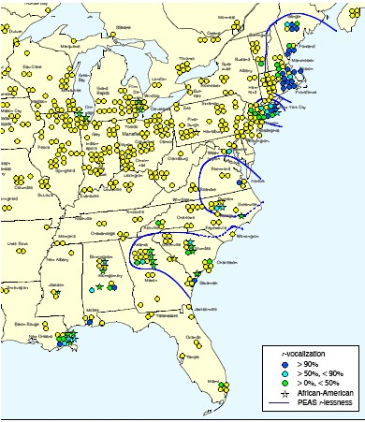
Remaining vocalization of (R) in the Eastern U.S. (Atlas of North American English, Map 9.3

Slide 46
Vocalization of (R) in Philadelphia
Ethnicity
Primary Primary & secondary Italian Others Italian Others Total
Some (r-0) 25 9 23 11 34
No (r-0) 12 14 8 18 26
Total 37 23 31 29 60
Fischer’s exact test .0336 .0086

Slide 47
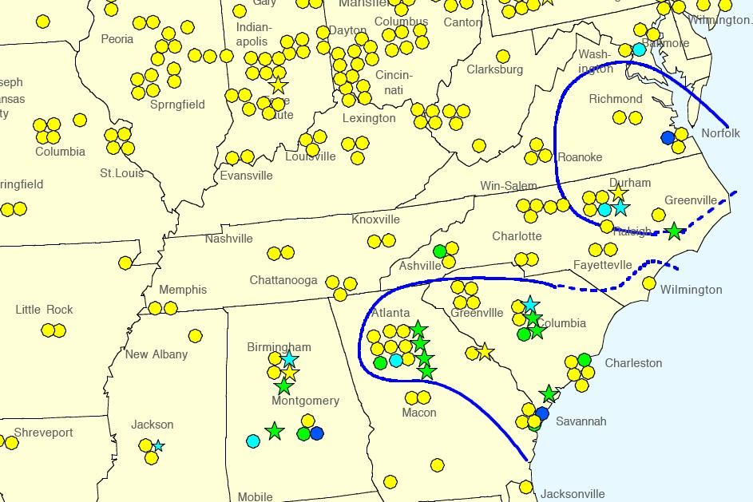
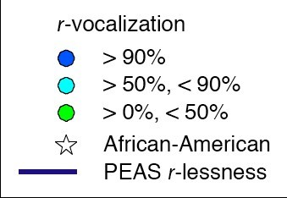
Remaining vocalization of (R) in the South
from Map 9.3, Atlas of North American English.

Slide 48
Mean ratings of Newscast Experiment for (ING) and (R) by Philadelphia subjects [N=35]
AH (ING) AH(R)

Slide 49
(ING) and (R) compared
(ING) (R)
Slope 1.21 0.89
    r² 0.94 0.83

Slide 50
Mean ratings of (R) in Newscast Experiment for two Southern speakers. JB = white male. SH = African American female.
p = .002
p = .012

Slide 51
Differential response by age and social class

Slide 52
Mean ratings of Newscast Experiment on (ING) for high school student groups of three different class backgrounds

Slide 53
r² fit to logarithmic function for 56 individual subjects by age

Slide 54
r² distribution for 56 individual subjects of Experiment 2

Slide 55
r² distribution for 56 individual subjects of Experiment 2
>23 years old

Slide 56
r² distribution for 31 individual subjects under 23 years old

Slide 57
Slope of logarithmic function for 56 individual subjects by r²

Slide 58
Data output of Broadcast.rev
NC-ING-50d-3AH-PAF: 0,500,15 532,32 558,35 610,36 672,*72 673
NC-ING-90-3AH-PAF: 0,500,15 748,*57 749
NC-ING-70-3AH-PAF: 0,500,19 501,25 448,31 335,42 231,45 107,*63 107
NC-ING-30-3AH-PAF: 0,500,10 80,39 229,41 181,42 80,*74 74
AUD-ING-50b-5TM-PAM: 0,500,10 491,11 426,11 393,12 357,19 466,*22 466
AUD-ING-50a-5TM-PAM: 0,500,11 504,12 694,*19 694
NC-ING-0-3AH-PAF: 0,500,5 429,6 327,7 289,13 243,14 208,24 156,37 133,39 109,42 32,44 71,*57 72
NC-ING-100-3AH-PAF: 0,500,11 464,13 439,18 499,19 637,20 671,*61 689
NC-ING-80-3AH-PAF: 0,500,6 499,8 474,9 450,17 413,36 379,*59 360
NC-R-50d-3AH-PAF: 0,500,16 298,18 273,27 559,28 633,31 353,31 283,*35 283
NC-R-80-3AH-PAF: 0,500,6 584,9 450,24 606,25 650,26 528,27 413,27 339,28 311,29 291,*32 291
NC-R-30-3AH-PAF: 0,500,9 534,10 570,19 621,21 642,26 621,27 372,28 311,29 346,29 483,*31 466
NC-R-70-3AH-PAF: 0,500,9 590,14 362,16 278,19 634,21 716,26 859,*31 859
AUD-ING-b-13JB-CWM: 0,500,7 376,7 477,11 169,13 106,16 35,*18 35
AUD-ING-a-13JB-CWM: 0,500,5 375,8 636,8 664,*16 663
NC-R-0-3AH-PAF: 0,500,9 420,10 366,13 300,22 257,*32 257
NC-R-100-3AH-PAF: 0,500,5 534,7 492,8 637,12 545,14 683,19 721,21 700,24 725,*30 720
NC-R-90-3AH-PAF: 0,500,8 651,19 609,20 669,23 709,*36 709

Slide 59
Timing of /in/ variants in the Broadcast experiment

Slide 60
Time record of responses to Broadcast Experiment by Katie B., 19, NYC: r² =.83

Slide 61
Time record of responses to Broadcast Experiment by Chris W., 46, Washington DC: r² =.89

Slide 62
Time record of responses to Broadcast Experiment by Angelica K., 20, Gettysburg, PA: r² =.88

Slide 63
Time record of responses to Broadcast Experiment by Annie F., 18, Setauket, NY: r² =.00

Slide 64
Time record of responses to Broadcast Experiment by Daphne L., 18, Los Angeles, CA: r² =.00

Slide 65
Sensitivity to internal constraints

Slide 66
Percent /in/ by grammatical category of the stem for 33 speakers in lower middle class Philadelphia neighborhoods
is going to
is working
start working
likes working on it
swimming pool
swimming
ceiling
interesting
source: Labov 2001, Ch. 3.

Slide 67
Historical continuity of the sociolinguistic variable (ing)
10th century Verbal noun Participle
-inge -inde
loss of final shwa /iNg´/ /ind´/
loss of final C /iNg/ /ind/
15th century
fixed orthography -ing /iN/ /in/
social stratification
19th century
20th century
stable social & /iN/ ~ /in/
stylistic variation
(favored in nouns ) (favored in verbs)

Slide 68
The Audition Protocol
    A young actor from a highly educated family is reading for the part of a construction worker in a Philadelphia play. There are two trials in his audition for the part. Please rate each of his trials on the scales below (from perfectly natural to very unnatural) by putting a check in one box.
Perfectly Very
natural . unnatural
1 2 3 4 5 6 7
/ ______ / ______ / _____ / ______ / ______ / ______ / _______ /
    Husband [to wife]: Look baby, I know I was supposed to be painting the ceiling tonight. But they had me working since six in the morning on the god forsaken federal building. We were fixing the wiring on the west wall, and I was hanging onto the pipe railing all day. My back is killing me.

Slide 69
Responses to the Audition Experiment for (ING). TM = AA Northern male speaker. AH = AA Northern female speaker. Significance of normal vs reversed by t-test: solid line: p < .01; dashed line p < .05; dotted line, not significant.

Slide 70
The (R) variable
pre-consonantal and final (syllable coda) >
word final before a vowel (syllable initial) >
word internal before a vowel (syllable initial)
four, forty
four of
forage

Slide 71
Audition text for (r) with syllable coda /r/ (green) opposed to syllable initial /r/ (red)
A juvenile delinquent for a two week run? You want a volunteer to go back in time? It won’t be a hard part to play. I’ve had to go back to where I was raised more than once, you know, return to your roots. I’m not so sure I should do it. For as long as I can remember I’ve had this fear of my nastier self taking over again. What was I like then? You better ask my sister and brother. No, leave my sister out of it. We didn’t get along. It was just my brother and me, if there was any trouble around we would have started it for sure.

Slide 72
Audition results for (R) in responses to White Southern speaker JB in Columbia and Philadelphia. Solid line p < .01, Dotted line n.s.

Slide 73
The properties of the sociolinguistic monitor
    • Within the limited range of our experiments, the temporal window of the sociolinguistic monitor is reasonably wide: it operates continuously across the time frame of the experiment.
    • Subjects show a striking consistency in their evaluation of sociolinguistic variables, clearly sensitive to differences in frequency as small as 10%.
    • Response of the SLM to sociolinguistic variants is not symmetrical: it is sensitive primarily to the frequency of marked forms rather than the frequency of unmarked forms.

Slide 74
The properties of the sociolinguistic monitor
    • The response of the SLM is not linear, but is determined by the proportional increase in the frequency of marked forms observed.
    • Uniform sensitivity of the SLM is characteristic of the adult population, developing considerably later than other sociolinguistic functions.
    • The SLM is sensitive to structural constraints on linguistic variables as well as frequency of marked variants.

Slide 75
Sensitivity to percent differences in apical /in/ in Newscast Experiment 2 as shown by t-test probabilities. Site: Philadelphia. Speaker: SA. N=36.
.017
n.s.
.0007
.0005
.0036
.000000009

