Slide 1
Lambda Expression

Slide 2
Lambda Expression
Java lambda expressions are new in Java 8(March 2014).
Java lambda expressions are commonly used to implement simple event listeners / callbacks, or in functional programming with the Java Streams API.
http://tutorials.jenkov.com/java/lambda-expressions.html

Slide 3
Java Lambdas and the Single Method Interface
Event listeners in Java are often defined as Java interfaces with a single method. Here is a fictive single method interface example
public interface StateChangeListener {
public void onStateChange(State oldState, State newState);
}
Any interface with a SAM(Single Abstract Method) is a functional interface, and its implementation may be treated as lambda expressions

Slide 4
Java Lambdas and the Single Method Interface
Imagine you have a class called StateOwner which can register state event listeners.
Before Java 8, you could add an event listener using an anonymous interface implementation, like this
public class StateOwner {
public void addStateListener(StateChangeListener listener) { ... }
}
StateOwner stateOwner = new StateOwner();
stateOwner.addStateListener(new StateChangeListener() {
public void onStateChange(State oldState, State newState) {
System.out.println(“State changed”);
}
}
);

Slide 5
Java Lambdas and the Single Method Interface
Since Java 8 you can add an event listener using a Java lambda expression, like this:
public interface StateChangeListener {
public void onStateChange(State oldState, State newState);
}
public class StateOwner {
public void addStateListener(StateChangeListener listener) { ... }
}
StateOwner stateOwner = new StateOwner();
stateOwner.addStateListener(
(State oldState, State newState) -> System.out.println("State changed")
);

Slide 6
Lambda Parameters
The parameters of a lambda expression have to match the parameters of the method on the single method interface
If the parameter types can be inferred, you can omit them.
public interface StateChangeListener {
public void onStateChange(State oldState, State newState);
}
StateOwner stateOwner = new StateOwner();
stateOwner.addStateListener(
(State oldState, State newState) -> System.out.println("State changed")
);
StateOwner stateOwner = new StateOwner();
stateOwner.addStateListener(
(oldState, newState) -> System.out.println("State changed")
);

Slide 7
Lambda Parameters
Zero Parameters
One Parameter
Multiple Parameters
Parameter Types
() -> System.out.println("Zero parameter lambda");
(param) -> System.out.println("One parameter: " + param);
param -> System.out.println("One parameter: " + param);
(p1, p2) -> System.out.println("Multiple parameters: " + p1 + ", " + p2);
(Car car) -> System.out.println("The car is: " + car.getName());

Slide 8
Lambda Function Body
The body of a lambda expression is specified to the right of the -> in the lambda declaration
If your lambda expression needs to consist of multiple lines, you can enclose the lambda function body inside the { } bracket
(oldState, newState) -> System.out.println("State changed")
(oldState, newState) -> {
System.out.println("Old state: " + oldState); System.out.println("New state: " + newState);
}

Slide 9
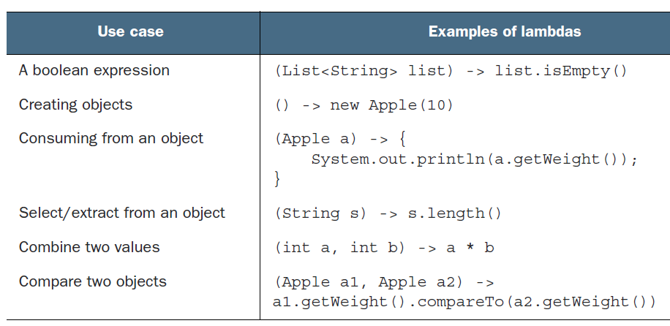
Lambda Expression Examples
Modern Java in Action: Lambda, streams, functional and reactive programming, 2018

Slide 10
Returning a Value
You can return values from Java lambda expressions
You just add a return statement to the lambda function body
In case all your lambda expression is doing is to calculate a return value and return it, you can specify the return value in a shorter way
(param) -> {
System.out.println("param: " + param);
return "return value";
}
(a1, a2) -> { return a1 > a2; }
(a1, a2) -> a1 > a2

Slide 11
Variable Capture
A Java lambda expression is capable of accessing variables declared outside the lambda function
Java lambdas can capture the following types of variables:
Local variables
Class variables
Static variables

Slide 12
Local Variable Capture
A Java lambda can capture the value of a local variable declared outside the lambda body
This is possible if, and only if, the variable being references is "effectively final", meaning it does not change its value after being assigned
public interface MyFactory {
public String create(String message);
}
public class LocalVariableCapture {
public static void main(String[] args) {
String greeting = "Hello";
MyFactory myFactory = (message) -> {
return greeting + ":" + message;
};
System.out.println(myFactory.create("Java Lambda"));
}
}

Slide 13
Class Variable Capture
A lambda expression can also capture an class variable in the object that creates the lambda
public class EventConsumerImpl {
private String name = "MyConsumer";
public void attach(MyEventProducer eventProducer) {
eventProducer.listen( e -> {
System.out.println(this.name);
});
}
}

Slide 14
Static Variable Capture
A Java lambda expression can also capture static variables
public class EventConsumerImpl {
private static String someStaticVar = "Some text";
public void attach(MyEventProducer eventProducer) {
eventProducer.listen(e -> {
System.out.println(someStaticVar);
});
}
}

Slide 15
Method References
In the case where all your lambda expression does is to call another method with the parameters passed to the lambda, the Java lambda implementation provides a shorter way to express the method call
interface Print {
void execute(String msg);
}
public class MRExample1 {
private static void doSomething(String value, Print print) {
print.execute(value);
}
public static void main(String[] args) {
doSomething("Hello", (String msg) -> System.out.println(msg));
doSomething("Java", System.out::println);
}
}

Slide 16
Q&A

