Slide 1
Java Documentation Comments
The javadoc Tags
javadoc Tool

Slide 2
Java comments
Java Comments
/* comments */
// line comment
/** Java documentation comment */
Java Documentation Comment
allow you to embed information about your program into the program itself.
Documentation comments make it convenient to document your programs.
You can then use the javadoc utility program to extract the information and put it into an HTML file.

Slide 3
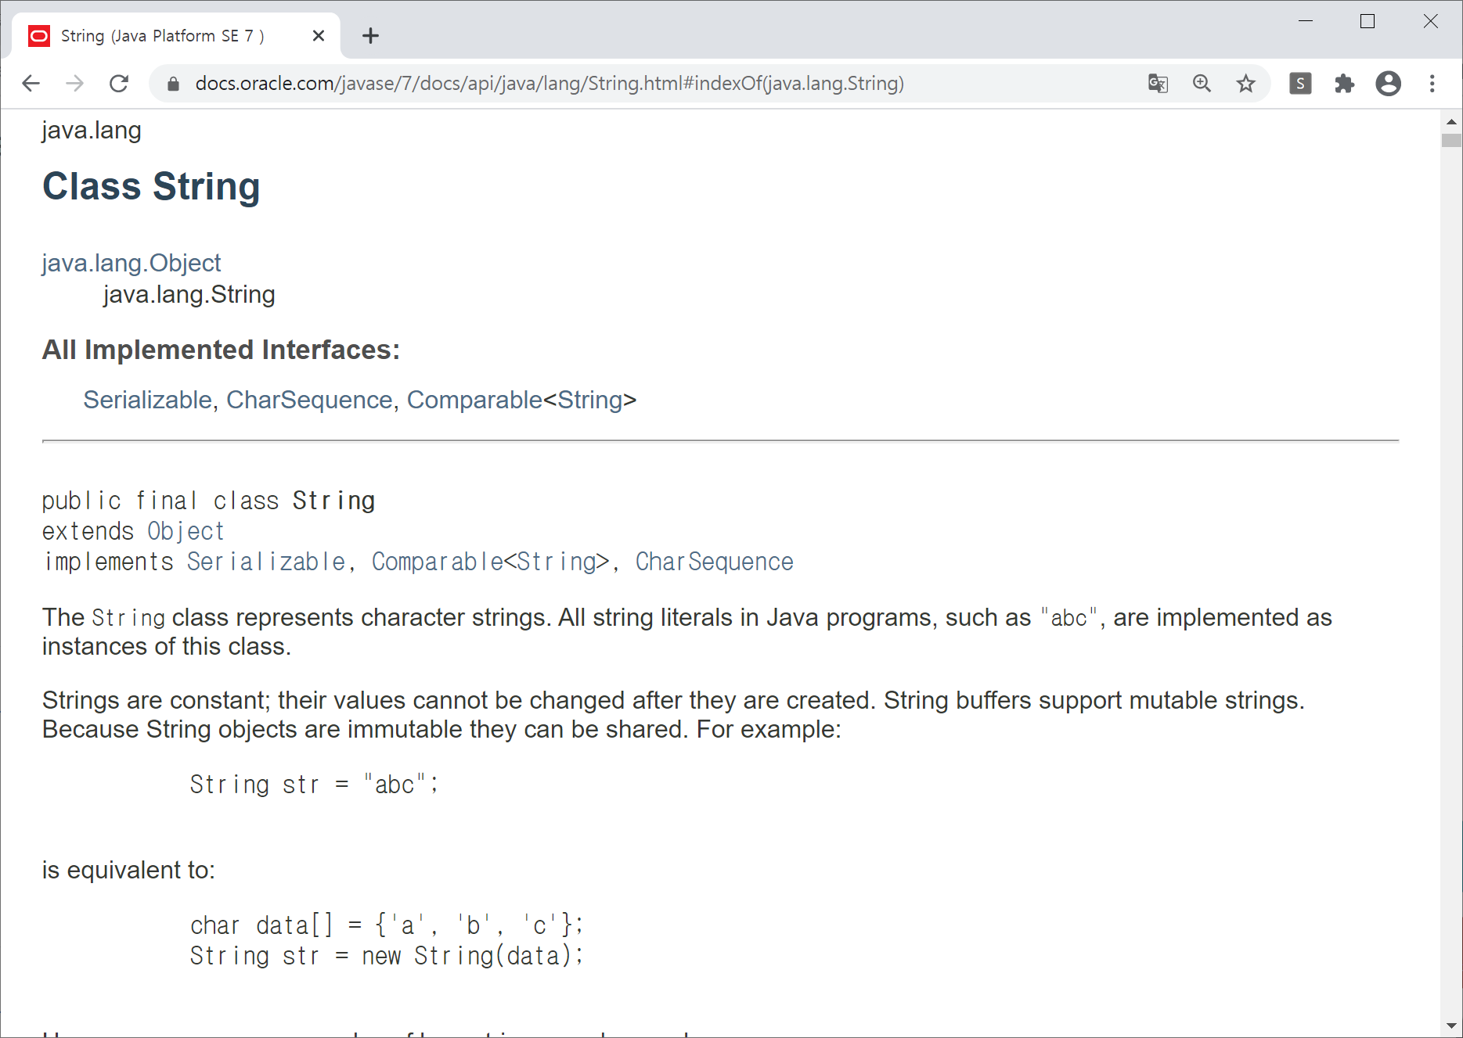
Java API Documentation

Slide 4
package javadoc;
import java.io.*;
/**
* This class demonstrates documentation comments.
* @author Ayan Amhed
* @version 1.2
*/
public class SquareNum {
/**
* This method returns the square of num.
* This is a multiline description. You can use
* as many lines as you like.
* @param num The value to be squared.
* @return num squared.
*/
public double square(double num) {
return num * num;
}

Slide 5
/**
* This method inputs a number from the user.
* @return The value input as a double.
* @exception IOException On input error.
* @see IOException
*/
public double getNumber() throws IOException {
InputStreamReader isr = new InputStreamReader(System.in);
BufferedReader inData = new BufferedReader(isr);
String str;
str = inData.readLine();
return (new Double(str)).doubleValue();
}
/**
* This method demonstrates square().
* @param args Unused.
* @exception IOException On input error.
* @see IOException
*/
public static void main(String args[]) throws IOException
{
SquareNum ob = new SquareNum();
double val;
System.out.println("Enter value to be squared: ");
val = ob.getNumber();
val = ob.square(val);
System.out.println("Squared value is " + val);
}
}

Slide 6
How to use javadoc tool
% javadoc SquareNum.java

Slide 7
Invoking javadoc in IntelliJ
Tools > Generate JavaDoc…

Slide 8
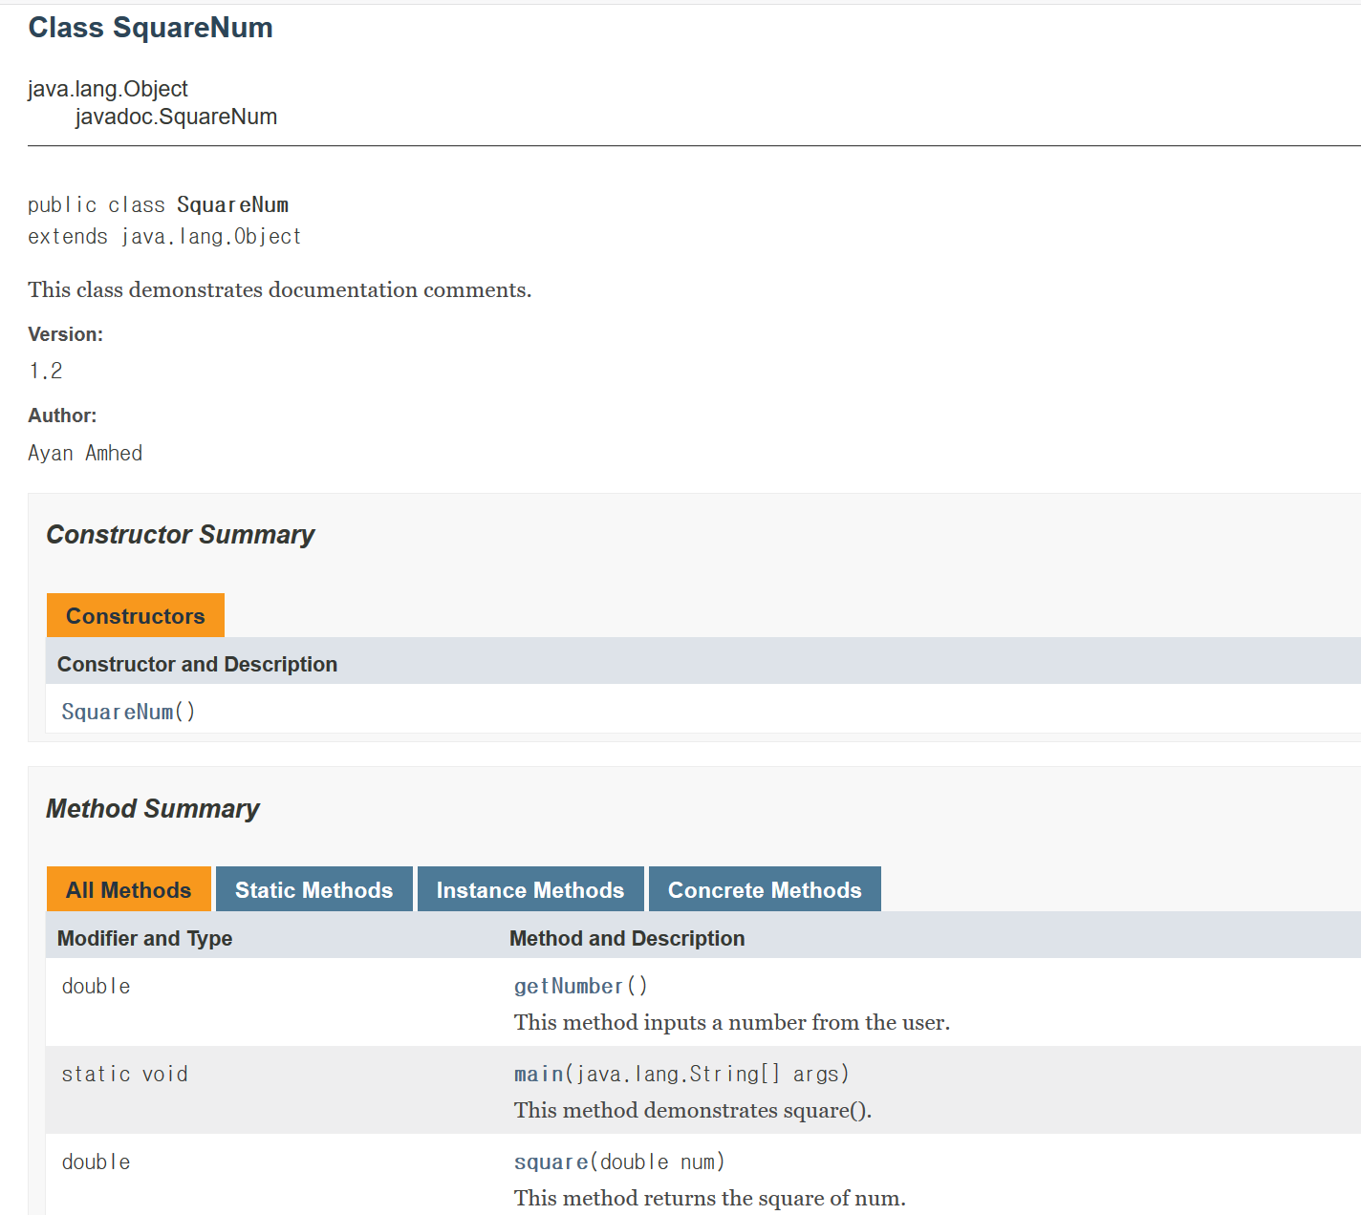
The Generated Documentation

Slide 9
JavaDoc Tags: Summary
Tag & Parameter | Usage | Applies to
@author name | Describes an author. | Class, Interface, Enum
@version version | Provides software version entry. Max one per Class or Interface. | Class, Interface, Enum
@since since-text | Describes when this functionality has first existed. | Class, Interface, Enum, Field, Method
@see reference | Provides a link to other element of documentation. | Class, Interface, Enum, Field, Method
@param name description | Describes a method parameter. | Method
@return description | Describes the return value. | Method
@exception classname description @throws classname description | Describes an exception that may be thrown from this method. | Method

Slide 10
References
Java Documentation Comments from Tutorials Point
http://www.tutorialspoint.com/java/java_documentation.htm
How to Write Doc Comments for the Javadoc Tool
http://www.oracle.com/technetwork/java/javase/documentation/index-137868.html
Javadoc Tool
http://www.oracle.com/technetwork/java/javase/documentation/index-jsp-135444.html

