Slide 1
Streams
Modern Java in Action: Lambda, streams, functional and reactive programming
https://docs.oracle.com/javase/tutorial/collections/streams/
https://www.baeldung.com/java-streams
http://tutorials.jenkov.com/java-collections/streams.html

Slide 2
Streams: Since Java 8
Streams are an update to the Java API that let you manipulate collections of data in a declarative way
The following example prints the name of all members contained in the collection roster with a for-each loop
The following example prints all members contained in the collection roster but with the aggregate operation forEach:
for (Person p : roster) { // external iteration
System.out.println(p.getName());
}
roaster.stream() // build Stream<Person> from List<Person>
.forEach(e -> System.out.println(e.getName()); // internal iteration

Slide 3
Streams
A sequence of elements from a source that supports data-processing operations.
A sequence of elements
a stream provides an interface to a sequenced set of values of a specific element type
Source
Streams consume from a data-providing source such as values, collections, arrays, or I/O resources
Data-processing operations
Streams support common operations to manipulate data, such as filter, map, reduce, find, match, sort, and so on
Stream operations can be executed either sequentially or in parallel.

Slide 4
Stream vs Collection
The following example create a list of the name of all dishes contained in the collection menu with a for-each loop
The following example create a list of the name of all dishes contained in the collection menu with a stream
List<String> names = new ArrayList<>();
for (Dish dish: menu) {
names.add(dish.getName());
}
List<String> names = menu.stream()
.map((Dish dish) -> dish.getName()) // or .map(Dish::getName)
.collect(Collectors.toList());

Slide 5
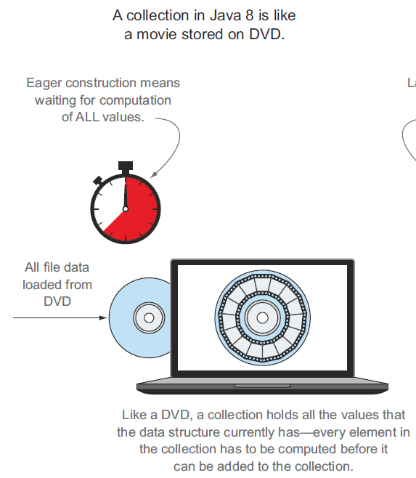
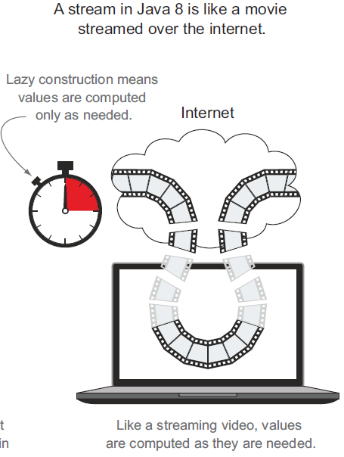
Stream vs Collection (cont’d)

Slide 6
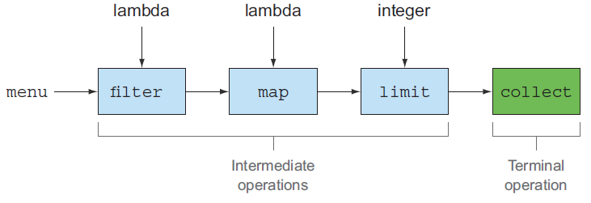
Stream Operations: Intermediate vs Terminal
List<String> names = Dish.menu.stream()
.filter(dish -> dish.getCalories() > 300)
.map(Dish::getName)
.limit(3)
.collect(toList());
Intermediate operations: filter, map, limit, sorted, distinct…
Terminal operations: forEach, count, collect, reduce…

Slide 7
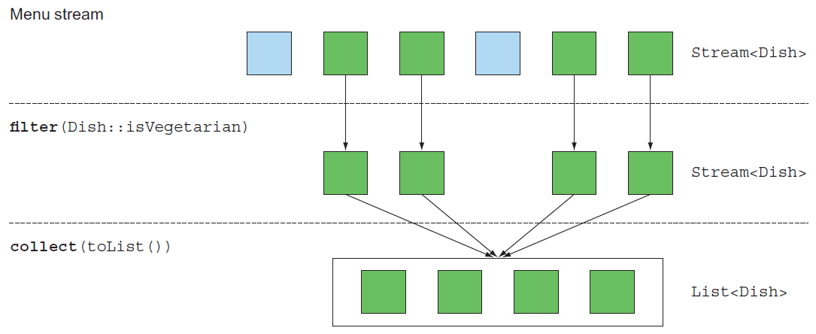
Filtering with Predicate
filter operation takes as argument a predicate and returns a stream of all elements matching the predicate
List<Dish> vegetarianDishes = Dish.menu.stream()
.filter(Dish::isVegetarian).collect(Collectors.toList());

Slide 8
Slicing using Filter
List<Dish> specialMenu = Arrays.asList(
new Dish("seasonal fruit", true, 120, Dish.Type.OTHER),
new Dish("prawns", false, 300, Dish.Type.FISH),
new Dish("rice", true, 350, Dish.Type.OTHER),
new Dish("chicken", false, 400, Dish.Type.MEAT),
new Dish("french fries", true, 530, Dish.Type.OTHER) );
List<Dish> filteredMenu = specialMenu.stream()
.filter(dish -> dish.getCalories() < 320)
.collect(Collectors.toList()); // seasonal fruit, prawns

Slide 9
Slicing using Filter
List<String> versions = new ArrayList<>();
versions.add("Lollipop");
versions.add("KitKat");
versions.add("Jelly Bean");
versions.add("Ice Cream Sandwidth");
versions.add("Honeycomb");
versions.add("Gingerbread");
// print all versions whose length is greater than 10 character
System.out.println("All versions whose length greater than 10");
versions.stream()
.filter(s -> s.length() > 10)
.forEach(System.out::println);
System.out.println("first element which has letter 'e' ");
String first = versions.stream()
.filter(s -> s.contains("e"))
.findFirst().get();
System.out.println(first);

Slide 10
Counting using Filter
// Count the empty strings
List<String> strList = Arrays.asList("abc", "", "bcd", "", "defg", "jk");
long count = strList.stream()
.filter(s -> s.isEmpty()) // String::isEmpty
.count();
System.out.printf("List %s has %d empty strings %n", strList, count);
// Count String with length more than 3
long num = strList.stream()
.filter(s -> s.length()> 3)
.count();
System.out.printf("List %s has %d strings of length > 3 %n", strList, num);
// Count number of String which startswith "a"
count = strList.stream()
.filter(s -> s.startsWith("a"))
.count();
System.out.printf("List %s has %d strings starting with 'a' %n", strList, count);

Slide 11
Creating List using Filter
// Remove all empty Strings from List
List<String> filtered = strList.stream()
.filter(s -> !s.isEmpty())
.collect(Collectors.toList());
System.out.printf("Original List : %s, List without Empty Strings : %s %n", strList, filtered);
// Create a List with String more than 2 characters
filtered = strList.stream()
.filter(s -> s.length()> 2)
.collect(Collectors.toList());
System.out.printf("Original List : %s, filtered list : %s %n", strList, filtered);

Slide 12
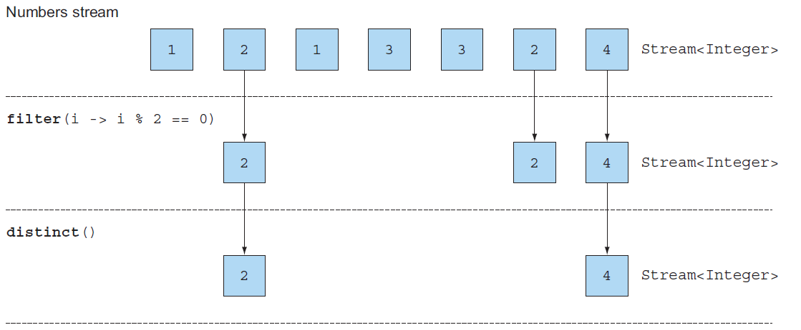
Filtering Unique Elements
distinct returns a stream with unique elements (according to the implementation of the hashcode and equals methods)
List<Integer> numbers = Arrays.asList(1, 2, 1, 3, 3, 2, 4);
numbers.stream().filter(i -> i % 2 == 0).distinct().forEach(System.out::println);

Slide 13
Mapping
map is applied to each element, mapping it into a new element
List<String> dishNames = Dish.menu.stream()
.map(Dish::getName)
.collect(Collectors.toList());
System.out.println(dishNames);
// [pork, beef, chicken, french fries, rice, season fruit, pizza, prawns, salmon]
List<Integer> dishNameLengths = Dish.menu.stream()
.map(Dish::getName)
.map(String::length)
.collect(Collectors.toList());
System.out.println(dishNameLengths);
// [4, 4, 7, 12, 4, 12, 5, 6, 6]

Slide 14
Converting using Map
// Create List of square of all distinct numbers
List<Integer> numbers = Arrays.asList(9, 10, 3, 4, 7, 3, 4);
List<Integer> distinct = numbers.stream()
.map( i -> i*i ).distinct()
.collect(Collectors.toList());
System.out.printf("Original List : %s, Square Without duplicates : %s %n",
numbers, distinct);
// Original List : [9, 10, 3, 4, 7, 3, 4], Square Without duplicates : [81, 100, 9, 16, 49]
// Convert String to Uppercase and join them using coma
List<String> G7 = Arrays.asList("USA", "Japan", "France", "Germany",
"Italy", "U.K.","Canada");
String G7Countries = G7.stream()
.map(x -> x.toUpperCase())
.collect(Collectors.joining(", ", "<", ">")); // delimiter, prefix, suffix
System.out.println(G7Countries);
// <USA, JAPAN, FRANCE, GERMANY, ITALY, U.K., CANADA>

Slide 15
Flat Mapping
Using the flatMap method has the effect of mapping each array not with a stream but with the contents of that stream.
split returns String[]
List<String> words = Arrays.asList("Hello", "World");
List<String[]> distinctWords1 = words.stream()
.map(word -> word.split("")).distinct()
.collect(Collectors.toList());
List<Stream<String>> distinctWords2 = words.stream()
.map(word -> word.split(""))
.map(Arrays::stream).distinct()
.collect(Collectors.toList());
List<String> uniqueCharacters = words.stream()
.map(word -> word.split(""))
.flatMap(Arrays::stream).distinct()
.collect(Collectors.toList()); // [H, e, l, o, W, r, d]

Slide 16
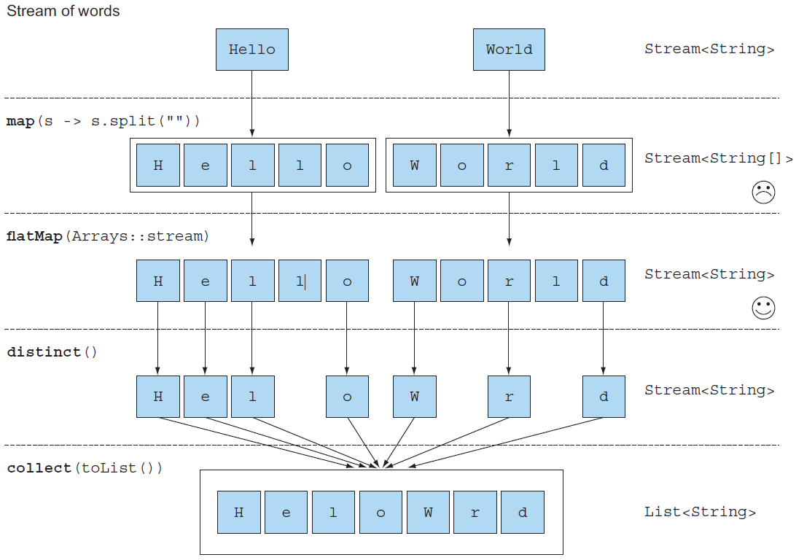

Slide 17
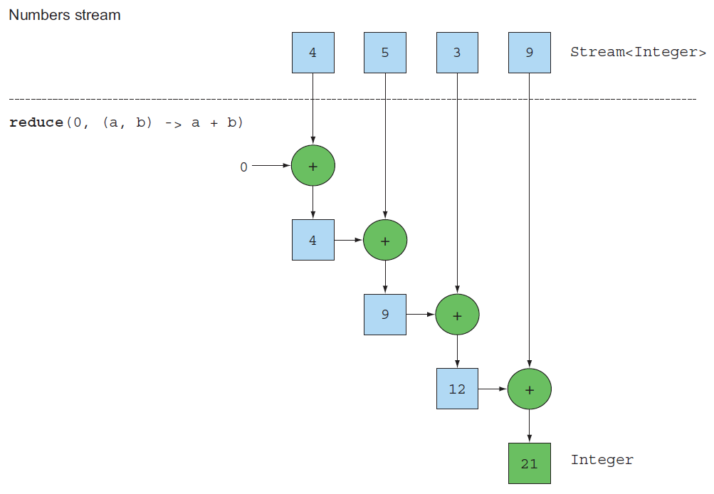
Reducing: Sum
int[] numbers = {4, 5, 3, 9};
int sum = Arrays.stream(numbers)
.reduce(0, (a, b) -> a + b); // 21
// .reduce(0, Integer::sum);
int product = Arrays.stream(numbers)
.reduce(1, (a, b) -> a * b); // 540

Slide 18
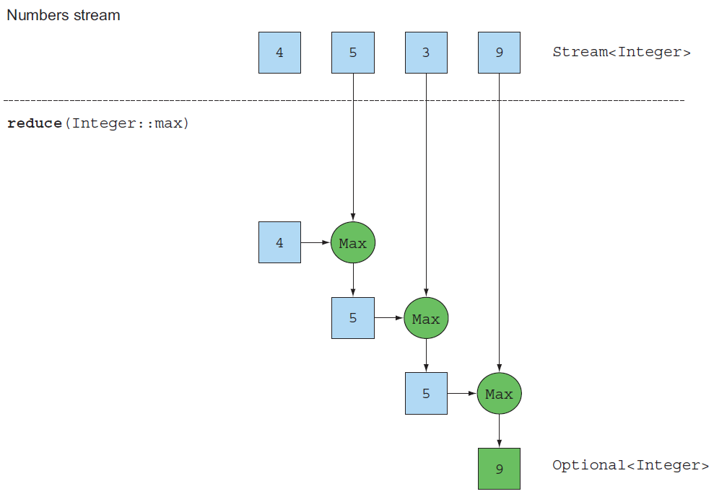
Reducing: Max, Min
int[] numbers = {4, 5, 3, 9};
OptionalInt max = Arrays.stream(numbers)
.reduce(Integer::max); // 9
OptionalInt min = Arrays.stream(numbers)
.reduce((x, y) -> x < y ? x : y); // 3

Slide 19
Matching
if (Dish.menu.stream().anyMatch(Dish::isVegetarian)) {
System.out.println("The menu is (somewhat) vegetarian friendly!!");
}
// all dishes are below 1000 calories
boolean isHealthy = Dish.menu.stream()
.allMatch(dish -> dish.getCalories() < 1000);
// no dishes are above 1000 calories
boolean isHealthy = Dish.menu.stream()
.noneMatch(d -> d.getCalories() >= 1000);

Slide 20
Pipelines
A pipeline is a sequence of data-processing operations.
List<Person> roaster = Arrays.asList(
new Person("Kim", Gender.MALE),
new Person("Lee", Gender.FEMALE),
new Person("Park", Gender.MALE)
);
for ( Person p : roaster ) {
if ( p.getGender() == Gender.MALE ) {
String name = p.getName();
String upperCaseName = name.toUpperCase();
System.out.println(upperCaseName);
}
}
roaster.stream()
.filter( p -> p.getGender() == Gender.MALE)
.map( p -> p.getName())
.map( s -> s.toUpperCase())
.forEach( s -> System.out.println(s));

Slide 21
Pipelines with Method Reference
Pipeline can be written more simply with method reference
roaster.stream()
.filter( p -> p.getGender() == Gender.MALE)
.map( p -> p.getName())
.map( s -> s.toUpperCase())
.forEach( s -> System.out.println(s));
roaster.stream()
.filter( p -> p.getGender() == Gender.MALE)
.map(Person::getName)
.map(String::toUpperCase)
.forEach(System.out::println);

Slide 22
Pipelines Example
List<String> versions = new ArrayList<>();
versions.add("Lollipop");
versions.add("KitKat");
versions.add("Jelly Bean");
versions.add("Ice Cream Sandwidth");
versions.add("Honeycomb");
versions.add("Gingerbread");
System.out.println("Element whose length is >= 10 and contains I or i");
versions.stream()
.filter(s -> s.length() >= 10)
.map(String::toUpperCase)
.filter(s -> s.contains("I"))
.forEach(System.out::println);
List<Integer> listOfNumbers = Arrays.asList(1, 2, 3, 4, 5, 6, 12, 18);
Integer lcm = listOfNumbers.stream()
.filter(i -> i % 2 == 0)
.filter(i -> i % 3 == 0)
.findFirst().get();
System.out.println("first number divisible by 2 and 3 in the list is : " + lcm); // 6
ICE CREAM SANDWIDTH
GINGERBREAD

Slide 23
List<Dish> lowCalorieDishes = new ArrayList<>();
for (Dish dish: Dish.menu) { // filter
if (dish.getCalories() < 400) lowCalorieDishes.add(dish);
}
Collections.sort(lowCalorieDishes, new Comparator<Dish>() { // sort
public int compare(Dish dish1, Dish dish2) {
return Integer.compare(dish1.getCalories(), dish2.getCalories());
}
});
List<String> lowCalorieDishesName1 = new ArrayList<>(); // map: a list of name
for (Dish dish: lowCalorieDishes1) {
lowCalorieDishesName1.add(dish.getName());
}
System.out.println(lowCalorieDishesName1); // [season fruit, rice]
List<String> lowCalorieDishesName2 = menu.stream()
.filter(dish -> dish.getCalories() < 400)
.sorted(Comparator.comparing(Dish::getCalories))
.map(Dish::getName)
.collect(Collectors.toList());
System.out.println(lowCalorieDishesName1); // [season fruit, rice]

Slide 24
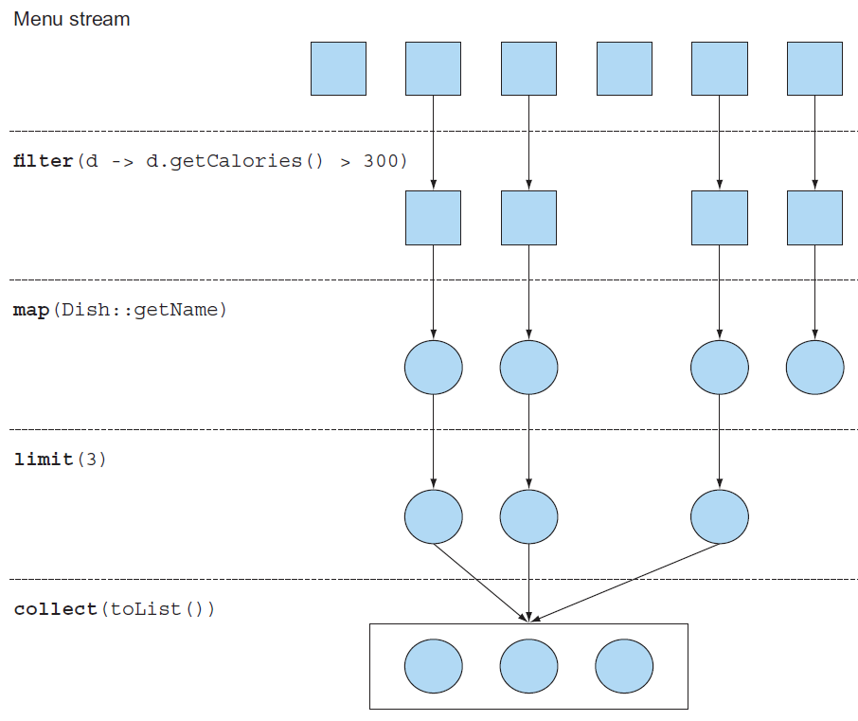
List<String> threeHighCalorieDishNames = menu.stream()
.filter(dish -> dish.getCalories() > 300)
.map(Dish::getName)
.limit(3)
.collect(Collectors.toList());

Slide 25
Building Streams
You can create streams in many ways
From a sequence of values
From an array
From a Collection
From a Files
From a generative function to create infinite streams
https://www.geeksforgeeks.org/10-ways-to-create-a-stream-in-java/

Slide 26
Streams from a Sequence of Values
You can create a stream with explicit values by using the static method Stream.of, which can take any number of parameters
Stream<String> stream1 = Stream.of("Modern ", "Java ", "In ", "Action");
stream1.map(String::toUpperCase).forEach(System.out::println);
Stream<String> stream2 = Stream.of("Modern ", "Java ", "In ", "Action");
stream2.map(String::toLowerCase).forEach( s -> System.out.print('[' + s + ']') );
MODERN
JAVA
IN
ACTION
[modern ][java ][in ][action]
In traditional Java interfaces, only abstract methods could be defined.
Java 8 introduce "default method“, which are interface methods with an implementation. Subclasses are not required to override default methods.
Also in Java 8, interfaces can have static methods.
In Java 9, private methods were introduced in interfaces

Slide 27
Streams from Arrays
You can create a stream from an array using the static method Arrays.stream or Stream.of, which takes an array as parameter
String[] strings = {"Modern ", "Java ", "In ", "Action"};
Stream<String> stream1 = Arrays.stream(strings);
stream1.map(String::toLowerCase).forEach(System.out::print);
Stream<String> stream2 = Stream.of(strings);
long longWordCount = stream2.filter(s -> s.length() > 4).count();
System.out.println(longWordCount); // 3
int[] numbers = {1, 2, 3, 4, 5};
long count = Arrays.stream(numbers).count(); // 5
int sum1 = Arrays.stream(numbers).filter( n -> n % 2 == 0).sum(); // 6(=2+4)
// 41(=4*4+5*5)
int sum2 = Arrays.stream(numbers).filter( n -> n >= 4).map(n -> n*n).sum();
modern java in action

Slide 28
Streams from Collection
You can create a stream from a Collection using the static method Collection.stream()
List<String> list1 = Arrays.asList("Modern ", "Java ", "in ", "Action ");
long wordCountWithDistinctiveLength = list1.stream()
.map(s -> s.length())
.distinct()
.count();
System.out.println(wordCountWithDistinctiveLength); // 3
List<String> list2 = new ArrayList<>();
String[] helloJava = {"Hello ", "Modern ", "Java "};
Collections.addAll(list2, helloJava);
list2.stream()
.filter(s -> s.contains("o"))
.map(String::toUpperCase)
.forEach(System.out::print); // HELLO MODERN

Slide 29
Streams from Files
Many static methods in java.nio.file.Files return a stream.
For example, a useful method is Files.lines, which returns a stream of lines as strings from a given file.
try {
Stream<String> lines = Files.lines(Paths.get("data.txt"));
lines.forEach(System.out::println);
} catch (IOException e) {
System.out.println(e);
}

Slide 30
Streams from Functions: iterate
Streams produced by iterate and generate create values on demand given a function
Stream.iterate(0, n -> n + 2) // seed, function
.limit(5)
.forEach(System.out::println); // 0 2 4 6 8

Slide 31
Streams from Functions: generate
generate doesn’t apply successively a function on each new produced value.
It takes a lambda to provide new values
Stream.generate(Math::random)
.limit(5)
.forEach(System.out::println); // five random numbers
IntStream ones = IntStream.generate(() -> 1).limit(5);
ones.forEach(System.out::println); // 1 1 1 1 1
IntStream twos = IntStream.generate(new java.util.function.IntSupplier() {
public int getAsInt() {
return 2;
}
}).limit(3);
twos.forEach(System.out::println); // 2 2 2

Slide 32
Streams from Functions: generate
import java.util.function.IntSupplier;
IntSupplier fib = new IntSupplier() {
private int previous = 0;
private int current = 1;
public int getAsInt() {
int oldPrevious = this.previous;
int nextValue = this.previous + this.current;
this.previous = this.current;
this.current = nextValue;
return oldPrevious;
}
};
IntStream.generate(fib).limit(5).forEach(System.out::println); // 0 1 1 2 3

Slide 33
performance
https://github.com/volkodavs/javafilters-benchmarks

Slide 34
Introduction
We're going to perform benchmarks against the different way to filter values in the array
stream + complex filter
stream + multiple filters
parallel stream + complex filter
parallel stream + multiple filters
old fashion loop

Slide 35
Stream + Complex Filter
public void complexFilter(ExecutionPlan plan, Blackhole blackhole) {
long count = plan.getDoubles()
.stream()
.filter(d -> d < Math.PI
&& d > Math.E
&& d != 3
&& d != 2)
.count();
blackhole.consume(count);
}

Slide 36
Stream + Multiple Filter
public void complexFilter(ExecutionPlan plan, Blackhole blackhole) {
long count = plan.getDoubles()
.stream()
.filter(d -> d > Math.PI)
.filter(d -> d < Math.E)
.filter(d -> d != 3)
.filter(d -> d != 2)
.count();
blackhole.consume(count);
}

Slide 37
Parallel Stream + Complex Filter
public void complexFilter(ExecutionPlan plan, Blackhole blackhole) {
long count = plan.getDoubles()
.stream()
.parallel()
.filter(d -> d < Math.PI
&& d > Math.E
&& d != 3
&& d != 2)
.count();
blackhole.consume(count);
}

Slide 38
Parallel Stream + Multiple Filter
public void complexFilter(ExecutionPlan plan, Blackhole blackhole) {
long count = plan.getDoubles()
.stream()
.parallel()
.filter(d -> d > Math.PI)
.filter(d -> d < Math.E)
.filter(d -> d != 3)
.filter(d -> d != 2)
.count();
blackhole.consume(count);
}

Slide 39
Old Fashion Loop
public void oldFashionFilters(ExecutionPlan plan, Blackhole blackhole) {
long count = 0;
for (int i = 0; i < plan.getDoubles().size(); i++) {
if (plan.getDoubles().get(i) > Math.PI
&& plan.getDoubles().get(i) > Math.E
&& plan.getDoubles().get(i) != 3
&& plan.getDoubles().get(i) != 2) {
count = count + 1;
}
}
blackhole.consume(count);
}

Slide 40
Environment
8 CPU, 64 GB RAM, OS version: 16.04.1 LTS (Xenial Xerus)
Parameter | Java 8 | Java 12
VM invoker | java-8-openjdk-amd64 | openjdk-12
VM options | -XX:+UseG1GC -server -Xmx1024m -Xms1024m
Warmup | 10 iterations, 1s each
Measurement | 10 iterations, 1000 ms each
Timeout | 10 min per iteration
Threads | 1 thread, will synchronize iterations
Benchmark mode | Throughput, ops/time
CPU | 8 cores

Slide 41
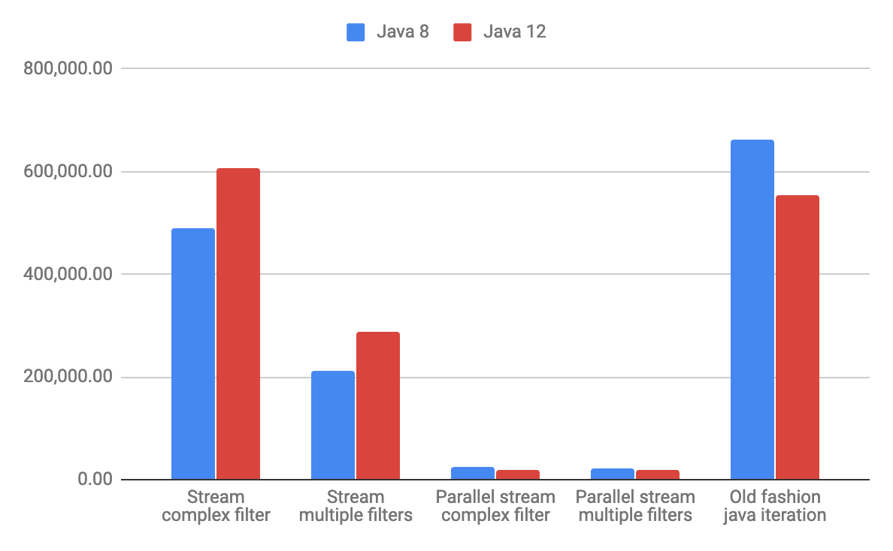
1,000 Element Array

Slide 42
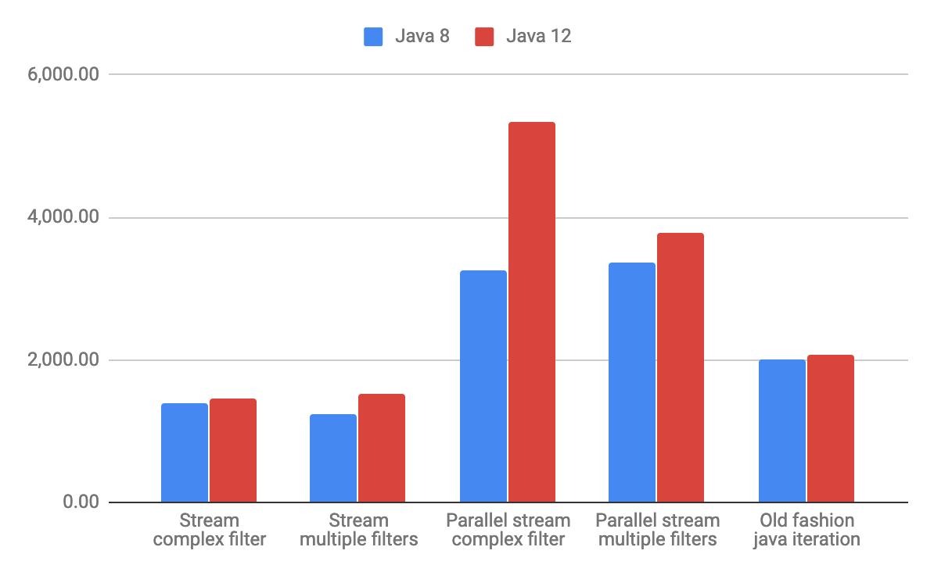
100,000 Element Array

Slide 43
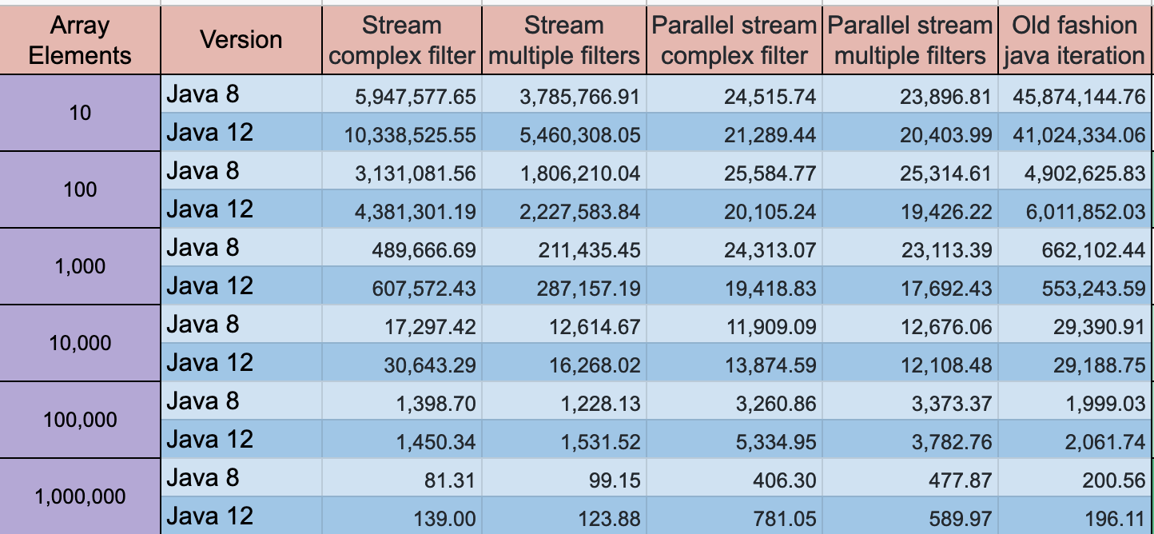
Summary
On a relatively small array old fashion loop shows the best results
For arrays of large size, parallel streams show better results.
Complex filter is better than multiple filters

Slide 44
Q&A

