Slide 1
Collections
Concept of a collection
Separating the interface from the implementation
Dynamic data structures
Generics
Java Collections Framework
Java Software Solutions, 9th Edition – Chapter 13 Collections
https://docs.oracle.com/javase/tutorial/collections

Slide 2
Concept of Collection
A collection is an object that represents a group of objects (known as its elements)
It helps us organize and manage other objects
A collection provides services for adding, removing and otherwise managing the elements it contains
Sometimes the elements in a collection are ordered, sometimes they are not
All collection classes in Java are generic
You create a collection that holds a specific type, such as ArrayList<String>
A collection is implemented with a particular underlying data structure
ArrayList is implemented using an array
LinkedList is implemented using a dynamic list

Slide 3
Abstraction
Collections, like all objects, are abstractions
They hide underlying details
They separate the interface of the object from its underlying implementation
This helps manage complexity and makes it possible to change the implementation without changing the interface

Slide 4
Dynamic Structures
A static data structure has a fixed size
Arrays are static – once you define the number of elements it can hold, the size doesn’t change
A dynamic data structure grows and shrinks at execution times as required its contents
A dynamic data structure is implemented using object references as links
Object reference is a variable that stores the address of an object
Object references can be used to create links between objects

Slide 5
Generics
A class can be defined to operate on a generic data type which is specified when the class is instantiated:
LinkedList<Book> myList = new LinkedList<Book>();
By specifying the type stored in a collection, only objects of that type can be added to it

Slide 6
Java Collections Framework
In Java, a collections framework is a unified architecture for representing and manipulation collections, enabling collections to be manipulated independently of implementation details
The collections framework consists of:
Collection interfaces
General-purpose implementations
Legacy implementation
Concurrent implementations
Algorithms
Infrastructure
Utilities
...
https://docs.oracle.com/javase/8/docs/technotes/guides/collections/reference.html

Slide 7
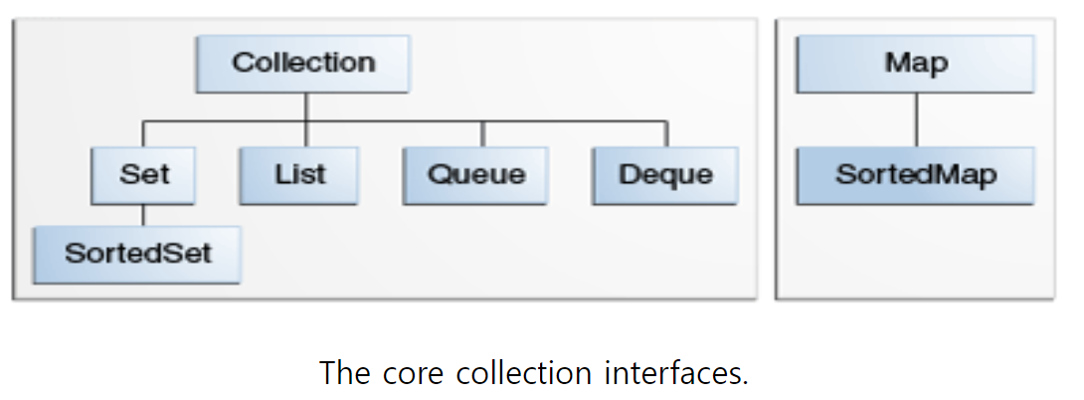
Collection Interfaces
The collection interfaces are divided into two groups
java.util.Collection
java.util.List
java.util.Set
java.util.SortedSet
java.util.Queue
java.util.Deque
java.util.concurrent.BlockingQueue
java.util.concurrent.BlockingDequeue
java.util.Map (a Map is not a true collection, but these interfaces contains collection-view operations)
java.util.SortedMap
Java.util.NavigableMap
Java.util.concurrent.ConcurrentMap
Java.util.concurrent.ConccurentNavigableMap

Slide 8
Collection Interfaces (cont’d)
java.util.Collection<E> interface
Superinterfaces: Iterable<E>
Known Subinterfces: List<E>, Set<E>, Queue<E>, Dequeue<E>, BlockingQueue<E>…
Method summary
Return Type | Method
boolean | add(E e)
boolean | addAll(Collection<? Extends E> c
void | clear()
boolean | contains(Object o)
boolean | isEmpty()
Iterator<E> | iterator()
boolean | remove(Object o)
boolean | removeAll(Collection<?> c)
int | size()
Object[] | toArray()
… | …
https://docs.oracle.com/javase/8/docs/api/

Slide 9
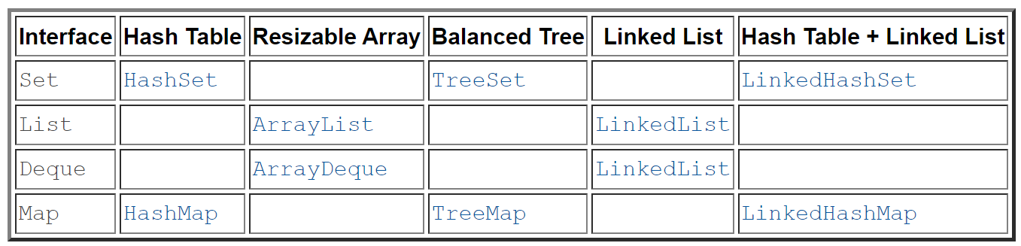
Collection Implementations
Classes that implement the collection interfaces typically have names in form of <implementation-style><Interface>
Summary of general-purpose implementations
Legacy implementations
Vector (List)
HashTable (Map)

Slide 10
Collection Implementation (Cont’d)
Concurrent Implementation of Collection Classes
Package java.util.concurrent offers concurrent versions of data structures
Interface | Implementation
Queue | ConcurrentLinkedQueue - An unbounded thread-safe queue based on linked nodes
BlockingQueue | LinkedBlockingQueue — an optionally bounded FIFO blocking queue backed by linked nodes ArrayBlockingQueue — a bounded FIFO blocking queue backed by an array PriorityBlockingQueue — an unbounded blocking priority queue backed by a heap DelayQueue — a time-based scheduling queue backed by a heap SynchronousQueue — a simple rendezvous mechanism that uses the BlockingQueue interface
BlockingDeque | LinkedBlockingDeque - An optionally-bounded blocking deque based on linked nodes
ConcurrentMap | ConcurrentHashMap - a highly concurrent, high-performance implementation backed up by a hash table

Slide 11
Utilities
java.util.Arrays class
Utility class contains static methods for manipulating arrays, such as ort, search, compare, hash, copy, resize…
java.util.Collections class
Utility class contains useful static methods that operate on or return collections
Algorithms
sort, reverse, search, shuffle, fill, copy, min, max, rotate, swap, disjoint, addAll
3rd party libraries
Apache Commons Collections
Guava: Google Core Libraries for Java
https://docs.oracle.com/javase/8/docs/api/java/util/Collections.html

Slide 12
Q&A

