Slide 1
Introduction to Java

Slide 2
What is Java?
Java supports object-oriented programming such as classes, inheritance, and polymorphism
Our first Java Program – Hello World !
public class HelloWorld {
public static void main(String[] args) {
System.out.println("Hello, World!") ;
}
}
Hello, World!

Slide 3
Java Program
A Java program is really a class definition with a method named main.
When the program is run, the method named main is invoked.
public class HelloWorld {
public static void main(String[] args) {
// Your actual codes are here
System.out.println("Hello, World!") ;
}
}

Slide 4
Another Java Program
Java is similar to C++ in many ways
Types: int, long, array
Control structures: for, while, do, return, break, continue
Function call and parameter passing
public class Factorial {
public static void main(String[] args) {
int values[] = {5, 10, 15} ;
for (int i: values)
System.out.println("Factorial of " + i + ":\t" + factorial(i)) ;
}
private static long factorial(final int n) {
long result = 1;
for (int i = 1; i <= n; i ++)
result *= i;
return result;
}
}

Slide 5
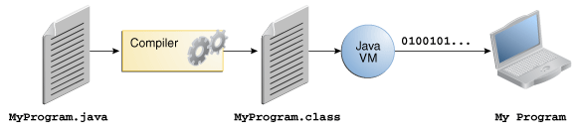
Java Compilation and Execution
Byte code is not for particular machine such as Intel.
Compiler
(javac)
Java Runtime Environment (Java Virtual Machine)
Java Program
(*.java)
Byte Code
(*.class)
Therefore, the byte code requires JRE for its execution
javac MyProgram.java
java MyProgram

Slide 6
Java Virtual Machine: Disadvantage
At run-time, it requires an additional translation from byte code to machine code
So, Java programs may show poor performance
Java Virtual Machine
translation
(Native) Machine Code
Byte Code
(*.class)

Slide 7
Java Virtual Machine: Advantage
Generally, porting to other system is very difficult!
Programs should be rebuilt for new system!
Windows
Machine Code
(HelloWorld.exe)
Source Program
(HelloWorld.cpp)
Linux
Byte Code
(HelloWorld)

Slide 8
Java Virtual Machine: Advantage
Java programs are portable:
No compilation is required!
This is called Write Once, Run Anywhere
JVM for Windows
Byte Code
(HelloWorld.class)
Java Program
(HelloWorld.java)
javac
Java Program
(HelloWorld.class)
JVM for Linux
Byte Code
(HelloWorld.class)

Slide 9
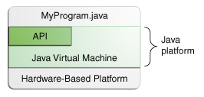
Where can we get JVM?
We can get JVM from Oracle free of charge.
https://www.oracle.com/technetwork/java/javase/downloads/index.html
JVMs for the following OSs are available
Windows x86, x64
Linux x86, x64
Solaris SPARC
Solaris x64
Mac OS X
* Dalvik is a JVM for Android!
We can also get specific VMs for specific platforms.

Slide 10
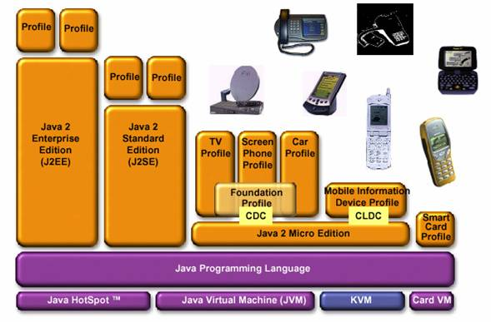
Java is very popular!
Java has been used for various applications.
Java offeres three editions for different applications
Java EE (Enterprise Edition)
Java SE (Standard Edition)
Java ME (Micro Edition)

Slide 11
Java is a system
Java provides a huge number of useful APIs.
Typical APIs are
Swing, JavaFX for GUI programming
Applet and Servlet for Web programming
Socket for Network programming
JDBC (Java Database Connectivity) for Database programming
RMI (Remote Method Invocation) for Distributed programming
JNI (Java Native Interface) for Native programming

Slide 12
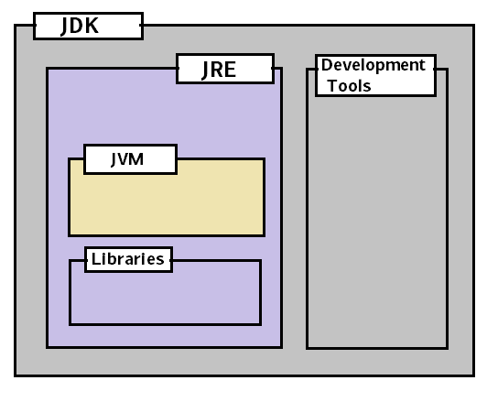
JDK vs JRE vs JVM

Slide 13
Programming Environment for Java
JDK (Java Development Kit)
the basic tools and libraries for developing Java applications
http://www.oracle.com/technetwork/java/javase/downloads/index.html
jdk
___________|________________
| | |
bin lib jre
| | _______|__________
java.exe tools.jar | |
javac.exe lib bin
javap.exe / \ / \
javah.exe ext rt.jar classic java.exe
javadoc.exe / i18n.jar / java.dll
jconsole iiimp.jar jvm.dll awt.dll
Before Java 9

Slide 14
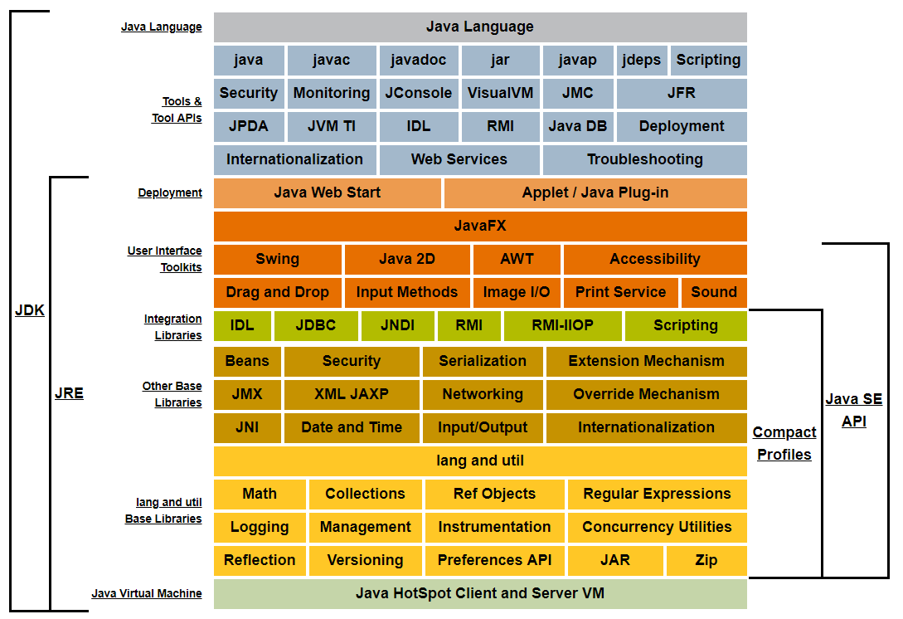
Java SE 8 Platform
https://docs.oracle.com/javase/8/docs/

Slide 15
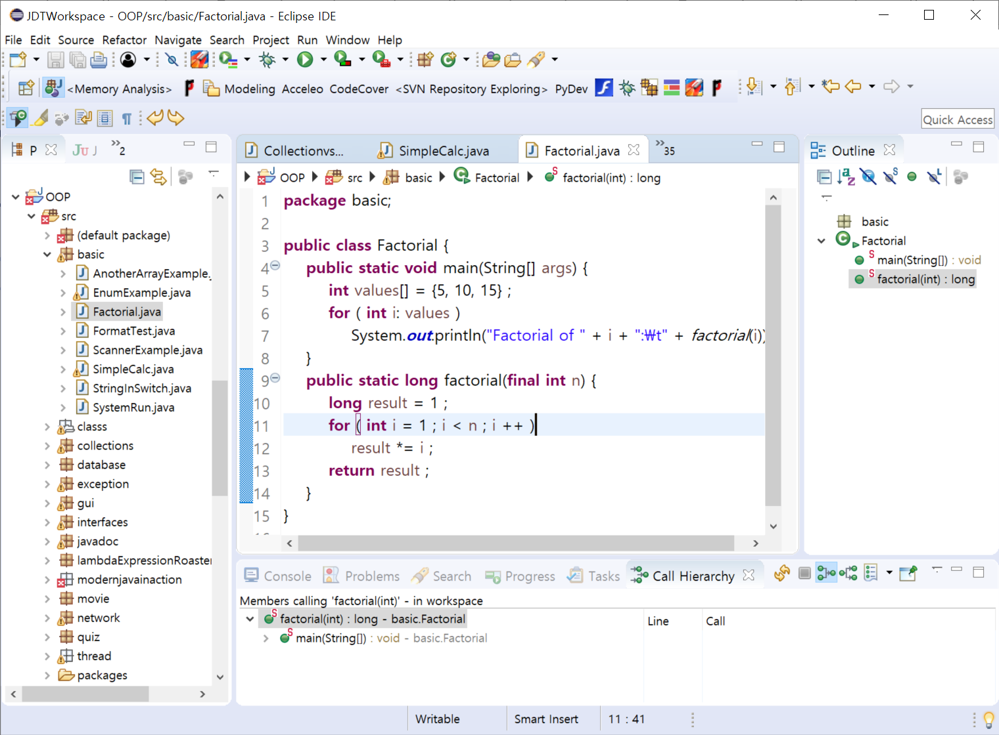
Programming Environment for Java
Eclipse: http://www.eclipse.org/

Slide 16
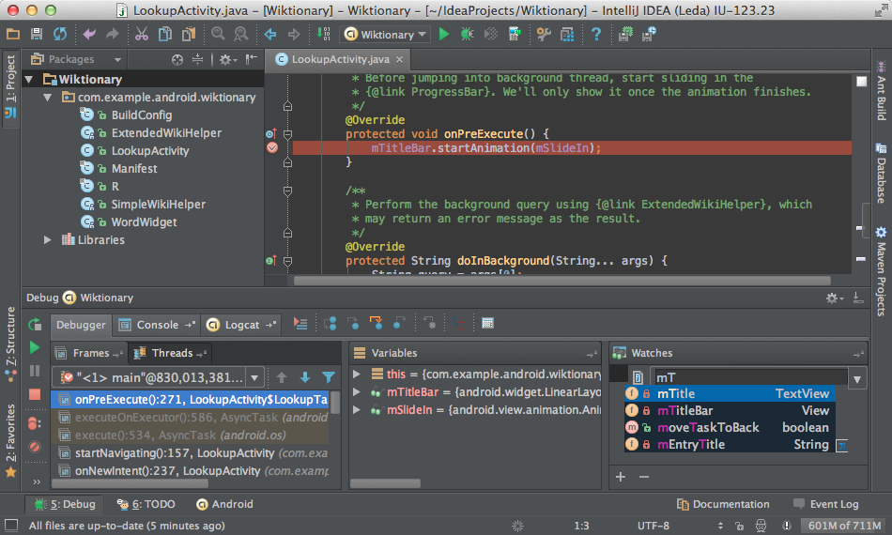
Programming Environment for Java
IntelliJ IDEA: https://www.jetbrains.com/idea/

Slide 17
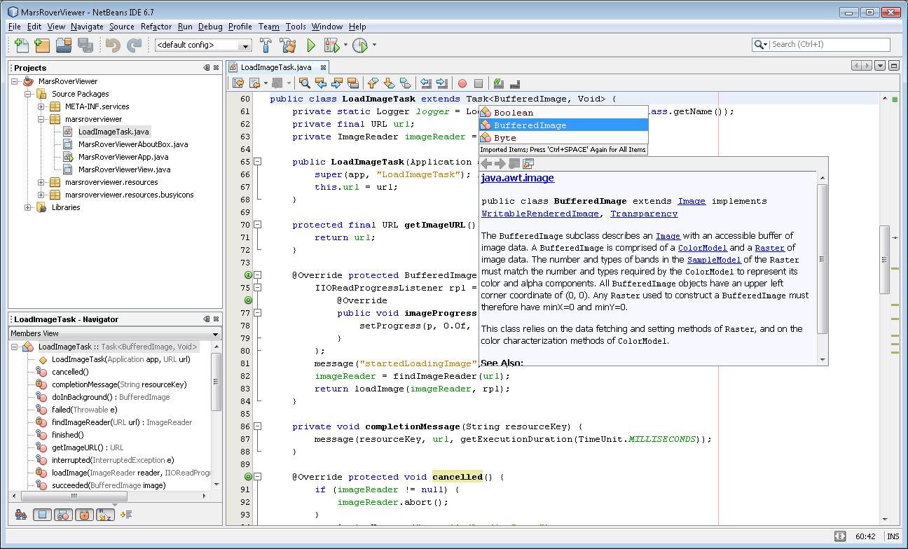
Programming Environment for Java
NetBeans: http://netbeans.org/

Slide 18
Information Sources on Java
The entry to Java: http://java.oracle.com/
Tutorials: http://docs.oracle.com/javase/tutorial/
Java SE 8 documentation: https://docs.oracle.com/javase/8/docs/
Java SE 8 API documentation: http://docs.oracle.com/javase/8/docs/api/

Slide 19
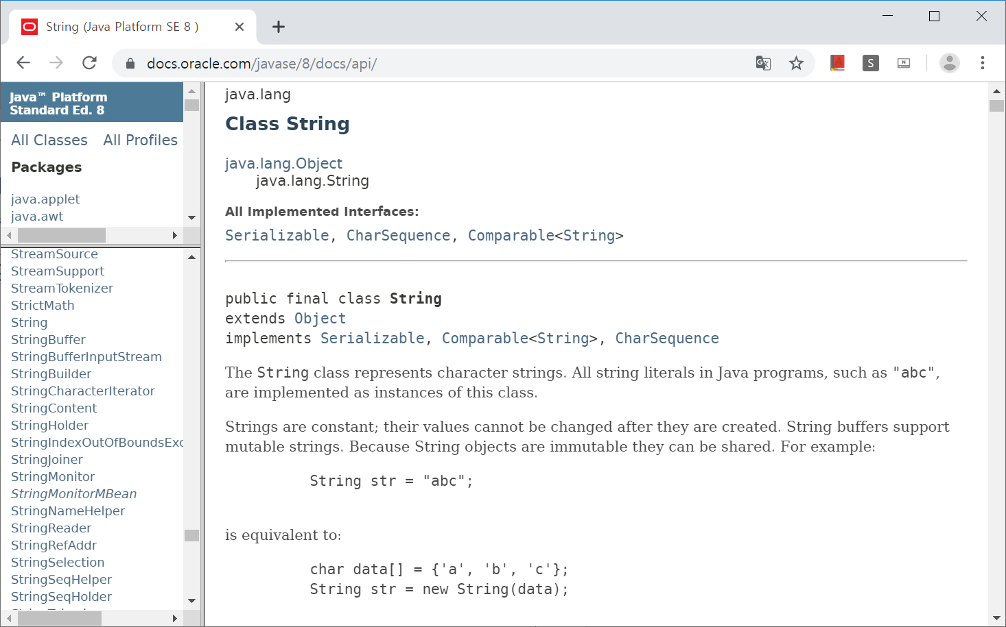
Java SE 8 API Documentation

Slide 20
Q & A

