Slide 1
Building a Japanese Mini-GPT Model
By: Damian Huck

Slide 2
Project Overview/Goals
Build a small GPT-style model trained on Japanese text.
Built entirely from scratch in Python + PyTorch
Learn how Transformers work internally.
Understand dataset prep, training, and generation.

Slide 3
How It Works
The Japanese dataset is loaded from a CSV file and combined into one
long training string for the model to learn from.
The script is then cleaned and removes emojis, English letters, and
symbols so only Hiragana, Katakana, Kanji, and key punctuation remain.
Every unique Japanese character is then assigned a numeric ID, the
model uses these IDs instead of raw text.
The encode() function turns sentences into integer sequences so
PyTorch can process them.
The model learns patterns in Japanese by predicting the next character
repeatedly across thousands of training steps.
The model uses self-attention to decide which characters influence each
prediction. An example of this could be that it learns that verbs appear at the
end of Japanese sentences, or that certain kanji pairs are often together.
After training, the model takes a starting token and predicts one new
character at a time, producing original Japanese like text.

Slide 4
What is Self-Attention
Self-attention is how the model decides which parts of a sentence matter
most when predicting the next character or word.
It looks at all characters in the input at the same time and assigns each one a
weight (importance score).
The model learns relationships between characters, such as:
Which kanji often appear together
  How particles (は, を, に) relate to other words
  That Japanese verbs usually appear at the end
  This helps the model understand context, not just memorize patterns.
Why it matters:
Self-attention is what allows GPT models to generate fluent, meaningful
text instead of random characters.

Slide 5
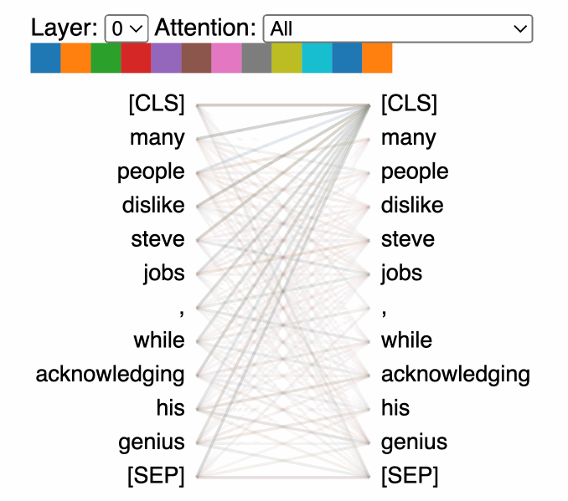
What is Self-Attention
Self-Attention GIF

Slide 6
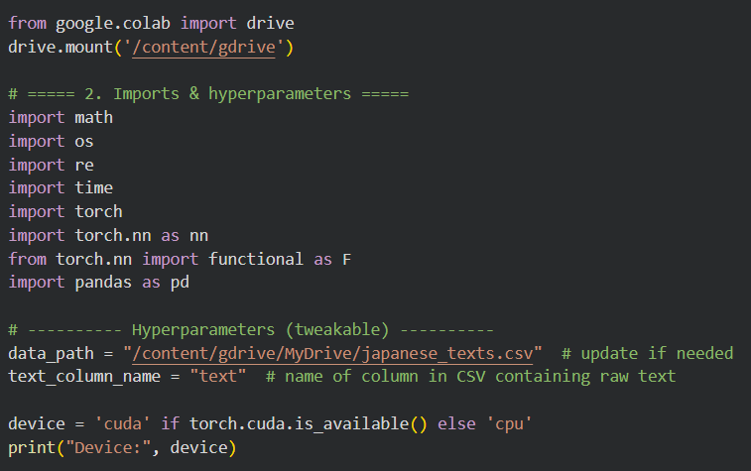
Environment: Google Colab + Drive + Device
Using Drive to get my CSV and check if I have a GPU or CPU

Slide 7
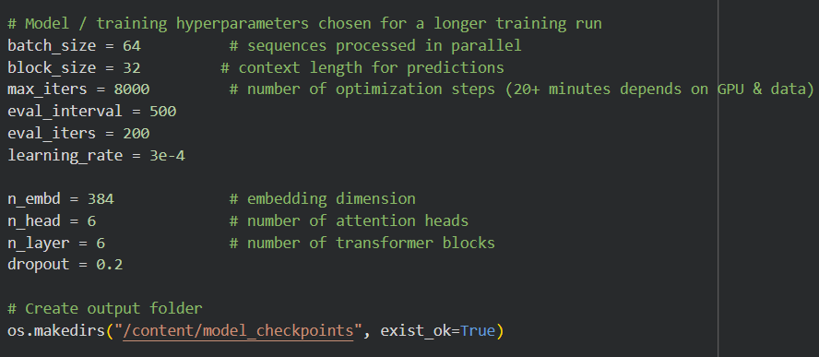
Model Hyperparameters
Key training settings that control how the Japanese GPT model learns
Hyperparameters shape speed, quality, and model behavior
I used small but realistic values for a custom character-level model

Slide 8
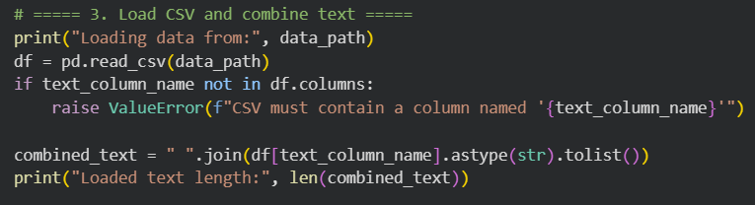
Loading the Japanese Dataset
CSV file loaded from Google Drive.
All text combined into one long training string.
Reads the CSV file from your Google Drive using pd.read_csv(data_path), loading all Japanese text into a DataFrame.
Checks that the CSV contains the correct column (named "text"); if not, it raises an error so you don’t train on the wrong data.
Combines all rows into one long training string using " ".join(...), then prints the total number of characters for confirmation.

Slide 9
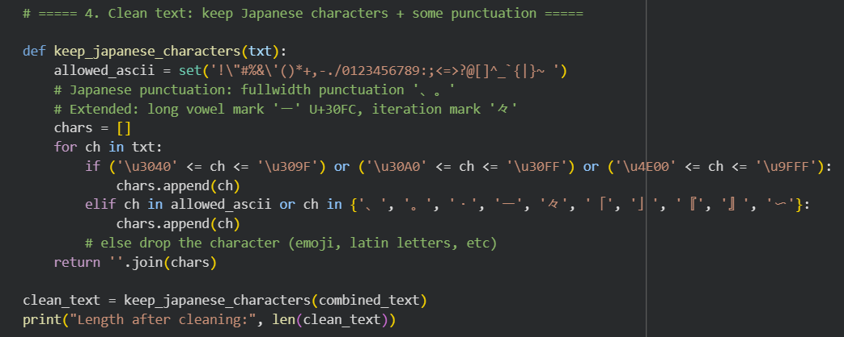
Cleaning the Text
Keeps only Japanese characters (Hiragana, Katakana, Kanji)
Remove symbols, emojis, and English letters

Slide 10
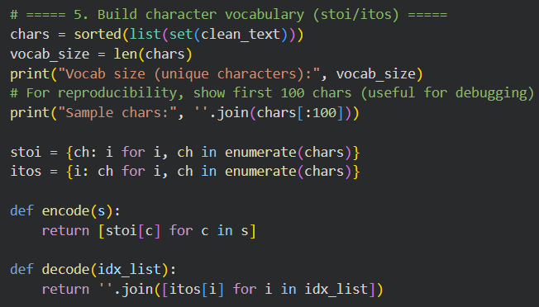
Building the Vocabulary
Every unique character gets a numeric ID.
Creates a vocabulary by taking every unique character in the cleaned text, sorting them, and
counting them, and this becomes the set of characters the model can learn.
Builds two dictionaries (stoi and itos) that map characters → numbers and numbers → characters,
allowing the model to switch between text and numeric IDs.
Defines encode() and decode() functions so the model can convert full strings into sequences of
numbers (for training) and convert model outputs back into readable Japanese text.

Slide 11
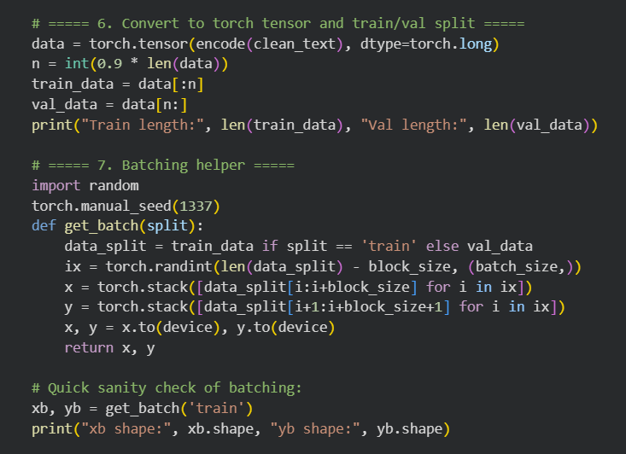
Preparing Training Batches
Convert all characters to PyTorch tensors.
Random batches help model generalize.
Train/validation split: 90% / 10%.

Slide 12

Self-Attention (Single Head)
Self-attention helps the model determine how much each part of a
sequence should influence every other part..
Learns which previous characters matter.
Backbone of Transformer models.
One attention head lets the model look back at previous characters
and decide which ones matter most.

Slide 13
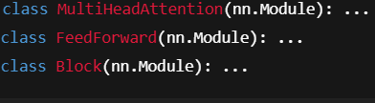
Transformer Block Structure
Multi-head attention + FeedForward network.
LayerNorm and skip connections included.
Multi-head attention = several heads in parallel
FeedForward = small fully-connected network
Block = attention + MLP + skip connections.

Slide 14
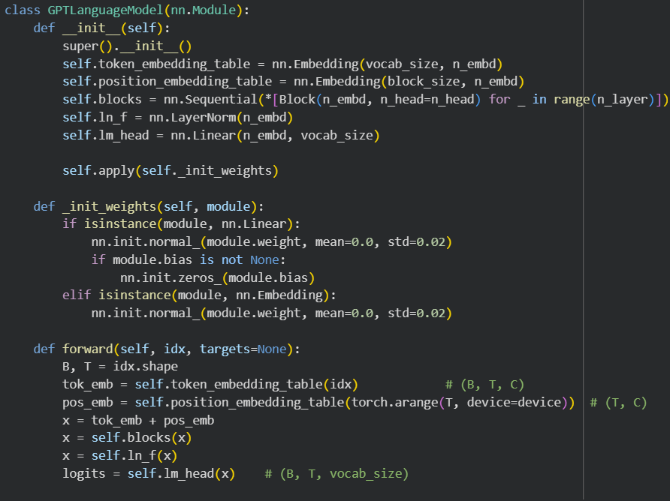
Building the GPT Model
Embeddings + multiple Transformer blocks.
Forward pass produces next-character predictions.

Slide 15
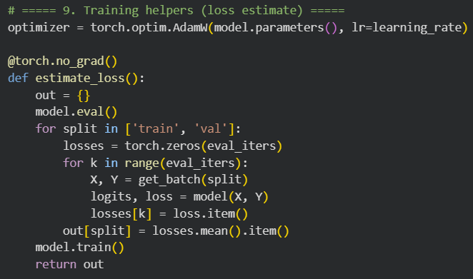
Training Loop
Uses AdamW optimizer.
Computes loss for train and validation.
Saves checkpoints while training.

Slide 16
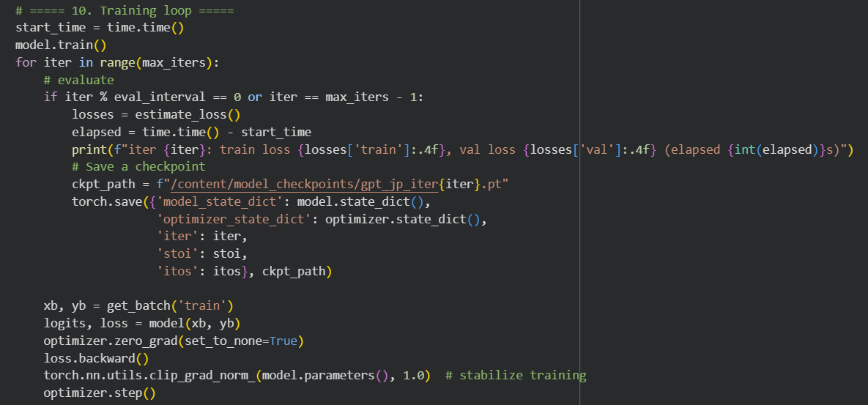
Training Loop Continued
This is the complete model: embeddings + multiple Transformer
blocks + output layer. Then generate lets it produce Japanese characters

Slide 17
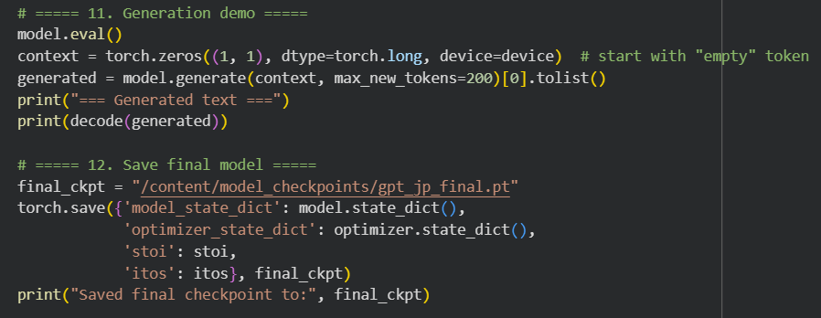
Japanese Text Generation
Model generates one character at a time.
Starts from an empty context and builds forward.

Slide 18
Reflection & Takeaways
Learned how GPT models work internally.
Clean data and batching are extremely important.
Future step: train with more data for better results.

