Slide 1
Case Study 2
Prepared by:
Joshua Hudson
Notes:
Hello and thank you for your time to go over our analysis of the talent management data your team provided DDSAnalytics. It is our hope that our findings will prove to add value to you and your team.

Slide 2

Analysis Overview
Top Attrition Factors
Attrition Prediction
Salary Prediction
Job Role Insights
Notes:
Okay lets get into it!
In this analysis we will:
Analyze The top three factors that had the highest contribution to employee turnover.
We with then Use a machine Learning model that predicts Attrition based on these top factors
Then we will see how Regression analysis can help predict salary, based on correlated factors
Then finally, we will review some interesting insights that your team will find useful.

Slide 3
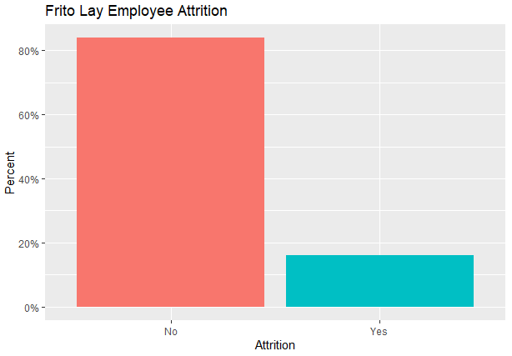
Top Attrition Factors
Salary v. Hourly Employees
Stock Option Level
Job Role
Notes:
Using Chi-Squared testing to test every factor in the available data, we were able to find the top three highest contributors to attrition.
Our analysis showed that the top three factors that contribute to attrition were:
Salary v. Hourly Employees
Stock Option Level
Job Role

Slide 4
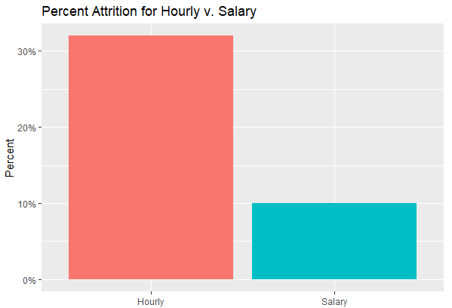
Hourly v. Salary
Notes:
To break this out, lets look the percentage of attrition within each of these top three groups.
Within hourly v salary, the percentage of attrition for hourly employees was about 3 times higher than that of salary employees

Slide 5
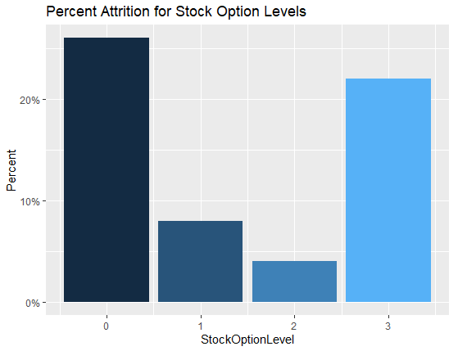
Stock Option Levels
Notes:
The next highest significant factor was stock option levels.
One would assume that employees with a 0 level stock option would have higher attrition rates than those with higher levels. That proved to be true for employees with stock option levels 1 and 2.
However, Oddly enough, the data showed that employees with stock option level 3 had nearly as high attrition rates as employees with stock option level 0.
We will investigate why that could be true in coming slides.

Slide 6
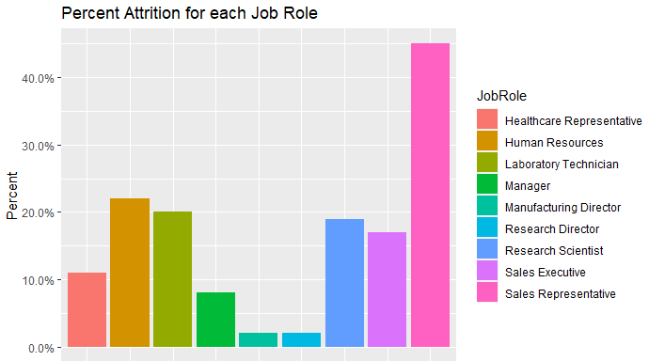
Job Role
Notes:
As for the Job Role’s contribution to Attrition rates,
Sales representatives showed to have the highest attrition, doubling in percentage of its closest competitor, Human Resources.
Interestingly, high responsibility roles as Manufacturing director and Research director had the lowest attrition rates between these groups.

Slide 7
Attrition Prediction
Actual\Prediction | Stayed w/ Company | Left Company
Stayed w/ Company | 215 | 30
Left Company | 5 | 11
Salary v. Hourly Employees
Stock Option Level
Job Role
KNN Model Results:
Accuracy: 0.87
Sensitivity: 0.98
Specificity: 0.27
Notes:
Now lets move on to the fun part!
Machine learning!
We used K-nearest neighbors or KNN for short to construct a model that could predict attrition using the top three highest factors metioned before:
Salary v. Hourly Employees
Stock Option Level
Job Role
From this analysis, this model proved to have high accuracy and sensitivity, but lacked in specificity.
Meaning it is overall an accurate model when it comes to predicting employees who do not leave the company. But struggles to predict when employees who do leave.

Slide 8
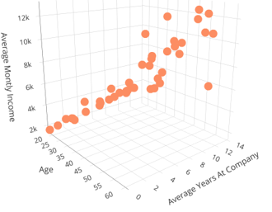
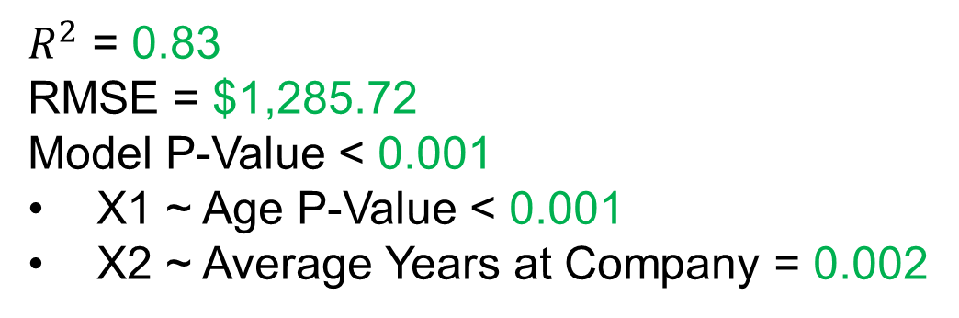
Salary Prediction
Income V. Age & Average Years at the Company
$Avg. Monthly Income=−\$1932.47+\$176\left(Age\right)+\$281(Avg. Years at Company)$ + error
$R^{2}$ = 0.83
RMSE = $1,285.72
Model P-Value < 0.001
X1 ~ Age P-Value < 0.001
X2 ~ Average Years at Company = 0.002
Notes:
We also used linear regression to help predict Average monthly income based on an employees age and the average amount of time the employee has been with the company.
As you can see on the 3dgraph, These factors turned out to be good expainatory variables to predict monthly income.
To quantify their goodness of fit we calculated this models:
r-square value which turned out to be 0.83 (Or 83% of the Avg. Monthly income’s variance is explained by this regression model)
RMSE or root mean squared error which was $1,285.72
And finally, the model and coefficients had a low p-values indicating a good correlation.

Slide 9
Interesting Finding
RS 2.6
RS 2.5
RS 2.7
RS 2.7
Notes:
Remember how we stated that it was odd that employees with the highest stock option level had a significantly high attrition rate (relative to other levels in that group)?
Well we explored this and it turns out that the employees that have the highest stock option level has the lowest average relationship satisfaction rating with their managers.
And the opposite is true for the employees that have the least attrition rate in this group. Meaning they have the highst average relationship satisfaction rating with their managers.

Slide 10
Analysis Summary
Top Attrition Factors
Attrition Prediction
Salary Prediction
Job Role Insights
Notes:
Okay lets get into it!
In this analysis we will cover:
The top three factors that had the highest contribution to employee turnover.
Used KNN to predict attrition rates (This model had high accuracy, sensitivity, but low specificity.
Used Regression analysis to predict salary based on Age and average years at the company
Then we examined why employees that have the highest stock options have high attrition rates.
And we saw that this group had low average relationship satisfaction ratings with their leadership.
Well that is all we had for you today.
We here at DDSAnalytics had a lot of fun analysing this data and hope that you and your team at Frito Lay find it useful and that it adds value.
Thank you

Slide 11
Thank You

