Slide 1
Unit 3
FOR LIVE SESSION ASSIGNMENT
DS 6306: Doing Data Science
Joshua Hudson

Slide 2
Unit 3 Code All code for the following slides is on a single r-markdown file and has been attached as an object on this slide (Below).

Slide 3
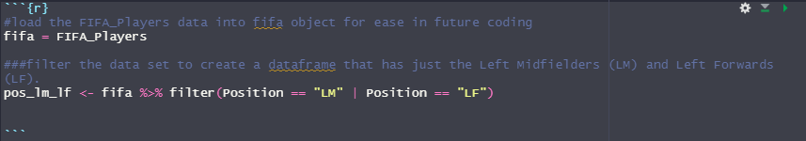
Part 1: We would like to analyze the Left Midfielders (LM) versus the Left Forwards (LF). (Estimated / expected time: 2 – 4 hours and at least 2+ slides). Part 1.1: Using the FIFA player data set, filter the data set to create a dataframe that has just the Left Midfielders (LM) and Left Forwards (LF).

Slide 4
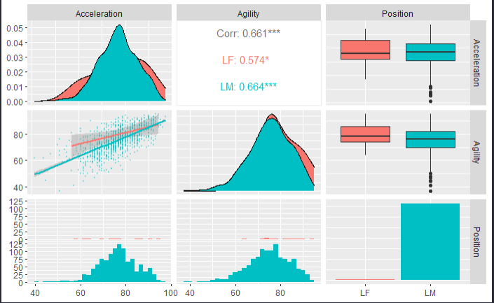
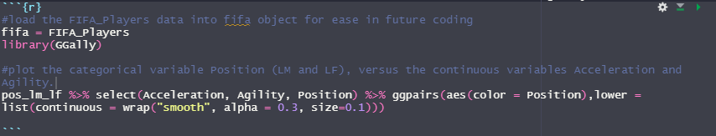
Part 1: We would like to analyze the Left Midfielders (LM) versus the Left Forwards (LF). (Estimated / expected time: 2 – 4 hours and at least 2+ slides). Part 1.2: Use Ggally and ggpairs() and the dataset you created above, to plot the categorical variable Position (LM and LF), versus the continuous variables Acceleration and Agility.

Slide 5
Part 1: We would like to analyze the Left Midfielders (LM) versus the Left Forwards (LF). (Estimated / expected time: 2 – 4 hours and at least 2+ slides). Part 1.3: Given the plot above, what relationships do you see? Comment on these.
Zooming in the Agility vs Acceleration plot from the ggpairs() plot in part 1.2, there appears to be a position relationship between agility and acceleration. That is, as the player’s acceleration increases, the player’s agility naturally will increase. This makes intuitive sense as agility is dependent on the player’s ability to accelerate when stopping/starting or changing direction.

Slide 6
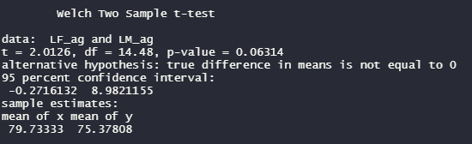
Part 1: We would like to analyze the Left Midfielders (LM) versus the Left Forwards (LF). (Estimated / expected time: 2 – 4 hours and at least 2+ slides). Part 1.4: Your client would like to formally test if the mean agility rating of left midfielders is different than that of the left forwards. Perform a 6 – step t-test to test for the difference in these means. (You may skip step 2 (draw and shade) if you like. If you are unfamiliar with the 6-step hypothesis test, see Stat 1 slides or the Bridge Course to review the 6-step hypothesis test.)
6 – Step T-Test:
Step 1: Identify the null (H_0) and alternative (H_a) hypotheses.
H_0 ~ The mean agility rating of left midfielders is the same as that of the left forwards
H_a ~ The mean agility rating of left midfielders is not the same as that of the left forwards
Step 2: alpha = 0.05 (was not specified, therefore assumed to be 0.05)
Step 3: Find the test statistic: t = 2.0126
Step 4: Find the p-value: 0.06314
Step 5: Reject or fail to reject H_0
p-value = 0.06314 > alpha = 0.05 = Fail to reject H_0
Step 6: Conclusion:
A two-sample t-test was performed to formally test if the mean agility rating of left midfielders is different than that of the left forwards.
With 95% confidence, there was not a significant difference in the mean agility rating of left midfielders than that of the left forwards.

Slide 7
Part 1: We would like to analyze the Left Midfielders (LM) versus the Left Forwards (LF). (Estimated / expected time: 2 – 4 hours and at least 2+ slides).
Part 1.5.1: Are the assumptions of this test reasonably met?
I made the following assumptions to conduct the t-test on the previous slide:
The significance level is 0.05
The LF and LM agility data was normally distributed
The LF data had far less data points than the LM data.
The variances between both data sets were unequal
I believe these assumptions are reasonable for this context and data sets. Further reasoning for these assumptions are on the following slides.

Slide 8
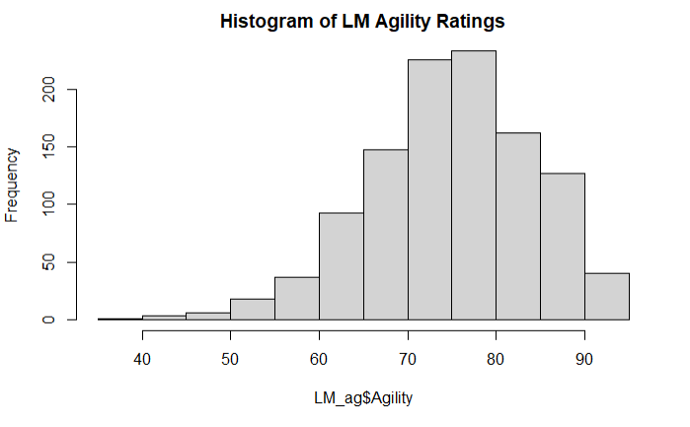
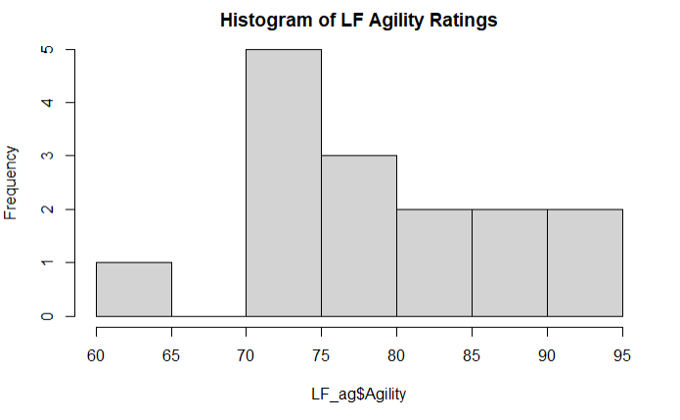
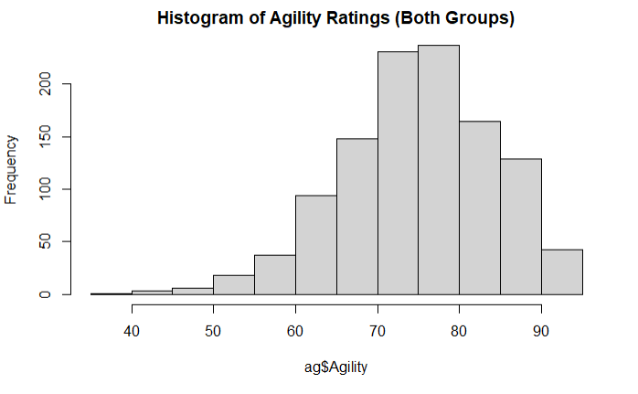
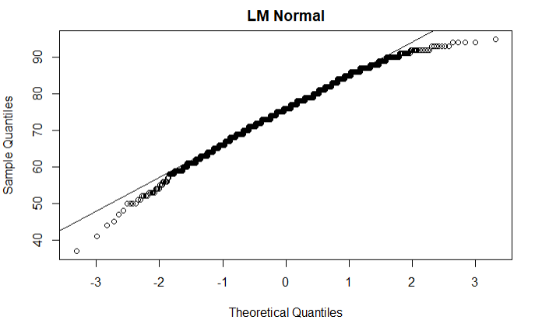
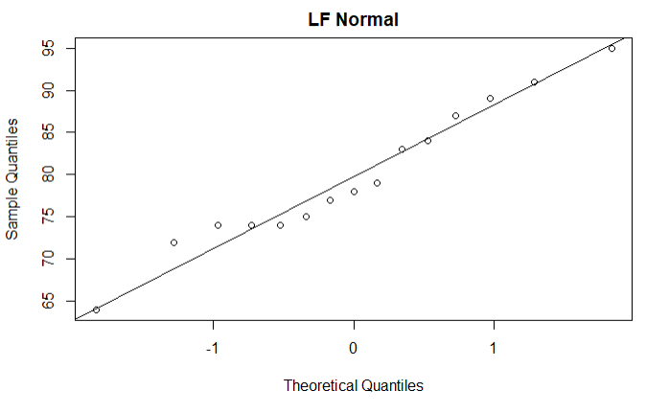
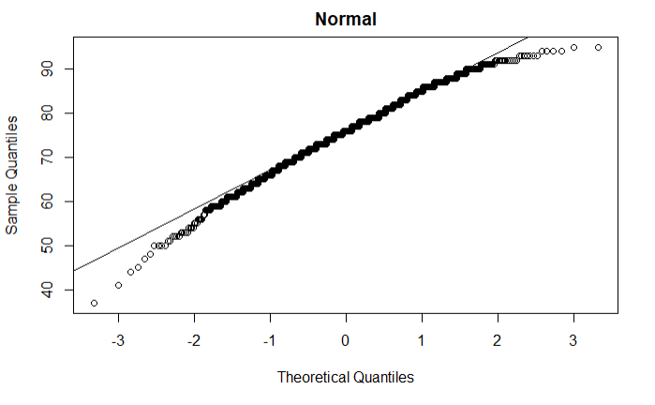
Part 1: We would like to analyze the Left Midfielders (LM) versus the Left Forwards (LF). (Estimated / expected time: 2 – 4 hours and at least 2+ slides).
1.5.2: If you have not had Stat 1, simply create a histogram of the agility scores for both groups (LM and LF)
The data for both positions combined and for each position (LM and LF) individually appears to be reasonably normal.

Slide 9
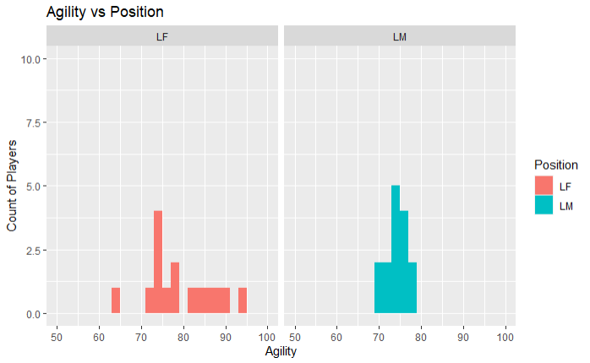
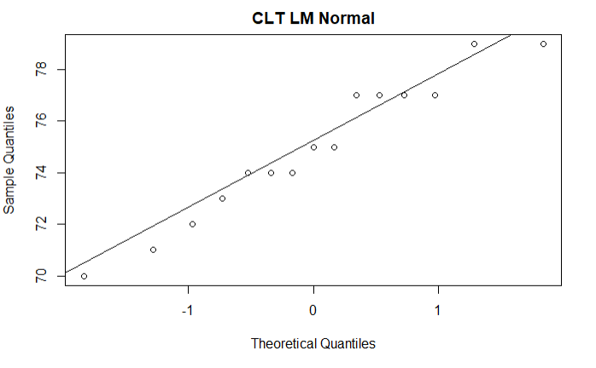
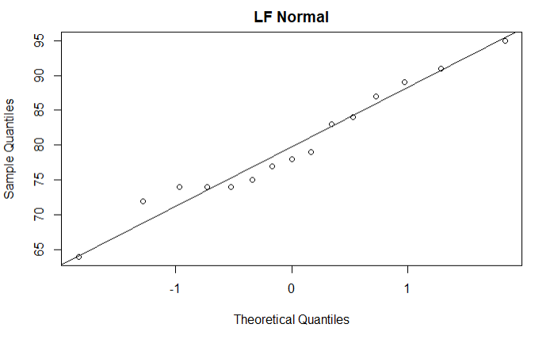
Part 1: We would like to analyze the Left Midfielders (LM) versus the Left Forwards (LF). (Estimated / expected time: 2 – 4 hours and at least 2+ slides).
1.5.3: Given what you know about the CLT, comment on if you believe the sampling distribution of sample means (of your sample size) will be reasonably normal.
As seen from the previous slide, the population data for both groups appeared to be reasonably normal. From what I understand of the CLT, if the CLT is applied*, the distribution would follow a much tighter normal distribution. This is demonstrated below.
*It would only make sense to apply the CLT for the LM data as it had a population size of 1095 observations. Whereas, the LF data only had a population size of 15 observations. With this in mind, I selected a sample size of 15 for the LM data (to match LF population size) to apply the CLT to the Agility ratings for the LM position.

Slide 10
Part 1: We would like to analyze the Left Midfielders (LM) versus the Left Forwards (LF). (Estimated / expected time: 2 – 4 hours and at least 2+ slides).
1.5.4: In addition, does there look like there is significant visual evidence to suggest the standard deviations are different?
Using the histograms from slide 8, there is no clear visual evidence that the standard deviations for between agility rating population data of LM and LF positions is significantly different. Again, the LF data set has a much smaller population size than LM data. Thus, no absolute conclusion can be visually drawn.
However, comparing the histogram (slide 9) of agility rating population data for the LF position to the sample LM position data that we applied the CLT, there is a clear visual indication that the sample LM position data that we applied the CLT has smaller standard deviations.

Slide 11
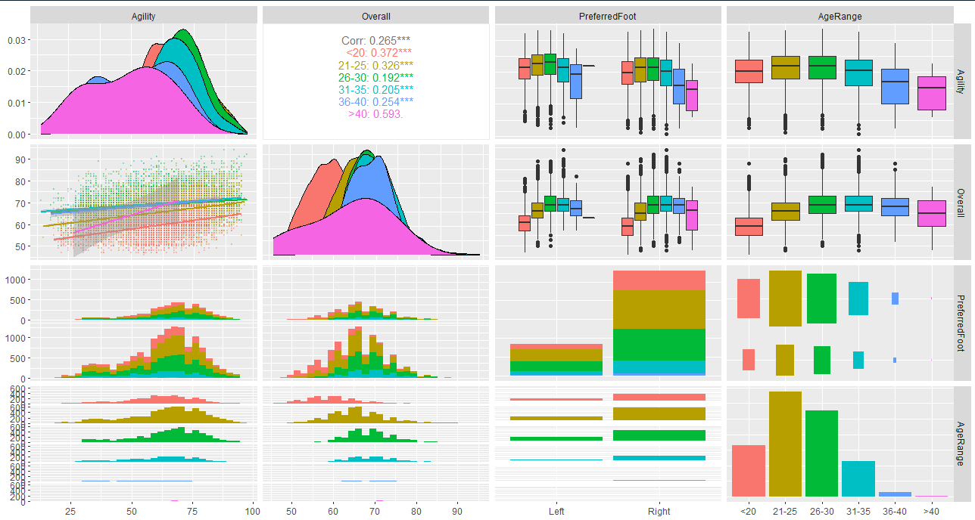
Part 2: (Estimated / expected time 3-5 hours and at least 3+ slides) Select/create at least 2 categorical variables and select two continuous variables and perform an EDA. Also, at least one of the categorical variables should be created from a continuous variable (using the cut() function). Part 2.1: Use these variables to explore the data and tell a story of what you discovered similar to what was shown in the asynch videos. You do not need to go so far as to use linear regression, but let your curiosity guide you along the way and feel free to use methods you are familiar with that are appropriate to answering those questions. Your evidence could be purely visual or could include additional methods, it is up to you… just do your best and have fun!
Selected Variables:
I wanted to know how a player’s preferred foot (categorical) and age range (categorical) could influence their overall performance (continuous) and agility rating (continuous).
EDA Method: ggpair plotting
Observations:
Overall performance increases as agility increases for all ages.
Overall performance peaks in the 26-30 and 31-35 year age ranges. Whereas, agility rating is similar for all ages.
Lowest performance age range is <20 year olds
Foot preference has no noticeable impact on the player’s agility rating or overall performance.
There are more players that prefer their right foot, than left.

Slide 12

Part 3: Takeaways and Question for Live Session ($≤1 hour)$ What were your 3-5 (or more) key takeaways from this unit? Were there any questions you had or topics that were fuzzy? (There is no minimum here. However, if you don’t have any questions, please simply state, “I didn’t have any questions, everything was pretty clear!” (or something to that effect.) ☺
Questions:
Was the LF position data used due to its small observation size for the Agility Ratings?
Is it a good practice to apply the CLT to a large population and compare it to a smaller population or sample size? Seems mis-matched or not “one to one”.
Are there formal tests that the Data Scientist can rely on to verify data is normal? Or will just looking at histograms, normality plots, etc… suffice in a professional environment?
Takeaways:
I like the ggpairs functionality to explore the data for meaningful, visual information.
This will serve well in the future as a jump off point to see what story the data could be telling.

Slide 13
Back Up

Slide 14
For Live Session: Unit 3
Part 1: We would like to analyze the Left Midfielders (LM) versus the Left Forwards (LF). (Estimated / expected time: 2 – 4 hours and at least 2+ slides).
Using the FIFA player data set, filter the data set to create a dataframe that has just the Left Midfielders (LM) and Left Forwards (LF).
Use Ggally and ggpairs() and the dataset you created above above, to plot the categorical variable Position (LM and LF), versus the continuous variables Acceleration and Agility.
Given the plot above, what relationships do you see? Comment on these.
Your client would like to formally test if the mean agility rating of left midfielders is different than that of the left forwards. Perform a 6 – step t-test to test for the difference in these means. (You may skip step 2 (draw and shade) if you like. If you are unfamiliar with the 6-step hypothesis test, see Stat 1 slides or the Bridge Course to review the 6-step hypothesis test.)
Are the assumptions of this test reasonably met? If you have not had Stat 1, simply create a histogram of the agility scores for both groups (LM and LF) and given what you know about the CLT, comment on if you believe the sampling distribution of sample means (of your sample size) will be reasonably normal. In addition, does there look like there is significant visual evidence to suggest the standard deviations are different? ….. If you have had Stat 1, create the plots listed above (and any other plots you might prefer) and be prepared to be a teacher and teach what you know about the assumptions of the t-test and if those are assumption are reasonably met here.

Slide 15
For Live Session: Unit 3
Part 2: (Estimated / expected time 3-5 hours and at least 3+ slides)
Select/create at least 2 categorical variables and select two continuous variables and perform an EDA. Also, at least one of the categorical variables should be created from a continuous variable (using the cut() function).
Use these variables to explore the data and tell a story of what you discovered similar to what was shown in the asynch videos. You do not need to go so far as to use linear regression, but let your curiosity guide you along the way and feel free to use methods you are familiar with that are appropriate to answering those questions. Your evidence could be purely visual or could include additional methods, it is up to you… just do your best and have fun!

Slide 16

For Live Session: Unit 3
Part 3: Takeaways and Question for Live Session ($≤1 hour)$
What were your 3-5 (or more) key takeaways from this unit?
Were there any questions you had or topics that were fuzzy? (There is no minimum here. However, if you don’t have any questions, please simply state, “I didn’t have any questions, everything was pretty clear!” (or something to that effect.) ☺

