Slide 1


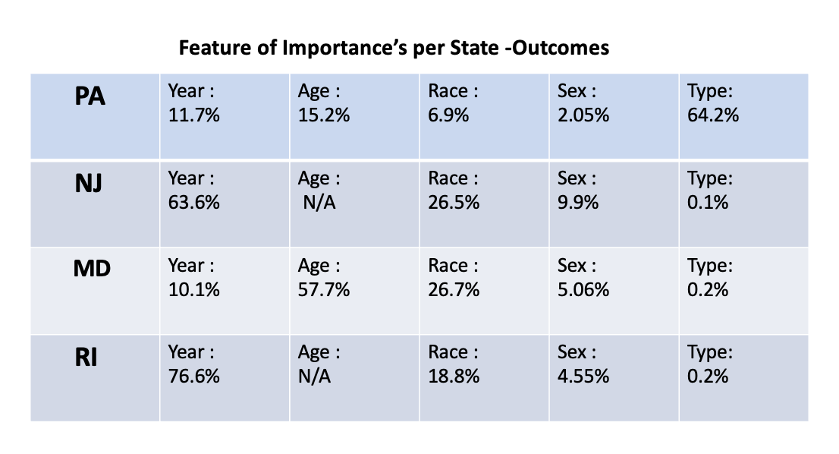
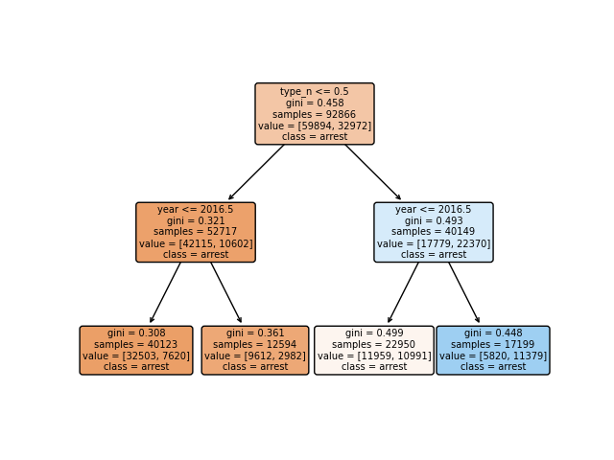
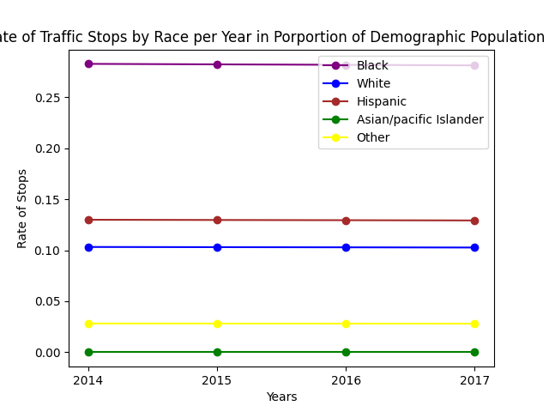
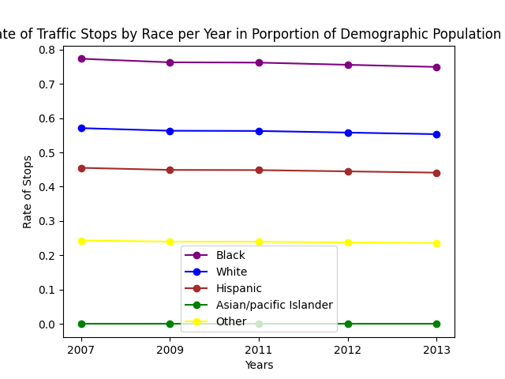
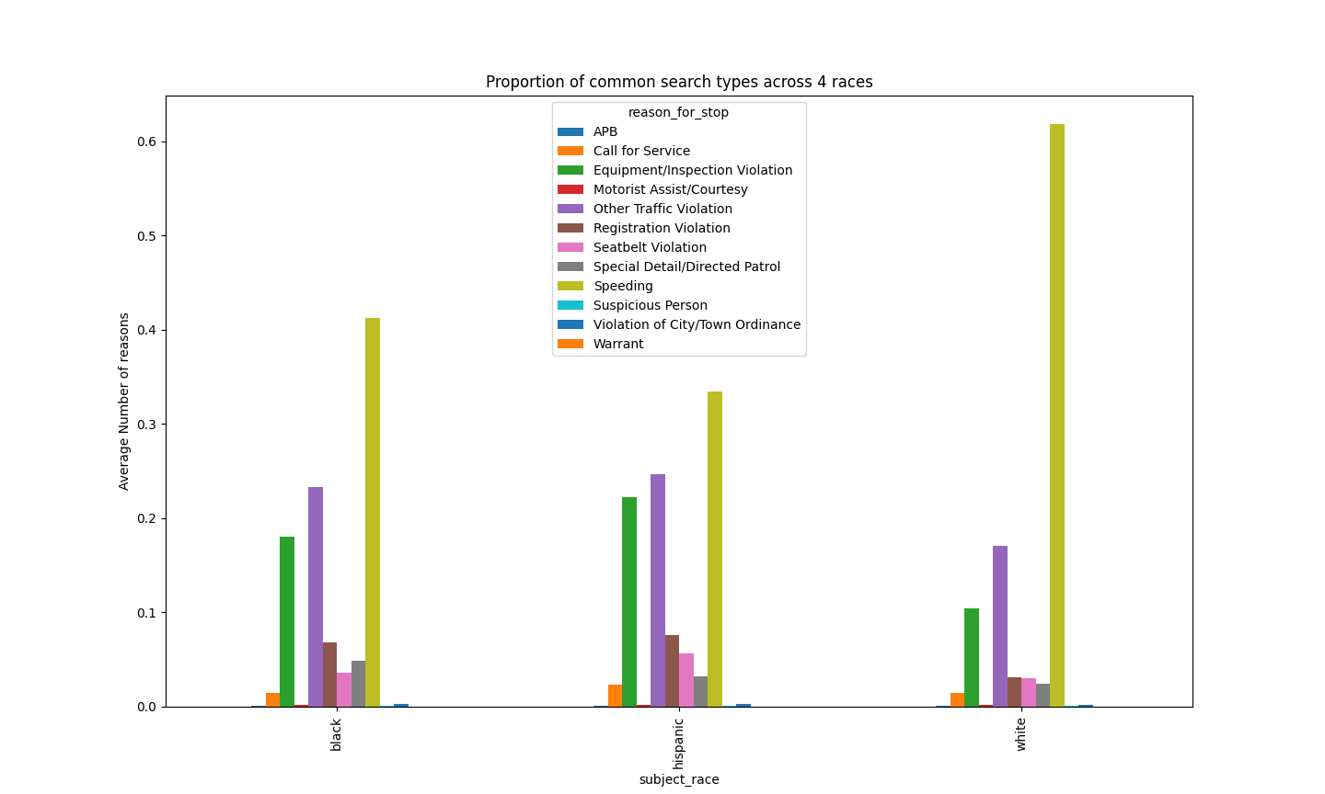
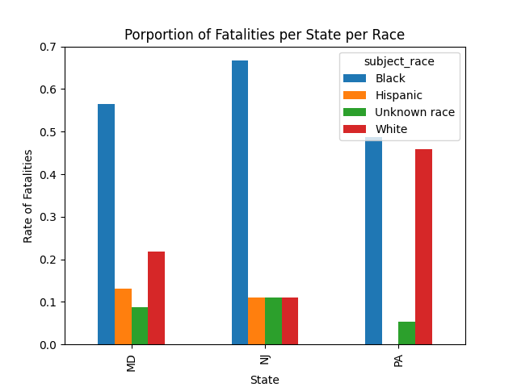
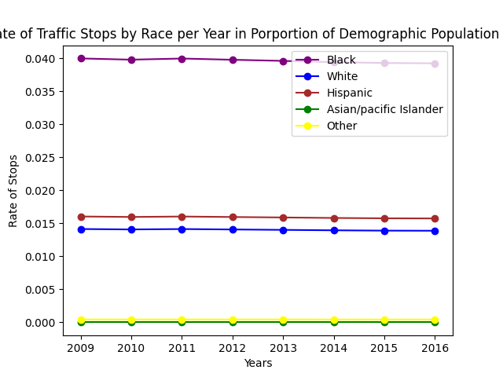
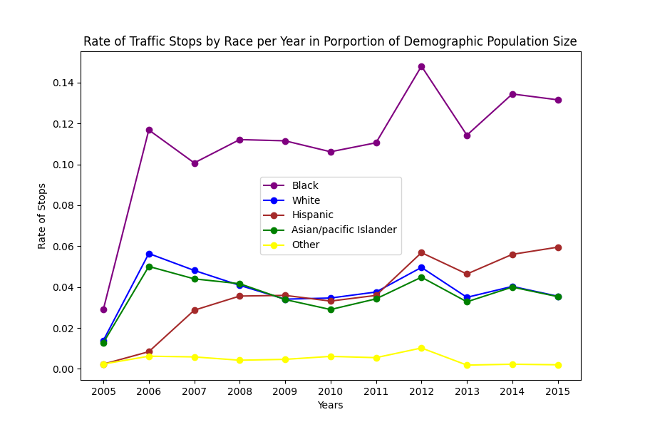
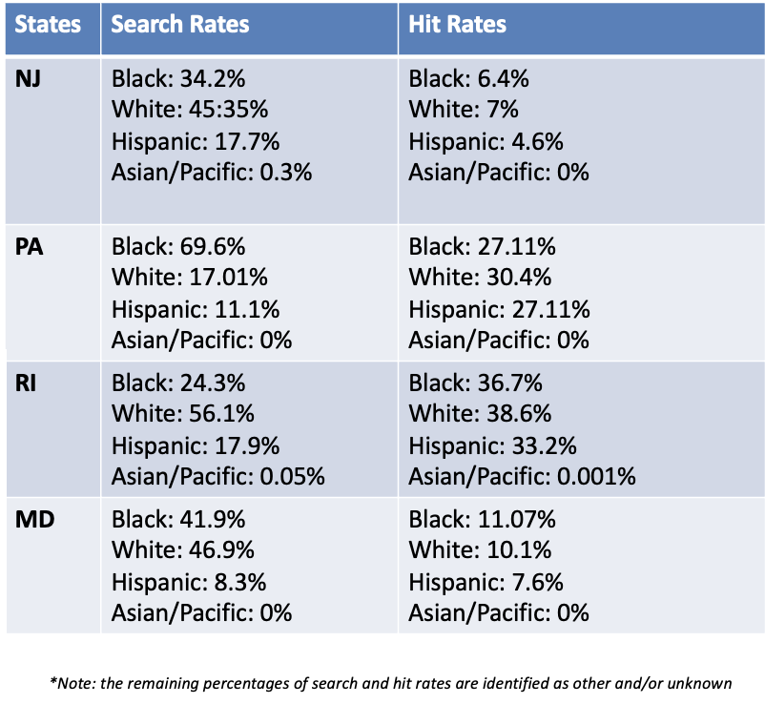
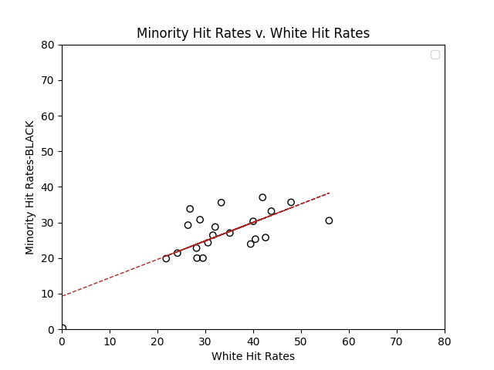
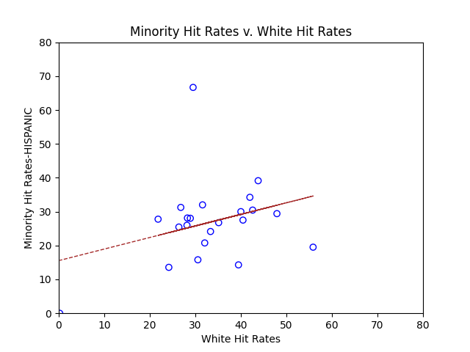
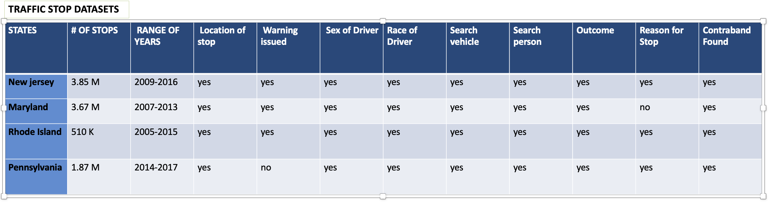
A Large Analysis of Traffic Stops Across
the Northeast region of the U.S
Huda Ali, Department of Engineering & Computer Science, Syracuse University
Introduction
Every year, millions of people get stopped due to traffic offenses, making this one of the most prevalent ways in which the public engages with the police. More than 10 percent of police killings that happened in 2021 were of traffic stops. As the relationship between the public and police increases in hostility a question is posed; Is there a racial disparity in police traffic stops?
I focused this study primarily in the Northeast region of the States which include, New Jersey, Maryland, Rhode Island, and Pennsylvania. From Stanford's Open Policing Project, I have gathered, compiled and analyzed datasets of these four states. Naturally, to effectively deduce if any disparities are occurring, we need to consider several factors. For example, the percentage of each demographic per region as well as the search and outcome rates of stops. We can further split this by race, sex year, and even district. In comparing the success rates and search rates, we can determine if there are any biases
.
Purpose
My goal in this project is to establish if there is any disparity due to bias in traffic stops across:
      New Jersey
      Rhode Island
      Maryland
      Pennsylvania
Combined population records with datasets by Stanford Open Policing Project
Analyzed data in categories of race, sex, year.
Algorithm
A decision tree is a form of supervised machine
learning that is used to categorize or predict depending
on the answers to a prior series of questions.
The model is supervised learning in the sense that it
is trained and evaluated on data that contains the
desired classification.
Results
I found that stops rates generally stay consistent throughout the years for most of the states with respect to demographic population size. They still however display a substantial discrepancy between races especially in Rhode Island where black people only make up about 5% of the population and white make up more than 75% percent. Below is a table that contains proportions of common reasons for stops per race in Rhode Island. Although, speeding averages the highest for all three races, equipment/inspection violation averages 10% higher in black and Hispanic individuals.
  How ever this could be due to the concentration
  of a particular race could be higher in ‘busier’ locations
  where police activity is higher. In order to see if there is a
  bias, we need to look at the success rates of the searches.
  To take in Becker’s outcome analysis, we can concur that
  if the search rates are higher in one race while the success rates
  are lower than its counterparts, then evidentially, bias exists.
  Let’s take Pennsylvania for example. The hit rates of minorities
  are much lower compared to white people.
Conclusion.
We need to encourage jurisdictions to collect individual-level stop data, which includes the date and time of the stop, the location of the stop, the driver's race, gender, and age, the reason for the stop, whether a search was conducted, the search type (for example, 'probable cause' or 'consent'), whether contraband was discovered during a search, the stop outcome (for example, a citation or an arrest), and the specific violation with which the driver was charged. Most governments only gather a fraction of this data.
Outlook
  More enforcement on public data in every jurisdiction
      Implement AI system to it records minimum requirements to solidify the integrity of the data
  Analysis throughout traffic policy changes
  Implement a veil of darkness test
Pennsylvania
Maryland
New jersey
Rhode island
Literature cited
Becker, G. Nobel Lecture: The Economic way of looking at behavior. J. Polit. Econ. 101, 385–409 (1993)
Becker, G. Te Economics of Discrimination (Univ. of Chicago Press, 1957).
“The Stanford Open Policing Project.” Openpolicing.stanford.edu, 2020, openpolicing.stanford.edu/data/
Police. “2021 Police Violence Report.” Policeviolencereport.org, 2021, policeviolencereport.org/
Materials and methods
The traffic data sets were mainly gathered from the Stanford Open Policing.
Most of the analytics is done manually and/or through the Pandas Library.
Acknowledgments
The 2022 LSAMP Summer REU Program is sponsored by​​ - NSF HRD 1712733
Special thanks to Professor Soundarajan for mentoring me through this process.

