Slide 1
HOTEL MANAGEMENT SYSTEM
Huda Hashim 18636
Ayesh Rehman 19691
Ahsan Hameed 19755

Slide 2
TABLE OF CONTENTS
01
04
About the Project
Conceptual Model
02
05
Technologies Used
Logical Model
03
Major Requirements
The idea behind the project
The first-cut model of the system
The technologies used to develop the system along with the database
Structured interpretation of the conceptual model.
06
Updated Model and Screens
Functional requirements of our Manageent System
Normalized Model and Screens of the program.

Slide 3
About the Project
The Topic for our project is Hotel Database Management System. It will be used to access, manage and manipulate the data that is gathered as well as manage the tasks that are required to run the operations of a hotel smoothly. It is usually designed to simplify and improve efficiency of the hotel’s operations.

Slide 4


Technologies Used
JAVA/NET BEANS
My SQL/ SQLPLUS
URWIN

Slide 5
MAJOR REQUIREMENTS
Services (Including both rooms and all the extra services combined)
Staff Management (Management of the staff and allocation of the room service)
Searching (Searching for existing bookings, customers, staff members, rooms, etc)
Payments (Check Out and The Payment Process)
User Interface (Easy and Clean User Interface for easy access)

Slide 6
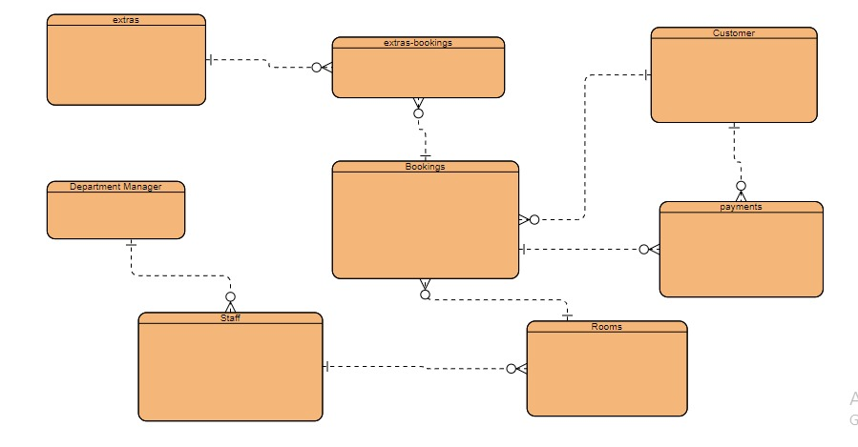
Initial
Conceptual Model

Slide 7
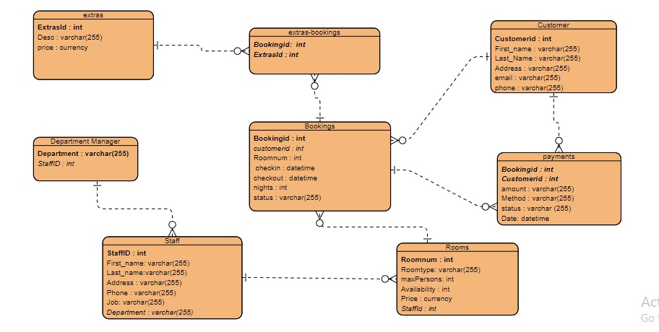
Initial
Logical Model

Slide 8
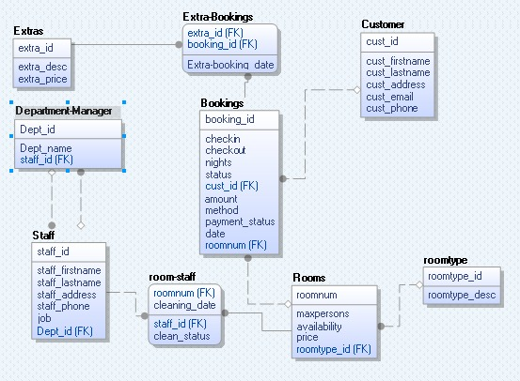
Changes to our Logical and Conceptual Model
So, after going through our UMLs again and normalization of the tables, we ended up with a different and more robust design for our conceptual and logical design, consequently, the whole program as well.

Slide 9
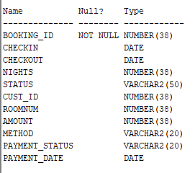
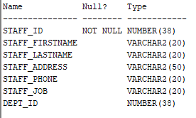
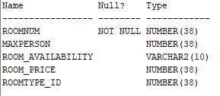
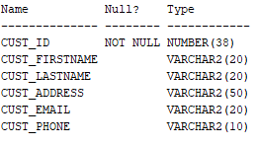
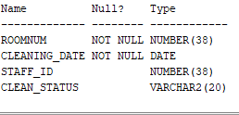
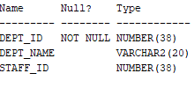
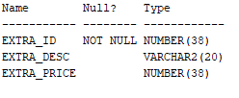
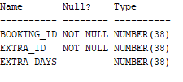

ROOMS
STAFF
BOOKINGS
DEPARTMENT-MANAGER
ROOM-STAFF
CUSTOMER
ROOM-TYPE
EXTRAS
EXTRA BOOKINGS

Slide 10
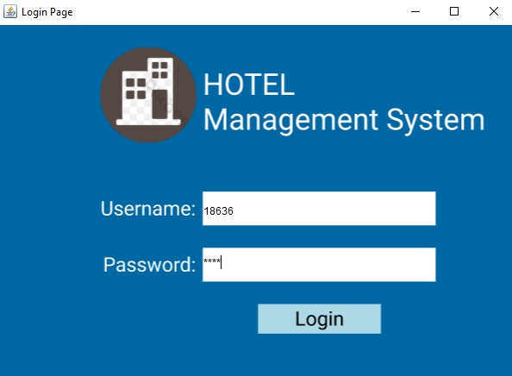
PROJECT SNIPETS
We used Java for the front end and used SQL for the Back End.
Then we integrated the both and ending up with our working program.
The end result is shown in the screens as follows.

Slide 11
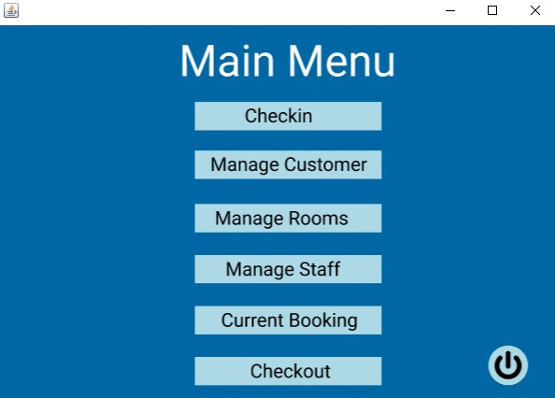

Slide 12
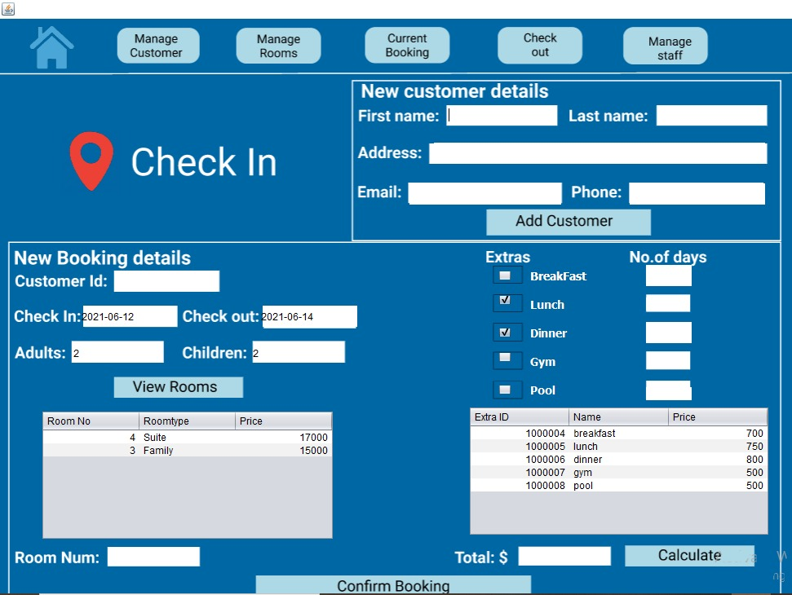

Slide 13
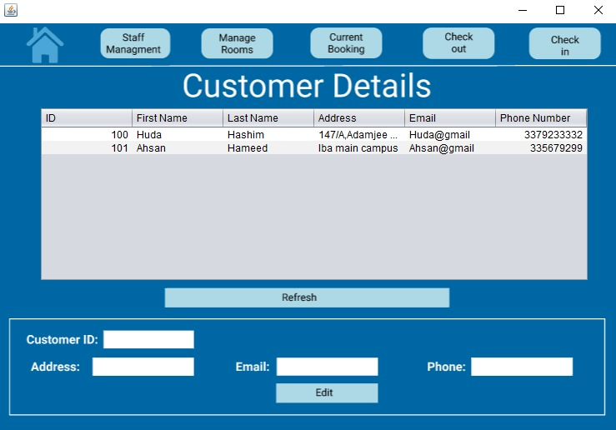

Slide 14
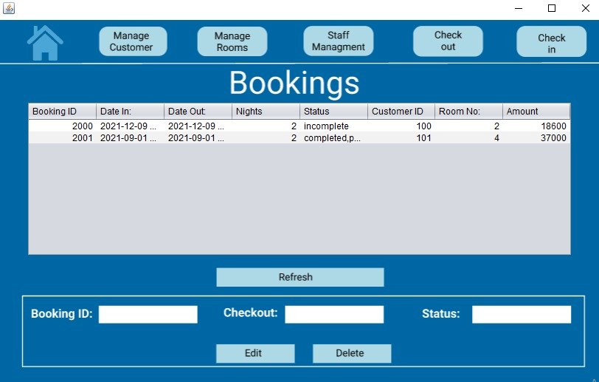

Slide 15
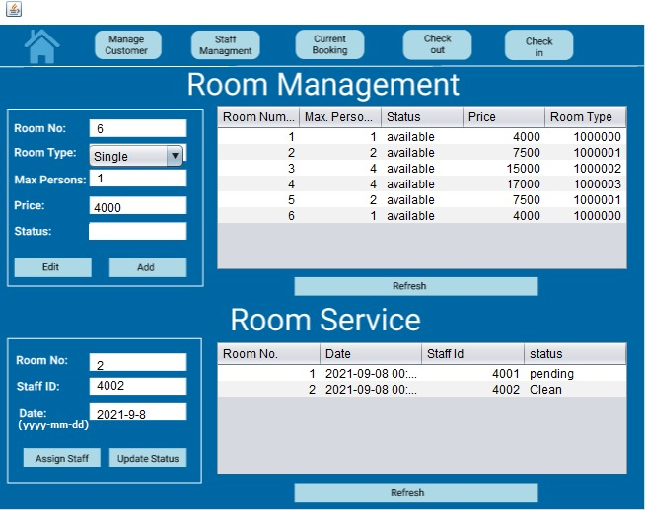

Slide 16
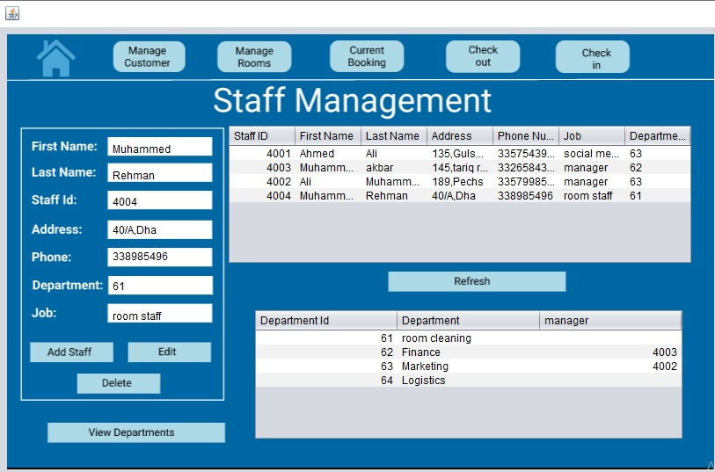

Slide 17
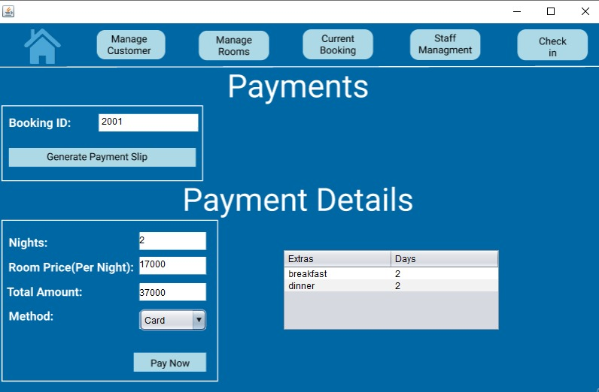

Slide 18
Now for the Project Demonstration

Slide 19
THANK YOU!

