Slide 1

SafePath App​
​
More than Navigation, Smarter, Safer Journeys​
Group 2
Sai Priyanka Basa Shanker-Team lead
Huda Ibrahim
Karan Joseph
Shalini Kuruguntla
Hina Kausar

Slide 2
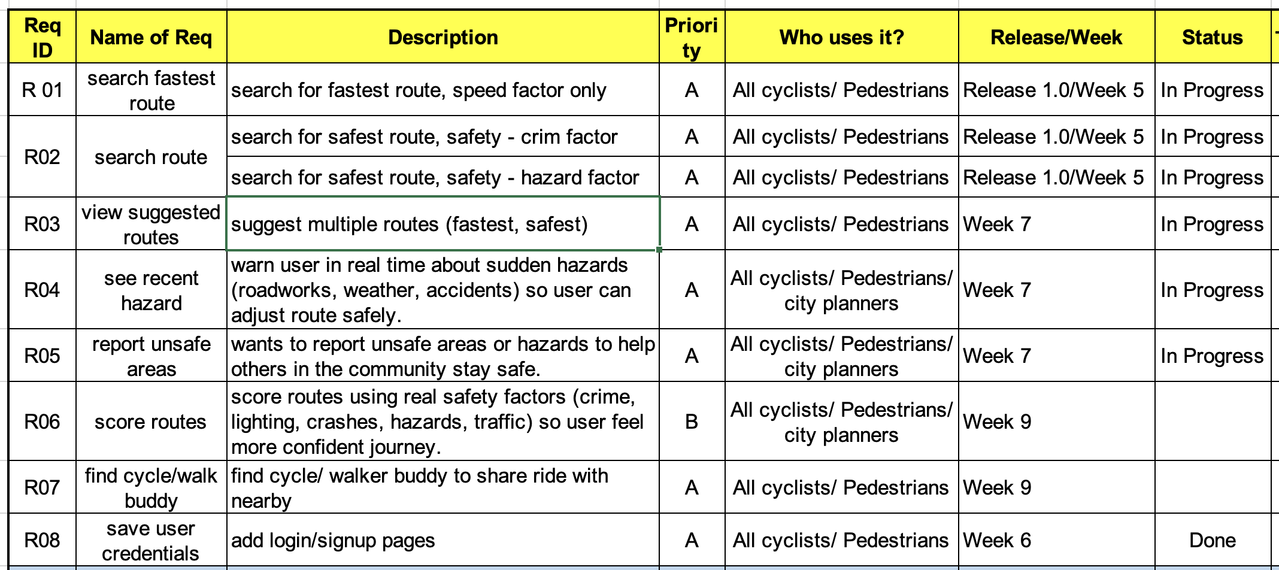
Requirement Specification

Slide 3
Challenges
1. Live Data Integration Issues
2. Route Suggestion
3. Hazard Detection & Reporting
4. Location Tracking Problems
5. Hosting & Deployment Issues
Notes:
1- Live Data Integration Issues
Challenge
Difficulty fetching and updating real-time data (e.g., live crime/hazard reports) leads to delays, inconsistencies, and data quality issues.
Integrating data from heterogeneous sources (with different formats, schemas, and inconsistent timestamping) makes merging and processing difficult. ScienceDirect+2PMC+2
Streaming or real-time ingestion systems may face latency, scalability bottlenecks, and issues related to fault tolerance. arXiv+1
Suggested Solution
Adopt a streaming ingestion architecture (e.g., Kafka/Streams, AWS Kinesis) to handle continuous data flows rather than batch-only ETL.
Use a schema registry or metadata layer to align disparate source schemas; perform transformation/normalisation early in pipeline.
Implement change-data-capture (CDC) or incremental update mechanisms so only changed records get processed. irjmets.com
Build robust data validation & cleansing steps: check for missing or out-of-range values, timestamp drift, duplicate records.
Use micro-services or serverless functions to decouple ingestion, transformation, storage. Use time-series database (e.g., InfluxDB) or event-store for real-time updates.
Monitor latency, queue-backlog, error rates; build alerts for when data freshness exceeds threshold (e.g., >30s).
2- Route Suggestion Page
Challenge
Generating safe, optimized routes dynamically (with safety as priority) is complex: you must consider multiple risk factors (crime data, hazard reports, lighting, traffic) and compute cost metrics accordingly. ScienceDirect+1
Map rendering delays or incorrect path visualization: e.g., polylines not aligned to actual roads; UI freeze when route calculation takes long.
Dynamic traffic or hazard updates may invalidate a previously suggested route; rerouting needs to be fast.
Lack of up-to-date data or missing risk-weights leads to sub-optimal “safe” route suggestions.
Suggested Solution
Use a graph-weighted routing engine (e.g., OpenStreetMap + GraphHopper or OSRM) and integrate risk weights (e.g., hazard count, crime rate) into edge weights.
Precompute a safety heatmap (grid or graph) that assigns risk values to segments; then routing engine queries this map.
Use asynchronous route computation with web-worker (for frontend) or background job (for backend) so UI remains responsive.
Cache frequently used origin/destination pairs; use incremental rerouting if hazards appear mid-journey.
Use map-tiling and vector-tile rendering to speed up display; on mobile, reduce polyline complexity for responsiveness.
Consider multi-objective optimization: minimize distance + exposure (risk) + time. Use heuristics if full optimum is too slow.
3. Hazard Detection and Reporting Page
Challenge
Real-time identification and display of nearby hazards is difficult because hazards may be crowd-submitted, so data freshness, validity, and location accuracy vary.
Some hazards may not be geolocated correctly (e.g., user enters approximate street name rather than GPS point).
There may be duplicate hazards or stale hazards (already resolved) cluttering the map.
UI performance: loading many hazard markers can slow down map rendering (especially mobile).
Need for trust/verification: user-reported hazards may be false/duplicate; need to de-duplicate or moderate.
Suggested Solution
Implement a crowdsourcing workflow: user submits hazard → backend queues for light moderation or automatic checks (e.g., compare location/time with existing records).
Use spatial indexing (e.g., R-tree) for querying hazards within radius of user device quickly.
Use marker-clustering for dense hazard areas to maintain UI performance.
Use push updates or WebSockets to propagate new hazard reports to relevant user sessions in near-real-time.
For data validity: allow users to vote or confirm hazards are active (e.g., “still there” button). Use status lifecycle fields (active/resolved).
Use geolocation along with user-device sensor metadata (timestamp, device id) to check submission validity.
4. Location Tracking Problems
Challenge
Inaccurate GPS readings on smartphones lead to incorrect route calculations or misalignment of the user position on map. ResearchGate
Slow location updates (e.g., polling too infrequently) cause lag in tracking, especially during navigation.
Indoor or urban canyon environments (tall buildings) complicate GPS reception; sensor drift occurs. ResearchGate+1
Many devices differ in hardware sensitivity; results vary across devices. ResearchGate
Privacy and permission issues: users may deny location permission or disable background tracking, which hampers the feature.
Suggested Solution
Use fused location provider (on Android/ iOS) combining GPS, WiFi, cell-tower, inertial sensors for better accuracy and smoothing.
Implement adaptive polling: increase update frequency when user is moving fast, reduce when stationary to save battery.
Use map matching: snap raw GPS points to nearest road segments to correct drift and align with route.
In indoor / poor-GPS scenarios: fallback to WiFi/Bluetooth localisation or ask user to manually confirm position.
Log and analyse device-specific accuracy to identify low-quality devices or outlier readings; show user a “poor signal” notification if accuracy > X m.
Provide UI feedback: show estimated accuracy circle (e.g., “± 15 m”) so user knows position certainty.
5. Hosting & Deployment Issues
Challenge
Front-end hosted (e.g., on Vercel) but backend not reachable from same domain → cross-domain CORS issues, wrong base URL, deployment mis-configuration.
Environment variables may not be correctly set for production (API URLs, auth keys).
If backend and frontend live on different domains/sub-domains, cookies/auth tokens may not be shared due to SameSite, secure flag, or CORS restrictions.
Deployment mismatch between environments (dev vs prod) causing endpoints to fail or resources to be unreachable.
Lack of continuous deployment / CI-CD process causes inconsistent versions and drift between environments.
Suggested Solution
Ensure backend exposes a production-ready API endpoint, and frontend uses correct base URL (e.g., https://api.safepath.app) rather than relative /api/... if domain differs.
Configure CORS properly on backend: allow frontend domain, set proper Access-Control-Allow-Origin, Allow-Credentials etc.
Use environment variables in both deployments: for frontend build (Vercel) set NEXT_PUBLIC_API_URL, for backend set NODE_ENV=production, CORS_ORIGIN=https://safepath.app.
Adopt CI/CD pipelines: every push to main branch triggers build & deploy of frontend + backend; environment parity ensures consistent behaviour.
Use monitoring/health-check endpoints on backend (/health) and tie them into uptime alerts.
Use versioning for APIs (e.g., /v1/routes, /v1/hazards) to avoid breaking changes between frontend/backend.
Consider running backend server behind a reverse-proxy or API-gateway that can handle domain mapping, rate-limiting, and secured access.

Slide 4
Ongoing Improvements and Best Practices
Utilize reliable, well-documented APIs.
Develop and optimize route-generation algorithms.
Use secure authentication (e.g., JWT/OAuth) and proper input validation.
Strengthen authentication and security.
Optimize database performance
Automate hazard data collection and synchronization.
Enhance geolocation precision through high-accuracy GPS configurations, continuous background tracking.
Notes:
Utilize reliable, well-documented APIs (e.g., OpenStreetMap, GraphHopper, or Google Maps) and implement smart caching mechanisms to maintain smooth, low-latency real-time data updates while reducing external API calls and server load.
Develop and optimize route-generation algorithms using efficient graph-based approaches (e.g., Dijkstra, A*, or multi-criteria routing) and validate performance with real GPS datasets to ensure accuracy and responsiveness under real-world conditions.
Strengthen authentication and security through standardized protocols such as JWT (JSON Web Token) or OAuth 2.0, combined with comprehensive input validation, rate limiting, and encryption to protect user data and prevent unauthorized access.
Optimize database performance by applying spatial indexing, connection pooling, and scheduled backups, ensuring data integrity, fast queries (especially for hazard and route lookups), and reliable disaster recovery.
Automate hazard data collection and synchronization with precise timestamps, data versioning, and update rules to ensure consistency between live reports, archived data, and user-generated submissions.
Enhance geolocation precision through high-accuracy GPS configurations, continuous background tracking, and map-matching techniques that align raw GPS coordinates to real road networks for more reliable navigation and safety alerts.

Slide 5
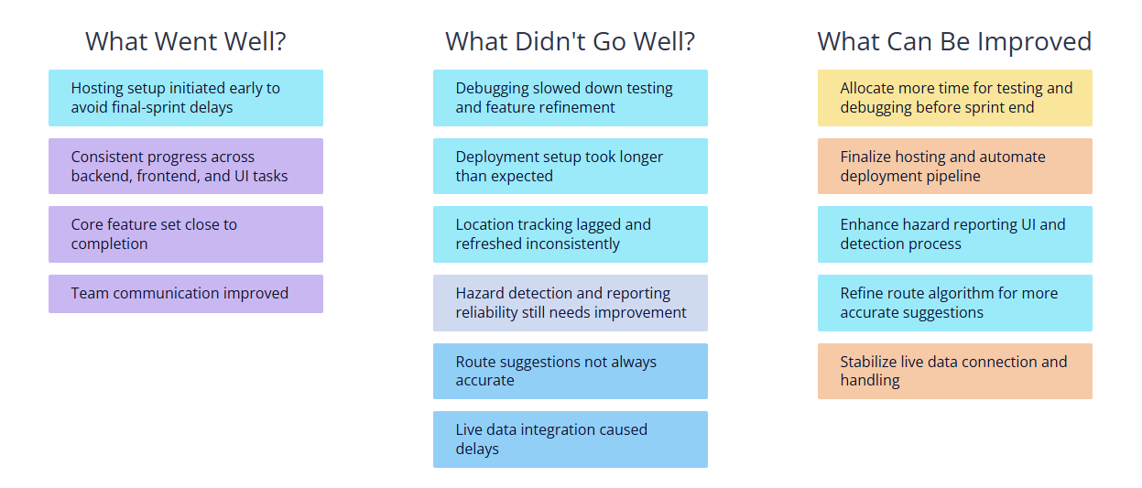
Retrospective

Slide 6

Demo Time

