Slide 1


SafePath
More than Navigation, Smarter, Safer Journeys
MSc Computer Science - Team Project
Group 2
Huda Ibrahim • Hina Kausar • Shalini Kuruguntla
Sai Priyanka Basa Shanker • Karan Joseph

Slide 2
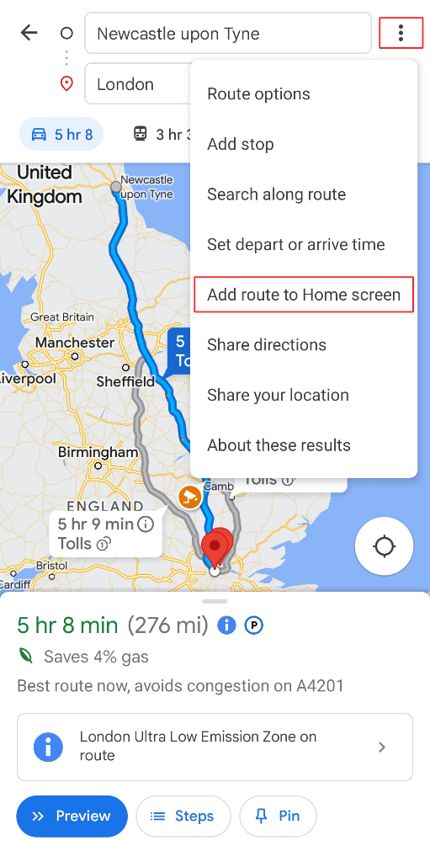
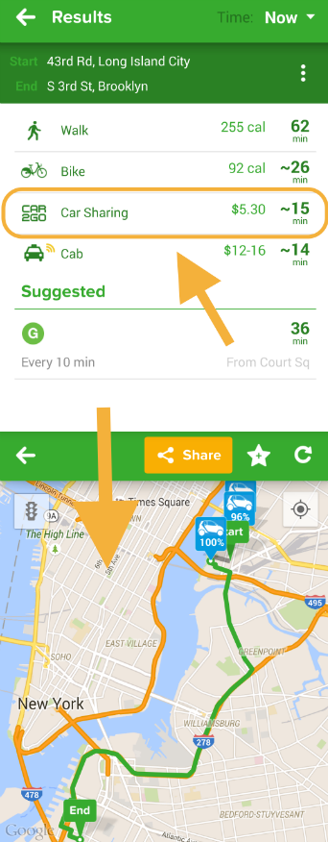
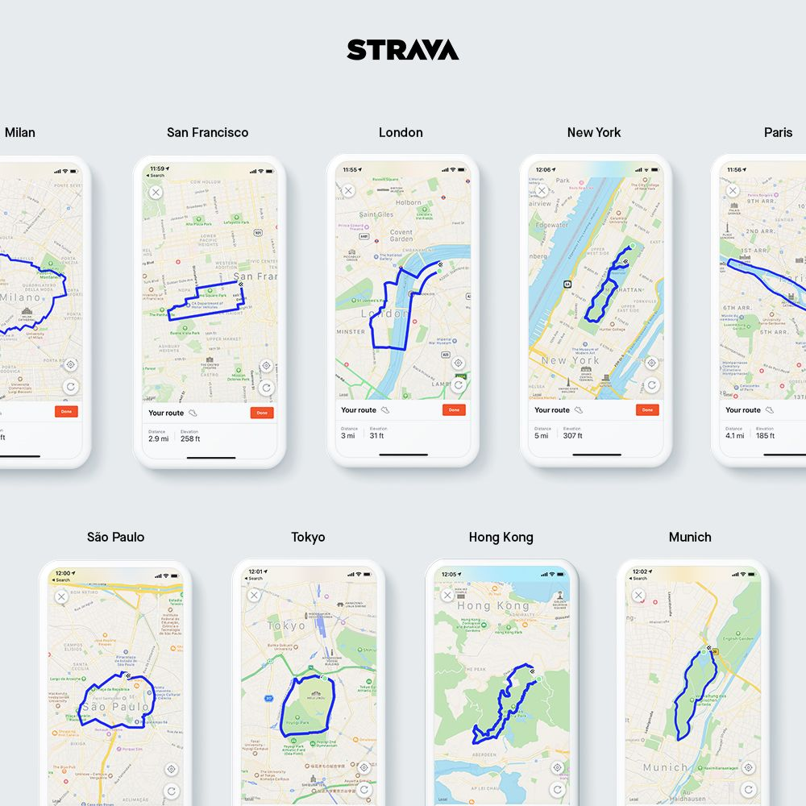
Comparison of Existing Solutions
1. Google Maps
2. Strava
3. Citymapper

Slide 3
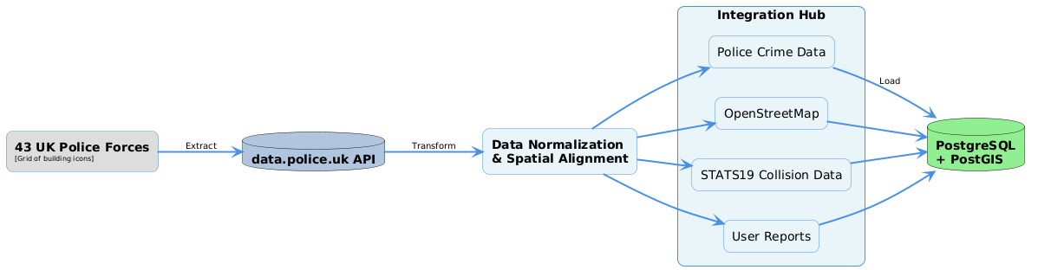
Data Integration Challenge Flowchart

Slide 4
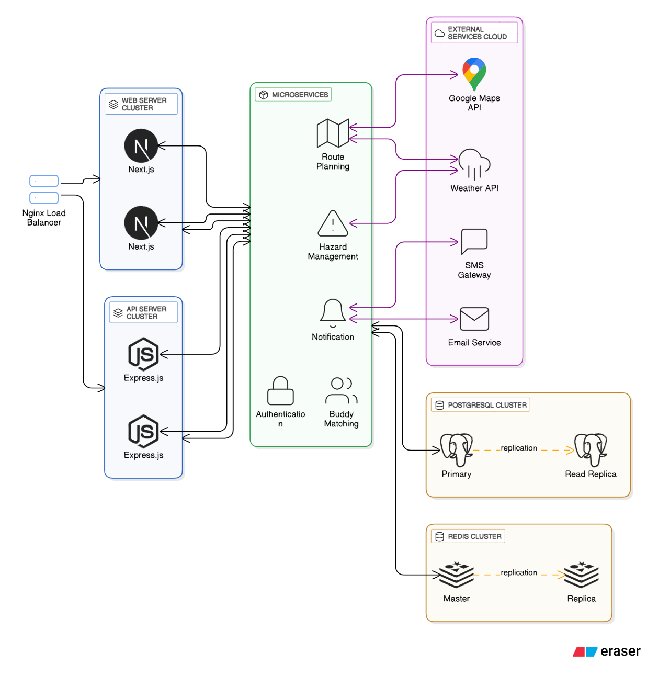
System Architecture Diagram

Slide 5
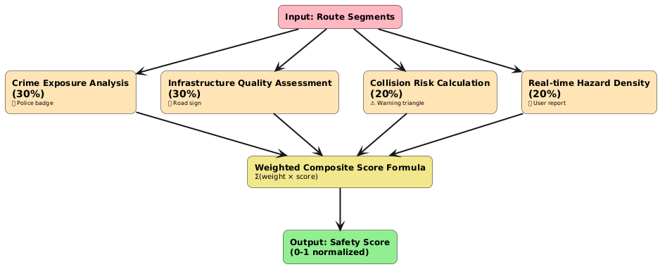
Safety Scoring Algorithm Flowchart

Slide 6
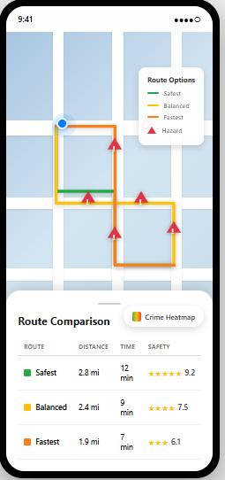
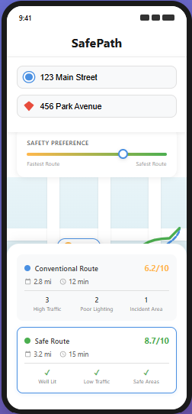
User Interface Mockup:
1. Route Planning Screen
2. Interactive Map with Routes

Slide 7
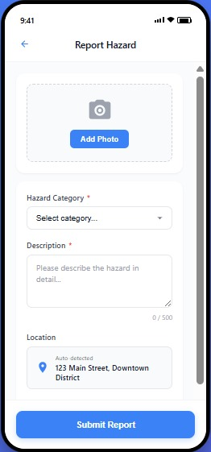
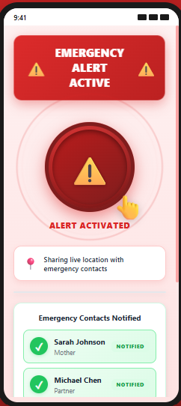
User Interface Mockup:
3. Hazard Reporting Interface
4. Emergency Alert Screen

Slide 8
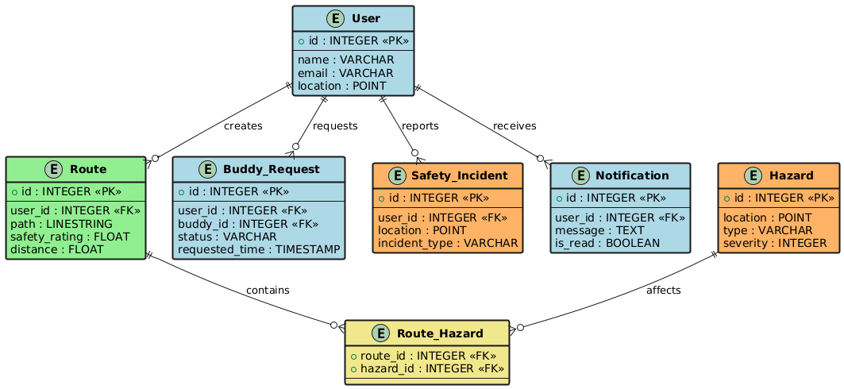
Database Entity-Relationship Diagram

Slide 9
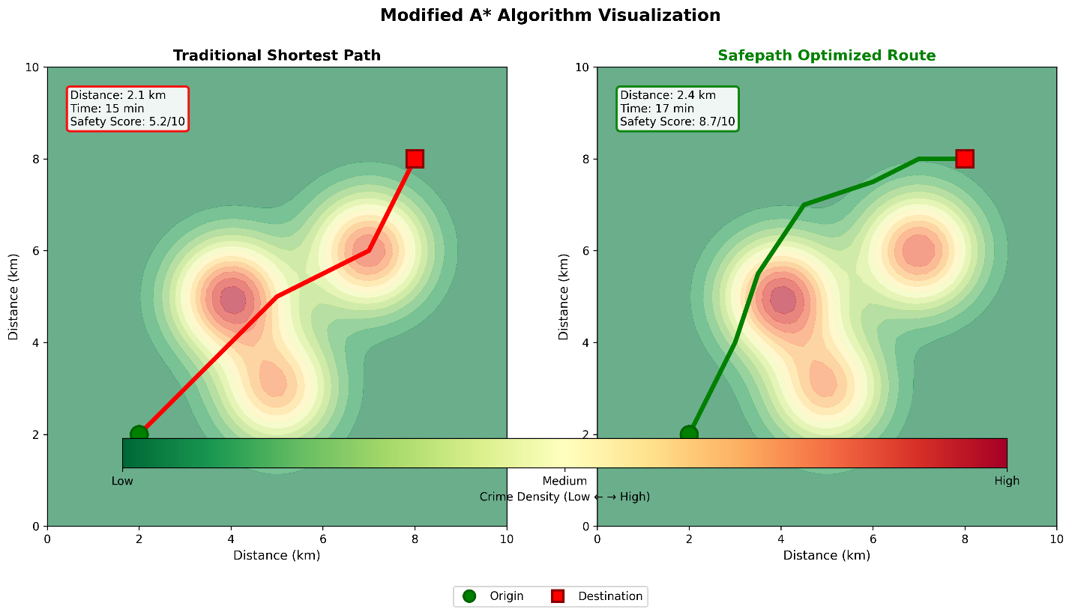
Modified A* Algorithm Visualization

Slide 10
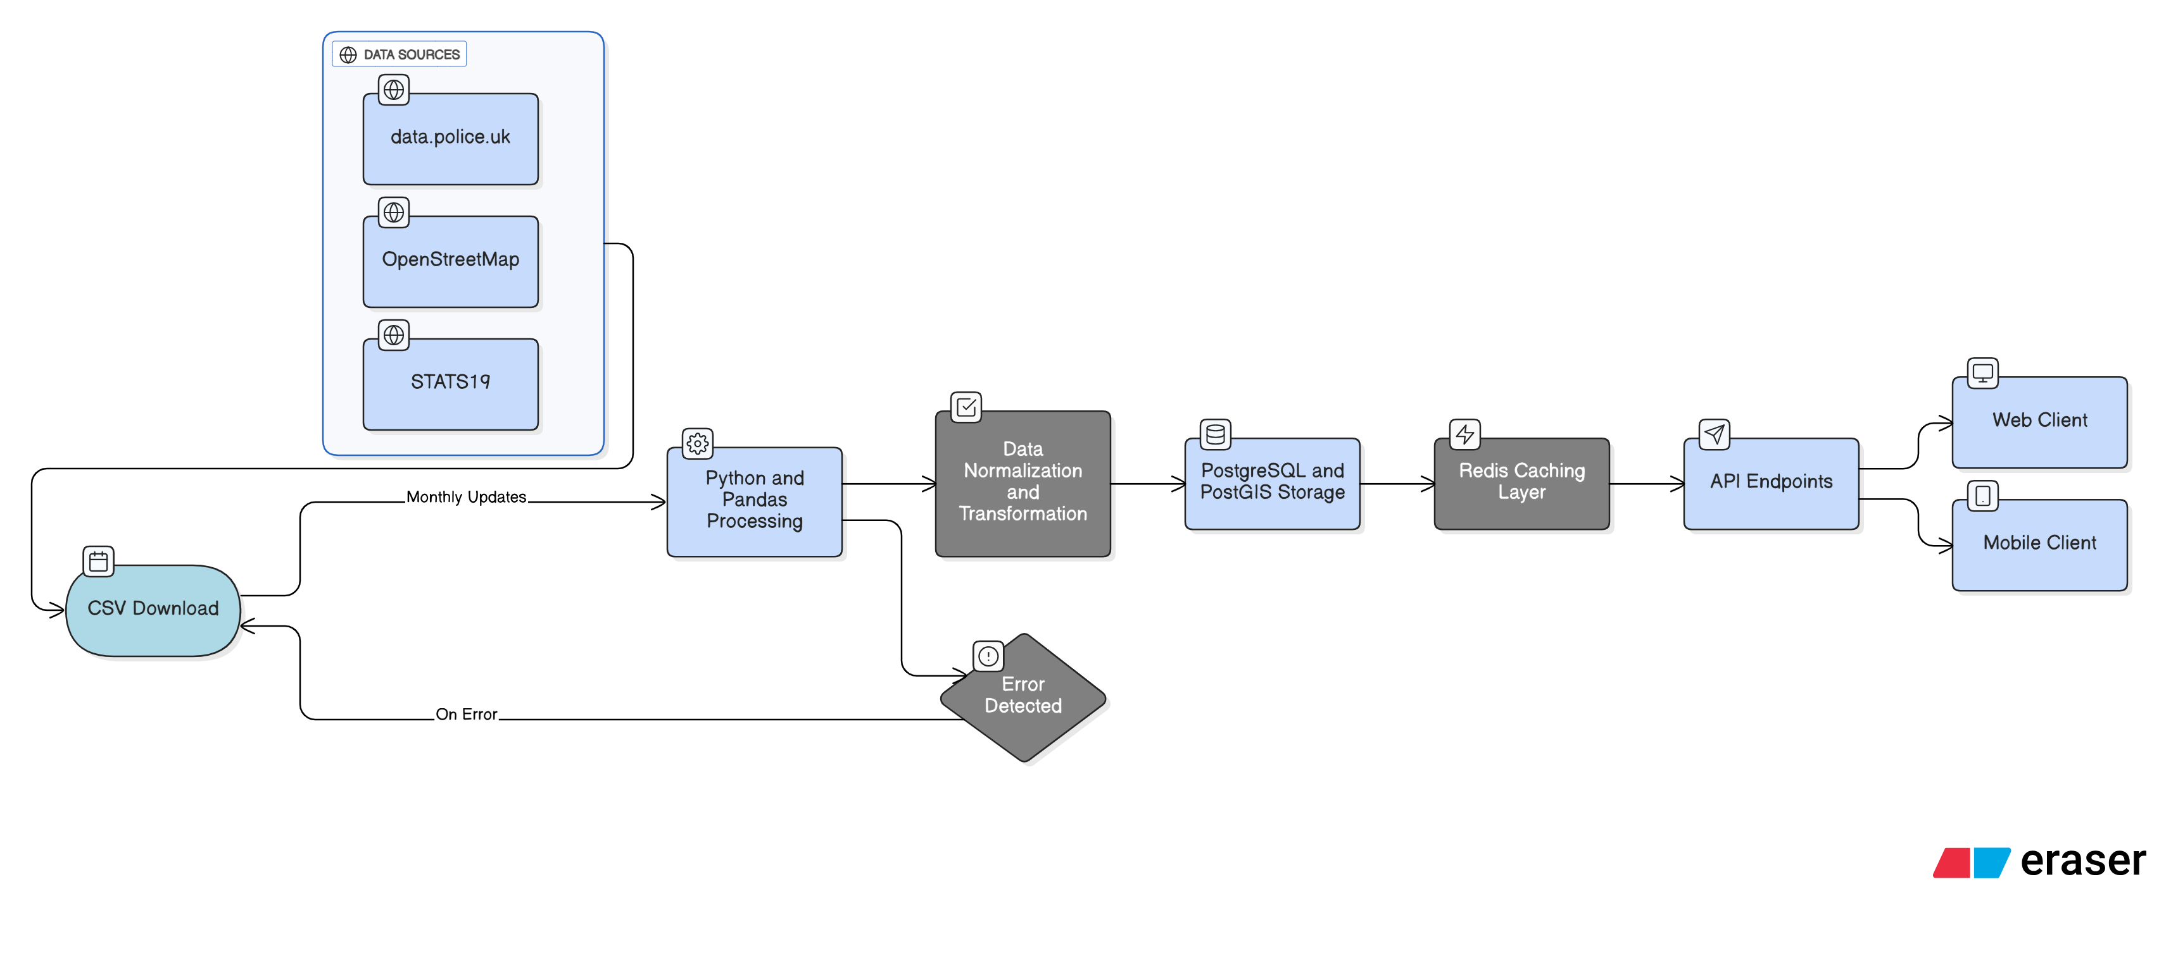
Data Pipeline Architecture

Slide 11
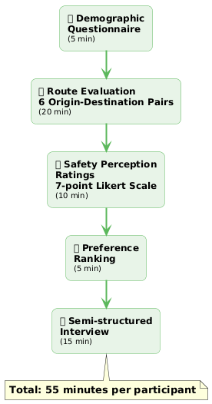
User Study
Protocol Flowchart

Slide 12
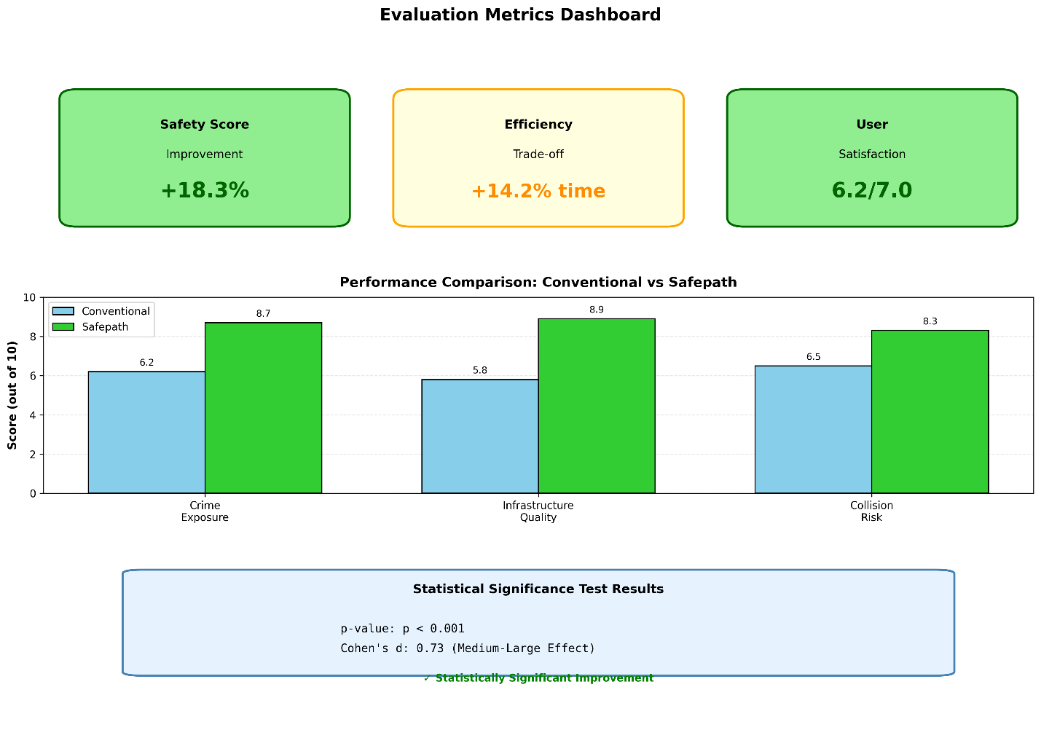
Evaluation Metrics Dashboard Mockup

Slide 13
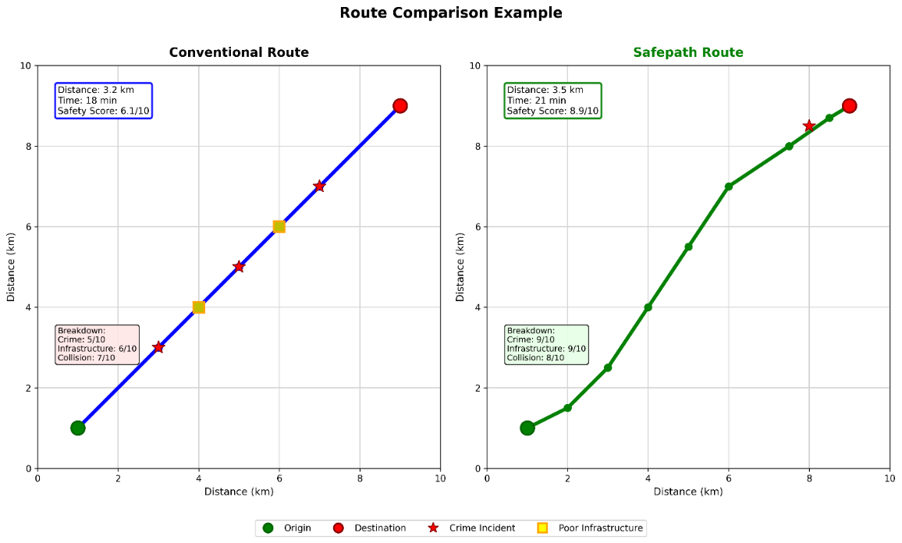
Route Comparison Example

Slide 14
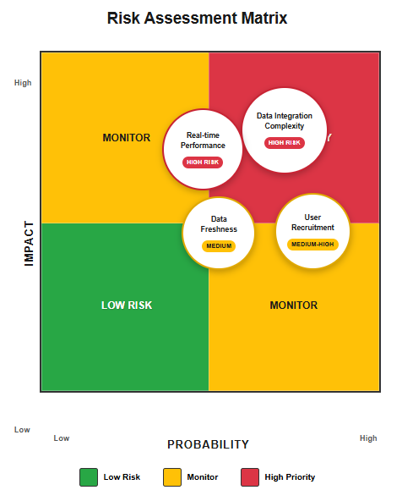
Risk Management Matrix

Slide 15
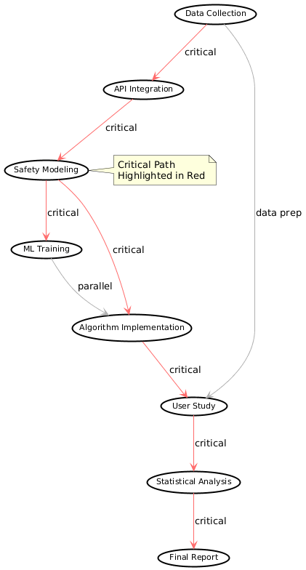
Milestone Dependencies Network

Slide 16
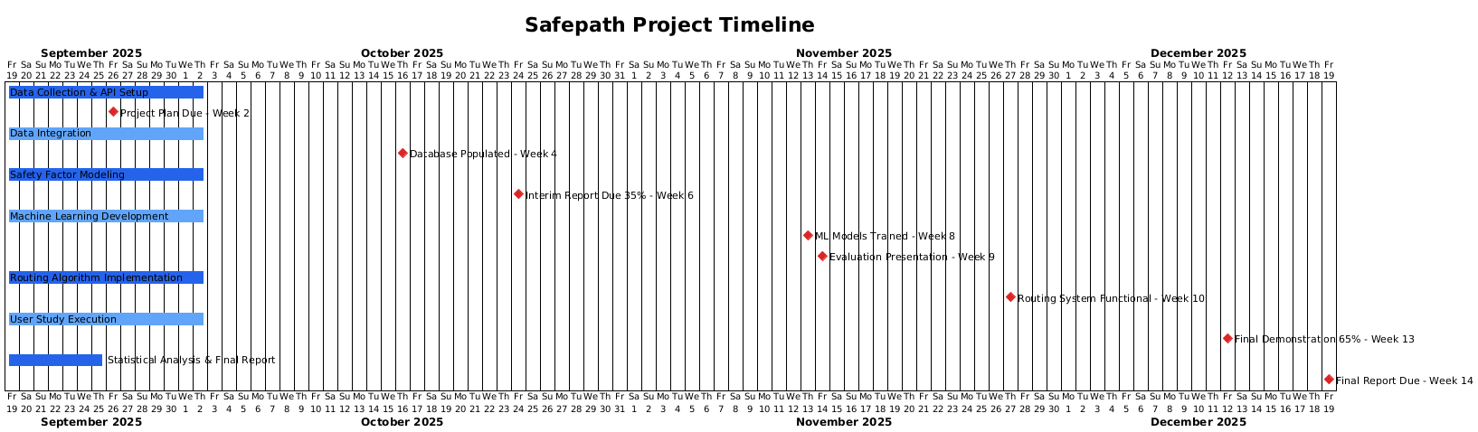
14-Week Project Timeline (Gantt Chart)

