Slide 1
Crystallum Credit
Card Company (CCCC)
Team 1 Project 4
Huda A, Angele G, Hwa H , Kafayat L, William M, Fannie P , Dantrell P
Notes:
"What is the worst part about letting someone borrow some money... you don't know if they're gonna pay you Back."

Slide 2
Intro
Crystallum Credit Card Company (CCCC) is a relatively new banking institution (we’ve been in business for 5 years) and we’re still working to fine tune our business decision making. We focus on offering credit worthy customers with the right amount of credit for their purchasing needs.
Recently, the Executive Team and Board of Directors asked our data analyst team to pull data together on existing customers and review their credit limit, utilization ratio, income, and several other factors to try to come up with two separate models.
The first model wants to predict what credit score should a potential customer have in order to receive credit and what would their credit limit be.
The second model wants to predict who will pay CCCC back.

Slide 3
Data sources and preliminary information
We used 3 CSVs from 2 data sources
The first dataset consists of 10,127 customers mentioning their age, salary, marital_status, credit card limit, credit card category, etc.
https://www.kaggle.com/datasets/sakshigoyal7/credit-card-customers
This second dataset consists of 777,715 customers mentioning various characteristics such as : gender, property ownership, number of children, annual income, Income category, education level, marital status, etc.
https://www.kaggle.com/datasets/rikdifos/credit-card-approval-prediction
From these data sources, we created 2 models:
The first model used one CSV comprised of 10,127 unique customer data; this was the data used to predict the credit score /credit limit from CCCC.
The second model used two CSVs merged together and comprised of 777,715 unique customer data points to compute of those who received credit, who would pay back CCCC and not become delinquent.

Slide 4
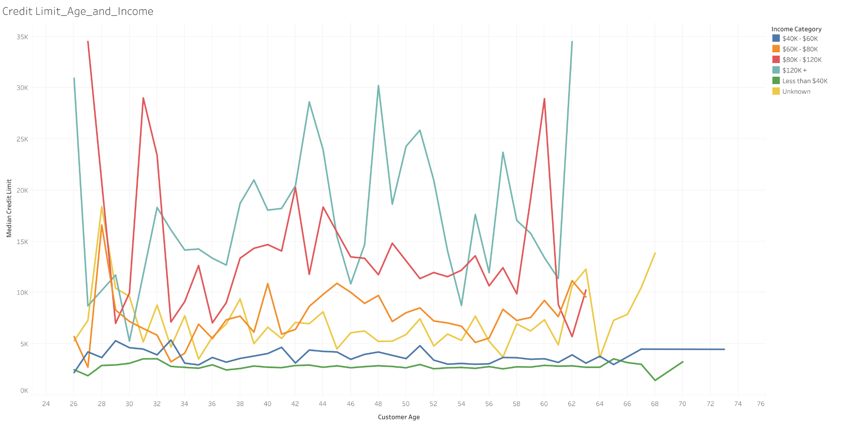
What does our current customer data tell us?
We reviewed the data for all of our 10,127 unique customers to understand our starting point.

Slide 5
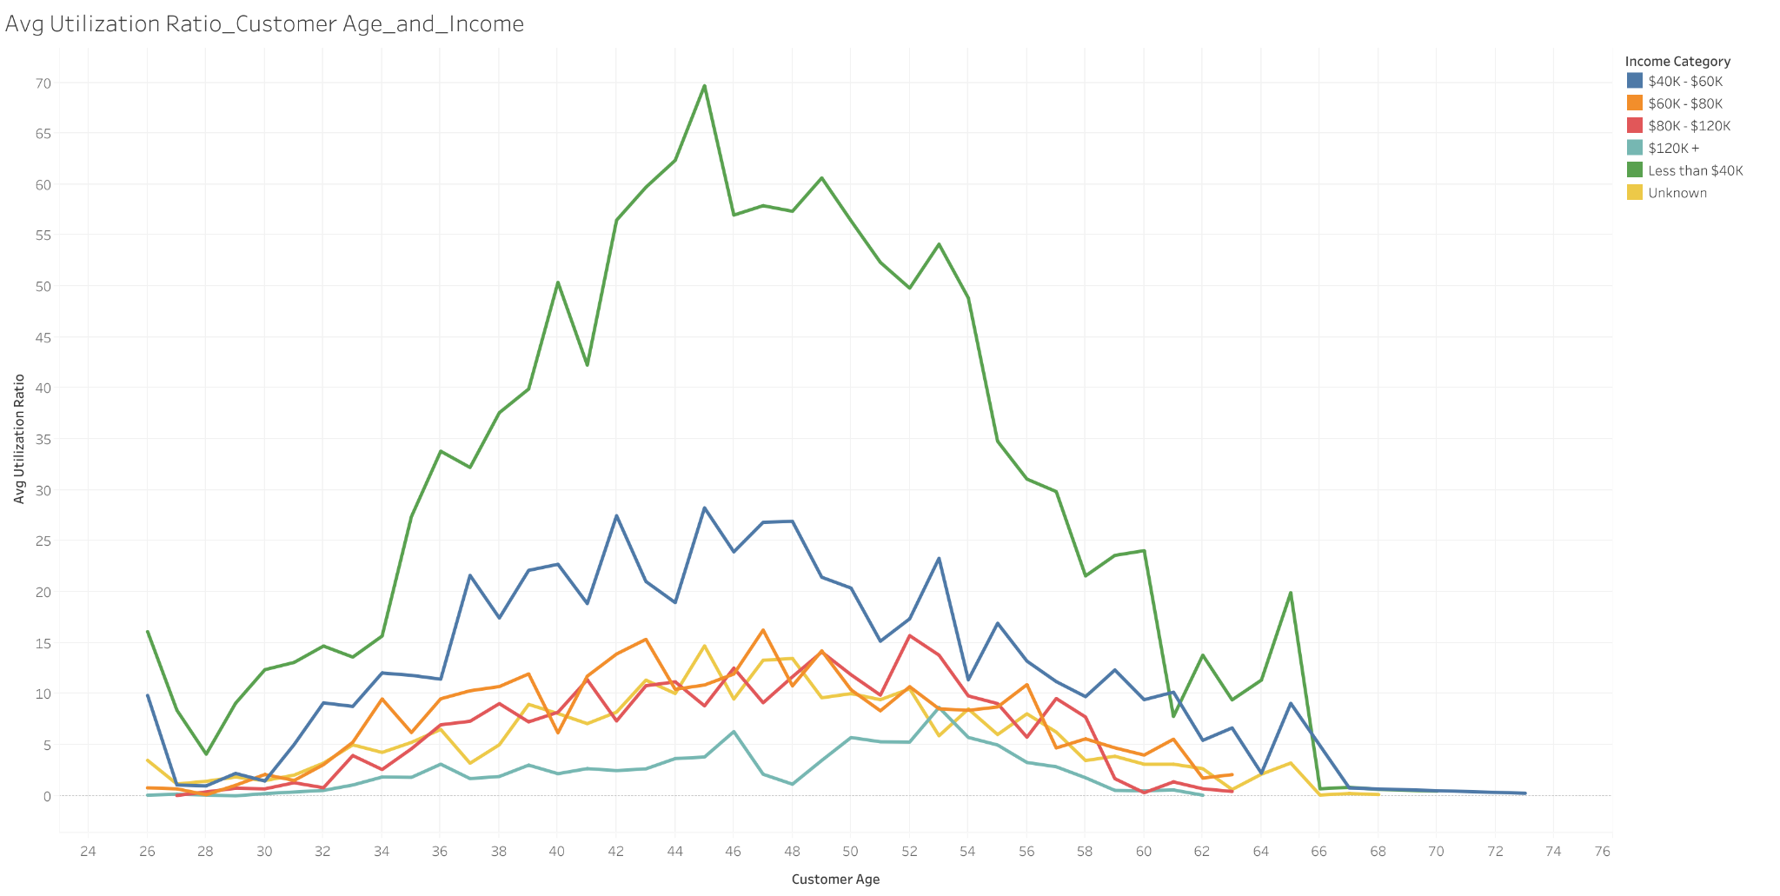
What does our current customer data tell us?
We reviewed the data for all of our 10,127 unique customers to understand our starting point.

Slide 6
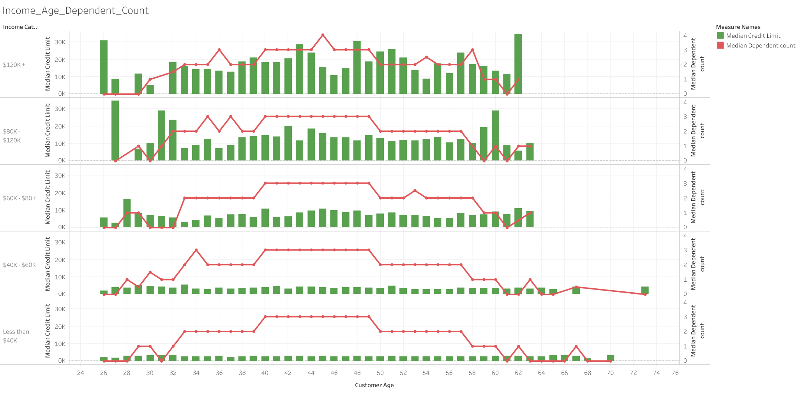
What does our current customer data tell us?
We reviewed the data for all of our 10,127 unique customers to understand our starting point.

Slide 7
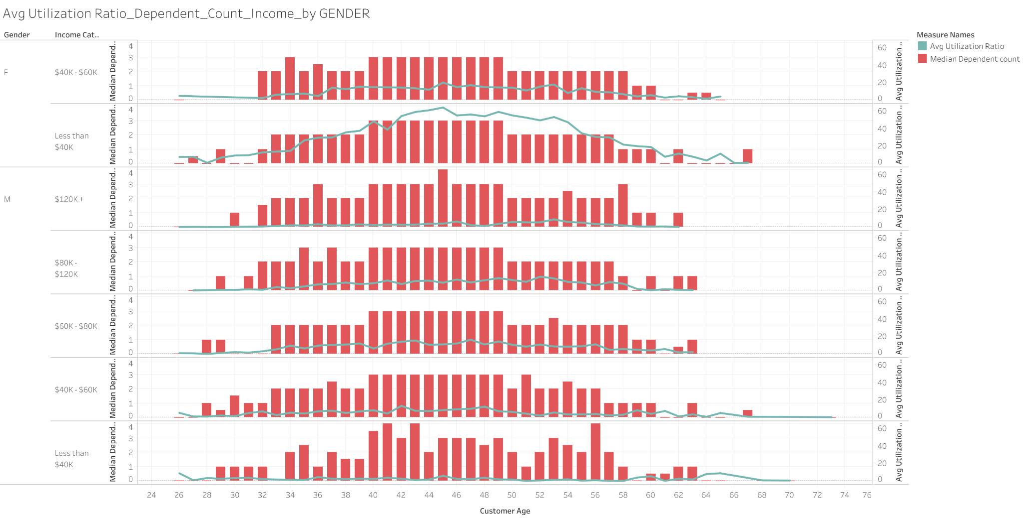
What does our current customer data tell us?
We reviewed the data for all of our 10,127 unique customers to understand our starting point.

Slide 8
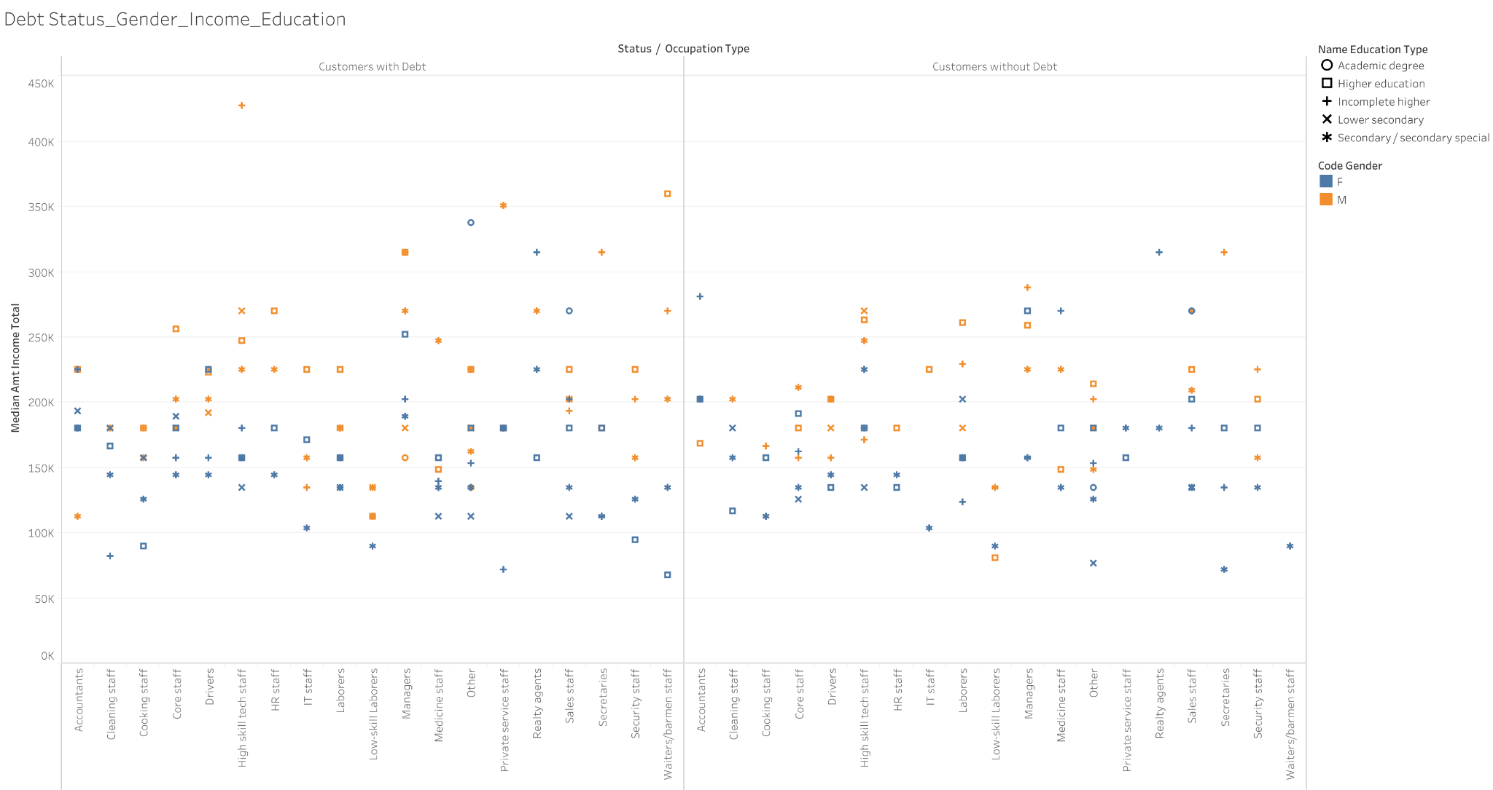
What does our current customer data tell us?
We reviewed the data for all of our 777,715 unique customers to understand our starting point.

Slide 9
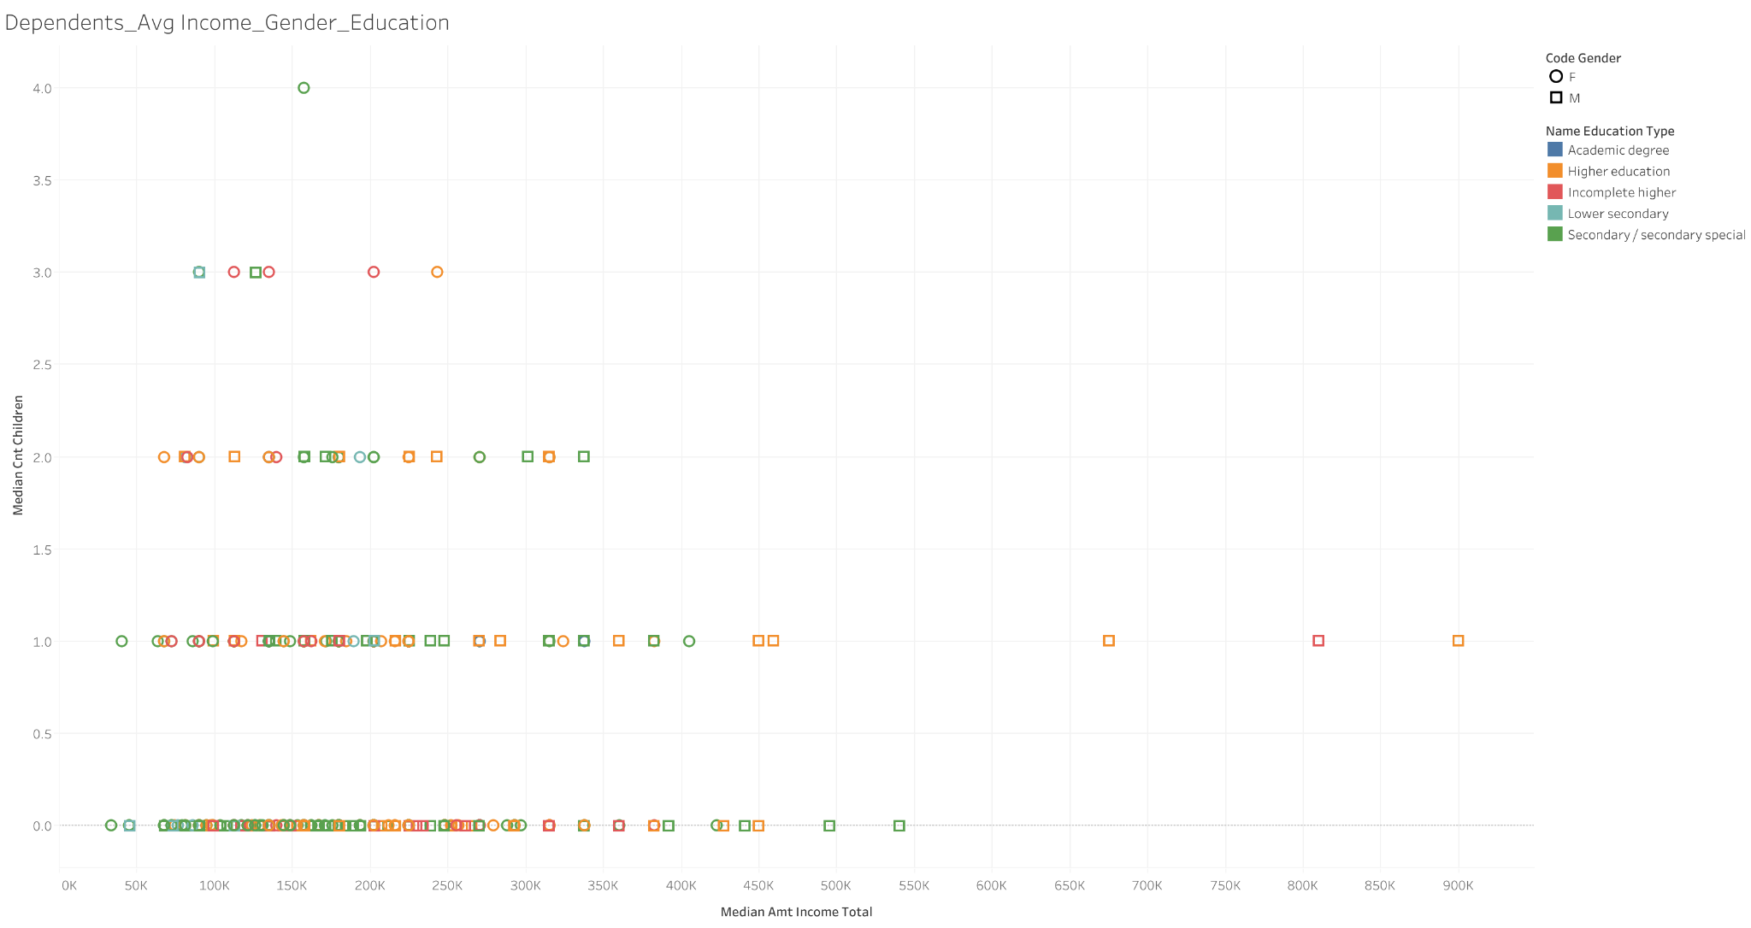
What does our current customer data tell us?
We reviewed the data for all of our 777,715 unique customers to understand our starting point.

Slide 10
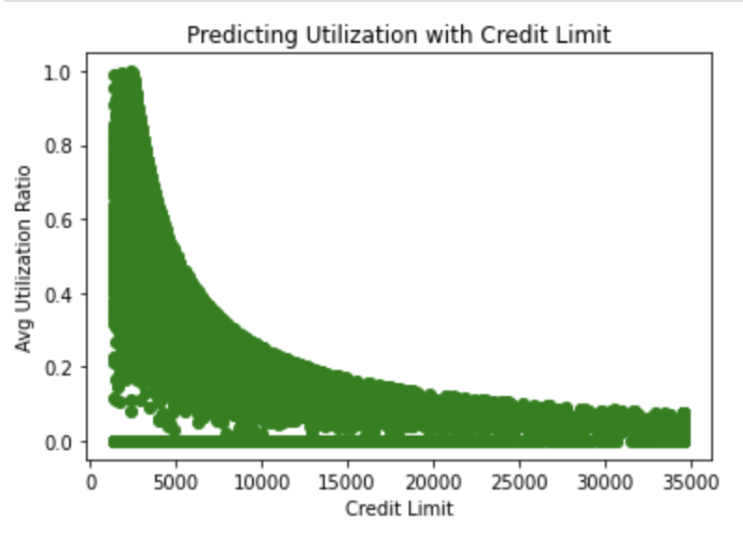
Searching for features to use to train potential models
Early review and visualizing of potential features showed us that credit limit was a good predictor to use at predicting a customer’s utilization ratio.
This factored into helping us at an attempt to create an internal score as a one to one feature

Slide 11
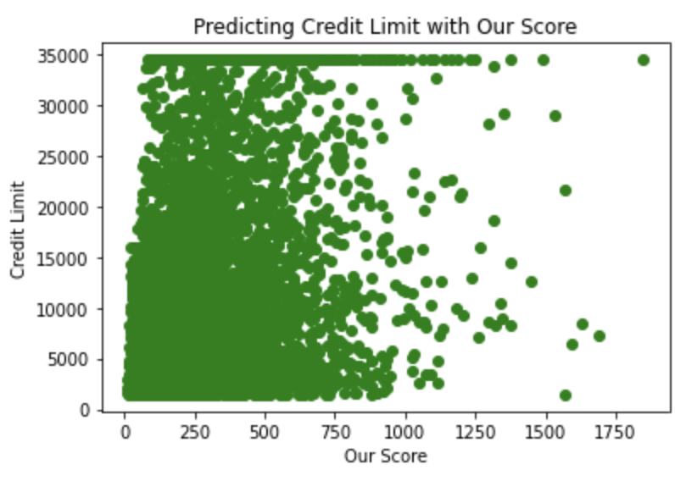
Approach
The idea behind our score feature is if you get a high score you should have a higher credit limit. How we calculate it: You want your composite score(Months on book * Education_Level * Marital_Status) to be a high number, and you want the weight (Dependent_count + Avg_Utilization_Ratio) to be a low number. So you would want the weight to either make the composite score bigger or at least not drag it down so when you multiply by the income you get a higher score. As visualized below it didn’t work perfectly but the data is leaning to the right. So we decided to move forward with it
Features represented
Months on book
Education Level
Marital Status
Dependent Count
Average Utilization Ratio
Notes:
Things we want to predict:
Predicting utilization with credit limit (we noticed that income is not a feature for predicting credit limit, however, credit limit looks to be pretty good at predicting credit card utilization.
Taking factors we find to be important in getting a credit score, and then turning it into a composite score that shows predicted credit limit for customers based on our composite credit score. (Scatter plot, shows high credit scores have higher credit limits) **Trell summarize findings on features
Features represented
Customer age
Gender
Dependent Count
Education Level
Marital Status
Income
Months on book
Total relationship count
Credit limit
Total revolving balance
Total transaction amount
Util ratio
Created composite score

Slide 12
Linear Regression Model Trial #1
Linear Regression Model Trial #2
The final features used: Dependent Cout, Education level, Marital status, Income, Total revolving balance, Months on book and our created score
How well did our Linear Regression Model do in predicting credit limit?
R-Squared was 0.5135971174362641
Used Manual Gradient Descent to compute a single prediction based on our pre-chosen optimal parameters
The ideal situation is that your functions converge
We wanted the best and quickest curve using different alpha

Slide 13
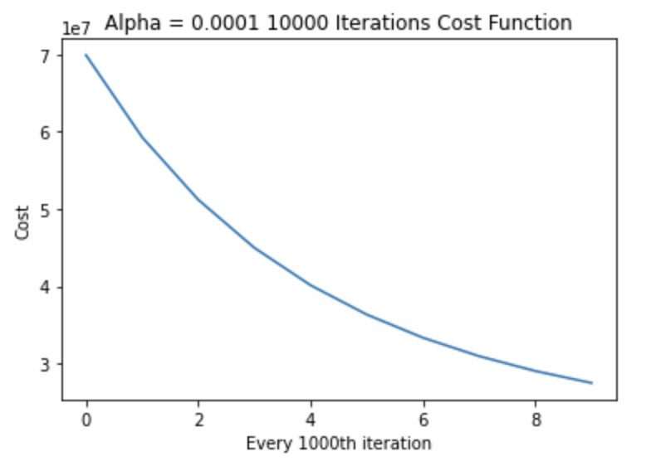
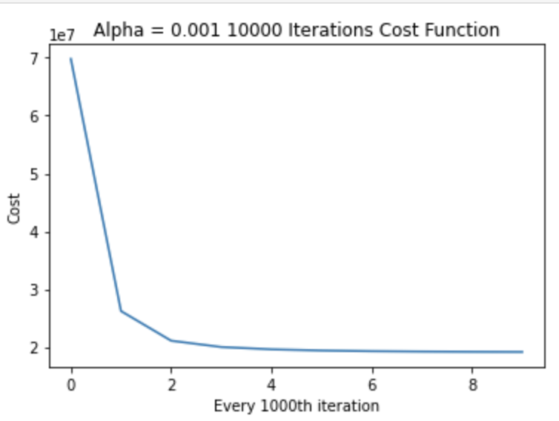
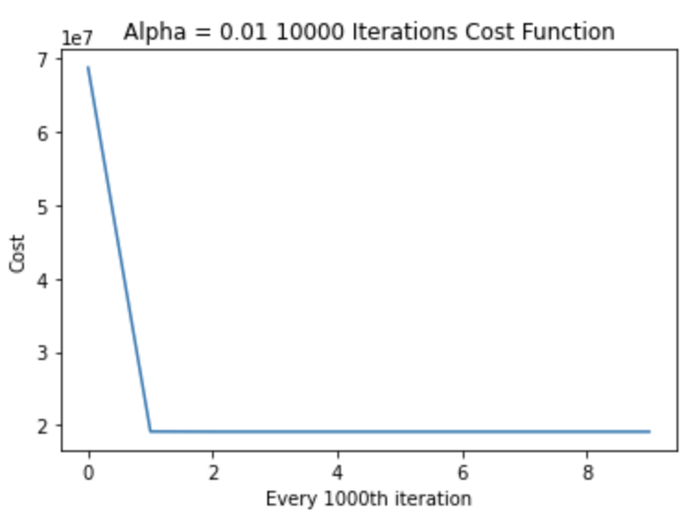
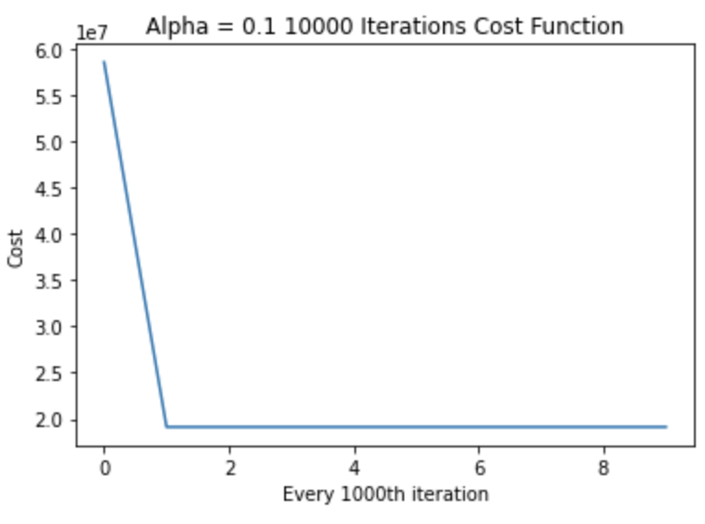
Gradient Descent Results with different learning rates
Iterations were incremented by 1,000, 10,000 and 100,000 at a time

Slide 14
Trail #3 tried using Logistic Regression (instead of Linear) to improve predictions
Separated potential customers by either high credit limit possible or low credit limit possible
Goal: Predict Credit Limit Range
Random Forest Classifier Method
Score for Training: 1
Score for Testing: 0.99
Confusion Matrix

Slide 15
Will customers pay us back?
Logistic Regression Model
The logistic regression model was created to predict whether the customers who receive credit from us will pay us back.
We looked at the status of payments and reworked the values in the ‘STATUS’ column so it can only hold 0 or 1.
Created a Scatter plot to show status with every other column
Used “X dummies” to convert all values to numbers (encoding)
Notes:
Into to what Huda and the ML did, someone else could talk here to intro the ML does not have to be Huda as the explaining needs to be her

Slide 16
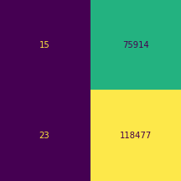
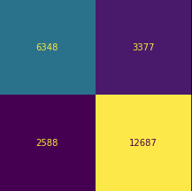
Trial #1
Those who had either paid off their balance or had no loan were given a value of 1.
Those who were past due regardless of how many days, were given a value of 0.
Confusion Matrix:
Logistic Regression | Random Forest Classifier
Training Data Score: 0.612 | Training Data Score: 1.0
Testing Data Score: 0.609 | Testing Data Score: 0.7614

Slide 17
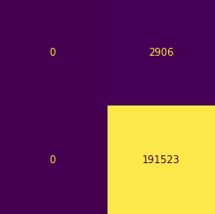
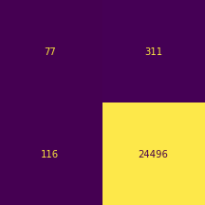
Trial #2
Those who had paid off their balance, had no loan, or past due by less than 30 days were given value 1.
Those who were past due by more than 30 days or overdue were given a value of 0.
Confusion Matrix:
Logistic Regression | Random Forest Classifier
Training Data Score: 0.985 | Training Data Score: 1.0
Testing Data Score: 0.985 | Testing Data Score: 0.98292

Slide 18
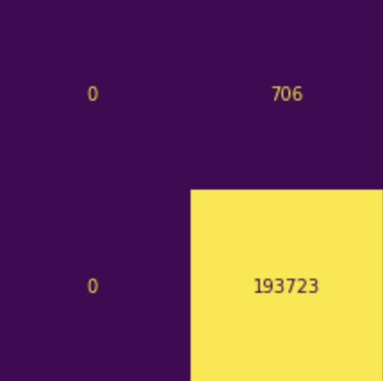
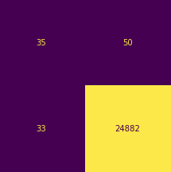
Trial #3
Those who had paid off their balance, had no loan, or past due were given a value of 1.
Those who were overdue, were given a value of 0.
Confusion Matrix:
Logistic Regression | Random Forest Classifier
Training Data Score: 0.996361 | Training Data Score: 1.0
Testing Data Score: 0.996368 | Testing Data Score: 0.99668

Slide 19
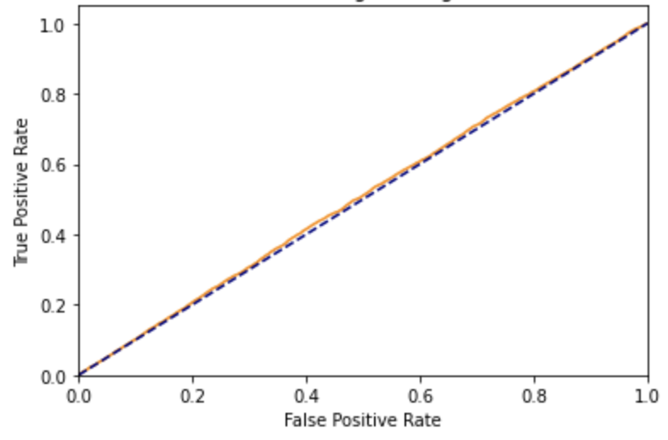
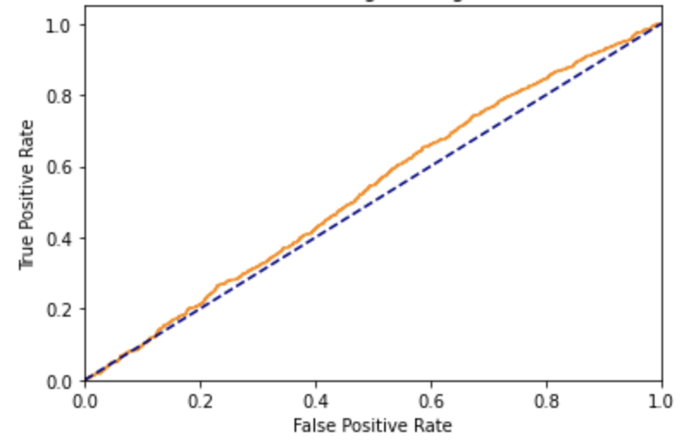
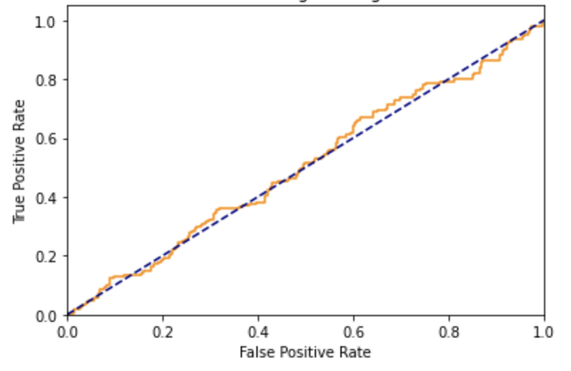
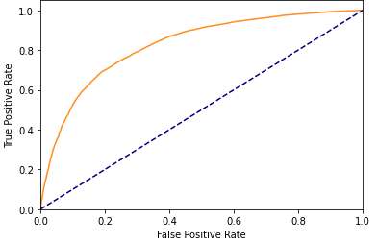
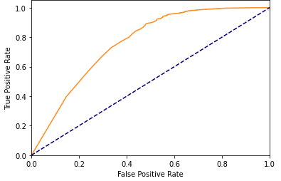
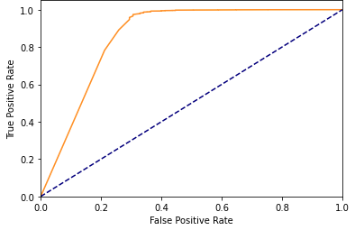
ROC Curve
Trial #1 | Trial #2 | Trial #3
Logistic Regression
Random Forest Classifier

Slide 20

Executive Team. Here are the takeaways
With the method we have developed here that has machine learning at its core.
Precision
Cost effective
Scales
Only improves as we use it
Lets make some money!
Notes:
“ worst part about leading money id knowing whether your getting paid back right !?
"No more guessing… with our method You’re going to know who is most likely to pay you back." "A technological level of accuracy in business decisions unmatched." "The best part is it only gets smarter as you feed it data!"

Slide 21
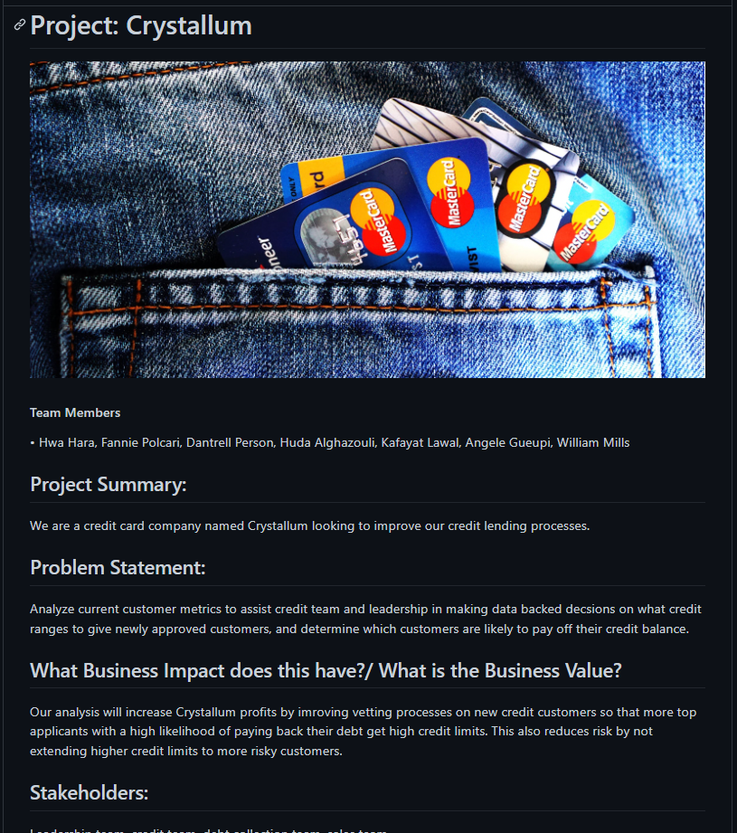
How did all the technology work together.
Amazing coordination between team members.
We utilized Slack to do the bulk of our communication, we implemented ML, SqLite, Jupyter notebook, Github, and Tableau. With all the other amazing skills from this team.
Notes:
Anything we don’t feel had it’s on slide we point to it here.
We used all that data set in sql lite

Slide 22
Thank you for listening!

