Slide 1
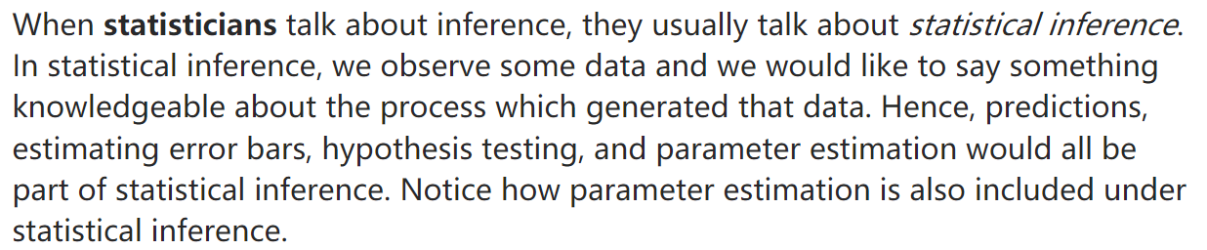
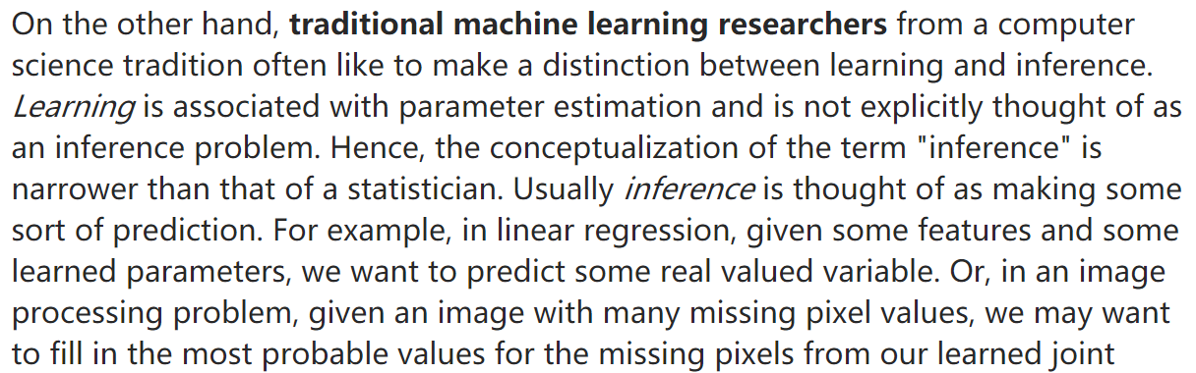
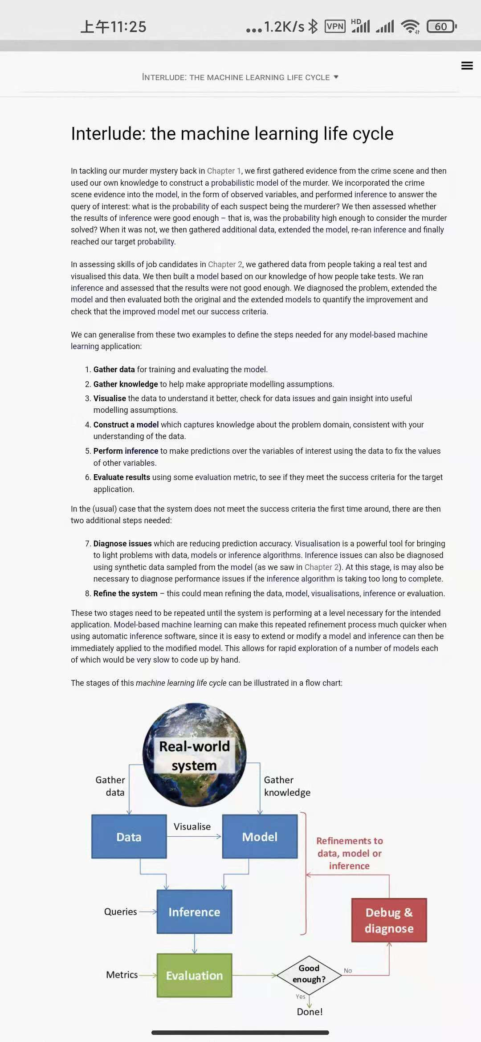
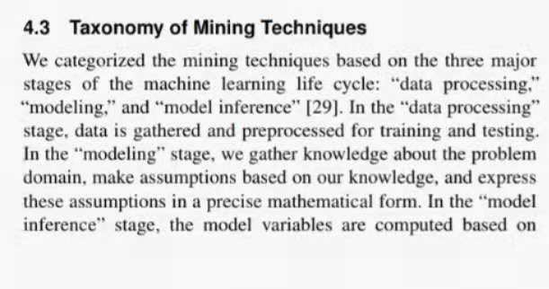
statisticians
Workflow
Example
Inference
Modeling: Reason about the data generation process and choose the stochastic model that approximates the data generation process best.
Model validation: Evaluate the validity of the stochastic model using residual analysis or goodness-of-fit tests.
Inference: Use the stochastic model to understand the data generation process .
Prediction
Modeling: Consider several different models and different parameter settings.
Model selection: Identify the model with the greatest predictive performance using validation/test sets; select the model with the highest performance on the test set.
Prediction: Apply the selected model on new data with the expectation that the selected model also generalizes to the unseen data.
Inference: You want to understand how ozone levels are influenced by temperature, solar radiation, and wind. Since you assume that the residuals are normally distributed, you use a linear regression model. In order to harness the information from the full data set and you do not care about predictive accuracy, you fit the model on the full data set. On the basis of the fitted model, you interpret the role of the features on the measured ozone level, for example, by considering the confidence bands of the estimates.
Prediction: You want to predict future ozone levels using historic data. Since you believe that there is a linear relationship between the ozone level and measurements of temperature, solar radiation, and wind, you fit several linear models (e.g. using different sets of features) on the training data and select the model minimizing the loss on the test set. Finally, you use the selected model for predicting the ozone level. Note that you do not care at all about the Gaussian assumption of the model or the additional information that is available on the model estimates as long as the model minimizes the test error.
Inference: Use the model to learn about the data generation process.
Prediction: Use the model to predict the outcomes for new data points.
machine learning
researchers
Liu shixia

Slide 2
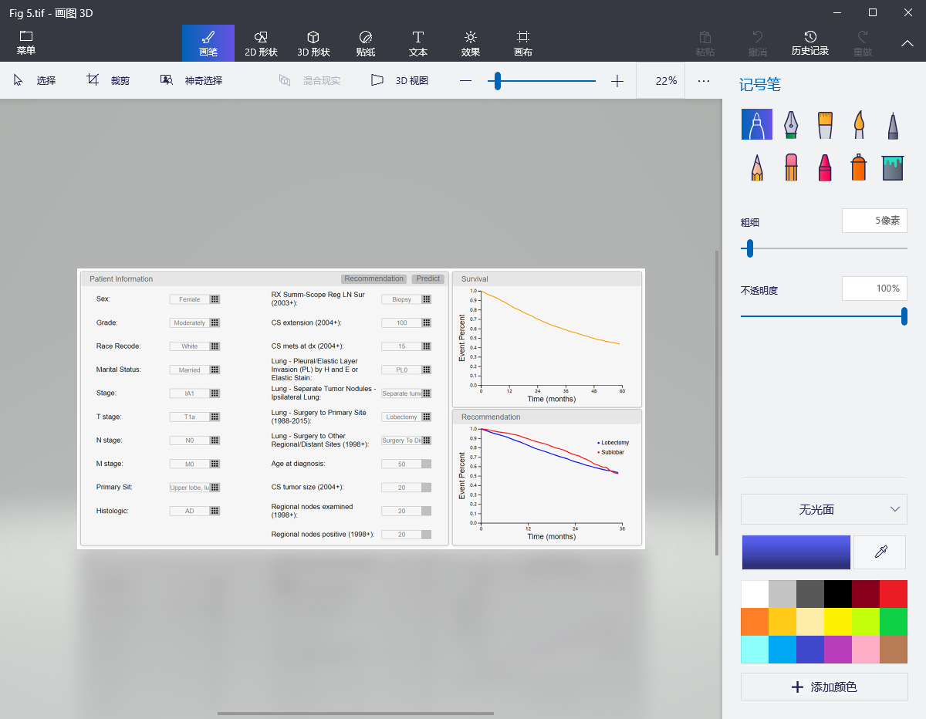
Admission information
Age
History information
D_AIDS
5
4
3
4
GCS
Vital signs
Treatment information
D_mechvent

