Slide 1




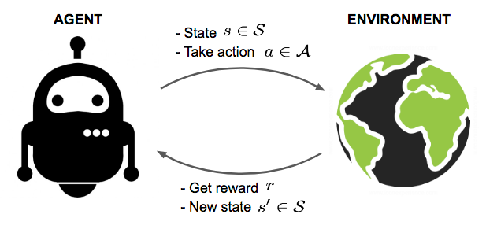
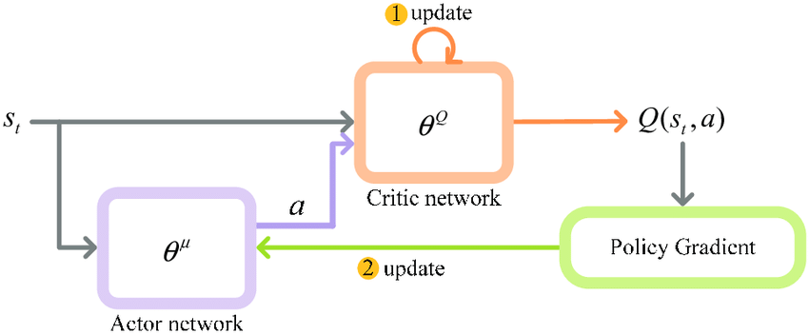
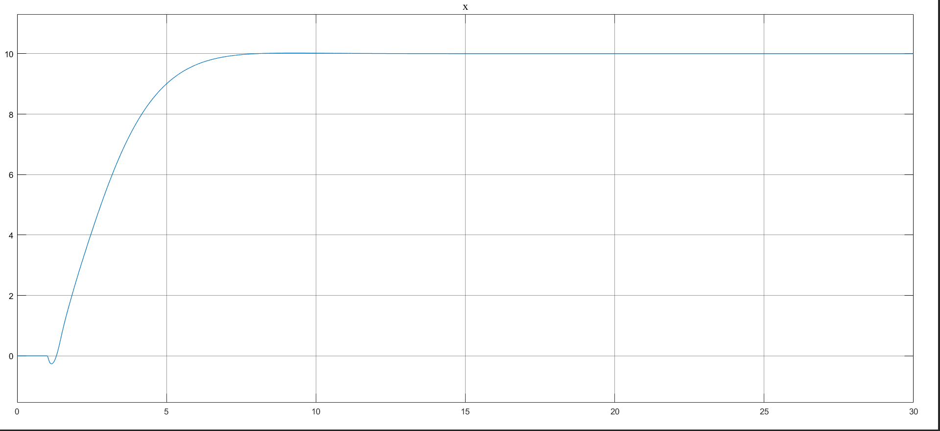
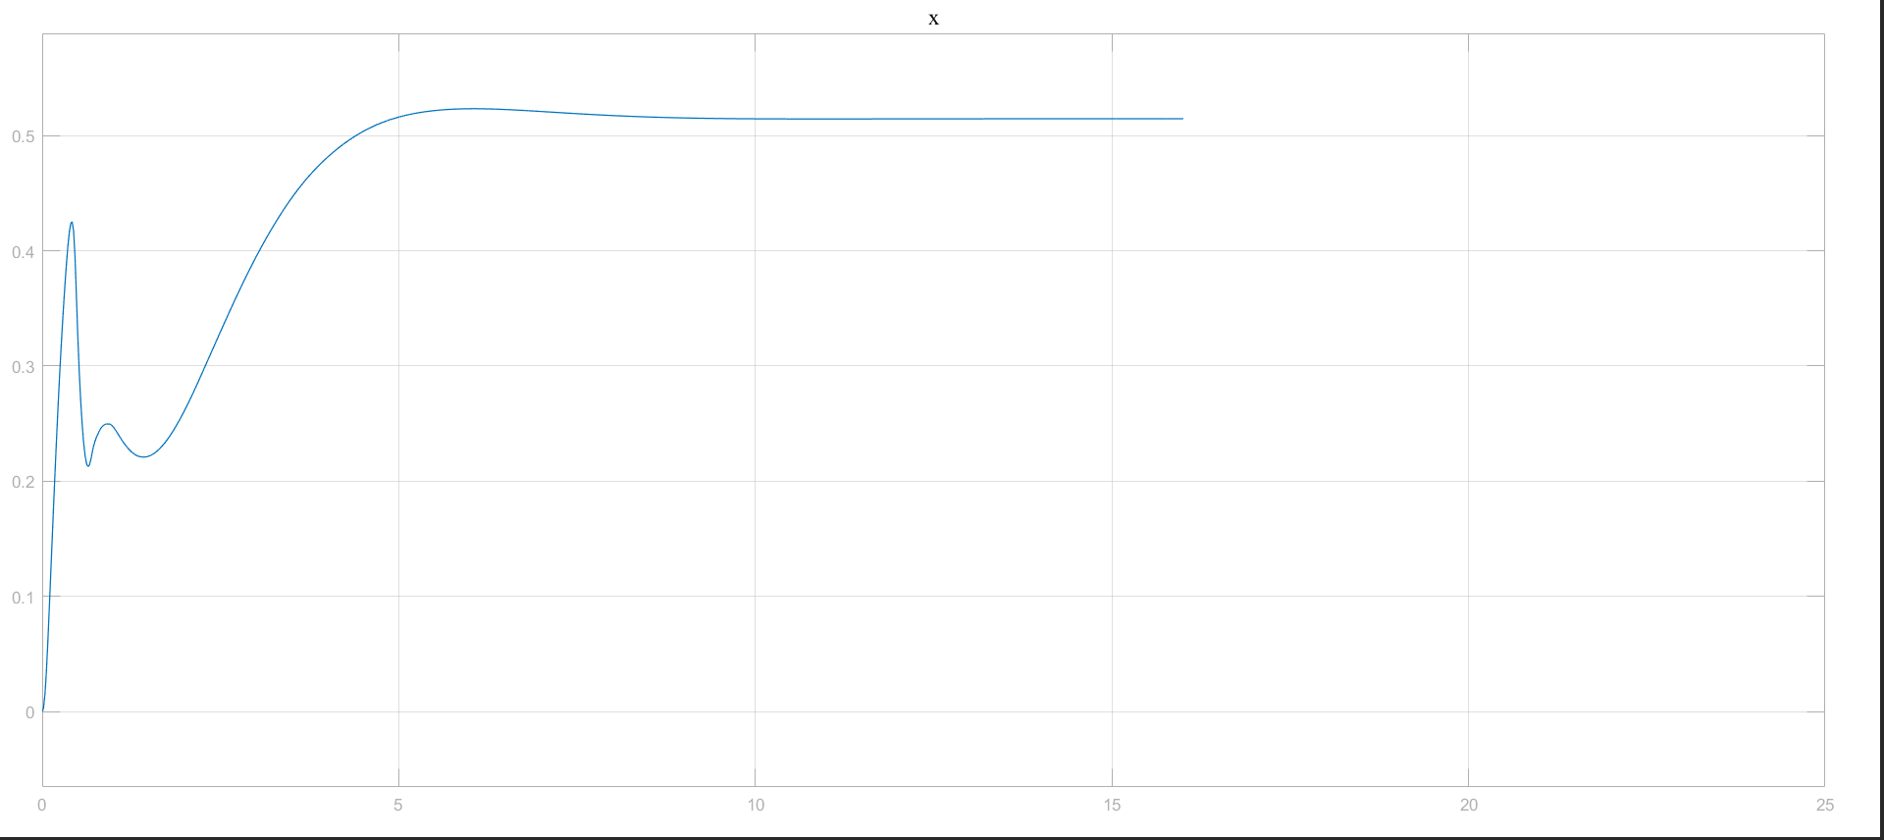
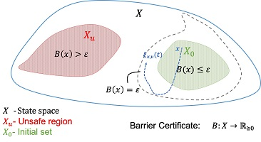
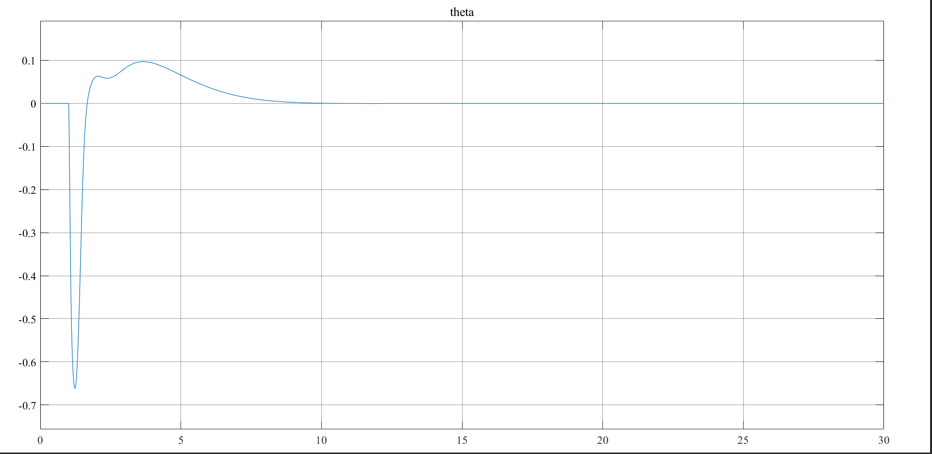
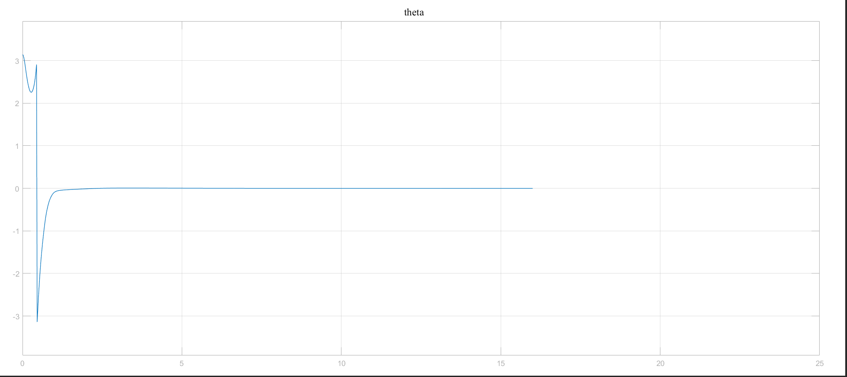
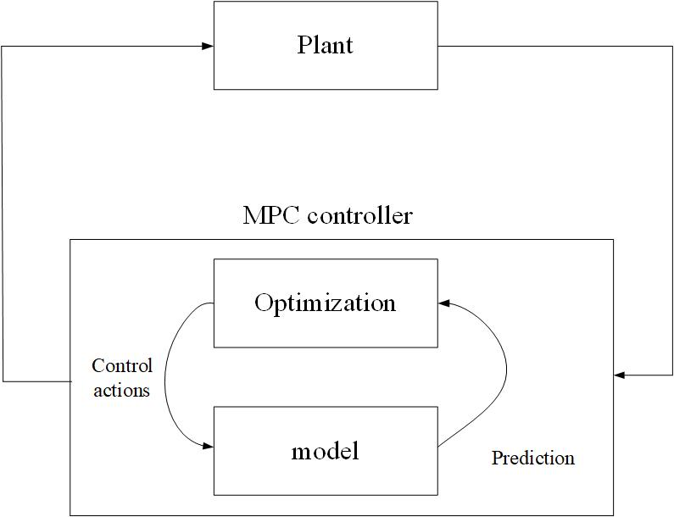
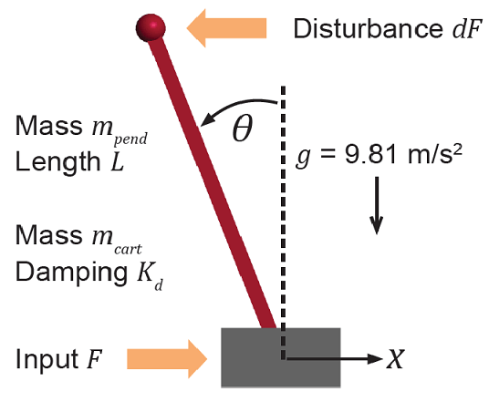
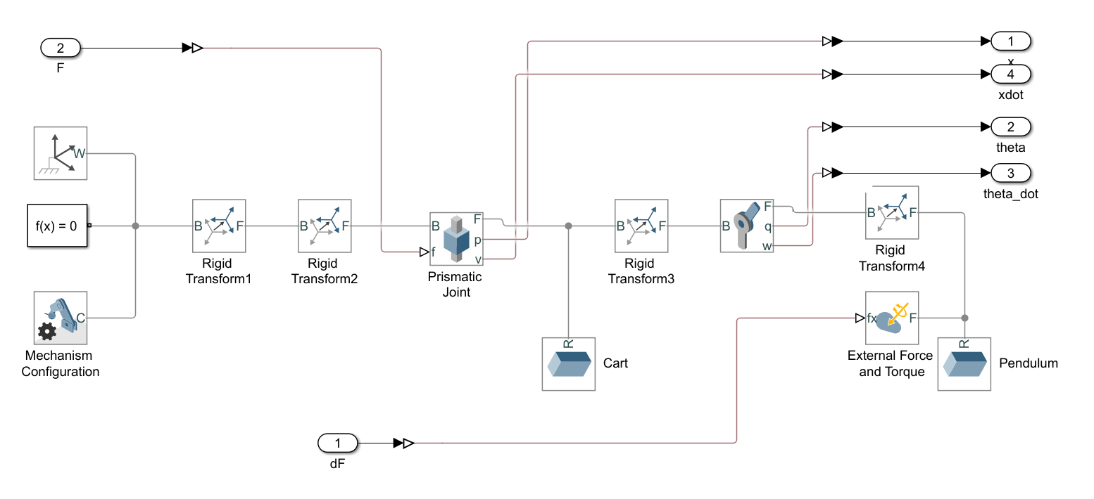
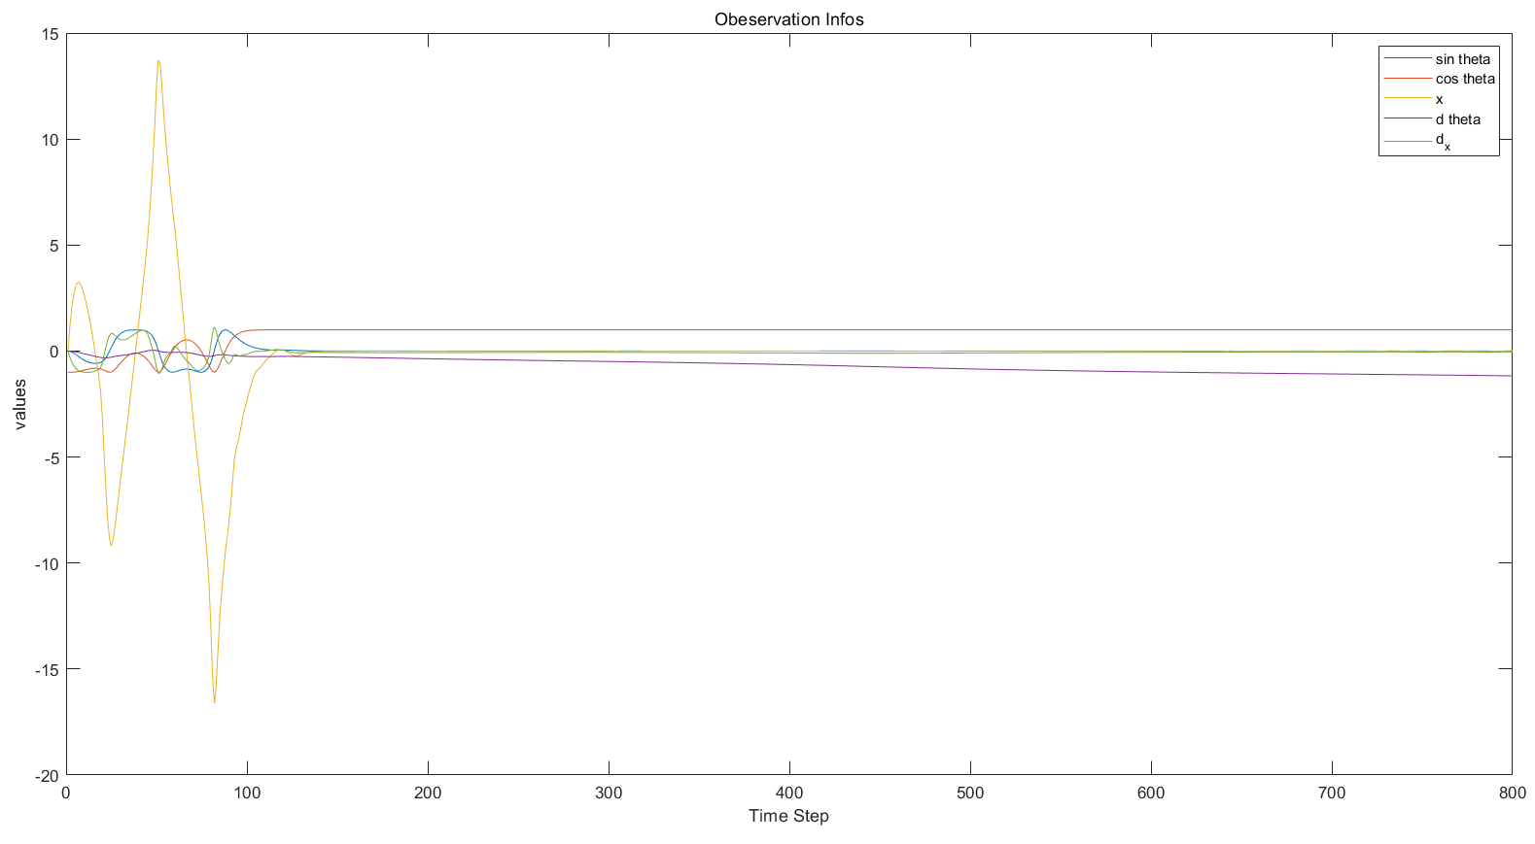
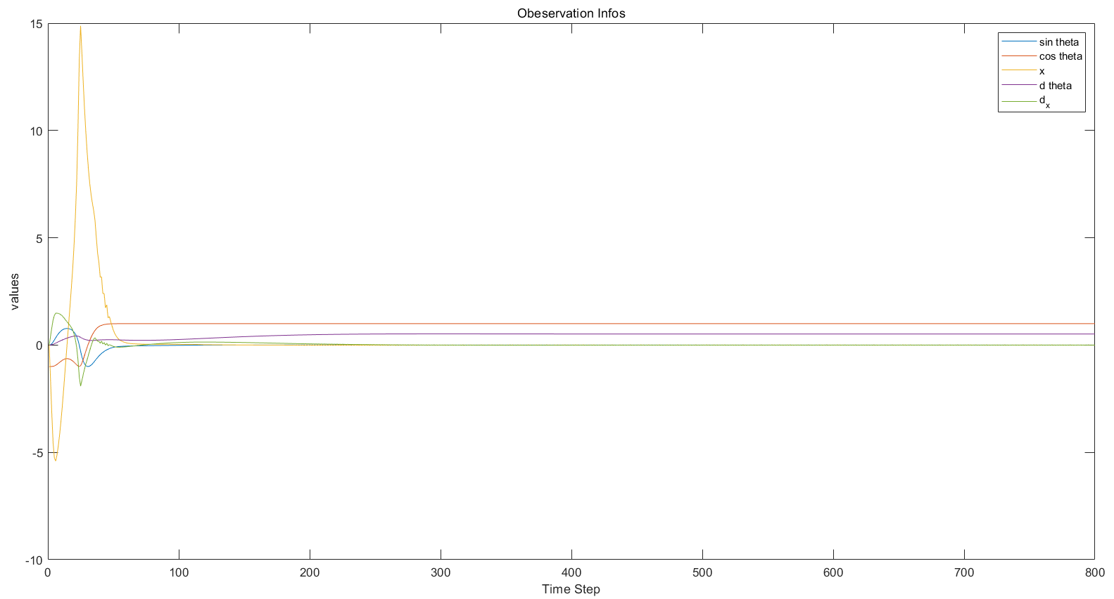
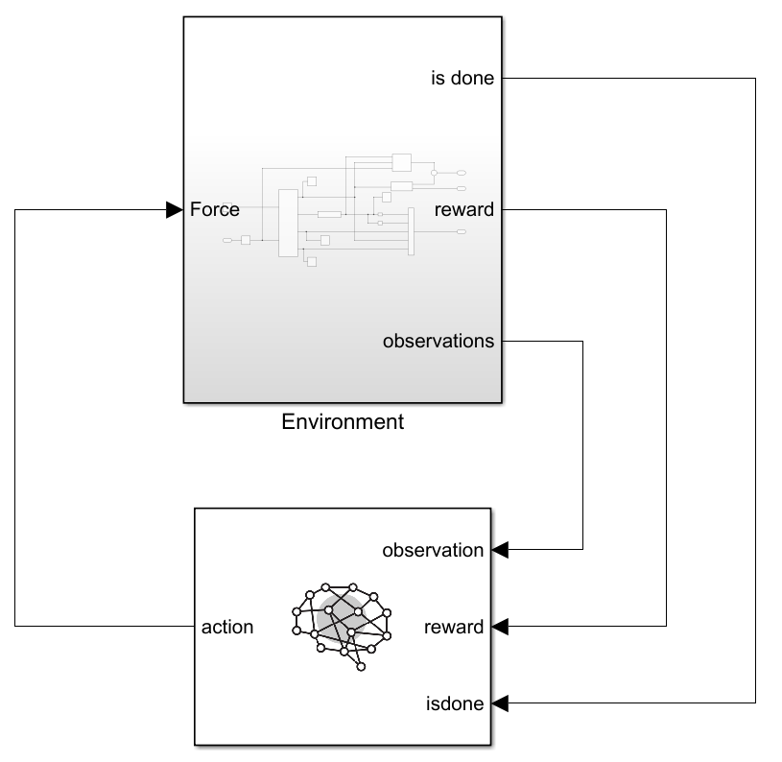
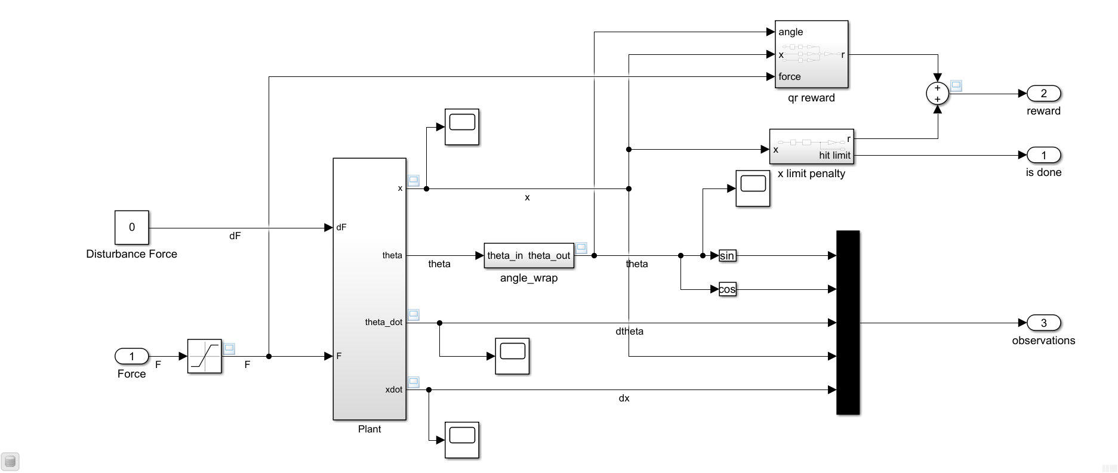
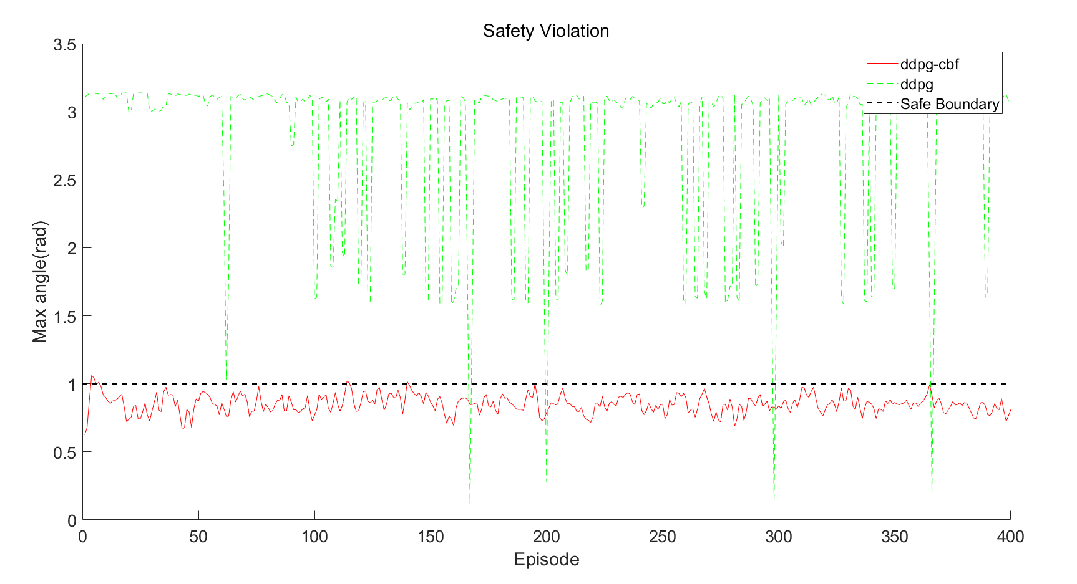
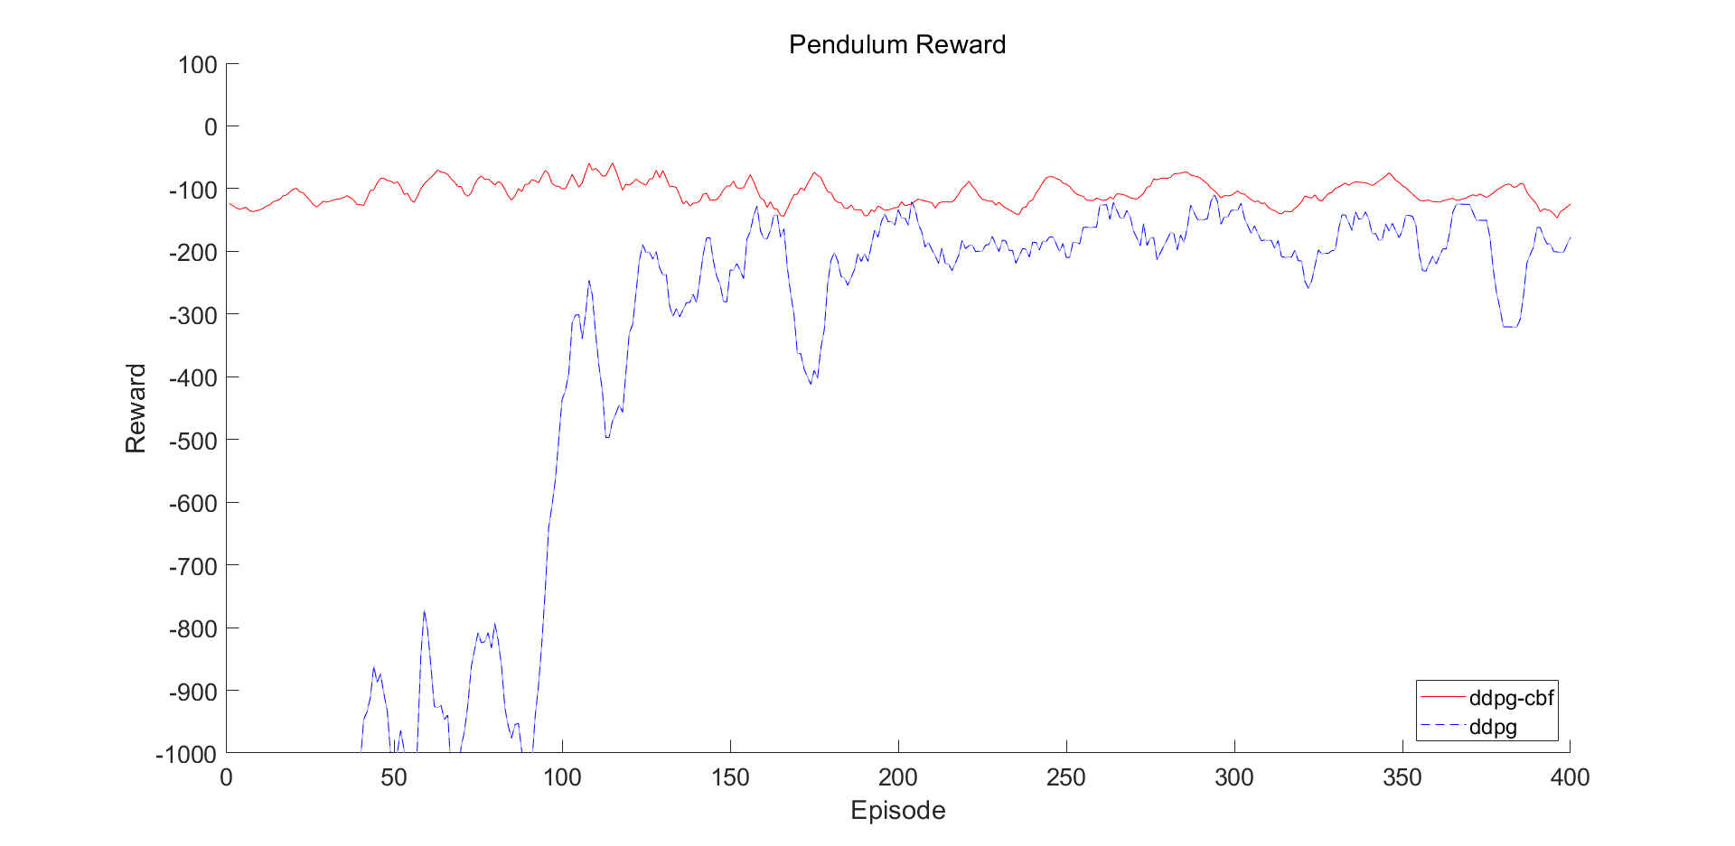
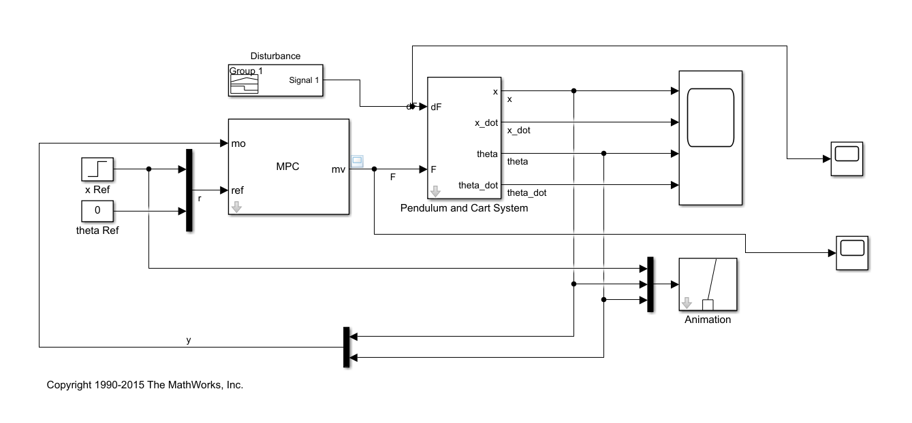

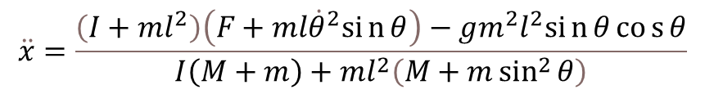
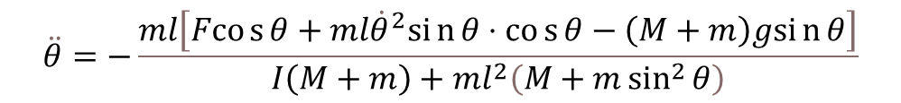
Reinforcement Learning for Autonomous Systems
Presenter : Xu Haoran SID : 1155124383 Supervisors: Dr. Han Dongkun , Mr. Huang Hejun
Find full report here.
Introduction
Even with the rapid development of the learning-based control approaches, e.g., deep learning and reinforcement learning guided control, the majority industry players still prefer those classical controllers such as proportional integral derivative controller (PID) and model predictive control (MPC) controller which are completely controllable and explainable all the time. Reinforcement learning (RL) controller has good performance in simulations but the exploration and exploitation processes contain some potential dangerous actions which are definitely rejected in all the safety critical scenarios.
Recently, combining the RL with safety guarantee over learning process, also known as the safe reinforcement learning is relaxing the application in safety-critical systems control, proposed a framework to complete the safety guarantee and further combined the control barrier function as part of the controller to improve the RL control policy.
Background
Research Objectives
(1) Reinforcement Learning
The agent continuously takes actions according to the environment and gets feedback from environment. The purpose is for the agent to learn an optimal policy that maximizes the long-term reward.
compare the performance of DDPG controller and MPC controller via a cart-pole model;
verify the influence factors during DDPG learning process;
validate the superiority of combing CBF into RL algorithm both in learning efficiency and safety guarantee via a pendulum model.
Figure 1. Agent interacts with environment and tries to maximize rewards.
Results
(2) Deep Deterministic Policy Gradient
Deep Deterministic Policy Gradient (DDPG) algorithm is an off-line actor-critic method that computes the policy gradient based on sampled trajectories and an estimation of the action-value function. Fig. 2 shows the basic structure of DDPG algorithm.
Figure 2. Basic structure of DDPG
(3) Control Barrier Functions
Based on the invariant set principle, it certifies that state trajectories starting from the safe region will never enter unsafe region.
Figure 10: Output of x in MPC control System and DDPG Control System
Figure 3. The state trajectories in the safe region will never enter unsafe region.
(4) Model Predictive Control
Model predictive control (MPC) is an advanced method of process control that has the ability to anticipate future events and take control actions accordingly.
Figure 11: Output of θ in MPC Control System and DDPG Control System
Figure 4. Basic structure of MPC controller
The goal of the two control systems is to make x remains unchanged and theta remains 0 using minimal control effort. Therefore, we can conclude that DDPG agent has a better performance compared to MPC controller in our cart-pole system control tasks.
Case Study
Figure 5 : Cart-Pole System
Figure 6 : Cart-Pole Model Used in the Control Systems
Figure 12 : Observation Information with Force Limit 15 and Force Limit 200.
To make comparison between DDPG agent and MPC controller, we choose to use classic cart-pole model in MATLAB :
By increasing the force limit from the default value 15 to the new value 200, the time cost to re-balance the cart-pole system can be reduced as much as a half. Therefore, we can change the force limit accordingly in different environments to make our DDPG agent preforms better. The flexibility of DDPG agent is also an advantage over MPC controller since we can choose to use different force limit settings in different situations.
$$\ddot{θ}=−\frac{ml\left[Fcos{θ}+ml{\dot{θ}}^{2}sin{θ}⋅cos{θ}−\left(M+m\right)gsin{θ}\right]}{I\left(M+m\right)+ml^{2}\left(M+m\sin^{2}{θ}\right)}$$
$$\ddot{x}=\frac{\left(I+ml^{2}\right)\left(F+ml{\dot{θ}}^{2}sin{θ}\right)−gm^{2}l^{2}sin{θ}cos{θ}}{I\left(M+m\right)+ml^{2}\left(M+m\sin^{2}{θ}\right)}$$
Figure 7: Structure Overview of DDPG Control System
Figure 8: Detailed Structure of DDPG Control System
Figure 13 : Comparison between DDPG and DDPG-CBF Algorithm on Episode Reward and Safety Violation
The combination of DDPG and CBF has a much better performance than the original DDPG in safety violation control and also performs better in learning efficiency.
Conclusion
(1)We have compared the performance between the DDPG controller and MPC controller in a Cart-Pole system.
(2)We also tested different system input to prove the advantages of the DDPG controller.
(3)We combined CBF into DDPG controller to satisfy the safety guarantee over processes.
In the future, we are planning to further explore more combination of safety guarantee and RL algorithms based on the real-world equipment for advanced performance.
Figure 9: Detailed Structure of MPC Control System
We design two control systems: DDPG control system and MPC control system based on the cart-pole model.
References:
[1] R. S. Sutton and A. G. Barto, Reinforcement learning: An introduction. MIT press, 2018.
[2] R. Cheng, G. Orosz, R. M. Murray, and J. W. Burdick, “End-to-end safe reinforcement learning through barrier functions for safety-critical continuous control tasks,” in Proceedings of the AAAI Conference on Artificial Intelligence, pp. 3387–3395, 2019.
[3] L. P. Kaelbling, M. L. Littman, and A. W. Moore, “Reinforcement learning: A survey,” Journal of artificial intelligence research, vol. 4, pp. 237–285, 1996.
[4] M. I. Salem, Fawzan; Mosaad, “A comparison between mpc and optimal pid controllers: Case studies,” in Michael Faraday IET International Summit 2015, IET, 2015.
[5] A. D. Ames, S. Coogan, M. Egerstedt, G. Notomista, K. Sreenath, and P. Tabuada, “Control barrier functions: Theory and applications,” in 2019 18th European Control Conference (ECC), pp. 3420–3431, IEEE, 2019.
Find full reference here.

