Slide 1



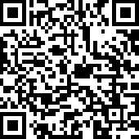
Reinforcement Learning for Autonomous Systems
Undergraduate Summer Research Internship 2021
Presenter:
Xu Haoran
SID: 1155124383
Supervisors:
Dr. Han Dongkun
Mr. Huang Hejun

Slide 2
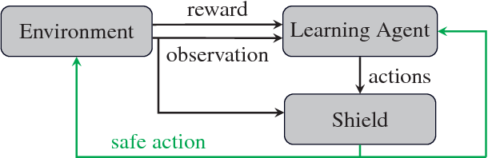
Introduction:
1
Figure 1 : Basic Structure of Safe Reinforcement Learning

Slide 3
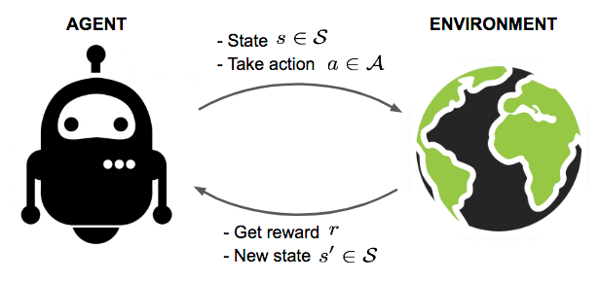
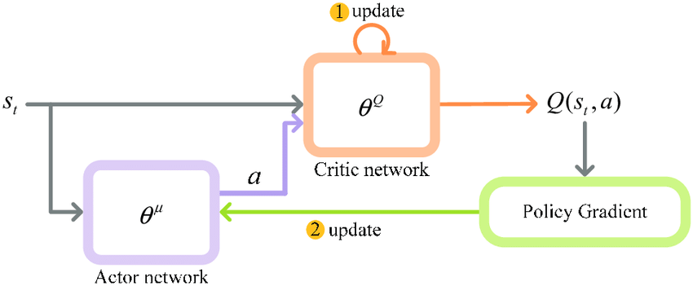
2
Background:
(1) Reinforcement Learning
The agent continuously takes actions according to the environment and gets feedback from environment. The purpose is for the agent to learn an optimal policy that maximizes the long-term reward.
Figure 2. Agent interacts with environment and tries to maximize rewards.
(2) Deep Deterministic Policy Gradient
Add a shield, which monitors the actions selected by the learning agent and corrects them if the chosen action is unsafe.
Figure 3. Basic structure of shield learning

Slide 4
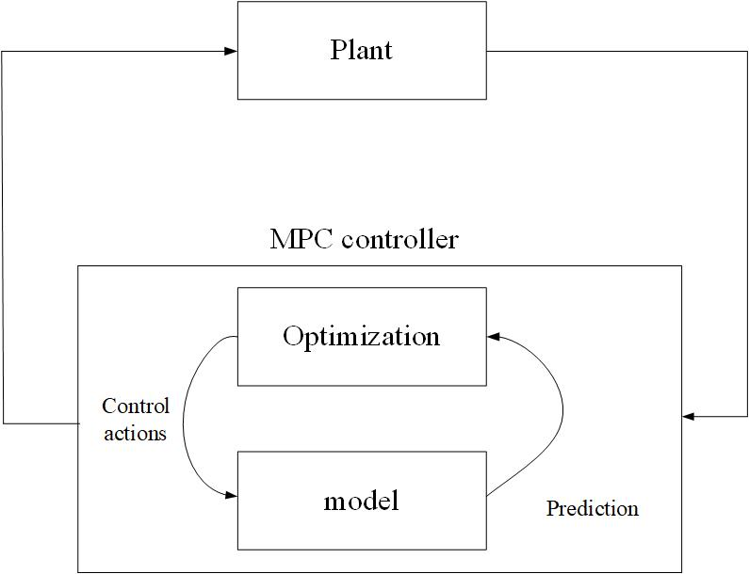
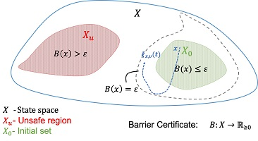
2
Background:
(3) Model Predictive Control
Model predictive control (MPC) is an advanced method of process control that has the ability to anticipate future events and take control actions accordingly.
Figure 4. Basic structure of MPC controller
(4) Control Barrier Functions
Based on the invariant set principle, it certifies that state trajectories starting from the safe region will never enter unsafe region.
Figure 5. The state trajectories in the safe region will never enter unsafe region.

Slide 5
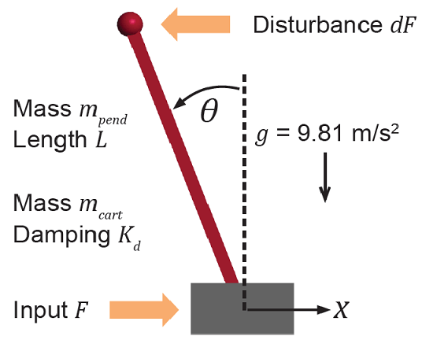
3
Case Study:
Figure 6 : Cart-Pole System

Slide 6
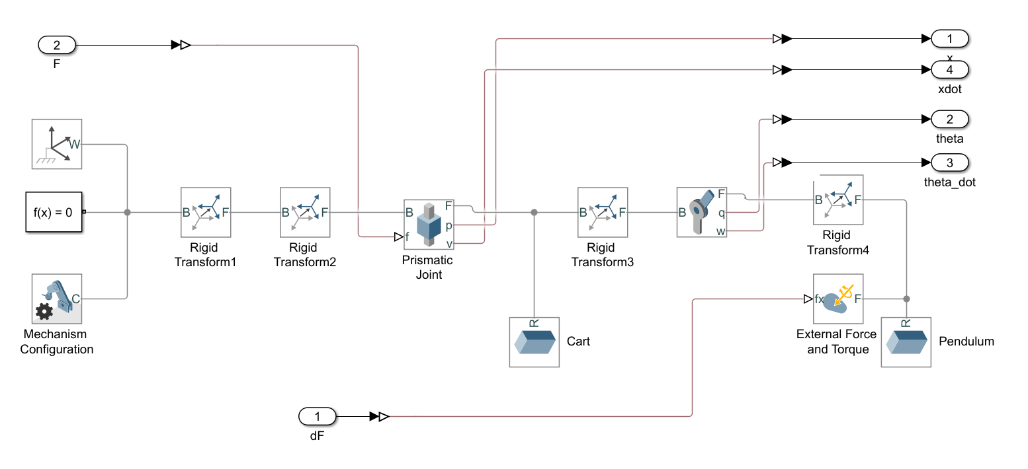
3
Case Study:
Figure 7 : Cart-Pole Model Used in the Control Systems

Slide 7
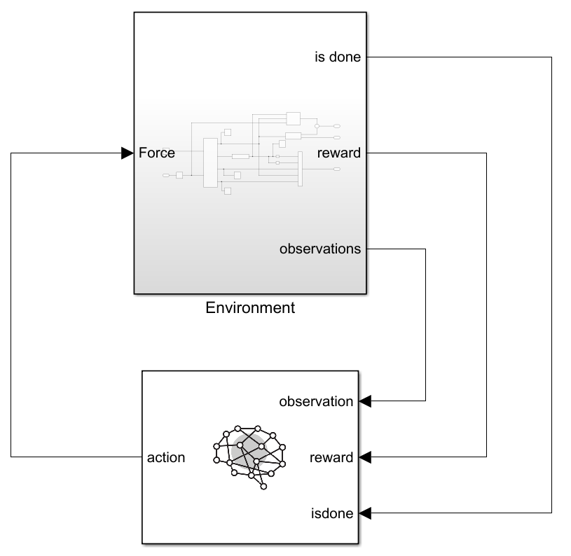
3
Case Study:
Figure 8: Structure Overview of DDPG Control System

Slide 8
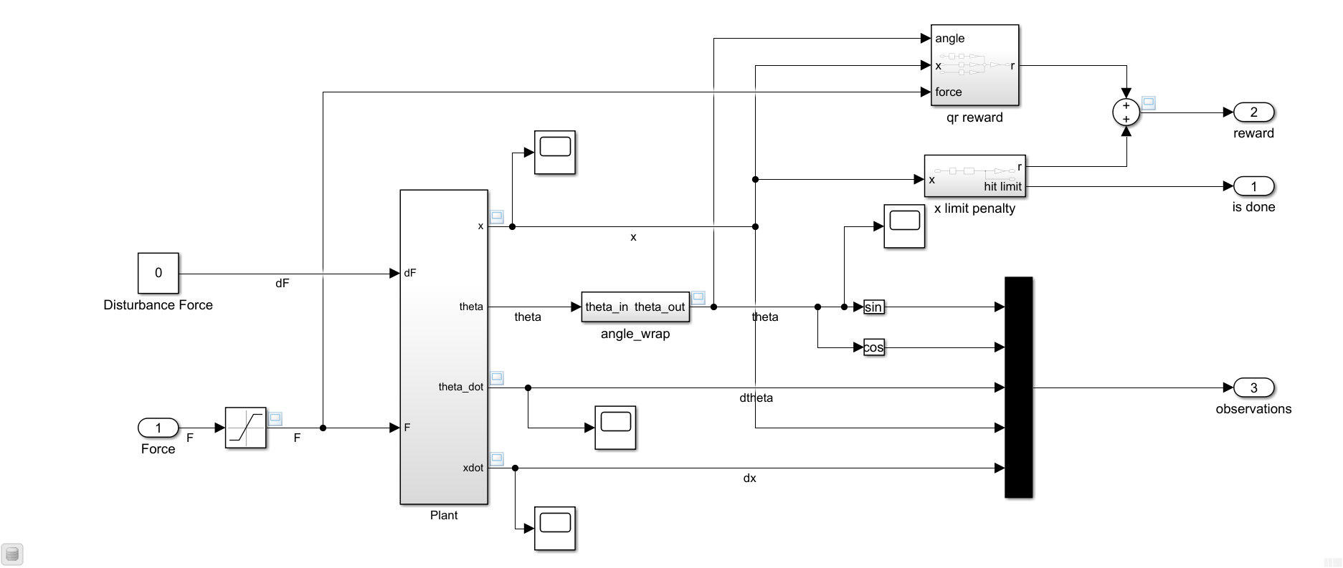
3
Case Study:
Figure 9: Detailed Structure of DDPG Control System

Slide 9
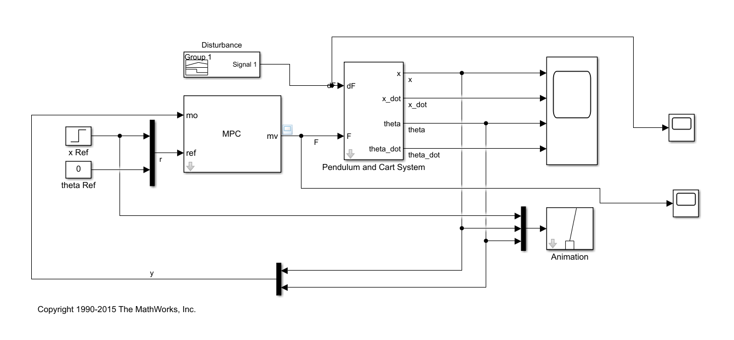
3
Case Study:
Figure 10: Detailed Structure of MPC Control System

Slide 10
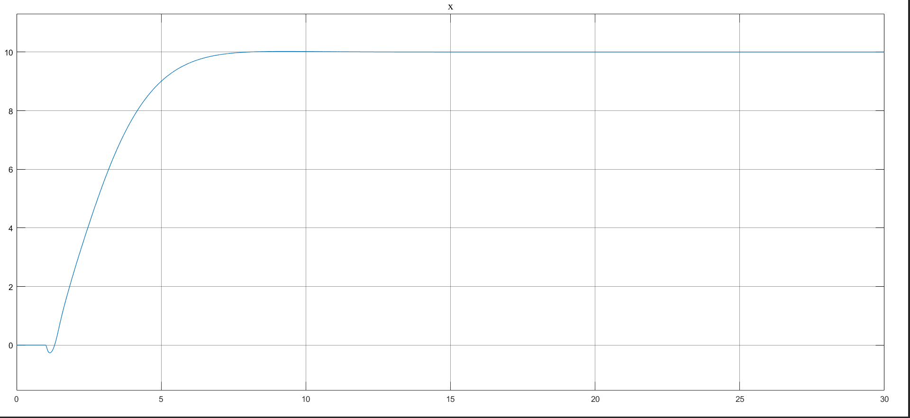
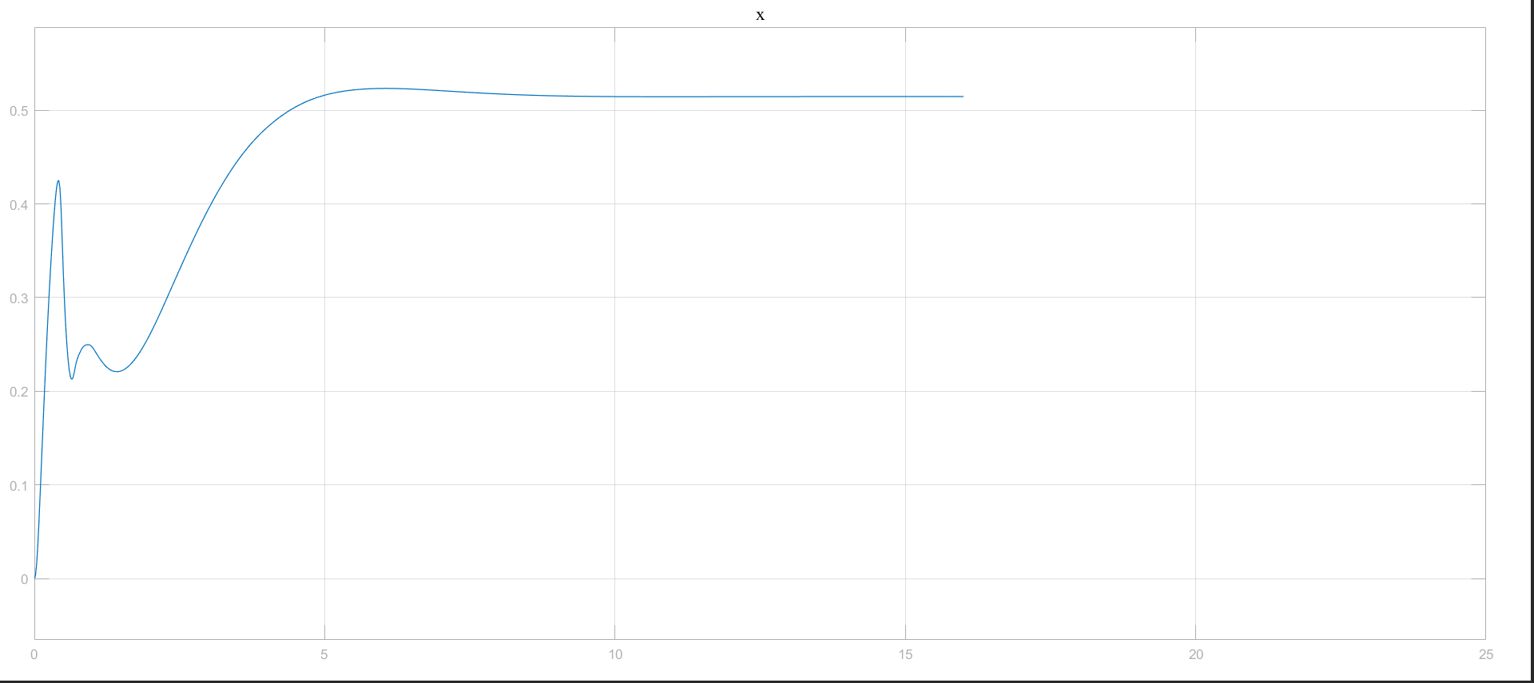
4
Results:
Figure 11: Output of x in MPC control System and DDPG Control System

Slide 11
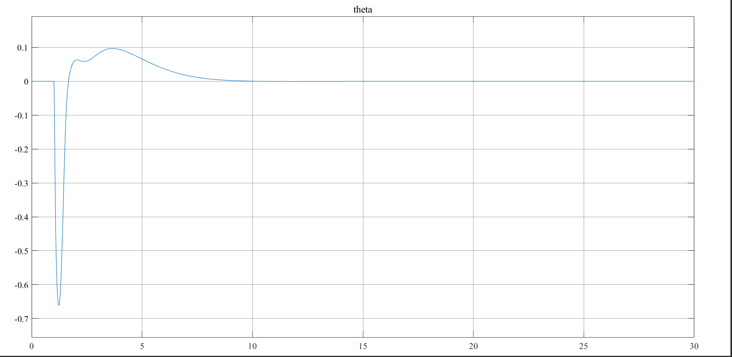
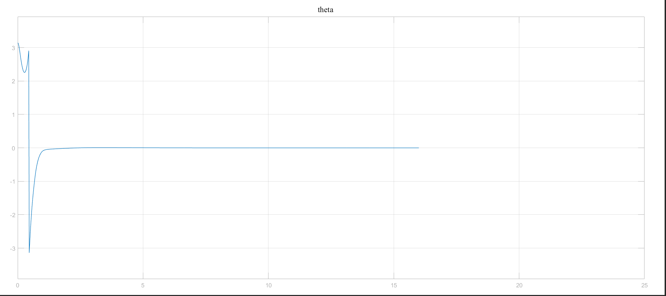
4
Results:
Figure 12: Output of θ in MPC control System and DDPG Control System

Slide 12
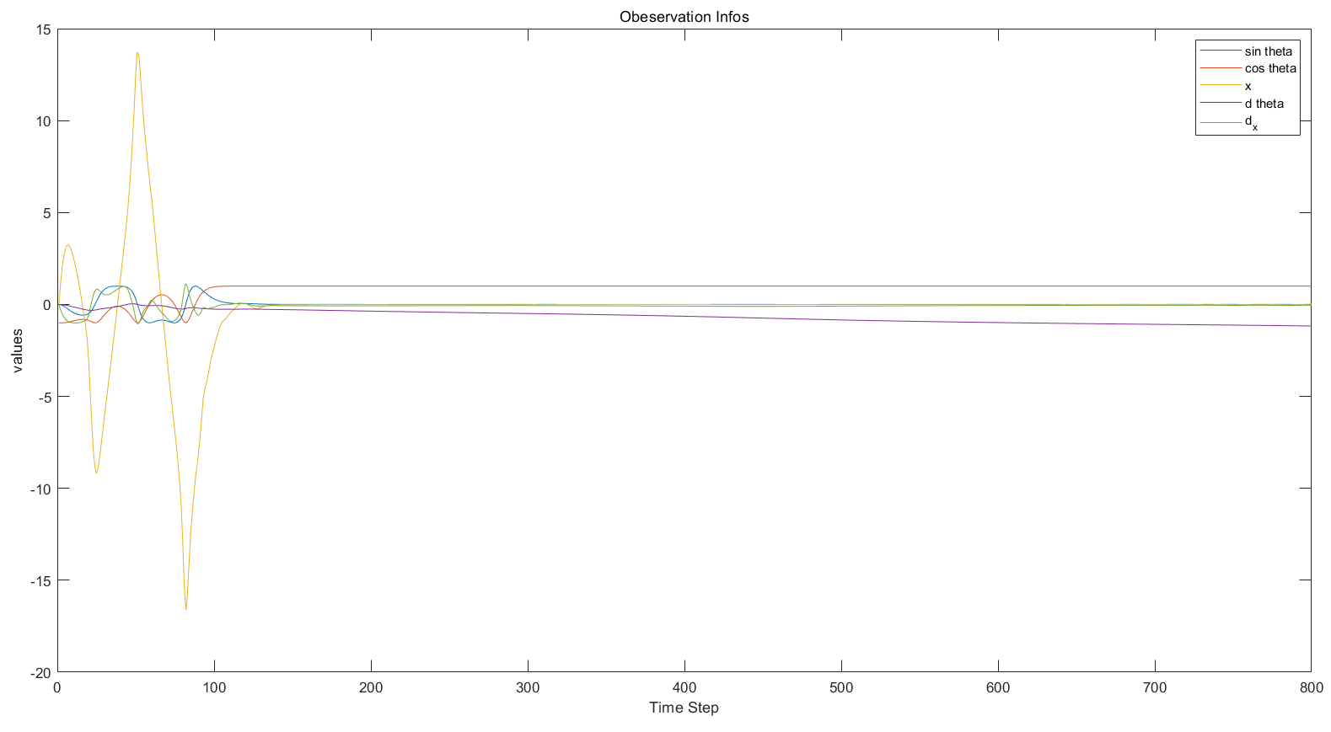
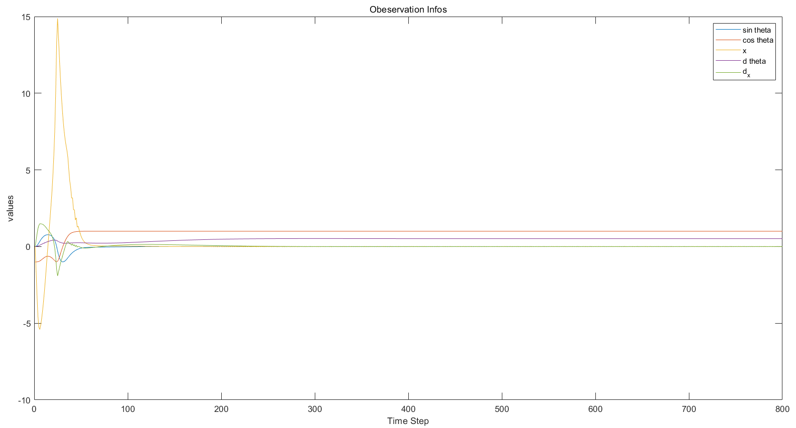
4
Results:
Figure 13: Observation Information with Force Limit 15 and Force Limit 200

Slide 13
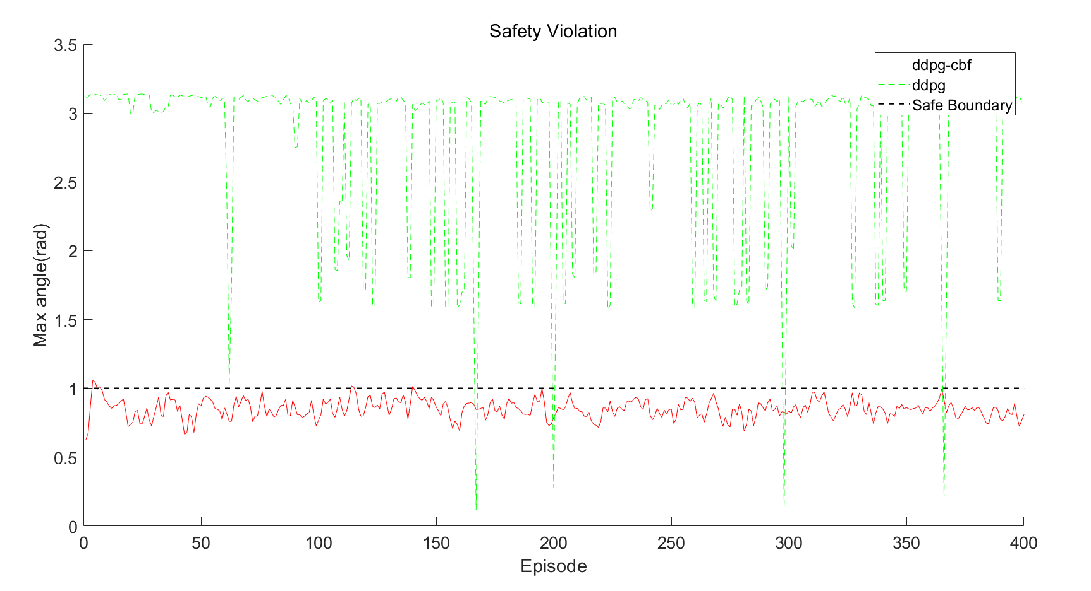
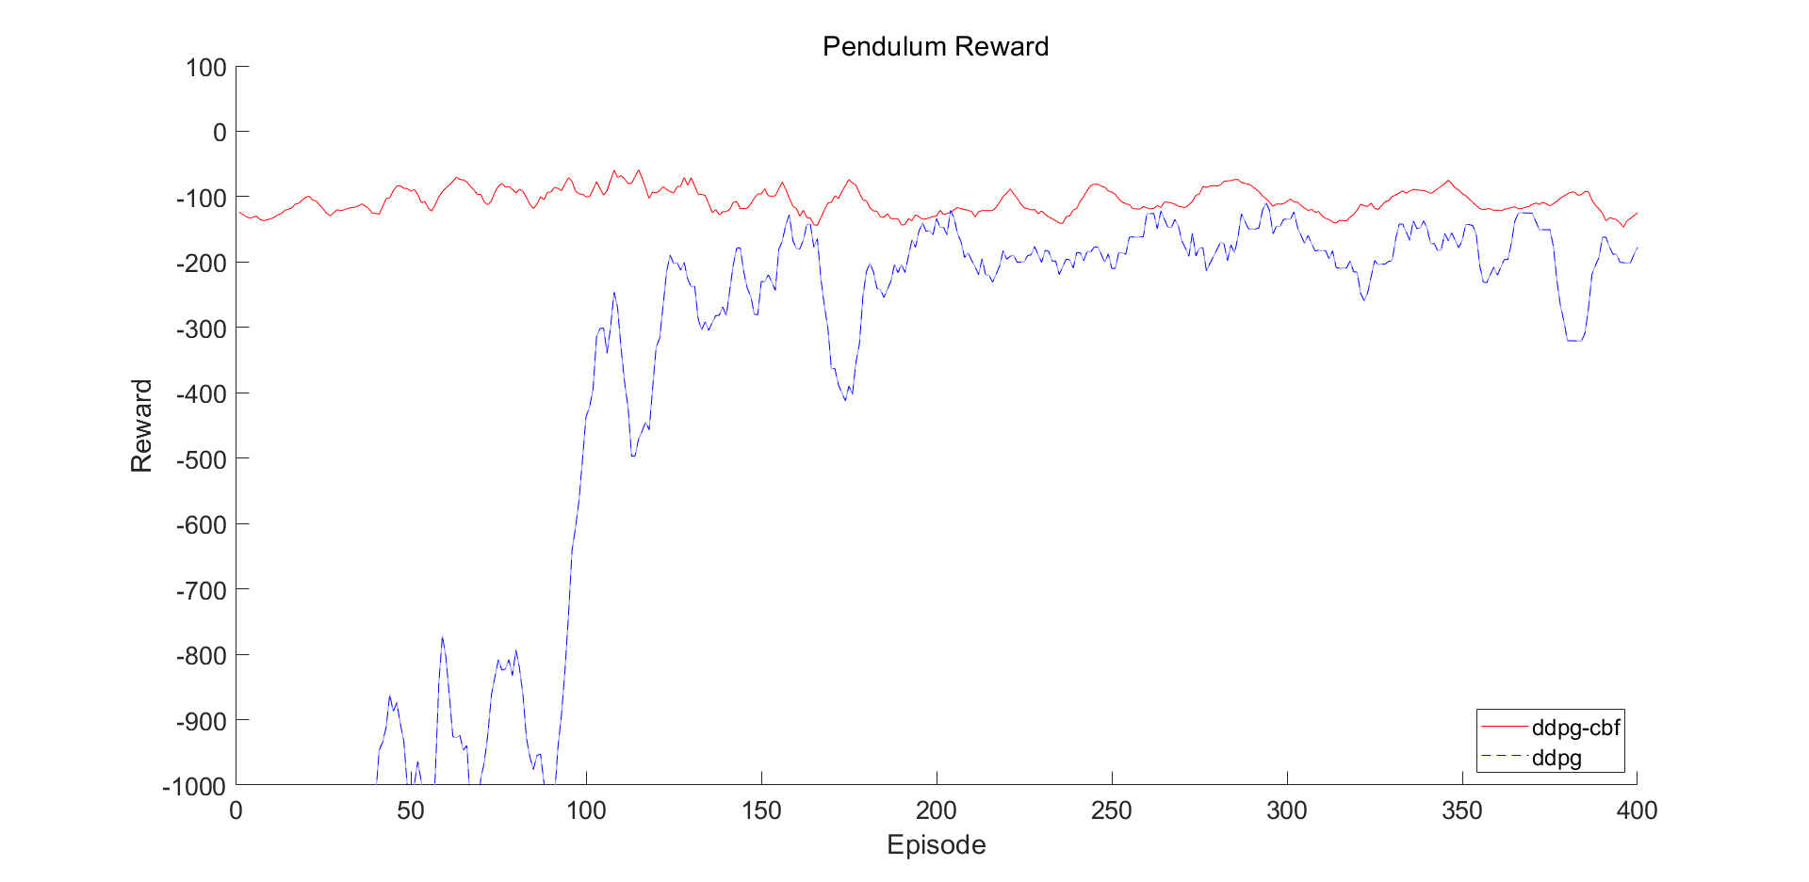
4
Results:
Figure 14 : Comparison between DDPG and DDPG-CBF Algorithm on Episode Reward and Safety Violation

