Slide 1
Demo 1: Genome-wide association studies
Ashlyn Anderson
PhD Candidate, Cochran lab
5/28/26

Slide 2
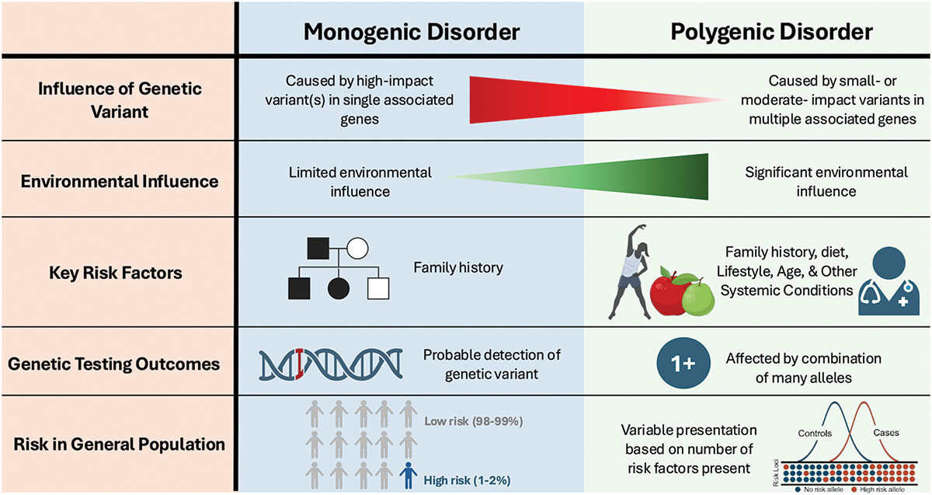
Mendelian vs complex disorders

Slide 3
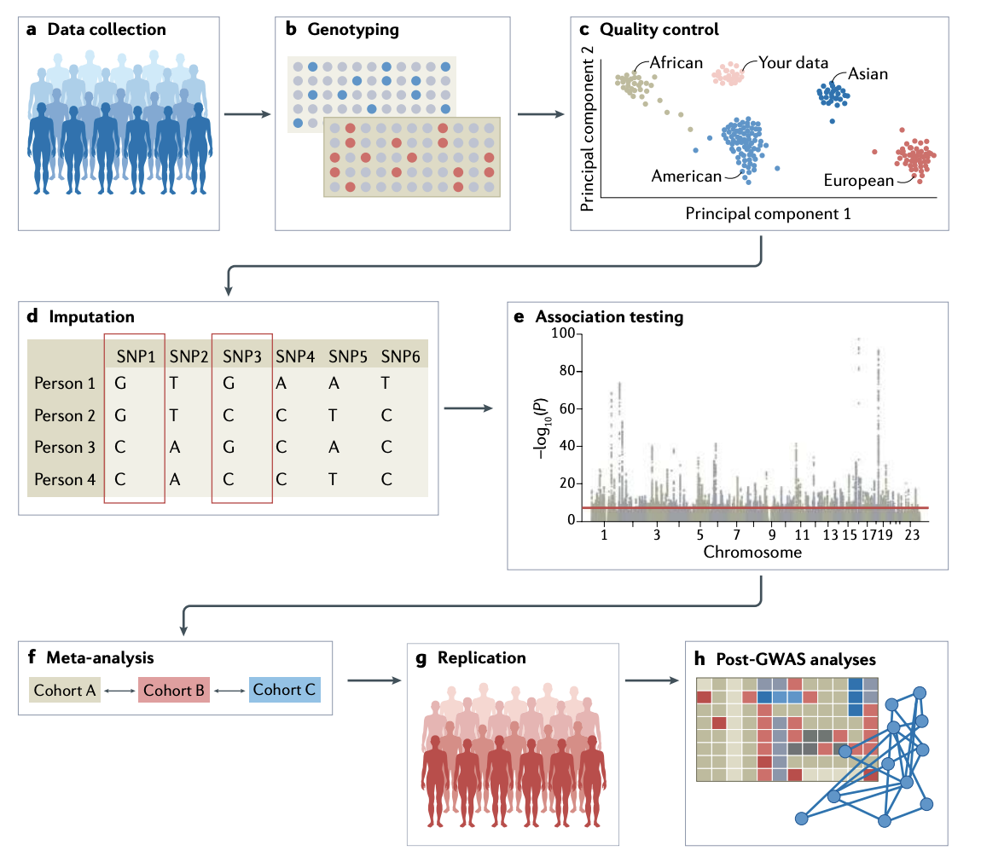
Genome-wide association studies
Uffelmann et al., 2021

Slide 4
Genome-wide association studies
Uffelmann et al., 2021

Slide 5
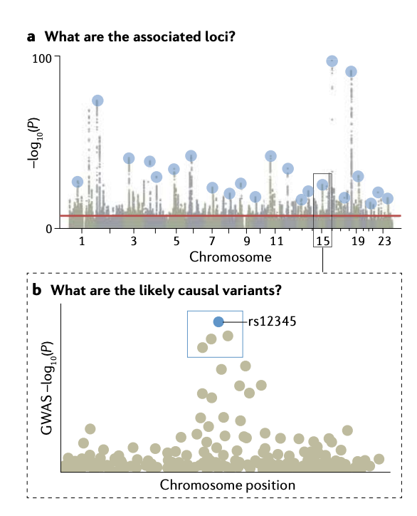
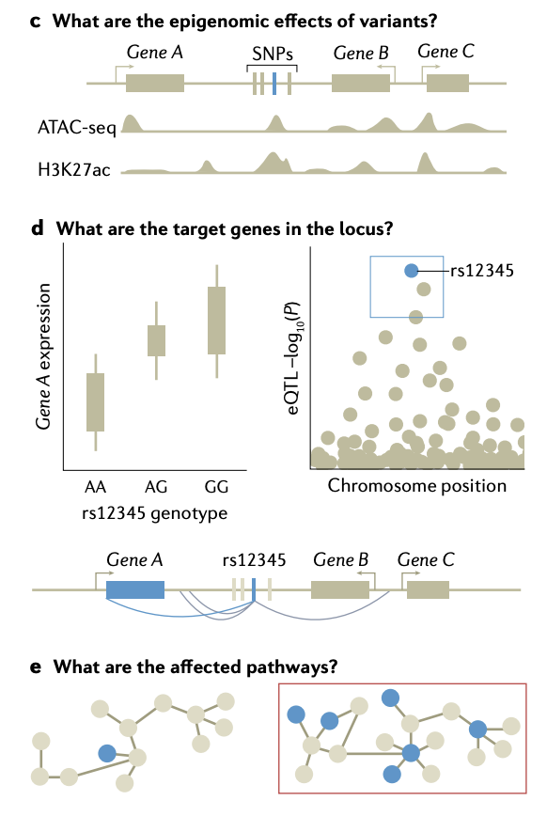
Interpreting GWAS
Uffelmann et al., 2021

Slide 6
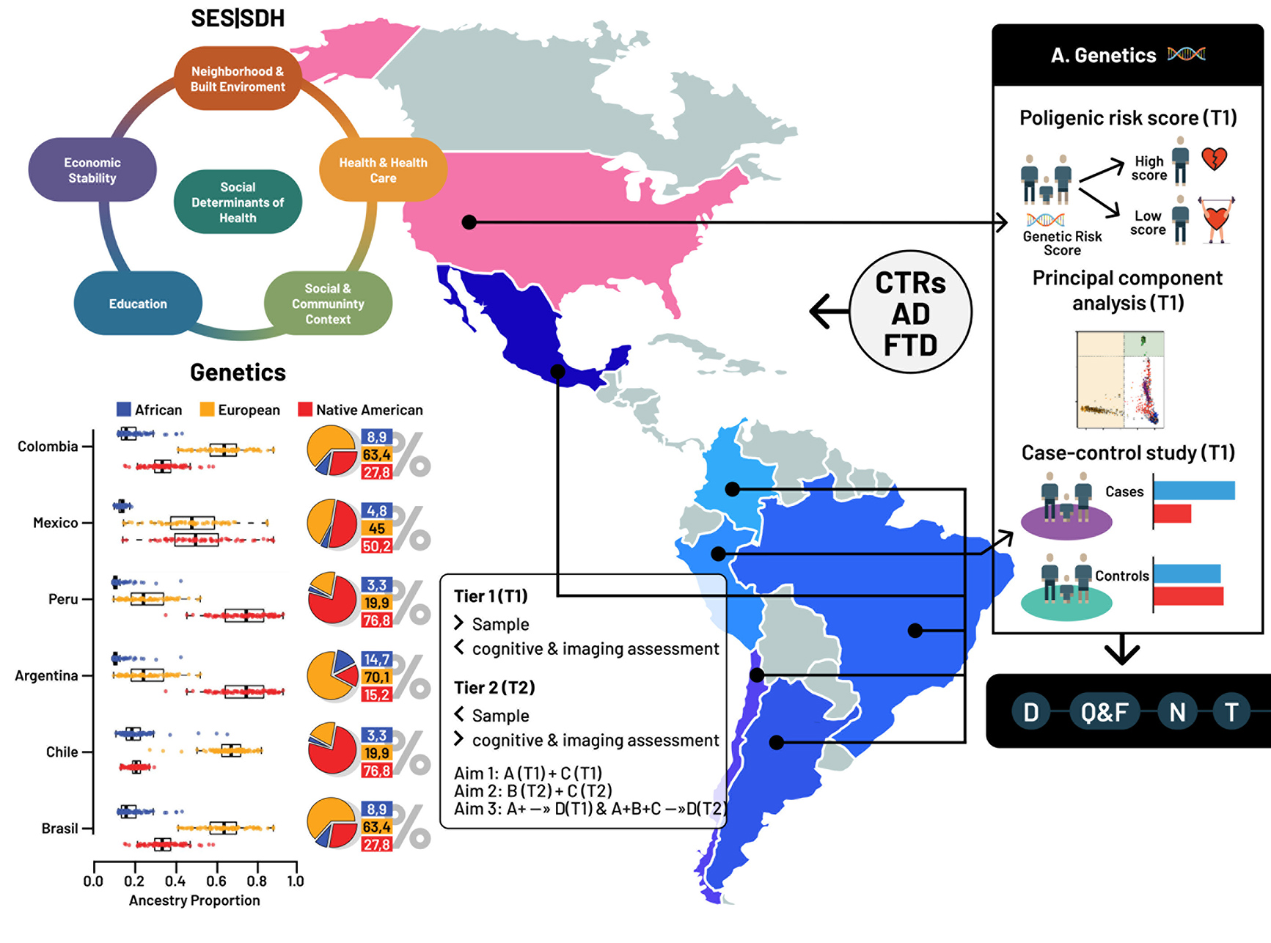

Today’s Data: ReD-Lat

