Slide 1
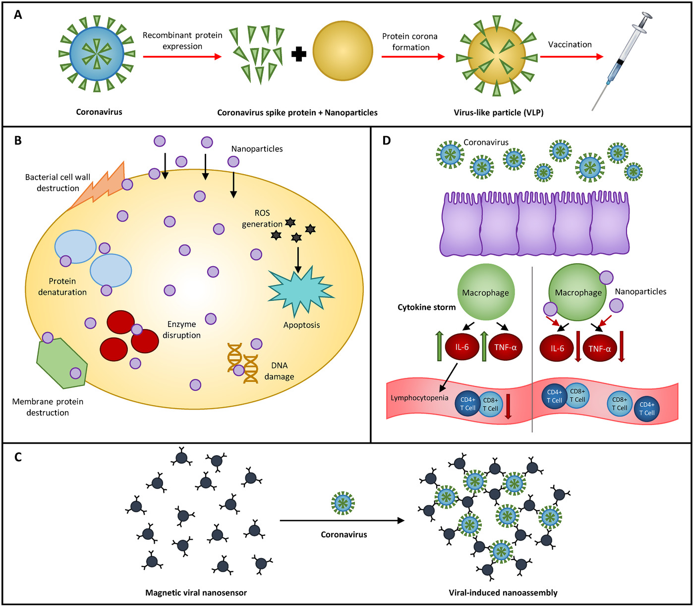
Potential nanoparticle applications for prevention, diagnosis, and treatment of COVID‐19
VIEW, Volume: 1, Issue: 4, First published: 25 September 2020, DOI: (10.1002/VIW.20200105)
Notes:
Possible mechanisms of application for NPs. (A) Protein corona formation occurs when NPs spontaneously take up viral protein markers. The resulting VLP can be used for vaccination against future coronavirus infections. (B) Various antimicrobial mechanisms of NPs. (C) Mechanism used by nanosensor to detect SARS‐CoV‐2 virus. (D) Cytokine storm syndrome following SARS‐CoV‐2 infection. Following infection, MΦs secrete large amounts of IL‐6 and TNF‐α cytokines, leading also to downregulation of CD4+ and CD8+ T‐cells. NPs with specific surface functionalizations can neutralize these pro‐inflammatory cytokines.
IF THIS IMAGE HAS BEEN PROVIDED BY OR IS OWNED BY A THIRD PARTY, AS INDICATED IN THE CAPTION LINE, THEN FURTHER PERMISSION MAY BE NEEDED BEFORE ANY FURTHER USE. PLEASE CONTACT WILEY'S PERMISSIONS DEPARTMENT ON PERMISSIONS@WILEY.COM OR USE THE RIGHTSLINK SERVICE BY CLICKING ON THE 'REQUEST PERMISSIONS' LINK ACCOMPANYING THIS ARTICLE. WILEY OR AUTHOR OWNED IMAGES MAY BE USED FOR NON-COMMERCIAL PURPOSES, SUBJECT TO PROPER CITATION OF THE ARTICLE, AUTHOR, AND PUBLISHER.

