Slide 1
Beginning Software Craftsmanship
Jeff Valore | @CodingWithSpike
Brendan Enrick | @brendoneus

Slide 2
Key Principles
Keep It Simple
YAGNI
Don't Repeat Yourself
Separation of Concerns
Explicit Dependencies
Single Responsibility
Open/Closed
Liskov Substitution
Interface Segregation
Dependency Inversion

Slide 3
The General Principle
“The General Principle of Software Quality is that improving quality reduces development costs.”
- Steve McConnell, Code Complete
Notes:
…and reduces maintenance costs.

Slide 4
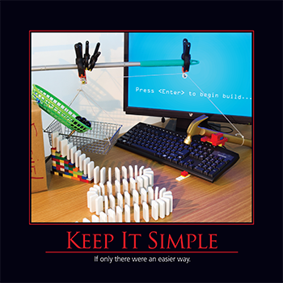
Keep It Simple
KISS
Simple solutions are easier to understand than complex ones
"Everything should be as simple as possible, but no simpler." – Albert Einstein
Notes:
Simple doesn’t mean naïve or ignorant. The best designs are all simple, having eliminated everything that is no longer needed. At first, your code may be naïve as you solve the problem step by step. When your solution is working, your resulting code may be a convoluted mess. It’s at this moment that you must simplify the code, while you still understand it completely and you know that it works in its current form. However, avoid being overly clever as you simplify the solution – for instance don’t introduce additional abstraction of flexibility purely because you might need it.

Slide 5

Simple Design – Kent Beck
Passes its tests
Minimizes duplication
Maximizes clarity
Has fewer elements
Notes:
In priority order.

Slide 6

YAGNI
You Aren't Gonna Need It
Build what is needed today, today
Keep code clean and simple; adding to it tomorrow will be straightforward
Don't waste time building things you might need

Slide 7
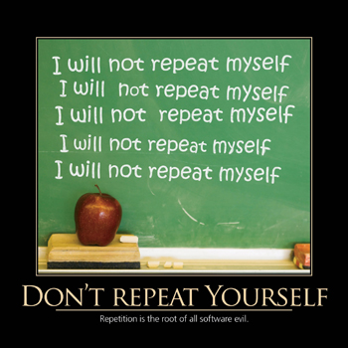
Don't Repeat Yourself (DRY)
Every concept in your application should have a single, canonical place in which it is defined.
Avoid copy-paste programming.
Repetition is the root of all programming evil.
Duplication is waste, and creates technical debt.
Notes:
Huge source of bugs, especially regressions.
Duplication = technical debt.
Suspect conditionals that are repeated in many locations (e.g. role checks)

Slide 8
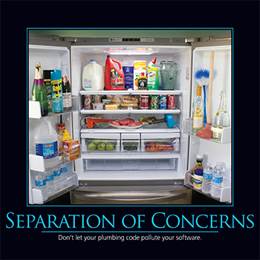
Separation of Concerns
Separate code by responsibility
Separate code by abstraction level
Separate solution modules by their architectural layer
Prefer modular code communicating through well-defined interfaces
Notes:
Can usually tell right away by “code shape” (length or depth) if this is violated

Slide 9
Explicit Dependencies
Methods and classes should explicitly require any collaborators they need in order to function correctly.
Implicit, hidden dependencies are a frequent source of bugs
Implicit dependencies promote tight coupling
Be aware of static method calls and the new keyword
Remember, "new is glue"
Notes:
DEMO

Slide 10
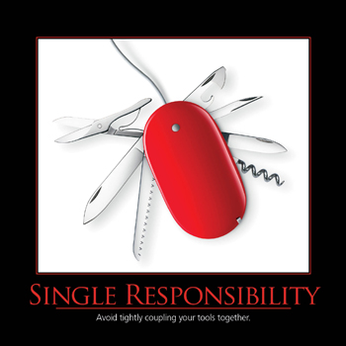
Single Responsibility
Classes should have only one reason to change.
Examples:
Persistence
Validation
Notification
Error Handling
Logging
Collaborator selection / construction
Notes:
Do one thing, do it well.
Code shape (excessive length or depth) is usually an indicator that this has been violated.
Also:
Formatting
Parsing
Mapping
DEMO

Slide 11
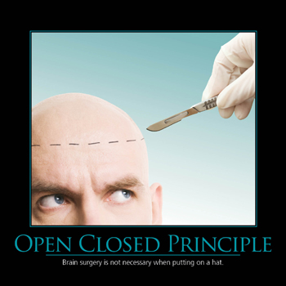
Open/Closed
Software entities should be open to extension, but closed to modification
Clients should be able to change the entity's behavior
Doing so should not require altering the entity's source code
Apply only when change is likely.
Notes:
Follow the “fool me once, shame on you, fool me twice, shame on me” rule. Only apply OCP refactoring if module changes more than once.
Remember, no design can be closed to all changes, and OCP adds complexity, so only address it when it is causing pain.
Provide example of photo import app.
DEMO

Slide 12
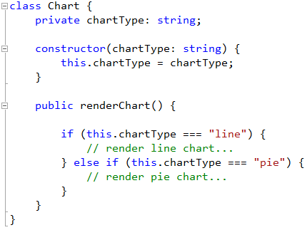
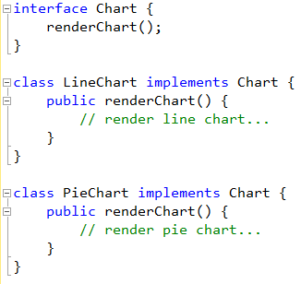
Open/Closed
Notes:
In first example, adding a chart type risks breaking other chart types.
Could also use strategy pattern.

Slide 13
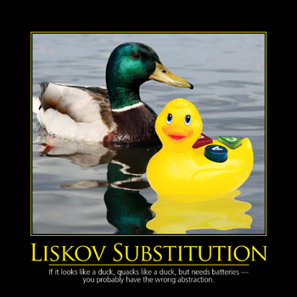
Liskov Substitution
Subtypes must be substitutable for their base types.
"Is-A" is not sufficient; "Is-Substitutable-For" is required
Look for type checking in polymorphic code as a "code smell" indicating this principle is being violated
Notes:
Example: square vs. rectangle

Slide 14
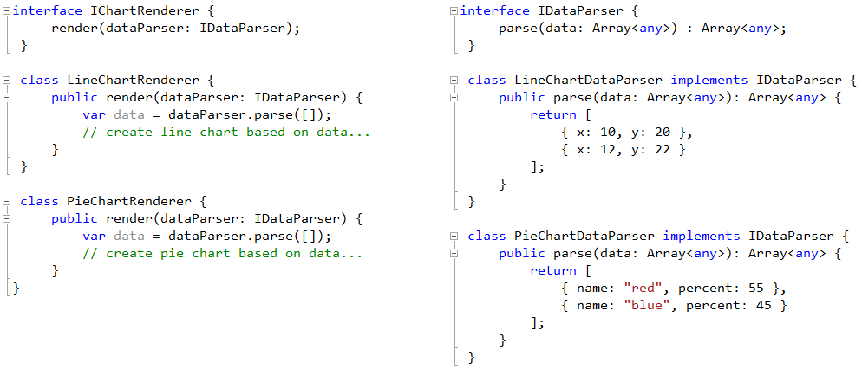
Good or Bad?
Notes:
This is good separation of concerns, but violates Liskov’s substitution because the IDataParsers aren’t interchangeable.
More frequently violated in dynamic languages.

Slide 15
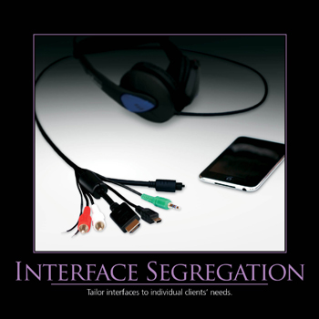
Interface Segregation
Don't force clients to depend on methods they do not need
Clients should define their interfaces
Break large interfaces up into smaller ones
Notes:
Example: Breaking up a fat interface into smaller ones
Interfaces that break “Single Responsibility”

Slide 16
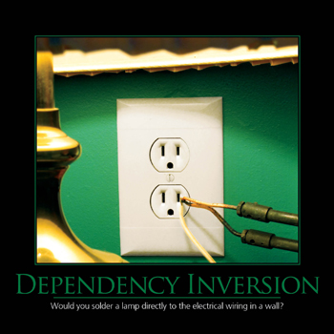
Dependency Inversion
High level modules should not depend on low level modules. Both should depend on abstractions.
Abstractions should not depend on details; details should depend on abstractions
Invert typical code dependency directionality
Notes:
“New is Glue”
Discuss N-Tier vs. Ports and Adapters / Onion architecture.
Discuss event-based programming.

Slide 17
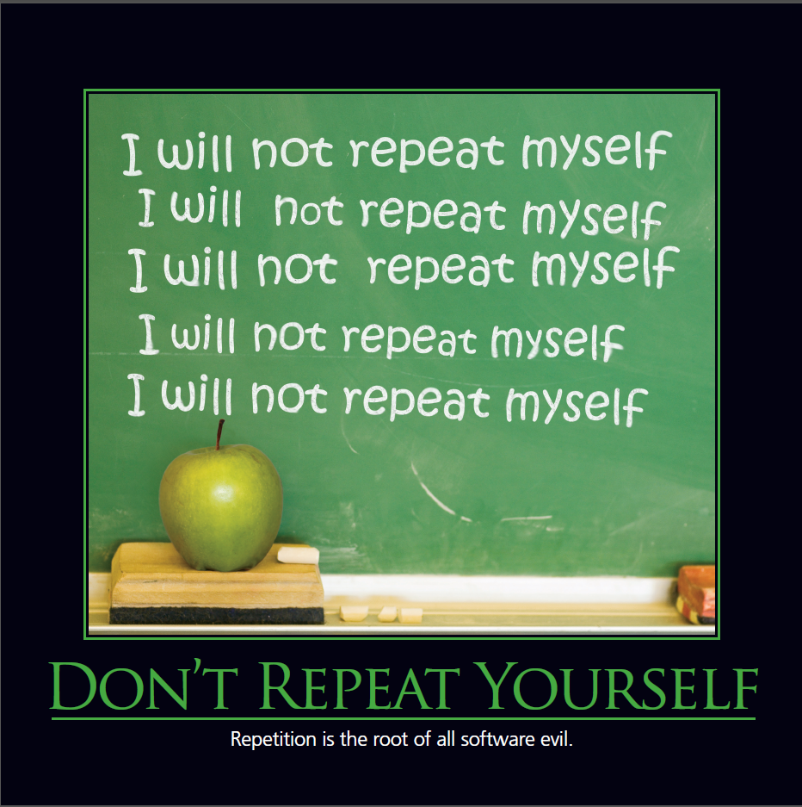
Don't Repeat Yourself (DRY)
Advice that is worth repeating
Many design patterns exist solely to achieve this principle
Clean up duplication whenever you can in your code

Slide 18
Pain Driven Development
Don't try to apply every principle, all the time
Keep It Simple
YAGNI
Follow principles when their violation is causing you pain
Notes:
Rule of 3, the third time you do something, apply a refactoring to abide by these principles

Slide 19

Discuss

Slide 20
Thank you!
Brendan Enrick
@brendoneus
brendan.enrick.com
Jeff Valore
@CodingWithSpike
CodingWithSpike.com

