Slide 1
Intermediate Software Craftsmanship
Jeff Valore | @CodingWithSpike
Brendan Enrick | @brendoneus

Slide 2
Key Patterns
Strategy Pattern
Factory Method Pattern
Command Pattern
Rules Engine Pattern

Slide 3
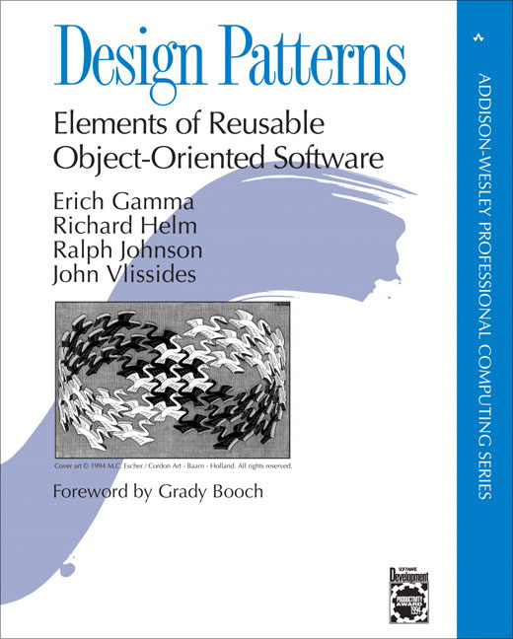
Why Use Design Patterns?
Accepted solution to a common problem
Common language for programmers
Easier to work with other people’s code

Slide 4
Strategy : Intent
Encapsulate a family of related algorithms
Let the algorithm vary and evolve independently from the class(es) using it
Allows classes to maintain a single purpose
Single Responsibility Principle (SRP)
Open/Closed Principle (OCP)

Slide 5
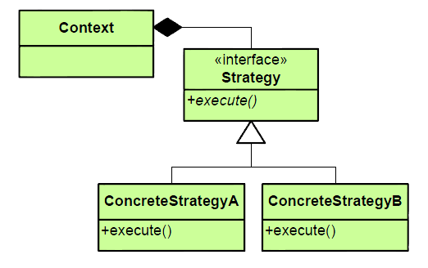
Strategy : Structure

Slide 6
Strategy : Common Usage
Dependency Inversion and Injection
Decouple class dependencies and responsibilities
Create interfaces for each responsibility
Inject interfaces via constructor (or parameters)

Slide 7
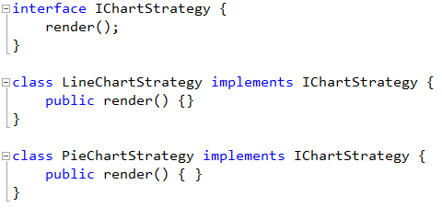
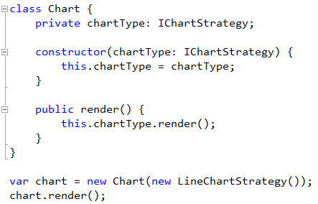
Strategy : Example

Slide 8
Avoid Hidden Dependencies
Follow Explicit Dependencies Principle
Classes should declare their dependencies via their constructor
Avoid static calls that depend on state
Avoid directly instantiating classes with side effects

Slide 9
Factory : Intent
Separate object creation from the decision of which object to create
Defer creation of objects
Add new classes and functionality without breaking client code
Notes:
Encapsulate complex creation logic in the factory; let factory determine which specific instance is used.
Only create objects, especially expensive ones, when needed.
Maintain flexibility in code – Open/Closed Principle – new classes can be added and only the factory needs to know about them. They can even be added as plug-ins by simply dropping them into a folder.

Slide 10
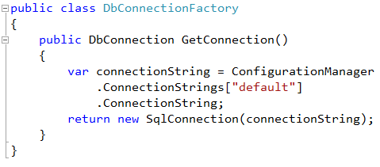
Factory : Example
Notes:
Note that the factory returns a SqlConnection, so swapping a different type could be done in this one place.

Slide 11
Command : Intent
Represent an action as an object
Decouple performing the action from the client that is issuing the command
Common uses:
Delayed execution
Logging activity
Scaling processes
State machine implementation

Slide 12
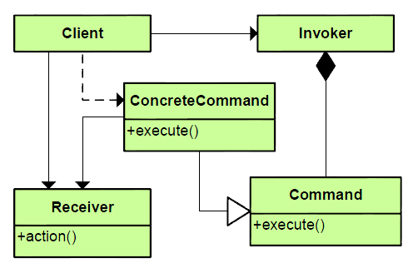
Command : Structure

Slide 13
State Transitions
Pending
Published
Archived
Notes:
The arrows can be represented by commands. Unlike basic object oriented design, which teaches that the nouns in a problem are the classes and the verbs are methods, the Command pattern represents verbs as classes.
Another classic example is to hold onto an array of commands to implement an “undo” list.

Slide 14
Rules Engine
Useful when set of special cases is constantly changing/growing
Examples:
Game rules
Pricing rules
Advertisement target/selection rules

Slide 15
Rules Engine Components
Rule Interface (special case of Command pattern)
Evaluate the rule
(optional) IsMatch
Rule engine
Maintains collection of rules
(Matches and) Evaluates rules in correct order

Slide 16

More Common Patterns
Singleton
A class of which only a single instance can exist
Adapter
Match interfaces of different classes
Proxy
An object representing another object

Slide 17

Discuss

