Slide 1
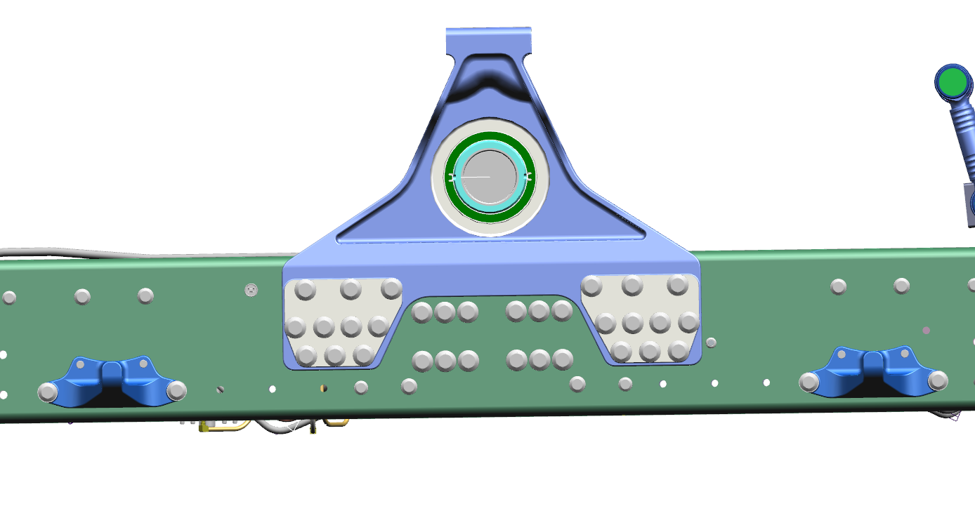
1. Trunnion bracket with Long Member
2. V Rod corner bracket with frame
3.Articulation stopper with frame

Slide 2
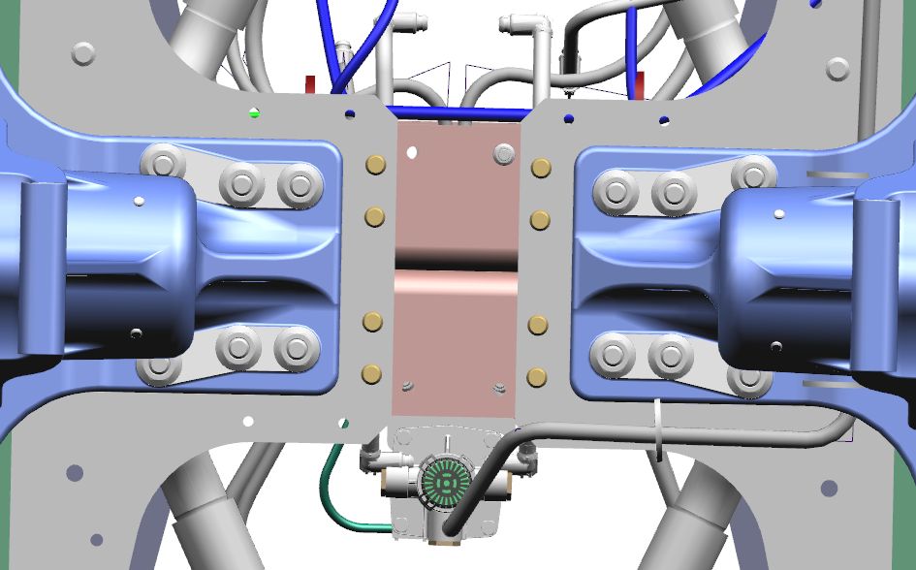
1. Trunnion bracket with Cross Member

Slide 3
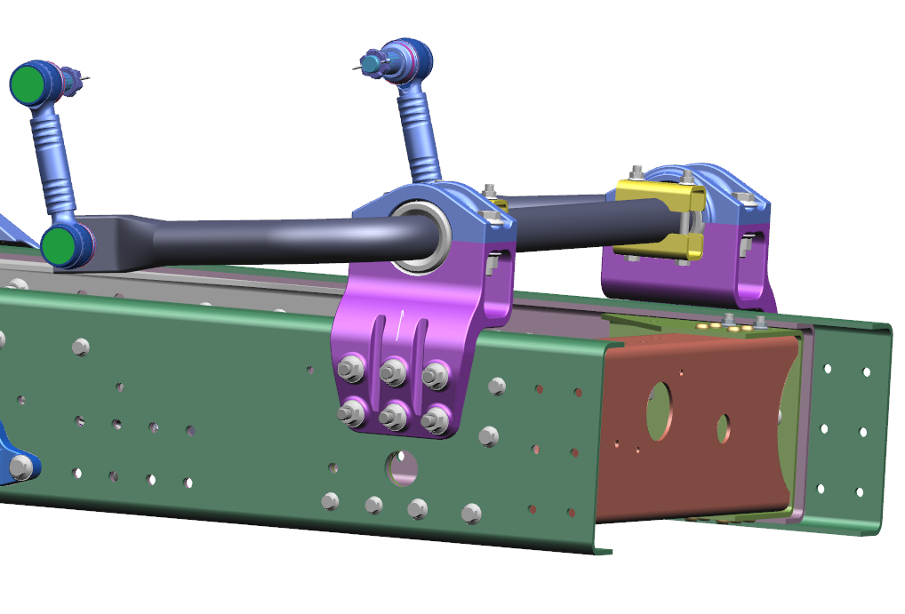
4. Anti roll bar sub assembled mounting with frame

Slide 4
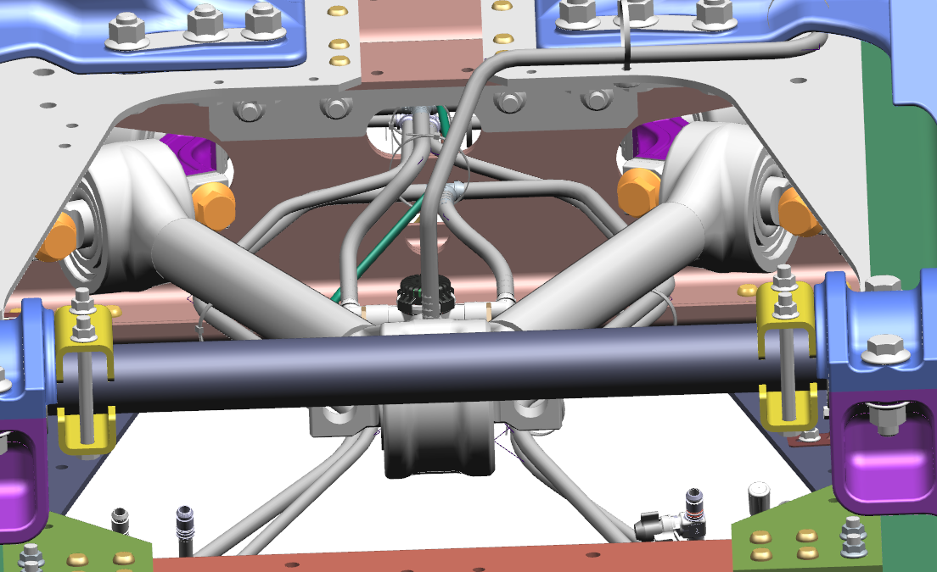
5. V rod mounting with corner bracket

Slide 5
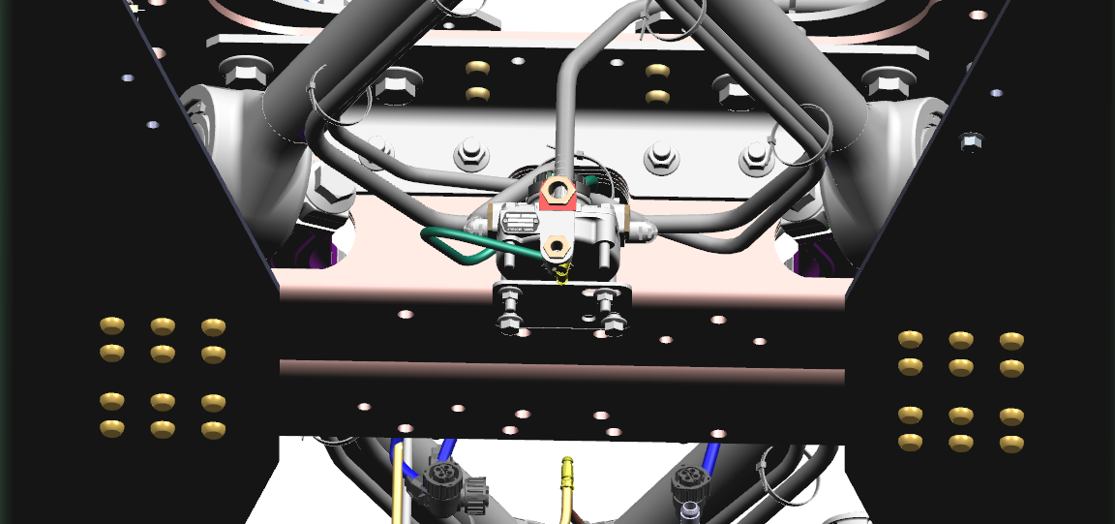
6. Parking Relay valve fitment on aligated X/M
7. Parking Relay valve on aligated X/M pipe connection

Slide 6
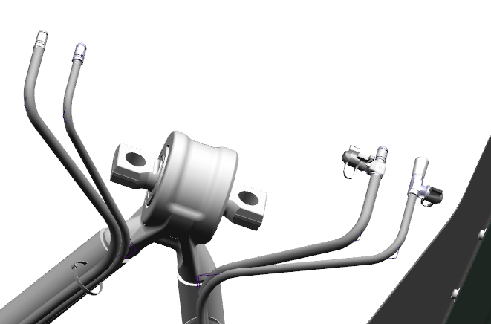
8. PTC connector on the Rear Rear Brake pipe Voss connector

Slide 7
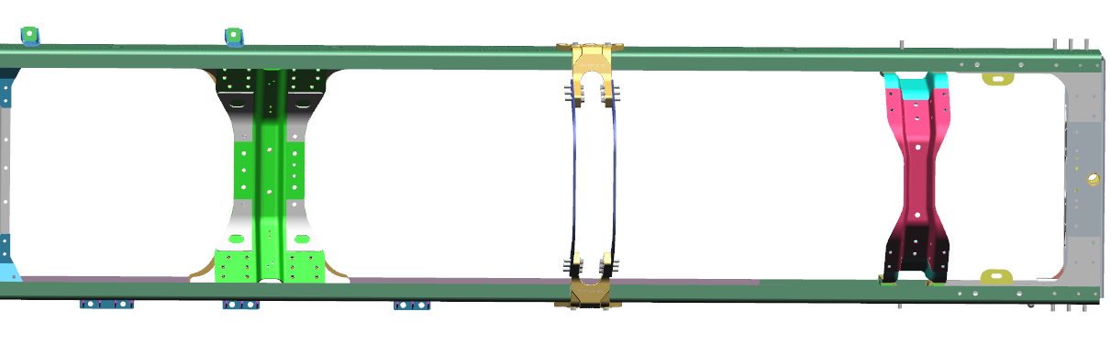
9. Resilience bracket qty 05 on Frame

Slide 8
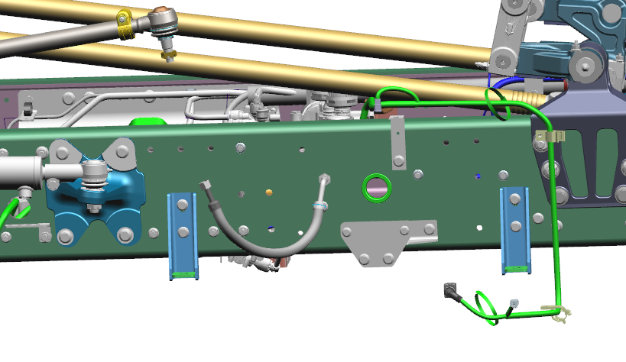
9.1 Resilience bracket qty 02 on RH L/M( Steering GB side)

Slide 9
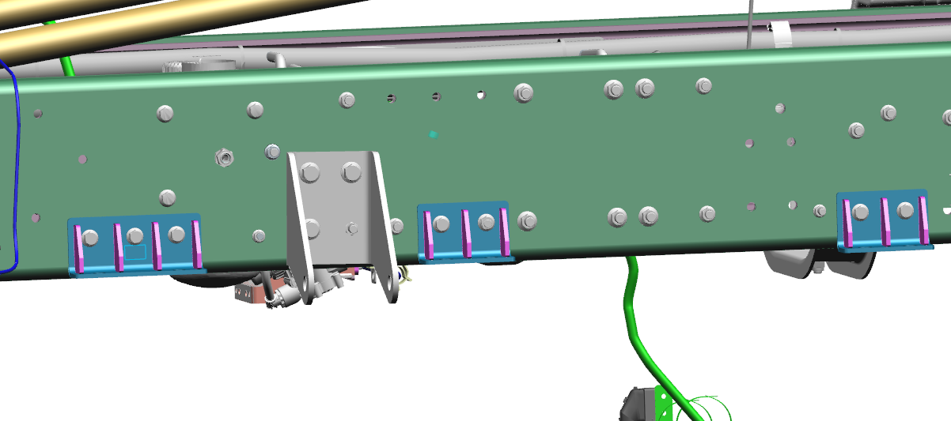
9.1. Resilience bracket qty 03 on LH L/M( Co driver side)

Slide 10
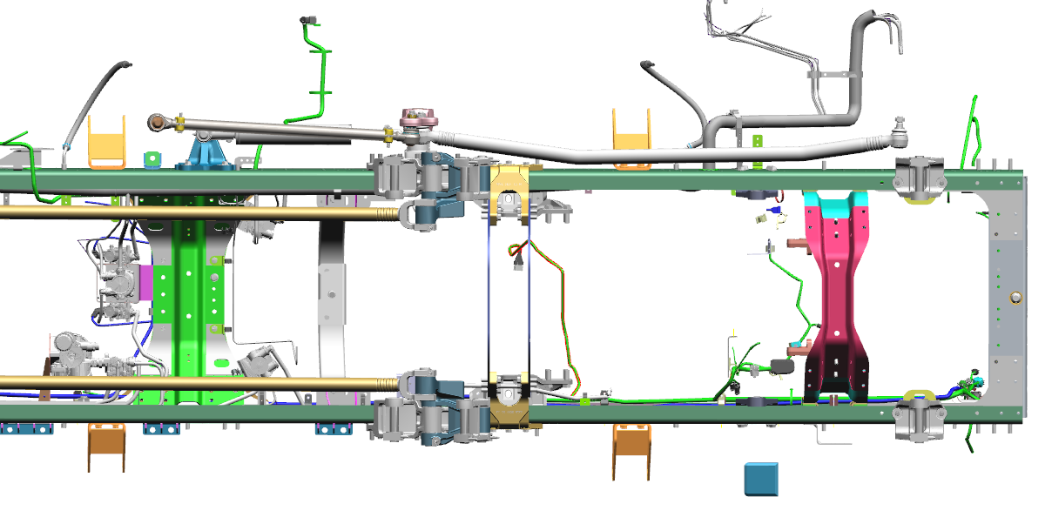
10. Front Shock absorber bracket qty 04 on Frame
Vehicle Front

Slide 11
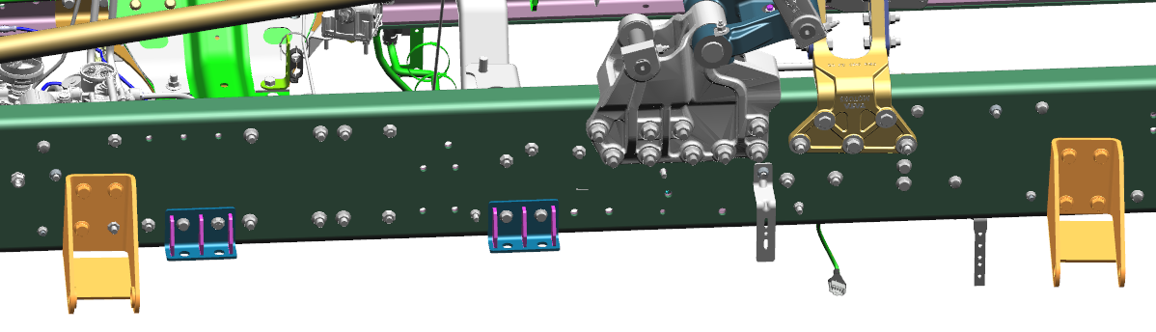
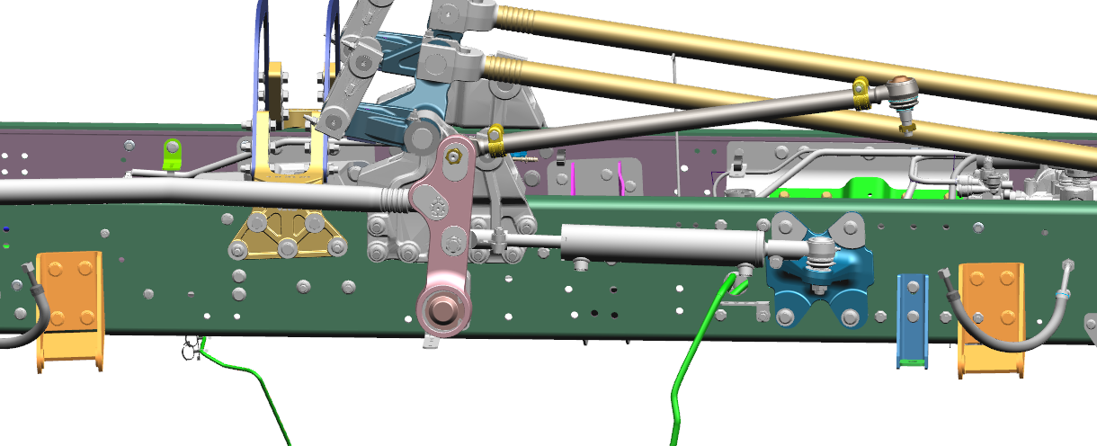
LH L/M( Co driver side)
Vehicle Front
RH L/M(Driver side)

