Slide 1
Data Extraction from Scanned In Tower Cards
BY: Khac Hieu Dinh
Drexel University – Class of 2023
B.S. Mechanical Engineering and Mechanics
DEPARTMENT: T&S Engineering, Equipment and Standards
MANAGER: Donald Elmore
MENTOR: Jeffrey Swiatek, Pidlaoan Eugene

Slide 2
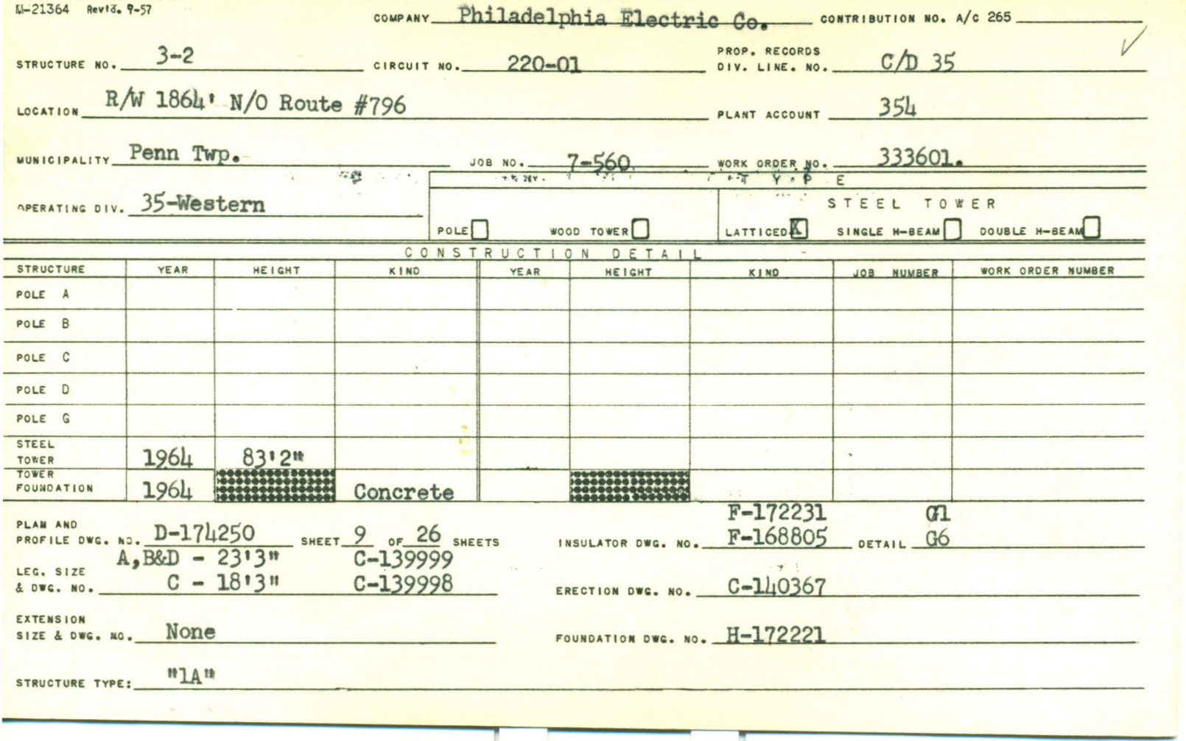
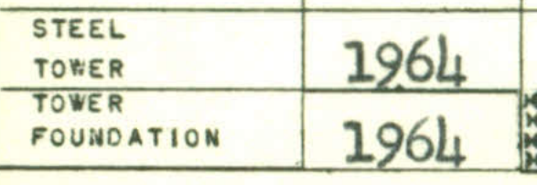
OBJECTIVE
Approximately 7000 PECO Transmission Structure Card dated back to the 1900s.
Knowing when the structure was built => structure age => use age in calculating asset health.

Slide 3

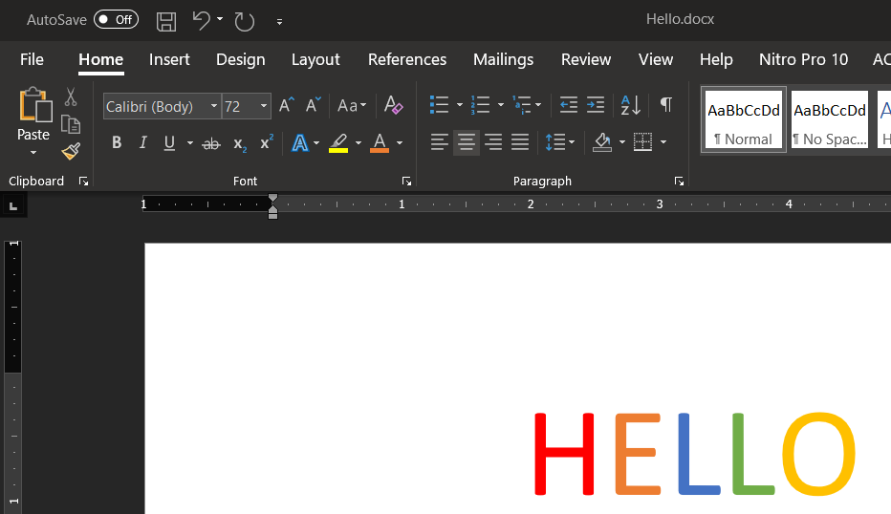
PROBLEM – MASS PROCESSING DIGITAL DATA
Although the circuit breaker timing pages were originally a MSWord (text) template, they were printed out and scanned back in as Image-Only PDFs
What the computer sees:
…[255,255,255],[255,255,255][255,255,255],[255,255,255],…
…[255,255,255],[255,000,000][255,000,000],[255,000,000],…
…[255,255,255],[255,000,000][255,000,000],[255,000,000],…
…[255,255,255],[255,000,000][255,000,000],[255,000,000],…
…[255,255,255],[255,000,000][255,000,000],[255,000,000],…
What the computer sees:
U+0048 U+0045 U+004C U+004C U+004F
Or, when translated using Unicode:
H E L L 0
??????

Slide 4




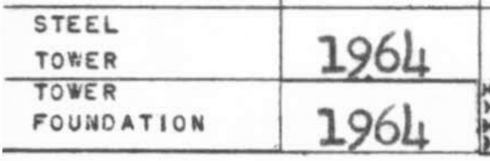
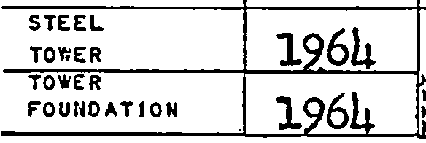
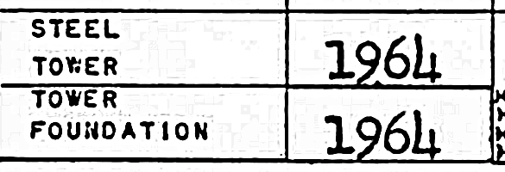
SOLUTION
Tesseract
OCR
Optical Character Recognition
Image Processing

Slide 5
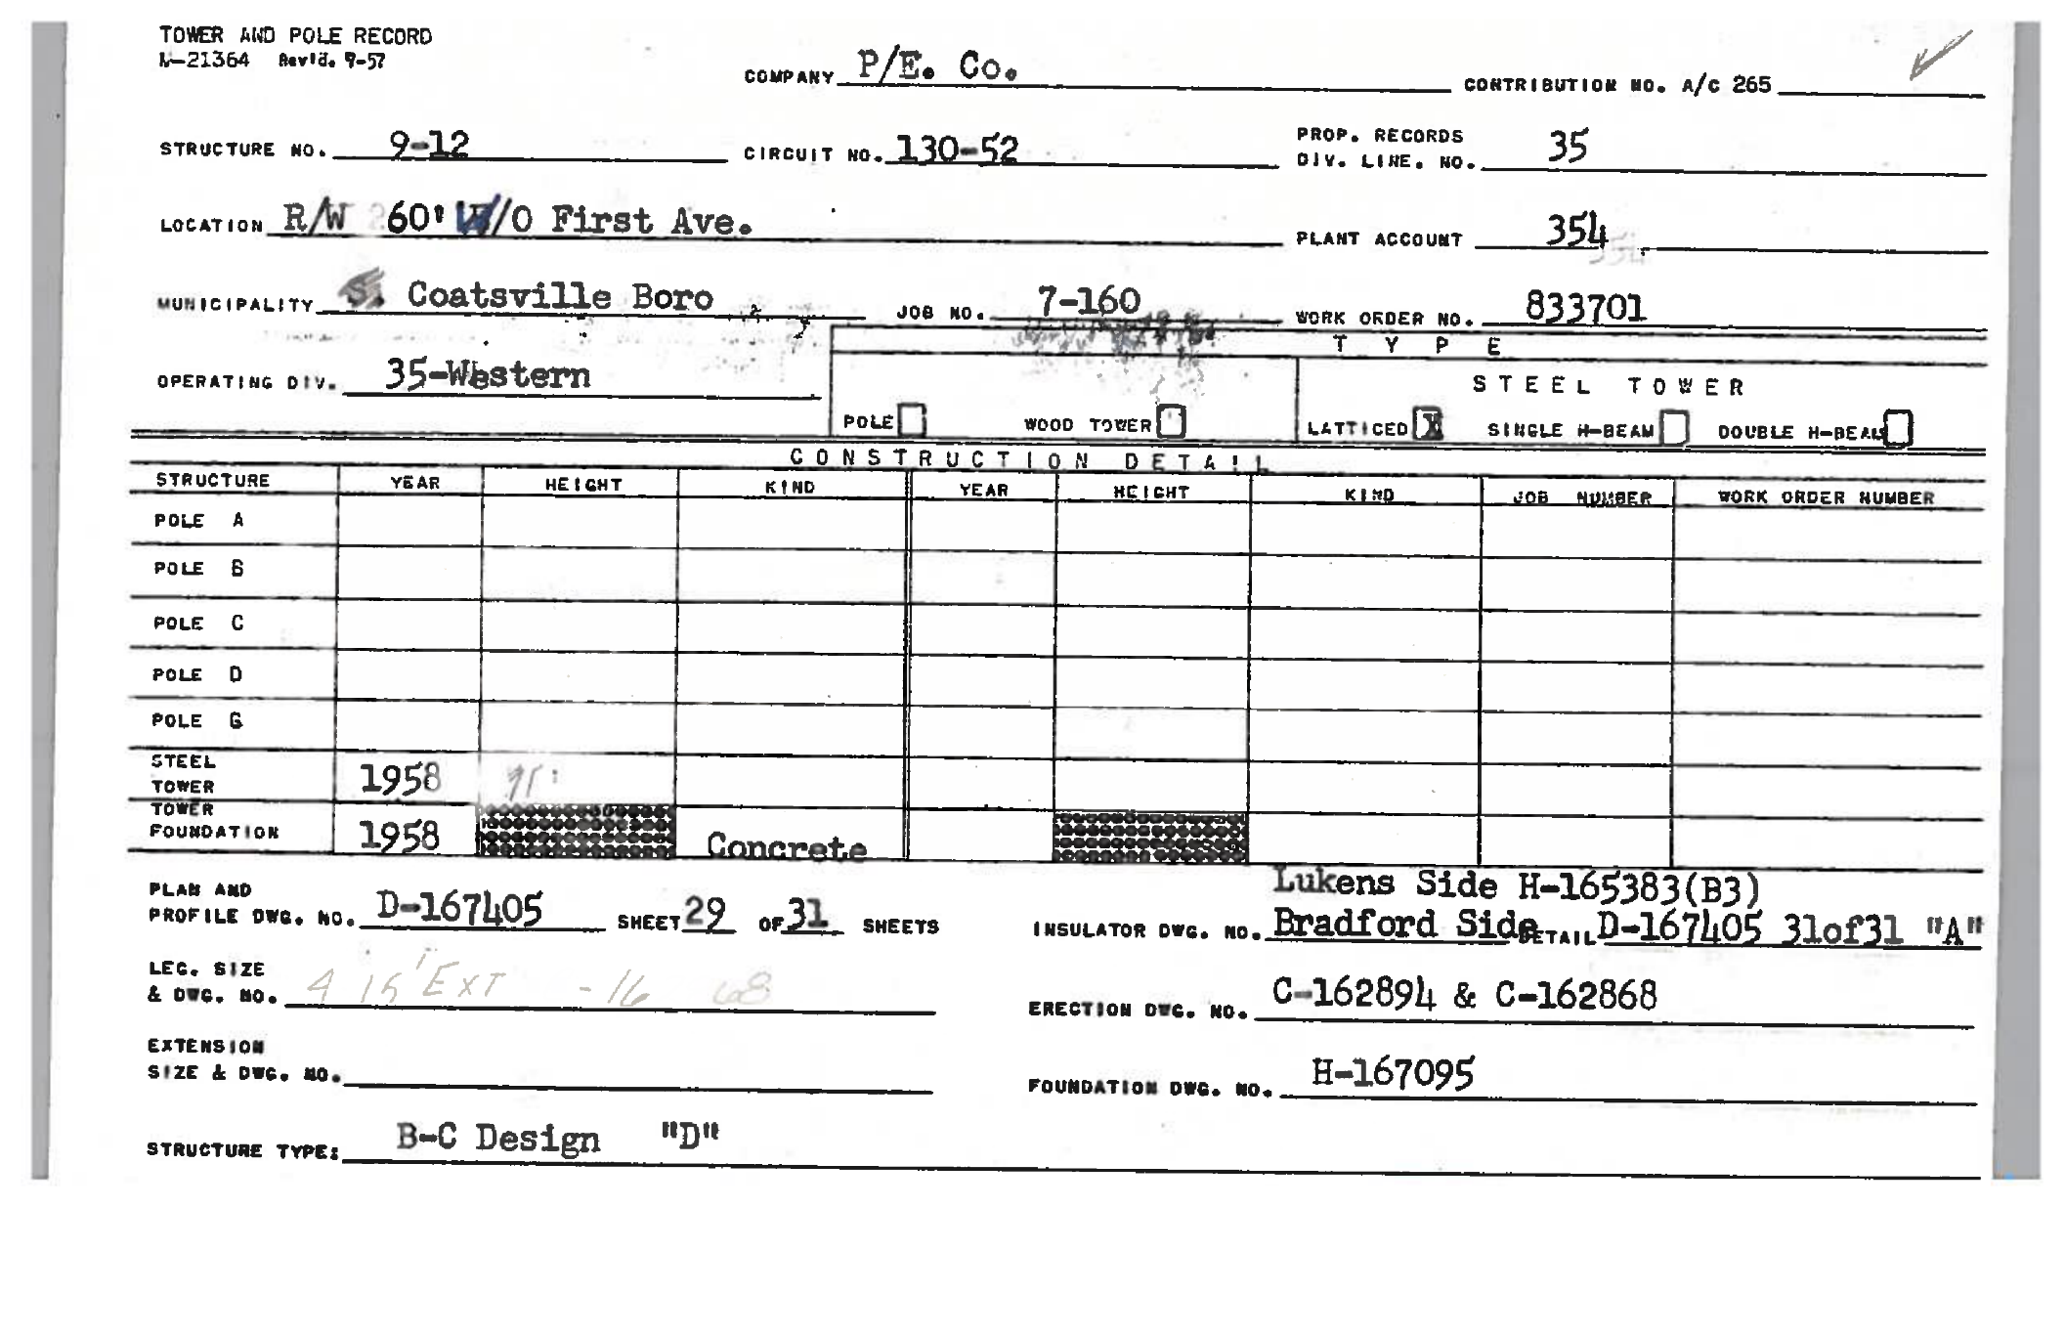
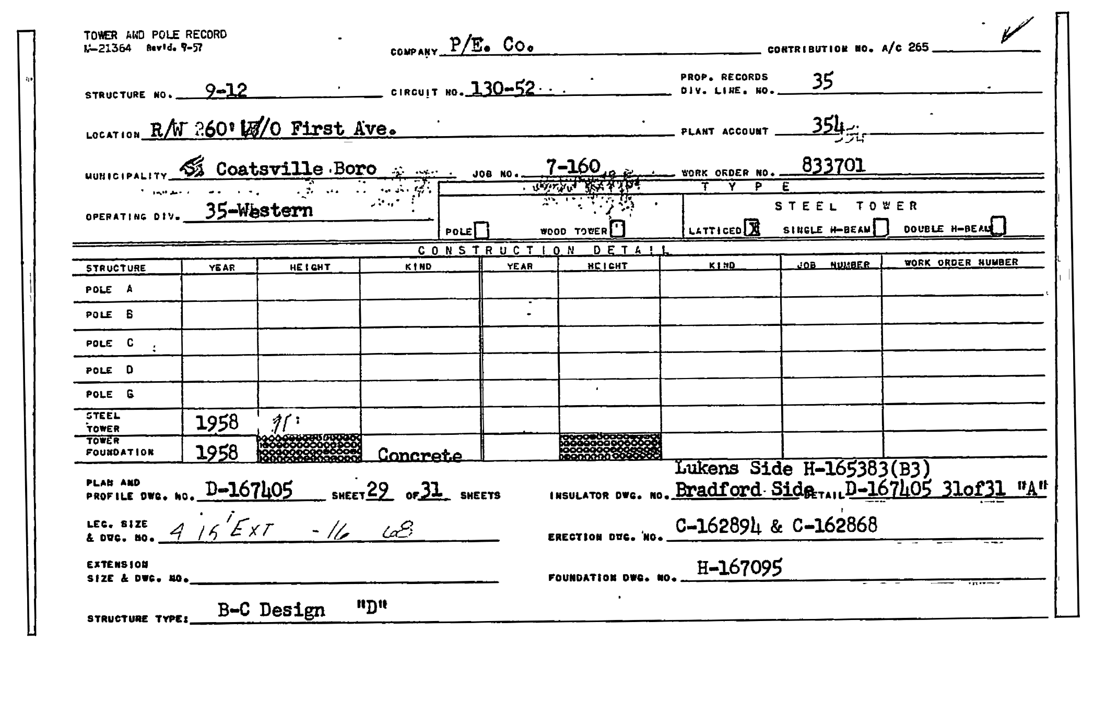
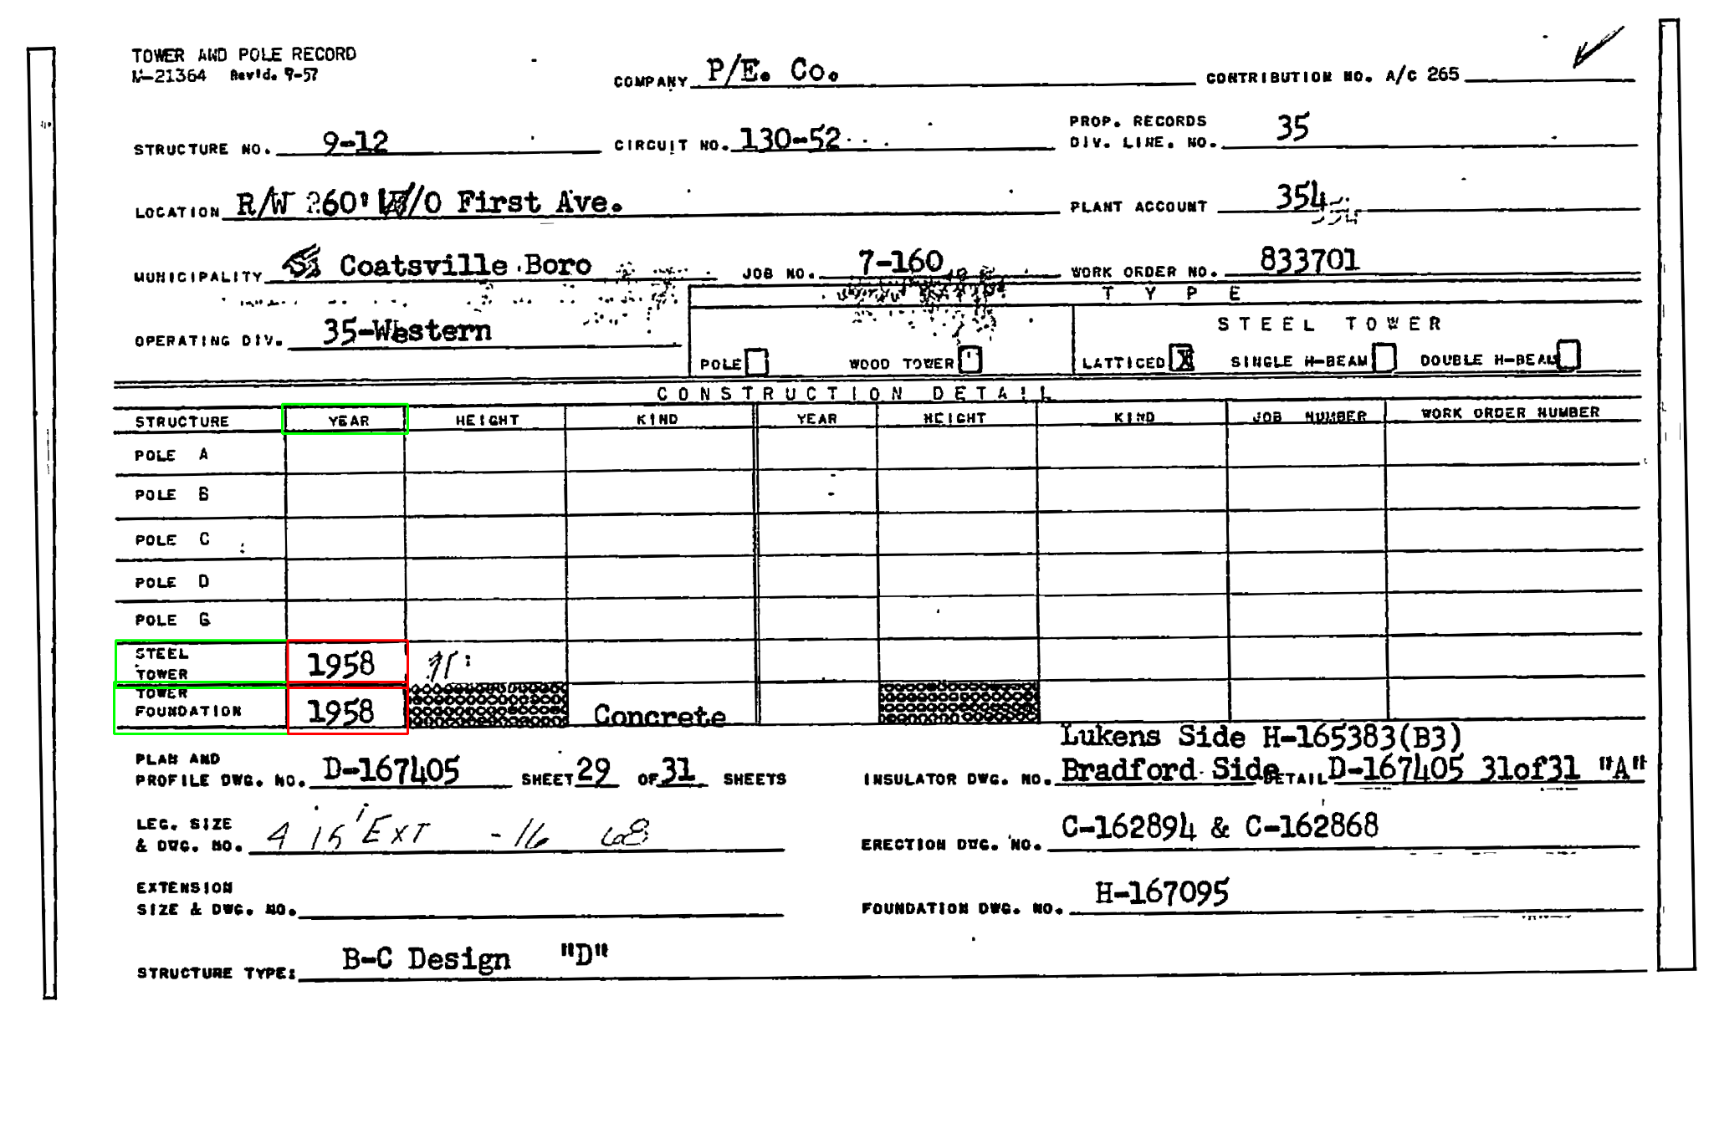
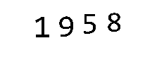
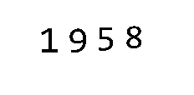





GENERAL PROCESS PIPELINE
5. Post Processing / Fields Crosschecks
3. Cut Out Region of Interest and Perform Final Processing
1. Preliminary Image Processing (gray-scale + noise removal + skew-correction).
2. Use Template Match to Locate Anchors / Fields
4. Feed the Image to Tesseract
SUPPLIED EXAMPLE FEATURES
Tesseract Reads: “1958”
Tesseract Reads: “1958”
CROSS CHECK
FINAL GUESS: 1958

Slide 6
RESULT AND FUTURE IMPROVEMENTS
For 220kV Towers, the script took 6 hours to process 3667 cards.
42% High Confidence Guess.

Slide 7
VISIT MY POSTER TO LEARN HOW YOU CAN USE THIS EXTRACT OTHER ARCHIVED IMAGE DATA
DISCLAIMER: DOES NOT WORK WITH IRREGULAR WRITTEN DATA (HAND-WRITTEN)

