Slide 1
Useful Python concepts

Slide 2
Collections
Data slicing
Data pickle
Unpacking with asterik symbol

Slide 3
Sets, lists, dictionaries etc.
some_set = set() <- good for keeping unique members
some_list = [] <- indexed array
some_dictionary = {} <- indexing via defined keys

Slide 4
some_list = []
some_list.append(0)
some_list.append(0)
some_list.append(1)
print(some_list) # prints [0, 0, 1]
print(set(some_list)) # prints {0, 1}

Slide 5
some_dict['entry'] = 'entry in dictionary'
print(some_dict[‘entry’])
# prints {'entry': 'entry in dictionary’}
key
value

Slide 6
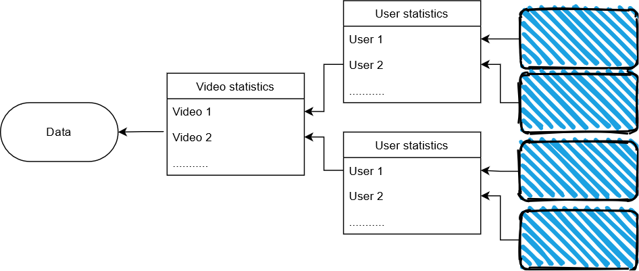
Nested dictionaries/lists

Slide 7
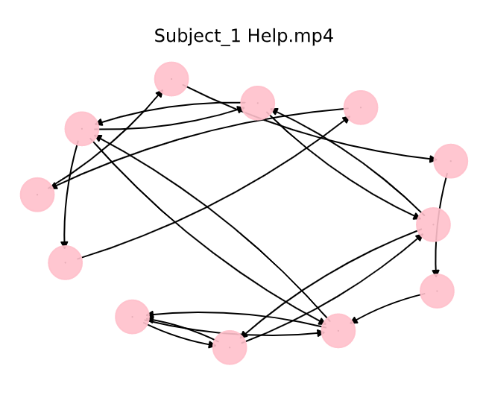
data['Help.mp4']['Subject_1']

Slide 8
Data slicing (similar to matlab)
Array[start:end:step]
Array[:]
Array[:,i] <- i represents colum index
Array[-1]

Slide 9
Data pickle
Saves python object as a character stream
import pickle
def save_obj(obj, name ):
with open('obj/'+ name + '.pkl', 'wb') as f:
pickle.dump(obj, f, pickle.HIGHEST_PROTOCOL)
def load_obj(name ):
with open('obj/' + name + '.pkl', 'rb') as f:
return pickle.load(f)

Slide 10
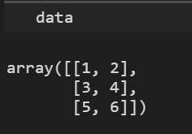
Asterik symbol for unpacking iterable data
def foo(lst):
num = lst[:,0] + lst[:,1]
return num
def bar(num1, num2, num3):
print(num1, num2, num3)
bar(*foo(data))
3 7 11

