Slide 1

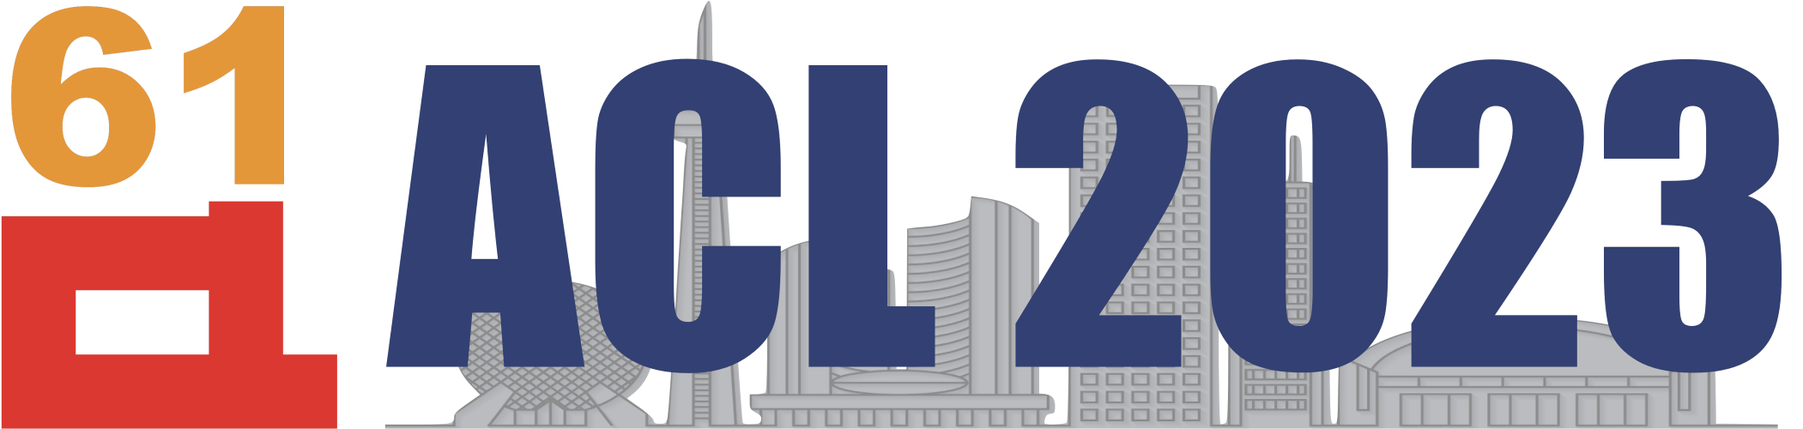
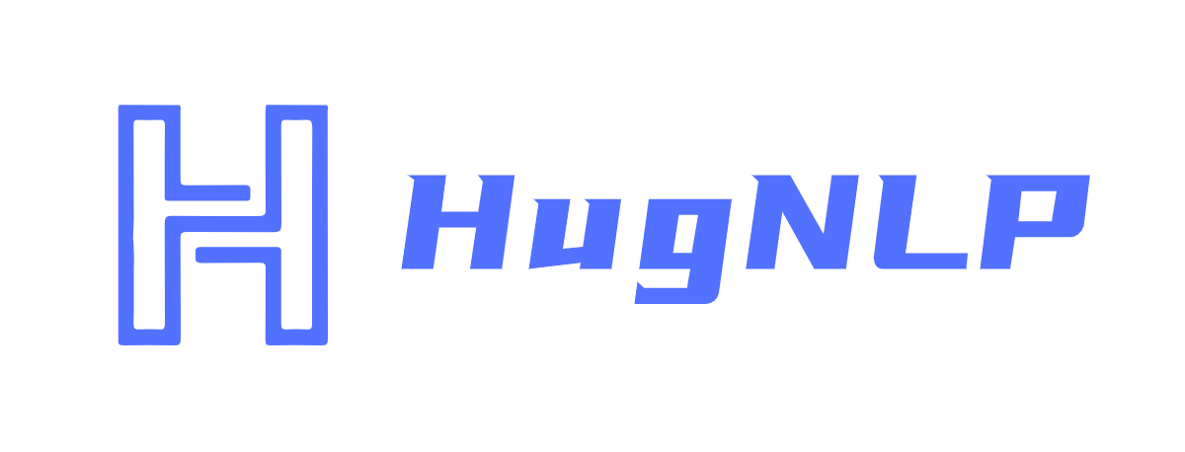
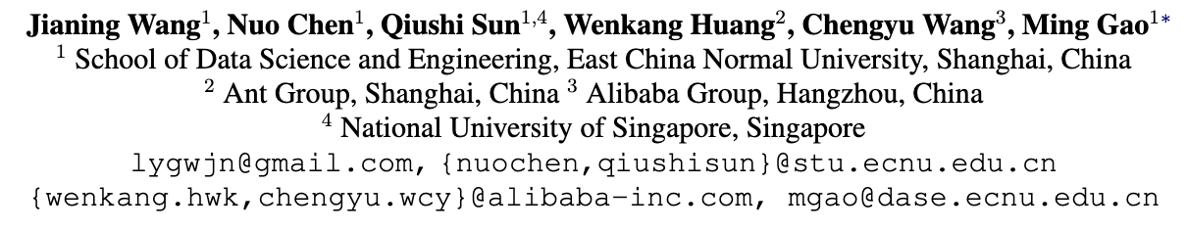
HugNLP: Towards Unified and Comprehensive Open-Source Library for Natural Language Processing
https://github.com/wjn1996/HugNLP
Notes:
Hello, my name is Jianing Wang, I’m from East China Normal University.
Now, We provide a novel library called HugNLP, which is a unified and comprehensive open-source library for natural language processing.

Slide 2
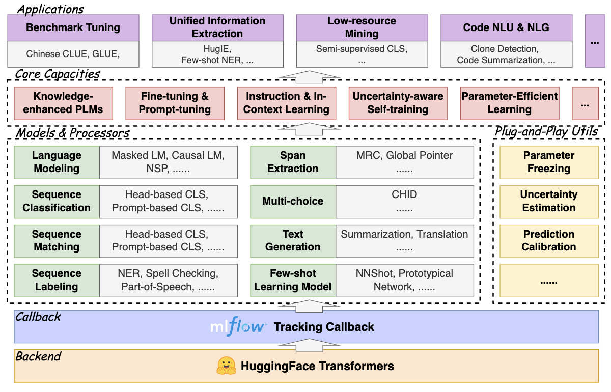
Architecture
Notes:
HugNLP is a hierarchical framework. The backend is based on HuggingFace, and we use MLFlow as the tracking callback.
We also design three components, such as processors, models, and applications. And some plug-and-play tools with multiple core capacities. HugNLP is easy for researcher to develop the off-the-shell applications. Now, we provide some demonstrations about our library.
---
This is the code, you can git clone this code from GitHub and develop yourself.
We provide some pre-built processors, models and applications. More functions are under the construction.
Next, we show you about a universal information extraction. Users can choose our hugie model and make prediction on named entity recognition and event extraction. For example
We can obtain the host place of Olympics games in 2008 years is Beijing.

Slide 3
Thank You!
HugNLP: Towards Unified and Comprehensive Open-Source Library for Natural Language Processing
https://github.com/wjn1996/HugNLP
Notes:
I wish you will be interested in our project. Thank you for your listening!

