Slide 1

But words are things, and a small drop of ink, falling like dew upon a thought, produces
That which makes thousands, perhaps millions, think ...
Lord Byron, Don Juan

Slide 2
from Lord Byron’s Don Juan, Canto the Third
LXXXVIII
But words are things, and a small drop of ink,
Falling like dew, upon a thought, produces
That which makes thousands, perhaps millions, think;
’T is strange, the shortest letter which man uses
Instead of speech, may form a lasting link
Of ages; to what straits old Time reduces
Frail man, when paper -- even a rag like this,
Survives himself, his tomb, and all that’s his.

Slide 3

Lasting Linguistics:
Making a Meaningful Mark
Notes:
This talk is about the work that we do with languages that are much less well documented, than national languages, even if not actually endangered. Even if a language may have 100,000 speakers today, within a generation it could become endangered, and a generation later it could become only a language of the past.

Slide 4
Does it Matter?
Yes. At least it should, and it can, but it doesn’t happen automatically.
Notes:
If we are given the opportunity to interact -- even briefly -- with a language community, and acquire information that is culturally significant --- language data, anthropological data, historical data, etc. --- which we are in a position to preserve (given our resources), what do we do with it? Whether for the sake of the language community itself or for the scientific community? So we should not fall for the mistaken idea that are work could not be important.

Slide 5
The Ethics of Fieldwork
What do you do with what you have learned and acquired?
  For the language community itself?
  For the scientific community?
Notes:
We should also not make the mistake of thinking that what we have learned is only private information --- We have been given a privilege, and there is a responsibility that comes with that privilege.

Slide 6
How long will it be relevant and accessible?
Months?
Years?
Decades?
Centuries?
Notes:
We can make other mistakes ---- think that our work will be relevant in the future, but it won’t be if we don’t do it right, and it may not be if it is not available to anyone, or only to very few.

Slide 7

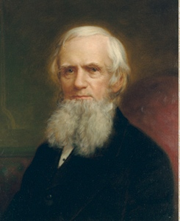
John Russell Bartlett
Notes:
John Russell Bartlett ...

Slide 8
Archiving à la 19th Century
American Ethnological Society
  Still in existence
  Publishes American Ethnologist
  Archives are now part of Smithsonian

Slide 9
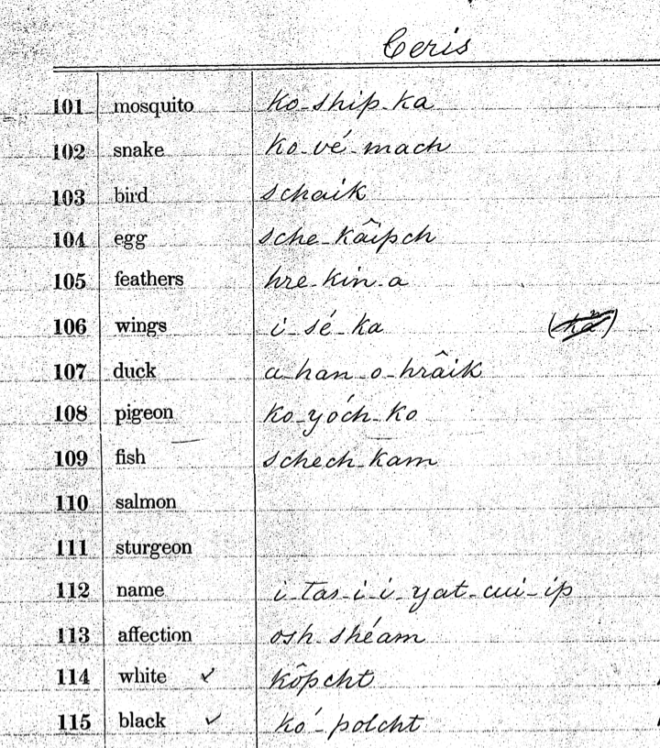
sam
Available from the archives of the Smithsonian Institution, Washington, D.C.

Slide 10
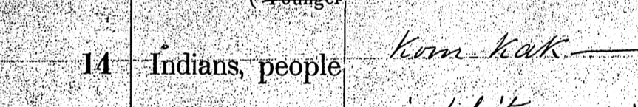

Slide 11
The first known recording of the
autoethnonym of the Seri people:
January 1, 1852, Hermosillo, Sonora.
John Russell Bartlett.

Slide 12
1976 data & analysis:
[koŋˈkaːk] /komkaːk/

Slide 13
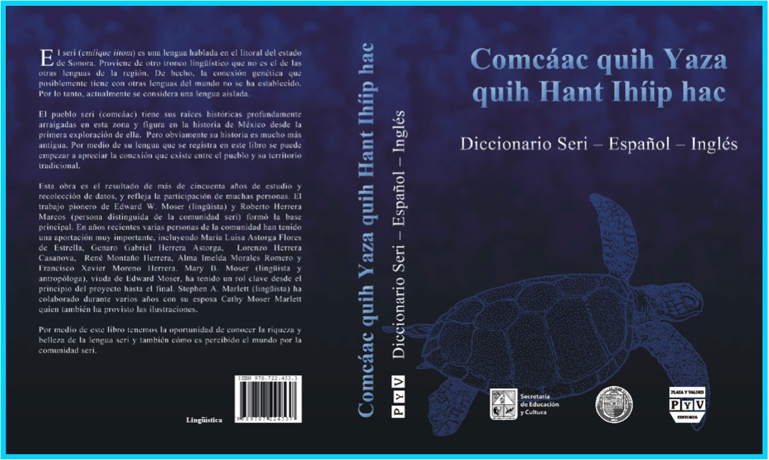

Slide 14
Is anything we are learning of interest?

Slide 15
Is anything we are learning of interest?
Amele (Roberts 1988), Seri (Farrell, Marlett & Perlmutter 1991) -- switch-reference system facts show the dominant theory does not work as intended for this phenomenon in these languages

Slide 16
Is anything we are learning of interest?
PHONOLOGY & PHONETICS
Mixtec (Marlett 1992, McKendry 2001) -- nasalization is a morpheme-level feature
Mixtec (Macaulay & Salmons 1995) -- glottalization is a morpheme-level feature
Quechua (Parker & Weber 1996) -- glottal features are root-level features

Slide 17
Is anything we are learning of interest?
Seri is one of the few languages in which /m/ is the “unmarked” nasal
Seri is one of the few languages with “empty” consonants (Marlett & Stemberger 1983)
Bimoba & Chumburung (Snider 1998, 2007) -- automatic downstep and non-automatic downstep have the same height

Slide 18
Is anything we are learning of interest?
MORPHOLOGY & LEXICON
Seri is one of a handful of languages with denominal kinship verbs (Marlett 2008)
Madija (Adams & Marlett 1988) -- feminine gender is the unmarked gender
Seri is one of only a handful of languages in which arm=hand=finger

Slide 19
Is anything we are learning of interest?
SYNTAX
Seri is one of the very few languages with impersonal passives of transitive verbs (Marlett 1984)
Hixkaryana (Derbyshire 1977, Derbyshire & Pullum 1979) --OVS languages make history

Slide 20
Factors
  Quality
  Readability
  Accessibility
Notes:
Three factors: quality of the work, the readability of it, and accessibility.

Slide 21

Quality
Data
Analysis
Metadata
Notes:
The work itself, that we are considering the quality of, includes at least three parts in itself: the data, the analysis, and the metadata. All three are important. Perhaps the part that we like the best is the analysis. But the part that is probably going to outlive everything else is the DATA itself, which has to be contextualized by the metadata (when it was acquired, how, etc.)

Slide 22
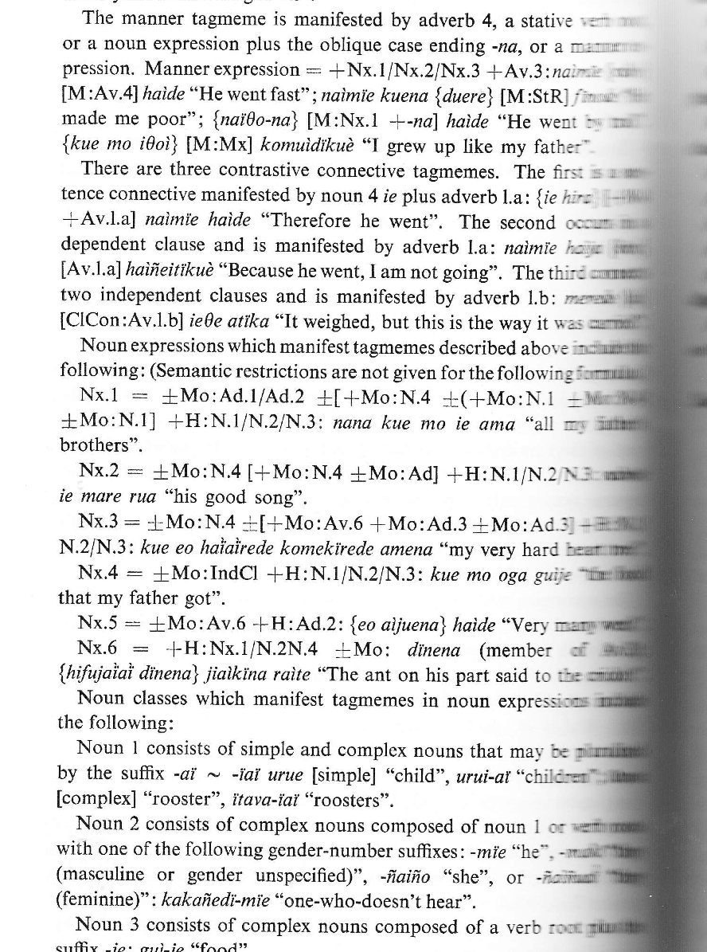

Slide 23
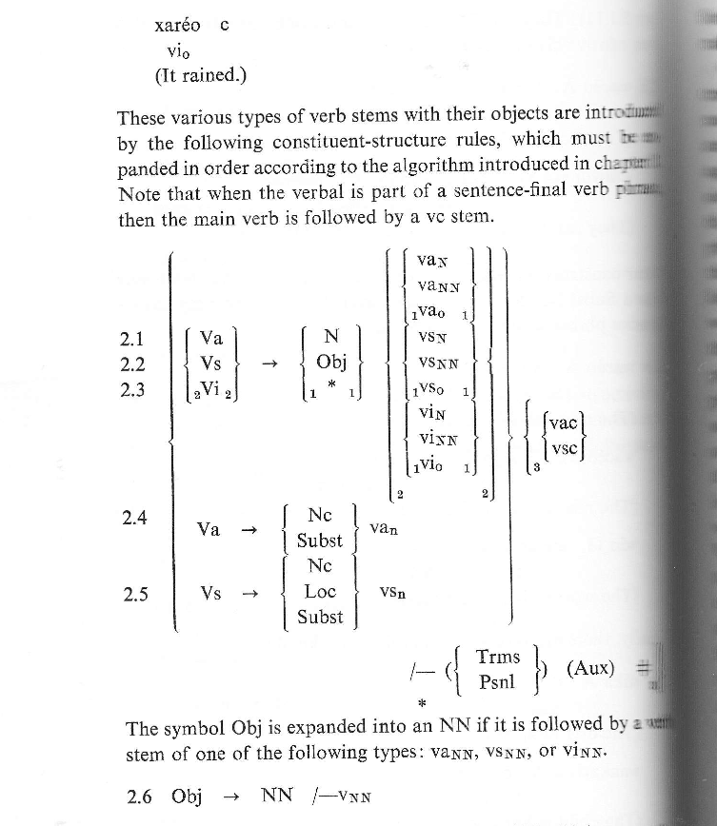

Slide 24
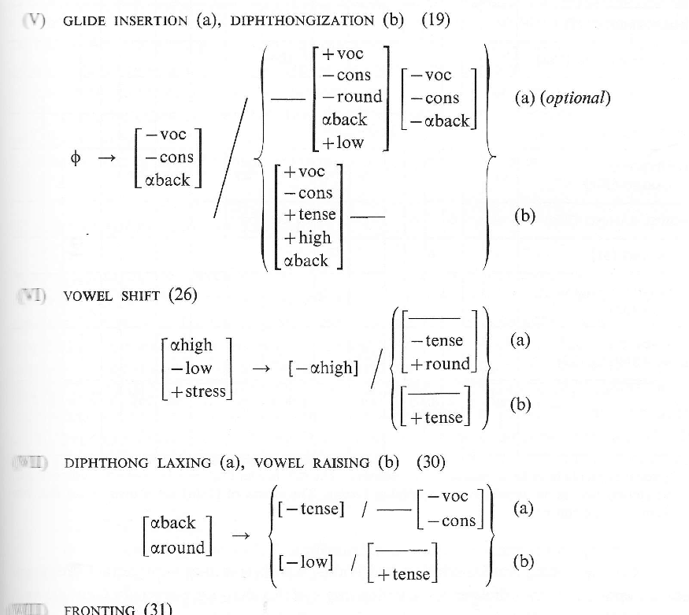

Slide 25
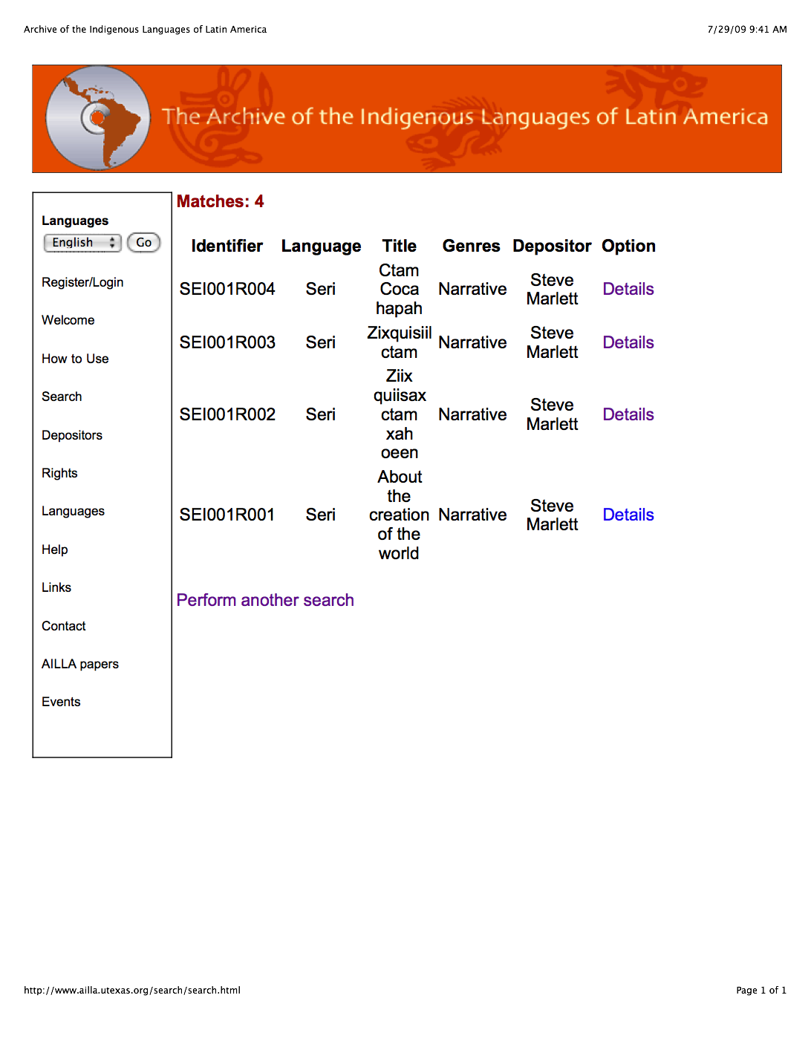

Slide 26
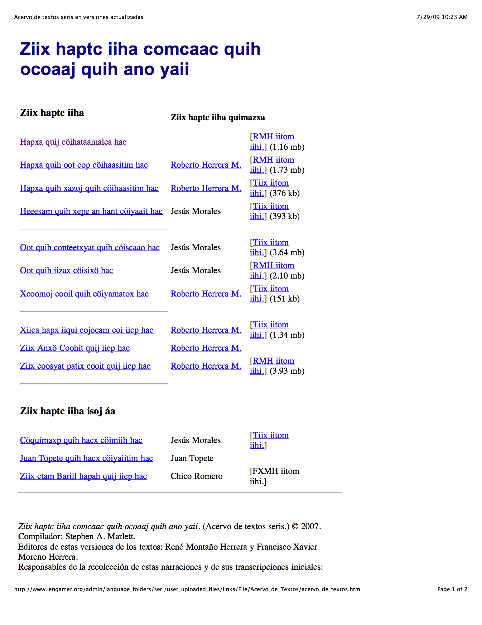

Slide 27
Readability
Language
  Readable at least by interested people in the language community?

Slide 28
Readability
Style & level
  Comprehensible to linguists 50 years later?
  Comprehensible to educated people now?
  Comprehensible to people in the language community?

Slide 29
Accessibility
Paper? What happens later to those copies? Where are they?
Internet? What happens when the website is removed?
Tapes & CDs? What happens when those CDs fade away?
Who can even find them?

