Slide 1
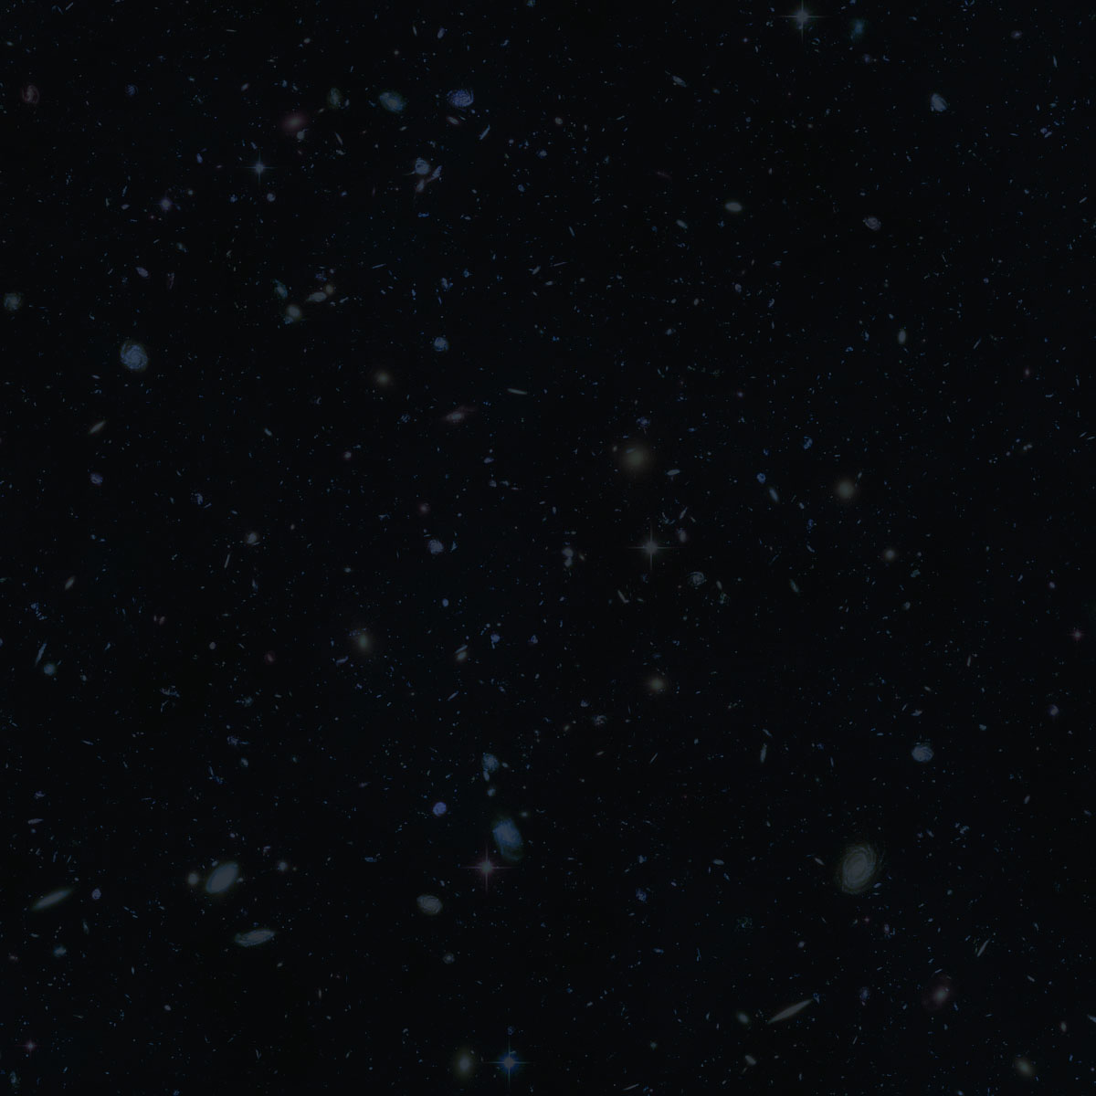

Echoes & Ripples to Hear the Age of the Universe
Hugh McDougall, UQ Astro, Pint of Science 2026

Slide 2
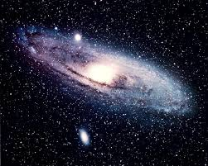
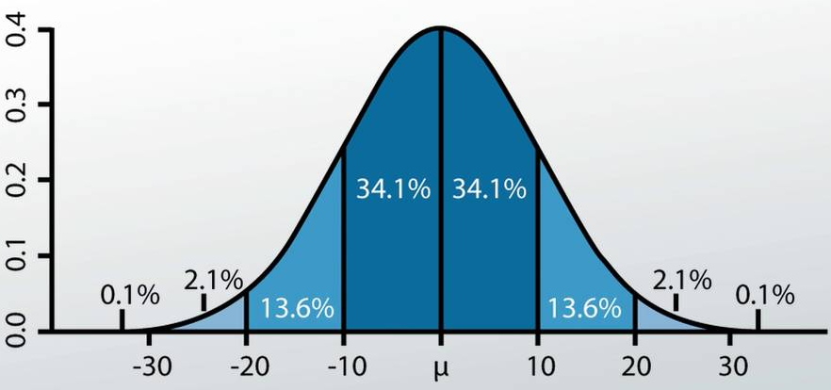
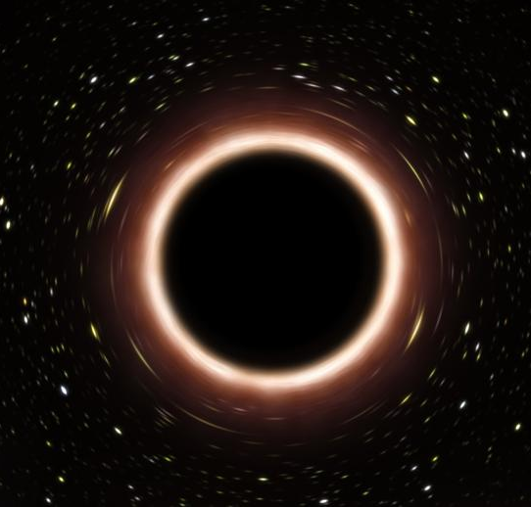
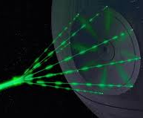
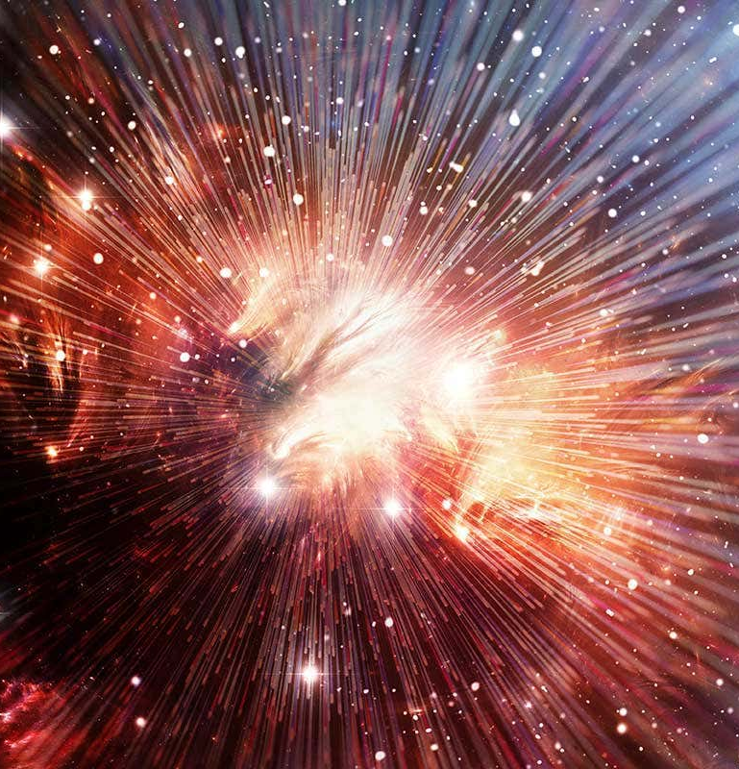
About Me: Hugh McDougall
  Final Year PhD Student at UQ
  Quasars – Mass Estimation, Gravitational Waves - Cosmology
My Speciality:
Astro-Statistics
Astronomy
In This Talk…
Statistics
Black Holes
Lasers
The Big Bang

Slide 3
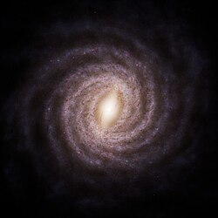
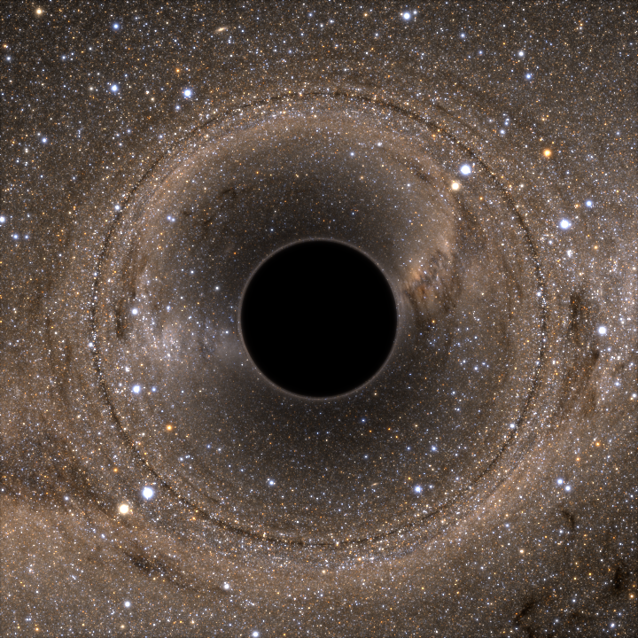
Black Holes
About 100 million in the galaxy
5x or more the mass of the sun
Invisible
If they’re invisible, how do we know they’re there?

Slide 4
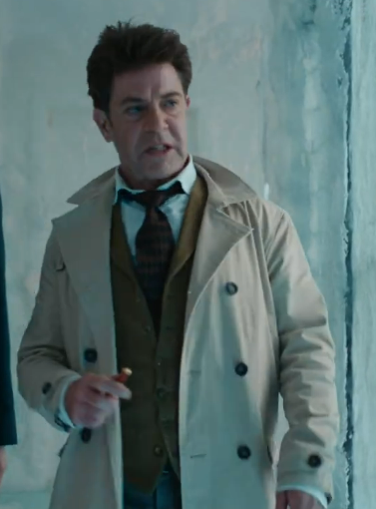

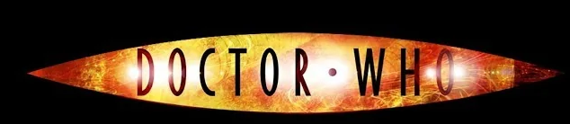
If I claim that there’s an invisible ghost in the room…
You’d probably have some doubts

Slide 5
Show Of Hands: Who Knows…?
Where Black Holes come from?

Slide 6

Black Holes: Simpler than Humans
Have opinions (unfortunate)
Economics
Middle Names
Neurology
Chemistry
Biology
G R A V I T Y
Favourite colours
Sinuses
Psychology
Fear of Public Speaking

Slide 7


Gravity Vs. Pressure: The Universal Tug-Of-War
Gravity Pulls Mass Together
Pressure Provides a Restoring Force

Slide 8
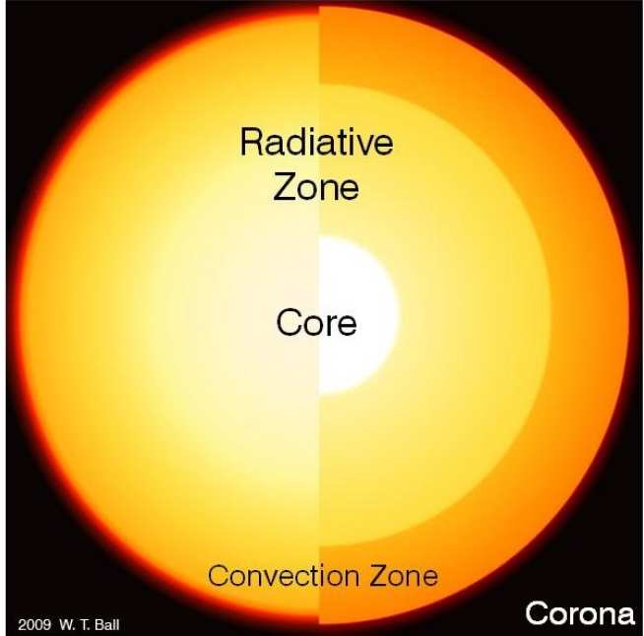
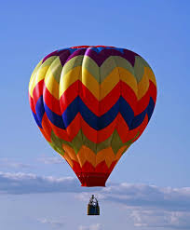

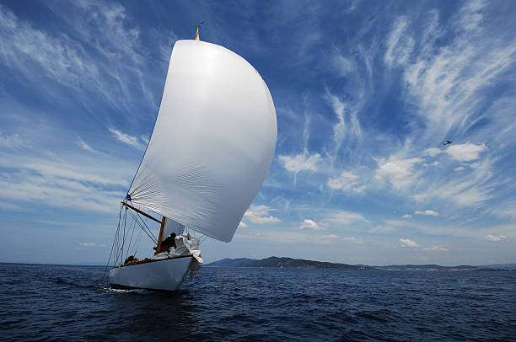
How Does The Sun Stay Up?
Electron Degeneracy Pressure
Gas Pressure
https://www.imperial.ac.uk/astrophysics/research/the-sun/solar-basics/
Radiation Pressure

Slide 9
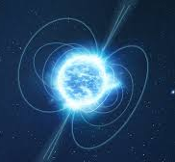



Massive Star
$$25 M_{⊙}$$
Heavy Star
$$4 M_{⊙}$$
Sun(ish) Star
$$1 M_{⊙}$$
White Dwarf
Neutron Star
Black Hole

Slide 10
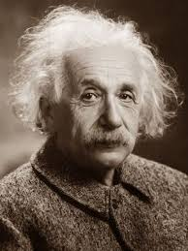
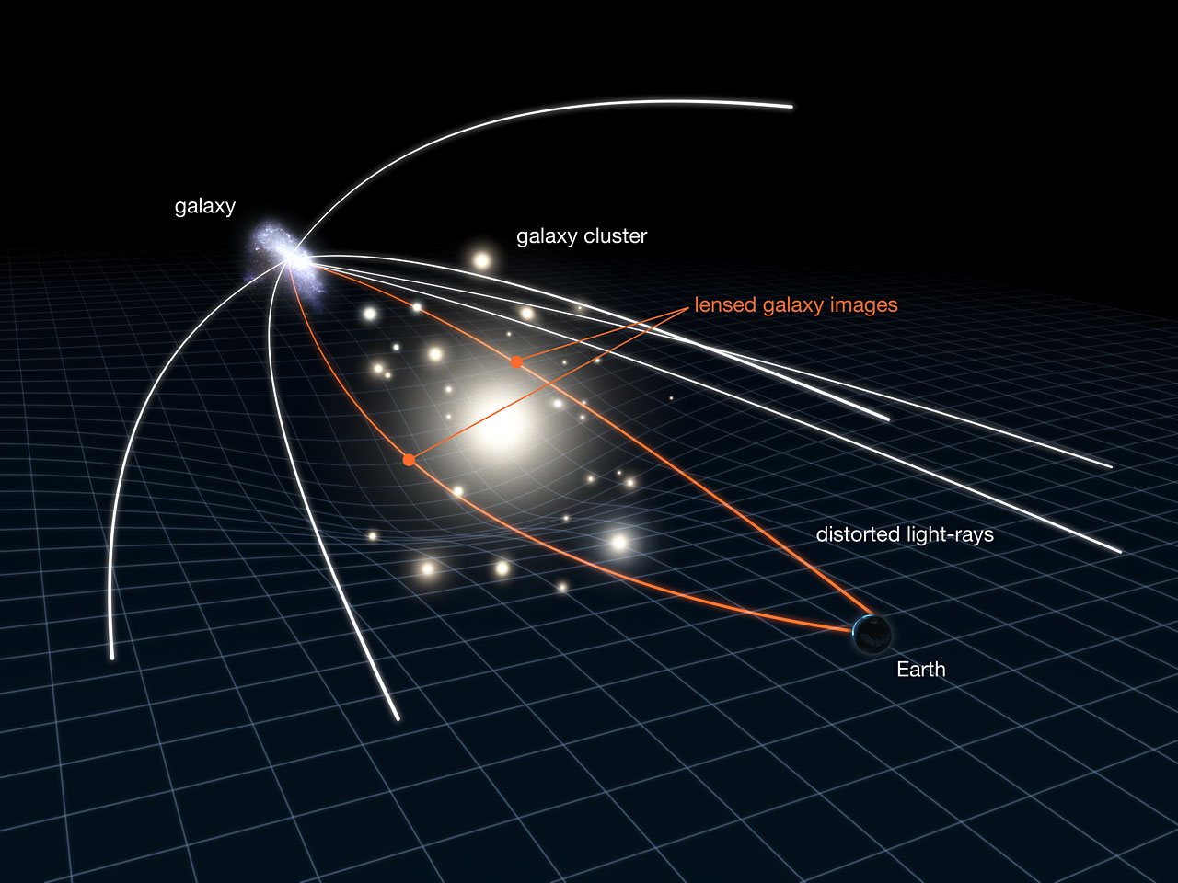

What When Gravity Get’s That Strong?
Two Major Discoveries:
Gravity isn’t just a pull, it’s a bending of space itself
This means that it affects everything, including light
$$Albo$$

Slide 11
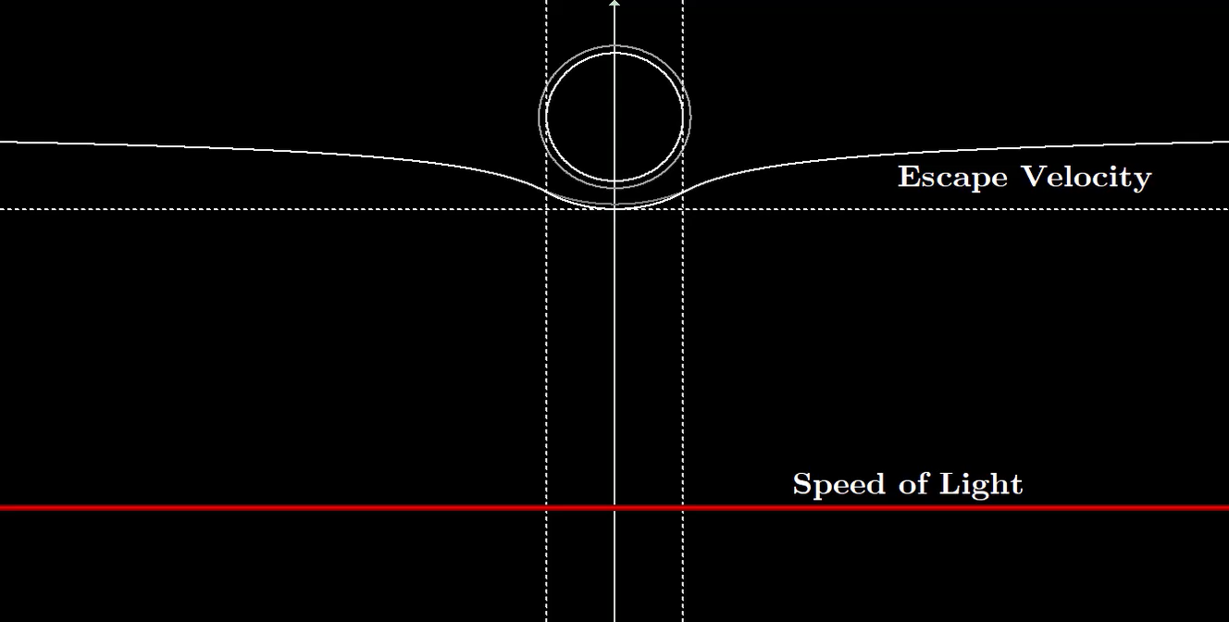
Escape Velocity Higher than Speed Of Light
A Black Hole

Slide 12
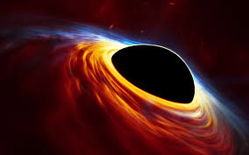
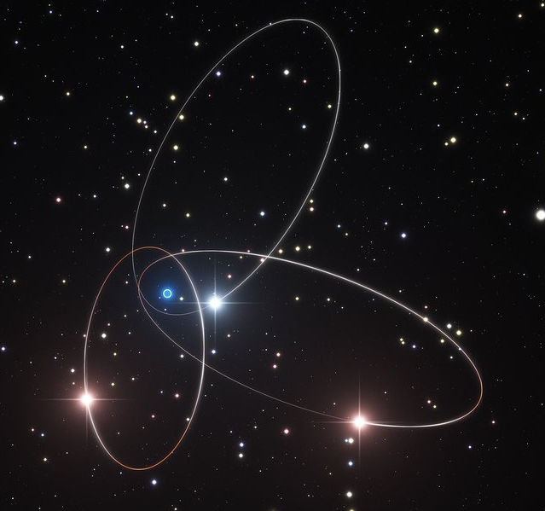
But Can We See them?
Accretion Disks
Orbits
Lensing
Infalling matter scrunches up and gets hot (hotter than almost anything else)
Gravity from Black holes invisibly tug on stars, sometimes forming binary pairs
Spacetime curvature creates a giant lens that distorts the image behind the black hole

Slide 13
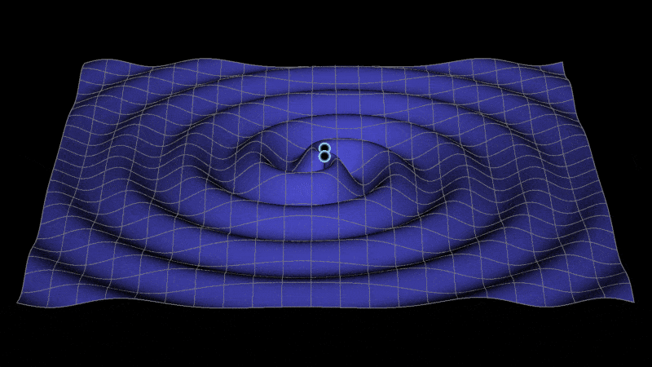
But What About Hearing Them?
These travel through space…
Courtesy: Jeffrey Bryant http://members.wolfram.com/jeffb/
Black Holes Spiral as they collide, creating waves in spacetime
And wash over the earth

Slide 14
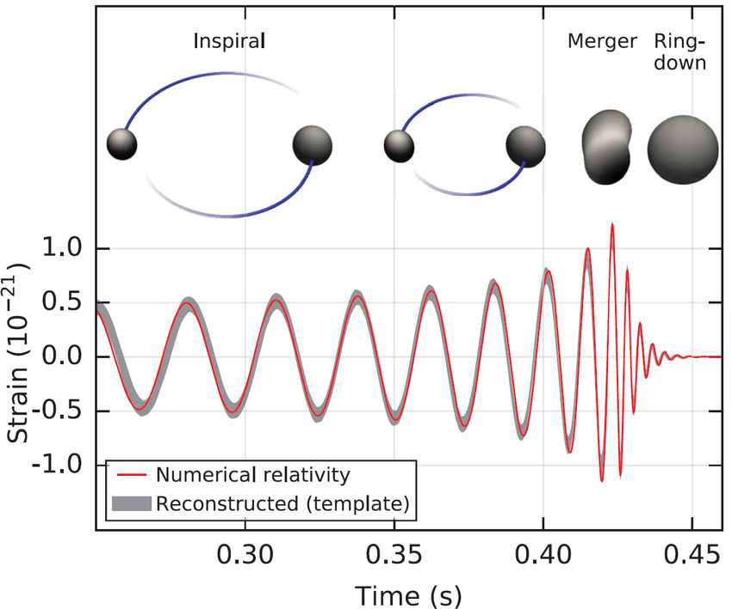
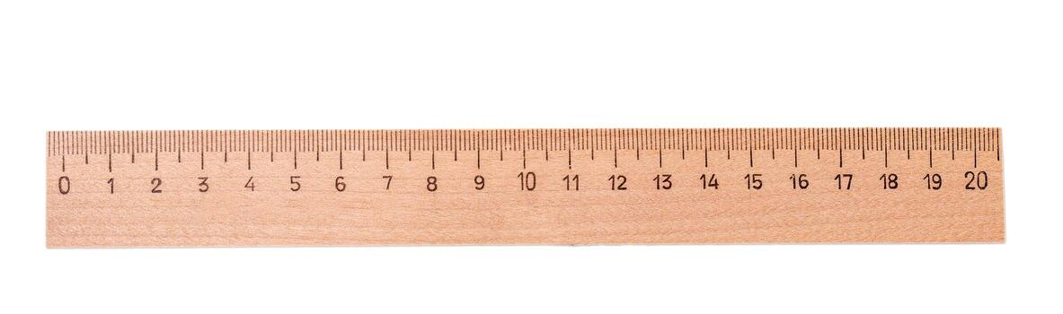
How do we detect this?
Ruler ripples with space: always measures the same thing
So we use two rulers and look at the difference

Slide 15
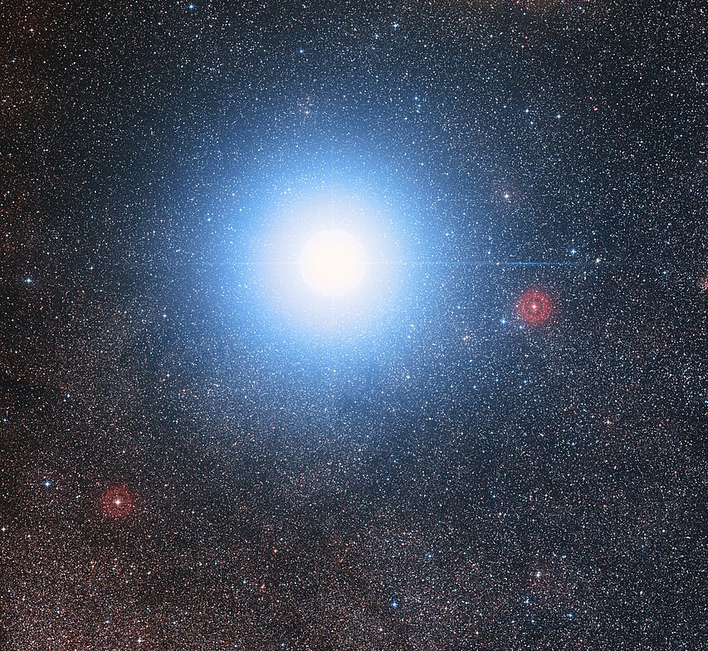



But…we’d Need a very Long Ruler
A “Loud” event stretches space by one part in $10^{21}$, or one part in a thousand million million million
$$\frac{ΔL}{L}≈\frac{1}{1,000,000,000,000,000,000,000}$$
4.5 Light Years
Change in length: $≈4mm$
Earth
Alpha Centauri

Slide 16
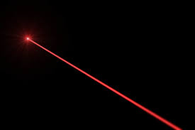
Laser Rulers!

Slide 17
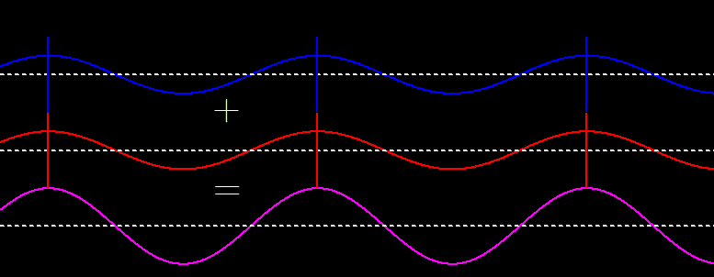
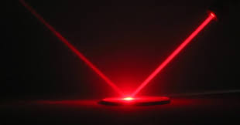
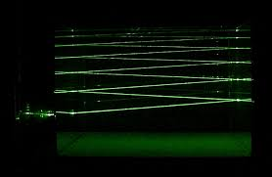
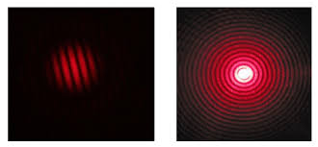
Why Lasers?
Light is a wave
Lasers can reflect
Tiny changes in path length create measurable differences in interference patterns
Lets us fold the path back on itself to make a really long ruler

Slide 18
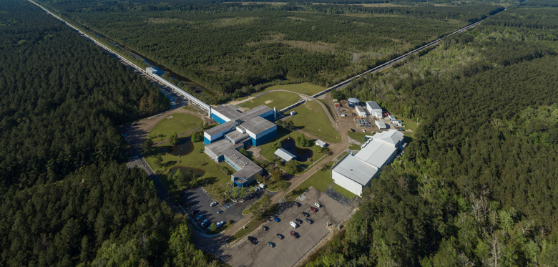

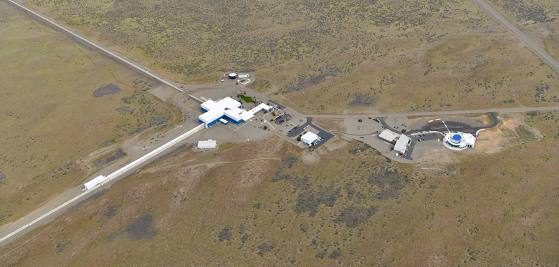
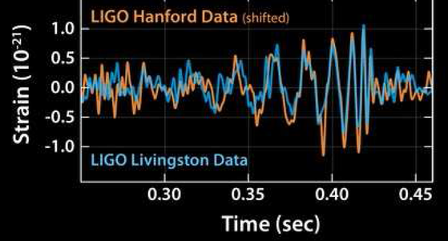
We already did it
LIGO: Laser Interferometer Gravitational-Wave Observatory
GW150914 (10 yrs ago):
The first ever recorded ‘sound’ of two black holes colliding

Slide 19

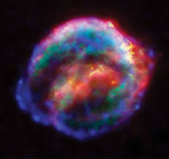
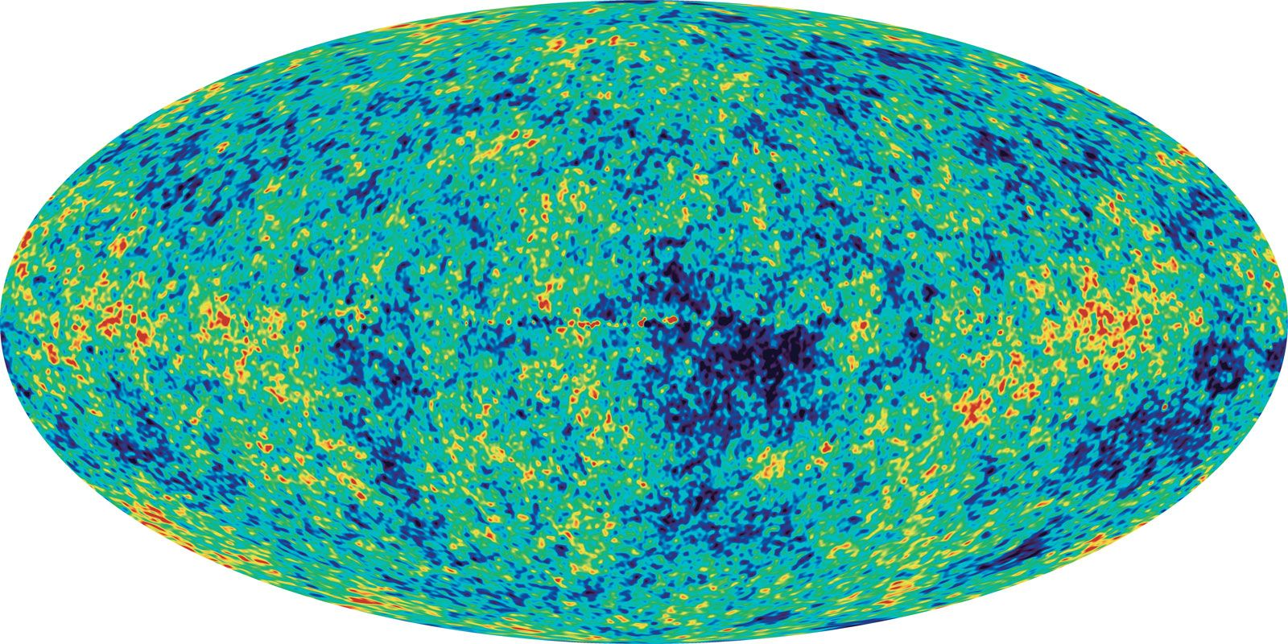
Why do I care? Cosmology
How do we measure this?
Supernovae:
Bright explosions from dying stars let us map out expansion history
The Cosmic Microwave Background (CMB):
An old picture of the young universe
The Universe is Expanding
Knowing how fast tells us the age of the Universe

Slide 20
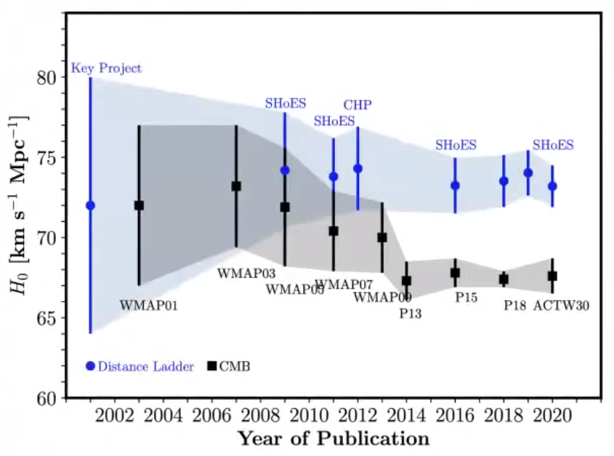
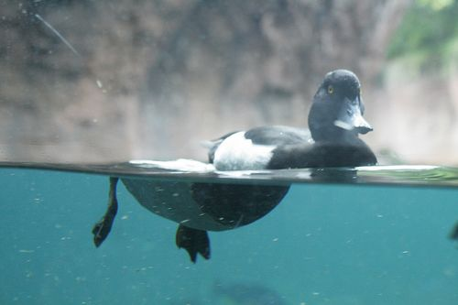
The Problem: Really Precise Measurements That Don’t Line Up
Supernovae
CMB

Slide 21
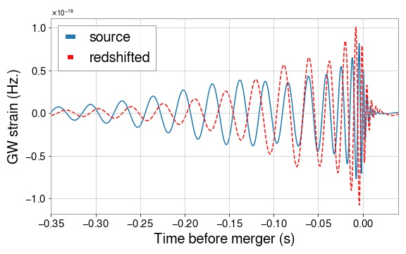

The Pitch of the Gravitational Wave Is a Speedometer
Moving Away: Low Pitch
Moving Toward You: High Pitch

Slide 22
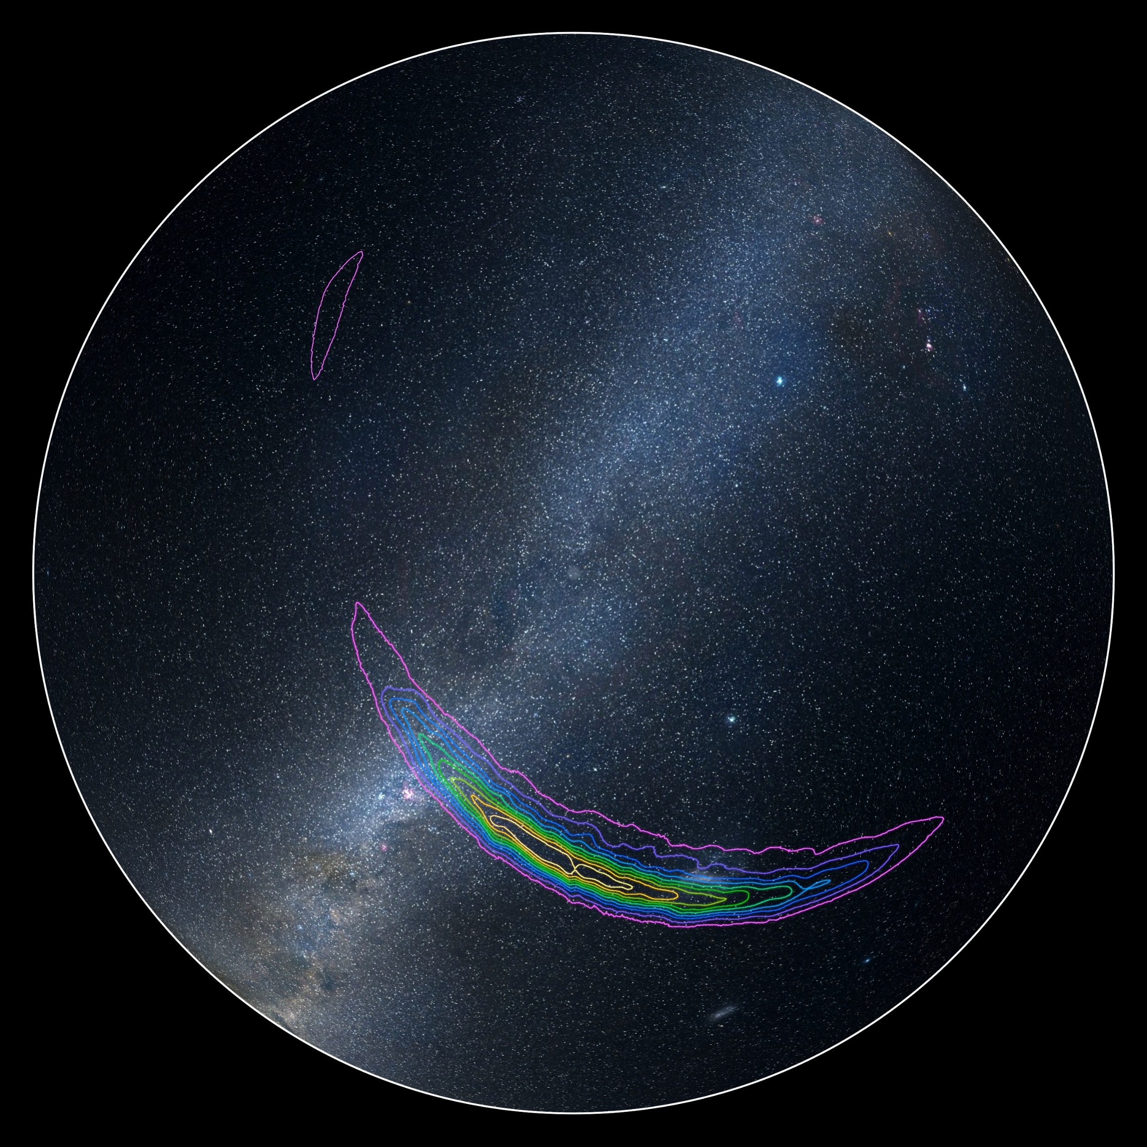

Why This is Hard (My Work)
Hard to tell where the sound comes from
Doppler shift gives you a lower pitch, but so do heavier black holes
Need to “Play Detective” to Piece Together Loose Clues

Slide 23
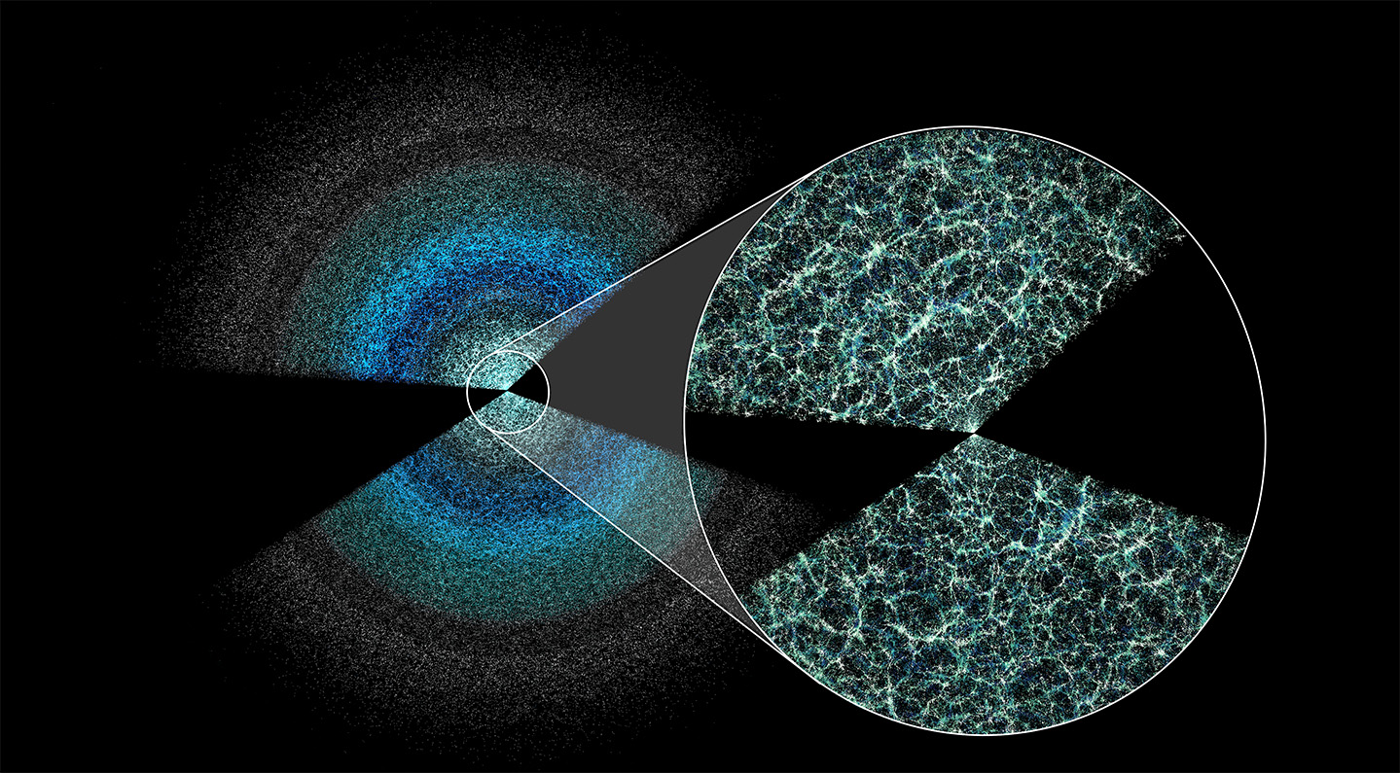
Only the first 10 years of GWs, but…
GW190403
27.1 Bill. Light Years
Away
More than halfway to the edge of the Universe
The Observable Universe
(~46.5 Billion Light Year Radius)

Slide 24
Thank You!
Questions?
Website: https://hughmcdougall.github.io/
Email: HughMcDougallEmail@gmail.com
GitHub: https://hughmcdougall.github.io/
Twitter: https://twitter.com/HughMcD_Astro

