Slide 1


Solving the Problem of False Positive Detections in Modern AGN Reverberation Mapping
Australian National University - Mt. Stromlo, Thu 3 Sep 2026

Slide 2




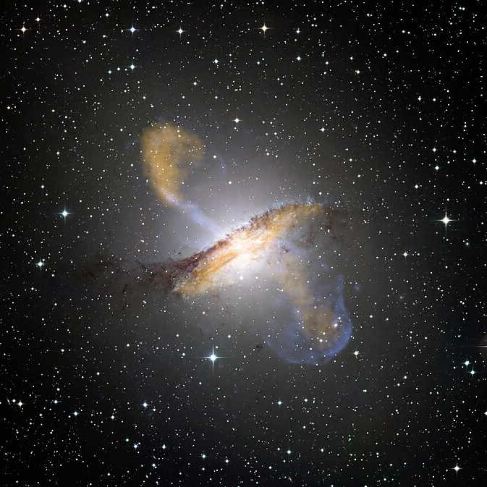
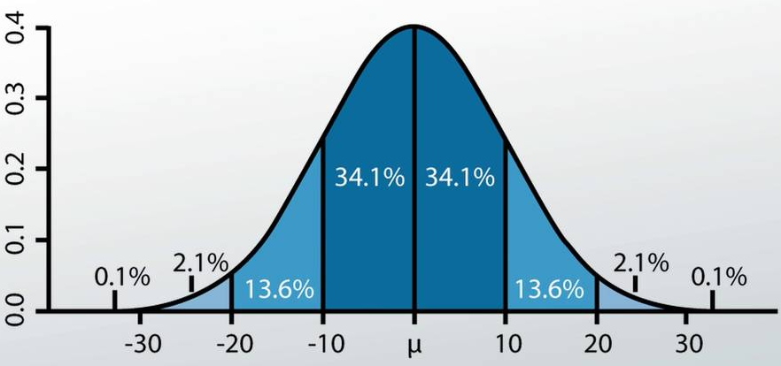
About Me (Hugh McDougall)
  Final Year PhD Student (88 days left)
Cosmology
Me
Astro-Statistics
Bayesian Stats Methods:
  Gaussian Processes
  JAX + NumPyro
Cosmology
  Active Galactic Nuclei
  Gravitational Waves
  (Sometimes)
Stats
Large-Scale Structure of Universe
Exoplanets
AGN
Reverberation
Mapping
Telescope
Image
Processing
Dark Energy
General
Relativity
Gaussian
Processes
Stellar
Astrophysics
Prof Tamara Davis
Stats
Methods
Dr Benjamin Pope
Supernova Cosmology
Radio Astronomy
My Science
My Methods
Reverberation mapping of supermassive black holes (more to come)
Finding ways to make difficult Bayesian models tractable

Slide 3
Today’s Talk
What is Reverberation Mapping?
Why is it so Difficult?
New Tools for Doing RM
(My Work)
Modern Surveys & Aliasing
LITMUS:
A new RM tool
Hierarchical
Modelling
Notes:
Add text

Slide 4
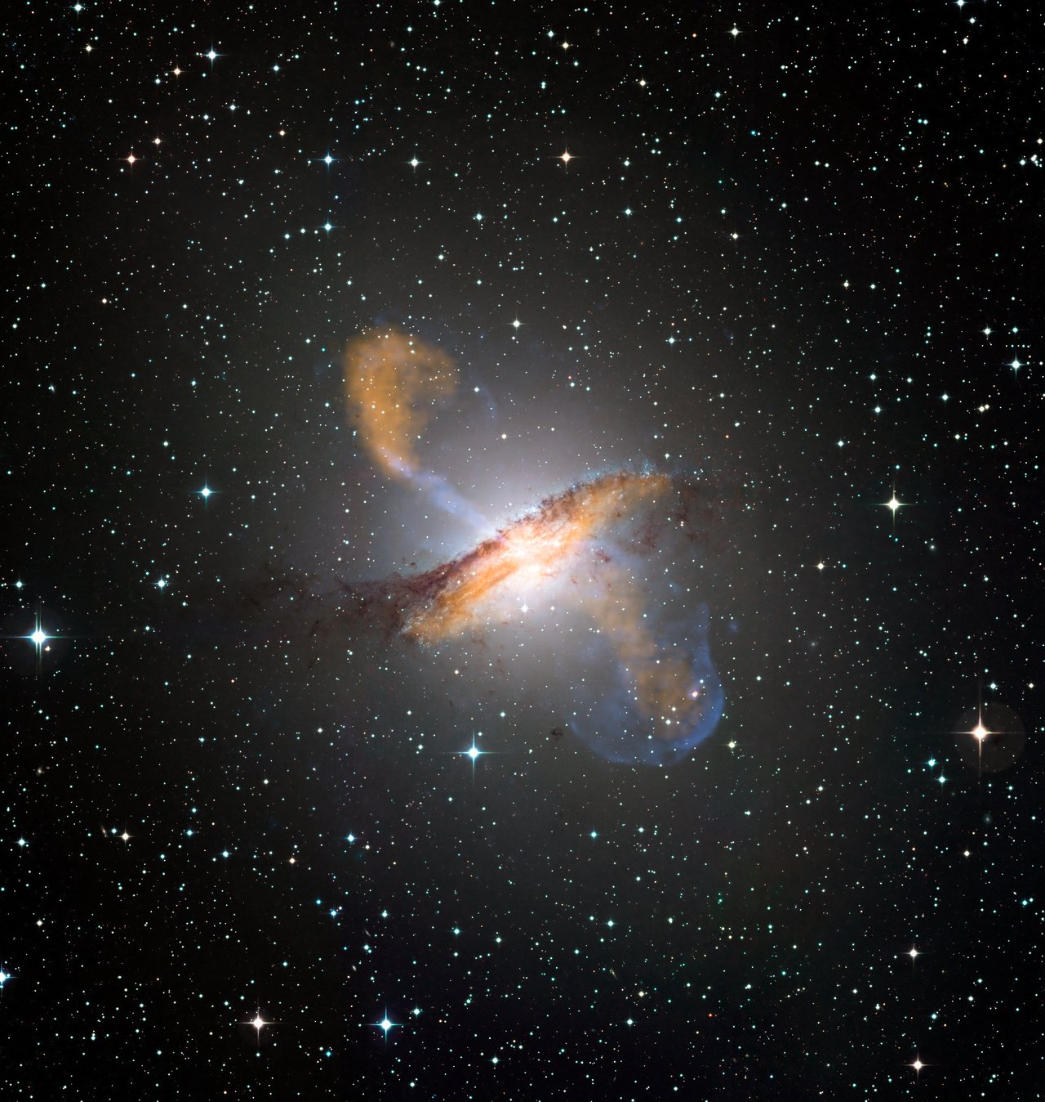
Part 1: Reverberation Mapping
(And why it’s so Hard)

Slide 5
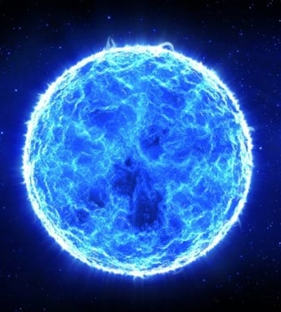
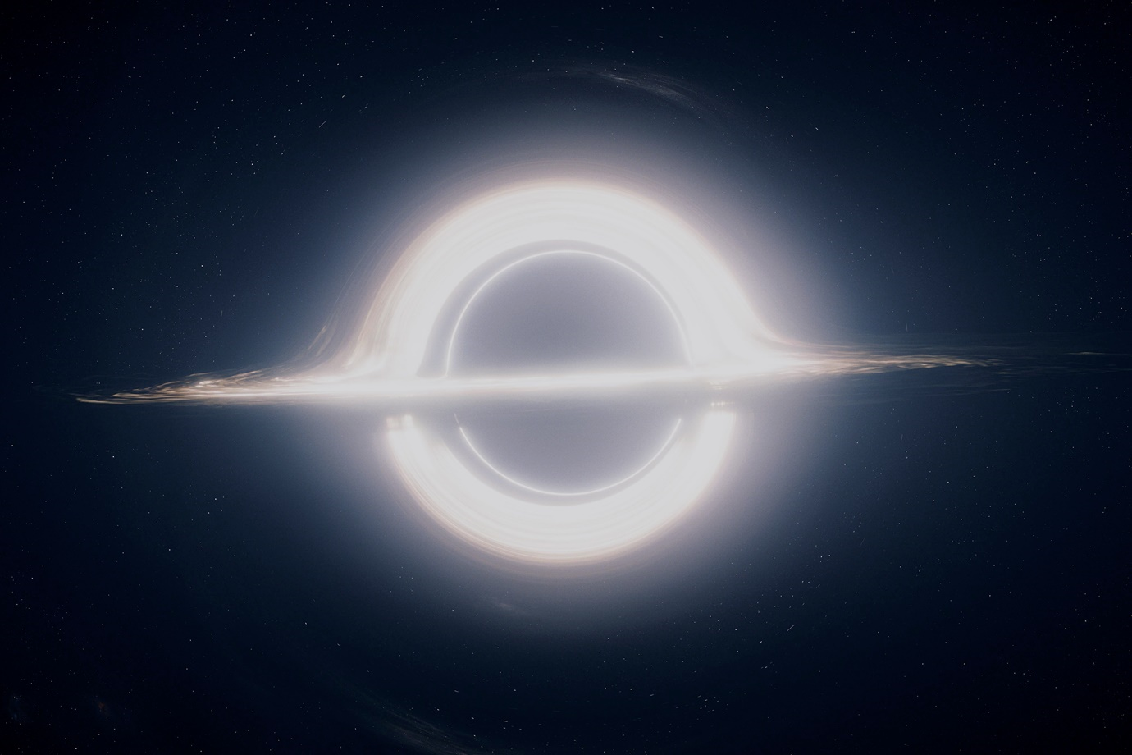
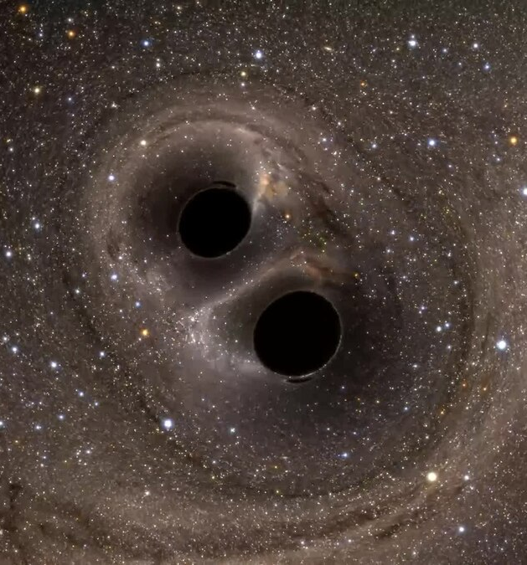
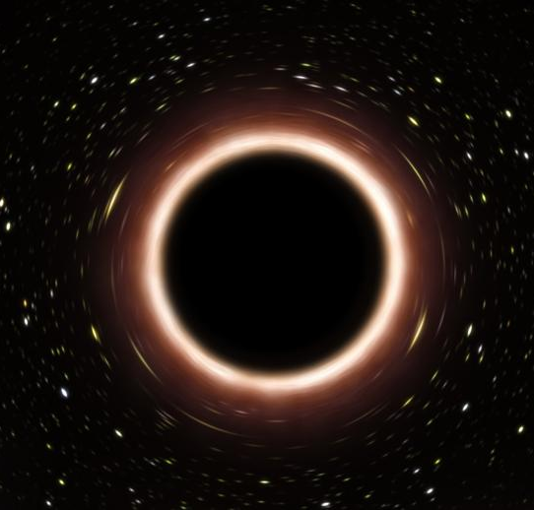
Supermassive Black Holes (SMBH)
Origins Unknown:
Many Theories
Super-Massive Black Holes act as Galactic Nuclei
Giant
Ancient Stars?
Small Black Holes Merging?
Co-Evolve with their host galaxies
Primordial Black Holes?

Slide 6
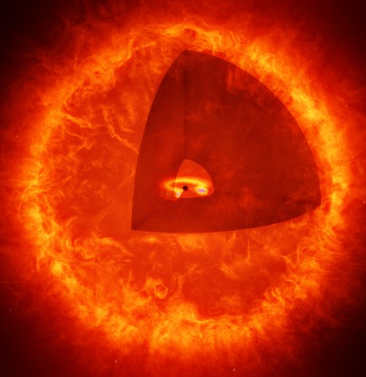
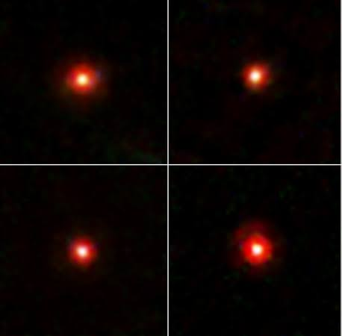
Motivation: SMBH and Galaxies
Co-Evolve with their host galaxies through feedback
Important Questions about little Red Dots / Early Galaxies
Gas
Gravity
Accretion
Disk
AGN Turns On
Galaxy Merger, New Fuel
Radiation Pressure
?
Star Formation Quenched
Gas Disperses
AGN Turns Off

Slide 7

Active Galactic Nuclei
Active Galactic Nuclei (AGN): SMBH that are accreting
Can be brighter than rest of galaxy
Important role in galaxy evolution
$10^{6}−10^{7}×$ smaller than galaxy
How do we get spatial information from a point source?

Slide 8
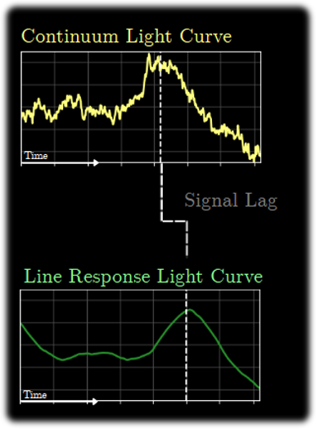
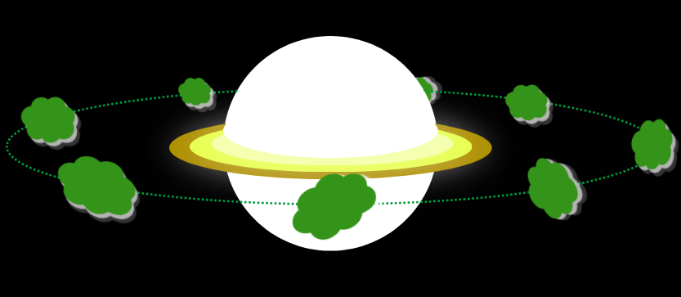
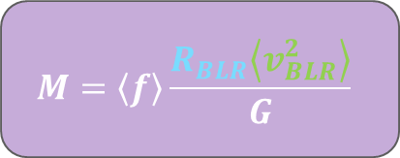

How to Weigh a Supermassive Black Hole?
Orbital Radius?
We need to know the BLR Radius
Accretion Disk
Approaching
Broad Line Region (BLR)
Doppler broadening acts like a speedometer
Receding
$$M=\left\langle f\right\rangle \frac{R_{BLR}\left\langle v_{BLR}^{2}\right\rangle }{G}$$
Balance gravity with centrifugal force $→$ Estimate SMBH Mass
Time for “echo” tell us size of the system: Reverberation Mapping

Slide 9
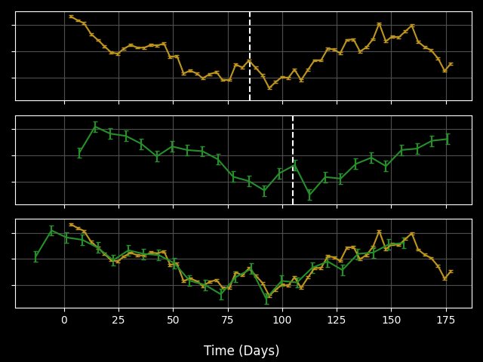
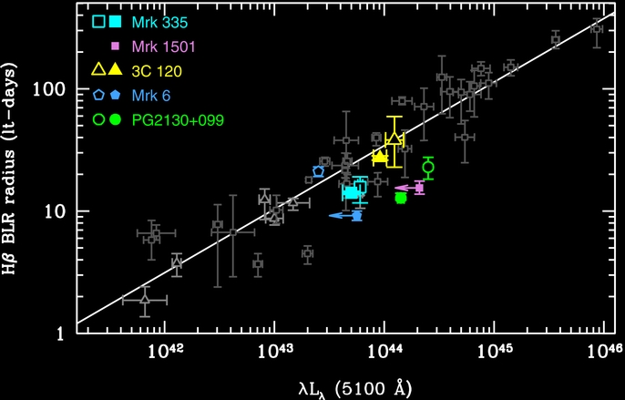
Reverberation Mapping – Old Methods
Simple Method: Linearly interpolate between measurements, calculate Cross Correlation Function and line up light curves
Brighter AGN are Bigger:
A Radius-Luminosity Relationship
Works for “traditional” RM surveys with good SNR, short lags, good coverage.
Tully-Fisher for AGN: A single-epoch radius + Mass Estimator

Slide 10


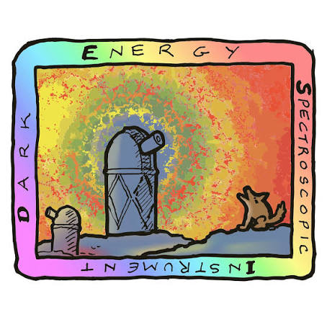



Modern RM Surveys – Industrial Scale
Old Surveys:
  $≤$A dozen AGN at a time, dedicated bespoke measurements
Modern Surveys:
  “Industrial Scale” RM, $≈1000$ sources over wide redshift range. “Statistically significant” sample, Multi-year surveys.
Established / Past
Upcoming
(Acc. Disk RM)
Notes:
Change to include example signal, remove line-Z graph and split into its own slide

Slide 11
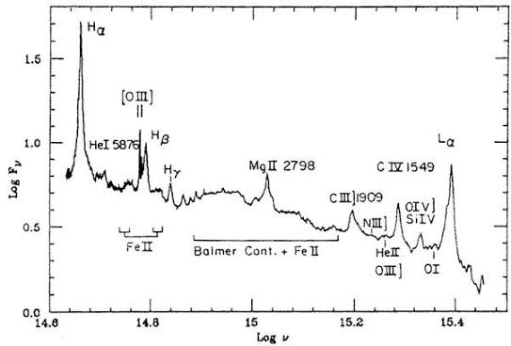
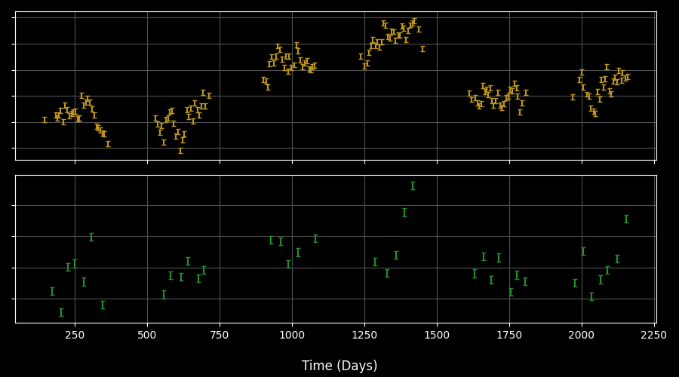

Modern RM Surveys – Challenges
Increasing Redshift – Different Lines Visible
Seasonal gaps: Can only see AGN for ½ of each year
Low
Redshift
Well Studied, Well Behaved
H$β$
Moderate
Redshift
Light curves hard to make because of FeII lines
MgII
High
Redshift
Lags can be too long to sees
CIV
Simple interpolation no longer viable
Notes:
Change to include example signal, remove line-Z graph and split into its own slide

Slide 12
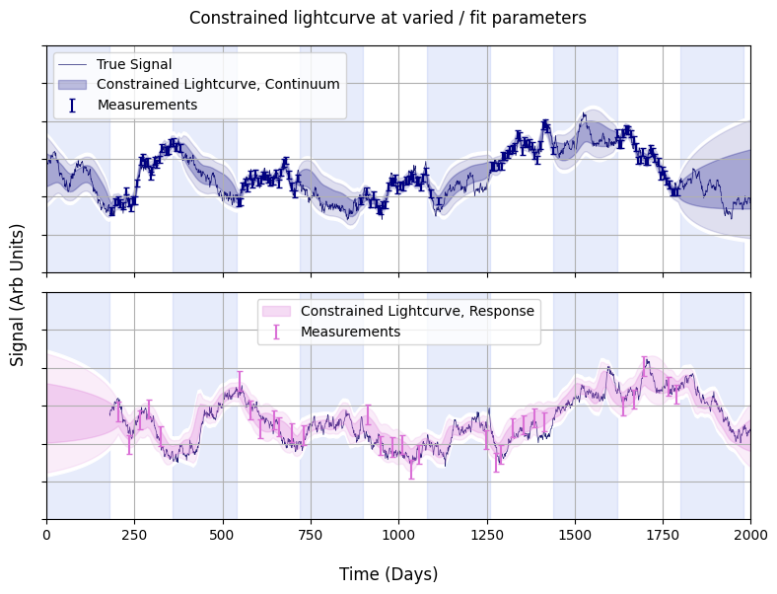
Recovering Lags with Gaussian Process Models
AGN Signals are stochastic but structured: signal takes time to vary (red noise over short timescales)
Light curves can be described as a Gaussian Process
Lag (and other parameters) can be fit a Bayesian way
Numerically expensive but not intractable

Slide 13
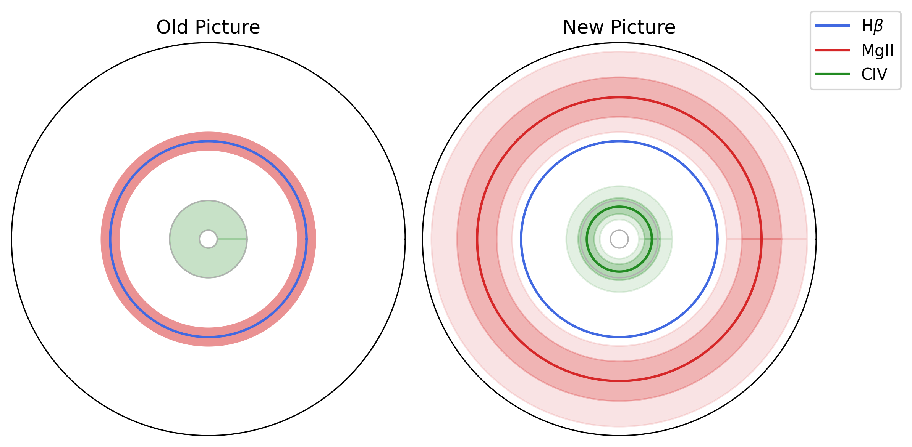
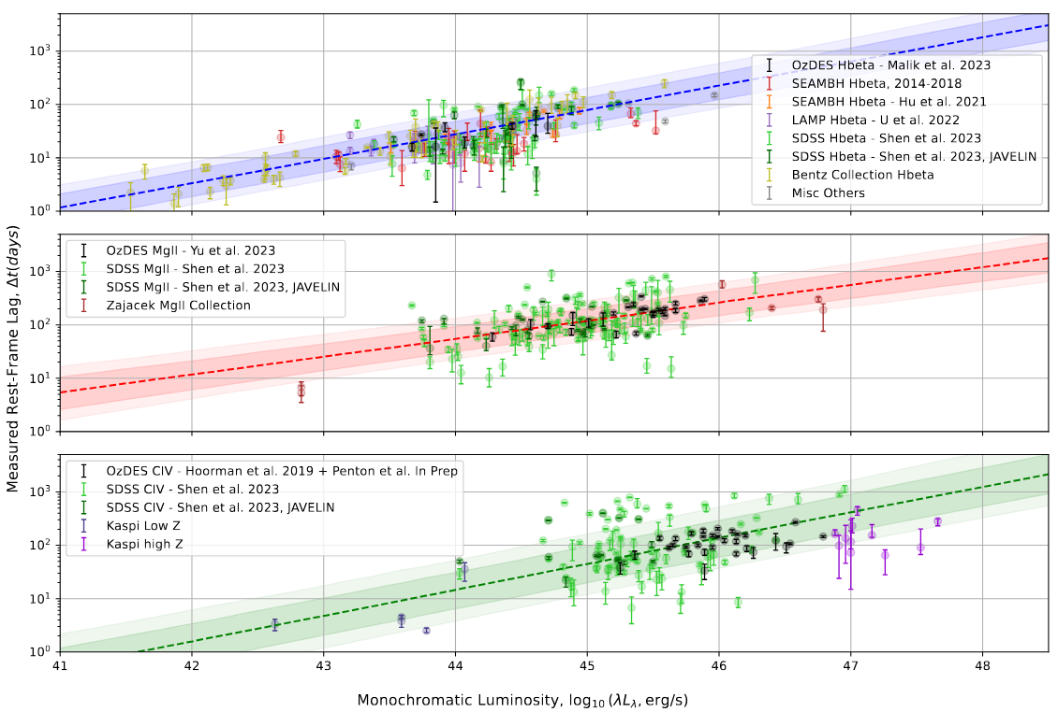
Industrial Scale RM: Goals
Different Lines May Emit From Different Radii
Different R-L Relations
for Each Line
Examine AGN populations and changes over time
Measure R-L Relationships for different lines at high-z
Measure Masses At High-z

Slide 14

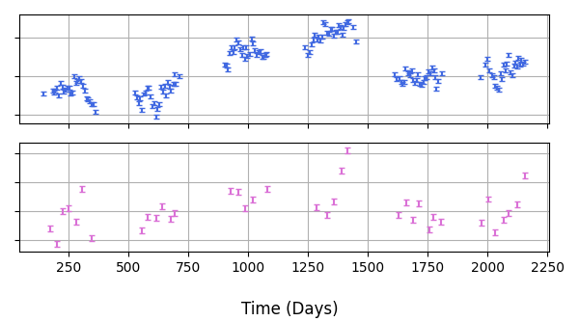
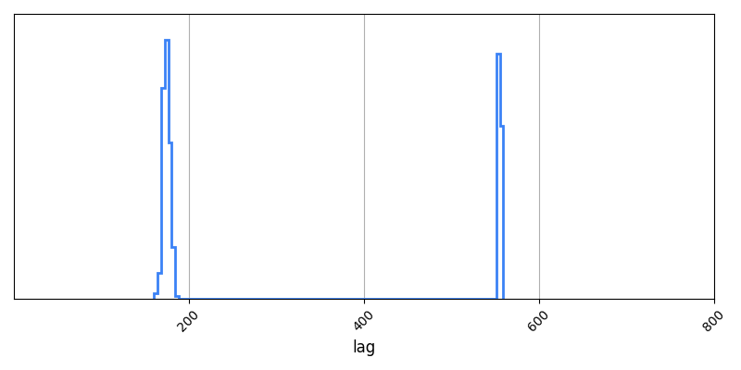
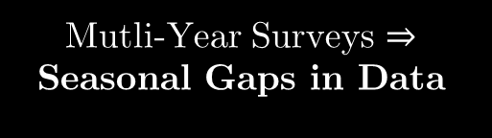
Modern RM Surveys: The Aliasing Problem
Fits with MCMC
True Lag,
180 d
Aliasing Peak
JAVELIN
Lag Posterior
Distribution
Mutli-Year Surveys $⇒$ Seasonal Gaps in Data
Multiple Peaks in Lag Posterior Distribution, “Aliasing”
Multi-Year Surveys $⇒$ False Positive Lags

Slide 15
Existing Method: “Cut and Constrain”
Patchwork mix of tools and significance measures from disparate tools and statistical frameworks
Vastly different approaches between works
“Cut & Constrain”
Build Light Curves From Observations
Choose a Lag Fitting Tool & Recover Lags
Discard Suspect Lags /w Reliability Measures
Constrain
R-L Relations
Closeness to aliasing peak?
Agreement /w linear interp?
Width of posterior peak?

Slide 16
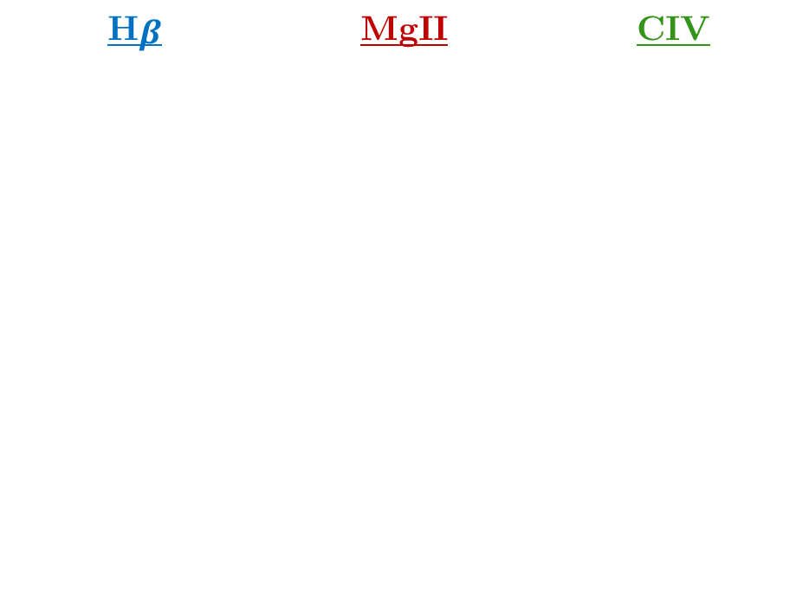
My Early Work: Compare Disparate Surveys
H$β$ | MgII | CIV
OzDES + SDSS Plus…
Barth et al. (2013) | Code & Welch (1982) | De Rosa et al. (2015)
Bentz et al. (2009) | Czerny et al. (2019) | Grier et al. (2019)
Bentz et al. (2013) | Lira et al. (2018 | Hoormann et al. (2019)
Bentz et al. (2014) | Metzroth et al. (2006) | Kaspi 2021
Bentz et al. (2016a) | Shen et al. (2016) | Lira et al. (2018)
Bentz et al. (2016b) | Shen et al. (2019) | Metzroth et al. (2006)
Fausnaugh et al. (2017) | Zajacek (2020) | Peterson et al. (2005)
Hu et al (2021) | Zajacek (2021) | Shen et al. (2019)
Li et al. (2021)
Lu et al. (2016)
Pei et al. (2014)
Rakshit et al. (2019)
U et al. (2022)
Zhang et al. (2019)
Surveys look extremely different:
But Why?

Slide 17
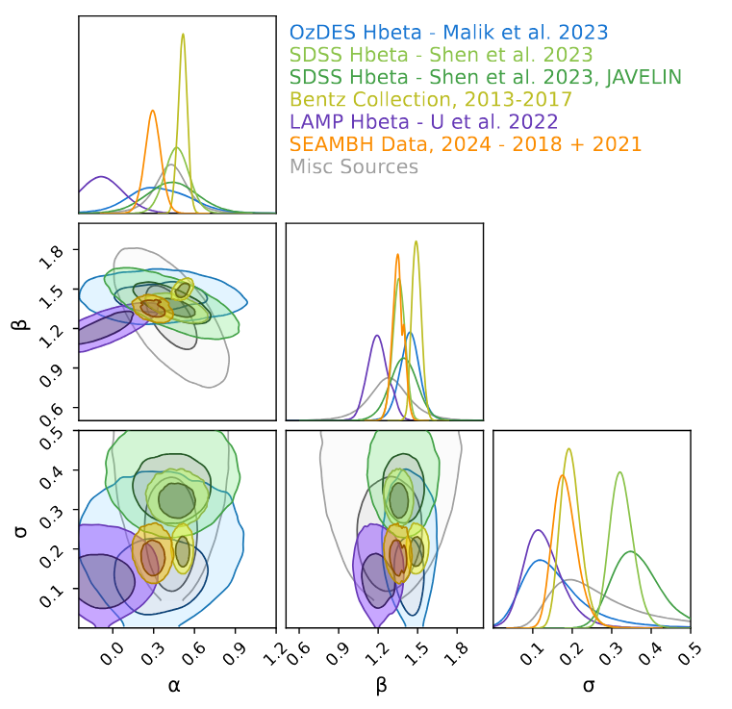
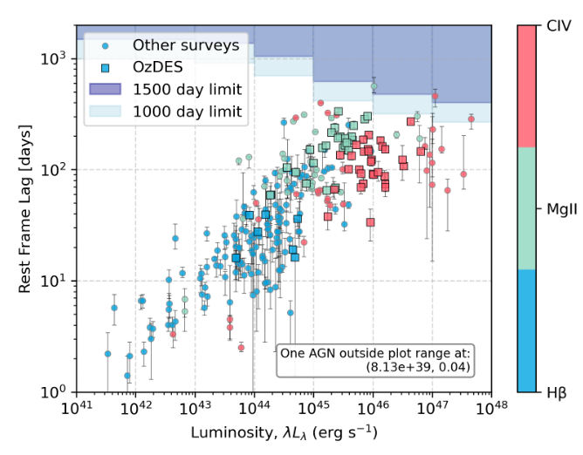


Project 1 - Why do Surveys Differ?
MgII
`
H$β$
Differences in Methods
CIV
Differences in
Targets
Differences in
Survey Length
Different types of AGN in different surveys
(Old News)
Can only see lags $≪$ Survey Length (“Lag Ceiling”)
Changing Cut and Constrain choices gives different results
Methods Dominate Results

Slide 18
My PhD: Modelling RM Lags Properly

Slide 19
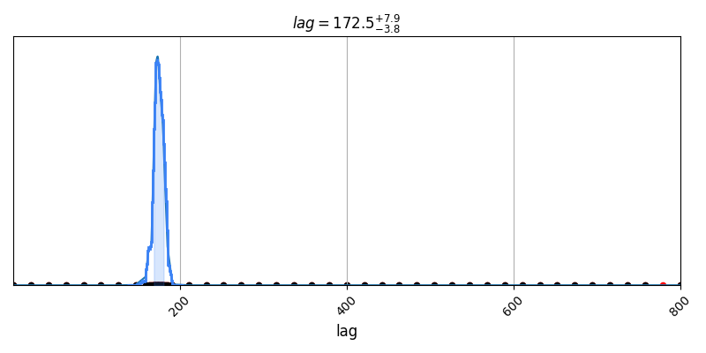
Step 1: Trying to Recreate JAVELIN
Lag Posterior Distribution from JAVELIN
Same data, same stats model, different aliasing peaks.
Why?
True Lag Posterior Distribution
Notes:
v

Slide 20
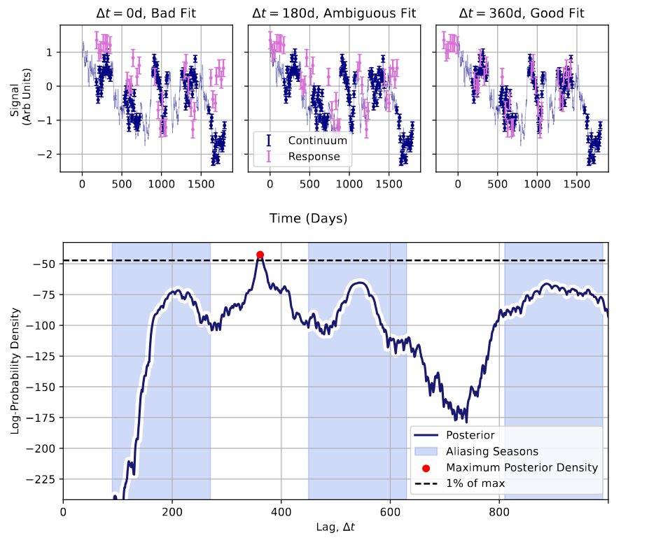
Reason: Inconvenient Likelihood
Lag-Axis Log Posterior distribution is extremely noisy and multimodal
We need to get here
JAVELIN’s MCMC fitter (emcee) can’t handle multimodal distributions
JAVELIN gets stuck here
Off-season Lags with no Overlap are Ambiguous: Locally Optimal fits

Slide 21
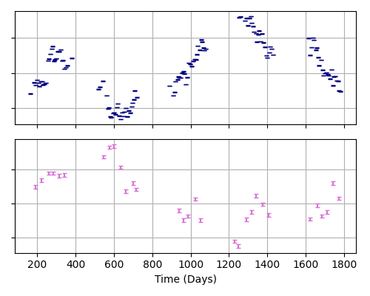
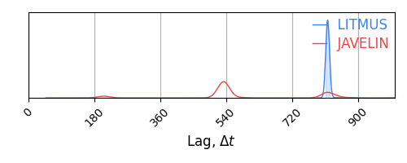

False Positives
These come from different AGN.
Multimodal Issue Fixed
$→$Well Constrained Lag:
A Confident Detection?
Coincidence can give a “Best Fit” Lags that isn’t necessarily a good fit.

Slide 22
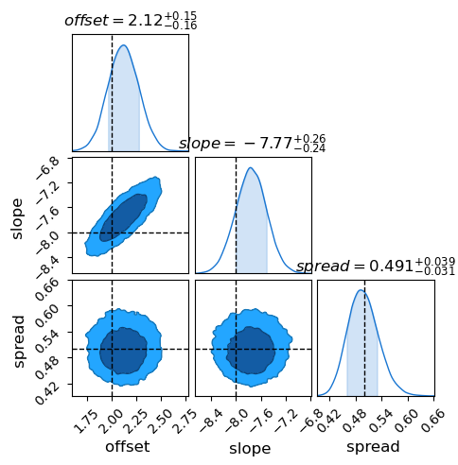
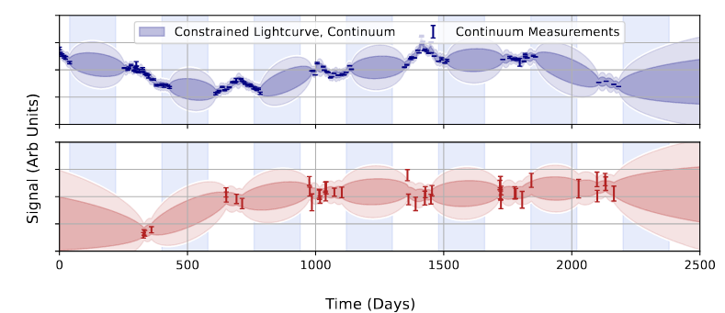
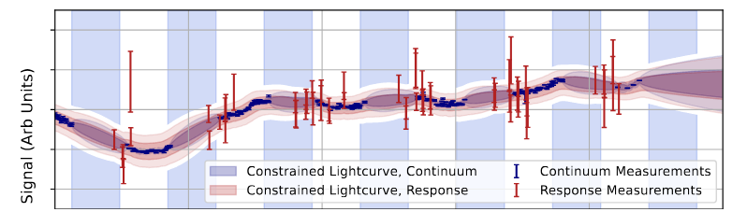

Compare Models With Bayes Factor
Probability Mass (Evidence)
Integrates To
$$𝒵 =∫ρ\left(θ\right) dθ$$
$$ρ\left(θ\right)=ℒ\left(D | θ\right)×π\left(θ\right)$$
Compare Models
$${BF}_{Lag}=𝒵_{Lag} / 𝒵_{No Lag}$$
Coupled Model (Lag)
Uncoupled Model (No Lag)

Slide 23

LITMUS: A New RM Tool
Mission Statement:
Measure Lags Properly
  Bayesian GP modelling
  Fix the multimodal issue
Proper Significance Measures
  Bayesian model comparison:
  Coupled vs uncoupled models
  We need to be able to integrate as well as explore the posterior

Slide 24
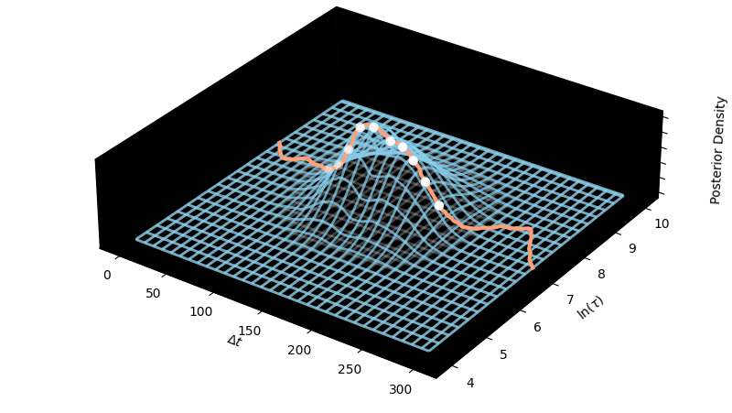
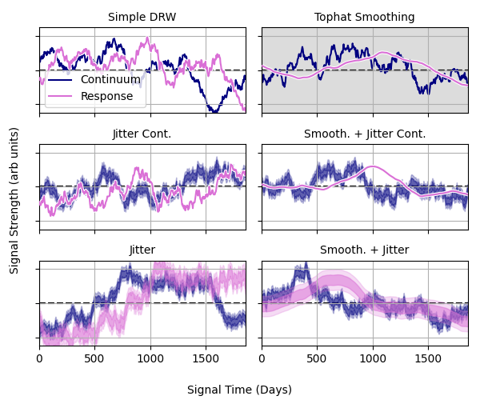
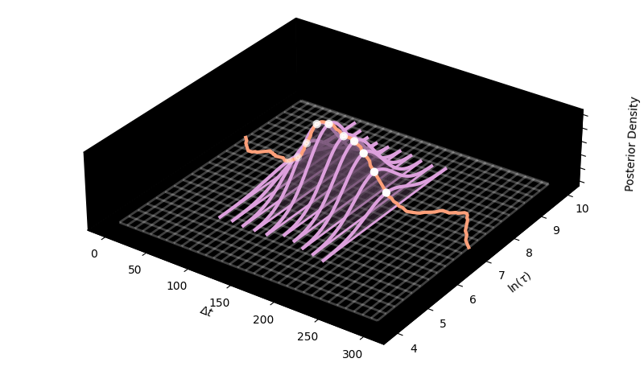


LITMUS: Other Features
Modular design lets us test different light curve models
Super-Fast Custom-Made Fitters with JAX and NumPyro (Laplace Approx Quadrature)

Slide 25
Applying to Real Data
Apply to Real Data
Do get more lags?
Do we get different lags?
How many sources can we get?

Slide 26
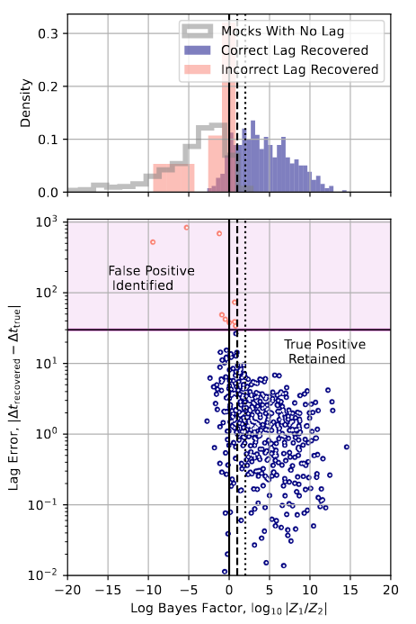

The Result: Very Few Lags
Semi-Bayesian Approach with the Cut and Constrain Framework:
Get lags and bayes factors for all AGN in survey
Repeat for a statistically similar set of AGN that you know don’t have lags
Use BF as a test statistic to get p-value (false positive rate) for each measured lag
Keep only the best sources (<5% FPR)
Result: Only $≈3\%$ Recovery Rate

Slide 27
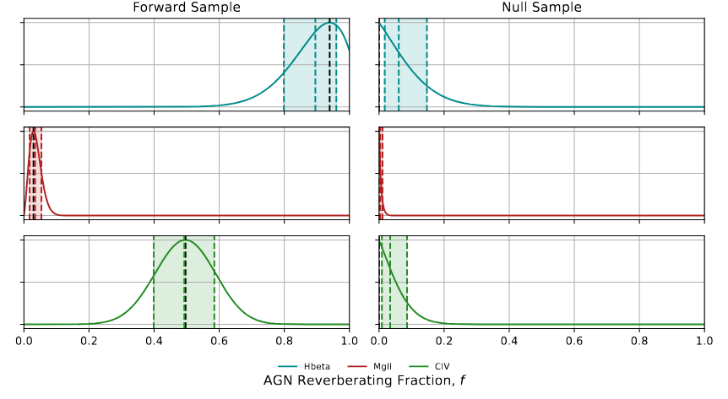

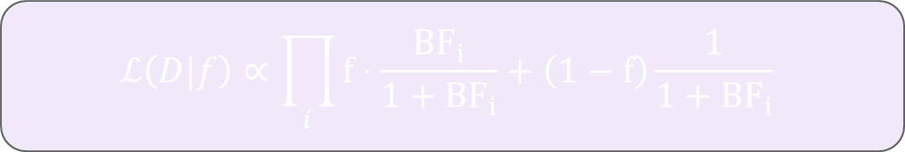

Why so few recoveries?
Do all AGN actually have lags? We can estimate $f=\frac{N_{has a lag}}{N_{Total}}$using Bayes Factors:
$$ℒ\left(D|f\right)∝\prod_{i}{f⋅\frac{BF_{i}}{1+BF_{i}}+\left(1−f\right)\frac{1}{1+BF_{i}}}$$
$$BF_{i}=Bayes Factor for Source i$$
Two Conclusions:
Many AGN don’t have lags
SNR is too low to see lags for most that do

Slide 28
Hierarchical Modelling

Slide 29
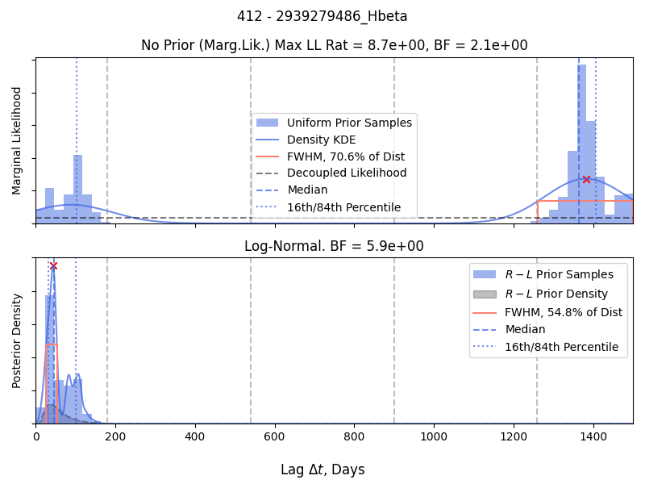
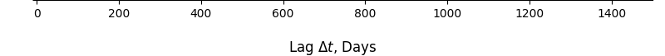


Population - Informed Priors
Fit with Uniform Lag Prior
Fit with Population Informed Prior
z = 0.581
$$BF=2.1$$
$$BF=5.9$$
How do we do this without confirmation bias?

Slide 30
Project 4 – Hierarchical Models
Uninformative (Uniform) Priors
Hierarchical Model
Discard Most Sources
Constrain Lags
Fit Lags
Constrain
R-L Relations
Lags Inform R-L Rel.
Selection Bias
R-L Informed Prior
Better Lag Yield
Constrain
R-L Relationship
R-L Prior Informs Lags
Fit Lags
Choose
R-L Relation
Confirmation Bias
Lags & R-L Prior Fit Simultaneously

Slide 31
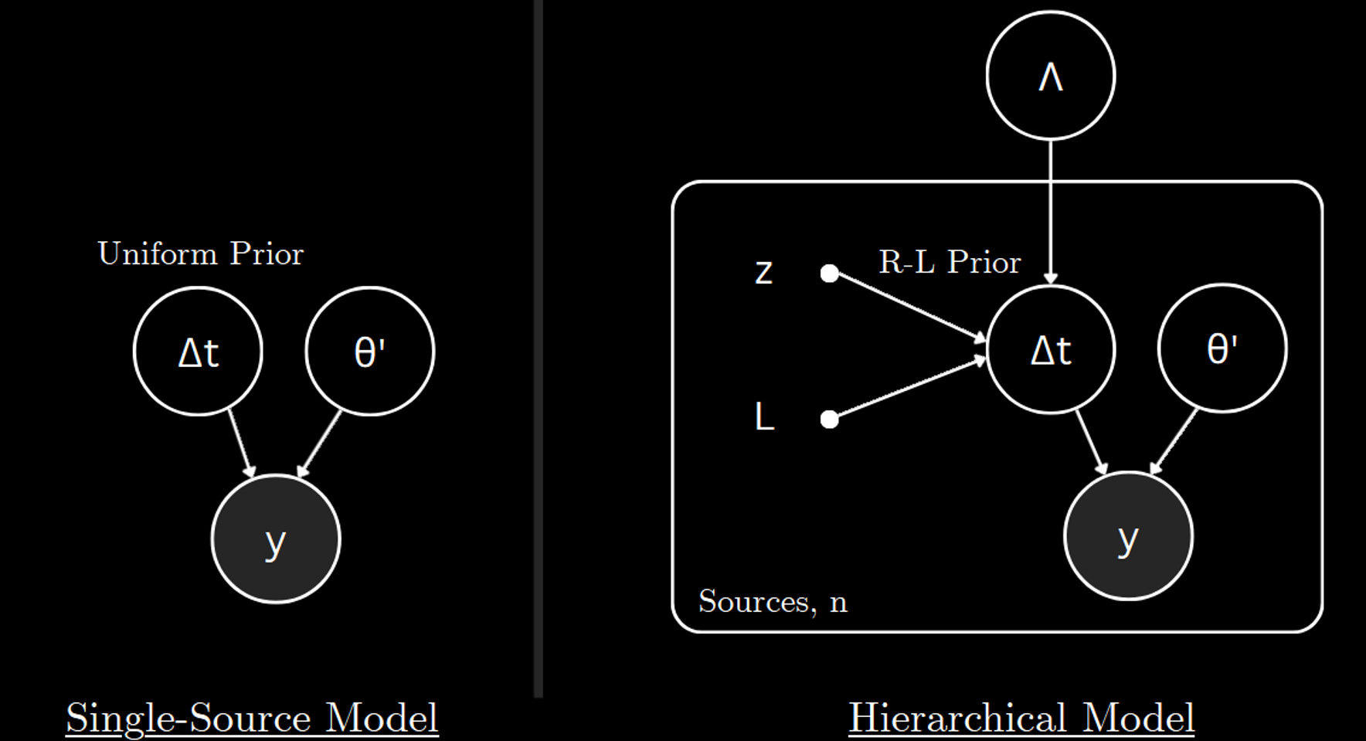
Answer: Hierarchical Models
Old Way
Fit Lags one at a time, discard all but the most convincing ones
$$P\left(Δt^{n},{φ^{′}}^{n}|d^{n}, Lag\right)∝π\left(φ_{n}^{′}\right)π_{∅}^{n}\left(Δt_{n}\right)ℒ_{Lag}\left(d^{n}|Δt_{n},φ_{n}^{′}\right)$$

Slide 32
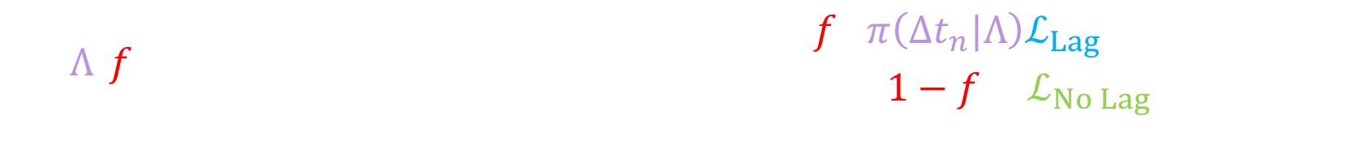
Answer: Hierarchical Models
~4 Hyper-Params
New Way
Lags & Population Hyper-parameters fit simultaneously in one giant Bayesian model
~6 Params per Source
100’s of Sources
Highly Multimodal and high dimensional: Can’t be fit with normal methods
RL Informed Prior
$$P\left(Λ,f,\left\{Δt^{n},{φ^{′}}^{n}\right\}|\left\{d^{n}\right\}\right)∝π\left(Λ,f\right)\prod_{n}{π\left(φ_{n}^{′}\right)\left(\begin{aligned}f⋅π\left(Δt_{n}|Λ\right)ℒ_{Lag}\left(d^{n}|Δt_{n},φ_{n}^{′}\right) \\ +\left(1−f\right)⋅ℒ_{No Lag}\left(d^{n}|φ_{n}^{′}\right)\end{aligned}\right)}$$
Reverb / non reverb frac
Lag & Lag-Free Likelihoods

Slide 33
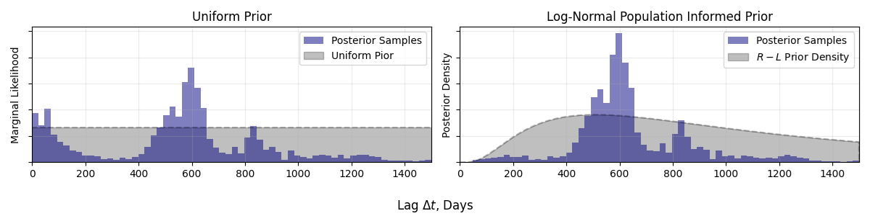
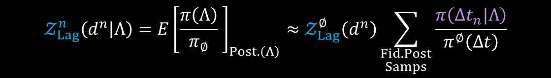
The Trick: Importance Sampling
We already have information about the posterior shape from our vague prior fits.
Importance Sampling lets us re-weight source-by-source fits to new priors
It also lets us marginalize over source parameters with Monte Carlo Integration:
$$𝒵_{Lag}^{n}\left(d^{n} | Λ\right)=E{\left[\frac{π\left(Λ\right)}{π_{∅}} \right]}_{Post.\left(Λ\right)}≈𝒵_{Lag}^{∅}\left(d^{n}\right)\sum_{\begin{aligned}Fid. Post \\ Samps\end{aligned}}{\frac{π\left(Δt_{n}|Λ\right)}{π^{∅}\left(Δt\right)}}$$

Slide 34
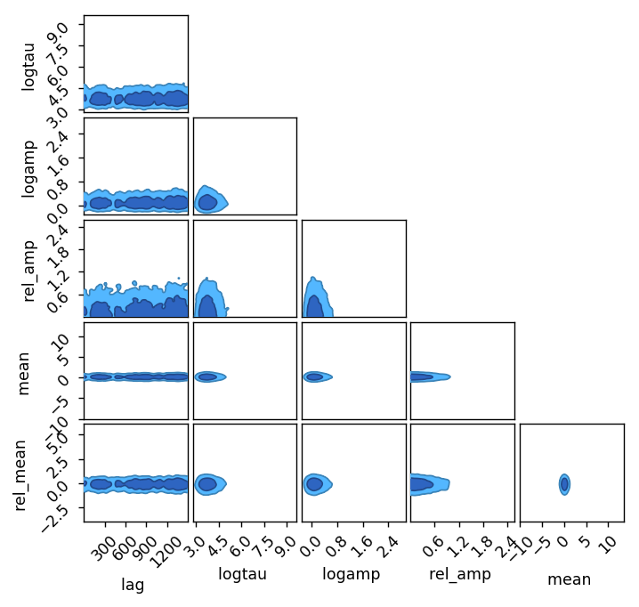
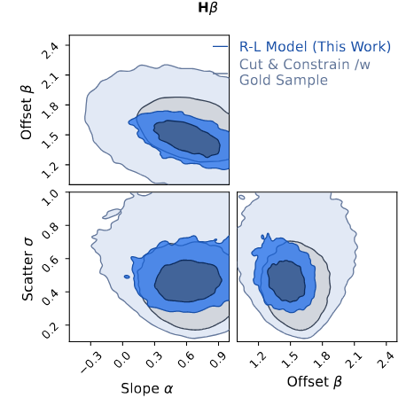


What does this do?
Population Params ($≈4$)
Source Params:
$6×100$s and hard
to fit
Marginalise out messy source params
Only 4 Params Remain

Slide 35

Hierarchical Importance Sampling: End Result
Importance Sampling lets us remove the hierarchical dimensions:
Integrate out
source params
$$P\left(Λ,f|\left\{d^{n}\right\}\right)∝π\left(Λ,f\right)\prod_{n}{\left(f⋅𝒵_{Lag}^{n}\left(d^{n}|Λ\right)+\left(1−f\right)⋅𝒵_{No Lag}\left(d^{n}\right)\right)}$$
Population Properties
From Importance Sampling Sum
Avail from Fiducial Uniform Prior Fit, $∅$
Flatten the problem from 1000’s of dimensions to only 4: can now be attacked like a much simpler problem
Trick borrowed from gravitational wave astronomy: “Recycling” Posterior Samples

Slide 36
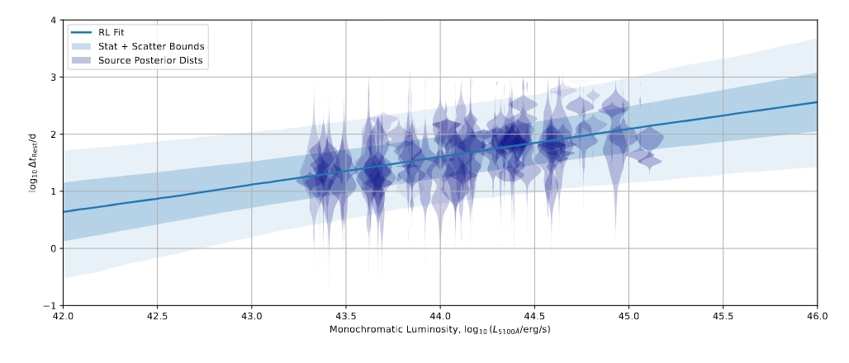
Does it Work?
Yes!
More than double the constraining power from the same data: Able to confirm the scaling relationship to $2σ$ where it was previously ambiguous

Slide 37
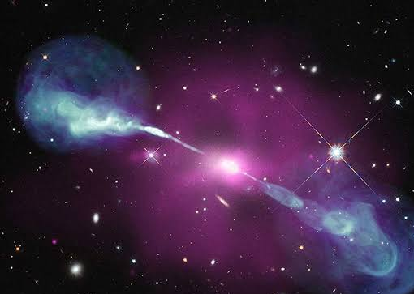
The Moral of the Story
For Reverberation Mapping:
Many RM high-z lags are false positives
LITMUS can fix this!
Hierarchical models let us measure masses and populations from low SNR data
For AGN:
100’s of new masses! OzDES alone can identify cosmic downsizing
MgII may not reverberate in the simple way that we though – implications for BLR models

Slide 38

The Future: More Data!
Similar AGN populations, different pipelines and systematics.
Will their results be the same?
Can be applied to many other RM types and Surveys!
(Acc. Disk RM)
Upcoming

Slide 39
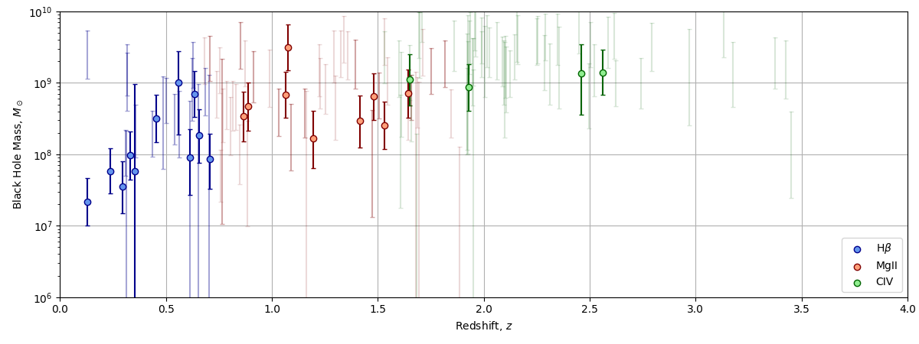

Results: Science
Old Method + LITMUS
(Cut and constrain):
A few dozen SMBH Masses
Cosmic Downsizing
New Method
(Hierarchical):
Hundreds of AGN masses

Slide 40

Thanks
Questions?

