Slide 1
Chart Guidebook
July 2015

Slide 2

Contents
What makes a good Grattan chart?
The rules
Grattan palette
Making charts replicable
Bar/column chart
Line chart
Area chart
Pie chart
Waterfall chart
Charts showing distribution
Combination and multiple charts
Charts appearing in a box
Advanced charts requiring other software

Slide 3
What makes a good Grattan chart?
based on rigorous analysis, but simple, elegant and easy to follow
highlights and provides evidence for a key point made in the text
maximises the data-ink ratio (minimises chart junk)
uses the Grattan palette so that it’s instantly recognisable
clearly labelled (axis, categories, etc.)
understandable without having to read additional text
doesn‘t mislead readers with chart manipulation tricks
How to ruin a chart
information overload
key point not obvious to reader
reader drawn to unimportant quirks instead of key message
too many bells and whistles
labels difficult to read

Slide 4
The rules
save the Grattan chart templates (\\unimelb.edu.au\UoM\Grattan-Institute\General\Templates\Charts\Office chart templates) to your local directory:
PC: C:\Users\<User Name>\AppData\Roaming\Microsoft\Templates\Charts
Mac: Macintosh HD\\Users\<User Name>\Library\Application Support\Microsoft\Office\Chart Templates\
to insert a chart with Grattan formatting, go to insert, charts, templates (mac: insert, charts, other, scroll to templates)
it is also possible to copy and paste data into most charts in this slide deck (right click on chart, edit data, paste into spreadsheet)
charts should utilise a full PowerPoint slide, stretched to the edges with no border
use Arial font (non-bold), size 22 for all axis and labels
avoid angled and vertical text
use textboxes for labels not shown on axes (Arial, size 22, use bold for coloured text)

Slide 5
The rules
use only Grattan colours, and avoid using greys to represent data (these clash with colours when printed in black and white) — if you want to draw readers’ attention away from certain data, use the lightest shade of yellow
axes should be black (including text)
gridlines should be grey
keep units displayed on y-axis to a minimum (ten gridlines is too many!)
scale units appropriately (e.g. use millions of dollars instead of dollars)
y-axis units label is generally displayed in chart subtitle (do not display on chart)
note: if units are $ or %, this is displayed in the chart title; it is not necessary to display this on the axis numbers as well, although sometimes this can help
only label x-axis when units not clear (year, state, country, etc. are obvious, but ‘financial year ending’ should be labelled)
to paste a chart into a report, copy the entire slide, then (in Word) ‘paste special’ and select ‘picture (enhanced metafile)’ (for a mac, just paste normally)

Slide 6
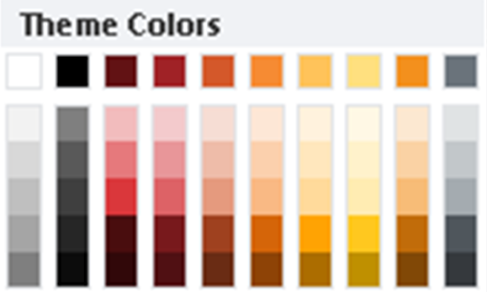
Grattan palette
Main theme
Grattan logo
Forecasts
Gridlines
Suggested order for colour use (for consistency, clarity, contrast):
one colour:
two colours:
three colours:
four colours:
five colours:
six colours:
seven colours:
If you require seven or more colours, are you are displaying too much information?
Avoid text in this colour

Slide 7
Grattan palette
Grattan Colour Scheme RGB
R = 255
G = 224
B = 127
R = 255
G = 195
B = 90
R = 246
G = 139
B = 51
R = 212
G = 88
B = 42
R = 160
G = 34
B= 38
R = 98
G = 18
B = 20
R = 217
G = 217
B = 217
R = 174
G = 174
B = 174
R = 130
G = 130
B = 130
R = 87
G = 87
B = 87
R = 43
G = 43
B = 43
R = 0
G = 0
B = 0
Grattan Official Logo Colours
Box Background Colour
R = 243
G = 144
B = 29
R = 106
G = 115
B = 123
R = 254
G = 240
B = 222
P 7

Slide 8
Making charts replicable
many Grattan charts are used in multiple reports and presentations; it should be easy for someone else to edit your chart in PowerPoint if you get hit by a bus
all Grattan charts should be checked by someone external to the program before publication, as part of the quality control process. The ‘notes’ below each slide should provide the reviewer with all necessary information:
chart title, units, data sources (with url), file path of analysis (ideally on the S drive so that anyone within Grattan can access it), and any additional information that the reader should be aware of
rather than linking your chart directly to a spreadsheet containing your analysis, data should be copied and pasted into the spreadsheet that appears when you right click on a chart and select ‘edit data’. This ensures that the link to the data is not lost when the chart file is saved in a different location
after report publication, all chart data (not analysis) should be saved in an Excel file to be uploaded to the Grattan website, so that all charts can be replicated (by anyone within or outside Grattan). A template for this file can be found at: S:\Templates\Chart data template\

Slide 9
Bar/column chart
useful for displaying data across different categories (e.g. states, cities, age groups)
can be used for time-series data when measuring flows or discrete time data (e.g. government spending by year, intake of international students by year)
vertical bars are preferred (Excel/PowerPoint refer to this as a ‘column chart’)
use horizontal bars when there are many categories, long category names, or positive and negative values (Excel/PowerPoint refer to this as a ‘bar chart’)
black border around bars, 0.25pt
if categories have no natural order, consider ascending/descending order by values
if multiple colours are used, these should be in from lightest to darkest (or vice versa), purely for asthetics

Slide 10
Bar/column chart
if there are multiple sets of categories (e.g. age groups by state), data can be displayed using stacked bars (if it makes sense to aggregate data) or clustered bars (if it does not make sense to aggregate)
for clustered bar, gap between columns should be set to around 70% (rule of thumb)
for stacked bar, appropriate gap between columns depends on the number of bars (usually a large gap works best for a small number of bars, and a small gap for a large number of bars)
stacked bar category labels should be shown to the right of chart (alternatively between bars if there are only two), using coloured text
clustered bar category labels should be shown at the top right of the chart, or below x-axis if there is insufficient space, using coloured boxes with black text (place a rectangle around legend with white fill and no border)

Slide 11
2010
2011
2012
Notes:
Example data with two sets of categories (city and year) – could be plotted either way

Slide 12
Not in labour force
Unemployed
Employed
away from work
Employed
part-time
Employed
full-time
Notes:
Percentage of 20-39 yrs. old graduates by labour force participation status
Purpose of chart: employment outcomes are better for those with a bachelor’s degree relative to those with a diploma
Note that this is created with a conventional stacked column, not a 100% stack (this avoids % signs on the y-axis, which should be in the title)

Slide 13
Other
WA
SA
Qld
Vic.
NSW
Notes:
Number of household solar PV systems installed (thousands)
Purpose of chart: to show that solar PV installations peaked in 2011-12, before incentives were wound back

Slide 14
1986
1991
1996
2001
2006
2011
Notes:
Average annual income ($) by age group, $2011
Purpose of chart: to show that incomes have grown in all age groups except those below 25
Axis units have thousands separator (appropriate for more than 10,000) but no $ sign (since this should be shown in title). Chart shows within-group income growth (or lack thereof) and income differences across age groups.

Slide 15
Proposed
interventions
Other
factors
Benchmark
effect size
Notes:
Effect of interventions on schooling outcomes
Purpose of chart: to show that interventions proposed in report have a stronger impact on results than other factors.
Horizontal bars used to accommodate long category names. Categories are ordered by values (within each group)

Slide 16
Positive
Negative
$ billion
Notes:
Difference in industry contribution to GDP in 2021 under forecast relative to baseline, $ billion
Purpose of chart: to show that the positive contribution of the gas industry to GDP due to price increase is much greater than the negative impact on manufacturing and mining.
Categories ordered from largest to smallest. Long category names look better on the y-axis, and positive/negative breakdown easier to see with horizontal chart.

Slide 17
$72,200
Energy storage system
Solar PV system
$52,200
$56,000
$34,200
$41,000
$26,000
$12,910
$16,200
$8,200
$11,200
Off-grid reliability level
Notes:
Installation price of an off-grid system versus cost of remaining connected to the grid over 10 years.
Purpose of chart: to show that going off the grid with solar and batteries costs a lot more than remaining connected to the grid, and households are likely to sacrifice some reliability to save money.
Data values can be displayed using text on chart instead of a y-axis (but ideally not too many)

Slide 18
Line chart
useful for displaying time-series data, particularly stocks or continuous time data (e.g. government debt, population, housing stock, cumulative installations)
some data are technically discrete, but have little variation across time and are better displayed on a line chart (e.g. GDP, income)
also useful for displaying the relationship between two variables (scatter chart, e.g. government benefits received by income percentile)
what is the key purpose of the chart — is it to show an overall trend, compare the trend between different groups, or to compare the values between different groups?
line width of 4 points (rule of thumb)
x-axis should be positioned ‘on tick marks’ rather than ‘between tick marks’
not all points in time need to be labelled on the x-axis, but should be clear where series begins and ends
category labels should be placed close to the relevant line or to the right of chart
can include forecasts, either using a dotted line, or by inserting a light-grey rectangle behind relevant area on chart
overlapping lines can get confusing — consider plotting on separate charts

Slide 19
Japan
Europe
US
Notes:
Gas prices ($US/GJ)
Purpose of chart: gas prices have increased in Japan and Europe (to a lesser extent), while prices have been relatively constant in the US (and much lower)

Slide 20
Forecast
Qld
NSW
Vic.
WA
Notes:
Example data with a forecast
Forecast area is a shape (rectangle) with light grey fill (no border), placed behind chart

Slide 21
Forecast made in
2012
2013
2014
2015
2016
Actual
Notes:
Budget surplus/deficit as a percentage of GDP.
Purpose of chart: to show that treasury forecasts have been too optimistic.
Dotted lines are another way of distinguishing forecasts, particularly when displaying multiple forecasts.

Slide 22
161
Electricity
136
Gas
100
Notes:
Index of real retail gas and electricity prices (100 = December 2008)
Purpose of chart: to show that gas and electricity prices have both grown significantly in real terms over five years, but electricity has grown by more.
Using an index makes more sense for the comparison, and key values can be displayed on the chart instead of y-axis (for this chart, the purpose is to show the overall growth – if you want to draw attention to the pattern of growth it would be better to include a y-axis)

Slide 23
Adelaide
Perth
Brisbane
Sydney
Melbourne
9%
8%
32%
12%
22%
IEA 2020
forecast
IEA 2030
forecast
Percentage decrease in solar PV system cost
Notes:
Net present value of installing a 3kW solar PV system by percentage decline in system cost. Breakeven points highlighted on chart.
Purpose of chart: shows that solar PV is likely to become economic in all cities (bar Melbourne) before 2020, according to IEA forecast.

Slide 24
Area chart
closely related to line chart and the stacked bar chart
stacked area charts are useful for time-series data with stocks rather than flows, where different categories naturally aggregate (e.g. states aggregate to country)
can also be used when the area under the curve has an explicit meaning
can sometimes be misleading (some areas may appear larger than they actually are, while some appear smaller)
with stacked area, category labels should be placed to the right of the chart
marimekko chart: created with an area chart, but looks like a bar chart (or stacked bar) with varying widths — the width of each bar represents another dimension

Slide 25
Rest of World
Australia
US
Italy
China
Germany
Notes:
World solar PV capacity (GW)
Purpose of chart: to show that Australia’s solar PV capacity is a small fraction of global capacity (and other countries, such as Germany, have a much higher capacity)
Black is used for Australia to stand out from other countries

Slide 26
Non-mining
Mining
Notes:
Business investment as a percentage of GPD
Purpose of chart: mining is currently a large share of business investment

Slide 27
Electricity consumed
Solar output consumed
Solar exported to grid
Notes:
Average pattern of daily consumption and solar PV output (kW), north-facing.
Purpose of chart: to show that solar PV output is typically low when household consumption is highest.
Consumption/output is represented by the area, whereas the line represents demand/production at a point in time.

Slide 28
Full time
Part time
No
children
Not in
labour force
Not in
labour force
With
children
Part time
Full time
Notes:
Female workforce participation by age cohort.
Purpose of chart: to show that most mothers either work part time or not at all.
Created with a stacked column chart, but presented as a stacked area.

Slide 29
Aluminium
(6.1%)
In scope
Out of scope
Cement & lime
(1.4%)
Alumina
(2.8%)
Black
coal
(5%)
Iron &
steel
(3.9%)
Oil & gas
(3.7%)
Petroleum &
coal products
(1.5%)
Brown
coal
(0.1%)
3
6
9
Share of national production (per cent)
Notes:
Emissions intensity (tonnes of CO2 per $m revenue) by industry by share of national production. Brackets correspond to share of national emissions.
(in scope/out of scope determined industries examined in the report)
To create marimekko chart, use an area chart, but set the X-axis to a ‘date axis’. Different coloured bars are selected separately.
There is a tendency for a date axis to go haywire for values less than 1, so often it is necessary to multiply all values by 100 (as in this case). When this happens, X-axis values need to be created using text boxes

Slide 30
Annual real growth rate, 2000-12 (per cent)
Tradables
Non-Tradables
Agriculture
Professional and
financial services
Wholesale and retail
Mining
Construction
Info. Tech
Education
Transport
Utilities
M’fg
Health
Other
2012 Gross
value added
(per cent)
Notes:
Purpose of chart: to show that output growth has been fastest in resources and non-tradables
Marimekko chart has been created on a 90 degree angle (necessarily) – chart can be rotated, cropped and expanded when pasted into report — size 16 font is equivalent when chart is expanded

Slide 31
Pie chart
useful for showing the proportion of one or two categories to the whole
analogous to a clock face, pie charts work best when the size of the category of interest is close to a quarter, half, or three-quarters (since these regions are easy for people to calculate) — the key arc should start at 12 o’clock moving clockwise
can be a misleading chart (rotation of pie can make it difficult to determine the size of some slices), so best to keep it simple, or use another chart
if all categories are of interest, the same information can be displayed in the more visually-appealing waterfall chart, or in a stacked bar
good practice to include the relevant percentages on the chart

Slide 32
Wholesale price: $4/GJ
(total bill: $947)
Wholesale price: $9/GJ
(total bill: $1075)
Green Costs
5.8
Wholesale
10.8
Green Costs
5.1
Wholesale
21.5
Retail
24.3
Retail
21.4
Network
59.1
Network
52.0
Notes:
Components of an average three-bedroom household’s gas bill – Sydney, 2014, percentage
Purpose of chart: to show that gas price increases will effectively double the wholesale component of a household’s gas bill, but that this is a small component overall
Important slice of the pie is emphasised in both cases, and percentages are shown on chart (since this can be difficult to determine directly from chart)

Slide 33
Wholesale price: $4/GJ
(total bill: $947)
Wholesale price: $9/GJ
(total bill: $1075)
Green Costs
5.8
Green Costs
5.1
Wholesale
10.8
Wholesale
21.5
Retail
24.3
Retail
21.4
Network
59.1
Network
52.0
Notes:
Alternative way of presenting the same pie chart – key slice of pie is shown in orange relative to a light shade of yellow.

Slide 34
Waterfall chart
used for showing how components aggregate to a total. Usually better than a pie chart for this purpose as it indicates both actual values and percentages
not a default chart in PowerPoint — created using a stacked column chart where some components are whited out (no fill, no border)
column width set to 20% (rule of thumb – set higher when there are few categories)
dotted line between bars created with error bars (layout tab, error bars)
can incorporate both positive and negative values

Slide 35
Notes:
Consumption of natural gas by end user, 2012-13, petajoules
Purpose of chart: to show that residential and small business gas use is much smaller than industrial use

Slide 36
83%
10%
7%
Notes:
Government HELP lending broken into components, billions of dollars, $2016-17
Purpose of chart: to show how much government reforms will save, as well as how much doubtful debt remains
Reverse waterfall

Slide 37
Benefits
Costs
Notes:
Net present value of installing a 3 kilowatt solar PV system in Brisbane over 15 years.
Purpose of chart: to show that the benefits of installing solar do not outweigh the costs over a 15 year period.
Data labels used for category names and figures. Error bars used for dotted lines and to hide y-axis when bars cross over.

Slide 38
−7
12
−10
−7
14
−41
25
0
Budget
deficit
2015-16
2015-16
budget
measures
Personal
income tax
growth
Other
revenue
growth
above GDP
Spending
growth
below GDP
Initial
deficit
growth at
nominal GDP
Other
Budget
deficit
2018-19
Notes:
2018-19 budget compared to 2014-15 budget, $billion (nominal)
Purpose of chart: to show that a significant proportion of the deficit reduction is due to bracket creep
Positive and negative contributions shown in different colours. Error bars used for dotted lines and to hide y-axis when bars cross over.

Slide 39
Minimum standard
Notes:
Equivalent year level by NAPLAN score, shown with minimum standards.
Purpose of chart: to shown that the relationship between NAPLAN score and progress is non-linear, and also that the rate at which the minimum standard grows is below average.

Slide 40
Charts showing distribution
histogram: shows the frequency or proportion of data points that lie within pre-specified bin ranges (use column chart with no gap between columns, or a scatter chart overlaid with an area chart)
scatter plot: used to visualise a relationship (especially linear) between two variables (usually the independent variable on x-axis), showing how this relationship is distributed. Can include a line of best fit, if relevant. Also can be used to show how the distribution of one variable differs across different categories
bubble chart: a scatter plot with weights — useful for displaying the relationship between two variables where data points have different weights (e.g. countries weighted by population)
average-min-max chart (similar to box plot): shows the spread of data across a range of categories from minimum to maximum (or a 95 per cent confidence interval) with the average/median displayed. Can also be used to display regression results (use stacked column with a scatter plot on secondary axis)

Slide 41
Weekly income ($)
Notes:
Distribution of weekly income (2011 census, $2011). Height of bar shows percentage within each band. Area of each bar is proportional to total income paid to each group (with the exception of the highest category, since some earn more than $3000/week)
Histograms look much better with the x-axis labels on the tick marks (rather than between). This chart is created as an area chart with a date axis (see: http://peltiertech.com/fill-under-between-series-in-excel-chart/ for details) – to ensure that bar on right is open, it is overlaid with an XY scatter to create black lines

Slide 42
Weekly income ($)
Notes:
Weekly electricity expenditure by weekly income (trend line shown)
Purpose of chart: shows that people who earn more spend more on electricity, but the relationship is weak.
Dots have a solid outline and transparent fill (easier to see when there is overlap). If more data are displayed, it is appropriate to reduce the size of the dots and increase transparency

Slide 43
Medicare
local areas
Cholecystectomy
Colectomy
Hip replacement
Appendectomy
Lumpectomy
Mastectomy
Knee replacement
CABG
Hysterectomy
Open prostatectomy
Closed prostatectomy
Tonsillectomy
Deviation from national average
Notes:
Purpose of chart: shows that there is a high level of regional variation in procedures

Slide 44
= 5 Mt
Wind
Solar
Coal
Notes:
Example bubble chart (e.g. could be cost per megawatt-hour on y-axis versus emissions intensity on x-axis, with size of the bubble representing power plant capacity)

Slide 45
North America
Australia
South America
Asia
Europe
Oceania
Africa
= 300m
GDP per capita ($US)
Notes:
Life expectancy explained by GDP per capita (log scale, base 10). Bubble size represents population
This is Hans Rosling’s famous chart presented with Grattan colours.

Slide 46
Coronary artery disease
Dyspepsia
Chronic heart failure
Hypertension
Low back pain
Panic disorder
COPD
Diabetes
Venous thromboembolism
Osteoporosis
Depression
Atrial ﬁbrillation
Cerebrovascular accident
Community-acquired pneumonia
Osteoarthritis
Preventive care
Surgical site infection
Asthma
Hyperlipidaemia
Obesity
Antibiotic use
Alcohol dependence
Percentage of appropriate care received
Notes:
Purpose of chart: to show there are high levels of inappropriate care, and high levels of variation in clinical practice.
Point estimate (scatter) and confidence intervals (stacked bar with 500% gap between columns) shown. Chart can be cropped and expanded to take up a single column of a report — size 16 font is equivalent when chart is expanded. (This chart appears to have height greater than width, but it is actually approximately height = width)

Slide 47
Combination and multiple charts
combination: chart with a secondary y-axis, and two (or more) chart types (e.g. bar chart and line chart). It is easy to mislead with such a chart, so caution is advised
tick marks on secondary y-axis should align with those on primary axis — ensure that axes’ units are formatted correctly
multiple charts with a common axis (2x1, 1x2, 3x1, 2x2, 3x2, etc.) — sometimes two categories cannot be display on the same chart, or it is easier to read when displayed separately

Slide 48
Megawatts
$ billion
Cumulative
spend (RHS)
Monthly installed
capacity (LHS)
Notes:
Monthly capacity of solar PV installed by cumulative amount spent (nominal).
Both axes have six tick marks (including zero), even though a different scale is used.

Slide 49
Income decline
Income increase
2011
1976
15-19
20-24
25-34
35-44
45-54
55-64
65-74
Notes:
Alternative way of presenting the data in slide 14 (area and line chart together), with two additional years added (over 75s excluded).
Colours used to indicate increase/decline, and light shade to indicate age group.

Slide 50
Value-added
Exports
90th percentile
90th percentile
Median
Median
10th percentile
Australia
10th percentile
Australia
Notes:
Manufacturing value-added % GDP and Manufacturing exports as a percentage of GDP, current prices – OECD members in 1970 plus Australia & New Zealand
Purpose of chart: to show that manufacturing in Australia’s manufacturing value added and exports are toward the lower end of the OECD distribution
Utilises both line and area charts. Both charts share y-axis (no need to put axis on both charts)

Slide 51
Value-added
90th percentile
Median
10th percentile
Australia
Exports
90th percentile
Median
10th percentile
Australia
Notes:
Same data as previous – alternative approach would be to have charts on top of each other rather than side-to-side.
Charts share x-axis. Chart can be cropped and expanded to take up a single column of a report — size 16 font is equivalent when chart is expanded.

Slide 52
Mining states
Output
price
Non-mining states
Real output
per capita
Population
Notes:
Indices comparing mining states to non-mining states (100 = 2003)
Charts share x-axis. Chart can be cropped and expanded to take up a single column of a report — size 16 font is equivalent when chart is expanded (lines are 3pt instead of 4pt).

Slide 53
Mining states
Non-mining states
Growth in average weekly earnings (real)
1995/6-
2002/3
2002/3-
2011/12
1995/6-
2002/3
2002/3-
2011/12
Growth in household income per person (real)
Notes:
Purpose of chart: all states benefitted from the mining boom, but real household disposable income grew much faster in mining states

Slide 54
NSW
Vic.
Peak demand
Total consumption
127
114
100
101
100
101
Qld
SA
135
119
114
100
100
96
Notes:
Index of peak electricity demand and total electricity consumption.
Purpose of chart: to show that peak demand has grown faster than total consumption in NSW, Vic., Qld and SA
Why four charts? Too many lines to display on one chart, plus it would be difficult to distinguish between states

Slide 55
Charts in boxes and advanced charts
charts that appear in a report box: design tab, background styles, format background, choose colour: R:254, G:240, B:222 to match box. Can be pasted into a box (small or large) in the normal way (make sure any text boxes have ‘no fill’)
advanced charts can be created using specialised software, for example:
map with colour-coded areas (choropleth): MapInfo, ArcGIS, Q-GIS, Stata, R, Tableau
square pie chart: an alternative to a pie chart, which looks much better when there are more categories (Tableau, LaTeX)
heat map matrix: relationship between two variables indicated by colour (R, Tableau, Excel, e.g. number of customers every hour across a week)
contour map: can show a density/histogram across two dimensions (Stata, R)
venn diagram: can be created using ‘SmartArt’, but venn diagram plotter allows the size and overlap of the circles to vary according to input data
interactive charts: unchartered waters for Grattan, but there’s a first for everything…

Slide 56
Sydney
Melbourne
Brisbane
Adelaide
Notes:
Background shaded same colour as box. Same data as slide 11 with categories reversed.
In this example, gridlines are set to box background colour, created using error bars (requires inputting data onto a secondary axis with a scatter plot)

Slide 57
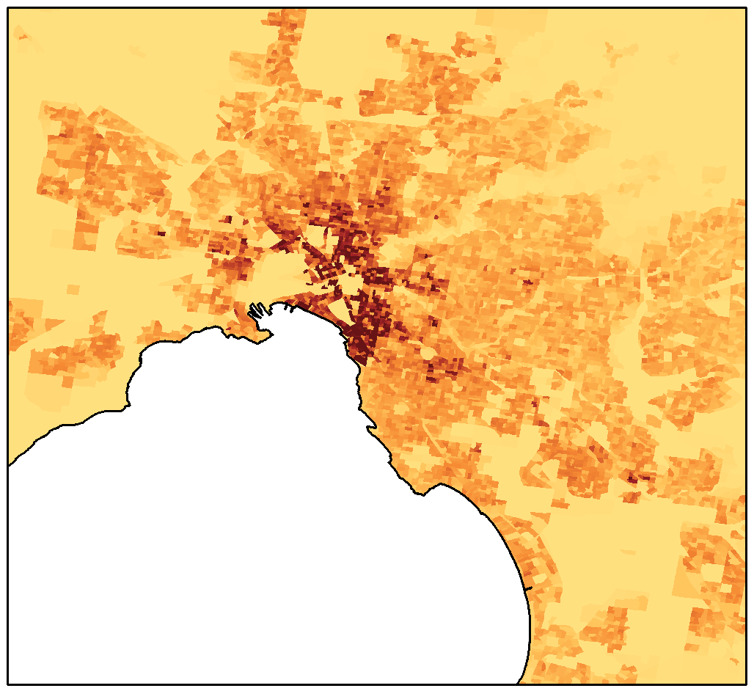
>5000
<50
0
10
kilometres
Notes:
Melbourne population density (number of working age people per square kilometre)
Map created using Stata

Slide 58
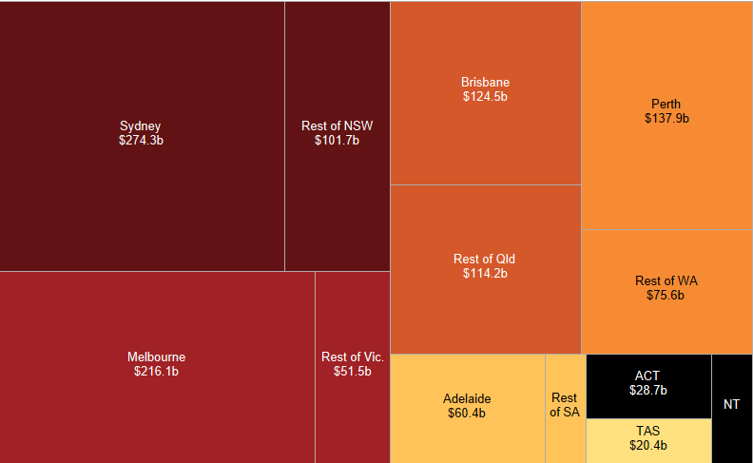
Brisbane
$124.5b
Rest of
NSW
$101.7b
Perth
$137.9b
Sydney
$274.3b
Rest of Qld
$114.2b
Rest of WA
$75.6b
Rest
of Vic.
$51.5b
Melbourne
$216.1b
ACT
$28.7b
Adelaide
$60.4b
TAS: $20.4b
Rest of SA
$16.3b
NT
$16.0b
Notes:
Economic activity by city/rest of state ($2011-12)
Example of a square pie chart, colour-coded by state (created in Tableau, with text added in PowerPoint)

Slide 59
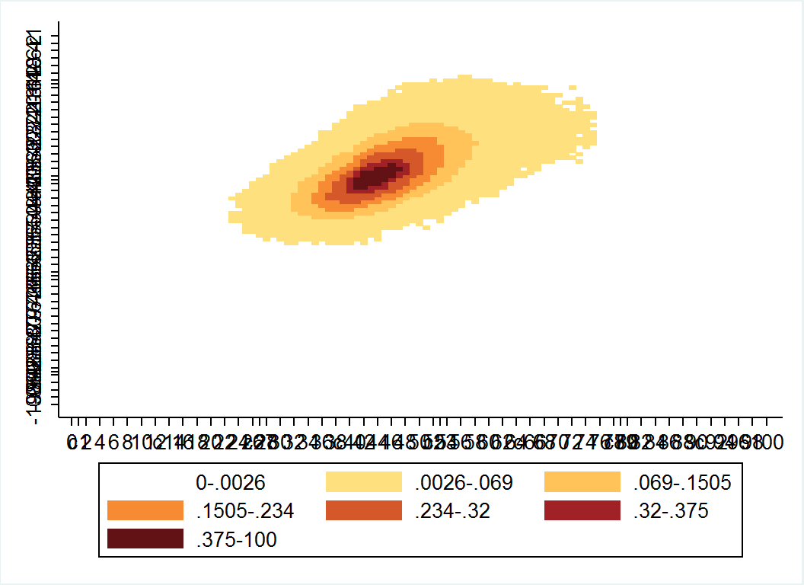
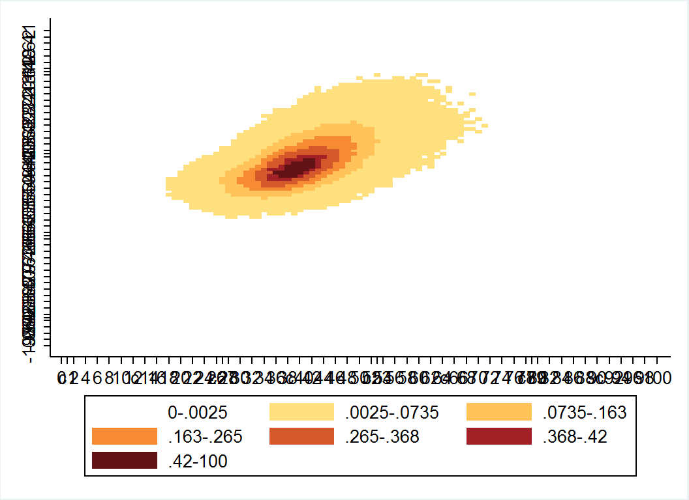
Highest SES quintile
Lowest SES quintile
Year 9 score
1
20
1
40
60
20
90
80
40
60
80
90
800
Year 3 score
Year 3 score
Notes:
Contour map of student learning progression, based on NAPLAN scores. Contour map created in Stata, with line chart overlaid. Line of best fit for high and low SES is shown on each chart.
Purpose of chart: to show that high-achieving year 3 students do not improve as much by year 9 in low SES areas relative to high areas.

Slide 60
kilowatt hours:
0
0.3
>1.0
Notes:
Example of a heat map matrix – a household’s half-hourly electricity consumption (kilowatts hours) over the month of January (created using conditional formatting in Excel, but there are more advanced programs for this). There are nearly 1500 data points in this chart, but the heat map shows particular patterns that wouldn’t be easy to see on other charts

Slide 61
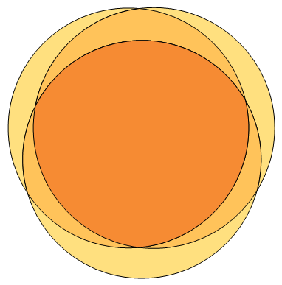
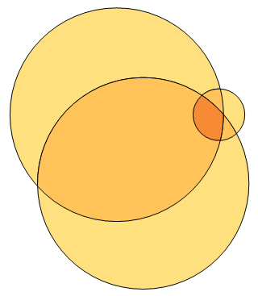
Melbourne
Brisbane
Hot water
(84)
Heating
(84)
Hot water
(70)
14
30
1
Heating
(4)
2
2
1
1
59
38
1
9
9
28
5
Cooking
(82)
Cooking
(68)
Notes:
Percentage of gas households connected to each appliance
Purpose of chart: to show that Melbourne households typically use gas for multiple appliances, while Brisbane households typically use gas for only one or two appliances.
Created using venn diagram plotter, with text and circle outlines added in PowerPoint.

