Slide 1
Intermittent component
Built capacity
Peak demand
Notes:
After five years of excess capacity, supply is now tightening
Units: Gigawatts
This figure compares total generation capacity with NEM peak demand since the NEM began
Sources: AER wholesale statistics as at end 2016-17
https://www.aer.gov.au/wholesale-markets/wholesale-statistics/generation-capacity-and-peak-demand
AEMO Generation information 2012-2017 for intermittent component (NOTE: info not available prior to 2012)

Slide 2
Notes:
Figure: Wholesale electricity prices have increased and are expected to remain above historic levels
Annual volume-weighted average wholesale prices since the NEM began + futures prices to 2019/20
Units: $/MWh
Notes: prices 4 years out tend to be lower because there is less demand – most hedging occurs up to 2 years out
Source: AER wholesale statistics
https://www.aer.gov.au/wholesale-markets/wholesale-statistics/annual-volume-weighted-average-spot-prices
AER wholesale statistics – average quarterly base futures prices to 2020, as at end of Q2 2017
https://www.aer.gov.au/wholesale-markets/wholesale-statistics/quarterly-base-futures-prices

Slide 3

Report scope
Resource adequacy
Sufficient and appropriate generation is built in time to meet future demand
Reliability
Supply availability
A dependable supply of electricity
Existing generation produces electricity when needed
The system is in
balance even when something breaks
Security

Slide 4
Proposed
Committed
Coal
Gas
Solar
Wind
NSW
VIC
QLD
SA
NSW
VIC
QLD
SA
Notes:
Figure: Proposed and committed projects, by fuel type and location
Units: ‘000 MW (Gigawatts of potential new generation by fuel type and region)
Notes: Potential new generation projects as at June 2017. Proposed projects are those that have been publicly announced and may have completed initial feasibility studies, but have not yet received a Final Investment Decision (FID). Projects at the Committed stage of development have received a FID and have either started, or are expected to start construction.
Rooftop solar PV installations not included. Hydro and biomass not included (only a very small share of proposed projects).
Source: Investment pipeline as at 5 June 2017, AEMO Generation Information: http://www.aemo.com.au/Electricity/National-Electricity-Market-NEM/Planning-and-forecasting/Generation-information

Slide 5
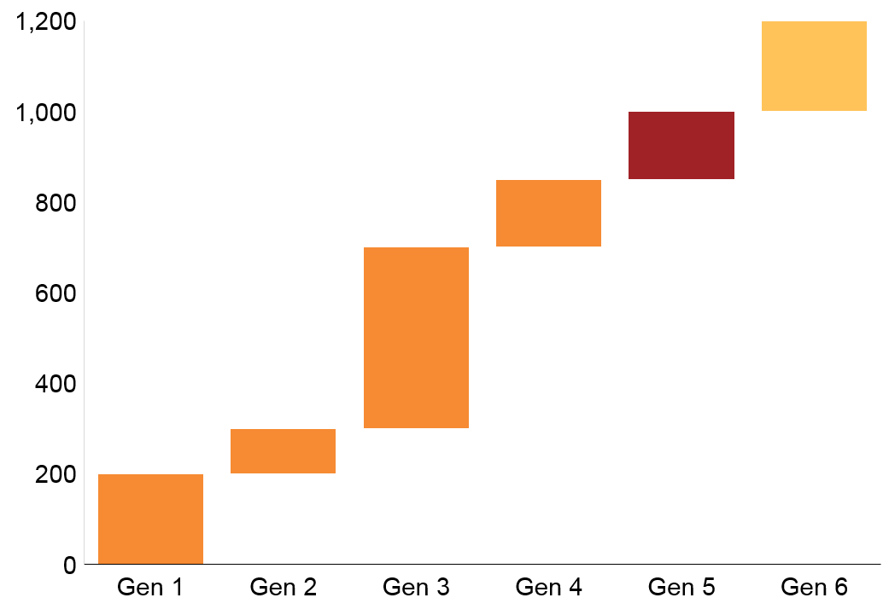
$75
$50
$40
$35
$30
$20
Notes:
Hypothetical example of the merit order / bid stack to meet demand of 1000 MW

Slide 6
Min – Max
Years forward
Notes:
Figure: A typical hedge profile
Source: reproduced from MEI 2016 - Submission to the The Energy Value of Distributed Generation Distributed Generation Inquiry Stage 1 Draft Report. http://www.esc.vic.gov.au/wp-content/uploads/2016/06/Melbourne-Energy-Institute.pdf

Slide 7
VIC
SA
Reliability standard
Notes:
Figure: Only two breaches in past years
Units: Unsupplied energy (% of regional native consumption)
Notes: Actual data not yet published for 2016-17.
Source: AEMC Annual market performance reports – 2016 + historical data in the 2015 and 2013 reports

Slide 8
Other
Additions
Wind
Gas
Coal
Retirements
Notes:
Source: AER provided data up to 2015-16; 2016-17 data comes from AEMO generation information
Note: Retirements exclude mothballed plant

Slide 9
Price
Other generators increase prices when intermittent renewables are unavailable
LRMC
Normal volatility
SRMC
Intermittent renewables depress prices when available
Time

Slide 10
SA
Above $300
QLD
NSW
VIC
Below $0
SA
VIC
NSW
QLD
Notes:
Frequency of prices below $0 or above $300 by financial year
Kael’s analysis in R (replicated by Kate)

Slide 11
Notes:
Figure: Trading activity has typically been lower in South Australia
Units: Volume of electricity traded by region as a share of regional consumption
Source: Grattan analysis of AFMA 2015 Data

Slide 12
Notes:
Figure: % megawatt hours under contracts of 1 year or less
Source: AFMA 2015 data

Slide 13
Notes:
Figure: Resource adequacy projections over time
Units: Number of years until first identified reserve shortfall
Notes: ESOO projections look up to 10 years out. The Victorian and South Australian resource adequacy projection for 2016 was impacted by the announcement of Hazelwood’s retirement
Source: Grattan analysis of AEMO Electricity Statement of Opportunities (ESOO) reports 2010-2016

Slide 14
Policy outcomes | Reliability mechanisms
 | Energy-only market | Day-ahead market | Strategic reserves | Capacity market
Supply available | ✓ | ✓ | ✗ | ✓
Back-up available | - | ? | ✓ | -
Sufficient generation built | ? | ? | ✗ | ✓
Cost to consumers | $ | $$ | $$ | $$$
Flexibility through the transition | ✓ | ✓ | ? | ?
Environmental performance | Depends on design
Notes:
Illustrative only

Slide 15
Capacity
Ancillary services
Energy
2014
2015
2016
Notes:
Notes: a = SPP, b = ERCOT, c = MISO Average, d = CAISO, e = PJM Average, f = ISO-NE Hub, g = NYISO Average
Source: ERCOT state of the energy market reports 2015 and 2016

Slide 16
Now
No
Resolve emissions reduction mechanism for the electricity sector
1. Governments implement the Finkel blueprint
Yes
2. AEMO implements a new resource adequacy monitoring system
Yes
3. ESB begins preliminary work on a retailer capacity obligation
Is there a model that works with the NEM?
No
Consider another capacity mechanism instead
Ongoing
Yes
4. AEMO and the ESB monitor the market
Have the criteria for intervention been met?
No
No further action required
Yes
Introduce preferred capacity mechanism
Notes:
Flow chart of recommendations

Slide 17
43%
(5% other)
Qld Gas Scheme
26%
26%
Solar
Wind
Gas
Coal joint venture
Coal
Notes:
New public and private investment in coal, gas and wind since the NEM began (1999-2016)
Units: Gigawatts
Notes: Coal, gas, wind and solar represent 95% of large-scale generation investment in the NEM since 1998. The other 5% includes hydro, landfill gas, diesel among other things. Joint ventures (50/50 public/private) are included in the government column (1.3 GW); Wind projects are subsidised through the RET;
Source: Pieced together from AER data of new investment over time by fuel type, AEMO generation information and Simshauser 2008.
See AER Fig 1.16 KG edits.xlsx

