Slide 1
Spatial Regression
SPATIAL EPIDEMIOLOGY
Week 6
Hugh Sturrock

Slide 2
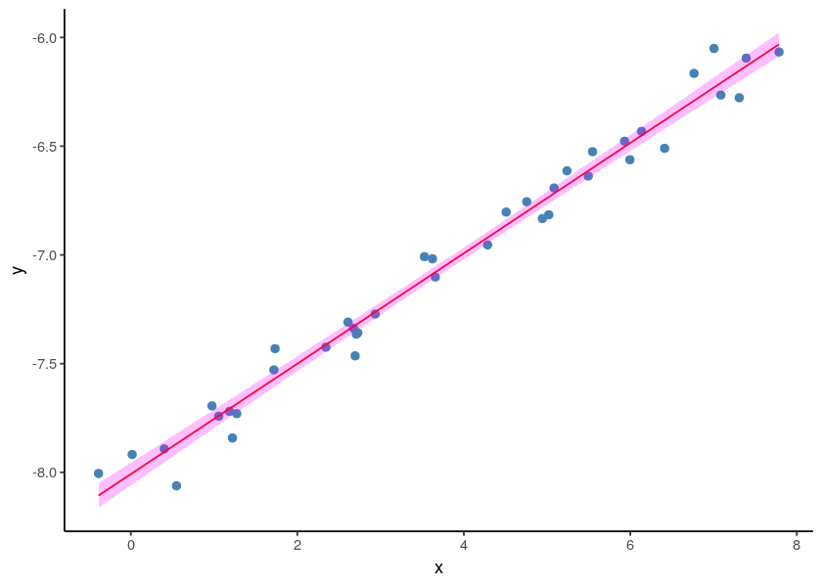
Linear Regression
We try to explain Y in terms of X.

Slide 3
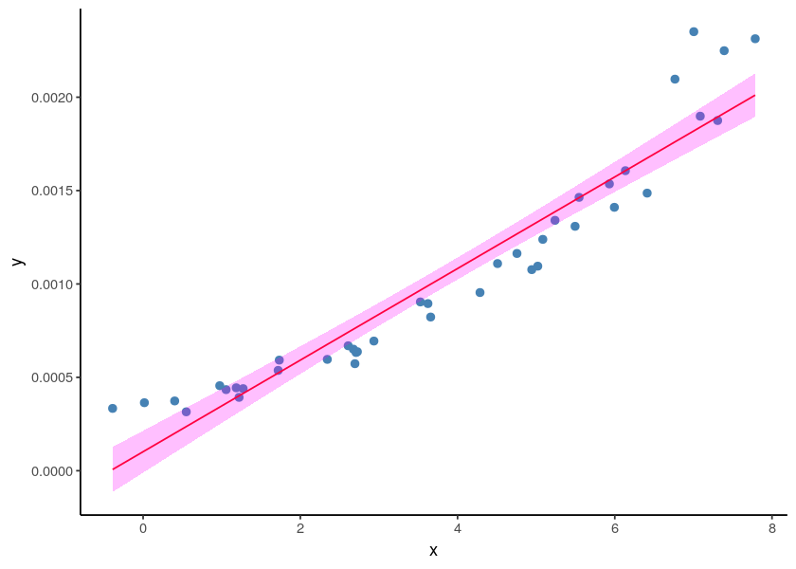
Linear Regression
Sometimes the standard linear regression is not a good assumption.

Slide 4
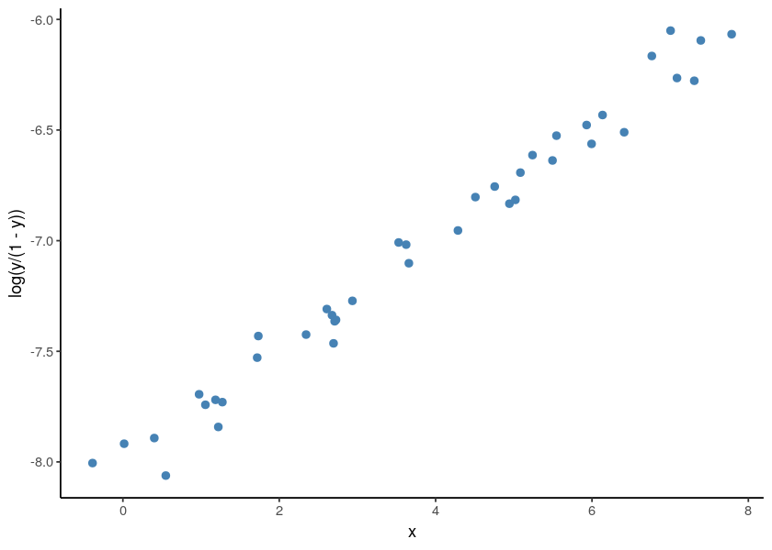
Generalized Linear Model
Find a transformation where the assumptions of the standard linear regression work.

Slide 5
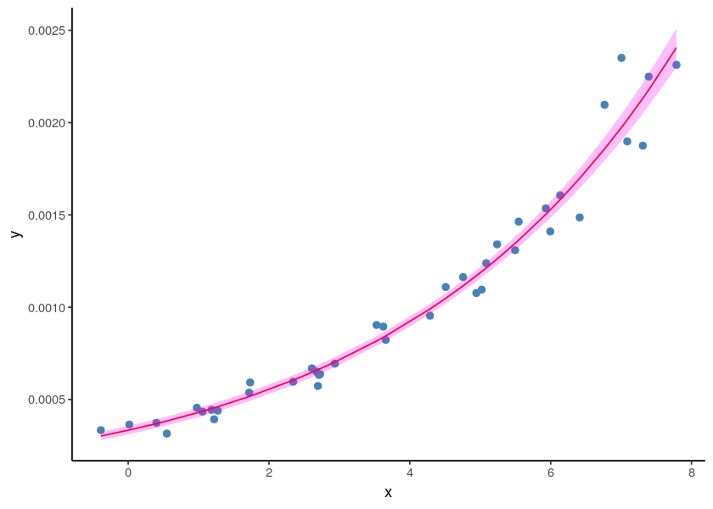
Generalized Linear Model

Slide 6
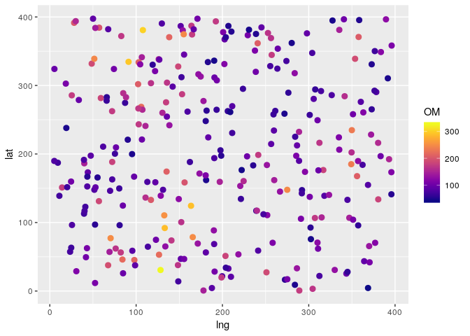
Example
Assumptions:
We are interested in a property of the soil, say amount of organic matter.
We take samples at different locations in a parcel.
We have one covariate: humidity .

Slide 7
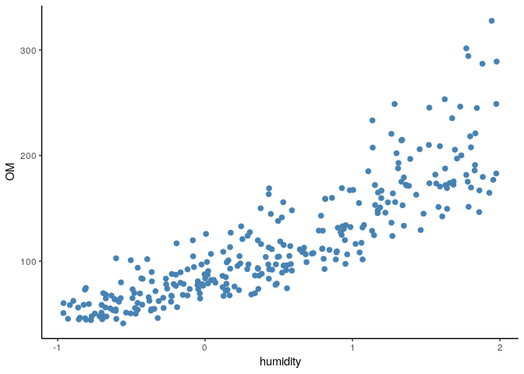
Example

Slide 8
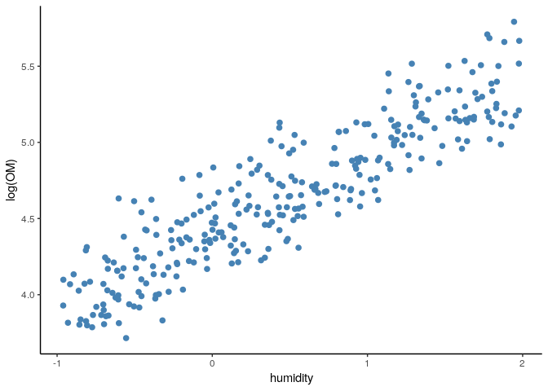
Example
We can use a GLM with log transformation.

Slide 9
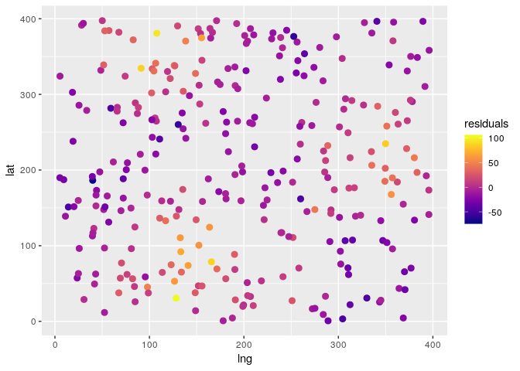
Example
Now look at the residuals.
They don’t look like i.i.d (not independent anyway)

Slide 10
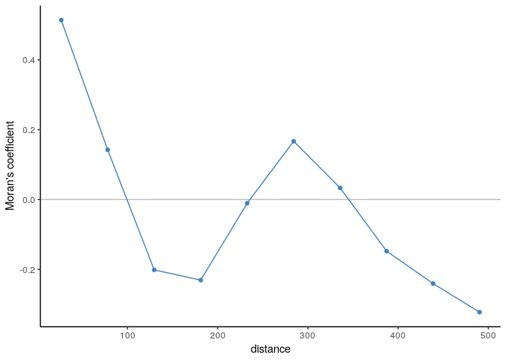
Example
If we calculate a correlogram from the residuals, there is clear evidence of residual spatial autocorrelation

Slide 11
Model-based geostatistics
Like a GLM, but we can add a spatially correlated random effect.
logy_{i} = β₀ + β₁x_{i} + e_{i} + b_{i}

Slide 12
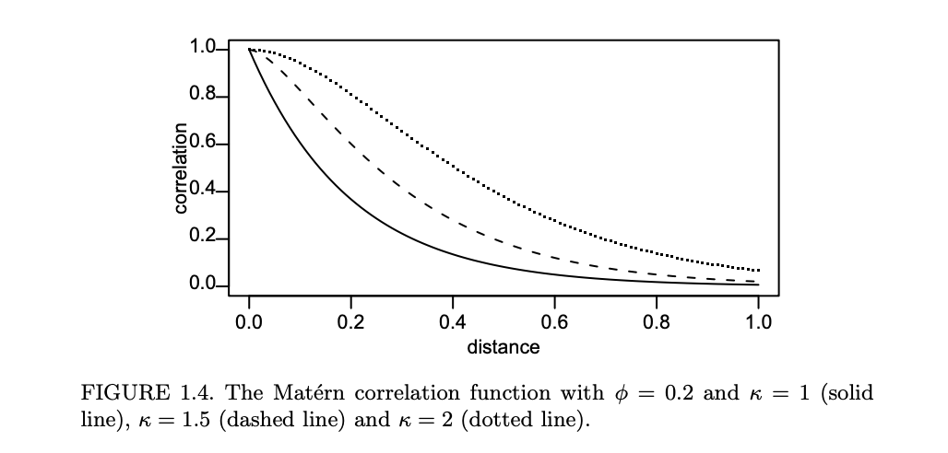
Model-based geostatistics
Like a GLM, but we can add a spatially correlated random effect.
Diggle PJ, Ribeiro PJ, Christensen OF. An introduction to model-based geostatistics. InSpatial statistics and computational methods 2003 (pp. 43-86). Springer, New York, NY.

Slide 13
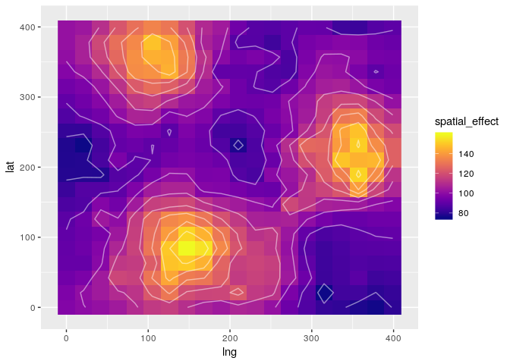
Example
Spatial effect incorporated as smooth function.

Slide 14
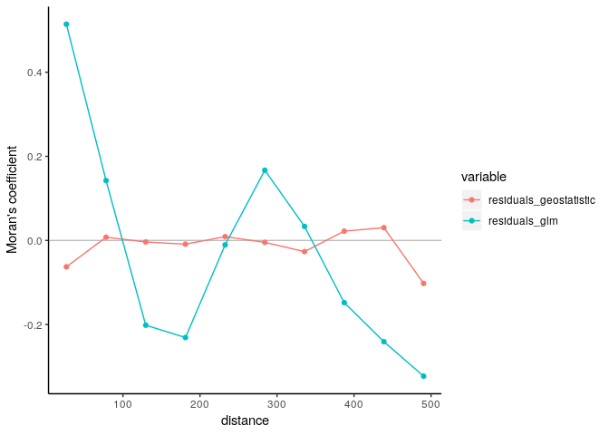
Example

Slide 15
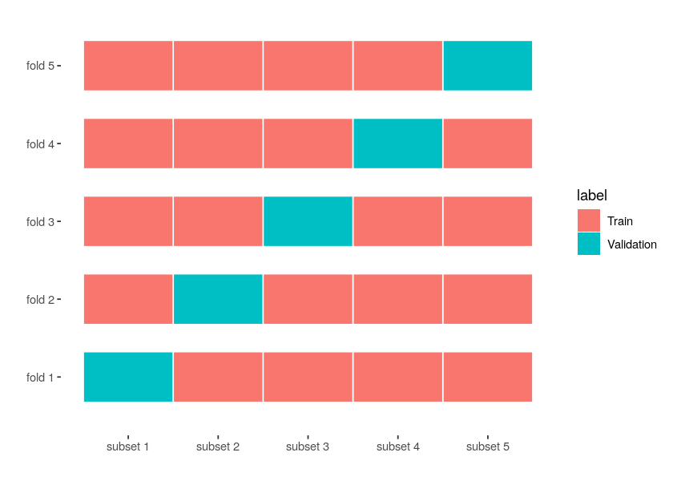
Cross-Validation
Can be used for model selection.
Compute MSE or a different metric of performance with competing models.

Slide 16
Cross-Validation
MSE of competing models
Non-spatial GLM
Spatial GLM
991.7 720.6
1954.4 1422.0
2160.0 1875.6
704.5 542.0
641.2 626.2
1076.8 967.4

Slide 17
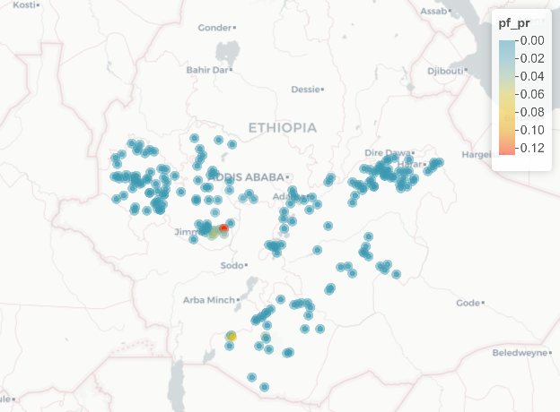
Ethiopia example
We have prevalence data of malaria.

