Slide 1
Spatial Regression
Applied Spatial Analysis for Public Health
Week 6

Slide 2
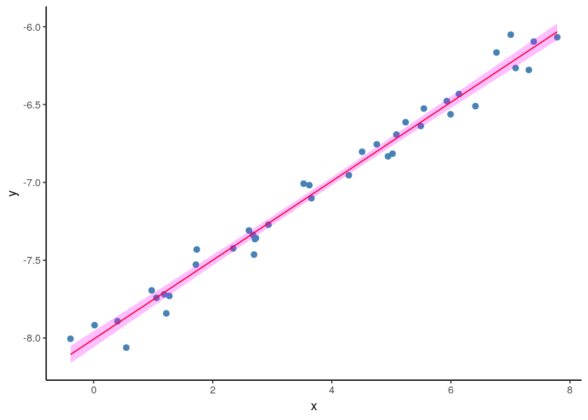
Linear Regression
We try to explain Y in terms of X.

Slide 3
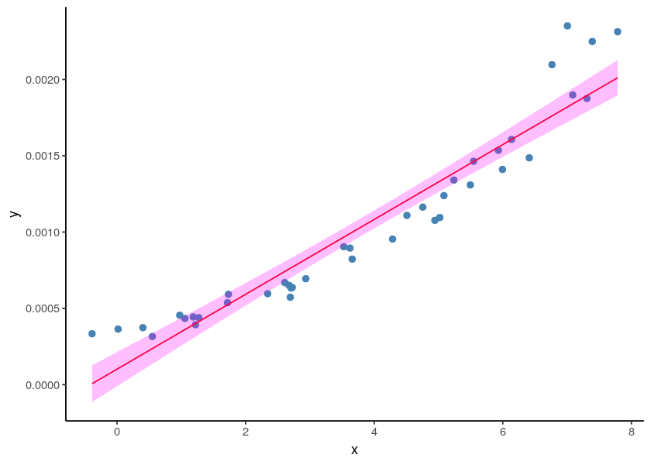
Linear Regression
Sometimes the standard linear regression is not a good assumption.

Slide 4
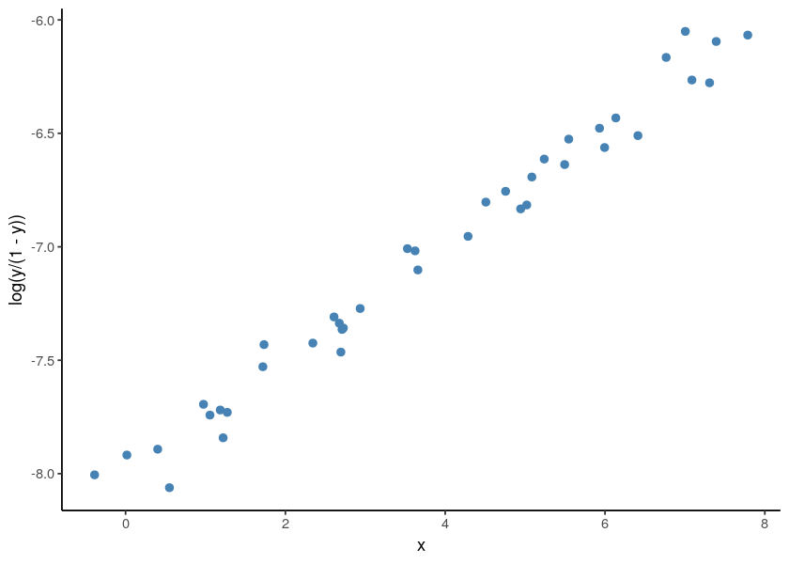
Generalized Linear Model
Find a transformation where the assumptions of the standard linear regression work.

Slide 5
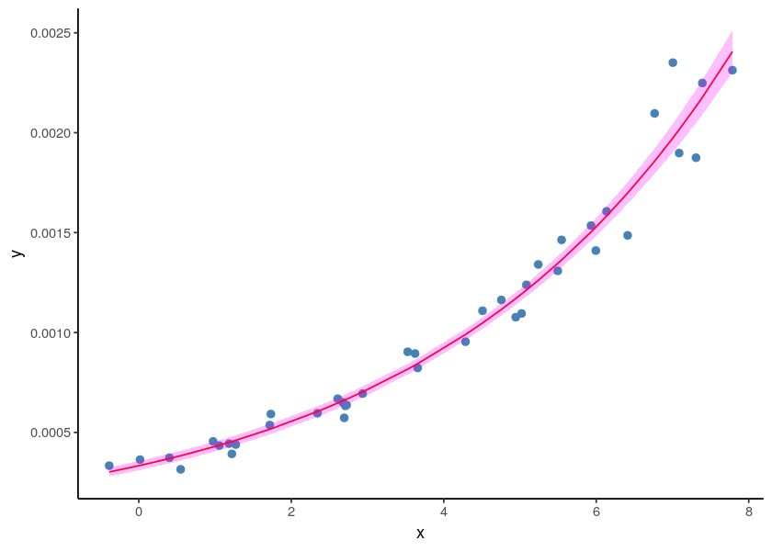
Generalized Linear Model

Slide 6
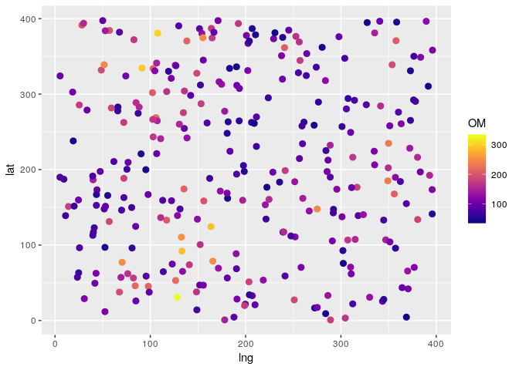
Example
Assumptions:
We are interested in a property of the soil, say amount of organic matter.
We take samples at different locations in a parcel.
We have one covariate: humidity .

Slide 7
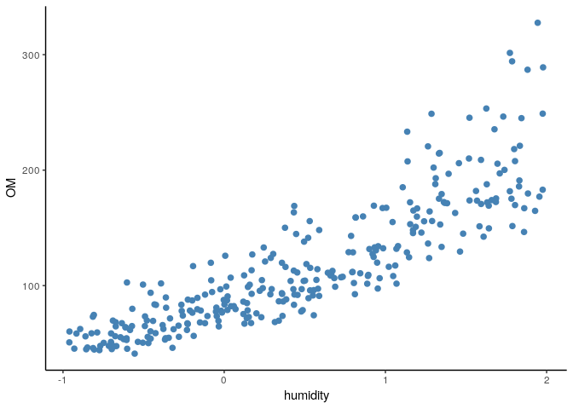
Example

Slide 8
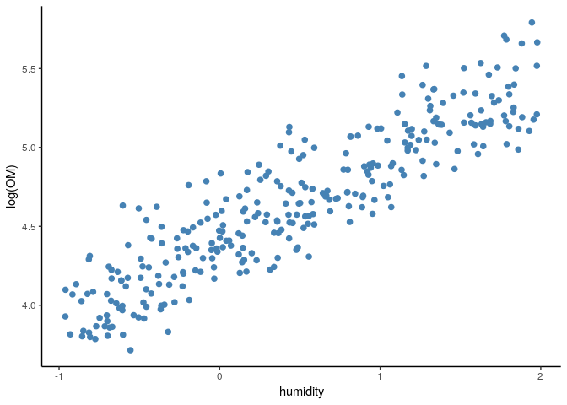
Example
We can use a GLM with log transformation.

Slide 9
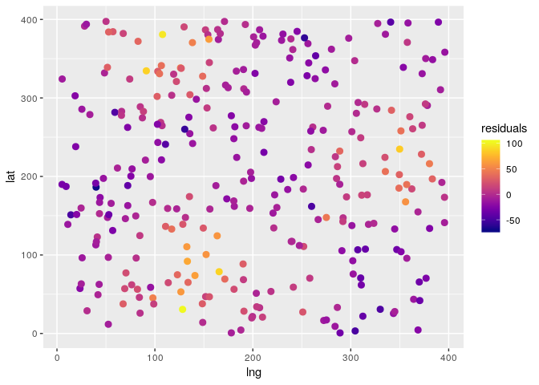
Example
Now look at the residuals.
Then don’t look like iid.

Slide 10
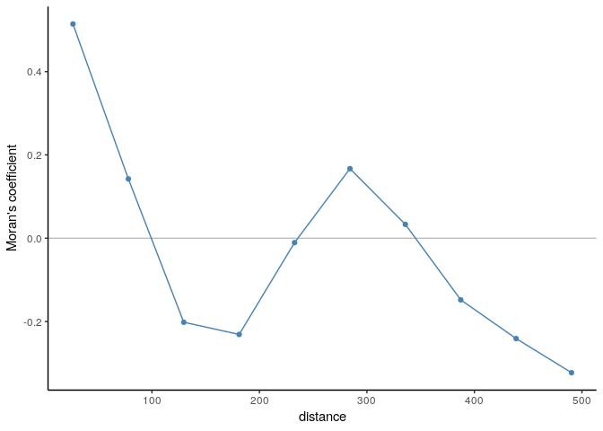
Example

Slide 11
Generalized Additive Model
Like a GLM, but we can add smooth functions as explanatory variables.

Slide 12
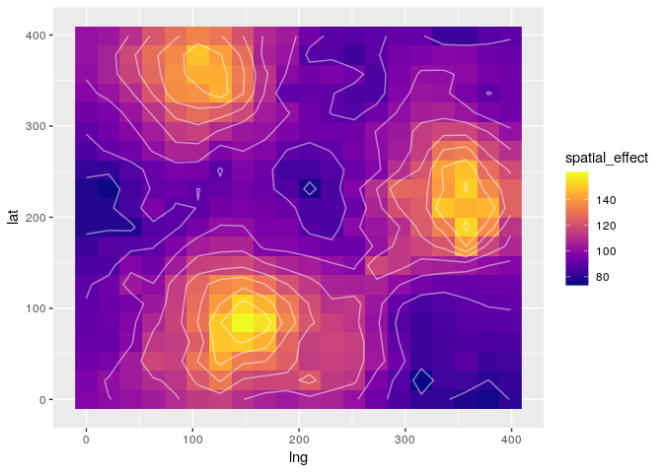
Example
Spatial effect incorporated as smooth function.

Slide 13
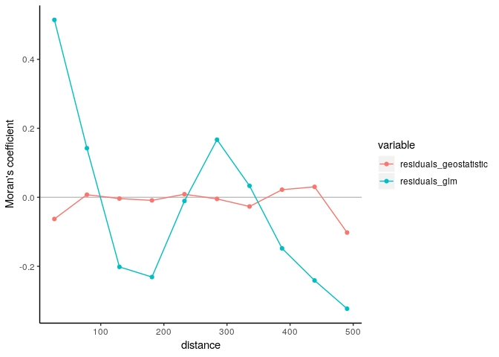
Example

Slide 14
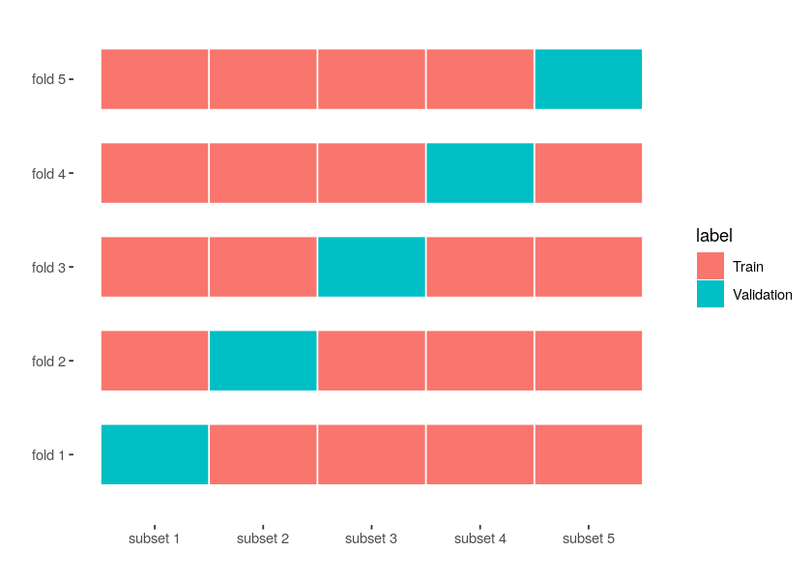
Cross-Validation
Can be used for model selection.
Compute MSE or a different metric of performance with competing models.

Slide 15
Cross-Validation
MSE of competing models
991.7 720.6
1954.4 1422.0
2160.0 1875.6
704.5 542.0
641.2 626.2
1076.8 967.4

Slide 16
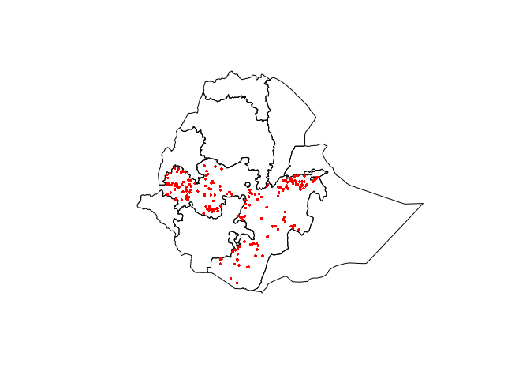
Ethiopia example
We have prevalence data of malaria.

Slide 17
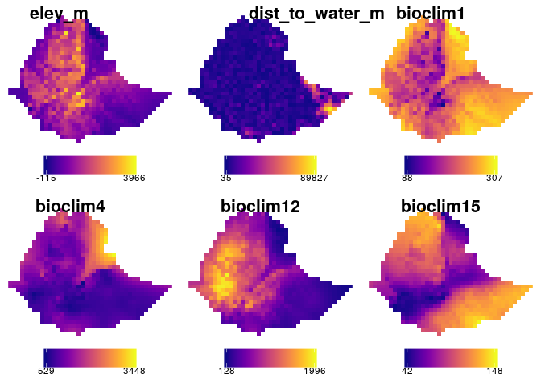
Ethiopia example
We have a set of bioclimatic covariates.

Slide 18
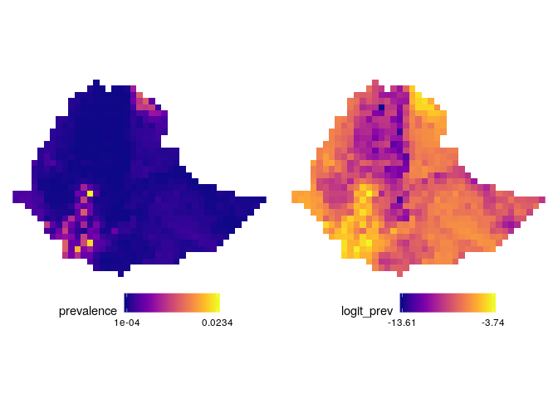
Burkina Faso
Geostatistic model using a Binomial family and logit transformation.

