Slide 1
Spatial Data Filetypes
Spatial Epidemiology in R
PH272C – Week 1
Fall 2018

Slide 2
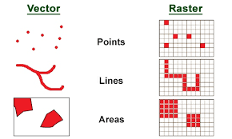
Data Representation
There are two main ways to portray real-world data: vector format and raster format.
Vector Format:
Space is defined by representing geographic features as:
Points
Lines
Polygons
Points are represented by a coordinate pair
Lines and polygons are represented as ordered lists of vertices
= houses (point)
= river (line) = lake (polygon)

Slide 3
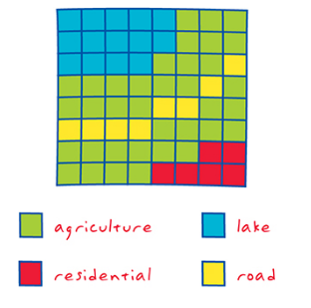
Data Representation
There are two main ways to portray real-world data: vector format and raster format.
Raster Format:
Space is defined as an array of equally sized cells arranged in rows and columns.
Each cell contains an attribute value and location coordinates.
Groups of cells that share the same value represent the same geographic feature.

Slide 4
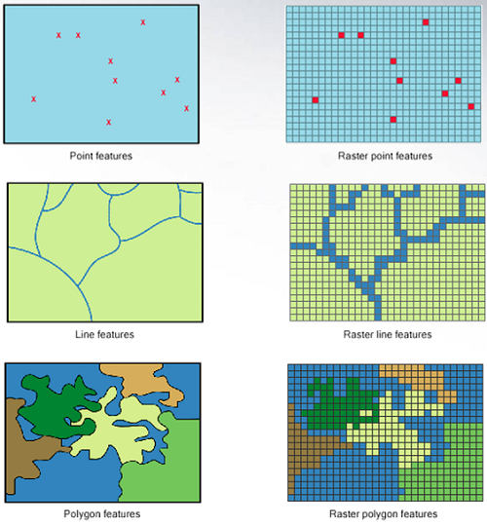
Attributes are associated with each vector feature vs attributes are associated with grid cells.

Slide 5
Shapefiles
For vector data
Made up of seven files:
.shp - shape format; the feature geometry itself
.shx - shape index format; a positional index of the feature geometry to allow seeking forwards and backwards quickly
.dbf - attribute format; columnar attributes for each shape, in dBase IV format
.prj – projection

Slide 6
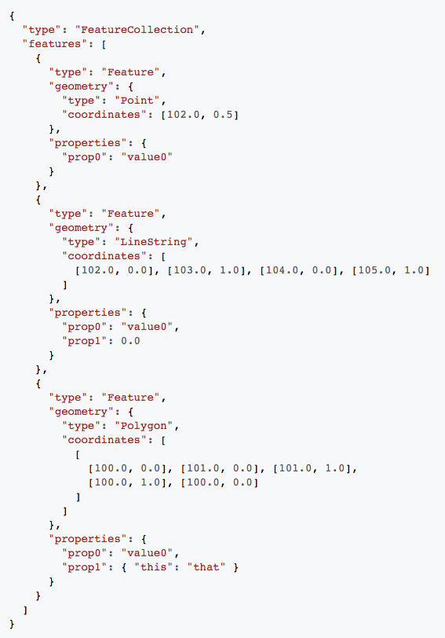
GeoJSON
JSON (JavaScript Open Notation) -
file containing information on geometry and attributes
For vector data
Essentially a single text file
Language of the web

Slide 7
Raster Files
ESRI Grid – proprietary binary andmetadataless ASCII raster formats used by ESRI
GeoTIFF –
TIFF variant enriched with GIS relevant metadata
IMG – ERDAS IMAGINE image file format

Slide 8
In R
All these file types can be read into R
Vector data held as ‘Spatial’ objects using the “sp” package
SpatialPoints
SpatialPolygons
SpatialLines
If present, attribute data are held in associated data.frame
E.g. SpatialPointsDataFrame
Raster data held in ‘raster’ object
RasterLayer or RasterStack (several layers stacked together)

