Slide 1
Resource Presentation: dodgr
GEO 511
Fall 2022
Eric Hughes

Slide 2

All authors and contributors
Mark Padgham: Author, maintainer
  Software Research Scientist for rOpenSci where he is developing a new system for peer-reviewing statistical software.
  Other packages he has created/contributed to: OSMDATA, BIKEDATA, GTFSROUTER, OSMPLOTR, GEODIST, ALLCONTRIBUTORS, MAPSCANNER, PKGSTATS, PKGCHECK, AUTOTEST
Andreas Petutschnig: Author.
Robin Lovelace: Contributor.
Andrew Smith: Contributor.
Malcolm Morgan: Contributor.
Shane Saunders: Copyright holder.
Sources:
https://mpadge.github.io/
https://cran.r-project.org/web/packages/dodgr/index.html

Slide 3
Package
Dodgr is an R package that allows users to:
Calculates many-to-many pairwise distances on dual-weighted graphs. “Dual-weighted graphs have two sets of weights for each edge, so routing can be evaluated with one set of weights, while distances can be calculated with the other.”
Allows for calculations based on various transportation modes and the ability to distinguish between distance or time as units of measure
Use routing through street networks (like Open Street Maps)

Slide 4
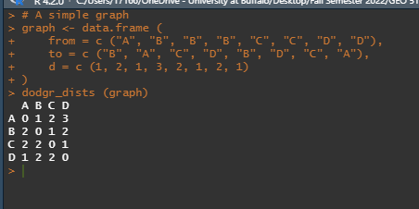
Example 1: dodgr_dists()

Slide 5
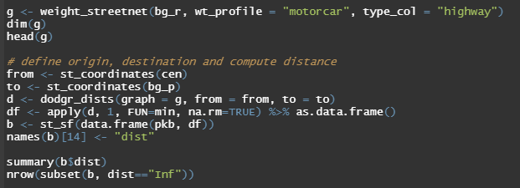
Example 2: dodgr_dists()

Slide 6
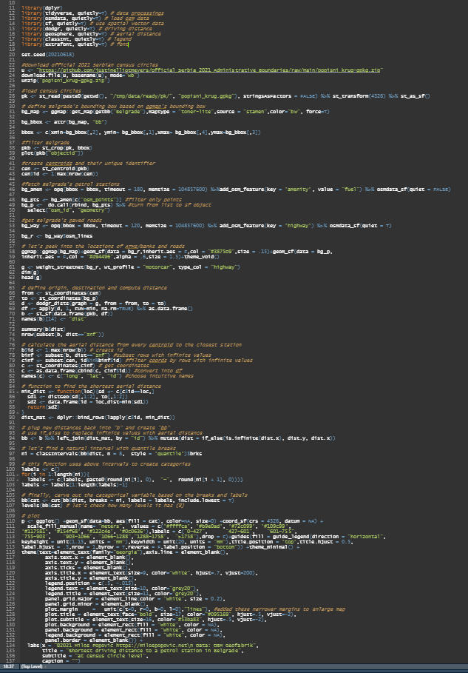
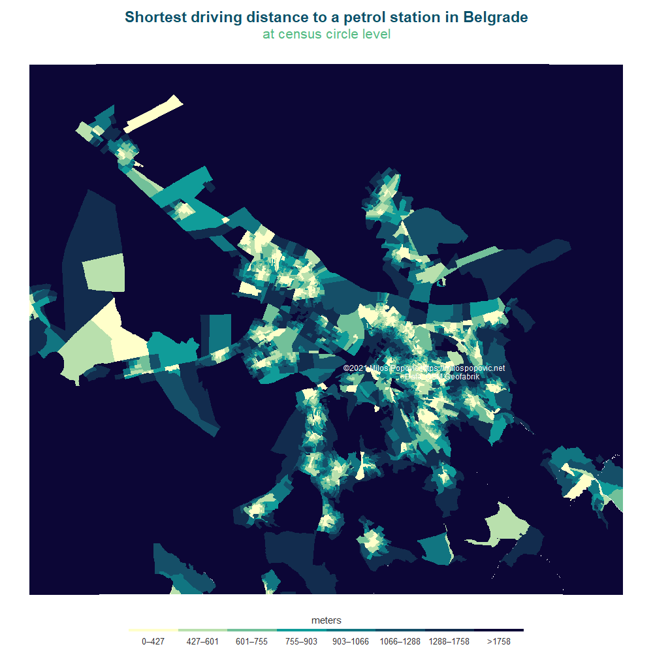
Plot for Example 2
Source: https://milospopovic.net/geo-business_intelligence-compute-shortest-driving-distance-in-r/

Slide 7
THANK YOU!

