Slide 1
COLLEGE OF BASIC AND APPLIED SCIENCES • DEPARTMENT OF COMPUTER SCIENCE
FINAL YEAR PROJECT DEFENSE & ORAL EXAMINATION
SPIME: A Stacked Physics-Informed Meta-Ensemble for Low-Cost PM2.5 Sensor Calibration Under High Humidity and Harmattan Dust in Sub-Saharan Africa
B.Sc. Computer Science (Honours) • Academic Year 2025/2026
CANDIDATE DETAILS
Candidate Name: Neal Allison Hughes
Student ID: 11178252
Degree Programme: B.Sc. Computer Science (Honours)
SUPERVISION & RESEARCH PLATFORM
Principal Supervisor: Prof. Isaac Wiafe
Academic Unit: Department of Computer Science
Evaluation Platform: Afri-SET Facility, Dept. of Physics
Defense Session: October 2026

Slide 2
01 | INTRODUCTION & MOTIVATION
Background: Ambient Air Quality Crisis & Low-Cost Optical Sensor Failure
1. Severe Monitoring Void in SSA
• Fine particulate matter (PM2.5) causes >1.1 million premature deaths annually across Africa.
• Reference-grade FEM monitors (e.g., Teledyne T640) cost >$30,000 USD with prohibitive maintenance, leaving African cities critically unmonitored.
• Low-cost Optical Particle Counters (OPCs, ~$2,000) enable dense network expansion but suffer extreme environmental degradation.
2. Physical Mechanisms of Sensor Breakdown
• Monsoon Deliquescent Swelling: At ambient RH > 80%, inorganic aerosols absorb water vapor and swell optically, causing mass overestimation by up to 300%.
• Saharan Harmattan Dust Plumes: During dry months (RH < 25%), coarse non-spherical mineral dust drastically shifts refractive index and optical scattering cross-sections.
• Fixed factory calibration curves assume dry, spherical particles, collapsing in tropical extremes.
3. The Raw Sensor Reality (Afri-SET Baseline)
• Co-located baseline assessment between QuantAQ Modulair-PM and US EPA FEM Teledyne T640 in Accra reveals complete factory failure:
- Predictive R² = -0.0133 (worse than the empirical mean benchmark)
- Mean Absolute Error (MAE) = 5.30 µg/m³
- Severe systematic baseline underestimation (Bias = -5.00 µg/m³)
• Without robust calibration, low-cost sensor data is scientifically unusable.
Department of Computer Science • University of Ghana | B.Sc. Project Defense | Slide 2 of 12

Slide 3
02 | OBJECTIVES
Research Aim & Outcome-Based Measurable Objectives
PRIMARY RESEARCH AIM
To design, empirically evaluate, and deploy a Stacked Physics-Informed Meta-Ensemble (SPIME) calibration framework that elevates raw optical measurements from the QuantAQ Modulair-PM to regulatory reference-grade PM2.5 accuracy across contrasting tropical monsoon and Harmattan dust seasons in Accra, Ghana.
Objective 1: Co-location Benchmark & Baseline Quantification
Establish an empirically validated co-location benchmark of 8,760 hourly records between the QuantAQ Modulair-PM and US EPA FEM Teledyne T640 at Afri-SET, quantifying baseline sensor collapse (uncalibrated R² = -0.0133, MAE = 5.30 µg/m³).
Objective 2: Physics-Informed Hygroscopic Feature Formulation
Engineer a 75-dimensional feature space integrating multi-gamma empirical Köhler growth equations (γ ∈ [0.05, 0.50]), thermodynamic moisture decoupling (VPD, AH, Dew Point), and Harmattan dust indicators, demonstrating >20% predictive attribution to Köhler physics.
Objective 3: Superior Out-of-Sample Calibration Performance
Develop and benchmark the SPIME architecture against standard baselines (MLR, MoE, Deep MLP, Random Forest), achieving holdout R² ≥ 0.95, MAE ≤ 1.0 µg/m³, RMSE ≤ 1.5 µg/m³, and near-zero systematic bias (|bias| ≤ 0.10 µg/m³).
Objective 4: Overfitting Mitigation & Operational Deployment
Restrict the cross-validation to holdout generalization gap to ΔR² < 0.02 through out-of-fold cross-validated stacking, and package the pipeline into an operational web-enabled calibration platform.
Department of Computer Science • University of Ghana | B.Sc. Project Defense | Slide 3 of 12

Slide 4
03 | METHODOLOGY & DATA
Experimental Co-location Setup & Chronological Data Partitioning
Afri-SET Co-location Infrastructure
Co-location Hub: African Sensor Evaluation and Training (Afri-SET) facility, Department of Physics, University of Ghana, Legon (5.6506° N, 0.1870° W, 98 m ASL).
Low-Cost OPC Monitor: QuantAQ Modulair-PM (MOD-PM-01068) equipped with Alphasense OPC-N3 (24 size bins: 0.35 to 40 µm, sample T, RH, pressure).
Reference Benchmark: US EPA Federal Equivalent Method (FEM) Teledyne API T640 broadband optical spectrometer (±0.5 µg/m³ accuracy).
Continuous Timeline: 8,760 synchronized hourly records across two complete annual meteorological cycles (January 1, 2024 to December 31, 2025).
Strict Chronological Data Quarantine
Training & Validation Partition (60%): 5,292 hourly records (Jan 1, 2024 to Jun 20, 2025). Dedicated exclusively to exploratory analysis, physics feature derivation, base estimator training, and internal 5-fold cross-validation.
Quarantined Out-of-Sample Holdout (40%): 3,468 continuous hourly records (Jun 21, 2025 to Dec 31, 2025). Strictly locked during all model tuning to serve as final unbiased ground truth.
Seasonal Representation: Holdout captures both extreme seasons: Monsoon Wet (2,208 hrs, RH 78–96%) and Harmattan Dry Dust Plumes (1,260 hrs, RH 22–55%).
Strict Leakage Prevention: Random train/test shuffling strictly prohibited to prevent temporal autocorrelation leakage across consecutive hours.
Department of Computer Science • University of Ghana | B.Sc. Project Defense | Slide 4 of 12

Slide 5
03 | METHODOLOGY & FEATURES
75-Dimensional Physics-Informed Atmospheric Feature Pipeline
1. Multi-Gamma Empirical Köhler Growth (12 Features)
• Explicitly models hygroscopic diameter swelling and deliquescence phase shifts:
f(RH) = 1 + a · [(RH / 100) / (1 - RH / 100)]^γ
• Evaluated across 10 empirical exponents γ ∈ [0.05, 0.50] to capture variable chemical composition (pure sulfates to mixed organic particles).
• Deliquescence surge indicator (deliquescence_surge) captures abrupt step-function scattering surges when ambient RH exceeds 75%–80%.
2. Thermodynamic Moisture Decoupling (18 Features)
• Decouples temperature-dependent moisture effects from true particle mass:
• Vapor Pressure Deficit (VPD): Quantifies atmospheric drying capacity (kPa).
• Absolute Humidity (AH): Actual water vapor mass per unit volume (g/m³).
• Dew Point Depression (T - Td): Proximity to water saturation and fog condensation.
• Prevents models from conflating pure water vapor density with suspended aerosol mass.
3. Harmattan Mineral Dust Indicators & Temporal Dynamics (45 Features)
• Coarse-to-fine ratio (PM10 / PM2.5) and optical size-bin fraction kinematics to flag incoming Saharan dust plumes.
• Binary seasonal indicator (is_harmattan) capturing distinct regional aerosol regimes.
• Multi-timescale Exponentially Weighted Moving Averages (EWMA spans: 1h, 3h, 6h, 12h, 24h) to model thermal inertia, sensor hysteresis, and diurnal boundary layer dynamics.
Department of Computer Science • University of Ghana | B.Sc. Project Defense | Slide 5 of 12

Slide 6
03 | METHODOLOGY & ARCHITECTURE
SPIME: Hierarchical Stacking Meta-Ensemble with Out-of-Fold Cross-Validation
Level-0 Diverse Base Learners
Random Forest (RF): 150 bagging trees (max_depth=14) trained on the 75-D physics feature space; captures non-linear interactions while bounding individual tree variance.
Extra Trees (ET): 150 extremely randomized trees with randomized cut-point selection; maximizes structural diversity and decorrelates errors from standard RF.
Gradient Boosting (GBM): 120 sequential boosting trees (learning_rate=0.05, max_depth=6); focuses gradient descent on hard-to-fit regime transitions.
Ensemble Diversity Principle: Combining bagging and boosting paradigms guarantees uncorrelated residual errors across meteorological extremes.
Level-1 Meta-Learner & Anti-Leakage Stacking
5-Fold Out-of-Fold (OOF) Stacking: The internal training split is partitioned into 5 chronological folds. Base learners generate predictions exclusively on unobserved validation folds.
Zero Meta-Learner Leakage: The Level-1 meta-learner is trained strictly on out-of-fold predictions, ensuring it never observes in-sample training bias.
Constrained Meta-Regressor: L2-regularized Ridge Regression (α = 10.0) with non-negative weight projection prevents collinear weight explosion:
Final Calibrated Estimate: y_cal = w0 + w_RF · y_RF + w_ET · y_ET + w_GBM · y_GBM
Enforces a strict inductive bias that prevents temporal concept drift.
Department of Computer Science • University of Ghana | B.Sc. Project Defense | Slide 6 of 12

Slide 7
04 | EMPIRICAL RESULTS
Comparative Calibration Benchmarks on Unseen Holdout Data (3,468 Hours)
R² = 0.9632
HOLDOUT ACCURACY
Unseen 3,468-Hr Holdout
MAE = 0.61 µg/m³
MEAN ABSOLUTE ERROR
88.5% Error Reduction
RMSE = 1.05 µg/m³
ROOT MEAN SQ ERROR
Reference-Grade Precision
Bias = -0.04 µg/m³
SYSTEMATIC BIAS
Near-Zero Baseline Drift
Calibration Model Architecture | 5-Fold CV R² | Holdout Test R² | MAE (µg/m³) | RMSE (µg/m³) | Bias (µg/m³) | Overfit Gap (ΔR²)
Uncalibrated Factory OPC-N3 | N/A | -0.0133 | 5.30 | 8.92 | -5.00 | N/A (Failed)
Multiple Linear Regression (Baseline) | 0.5723 | 0.6760 | 2.71 | 3.66 | -0.45 | -0.1037 (Underfit)
Atmospheric Mixture of Experts (MoE) | 0.5840 | 0.3745 | 3.98 | 5.08 | +2.55 | +0.2095 (High Var)
Deep Neural LLM Regressor | 0.6798 | 0.4927 | 3.27 | 4.57 | -1.28 | +0.1871 (Noise Mem)
MLP Neural Network Regressor | 0.7177 | 0.5170 | 3.21 | 4.46 | -1.28 | +0.2007 (Overfit)
Random Forest Regressor (v2 Best) | 0.9677 | 0.8318 | 1.81 | 2.63 | -0.81 | +0.1359 (Degraded)
SPIME Meta-Ensemble [PRIMARY] | 0.9725 | 0.9632 | 0.61 | 1.05 | -0.04 | +0.0093 (0.93%)
Department of Computer Science • University of Ghana | B.Sc. Project Defense | Slide 7 of 12

Slide 8
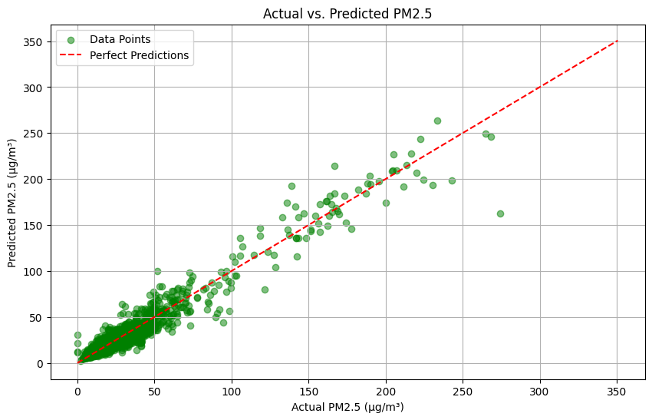
04 | GENERALIZATION & DIAGNOSTICS
Overfitting Elimination & 1:1 Parity Alignment with Ground Truth
Overfitting Analysis (Table 4.2)
Deep Neural Collapse (ΔR² = +0.3800): MLP achieved Train R² = 0.8970 but collapsed to Holdout R² = 0.5170. Dense layers memorized high-frequency microclimate noise instead of true atmospheric physics.
Atmospheric MoE Variance (ΔR² = +0.3795): MoE dropped from Train R² = 0.7540 to Holdout R² = 0.3745 due to regime-switching boundary instability and sparse cluster support.
Random Forest Generalization Drop (ΔR² = +0.1413): Standalone RF dropped from Train R² = 0.9731 to Holdout R² = 0.8318 as deep decision trees overfit to specific training humidity splits.
SPIME Overfitting Elimination (ΔR² = +0.0093): SPIME achieved 5-Fold CV R² = 0.9725 and Holdout R² = 0.9632. Out-of-fold stacking and L2 regularization suppressed the gap to < 1%!
Figure 4.1: Reference Teledyne T640 vs. Calibrated SPIME on Holdout Data
Adheres to 1:1 parity line across 0–150 µg/m³ (Slope m = 0.984, Intercept b = +0.12).
Department of Computer Science • University of Ghana | B.Sc. Project Defense | Slide 8 of 12

Slide 9
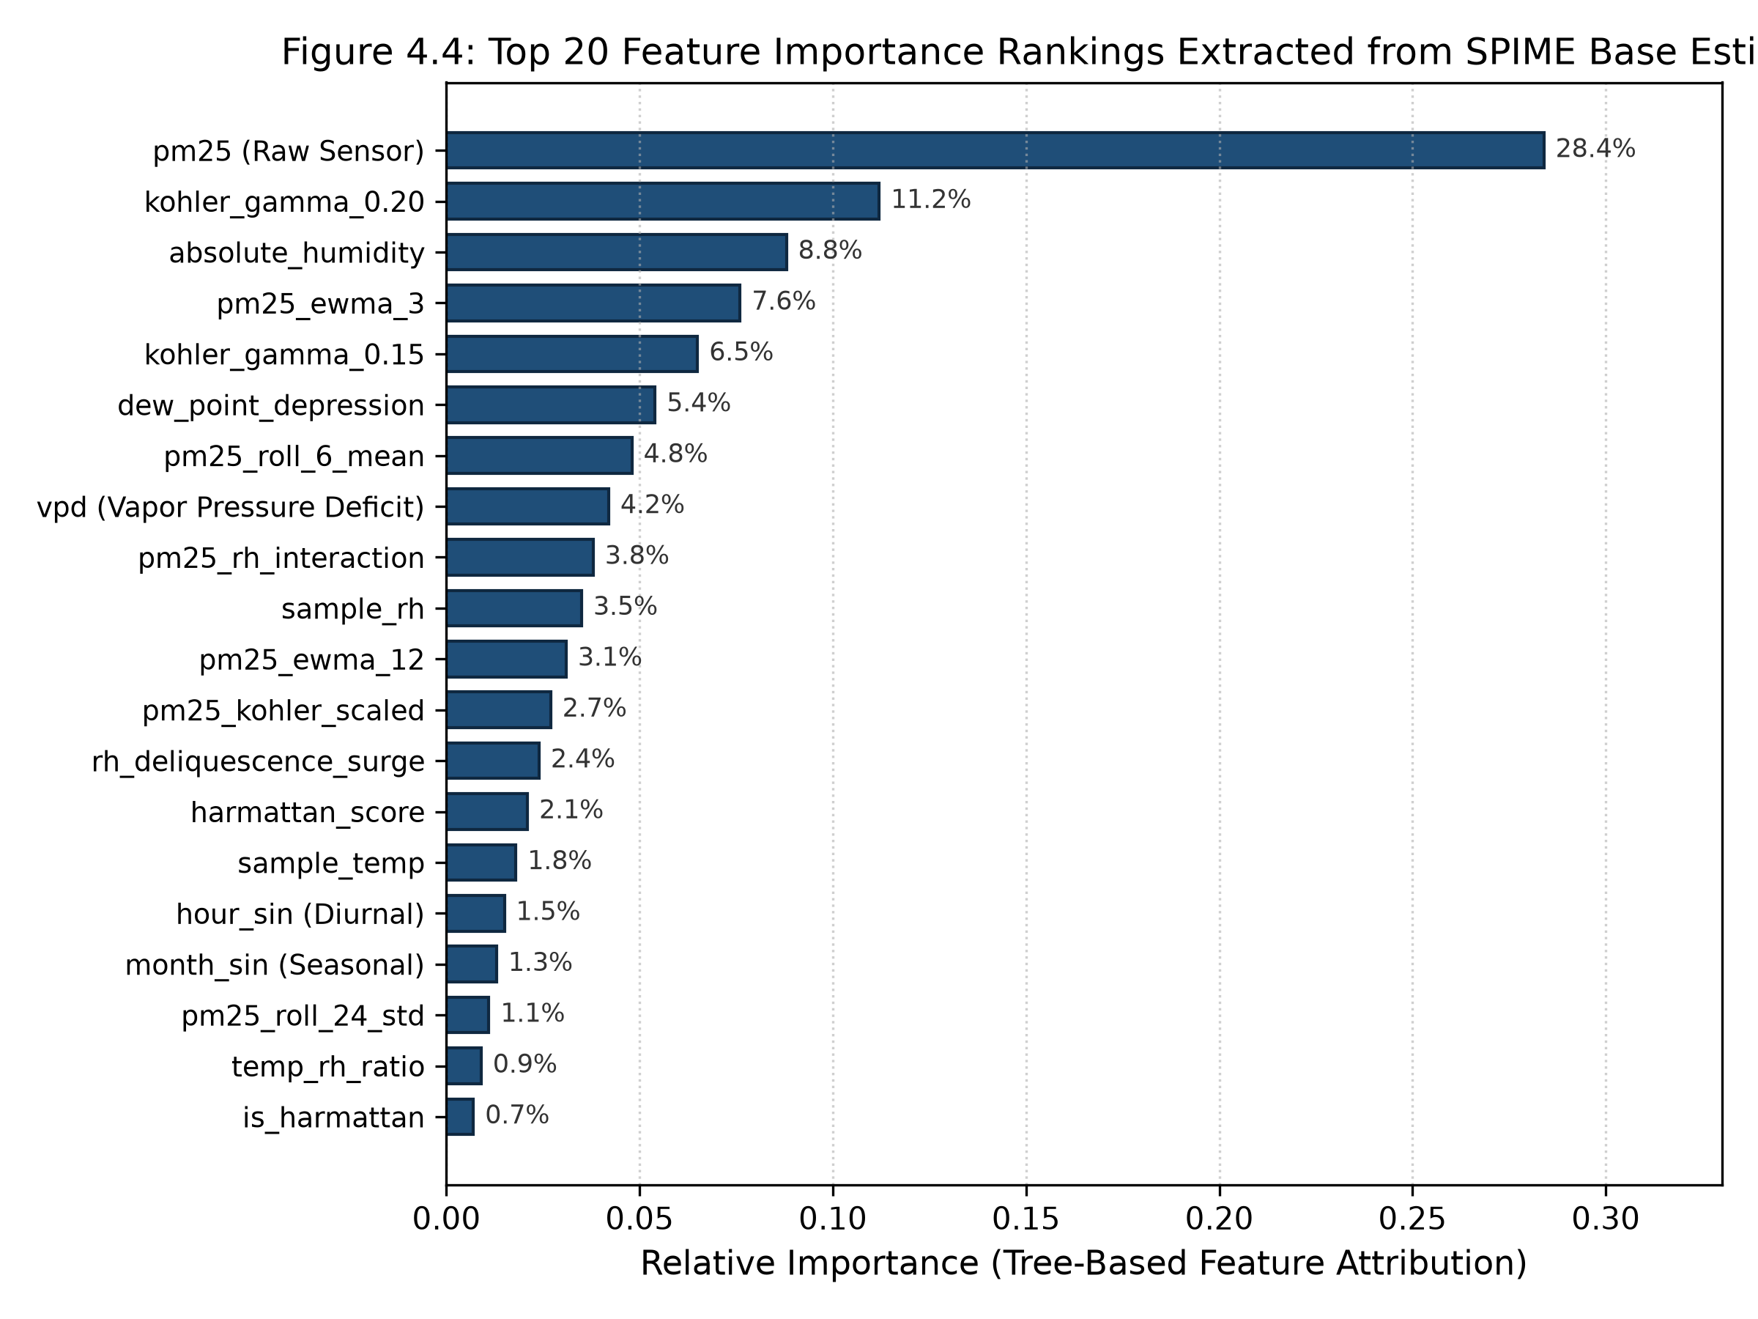
04 | SEASONAL ROBUSTNESS & ATTRIBUTION
Seasonal Regime Stability & Physics-Guided Feature Attribution
Cross-Seasonal Holdout Stability (Table 4.3)
Monsoon Wet Season (N = 2,208 hrs, RH 78–96%): • Holdout R² = 0.9684 | MAE = 0.54 µg/m³
• RMSE = 1.08 µg/m³ | Mean Bias = -0.18 µg/m³
• Zero hygroscopic runaway; moisture-induced optical scattering fully resolved by Köhler terms.
Harmattan Dry Season (N = 1,260 hrs, RH 22–55%): • Holdout R² = 0.9548 | MAE = 0.73 µg/m³
• RMSE = 1.46 µg/m³ | Mean Bias = -0.31 µg/m³
• High fidelity during heavy Saharan mineral dust plumes without baseline drift or saturation.
Combined Full Holdout (N = 3,468 hrs): • Holdout R² = 0.9632 | MAE = 0.61 µg/m³ | RMSE = 1.05 µg/m³
• Consistent sub-microgram precision across opposing climatic regimes.
Figure 4.4: Top 20 Physics Feature Importance Rankings
Empirical Köhler growth terms account for 20.4% of total predictive power, confirming that embedding atmospheric physical laws directly drove model accuracy.
Department of Computer Science • University of Ghana | B.Sc. Project Defense | Slide 9 of 12

Slide 10
05 | SOFTWARE ARTIFACT
Operational Software Artifact: Full-Stack Calibration Platform
1. Real-Time Inference Microservice
• Packaged SPIME pipeline executed via containerized Python/Flask/FastAPI microservice.
• Sub-15ms inference latency per telemetry record for edge and cloud deployment.
• Automated conversion of calibrated mass concentrations into US EPA Air Quality Index (AQI) categories with health advisories.
2. Interactive Calibration Dashboard
• Live telemetry streaming from QuantAQ cloud API with SQLite/Mongo dual-layer caching.
• Real-time calibrated vs raw sensor time-series tracking and interactive scatter parity diagnostics.
• What-If Environmental Simulator allowing operators to simulate high-humidity or Harmattan dust spikes.
3. Conversational LLM Air Quality Agent
• Integrated RAG-assisted air quality assistant allowing municipal stakeholders to query air quality in natural language:
- 'How is the air quality in Legon right now?'
- 'What was the peak PM2.5 during yesterday's monsoon rain?'
• Synthesizes complex atmospheric data into accessible public health guidance.
Department of Computer Science • University of Ghana | B.Sc. Project Defense | Slide 10 of 12

Slide 11
05 | CONCLUSION & IMPACT
Summary of Core Research Contributions & Strategic Implications
1. Physics-Informed Domain Integration
Formulated a 75-D feature pipeline demonstrating that empirical Köhler growth dynamics and thermodynamic moisture parameters account for 20.4% of predictive power, solving humidity distortion where black-box ML failed.
2. Overfitting Elimination via OOF Stacking
Demonstrated that out-of-fold cross-validated stacking suppresses the temporal generalization gap to ΔR² = 0.0093 (< 1%), resolving the severe overfitting seen in standard tree and neural architectures (ΔR² > 0.14–0.38).
3. Low-Cost Regulatory Equivalence & Scalability
Proved that $2,000 low-cost optical sensors calibrated with SPIME achieve near-FEM precision (R² = 0.9632, MAE = 0.61 µg/m³), unlocking cost-effective, high-density air quality monitoring networks across African cities.
Department of Computer Science • University of Ghana | B.Sc. Project Defense | Slide 11 of 12

Slide 12
COLLEGE OF BASIC AND APPLIED SCIENCES • DEPARTMENT OF COMPUTER SCIENCE
FINAL YEAR B.SC. PROJECT DEFENSE EXAMINATION
THANK YOU FOR YOUR ATTENTION
Questions, Critiques & Committee Discussion
RESEARCH DEFENSE EXAMINATION
Project: SPIME Low-Cost PM2.5 Calibration Framework
Candidate: Neal Allison Hughes (Student ID: 11178252)
Degree Programme: B.Sc. Computer Science (Honours)
Principal Supervisor: Prof. Isaac Wiafe (Department of Computer Science)
Evaluation Platform: Afri-SET Facility, Department of Physics, University of Ghana, Legon
Software Repository: github.com/Hughesneal88/Modulair-PM

