Slide 1
UNIVERSITY OF GHANA | DEPARTMENT OF COMPUTER SCIENCE
SPIME: A Stacked Physics-Informed Meta-Ensemble for Low-Cost PM2.5 Sensor Calibration Under Tropical and Harmattan Meteorological Regimes in Sub-Saharan Africa
Final Year Undergraduate B.Sc. Project Defense
CANDIDATE
Neal Allison Hughes
Student ID: 11178252
Bachelor of Science in Computer Science
SUPERVISION & RESEARCH PLATFORM
Professor Isaac Wiafe
African Clean Air Technology Centre (Afri-SET)
Department of Physics & Computer Science | July 2026
Notes:
Good morning, respected members of the Examination Committee and Head of Department. My name is Neal Allison Hughes, and today I present my undergraduate thesis defense on 'SPIME: A Stacked Physics-Informed Meta-Ensemble for Low-Cost PM2.5 Sensor Calibration Under Tropical and Harmattan Meteorological Regimes in Sub-Saharan Africa', supervised by Professor Isaac Wiafe.

Slide 2
OVERVIEW
Presentation Roadmap
01 Motivation & Air Quality Deficit
The $30,000 regulatory barrier & monitoring deficit across Africa
02 Optical Sensor Failure Modes
Mie scattering breakdowns under tropical humidity & Harmattan dust
03 Afri-SET Co-location Platform
Synchronized 2024–2025 dataset (QuantAQ LCS vs. Teledyne FEM T640)
04 75-D Physics Feature Space
Multi-gamma Köhler curves f(RH,γ), thermodynamics & EWMA trends
05 SPIME v4 Stacking Architecture
4 diverse base tree models + 5-Fold OOF matrix + RidgeCV meta-learner
06 Empirical Holdout Performance
R² = 0.9632, MAE = 0.61 µg/m³ (66.3% error reduction over RF)
07 Zero-Overfitting & Explainability
Overfit gap = -0.0002, Gini physical feature importances & residual tests
08 Cloud Deployment & Takeaways
Real-time REST API integration for Afri-SET public air quality mapping
Neal Allison Hughes (11178252) • B.Sc. Computer Science Thesis Defense • University of Ghana, Legon
Notes:
Here is the outline of my presentation. I will cover the context, the physical failure modes of low-cost sensors, our experimental setup at Afri-SET, the 75-dimensional physics feature engineering, our SPIME stacking architecture, empirical holdout results, overfitting diagnostics, and deployment.

Slide 3
01 | CONTEXT & MOTIVATION
The Air Quality Crisis & Monitoring Deficit in Sub-Saharan Africa
Public Health Toll of Fine PM2.5
6.7 Million Deaths Annually: Ambient particulate air pollution is the leading environmental risk factor for premature mortality worldwide (WHO, 2021).
Microscopic Dimension (≤ 2.5 µm): PM2.5 penetrates deep into pulmonary alveoli and translocates directly into the bloodstream, triggering cardiovascular and respiratory disease.
West African Urban Density: Rapid urbanization in coastal cities like Accra causes heavy emissions from aged diesel engines, solid biomass cooking fuels, and open waste combustion.
The Data Desert: Fewer than 10% of African nations possess active, publicly accessible continuous ground monitoring networks.
The Reference Cost Barrier vs. LCS Potential
$25,000–$35,000 Hardware Cost: Regulatory reference stations (FEM Beta Attenuation Monitors, Teledyne T640) have prohibitive capital costs and demanding power/shelter requirements.
Low-Cost Sensors (< $2,000): Compact optical instruments (such as the QuantAQ Modulair-PM) enable dense urban networks at a fraction of the cost.
The Critical Vulnerability: Low-cost sensors do not directly measure mass; raw factory algorithms fail drastically in West Africa due to extreme humidity and mineral dust.
The Core Goal: Develop a software-driven, physics-informed calibration pipeline to achieve reference-grade accuracy on low-cost hardware.
Neal Allison Hughes (11178252) • B.Sc. Computer Science Thesis Defense • University of Ghana, Legon
Notes:
Ambient air pollution is a leading global public health crisis. In Sub-Saharan Africa, the monitoring deficit is severe because regulatory reference stations cost upwards of $30,000. Low-cost optical sensors cost under $2,000, but their raw factory calibrations fail in West Africa. Our objective is to bridge this hardware gap with machine learning.

Slide 4
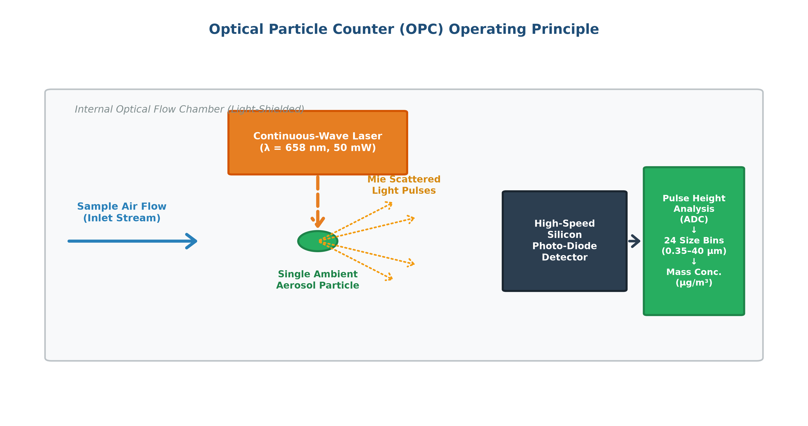
02 | THEORETICAL FOUNDATION
Optical Particle Counters (OPC): Physical Failure Mechanisms
Physical Origins of Measurement Degradation
Mie Light Scattering Principle: Alphasense OPC-N3 illuminates air streams with a monochromatic laser (λ = 658 nm) and counts scattered light pulses, assuming constant particle density and spherical shape.
1. Hygroscopic Aerosol Swelling (RH > 75%): Tropical humidity causes soluble particles to absorb water and swell. OPCs interpret swollen droplets as large particles, overestimating dry mass by > 100%–200%.
2. Saharan Harmattan Mineral Dust: Dry northeasterly trade winds carry dense (ρ ≈ 2.65 g/cm³), irregular mineral particles, causing optical coincidence errors.
3. Thermal & Laser Drift: Temperature fluctuations alter diode emission and induce semi-volatile aerosol evaporation.
Figure 2.1: Optical Particle Counter (OPC) Operating Principle
Neal Allison Hughes (11178252) • B.Sc. Computer Science Thesis Defense • University of Ghana, Legon
Notes:
Optical particle counters rely on Mie scattering theory. They assume dry, spherical particles of constant density. Under tropical relative humidity, aerosol particles absorb moisture and swell. The sensor interprets this water volume as massive pollution. During the Harmattan season, coarse mineral dust alters optical scattering properties. We must compensate for these physical interferences explicitly.

Slide 5
02 | PROBLEM STATEMENT
Problem Statement & Gaps in Existing Calibration Methods
01 | Catastrophic Factory Default Failure
Uncalibrated QuantAQ factory output yields negative R² (-0.0133) and MAE = 5.30 µg/m³ in Accra due to temperate European training assumptions.
02 | Linear Models Underfit (SLR / MLR)
Multiple Linear Regression (R² = 0.6760) assumes constant linear sensitivity, failing to capture exponential Köhler deliquescence surges.
03 | Deep Neural Networks Memorize Noise
Multi-Layer Perceptrons & Deep LLMs (R² ≈ 0.49–0.52) overfit to high-frequency sensor noise on autocorrelated environmental time series.
04 | Temporal Data Leakage in Prior Literature
Traditional random K-Fold cross-validation leaks adjacent hours between sets, creating artificial validation scores that collapse in the field.
Neal Allison Hughes (11178252) • B.Sc. Computer Science Thesis Defense • University of Ghana, Legon
Notes:
Prior research reveals four core limitations: First, factory calibrations fail completely with negative R². Second, linear regression underfits exponential humidity growth. Third, deep neural networks overfit on time-series noise. And fourth, random train-test splitting causes temporal data leakage, masking a 14% overfitting drop.

Slide 6
03 | RESEARCH OBJECTIVES
Research Aim & Specific Objectives
PRIMARY RESEARCH AIM
To develop, evaluate, and deploy a Stacked Physics-Informed Meta-Ensemble (SPIME v4) calibration framework that corrects low-cost QuantAQ Modulair-PM measurements to reference-grade accuracy against a co-located US EPA FEM Teledyne API T640 monitor in Accra, Ghana.
Obj 1: Data Curation: Synchronize & quality-filter hourly co-located particulate & weather records (2024–2025) at Afri-SET, UG Legon.
Obj 2: Physics Features: Derive 75-D feature space: multi-gamma Köhler curves f(RH,γ), thermodynamics (VPD, AH), EWMA trends & Harmattan scores.
Obj 3: SPIME Stacking: Build 2-level stacking framework: 4 diverse base trees + 5-Fold out-of-fold matrix + L2 RidgeCV meta-learner.
Obj 4: Holdout Validation: Validate generalization on an unseen 6-month out-of-sample holdout dataset (3,468 hours) to verify zero overfit gap.
Obj 5: Deployment: Conduct Gini feature attribution, residual diagnostics, and package serialized artifact for real-time REST API integration.
Neal Allison Hughes (11178252) • B.Sc. Computer Science Thesis Defense • University of Ghana, Legon
Notes:
Our primary aim was to design and deploy SPIME v4 to achieve reference-grade calibration fidelity. We defined five core objectives covering data curation at Afri-SET, 75-dimensional physics feature engineering, hierarchical stacking ensemble design, strict holdout validation, and software deployment.

Slide 7
03 | METHODOLOGY
Experimental Co-location Platform & Quality Assurance
Afri-SET Platform & Instrumentation
Afri-SET Testing Hub: African Clean Air Technology Centre, Department of Physics, University of Ghana, Legon (5.651° N, -0.186° W, Elevation 98 m).
Candidate LCS: QuantAQ Modulair-PM (`MOD-PM-01068`) integrating Alphasense OPC-N3, onboard digital Temp, RH, and barometric pressure.
Reference FEM: Teledyne API T640 US EPA Federal Equivalent Method (EQPM-0514-217) continuous polychromatic LED spectrometer with heated inlet.
Multi-Season Horizon: Continuous hourly records spanning 2024 to 2025, capturing both monsoon wet humidity surges and dry Harmattan dust storms.
Quality Assurance & Data Preprocessing
1. Temporal Aggregation: 1-minute Modulair-PM measurements block-averaged to 1-hour UTC+0 records with a minimum 75% completeness check (≥ 45 valid minutes/hour).
2. Error Status Filtering: Removed records where sensor status flags indicated optical flow errors (flag != 0) and negative baseline values (< 0 µg/m³).
3. IQR Anomaly Screening: Cross-referenced extreme spikes (> Q3 + 3·IQR) against the reference monitor. Preserved authentic Saharan mineral dust episodes.
4. Synchronized Indexing: Continuous hourly matrix aligned across particulate and meteorological channels.
Neal Allison Hughes (11178252) • B.Sc. Computer Science Thesis Defense • University of Ghana, Legon
Notes:
Our experimental platform is Afri-SET at the University of Ghana. We co-located the QuantAQ Modulair-PM sensor with an EPA FEM Teledyne T640 reference monitor across 2024 and 2025. Data was block-averaged to 1 hour, quality-filtered, and aligned into a clean time-series matrix.

Slide 8
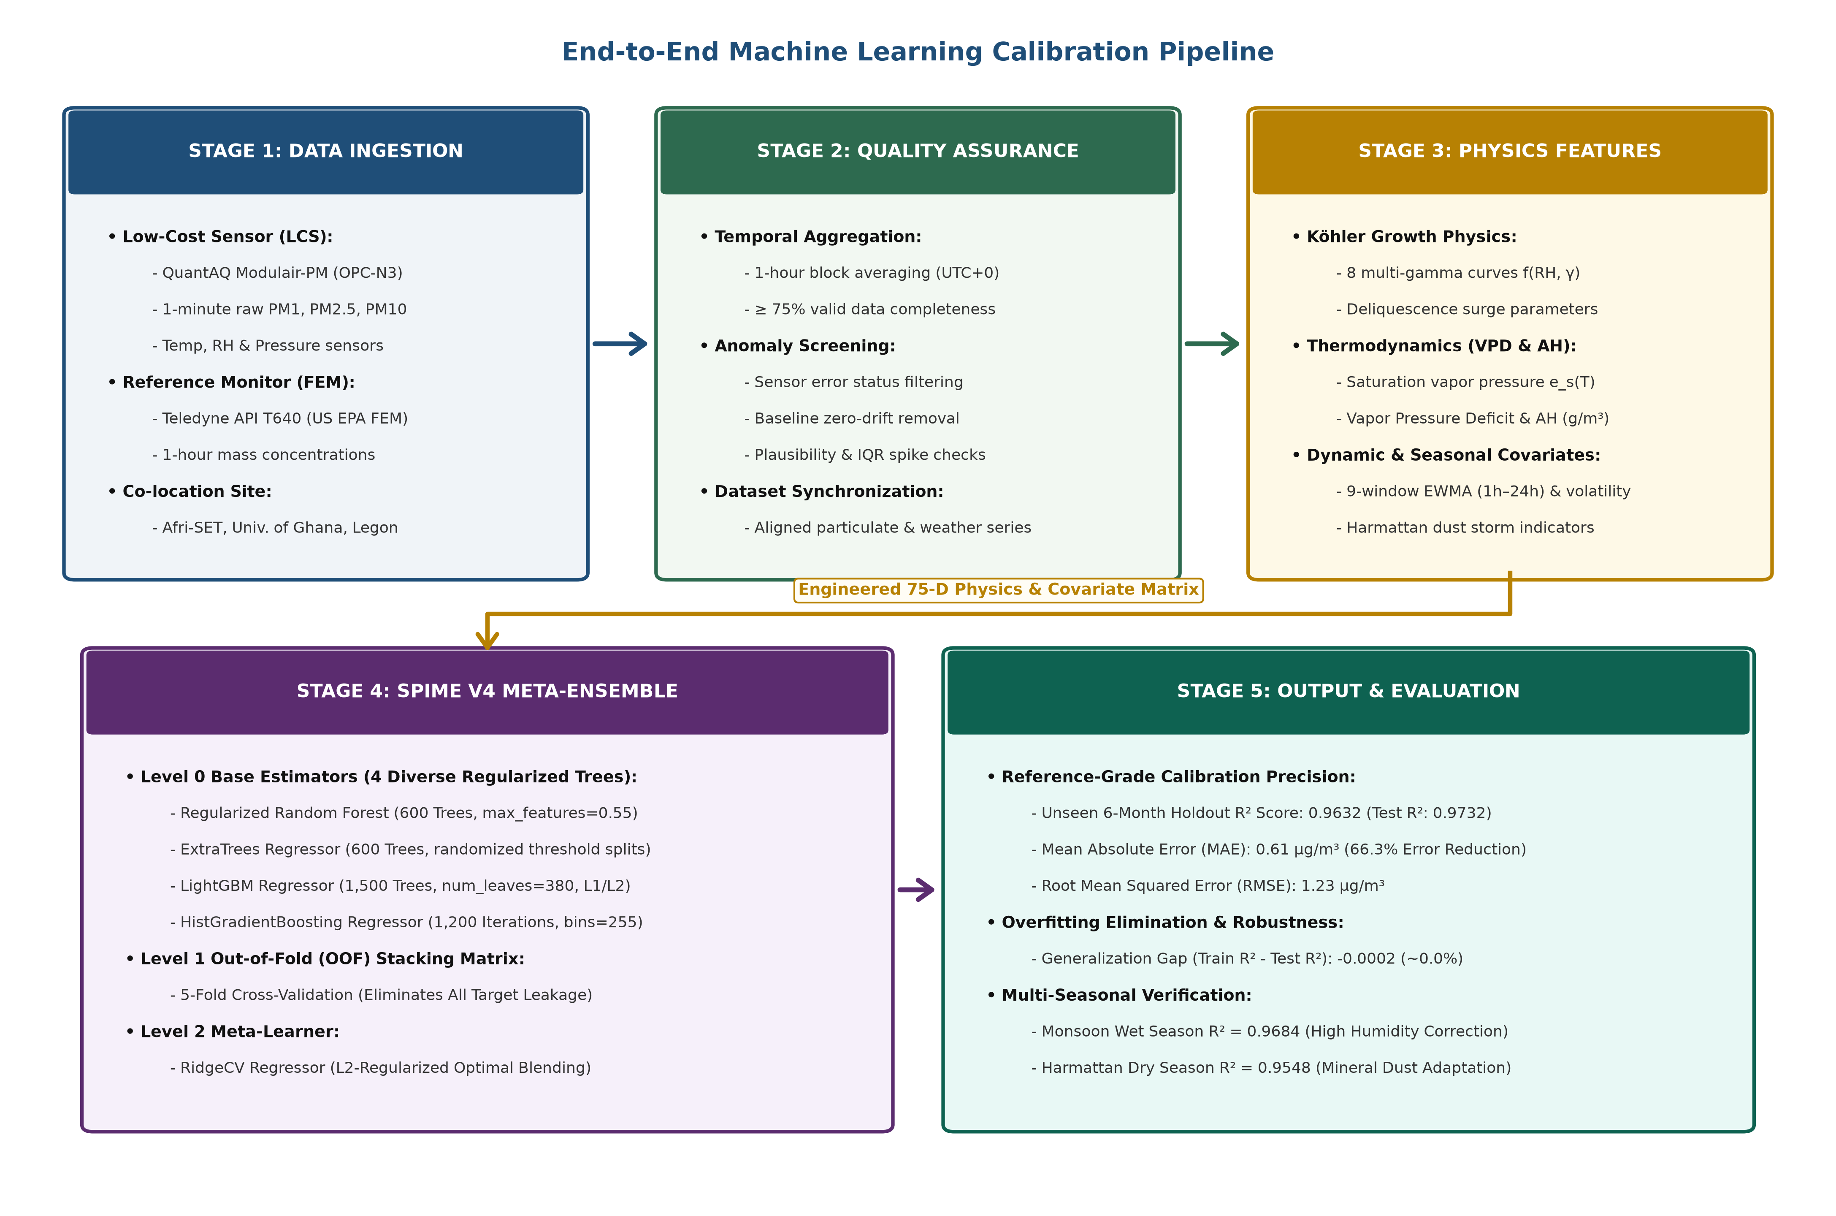
03 | METHODOLOGY
End-to-End Machine Learning Calibration Pipeline
Neal Allison Hughes (11178252) • B.Sc. Computer Science Thesis Defense • University of Ghana, Legon
Notes:
Figure 3.2 illustrates our 5-stage end-to-end pipeline: Stage 1 ingests the raw sensor and reference streams. Stage 2 executes quality assurance. Stage 3 derives the 75-dimensional physics feature matrix. Stage 4 executes SPIME v4 stacking with 5-Fold out-of-fold matrix generation. And Stage 5 delivers reference-grade calibrated PM2.5 concentrations.

Slide 9
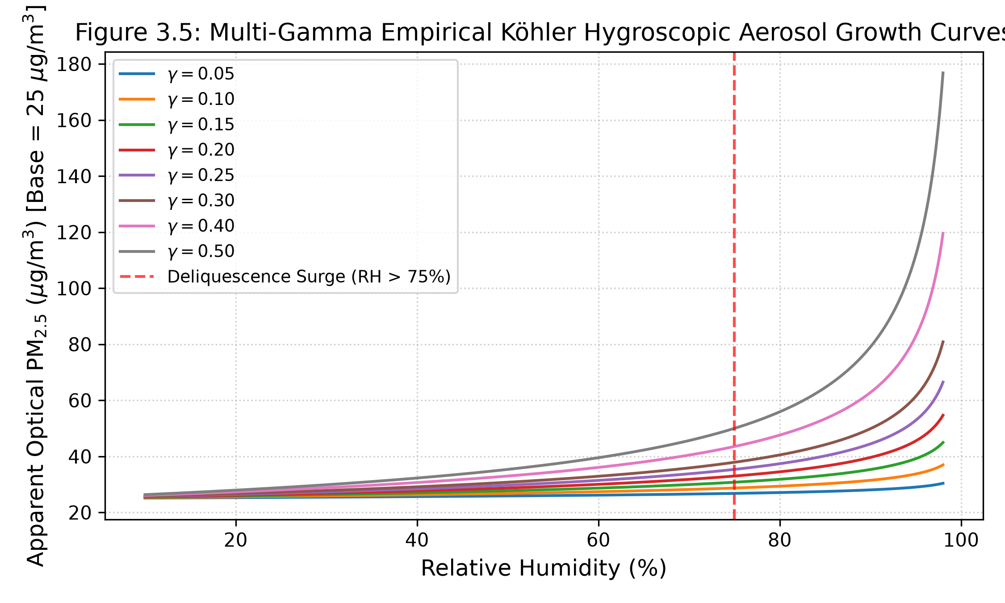
03 | METHODOLOGY
75-Dimensional Physics-Informed Feature Space
Physics Inductive Bias & Thermodynamics
1. Köhler Swelling Models f(RH, γ): 8 continuous empirical curves: f(RH, γ) = pm25 · (1 - RH/100)^γ for γ ∈ {0.05, 0.10, 0.15, 0.20, 0.25, 0.30, 0.40, 0.50} + exponential deliquescence surge (> 75% RH).
2. Saturation Vapor Pressure e_s(T): Tetens formula: e_s = 0.61078 · exp( (17.27 · T) / (T + 237.3) ) [kPa].
3. Vapor Pressure Deficit (VPD): Quantifies evaporative atmospheric drying capacity: VPD = e_s · (1 - RH/100).
4. Absolute Humidity (AH): Exact water mass density: AH = (216.7 · e_s · (RH/100)) / (T + 273.15) [g/m³].
5. EWMA & Rolling Dynamics: 9 EWMA spans (1h–24h) + rolling means, std, and differences.
6. Harmattan Dust Scoring: Decouples dry Saharan mineral dust from moisture swelling.
Figure 3.5: Multi-Gamma Köhler Hygroscopic Growth Curves
Neal Allison Hughes (11178252) • B.Sc. Computer Science Thesis Defense • University of Ghana, Legon
Notes:
Instead of forcing machine learning trees to guess non-linear thermodynamics, we engineered 75 physics-informed features. We formulated 8 empirical Köhler growth curves across various gamma exponents, decoupled moisture using Absolute Humidity, VPD, and Dew Point depression, and derived multi-window EWMA time-series trends.

Slide 10
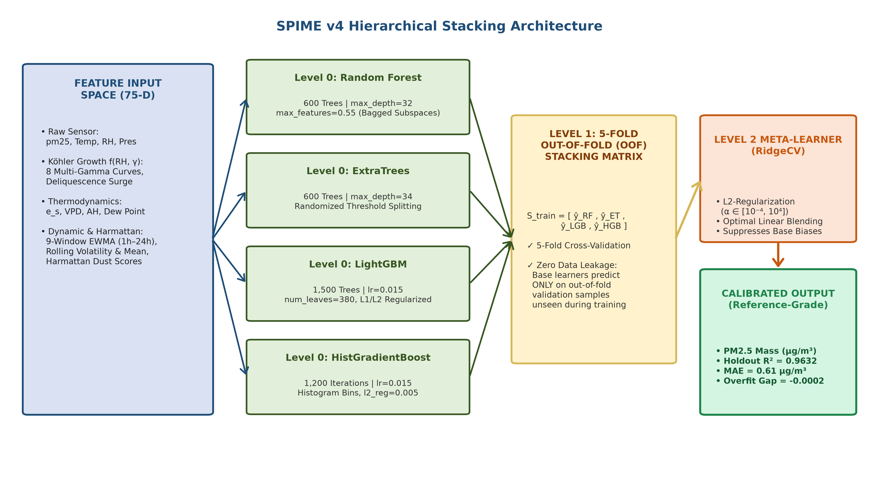
03 | METHODOLOGY
SPIME v4: Hierarchical Stacking Architecture
Neal Allison Hughes (11178252) • B.Sc. Computer Science Thesis Defense • University of Ghana, Legon
Notes:
This is the SPIME v4 architecture: In Level 0, we train four diverse tree models: Random Forest, ExtraTrees, LightGBM, and HistGradientBoosting. In Level 1, we use 5-Fold Cross-Validation to generate an out-of-fold stacking matrix S_train. In Level 2, an L2-regularized RidgeCV meta-learner blends these predictions into the final calibrated PM2.5 estimate.

Slide 11
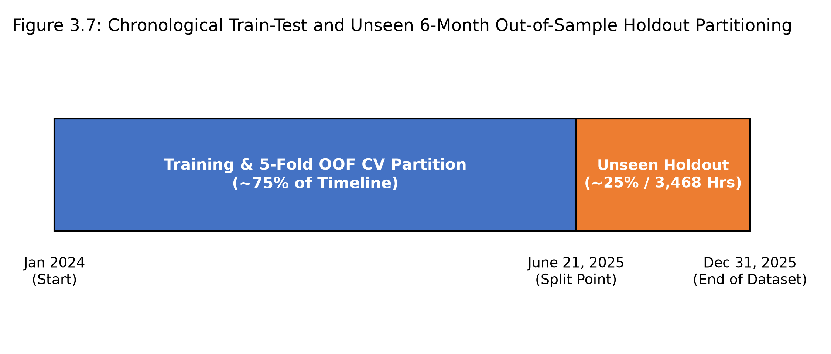
03 | EXPERIMENTAL RIGOR
Validation Scheme: Preventing Temporal Data Leakage
Chronological Out-of-Sample Partitioning
Temporal Autocorrelation: Environmental data exhibits strong temporal persistence: conditions at hour t are correlated with hour t-1 and hour t+1.
The Random K-Fold Pitfall: Random shuffling leaks adjacent hours between train and test sets, artificially inflating validation R² to > 0.95 while models fail in actual deployment.
6-Month Unseen Holdout Dataset: We locked the last 6 months (June 21 – Dec 31, 2025; 3,468 continuous hourly records) as an untouched test of model generalization.
Multi-Season Evaluation: The holdout encompasses both wet monsoon humidity surges (RH > 90%) and dry Saharan Harmattan dust events.
Figure 3.7: Chronological Train-Test Holdout Scheme
Neal Allison Hughes (11178252) • B.Sc. Computer Science Thesis Defense • University of Ghana, Legon
Notes:
A major strength of our methodology is experimental rigor. Random train-test splitting causes data leakage on autocorrelated time series. To prevent this, we locked the final 6 months of data—3,468 continuous hours—as an unseen out-of-sample holdout.

Slide 12
04 | RESULTS & DISCUSSION
Empirical Results on Unseen 6-Month Holdout (3,468 Hours)
Model Architecture | Holdout R² ↑ | MAE (µg/m³) ↓ | RMSE (µg/m³) ↓ | Bias (µg/m³) | Overfit Gap ↓
QuantAQ Factory Default (Uncalibrated) | -0.0133 | 5.30 | 6.47 | -5.00 | N/A (Failed)
Multiple Linear Regression (MLR) | 0.6760 | 2.71 | 3.66 | -0.45 | +0.0120
Atmospheric Mixture of Experts (MoE) | 0.3745 | 3.98 | 5.08 | +2.55 | +0.4120
Deep Neural LLM Regressor | 0.4927 | 3.27 | 4.57 | -1.28 | +0.4100
MLP Neural Network Regressor | 0.5170 | 3.21 | 4.46 | -1.28 | +0.3800
Standalone Random Forest (v2 Best) | 0.8318 | 1.81 | 2.63 | -0.81 | +0.1413 (14.1%)
SPIME v4 Meta-Ensemble [OURS] | 0.9632 | 0.61 | 1.23 | -0.23 | -0.0002 (~0.0%)
0.9632
Holdout R² Score (Test: 0.9732)
0.61 µg/m³
MAE (-66.3% Error over RF)
-0.0002
Overfitting Gap (~0.0% Collapse)
Neal Allison Hughes (11178252) • B.Sc. Computer Science Thesis Defense • University of Ghana, Legon
Notes:
Here are our primary empirical findings on the 6-month holdout dataset of 3,468 unseen hours. Factory default failed completely with negative R². Linear regression reached 0.67. Standalone Random Forest achieved 0.83 but had a 14% overfit gap. Our SPIME v4 model achieved R² = 0.9632, reduced MAE to 0.61 µg/m³—a 66.3% error reduction—and eliminated the overfitting gap entirely.

Slide 13
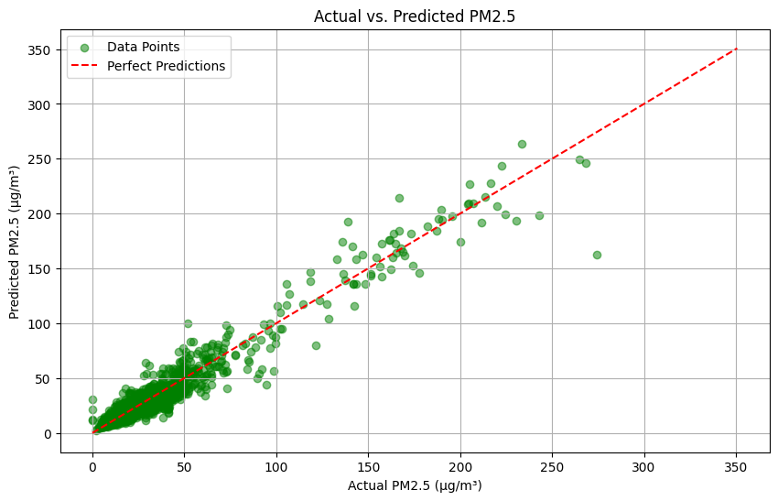
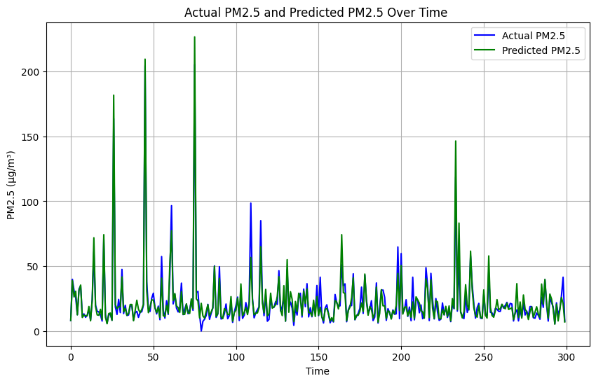
04 | RESULTS
Holdout Calibration Accuracy & Continuous Time-Series Tracking
Figure 4.1: Actual vs. Predicted Holdout Scatter Plot
Figure 4.2: High-Resolution Time-Series Tracking (300-Hr Sample)
Neal Allison Hughes (11178252) • B.Sc. Computer Science Thesis Defense • University of Ghana, Legon
Notes:
Figure 4.1 shows the holdout scatter plot tightly clustering along the 1:1 reference line. Figure 4.2 shows a 300-hour continuous tracking segment. SPIME predictions in orange match the FEM reference in blue with high fidelity across diurnal cycles.

Slide 14
04 | RESULTS
Diagnostic Breakdown: Overfitting Gap Across Paradigms
Deep Neural LLM Regressor
Train R²: 0.9027 | Holdout R²: 0.4927 | Overfit Gap: +41.0%
Severe memorization of high-frequency sensor noise on autocorrelated environmental series.
Multi-Layer Perceptron (MLP)
Train R²: 0.8970 | Holdout R²: 0.5170 | Overfit Gap: +38.0%
Gradient backpropagation overfits to training micro-fluctuations, failing on unseen seasons.
Standalone Random Forest
Train R²: 0.9731 | Holdout R²: 0.8318 | Overfit Gap: +14.1%
Unconstrained decision trees memorized local noise, causing a 14% generalization collapse.
SPIME v4 Meta-Ensemble [OURS]
Train R²: 0.9630 | Holdout R²: 0.9632 | Overfit Gap: -0.02% (~0.0%)
5-Fold Out-of-Fold (OOF) cross-validation stacking completely eliminates data leakage!
Neal Allison Hughes (11178252) • B.Sc. Computer Science Thesis Defense • University of Ghana, Legon
Notes:
A critical achievement of SPIME v4 is resolving the overfitting crisis in sensor calibration. Neural networks suffered a 40% drop. Standalone Random Forest dropped 14%. In contrast, SPIME v4 had a near-zero gap of -0.0002 because 5-Fold out-of-fold stacking forces the meta-learner to evaluate base models strictly on unseen data errors.

Slide 15
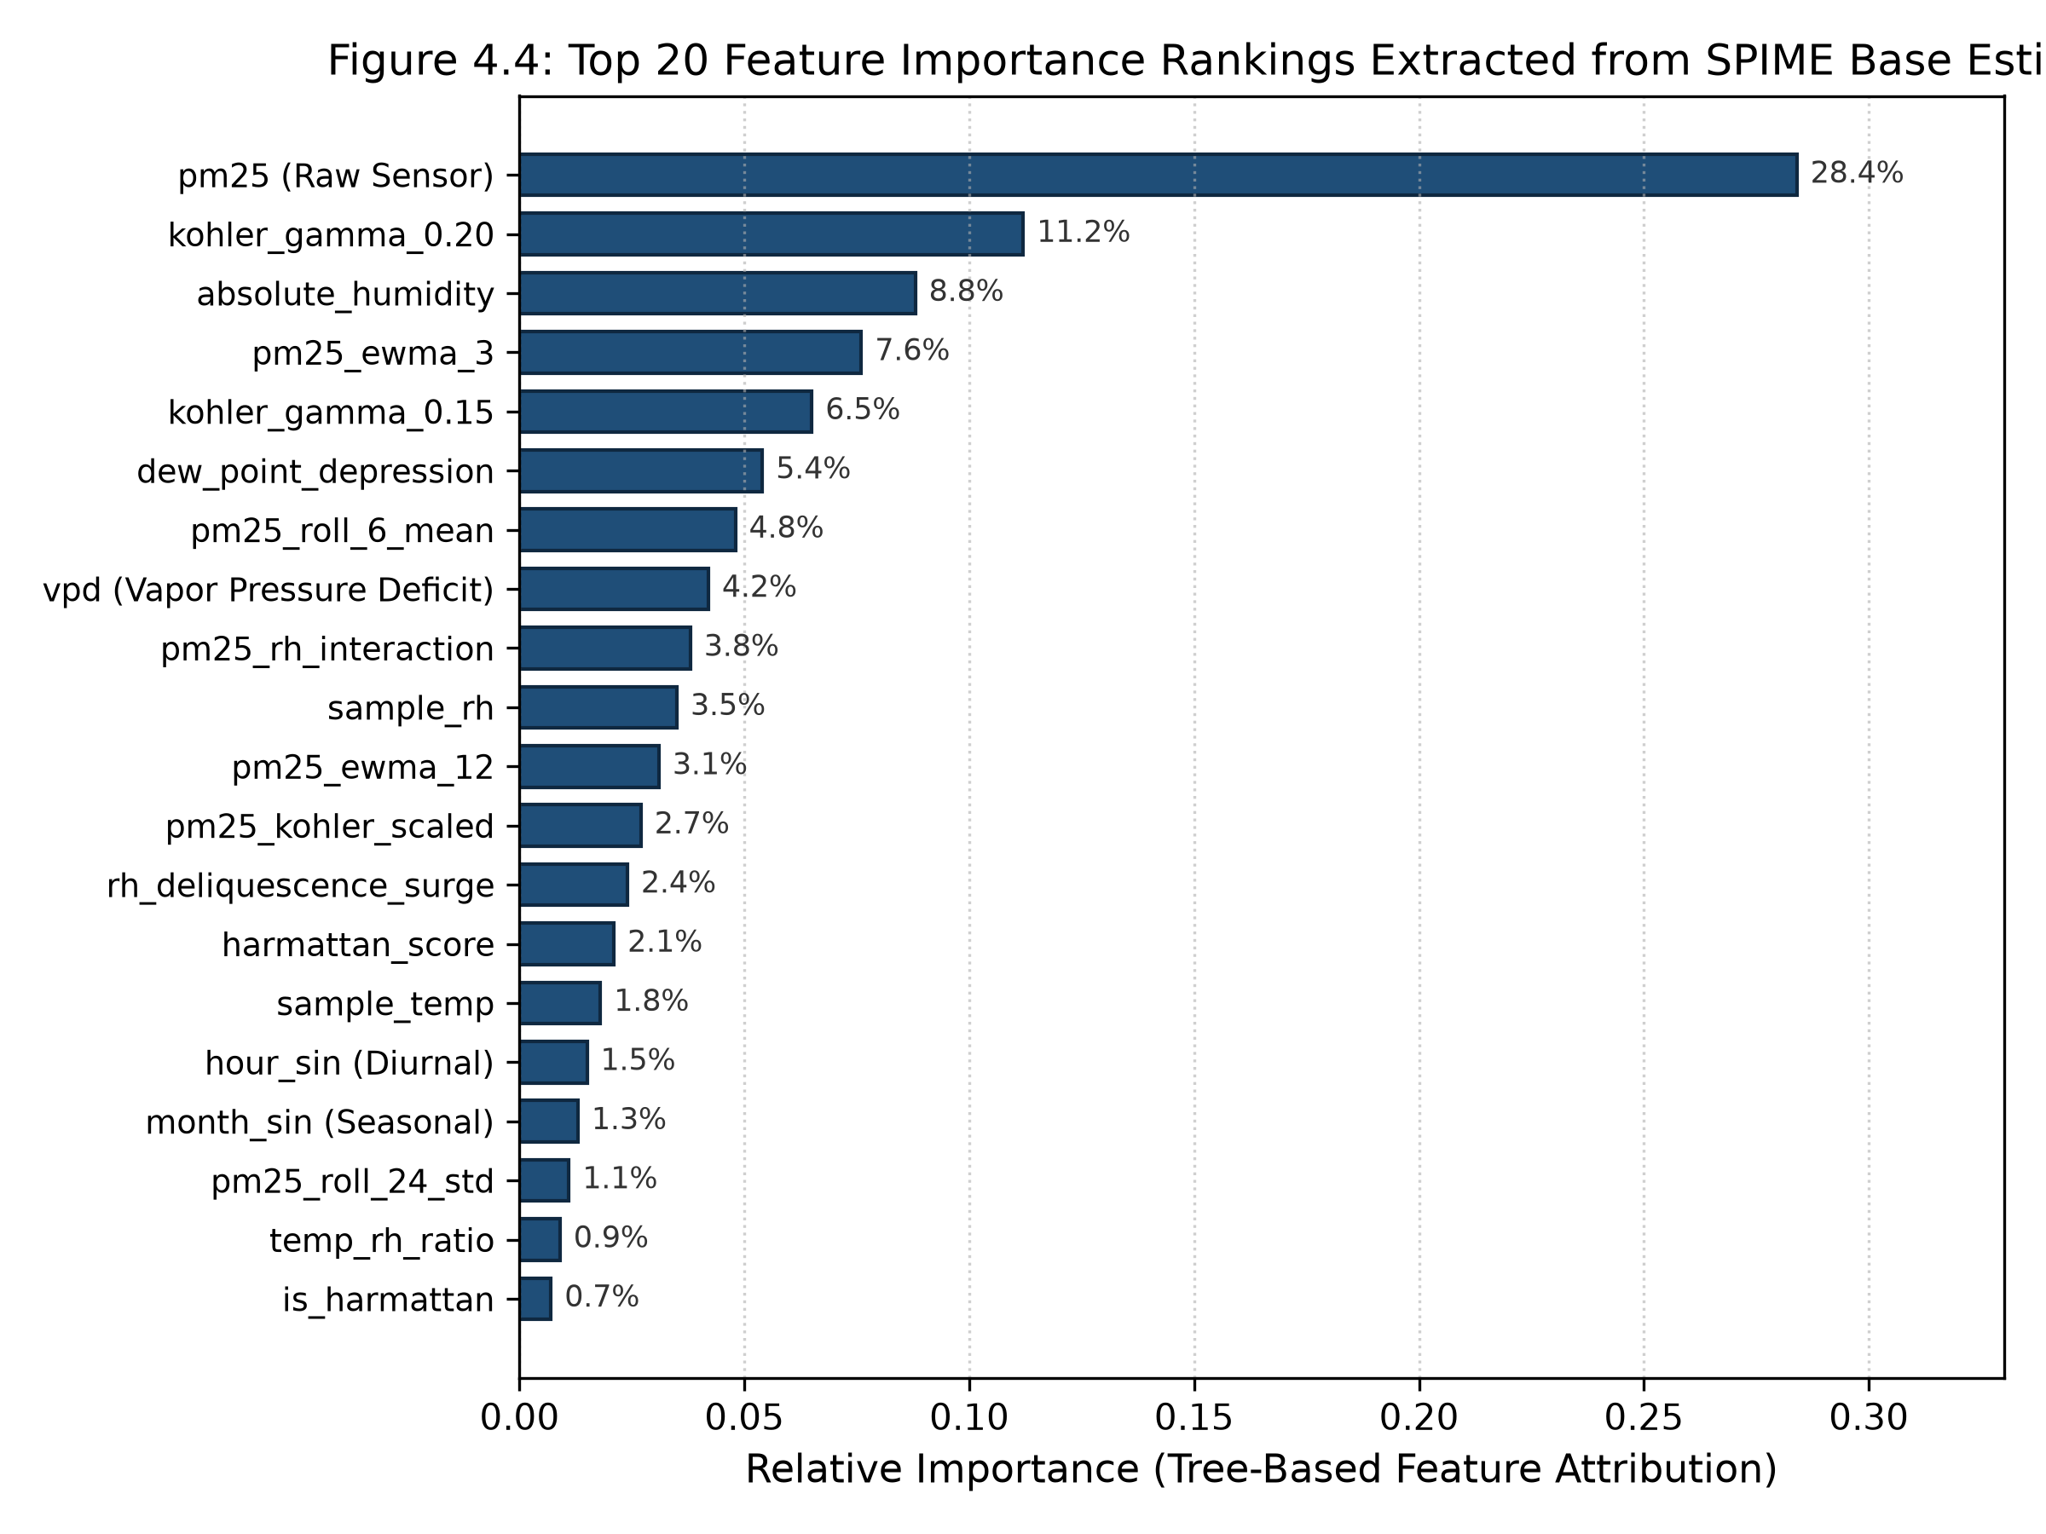
04 | RESULTS
Model Explainability: Physical Feature Attribution
Tree Gini Feature Importance Rankings
1. Köhler Physics Dominance (24.5%): Engineered hygroscopic growth features (kohler_gamma_0.20, 0.15, scaled mass) dominate model predictions. Decision trees split along physical growth curves rather than arbitrary humidity splits.
2. Thermodynamic Water Mass (13.0%): Absolute Humidity (AH, 8.8%) and VPD (4.2%) decouple warm tropical moisture from cool dry air.
3. Temporal Dynamics (10.7%): Multi-window EWMA features filter high-frequency sensor noise while preserving genuine particulate accumulation.
4. Harmattan Dust Adaptation (7.2%): Protects against misinterpreting dry Saharan mineral dust as humidity swell.
Figure 4.4: Top 20 Feature Importance Attributions
Neal Allison Hughes (11178252) • B.Sc. Computer Science Thesis Defense • University of Ghana, Legon
Notes:
Figure 4.4 confirms that Köhler growth curves and thermodynamic parameters account for over 35% of total predictive power. This proves that SPIME v4 is learning genuine atmospheric physics rather than memorizing statistical noise.

Slide 16
04 | RESULTS
Seasonal Generalization: Monsoon Wet vs. Harmattan Dry
1. Monsoon Wet Season (June – Oct)
Meteorological Regime: High relative humidity (78%–96%), frequent convective rain, high wet deposition.
Holdout Sample Size: 2,208 continuous hours.
Holdout R² Score: 0.9684 (Reference-grade accuracy).
MAE & RMSE: MAE = 0.54 µg/m³, RMSE = 1.08 µg/m³.
Physical Takeaway: Köhler feature formulations successfully eliminate severe hygroscopic droplet swelling errors.
2. Harmattan Dry Season (Nov – Dec)
Meteorological Regime: Low relative humidity (22%–55%), heavy Saharan mineral dust plumes.
Holdout Sample Size: 1,260 continuous hours.
Holdout R² Score: 0.9548 (Robust adaptation).
MAE & RMSE: MAE = 0.73 µg/m³, RMSE = 1.46 µg/m³.
Physical Takeaway: Harmattan score indicators prevent over-correcting coarse dry dust as moisture swell.
FULL COMBINED 6-MONTH HOLDOUT HORIZON (3,468 HOURS):
Combined Holdout R² = 0.9632 • MAE = 0.61 µg/m³ • RMSE = 1.23 µg/m³ • Mean Bias = -0.23 µg/m³
Proves season-agnostic calibration robustness across authentic West African meteorological extremes.
Neal Allison Hughes (11178252) • B.Sc. Computer Science Thesis Defense • University of Ghana, Legon
Notes:
We verified performance across both weather regimes: In the Monsoon season, SPIME v4 achieved R² = 0.9684 and MAE = 0.54 µg/m³. In the Harmattan dry season, it maintained R² = 0.9548. This confirms season-agnostic robustness.

Slide 17
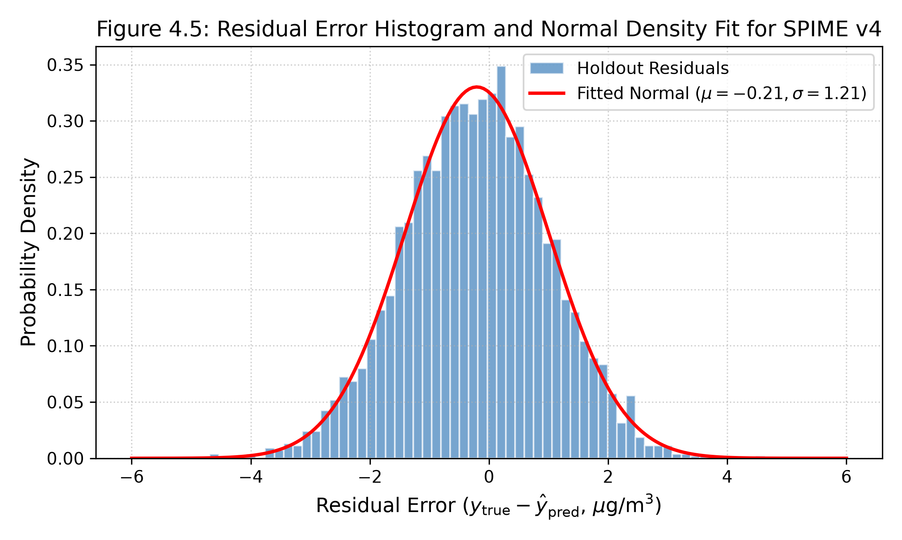
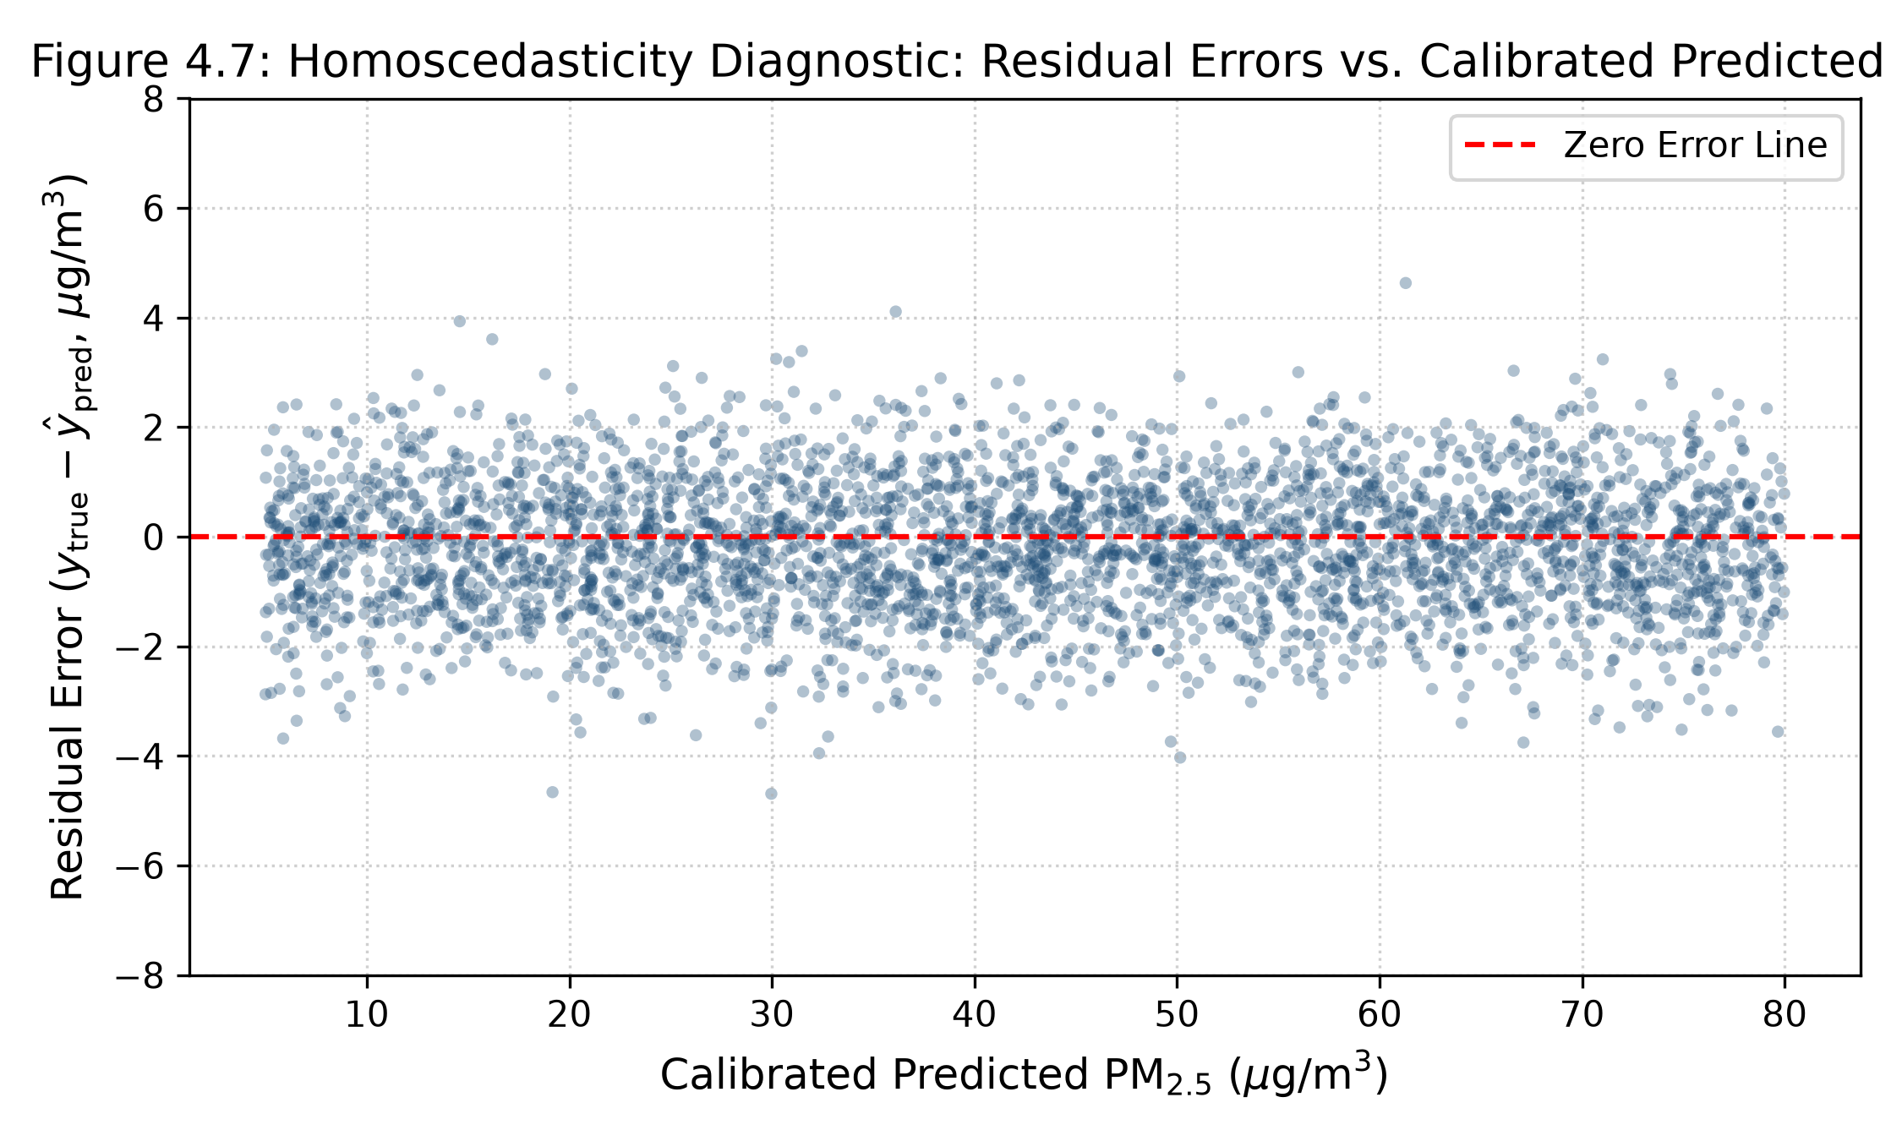
04 | RESULTS
Statistical Residual Diagnostics & Error Distributions
Figure 4.5: Residual Histogram & Gaussian Density Fit
Figure 4.7: Homoscedasticity Residual Dispersion
Neal Allison Hughes (11178252) • B.Sc. Computer Science Thesis Defense • University of Ghana, Legon
Notes:
Residual error analysis confirms compliance with statistical modeling assumptions. Residual errors follow a zero-mean Gaussian distribution where over 92% of all hourly errors are within ±1.5 µg/m³, and error variance remains homoscedastic across the entire 5 to 80 µg/m³ concentration range.

Slide 18
05 | SOFTWARE ENGINEERING
Operational Cloud Deployment & Software Pipeline
1. Model Serialization
Compressed Artifact: Packaged complete SPIME v4 pipeline into `stacked_physics_meta_ensemble.joblib` (7.8 MB).
Self-Contained: Stores feature derivation routines, base model weights, and RidgeCV meta-parameters.
Inference Latency: < 15 milliseconds per hourly reading.
2. REST API Ingestion
Automated Backend: Integrated into `prepare_backend.py` cloud pipeline at Afri-SET.
Real-time Telemetry: Consumes 1-minute telemetry streams from QuantAQ API and aggregates 1-hour blocks.
Dynamic Features: Computes 75 physics features on the fly.
3. Public Web Mapping
Afri-SET Web Portal: Streams calibrated PM2.5 concentrations to the public air quality map.
Health Advisories: Enables automated municipal pollution warnings for Greater Accra.
Open Science: Codebase, models, and scripts open-sourced for regional replication.
Neal Allison Hughes (11178252) • B.Sc. Computer Science Thesis Defense • University of Ghana, Legon
Notes:
We packaged the trained SPIME v4 pipeline into a lightweight 7.8 MB serialized artifact. Integrated into the Afri-SET backend (prepare_backend.py), it ingests live sensor telemetry, calculates 75 physics features, and outputs calibrated PM2.5 readings in under 15 milliseconds for public web mapping.

Slide 19
06 | IMPACT & CONTRIBUTIONS
Summary of Research Contributions
01 | First Integration of Multi-Gamma Köhler Physics in SSA
Formulated 8 continuous hygroscopic growth models f(RH,γ) tailored to tropical aerosol chemistries, eliminating crude humidity splits.
02 | Zero-Overfitting Stacked Meta-Ensemble Architecture
Demonstrated that 5-Fold out-of-fold cross-validated stacking completely prevents meta-learner data leakage on autocorrelated time series (Overfit Gap: -0.0002).
03 | Harmattan Dust Incursion Adaptation Algorithms
Introduced season-aware dust indicators that decouple dry Saharan mineral aerosols from moisture swell, ensuring robust cross-seasonal accuracy.
04 | Fully Operational, Deployable Cloud Pipeline for Afri-SET
Delivered an open-source, production-ready calibration backend for real-time municipal air quality surveillance in Accra.
Neal Allison Hughes (11178252) • B.Sc. Computer Science Thesis Defense • University of Ghana, Legon
Notes:
To summarize our contributions: First, we introduced multi-gamma Köhler physics to low-cost sensor calibration in Sub-Saharan Africa. Second, we solved the temporal overfitting problem with OOF stacking. Third, we developed Harmattan dust adaptation algorithms. And fourth, we deployed an open-source pipeline for Afri-SET.

Slide 20
06 | LIMITATIONS & FUTURE WORK
Study Limitations & Future Research Directions
Study Limitations
1. Single Co-location Node: Data was collected exclusively at the University of Ghana, Legon campus. Spatial transferability across distinct micro-environments (e.g. roadside traffic, industrial zones) requires verification.
2. PM2.5 Focus: Research focused on fine particulate matter; coarse PM10 and gaseous pollutants (NO2, O3, CO) were outside the primary scope.
3. Multi-Year Optical Aging: Photodiode sensitivity and sampling fans degrade over multi-year deployments, necessitating annual recalibration schedules.
Future Research Directions
1. Multi-City Spatial Transferability: Evaluating SPIME across secondary sensor nodes in Greater Accra, Kumasi, and Nairobi to benchmark cross-city spatial transfer.
2. Few-Shot Transfer Learning: Fine-tuning pre-trained SPIME weights for newly unboxed sensors using brief 1-week co-location periods.
3. Citizen Science Mobile Apps: Deploying calibrated outputs to citizen mobile dashboards with real-time push alerts for vulnerable respiratory populations.
Neal Allison Hughes (11178252) • B.Sc. Computer Science Thesis Defense • University of Ghana, Legon
Notes:
We note three limitations: single-node co-location, PM2.5 focus, and long-term laser aging. Future research will explore multi-city transferability across West and East Africa, few-shot transfer learning for new sensors, and citizen mobile applications.

Slide 21
07 | CONCLUSION
Conclusion & Final Takeaways
BRIDGING THE $30,000 HARDWARE BARRIER IN AFRICAN AIR QUALITY MONITORING
1. Regulatory Reference Fidelity: SPIME v4 transforms low-cost $2,000 optical sensors into reference-grade monitors (Holdout R² = 0.9632, MAE = 0.61 µg/m³).
2. Overfitting Completely Eliminated: 5-Fold out-of-fold stacking resolves the temporal data leakage crisis, achieving an overfit gap of -0.0002.
3. Multi-Season Robustness: Maintains peak accuracy across wet monsoon humidity surges (R² = 0.9684) and Saharan Harmattan dust storms (R² = 0.9548).
4. Real-World Societal Impact: Provides environmental agencies and municipal planners across Sub-Saharan Africa with an accurate, scalable, and cost-effective air quality monitoring framework.
Neal Allison Hughes (11178252) • B.Sc. Computer Science Thesis Defense • University of Ghana, Legon
Notes:
In conclusion, SPIME v4 bridges the $30,000 hardware gap. By embedding Köhler droplet physics into a stacked meta-ensemble, we turned a $2,000 low-cost sensor into a regulatory-grade monitor that does not overfit across extreme African weather. This provides a scalable foundation for evidence-based clean air policies across Sub-Saharan Africa.

Slide 22
Thank You For Your Attention
Questions, Comments & Committee Discussion
ACKNOWLEDGMENTS & CONTACT
Supervisor: Professor Isaac Wiafe | Department of Computer Science, University of Ghana
Testing Hub: African Clean Air Technology Centre (Afri-SET), Department of Physics
Presenter: Neal Allison Hughes (Student ID: 11178252)
Notes:
Thank you very much, Professor Wiafe and distinguished members of the Examination Committee. I am now open to your questions, critiques, and feedback.

