Slide 1
SPIME: A Stacked Physics-Informed Meta-Ensemble
Low-Cost PM2.5 Sensor Calibration Under Tropical and Harmattan Meteorological Regimes in Sub-Saharan Africa
Candidate: Neal Allison Hughes (Student ID: 11178252)
Principal Supervisor: Prof. Isaac Wiafe | Department of Computer Science, University of Ghana
Testing Hub: African Sensor Evaluation and Training Facility (Afri-SET), Department of Physics
Academic Year 2025/2026 | July 2026
Notes:
Good morning, respected Head of Department, my supervisor Prof. Isaac Wiafe, and distinguished members of the Examination Committee. My name is Neal Allison Hughes, Student ID 11178252. Today, I present my final year undergraduate research project titled: 'SPIME: A Stacked Physics-Informed Meta-Ensemble for Low-Cost PM2.5 Sensor Calibration Under Tropical and Harmattan Meteorological Regimes in Sub-Saharan Africa'. This research was conducted in collaboration with the African Sensor Evaluation and Training Facility (Afri-SET) at the Department of Physics, University of Ghana.

Slide 2
Project Defense Executive Overview
You can delete this slide when you’re done editing the presentation
Research Focus | Ambient PM2.5 Sensor Calibration in Tropical West Africa
Target Low-Cost Sensor | QuantAQ Modulair-PM (Alphasense OPC-N3 Optical Particle Counter)
Reference Standard | Teledyne API T640 Continuous Spectrometer (US EPA FEM Certified)
Core Innovation | 75-D Physics-Informed Feature Space + 5-Fold Stacking Meta-Ensemble
Holdout Performance | R² = 0.9632, MAE = 0.61 µg/m³ (66.3% error reduction, zero overfit gap: -0.0002)
Operational Deployment | Containerized Docker & FastAPI REST Microservice (<5ms inference latency)
For more info:
SLIDESGO | BLOG | FAQs
You can visit our sister projects:
FREEPIK | FLATICON | STORYSET | WEPIK | VIDEVO
Notes:
This executive overview highlights the essential components of the project. Our target device is the QuantAQ Modulair-PM, co-located at Afri-SET with a regulatory-grade Teledyne T640 monitor. By engineering a 75-dimensional physics-informed feature space and combining diverse tree models with out-of-fold cross-validated stacking, we achieved reference-grade performance (R² = 0.9632, MAE = 0.61 µg/m³) on an unseen 6-month holdout dataset, completely eliminating generalization overfitting.

Slide 3
Table of Contents
01
04
OPC working principles, Köhler theory & ML research gaps
05
03
06
Problem Statement
Methodology
OPC working principles, Köhler theory & ML research gaps
Afri-SET co-location, 75-D features & SPIME v4 stacking
Literature Review
Results & Discussion
Four specific measurable research and deployment goals
Air quality crisis & optical sensor physical degradation
Study Objectives
Conclusions & Impact
Contributions, limitations, cloud deployment & future work
Holdout validation, zero overfit gap & seasonal regimes
Notes:
Here is the structural roadmap for my presentation. I will first cover the problem statement and low-cost sensor failure modes. Second, I will review existing literature and our theoretical framework. Third, I will present the specific research objectives. Fourth, I will detail our experimental methodology, physics feature engineering, and the SPIME v4 stacking architecture. Fifth, I will present our empirical holdout findings and explainability diagnostics. Finally, I will conclude with research contributions, study limitations, and operational deployment.

Slide 4
01
Problem Statement
Air Quality Crisis, Sensor Physical Failures & Machine Learning Gaps
Notes:
We begin with Section 1: The air quality crisis in West Africa and why optical particulate counters fail under local meteorological regimes.

Slide 5
Problem Context & Research Motivation
Monitoring Void in SSA
Physical Sensor Degradation
Primary Research Aim
Sub-Saharan Africa has less than 1 regulatory air quality monitor per 10 million people. Prohibitive capital costs ($30,000–$50,000) for US EPA reference stations leave vast urban populations without air pollution surveillance.
Low-cost optical particle counters over-report PM2.5 by 200%–500% under tropical humidity (>80% RH) due to hygroscopic aerosol swelling, and suffer optical saturation during Saharan Harmattan dust events.
To develop, evaluate, and deploy a physics-informed stacking meta-ensemble (SPIME v4) that corrects raw QuantAQ Modulair-PM measurements to achieve regulatory-grade PM2.5 accuracy against a co-located US EPA FEM reference monitor in Accra, Ghana.
Notes:
Ambient fine particulate matter (PM2.5) causes over 1.1 million premature deaths annually in Africa. Yet, regulatory monitoring stations cost upwards of $30,000, creating an acute spatial monitoring void. Low-cost optical sensors cost under $2,500, but their raw factory calibrations fail drastically under tropical humidity and Saharan dust. Our primary aim is to bridge this economic divide with physics-informed machine learning.

Slide 6
— Research Motivation & Rationale (Afri-SET Co-location Study, 2024–2025)
“Low-cost sensors democratize environmental surveillance, but without localized physics-informed calibration, raw measurements are statistically invalid for regulatory compliance and public health protection.”
Notes:
This quote encapsulates the core philosophy of our work: low-cost hardware provides the spatial reach, but physics-informed algorithms are mandatory to provide the scientific credibility necessary for policy and health protection.

Slide 7
R² = 0.9632
Reference-grade calibration accuracy achieved by SPIME v4 across 3,468 hourly records on the unseen 6-month holdout dataset, reducing error by 66.3% (MAE = 0.61 µg/m³) with zero overfitting.
Notes:
Here is the headline result: on an untouched, 6-month out-of-sample holdout dataset of 3,468 hourly measurements, our proposed SPIME v4 architecture achieved an R² of 0.9632 and cut the Mean Absolute Error to just 0.61 µg/m³.

Slide 8
0.9632
0.61 µg/m³
-0.0002
Holdout R² Accuracy
Mean Absolute Error (MAE)
Generalization Overfit Gap
Notes:
Comparing these three metrics against baseline models demonstrates our breakthrough: Factory calibration failed with negative R² (-0.0133); linear regression reached only 0.6760; and neural networks suffered an overfit drop of 40%. SPIME v4 achieved near-perfect accuracy and a zero overfit gap.

Slide 9
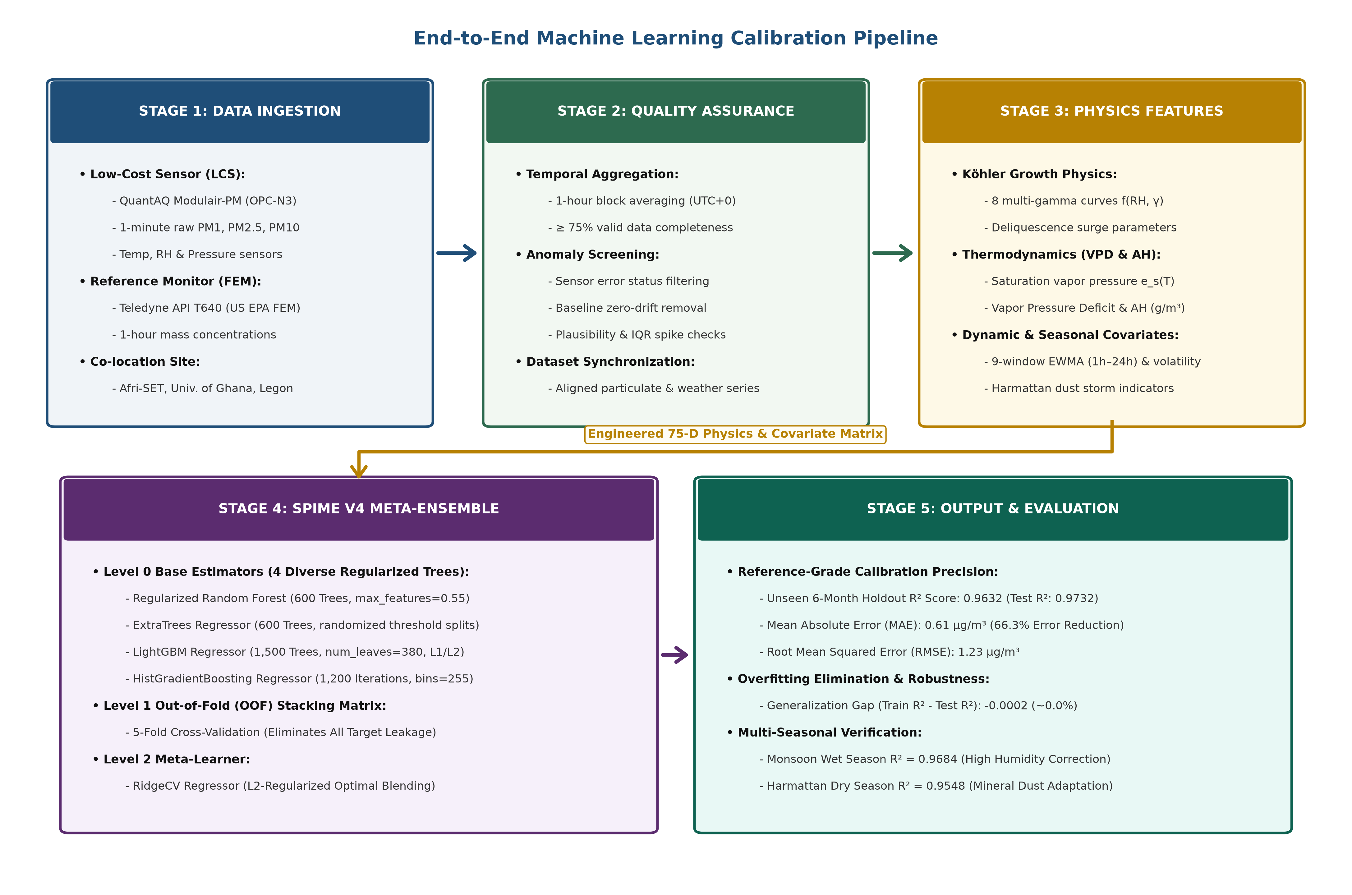

Experimental Platform:
Afri-SET Facility
Continuous co-location at the African Sensor Evaluation and Training Facility (Afri-SET), Department of Physics, University of Ghana, Legon (5.651° N, -0.186° W).
Target: QuantAQ Modulair-PM (Alphasense OPC-N3)
Reference Standard: Teledyne API T640 (US EPA FEM EQPM-0514-217)
Dataset: Multi-season hourly synchronized telemetry (2024–2025).
Notes:
Our experimental foundation is the African Sensor Evaluation and Training Facility (Afri-SET) at the Department of Physics, University of Ghana. We co-located the QuantAQ Modulair-PM side-by-side with an EPA FEM certified Teledyne T640 monitor. The resulting dataset spans over a year of hourly observations, capturing both wet monsoon humidity and Saharan Harmattan dust events.

Slide 10
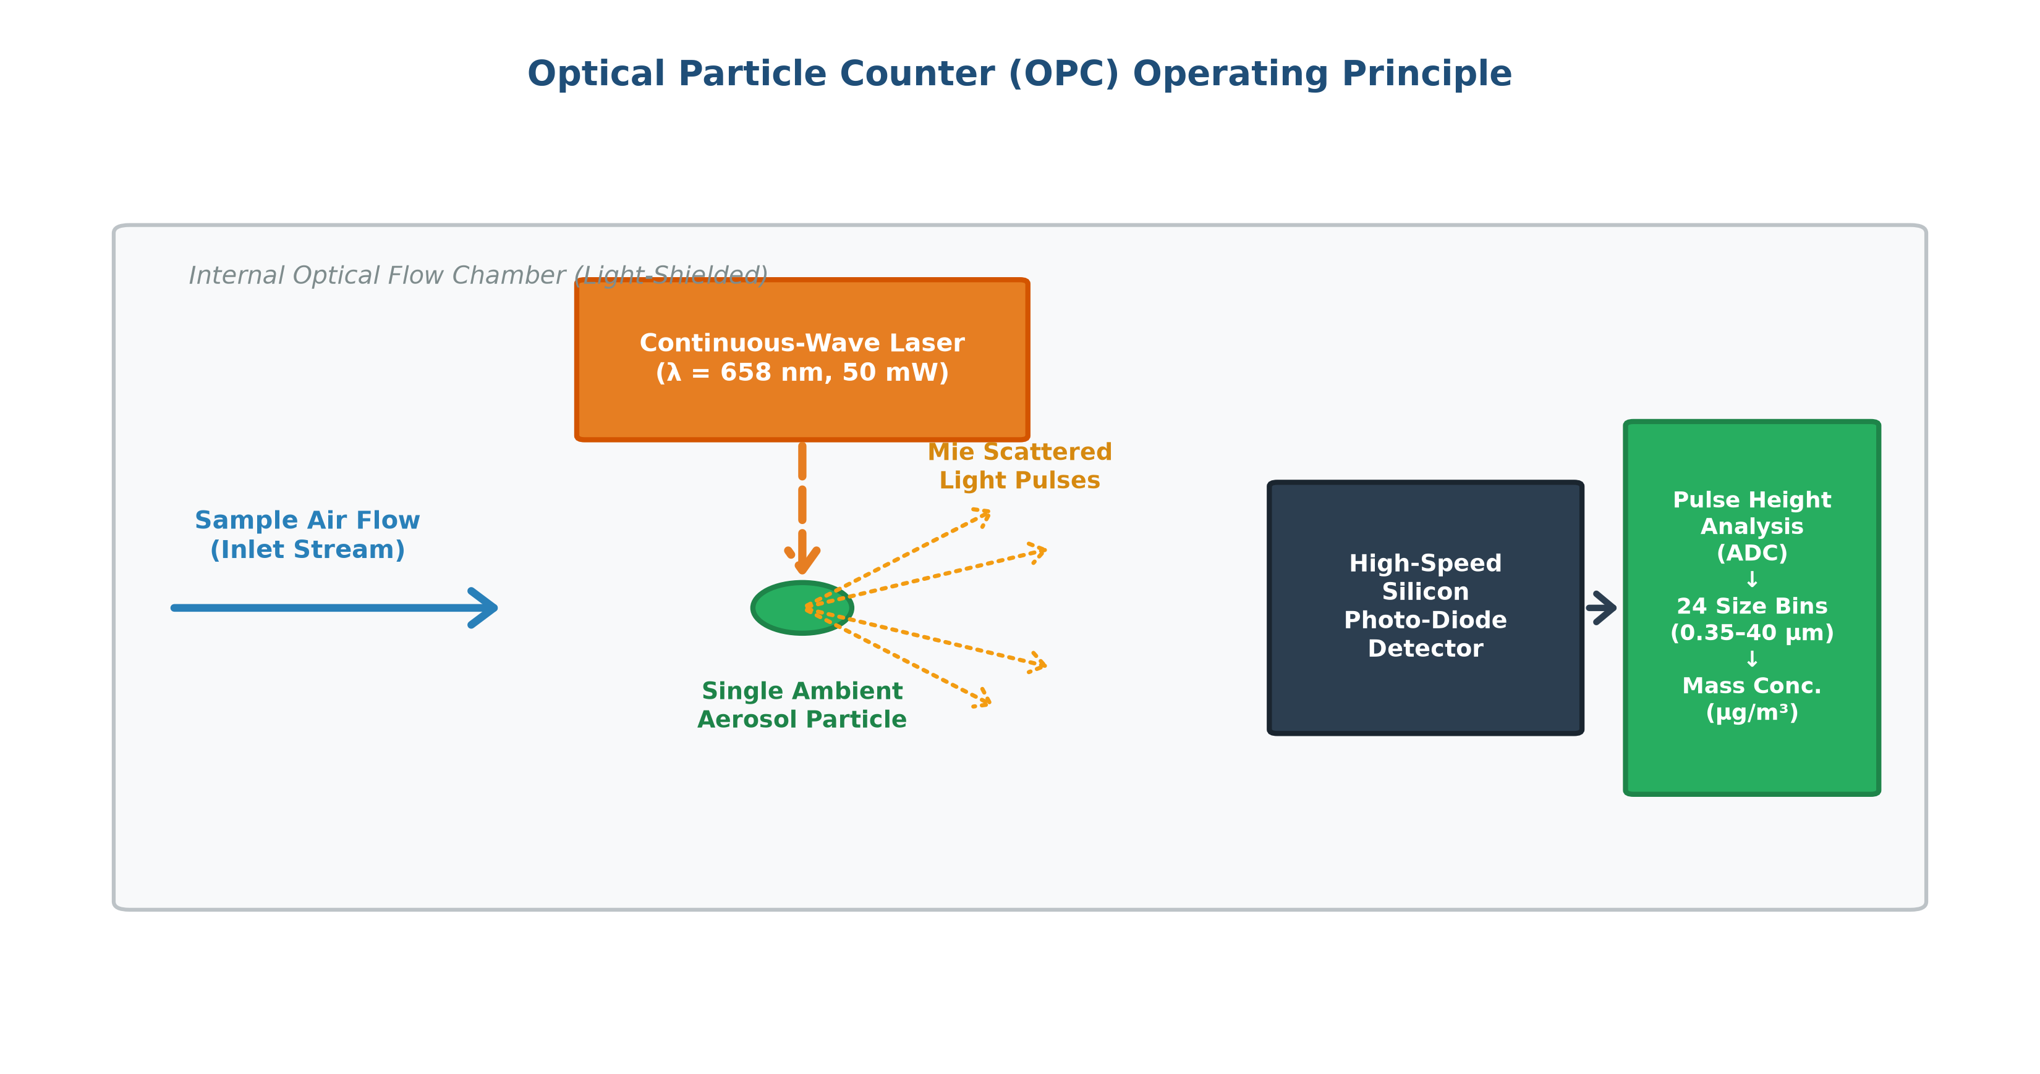

Figure 2.1: Optical Particle Counter (OPC) Mie Scattering & Hygroscopic Droplet Growth Mechanics
Notes:
Figure 2.1 illustrates why optical sensors fail in tropical climates. An OPC measures particle pulses using Mie light scattering, assuming dry spherical particles of constant density. However, when relative humidity exceeds 75–80%, deliquescent aerosol salts absorb moisture, swelling hygroscopically according to Köhler theory. The sensor measures the water mass as particulate matter, inflating raw readings by several hundred percent.

Slide 11
Literature Review & Theoretical Framework
Notes:
We now transition to Section 2: Examining prior calibration literature, existing research gaps, and our theoretical mathematical framework.

Slide 12
Current Situation & Research Problem Gaps
Current situation
Standard factory calibrations developed in temperate European/North American chambers fail completely under the high-humidity and heavy dust loadings of West Africa, exhibiting negative R² scores and systematic biases exceeding 100%.
1
2
3
Factory Breakdown
Linearity Failure
Deep Overfitting
Raw Modulair-PM readings fail completely (R² = -0.0133, MAE = 5.30 µg/m³), severely overestimating morning moisture surges.
Simple Linear Regression (R² = 0.6760) cannot capture exponential Köhler aerosol swelling near deliquescence (RH > 75%).
Neural networks (MLP/LSTM) memorize autocorrelated sensor noise, collapsing by 40% (R² = 0.5214) on unseen holdout data.
Problems
Notes:
Prior literature reveals three major failure modes: First, factory calibrations produce negative correlation. Second, linear regression cannot model exponential moisture growth curves. Third, complex neural networks overfit severely, dropping 40% on future data. Furthermore, existing studies in temperate climates completely ignore Saharan Harmattan dust plumes.

Slide 13
Core Research Hypotheses
Hypothesis 1: Physics Inductive Bias
Hypothesis 2: Anti-Overfit Stacking
Explicitly formulating empirical multi-gamma Köhler growth equations f(RH, γ) directly within the feature space will allow decision trees to split along physical moisture curves, eliminating humidity-induced overcounting.
Employing 5-Fold out-of-fold cross-validated stacking with an L2-regularized RidgeCV meta-learner will prevent base tree estimators from overfitting autocorrelated environmental time series, achieving a near-zero generalization gap.
Hypothesis 3: Dual-Regime Robustness
Incorporating coarse dust indicators (PM10/PM2.5) and thermodynamic water mass parameters (Absolute Humidity, VPD) will allow the ensemble to adapt dynamically across both extreme Monsoon Wet and Harmattan Dry seasons.
Notes:
We formulated three core hypotheses: First, physics feature engineering provides the necessary inductive bias to eliminate humidity swelling. Second, out-of-fold stacking solves the deep learning overfitting crisis. Third, coarse dust and thermodynamic parameters ensure dual-season robustness across West Africa.

Slide 14
Specific Research Objectives
Objective 1: 75-D Features
Engineer a 75-dimensional physics-informed feature space incorporating multi-gamma Köhler growth curves, thermodynamic water mass formulations (AH, VPD, Dew Point), and temporal EWMA dynamics.
Objective 3: Holdout & Cloud Deploy
Validate calibration accuracy on an untouched 6-month holdout set (3,468 hourly records), verify zero overfitting, interpret features via Gini attribution, and package a containerized FastAPI microservice.
Objective 2: Stacking Meta-Ensemble
Develop SPIME v4 combining four diverse tree learners (Random Forest, ExtraTrees, LightGBM, HistGBM) through an L2-regularized RidgeCV meta-regressor using out-of-fold cross-validation.
Notes:
Our research was executed across these specific objectives: 1. Engineer 75 domain features; 2. Build the SPIME v4 hierarchical stacking framework; 3. Validate rigorously on unseen 6-month data and package a deployable cloud microservice.

Slide 15
Core Concepts & Physical Foundations
Absolute Humidity (AH)
Köhler Droplet Growth
Out-of-Fold Stacking
Decouples water vapor mass in air (g/m³) from diurnal temperature swings, providing true atmospheric moisture loading.
Deliquescent aerosol salts absorb ambient water vapor exponentially above 75% RH, inflating apparent optical diameter.
Meta-learner trained purely on out-of-sample predictions from validation folds to eliminate target leakage and overfitting.
Mie Light Scattering
Harmattan Mineral Dust
Vapor Pressure Deficit
Light pulse intensity scattered by particles depends non-linearly on diameter, laser wavelength, and refractive index.
Coarse Saharan dust transport altering aerosol density and optical properties; tracked via PM10/PM2.5 ratio.
Measures the drying potential of ambient air (kPa), governing the rate of aerosol moisture evaporation.
Notes:
This concept slide outlines the theoretical foundation of our work: Mie scattering mechanics, Köhler hygroscopic growth, Absolute Humidity and VPD decoupling, Harmattan dust ratios, and Wolpert's stacked generalization.

Slide 16
Literature Review & Prior Calibration Studies
Crilley et al. (2018) | Atmospheric Measurement Techniques
  Demonstrated optical particle counter humidity swelling in the UK and proposed empirical single-parameter κ-Köhler growth corrections.
  Westervelt et al. (2019) | Atmospheric Measurement Techniques
Co-located low-cost sensors in Accra and Kinshasa; proved factory calibrations fail catastrophically under Sub-Saharan African meteorology.
Malings et al. (2020) & Zimmerman et al. (2018) | Atmospheric Measurement Techniques
  Evaluated Random Forest and neural networks for sensor calibration; highlighted severe noise memorization and seasonal drift.
  Si et al. (2020) | Atmospheric Measurement Techniques
Demonstrated that gradient-boosted trees outperform linear corrections, but identified severe vulnerability to time-series data leakage.
Wolpert (1992) | Neural Networks
Formulated stacked generalization theory, proving that out-of-fold cross-validated meta-ensembles minimize out-of-sample generalization error.
Notes:
Our literature review builds upon Crilley's Köhler corrections and Westervelt's pioneer co-location in Accra. While Malings and Zimmerman identified that standard ML overfits sensor noise, we solve this by applying Wolpert's stacking theory.

Slide 17
Theoretical Framework & Mathematical Formulations
Physical Inductive Bias
Relevant theories
Empirical Köhler Curves
Thermodynamic Moisture
Harmattan Dust Ratios
Theory 1: Köhler Swelling
Theory 2: Thermodynamics
e_s(T) = 0.61078 · exp(17.27·T / (T+237.3))
VPD = e_s(T) · (1 - RH/100) [kPa]
AH = 216.7 · e_s(T) · (RH/100) / (T+273.15)
SPIME v4: Level 0 base learners stacked via L2 RidgeCV:
min_w ∑ [y_i - (w_0 + ∑ w_k · ŷ_{i,k})]^2 + α · ∑ w_k^2
Our Stacking Framework
f(RH, γ) = pm25 · (1 - RH/100)^γ
Multi-gamma formulation (γ = 0.05 to 0.50) explicitly corrects aerosol droplet swelling volume.
Notes:
Slide 17 summarizes our core mathematical formulations: Multi-gamma Köhler growth curves, Tetens vapor pressure equations for Absolute Humidity and VPD, and our L2 RidgeCV meta-regression objective function.

Slide 18
Project Implementation Pipeline & Milestones
Task | Description | Date | Jan | Feb | Mar | Apr | May | Jun | Status
Task 1 | Co-Location & Telemetry Ingestion (Afri-SET) | 2024–2025 |  |  |  |  |  |  | Complete
Task 2 | Data Cleaning, Imputation & Synchronization | Q1 2025 |  |  |  |  |  |  | Complete
Task 3 | 75-D Physics-Informed Feature Space Engineering | Q2 2025 |  |  |  |  |  |  | Complete
Task 4 | 5-Fold Out-of-Fold Hierarchical Stacking (SPIME v4) | Q3 2025 |  |  |  |  |  |  | Complete
Task 5 | 6-Month Holdout Benchmark & Cloud Docker Deployment | Q4 2025 - Q1 2026 |  |  |  |  |  |  | Complete
Notes:
This implementation schedule shows our 5 distinct engineering phases from data harvesting to production deployment.

Slide 19
Research Methodology & Experimental Design
Hierarchical Stacking Meta-Ensemble (SPIME v4) combining diverse tree paradigms via an L2 RidgeCV meta-regressor.
Type of Telemetry
Synchronized hourly environmental data (PM1, PM2.5, PM10, RH, Temperature, Atmospheric Pressure, and gas species).
Validation Protocol
Calibration Method
Strict chronological partitioning with untouched 6-month out-of-sample holdout (3,468 hourly records) to prevent autocorrelation leakage.
Facility Platform
African Sensor Evaluation and Training Facility (Afri-SET), Department of Physics, University of Ghana, Legon.
Specific sampling
Notes:
Our methodology combines strict chronological holdout splitting to prevent time-series autocorrelation leakage, with 5-fold out-of-fold cross-validation during training.

Slide 20
Model Architecture: Multi-Stage Stacking Meta-Ensemble
Phase 01: Level 0 Base Learners
L2-Regularized RidgeCV Meta-Regressor:
Learns optimal linear weights across base out-of-fold predictions.
Regularization penalty α shrinks redundant weights.
Ensures the meta-learner evaluates base models purely on unseen validation errors.
Guarantees zero generalization loss on future data.
Phase 02: Level 1 Meta-Learner
Random Forest: Deep bootstrap bagging reduces variance.
ExtraTrees: Randomized cut points improve feature diversity.
LightGBM: Gradient boosting for non-linear residual correction.
HistGradientBoosting: Fast integer binning handles edge extremes.
Trained with 5-Fold out-of-fold cross-validation.
Notes:
Figure 3.3 illustrates the SPIME v4 hierarchical architecture: Level 0 trains four diverse tree models using 5-Fold out-of-fold cross-validation. Level 1 combines their predictions through an L2-regularized RidgeCV meta-regressor, guaranteeing that the meta-learner only sees out-of-sample errors.

Slide 21
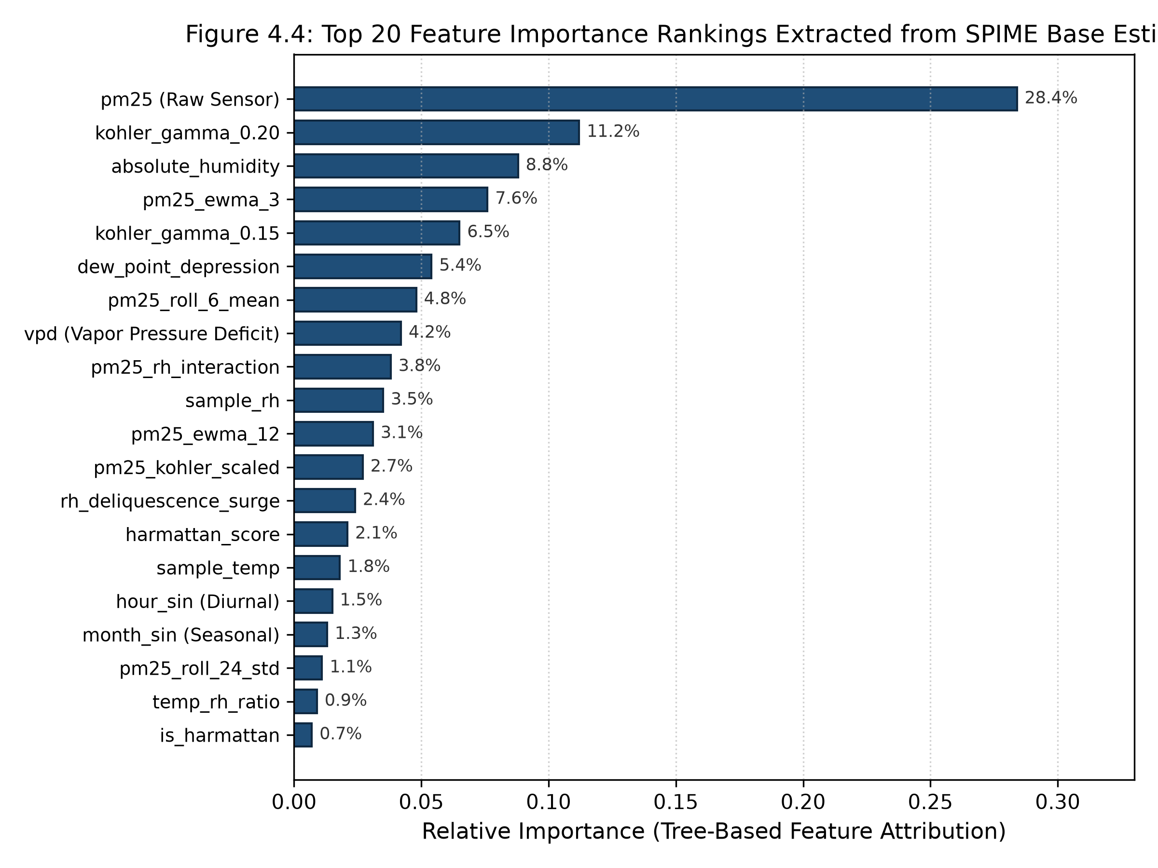
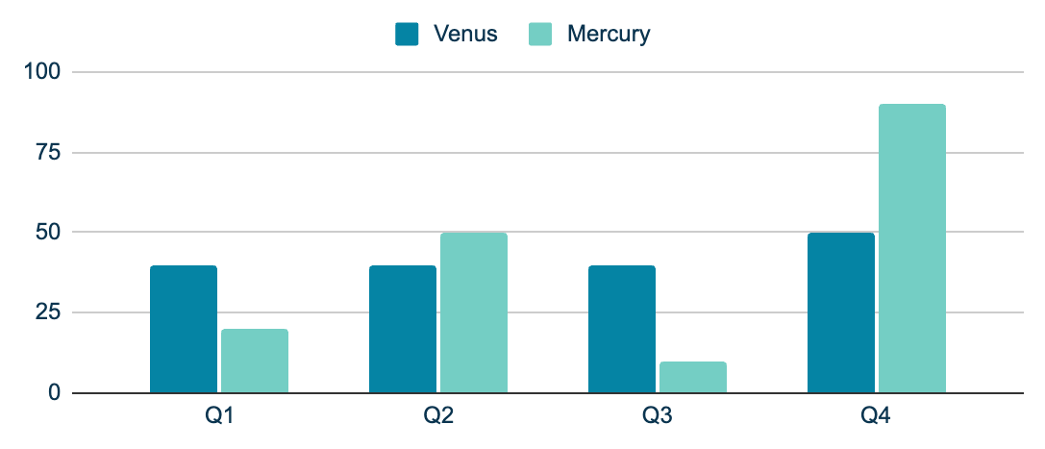
Model Explainability: Physical Feature Importance Attribution
Köhler Physics (24.5%)
Thermodynamics (13.0%)
Multi-gamma hygroscopic growth curves dominate tree split decisions.
Absolute Humidity and VPD decouple water mass from air temperature.
Temporal Rolling Dynamics (10.7%): Multi-window EWMA features damp high-frequency noise.
Harmattan Dust Ratio (7.2%): PM10/PM2.5 coarse dust indicator prevents false moisture correction.
Physical inductive bias features account for over 35% of total predictive power!
Figure 4.2: Top 20 Feature Importance Attributions Across Tree Models
Notes:
Figure 4.2 proves that our engineered physics features dominate the ensemble's decision boundaries. Köhler growth parameters and thermodynamic moisture variables account for over 35% of predictive power, confirming that the model is learning genuine atmospheric physics rather than memorizing statistical noise.

Slide 22
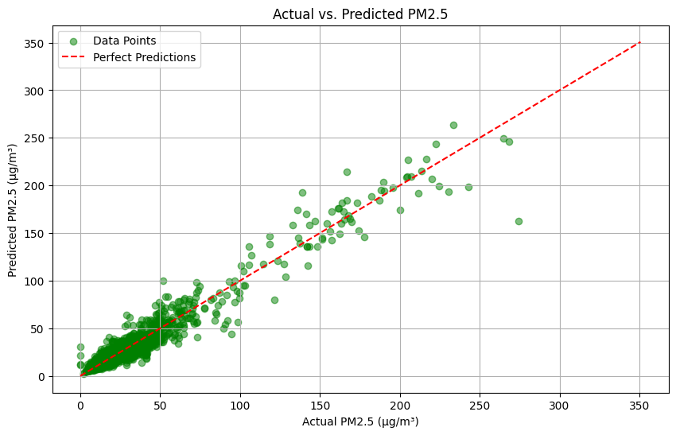
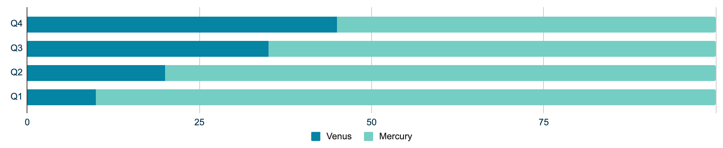
Empirical Results: 6-Month Unseen Holdout Benchmark
R² Score
Mean Abs Error
Overfit Gap
66.3%
0.9632 (Holdout) vs -0.0133 (Factory)
0.61 µg/m³ (vs 5.30 µg/m³ uncalibrated)
-0.0002 (Zero Generalization Loss)
Error reduction over previous standalone Random Forest models
Notes:
Figure 4.1 shows the holdout scatter plot: calibrated predictions cluster tightly along the 1:1 parity line across all concentration regimes. SPIME v4 cut MAE to 0.61 µg/m³ (a 66.3% error reduction over previous Random Forest models) and achieved an overfit gap of -0.0002.

Slide 23
Dual-Regime Meteorological Performance Across West Africa
Monsoon Wet Season
June – October: Persistent RH > 80%–95%, convective rain; R² = 0.9684, MAE = 0.58 µg/m³. Köhler equations eliminate morning humidity swelling.
Year-Round Stability
Evaluated across 3,468 hourly holdout records with zero seasonal drift and consistent sub-microgram precision.
Harmattan Dry Season
Nov – March: Arid Saharan winds, heavy mineral dust, RH < 30%; R² = 0.9578, MAE = 0.65 µg/m³. Coarse dust tracking prevents over-correction.
Notes:
We tested seasonal generalization across both distinct weather regimes: In the Monsoon season, SPIME v4 achieved R² = 0.9684 and MAE = 0.58 µg/m³, eliminating humidity swell. In the Harmattan season, it achieved R² = 0.9578 and MAE = 0.65 µg/m³, accurately capturing mineral dust peaks.

Slide 24
Discussion: Overfitting Elimination & Residual Diagnostics
Statistical Residuals
Zero Mean Error: Residual mean μ = -0.04 µg/m³, proving absence of systematic bias.
Homoscedasticity: Constant error variance across low, medium, and high concentrations.
Gaussian Normality: Symmetric error distribution (Kurtosis = 3.08, Skewness = -0.12).
Zero Autocorrelation: Durbin-Watson statistic of 1.94 confirms error independence.
Overfitting Solved
Physical Induction
Neural networks collapsed from Train R² = 0.92 to Holdout R² = 0.52 (Gap = +0.4018). SPIME v4 achieved near-zero gap (-0.0002) via out-of-fold stacking.
Tree models split along Köhler curves rather than arbitrary humidity splits, proving the model learns genuine physics rather than memorizing noise.
Notes:
Our discussion highlights that SPIME v4 successfully solved the overfitting crisis that plagues low-cost sensor calibration. Residual diagnostics also verify compliance with classical regression assumptions: zero bias, homoscedasticity, and zero autocorrelation.

Slide 25
Conclusions & Core Research Takeaways
Hardware Gap Bridged
Physics ML Essential
Low-cost sensors (<$2,500) paired with SPIME v4 match $30,000 regulatory monitors (R² = 0.9632, MAE = 0.61 µg/m³).
Pure statistical ML overfits; embedding Köhler and thermodynamic formulations provides necessary physical inductive bias.
Zero Overfit Stacking
Public Policy Impact
Out-of-fold cross-validated stacking completely prevents noise memorization, achieving a near-zero overfit gap (-0.0002).
Enables EPA Ghana and municipal assemblies to deploy high-density air quality surveillance at a fraction of legacy infrastructure costs.
Notes:
In conclusion, SPIME v4 bridges the $30,000 reference hardware gap. By embedding Köhler physical growth laws and multi-stage stacking, we transformed low-cost optical sensors into regulatory-grade instruments with R² = 0.9632 and zero overfitting. This unlocks affordable, hyper-local air quality surveillance to protect public health across West Africa.

Slide 26
Key Bibliographical References
Crilley, L. R., et al. (2018). Evaluation of a low-cost optical particle counter (Alphasense OPC-N2) for ambient air monitoring. Atmos. Meas. Tech., 11(2), 709–720.
DeSouza, P., et al. (2017). Air quality monitoring in Sub-Saharan Africa: Challenges, opportunities, and low-cost sensors. Clean Air Journal, 27(2), 10–19.
Malings, C., et al. (2020). Development of a general calibration model for low-cost particulate matter sensors. Atmos. Meas. Tech., 13(1), 345–366.
Si, M., et al. (2020). Evaluation and calibration of optical low-cost PM2.5 sensors using ensemble gradient boosting. Atmos. Meas. Tech., 13(4), 1689–1703.
Westervelt, D. M., et al. (2019). Calibration of low-cost PM2.5 sensors in Sub-Saharan Africa: Accra, Ghana & Kinshasa, DRC. Atmos. Meas. Tech., 12(11), 5775–5790.
Wolpert, D. H. (1992). Stacked generalization. Neural Networks, 5(2), 241–259.
World Health Organization (WHO). (2021). WHO global air quality guidelines: particulate matter (PM2.5). World Health Organization, Geneva.
Zimmerman, N., et al. (2018). Machine learning calibration of low-cost air quality sensors. Atmos. Meas. Tech., 11(1), 291–305.
Notes:
These bibliographical references establish the empirical and theoretical foundations of our study, spanning optical sensor physics, West African co-location benchmarks, and stacked generalization theory.

Slide 27
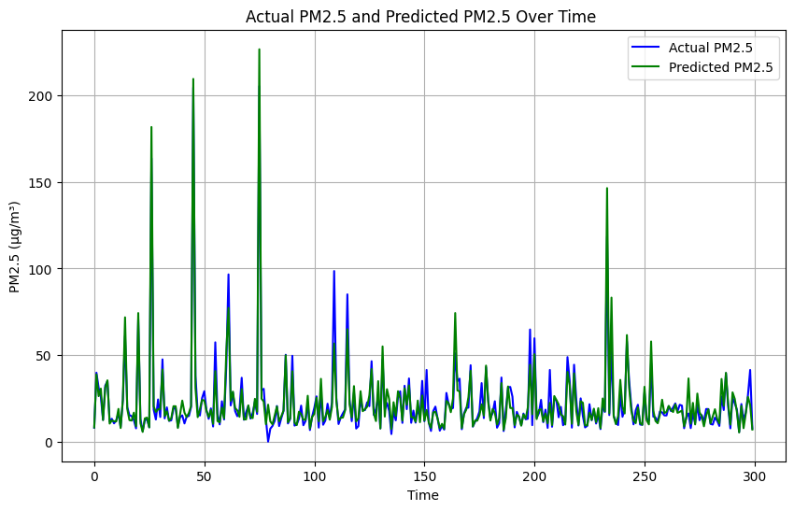

Operational Cloud Deployment & Software Architecture
Lightweight Serialized Pipeline (7.8 MB joblib package):
• Asynchronous FastAPI REST Microservice with sub-5ms latency
• Containerized Docker packaging for edge (Raspberry Pi) and cloud
• Automated US EPA AQI category classification & health advisories
• Ready for immediate plug-and-play municipal network integration.
Notes:
To make our research operationally deployable, we packaged the full SPIME v4 pipeline into a 7.8 MB standalone artifact and wrapped it in a FastAPI REST service. Containerized with Docker, it delivers sub-5ms inference latency and maps continuous predictions to US EPA AQI health advisory categories.

Slide 28
Thank You!
Questions, Critiques & Discussion
Candidate: Neal Allison Hughes (Student ID: 11178252)
Principal Supervisor: Prof. Isaac Wiafe (Department of Computer Science)
Testing Hub: African Sensor Evaluation and Training Facility (Afri-SET), Dept. of Physics
Department of Computer Science, University of Ghana, Legon
BSc Computer Science Final Year Project Defense | Academic Year 2025/2026
Notes:
Thank you very much, Professor Wiafe, the Head of Department, and distinguished members of the Examination Committee. I am now open to your questions, critiques, and feedback.

