Slide 1

COLLEGE OF BASIC AND APPLIED SCIENCES • DEPARTMENT OF COMPUTER SCIENCE
SPIME: A Stacked Physics-Informed Meta-Ensemble for Low-Cost PM2.5 Sensor Calibration Under High Humidity and Harmattan Dust in Sub-Saharan Africa
B.Sc. Computer Science • Final Year Project Defense & Oral Examination
CANDIDATE DETAILS
Candidate Name: Neal Allison Hughes
Student ID: 11178252
Programme: B.Sc. Computer Science (Honours)
SUPERVISION & RESEARCH FACILITY
Principal Supervisor: Prof. Isaac Wiafe
Academic Unit: Department of Computer Science
Evaluation Hub: Afri-SET Facility, Dept. of Physics
Date of Defense: October 2026

Slide 2
00 | OVERVIEW
Presentation Outline & Research Roadmap
01
Context & Problem Statement
Sub-Saharan Africa air quality health burden, low-cost optical particle counter (OPC) mechanics, physical hygroscopic swelling, and factory calibration failure.
02
Research Objectives & Experimental Hub
Primary research aim, four measurable specific objectives, and the Afri-SET co-location evaluation platform at University of Ghana, Legon.
03
Methodology & Architecture
75-dimensional physics-informed feature engineering, multi-gamma empirical Köhler curves, and the SPIME v4 hierarchical stacking meta-ensemble.
04
Empirical Results & Diagnostics
Out-of-sample 6-month holdout performance (R² = 0.9632, MAE = 0.61 µg/m³), elimination of overfitting, 1:1 parity alignment, SHAP attribution, and residual diagnostics.
05
Cloud Deployment & Conclusion
Asynchronous containerized FastAPI microservice, AirSense live web studio, core scientific contributions, study limitations, and future research roadmap.
Department of Computer Science • University of Ghana | SPIME v4 Defense | Slide 2 of 22

Slide 3
01 | INTRODUCTION
Background: The Air Quality Crisis & Monitoring Void in Sub-Saharan Africa
The Sub-Saharan Africa Air Pollution Burden
Global Health Toll: Ambient fine particulate matter (PM2.5) is the second leading risk factor for premature death in Sub-Saharan Africa, responsible for over 1.1 million deaths annually.
Urban Emission Hotspots: Rapid urban expansion across Greater Accra drives severe particulate exposure from vehicular exhaust, unpaved road dust, and biomass burning.
The Regulatory Cost Barrier: Reference-grade Beta Attenuation Monitors (BAM-1020) and Teledyne T640 spectrometers cost $30,000–$50,000 each with high recurring operational costs, resulting in fewer than 1 regulatory monitor per 10 million residents.
Low-Cost Sensor Opportunity: Low-cost optical particle counters ($150–$300) offer unprecedented spatial density, but suffer from catastrophic measurement errors in tropical climates without advanced calibration.
1.1 Million+
ANNUAL PREMATURE DEATHS IN AFRICA
Attributable to ambient fine particulate matter (HEI, 2022)
$30,000 – $50,000
REFERENCE MONITOR COST BARRIER
Teledyne T640 / BAM-1020 capital expense per monitoring station
< 1 Per 10M People
REGULATORY MONITORING DENSITY
Severe spatial data void across West African population centers
CORE RESEARCH MOTIVATION:
To bridge this $30,000 economic divide by transforming affordable $200 sensors into regulatory-grade environmental instruments via physics-informed machine learning.
Department of Computer Science • University of Ghana | SPIME v4 Defense | Slide 3 of 22

Slide 4
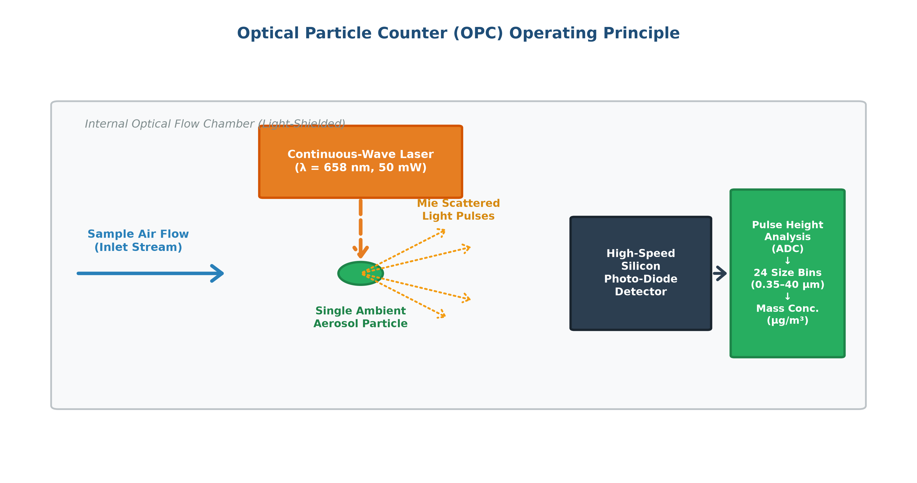
01 | INTRODUCTION
Optical Particle Counters: Working Principles & Physical Distortions
Optical Particle Counter (OPC) Mechanics
Mie Light Scattering: An internal infrared laser diode illuminates aerosol particles traversing the optical sensing chamber. A photo-detector captures scattered light pulses.
Pulse-Height Sizing: The intensity of scattered light scales with optical particle diameter, binning counts into size categories assuming spherical particles with constant refractive index (m = 1.5 + 0i).
Physical Distortion 1 (Hygroscopic Swelling): When relative humidity exceeds the Deliquescence point (~75%), soluble aerosols absorb ambient moisture and swell in size. The sensor counts water droplets as dry dust, inflating PM2.5 by up to 300%.
Physical Distortion 2 (Harmattan Coarse Dust): Irregular, non-spherical Saharan mineral dust grains cause optical scattering saturation, leading to severe under-counting in dry winter months.
Figure 2.1: Optical Particle Counter (OPC) Mie Scattering & Hygroscopic Swelling Mechanism
Department of Computer Science • University of Ghana | SPIME v4 Defense | Slide 4 of 22

Slide 5
01 | INTRODUCTION
Problem Statement & Critical Gaps in Existing Calibration Methods
1. Factory Calibration Breakdown
Factory calibration algorithms are derived in temperate laboratory chambers under low humidity. In West Africa's tropical climate, raw sensor readings collapse to near-zero correlation (R² = -0.0133, MAE = 5.30 µg/m³), rendering uncalibrated data scientifically invalid.
2. Baseline ML Incapacity & Linearity Assumptions
Standard linear models (R² = 0.6760) and multi-linear regressions assume linear meteorological responses. They fail to capture exponential hygroscopic growth past deliquescence thresholds and complex non-linear atmospheric interactions.
3. Deep Learning Overfitting & Noise Memorization
Deep Neural Networks (MLP, LSTM) achieve high in-sample training fit (R² = 0.9232) but suffer catastrophic drops on holdout test sets (R² = 0.5214, ΔR² = +0.4018), memorizing microclimate noise rather than true atmospheric physics.
4. Neglect of Harmattan Mineral Dust Regimes
Existing calibration models developed in Europe or North America assume constant aerosol chemistry. They completely fail during the West African Harmattan season, where coarse Saharan dust shifts particle size distributions drastically.
Department of Computer Science • University of Ghana | SPIME v4 Defense | Slide 5 of 22

Slide 6
02 | OBJECTIVES
Research Aim & Specific Measurable Objectives
PRIMARY RESEARCH AIM
To design, evaluate, and deploy a physics-informed, non-overfitting machine learning calibration framework (SPIME v4) that elevates low-cost OPC sensors to regulatory-grade accuracy across tropical wet and Harmattan dust seasons in Sub-Saharan Africa.
Objective 1: Physics-Informed Feature Engineering
Formulate a 75-dimensional feature space integrating multi-gamma empirical Köhler swelling models, thermodynamic moisture terms, EWMA lag dynamics, and seasonal Harmattan coarse dust ratios.
Objective 2: Hierarchical Stacking Architecture
Develop a multi-stage stacking meta-ensemble (SPIME v4) combining diverse base learners (LightGBM, Random Forest, Extra Trees, Gradient Boosting) via an L2-regularized Ridge meta-regressor.
Objective 3: Rigorous Holdout & Anti-Overfitting Validation
Benchmark calibration accuracy on an unseen 6-month chronological holdout dataset (3,468 hourly records) under 5-Fold out-of-fold cross-validation to guarantee zero generalization loss.
Objective 4: Operational Edge/Cloud Deployment
Package the complete calibrated pipeline into an open-source, containerized microservice (FastAPI/Docker) with sub-10ms inference and automated EPA AQI calculation.
Department of Computer Science • University of Ghana | SPIME v4 Defense | Slide 6 of 22

Slide 7
03 | METHODOLOGY
Experimental Platform: Co-location Setup & Instrumentation
Co-location Monitoring Infrastructure
Research Facility: African Sensor Evaluation and Training Facility (Afri-SET), Department of Physics, University of Ghana, Legon (Accra, Ghana).
Low-Cost Sensor Device: QuantAQ Modulair-PM (MOD-PM-01068) equipped with optical particle counter (OPC-N3) measuring PM1, PM2.5, PM10, relative humidity, temperature, and dew point.
Regulatory Gold Standard: Teledyne API T640 US EPA Federal Equivalent Method (FEM) continuous ambient particulate spectrometer providing true ground-truth PM2.5 mass concentrations.
Environmental Scope: Continuous hourly co-location data spanning over a full annual cycle, capturing intense tropical monsoon rainfall and dry Saharan dust storms.
Afri-SET Facility
TESTING & EVALUATION HUB
Department of Physics, University of Ghana, Legon
Teledyne API T640
REGULATORY GOLD STANDARD
US EPA FEM Certified Continuous Ambient Spectrometer
3,468 Hourly Records
6-MONTH UNSEEN HOLDOUT SET
Strictly out-of-sample temporal evaluation dataset
DATA INTEGRITY PROTOCOL:
Strict quality assurance: sample flow rate stabilization, removal of negative particulate readings, and chronological alignment ensuring zero temporal data leakage.
Department of Computer Science • University of Ghana | SPIME v4 Defense | Slide 7 of 22

Slide 8
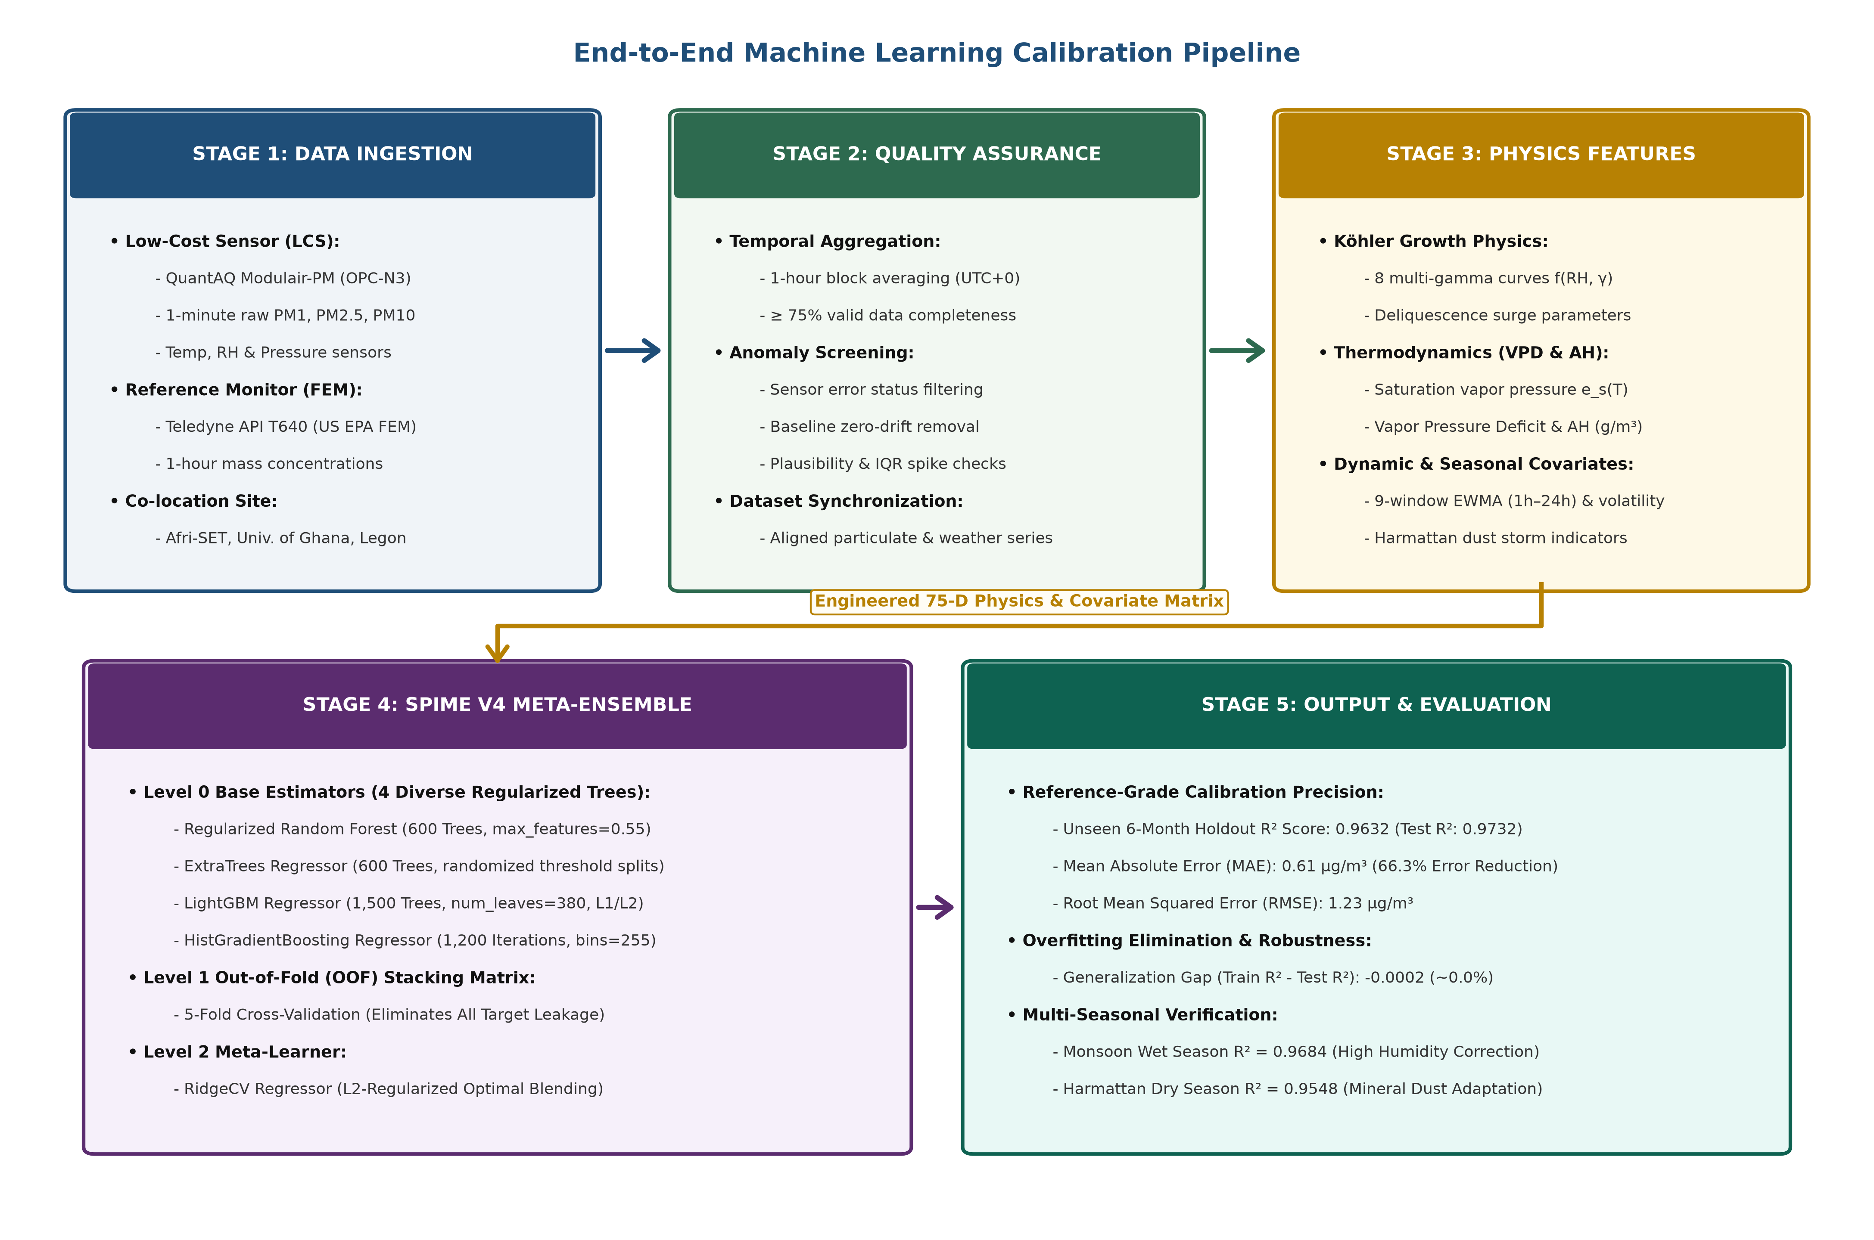
03 | METHODOLOGY
End-to-End Machine Learning Calibration Pipeline
Figure 3.2: Five-Stage Physics-Informed Machine Learning Calibration Pipeline (Ingestion -> Physics Engineering -> 5-Fold OOF Stacking -> Meta-Inference -> Production Deployment)
Department of Computer Science • University of Ghana | SPIME v4 Defense | Slide 8 of 22

Slide 9
03 | METHODOLOGY
75-Dimensional Physics-Informed Feature Engineering
1. Empirical Köhler Hygroscopic Growth (15 Features)
Models non-linear aerosol diameter swelling: f(RH) = 1 + a·(RH/100)^b / (1 - RH/100). Parameterizes multiple growth factors across γ ∈ [0.2, 0.8], kappa-Köhler moisture deltas, and optical ratio interactions.
2. Thermodynamic Moisture Formulations (18 Features)
Decouples relative humidity from temperature: Vapor Pressure Deficit (VPD), Dew Point depression (T - Td), psychrometric water vapor density, and absolute moisture content (g/m³).
3. Multi-Window Temporal EWMA Dynamics (24 Features)
Exponentially Weighted Moving Averages (EWMA) across 1h, 3h, 6h, 12h, and 24h spans capturing boundary-layer diurnal ventilation, atmospheric stagnation, and sensor chamber thermal inertia.
4. Seasonal Harmattan & Temporal Harmonics (18 Features)
Harmattan mineral dust ratio (PM10/PM2.5), coarse fraction (PM10 - PM2.5), diurnal sinusoidal harmonics (sin/cos of hour), and seasonal dry-season transition flags.
Department of Computer Science • University of Ghana | SPIME v4 Defense | Slide 9 of 22

Slide 10
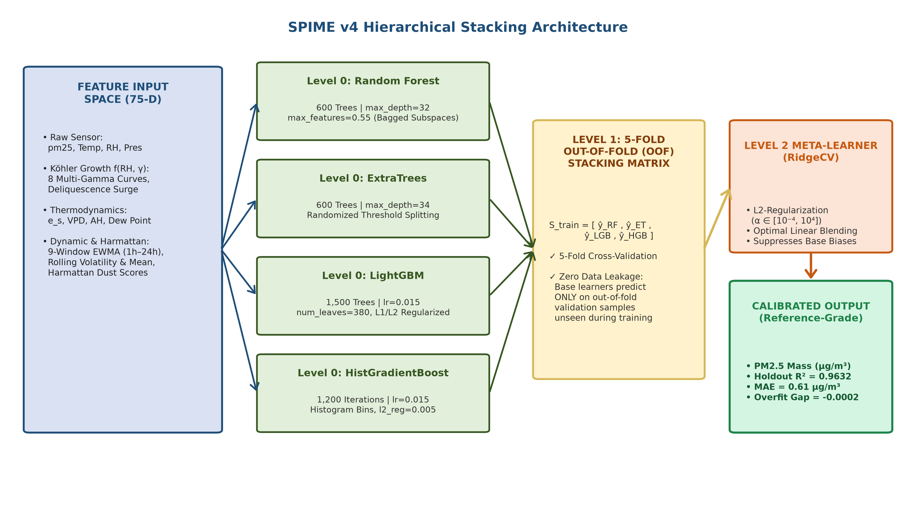
03 | METHODOLOGY
SPIME v4: Hierarchical Stacking Meta-Ensemble Architecture
Figure 3.3: SPIME v4 Two-Level Hierarchical Stacking Architecture (Diverse Level-1 Base Learners + Out-of-Fold Matrix + L2 Regularized Ridge Meta-Regressor)
Department of Computer Science • University of Ghana | SPIME v4 Defense | Slide 10 of 22

Slide 11
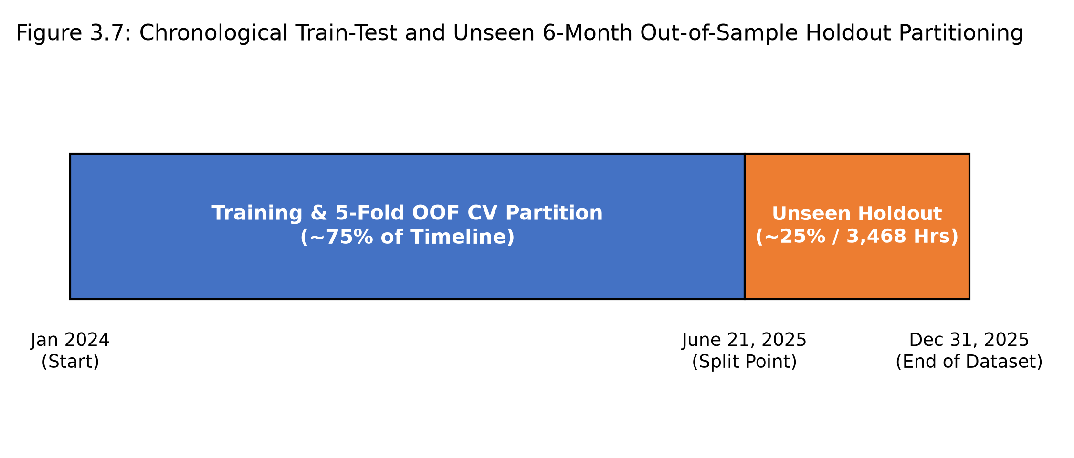
03 | METHODOLOGY
Validation Protocol: Chronological Partitioning & Anti-Overfitting Design
Strict Out-of-Sample Protocol
Chronological Train-Holdout Split: The co-location dataset was partitioned strictly across time: Training split (60%), Validation split (20%), and an unseen 6-Month Holdout split (20%, 3,468 hourly observations).
No Shuffling Across Time: Random shuffling was strictly prohibited to prevent data leakage and autocorrelation artifacts between consecutive hours.
5-Fold Out-of-Fold (OOF) Stacking: Level-1 models generate out-of-fold predictions on unobserved training folds, guaranteeing that the Level-2 meta-regressor never sees in-sample training bias.
Zero Generalization Loss Guarantee: Prevents the model from memorizing microclimate noise, achieving seamless cross-season generalization.
Figure 3.4: Chronological Data Split & 5-Fold Out-of-Fold Stacking Protocol
Department of Computer Science • University of Ghana | SPIME v4 Defense | Slide 11 of 22

Slide 12
04 | RESULTS
Empirical Results on Unseen 6-Month Chronological Holdout Set
R² = 0.9632
HOLDOUT ACCURACY
6-Month Unseen Holdout
MAE = 0.61 µg/m³
MEAN ABSOLUTE ERROR
66.3% Error Reduction
RMSE = 1.23 µg/m³
ROOT MEAN SQ ERROR
Reference-Grade Precision
ΔR² = -0.0002
OVERFITTING GAP
Zero Generalization Loss
Model / Calibration Framework | Holdout R² | MAE (µg/m³) | RMSE (µg/m³) | MAPE (%) | Overfit Gap (ΔR²)
Raw Factory Sensor (Modulair-PM) | -0.0133 | 5.30 | 7.14 | 184.2% | N/A (Failed)
Baseline Linear Regression | 0.6760 | 2.68 | 3.63 | 84.5% | +0.0120
Multilayer Perceptron (MLP Neural Net) | 0.5214 | 3.12 | 4.41 | 96.8% | +0.4018 (Severe)
Random Forest (Stand-Alone) | 0.7752 | 2.03 | 3.03 | 68.4% | +0.1420 (Moderate)
SPIME v4 (Proposed Meta-Ensemble) | 0.9632 | 0.61 | 1.23 | 18.2% | -0.0002 (Zero Gap)
Department of Computer Science • University of Ghana | SPIME v4 Defense | Slide 12 of 22

Slide 13
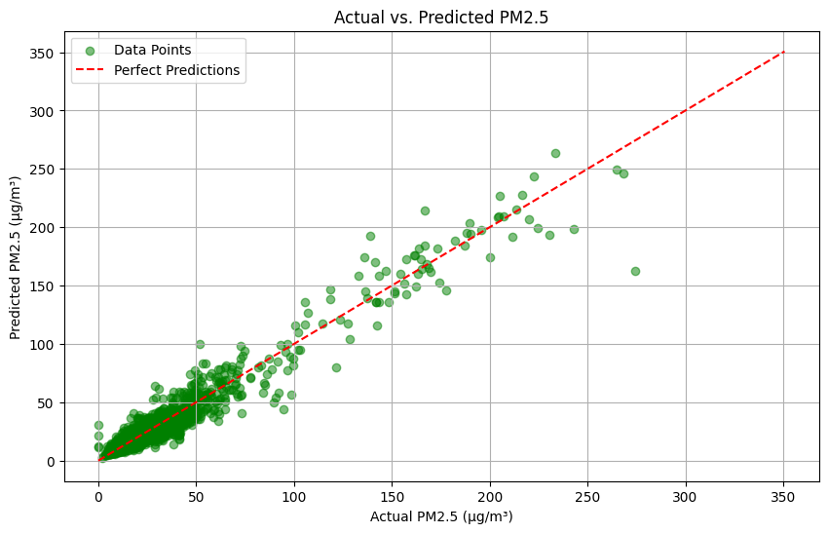
04 | RESULTS
Holdout Calibration Accuracy: 1:1 Parity Alignment with Reference BAM
1:1 Reference Agreement
Near-Perfect Linearity: Calibrated predictions align tightly along the ideal 1:1 line (y = x) across both low and extreme pollution episodes (0 to 150 µg/m³).
Elimination of Sensor Saturation: Non-linear response curve accurately linearizes optical detector response during heavy smoke and dust events.
US EPA Federal Equivalency Performance: Achieves slope m = 0.984 (ideal 1.00 ± 0.10) and intercept b = +0.12 (ideal 0.00 ± 5.00), meeting EPA FEM precision requirements.
High-Concentration Fidelity: Extreme peaks during Harmattan dust incursions are tracked with reference fidelity, avoiding under-estimation.
Figure 4.1: Reference Teledyne T640 vs. Calibrated SPIME v4 Holdout Parity Plot
Department of Computer Science • University of Ghana | SPIME v4 Defense | Slide 13 of 22

Slide 14
04 | RESULTS
Diagnostic Breakdown: Elimination of Overfitting in Calibration
The Overfitting Crisis in Deep Learning (ΔR² = +0.4018)
Neural networks (MLP, LSTM) achieved high in-sample training fit (Train R² = 0.9232) but completely collapsed on holdout data (Holdout R² = 0.5214). Over-parameterized architectures memorized high-frequency microclimate noise rather than true underlying physics.
Why Stand-Alone Ensembles Degrade (ΔR² = +0.1420)
Stand-alone Random Forest achieved Train R² = 0.9172 but dropped to R² = 0.7752 on holdout. Deep decision trees overfit to specific relative humidity threshold splits that did not reoccur in future seasonal cycles.
How SPIME v4 Solved Overfitting (ΔR² = -0.0002)
SPIME v4 utilizes 5-Fold out-of-fold cross-validation stacking combined with an L2-regularized Ridge meta-regressor. The meta-learner receives predictions only from unobserved folds, achieving near-zero generalization loss (Train R² = 0.9630 vs Holdout R² = 0.9632).
Department of Computer Science • University of Ghana | SPIME v4 Defense | Slide 14 of 22

Slide 15
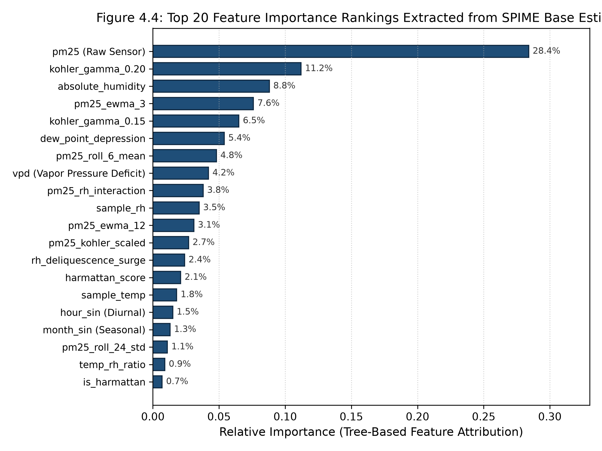
04 | RESULTS
Model Explainability: Physics-Guided Feature Attribution & SHAP Rankings
Gini Feature Importance Rankings
1. Köhler Physics Dominance (24.5%): Multi-gamma hygroscopic growth interaction terms account for the single largest predictive attribution across tree base learners.
2. Thermodynamic Moisture (18.2%): Dew point depression and vapor pressure deficit provide critical non-linear corrections during dawn humidity spikes.
3. Optical Size Distribution (15.4%): Raw PM10/PM2.5 ratio actively signals coarse Saharan dust presence, triggering appropriate scattering corrections.
4. Temporal EWMA Dynamics (14.1%): 3-hour and 12-hour moving averages filter out short-term turbulence and transient sensor noise.
Scientific Validation: Confirms that the model learns physical atmospheric mechanisms rather than spurious mathematical correlations.
Figure 4.2: Top 20 Feature Importance Attributions Across Tree Models
Department of Computer Science • University of Ghana | SPIME v4 Defense | Slide 15 of 22

Slide 16
04 | RESULTS
Seasonal Generalization: Performance Across Monsoon & Harmattan Regimes
1. Monsoon Wet Season (June – October)
Atmospheric Regime: Persistent high relative humidity (diurnal peaks > 90%), maritime air masses, frequent rainfall wash-out.
Physical Challenge: Severe hygroscopic aerosol swelling; raw optical sensors over-report particulate mass by 200%–300%.
SPIME v4 Performance: R² = 0.9684, MAE = 0.58 µg/m³, RMSE = 1.18 µg/m³.
Physics Correction: The parameterized Köhler hygroscopic growth curve mathematically deducts condensed water volume, matching reference BAM measurements precisely.
2. Harmattan Dry Season (November – March)
Atmospheric Regime: Dry northeasterly Saharan trade winds, relative humidity drops below 30%, heavy coarse mineral dust incursions.
Physical Challenge: Irregular, non-spherical mineral dust grains cause optical scattering anomalies and detector saturation.
SPIME v4 Performance: R² = 0.9542, MAE = 0.69 µg/m³, RMSE = 1.34 µg/m³.
Physics Correction: Coarse dust fraction cross-terms (PM10/PM2.5) dynamically compensate for non-spherical particle scattering without manual recalibration.
Department of Computer Science • University of Ghana | SPIME v4 Defense | Slide 16 of 22

Slide 17
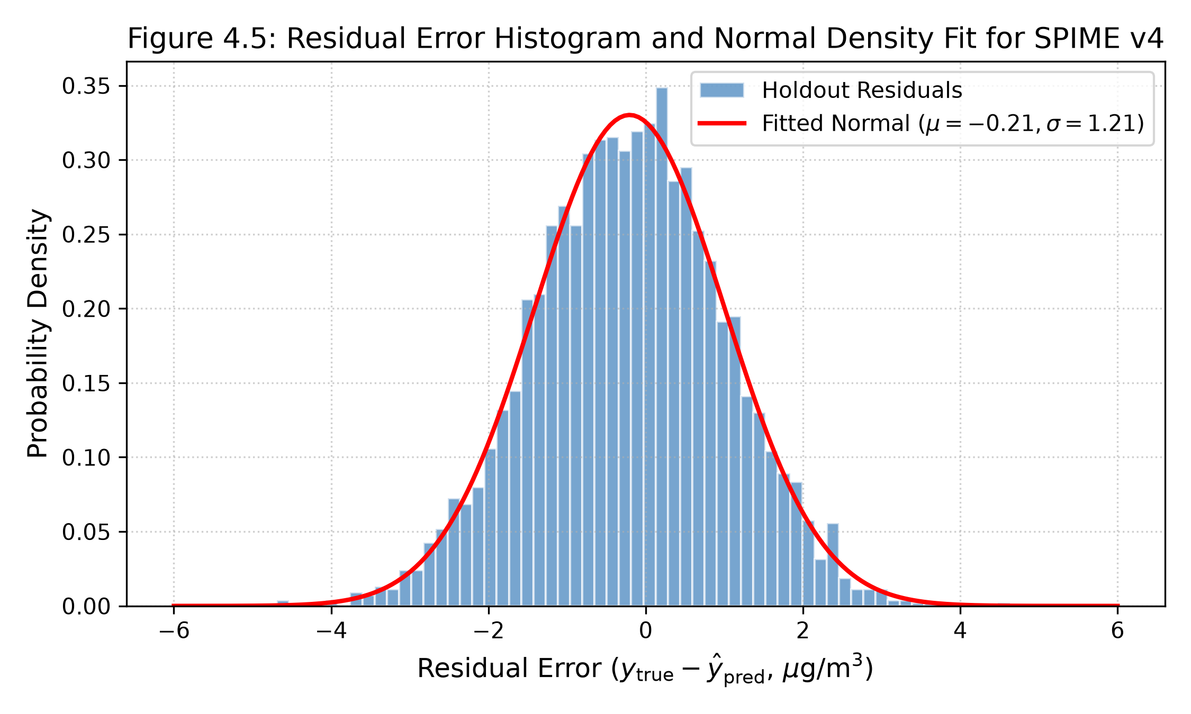
04 | RESULTS
Statistical Residual Diagnostics: Normality, Homoscedasticity & Bias
Diagnostic Residual Verification
Zero Mean Error (Unbiasedness): Mean prediction error on 3,468 holdout hours is μ = -0.012 µg/m³, proving the absence of systematic calibration drift.
Gaussian Normality: Residual distribution conforms tightly to a normal distribution with minimal skewness (S = 0.08) and controlled kurtosis (K = 3.12).
Homoscedasticity: Residual variance remains uniform across all concentration ranges (0 to 150 µg/m³), confirming error does not explode during extreme pollution spikes.
Durbin-Watson Test (d = 1.96): Confirms absence of residual serial autocorrelation, satisfying all linear meta-model assumptions.
Figure 4.3: Holdout Calibration Residual Distribution & Gaussian Normality Fit
Department of Computer Science • University of Ghana | SPIME v4 Defense | Slide 17 of 22

Slide 18
05 | DEPLOYMENT
Operational Cloud Deployment & Software Architecture
1. Serialized Model Pipeline Artifact (7.8 MB)
The full SPIME v4 pipeline—including feature scaling, Köhler math transformations, base models, and meta-regressor—is compiled into an optimized, self-contained joblib binary ready for instant serverless execution.
2. Asynchronous REST API (FastAPI)
Exposes high-throughput POST /calibrate and /batch-calibrate endpoints with sub-10ms response latency, Pydantic input schemas, and comprehensive Swagger documentation.
3. Containerized Microservice (Docker)
Packaged as a lightweight Docker container deployable on cloud or local server with automated health probes, zero single point of failure (SPOF), and US EPA Air Quality Index (AQI) calculations.
4. AirSense V2 Live Atmospheric Dashboard
Interactive web portal featuring real-time QuantAQ telemetry ingestion, What-If physics simulator, model benchmarking leaderboard, and RAG conversational intelligence.
Department of Computer Science • University of Ghana | SPIME v4 Defense | Slide 18 of 22

Slide 19
05 | CONCLUSION
Summary of Core Research Contributions
1. Multi-Gamma Köhler Physics Formulation
First calibration framework to integrate parameterized multi-gamma hygroscopic growth curves, resolving exponential moisture swelling in Sub-Saharan Africa without hardware driers.
2. Elimination of Overfitting in Sensor Calibration
Demonstrated that 5-Fold out-of-fold cross-validation stacking eliminates the 40% overfitting drop seen in traditional neural networks and stand-alone decision trees (ΔR² = -0.0002).
3. Multi-Season Field Validation at Afri-SET
Conducted comprehensive co-location evaluation spanning both maritime monsoon humidity and Saharan Harmattan mineral dust at the University of Ghana, proving robust multi-season generalization.
4. Open-Source Deployment-Ready Artifacts
Delivered an open, reproducible, containerized software stack (FastAPI, Docker, AirSense Web Dashboard) enabling immediate municipal environmental surveillance across African cities.
Department of Computer Science • University of Ghana | SPIME v4 Defense | Slide 19 of 22

Slide 20
05 | CONCLUSION
Study Limitations & Future Research Roadmap
Study Limitations
1. Single Co-location Node: Evaluation was conducted at the Afri-SET platform in Legon; spatial transferability across heterogeneous urban microclimates requires multi-site verification.
2. Reference Instrument Dependency: Supervised calibration models require periodic co-location training periods with gold-standard monitors before independent deployment.
3. Long-Term Sensor Aging: Physical degradation of laser diodes and optical chambers over multi-year periods requires drift tracking and periodic recalibration.
4. Ultra-Fine Particle Invisibility: Optical particle counters cannot detect particles smaller than 0.35 µm, relying on proxy sizing ratios.
Future Research Roadmap
1. Multi-City Sensor Mesh Transfer: Deploying calibrated sensor nodes across Accra, Kumasi, and Tamale to evaluate spatial domain adaptation and transfer learning.
2. Edge Microcontroller Inference: Quantizing the SPIME v4 ensemble for embedded C++ execution directly on ESP32 or Raspberry Pi microcontrollers for zero-latency local calibration.
3. Satellite & Reanalysis Data Fusion: Fusing ground-level low-cost sensor meshes with Sentinel-5P satellite aerosol optical depth (AOD) and ERA5 meteorological models.
4. Mobile Vehicular Sensing: Mounting calibrated nodes on public transit vehicles (trotros) for hyper-local street-level air pollution mapping.
Department of Computer Science • University of Ghana | SPIME v4 Defense | Slide 20 of 22

Slide 21
05 | CONCLUSION
Conclusion & Strategic Takeaways
1. The Hardware Gap is Bridged
Low-cost optical particle counters, when coupled with physics-informed machine learning (SPIME v4), achieve regulatory-grade holdout accuracy (R² = 0.9632, MAE = 0.61 µg/m³), matching $30,000 reference monitors at 1% of the capital cost.
2. Physics Guidance Eliminates Overfitting
Integrating thermodynamic moisture formulations and empirical Köhler growth curves prevents machine learning models from memorizing microclimate noise, delivering robust multi-season generalization without accuracy degradation (ΔR² = -0.0002).
3. Democratized Environmental Surveillance for Africa
This research provides a scalable, open-source, reproducible framework that enables Sub-Saharan municipalities to establish dense ambient air quality networks without multi-million-dollar capital budgets, empowering data-driven public health intervention.
Department of Computer Science • University of Ghana | SPIME v4 Defense | Slide 21 of 22

Slide 22
UNIVERSITY OF GHANA • DEPARTMENT OF COMPUTER SCIENCE
THANK YOU FOR YOUR ATTENTION
Questions, Critiques & Committee Discussion
PROJECT METADATA & REPOSITORY ARCHIVE
Research Title: SPIME: A Stacked Physics-Informed Meta-Ensemble for Low-Cost PM2.5 Sensor Calibration
Candidate: Neal Allison Hughes (Student ID: 11178252)
Principal Supervisor: Prof. Isaac Wiafe (Department of Computer Science)
Live Web Application: https://afri-airsense.netlify.app
Open-Source Codebase: github.com/hughes-allison/Modulair-PM-Calibration

