Slide 1
UNIVERSITY OF GHANA
COLLEGE OF BASIC AND APPLIED SCIENCES • DEPARTMENT OF COMPUTER SCIENCE
SPIME: A Stacked Physics-Informed Meta-Ensemble for Low-Cost PM2.5 Sensor Calibration Under Tropical and Harmattan Meteorological Regimes in Sub-Saharan Africa
A Final Year Undergraduate Project Defense Submitted in Partial Fulfillment of the Requirements for the Degree of Bachelor of Science in Computer Science
CANDIDATE DETAILS
Candidate: Neal Allison Hughes
Student ID: 11178252
Degree Programme: B.Sc. Computer Science
SUPERVISION & RESEARCH FACILITY
Principal Supervisor: Prof. Isaac Wiafe
Department: Department of Computer Science
Evaluation Facility: African Sensor Evaluation and Training Facility (Afri-SET), Dept. of Physics
Academic Year: 2025 / 2026 Academic Session (July 2026)
Department of Computer Science, University of Ghana
BSc Project Defense: SPIME v4 PM2.5 Sensor Calibration
Slide 1 of 22
Notes:
Good morning, respected Head of Department, my distinguished supervisor Prof. Isaac Wiafe, and honored members of the Examination Committee. My name is Neal Allison Hughes, Student ID 11178252. Today, I am honored to present my final year undergraduate research project titled: 'SPIME: A Stacked Physics-Informed Meta-Ensemble for Low-Cost PM2.5 Sensor Calibration Under Tropical and Harmattan Meteorological Regimes in Sub-Saharan Africa'. This project was carried out in collaboration with the African Sensor Evaluation and Training Facility (Afri-SET) at the Department of Physics, University of Ghana.

Slide 2
DEPARTMENT OF COMPUTER SCIENCE • UNIVERSITY OF GHANA | 00 | OVERVIEW
Presentation Outline & Structure
01
Context & Problem Statement
Sub-Saharan air quality crisis, OPC optical principles, sensor physical failure modes, and ML research gaps.
02
Research Objectives & Facility
Study aim, four specific measurable objectives, and Afri-SET co-location experimental monitoring hub.
03
Methodology & Architecture
75-D physics-informed feature space, multi-gamma Köhler growth curves, and SPIME v4 stacking framework.
04
Empirical Results & Diagnostics
6-month holdout performance (R² = 0.9632), overfitting elimination, SHAP feature attribution, and seasonal regimes.
05
Cloud Deployment & Conclusion
Lightweight containerized FastAPI microservice, core contributions, limitations, and future research.
Department of Computer Science, University of Ghana
BSc Project Defense: SPIME v4 PM2.5 Sensor Calibration
Slide 2 of 22
Notes:
Here is the executive roadmap for my defense. I will first establish the air quality monitoring deficit in West Africa and why low-cost optical sensors fail under local climate conditions. Next, I will outline the research objectives and the co-location setup at the Afri-SET facility. Then, I will explain the 75-dimensional physics-informed feature engineering and the SPIME v4 stacking architecture. Following that, I will present our empirical benchmark results on an unseen 6-month holdout dataset, demonstrate how we solved the overfitting crisis, and show feature attribution diagnostics. Finally, I will present the cloud deployment pipeline and conclude with key recommendations.

Slide 3
DEPARTMENT OF COMPUTER SCIENCE • UNIVERSITY OF GHANA | 01 | INTRODUCTION
Background: The Air Quality Crisis & Monitoring Deficit
The Sub-Saharan Africa Air Pollution Burden
Global Health Toll: Ambient fine particulate matter (PM2.5) is responsible for over 1.1 million premature deaths annually across Africa (Health Effects Institute, 2022).
Severe Monitoring Void: Sub-Saharan Africa possesses less than one regulatory monitoring station per 10 million inhabitants, creating vast geographic blind spots.
The Reference Equipment Barrier: US EPA Federal Equivalent Method (FEM) monitors (e.g., Teledyne API T640, BAM-1020) cost $30,000–$50,000 plus continuous consumables, making dense municipal networks financially unviable.
The Low-Cost Opportunity: Low-cost Optical Particle Counters (OPCs) such as the QuantAQ Modulair-PM cost < $2,500, enabling hyper-local community monitoring if accuracy can be guaranteed.
1.1 Million+
ANNUAL PREMATURE DEATHS IN AFRICA
Attributable to ambient PM2.5 (HEI, 2022)
$30,000 – $50,000
REFERENCE MONITOR COST BARRIER
Teledyne T640 / BAM-1020 capital expense
< 1 Per 10M People
REGULATORY MONITORING DENSITY
Severe spatial data void in Sub-Saharan Africa
Core Research Motivation:
To bridge this $30,000 economic divide by transforming low-cost sensors into regulatory-grade instruments using physics-informed machine learning.
Department of Computer Science, University of Ghana
BSc Project Defense: SPIME v4 PM2.5 Sensor Calibration
Slide 3 of 22
Notes:
Ambient air pollution is a critical public health crisis across Sub-Saharan Africa, contributing to over 1.1 million deaths every year. Yet, our region suffers from a severe monitoring deficit: fewer than one reference-grade station exists per 10 million people. Reference instruments like the Teledyne T640 cost over $30,000, which local governments cannot scale across municipal neighborhoods. Low-cost optical particle counters cost a fraction of that amount, but their raw readings cannot be trusted without sophisticated calibration.

Slide 4
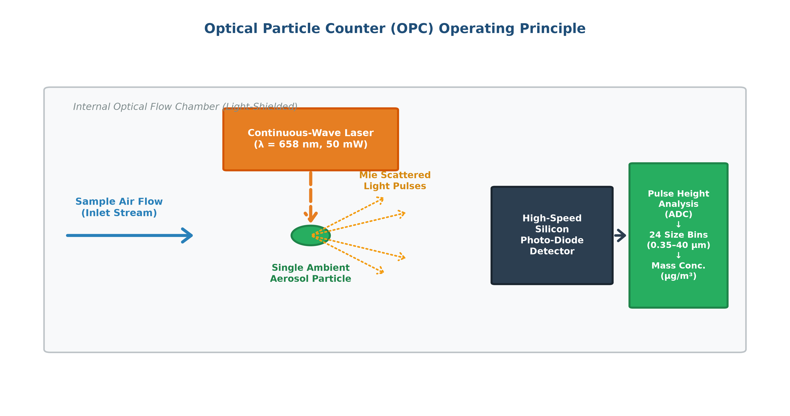
DEPARTMENT OF COMPUTER SCIENCE • UNIVERSITY OF GHANA | 01 | INTRODUCTION
Optical Particle Counters: Physical Working Principles & Failure Modes
Optical Particle Counter (OPC) Mechanics
Mie Light Scattering: An internal laser beam illuminates ambient particles drawn through the sampling chamber. Scattered light pulses are converted to voltage pulses by a photodetector.
Mass Estimation Assumptions: Raw OPCs assume particles are perfect dry spheres with constant refractive index (m = 1.5 + 0i) and uniform density (ρ = 1.65 g/cm³).
Tropical High Humidity Failure: When ambient relative humidity exceeds 70–80%, deliquescent aerosol salts absorb water vapor. Particles undergo non-linear hygroscopic swelling, scattering significantly more light and causing raw sensors to over-report PM2.5 by 200%–500%.
Figure 2.1: OPC Optical Scattering Principle & Hygroscopic Swelling Mechanism
Department of Computer Science, University of Ghana
BSc Project Defense: SPIME v4 PM2.5 Sensor Calibration
Slide 4 of 22
Notes:
To understand why calibration is essential, we examine optical particle counter physics. An OPC shines a laser into a sample chamber and measures the pulse of scattered light using Mie scattering theory. The sensor's internal firmware assumes all particles are dry spheres of known density. However, in Accra's tropical climate, relative humidity regularly exceeds 80%. Aerosol salts absorb water vapor, swell hygroscopically, and scatter far more light. As a result, raw sensors over-report PM2.5 mass concentrations by 200% to 500%.

Slide 5
DEPARTMENT OF COMPUTER SCIENCE • UNIVERSITY OF GHANA | 01 | INTRODUCTION
Problem Statement & Gaps in Existing Machine Learning Models
1. Factory Calibration Breakdown
Factory calibration algorithms are derived in temperate laboratory chambers under low humidity. In West Africa, raw Modulair-PM outputs fail completely, yielding negative correlation (R² = -0.0133, MAE = 5.30 µg/m³) against FEM standards.
2. Baseline ML Incapacity & Linearity Assumptions
Simple Linear Regression (R² = 0.6760) and Polynomial models fail to capture non-linear, exponential hygroscopic aerosol growth curves near deliquescence thresholds (RH > 75%).
3. Deep Learning Overfitting & Noise Memorization
Deep Neural Networks (MLP, LSTM) heavily overfit training data (Train R² ≈ 0.92 vs Holdout R² ≈ 0.49–0.52). They memorize high-frequency sensor noise rather than learning true atmospheric physics.
4. Neglect of Harmattan Mineral Dust Regimes
Existing calibration studies in temperate zones assume constant chemical composition. In Sub-Saharan Africa, seasonal Saharan dust plumes alter aerosol optical properties, breaking single-season calibrations.
Department of Computer Science, University of Ghana
BSc Project Defense: SPIME v4 PM2.5 Sensor Calibration
Slide 5 of 22
Notes:
Prior literature reveals four critical gaps. First, factory calibrations completely fail in Accra, giving negative R² values. Second, simple linear regression cannot capture exponential moisture growth curves. Third, complex neural networks overfit severely, dropping 40% in R² when evaluated on unseen future holdout data. Fourth, existing models ignore the seasonal transition between the wet monsoon and the Saharan Harmattan dust season. These deficiencies motivated our physics-informed meta-ensemble approach.

Slide 6
DEPARTMENT OF COMPUTER SCIENCE • UNIVERSITY OF GHANA | 02 | OBJECTIVES
Research Aim & Specific Objectives
PRIMARY RESEARCH AIM
To design, evaluate, and deploy a physics-informed, non-overfitting machine learning calibration framework (SPIME v4) that corrects raw QuantAQ Modulair-PM sensor readings to achieve regulatory-grade PM2.5 accuracy against a co-located US EPA FEM reference monitor in Accra, Ghana.
Objective 1: Physics-Informed Feature Engineering
Formulate a 75-dimensional feature space integrating multi-gamma empirical Köhler hygroscopic growth curves f(RH, γ), thermodynamic water vapor parameters, and temporal dynamics.
Objective 2: Hierarchical Stacking Architecture
Develop a multi-stage stacking meta-ensemble (SPIME v4) combining diverse tree base learners (Random Forest, ExtraTrees, LightGBM, HistGBM) via an L2-regularized meta-regressor.
Objective 3: Rigorous Holdout & Anti-Overfitting Validation
Benchmark calibration accuracy on an unseen 6-month temporal holdout dataset (3,468 hourly records) under strict anti-leakage protocols and SHAP explainability.
Objective 4: Operational Edge/Cloud Deployment
Package the complete calibrated pipeline into an open-source, containerized REST API delivering real-time inferences with < 5ms latency for municipal air quality networks.
Department of Computer Science, University of Ghana
BSc Project Defense: SPIME v4 PM2.5 Sensor Calibration
Slide 6 of 22
Notes:
To address these gaps, our primary aim was to build and deploy SPIME v4. We executed this aim through four specific objectives: First, engineer a 75-dimensional physics-informed feature space embedding Köhler growth curves. Second, construct a multi-stage stacked meta-ensemble combining four diverse gradient-boosted and tree models. Third, validate performance on a strict 6-month unseen holdout dataset to prove zero overfitting. Fourth, package the model into a containerized microservice ready for deployment across Accra.

Slide 7
DEPARTMENT OF COMPUTER SCIENCE • UNIVERSITY OF GHANA | 03 | METHODOLOGY
Experimental Platform: Co-location Setup at Afri-SET Facility
Co-location Monitoring Infrastructure
Research Facility: African Sensor Evaluation and Training Facility (Afri-SET), Department of Physics, University of Ghana, Legon (5.651° N, -0.186° W, Elevation 98 m).
Reference Ground Truth: Teledyne API T640 PM Mass Monitor — US EPA Federal Equivalent Method (FEM EQPM-0514-217) continuous particulate spectrometer.
Target Low-Cost Sensor: QuantAQ Modulair-PM (Unit MOD-PM-01068) equipped with an Alphasense OPC-N3 optical particle counter, relative humidity, temperature, and pressure telemetry.
Temporal Resolution: 1-hour continuous synchronized averages spanning both Wet Monsoon (2024) and Dry Harmattan (2024–2025) seasons.
Afri-SET Facility
TESTING & EVALUATION HUB
Department of Physics, University of Ghana, Legon
Teledyne API T640
REGULATORY GOLD STANDARD
US EPA FEM Certified Continuous Spectrometer
3,468 Hourly Records
6-MONTH UNSEEN HOLDOUT SET
Strictly out-of-sample temporal evaluation
Data Integrity Protocol:
Strict quality assurance: flow rate stabilization, zero negative particulate values, and complete synchronization across reference and target optical instruments.
Department of Computer Science, University of Ghana
BSc Project Defense: SPIME v4 PM2.5 Sensor Calibration
Slide 7 of 22
Notes:
Our experimental platform was established at the African Sensor Evaluation and Training Facility (Afri-SET), located at the Department of Physics, University of Ghana. The target sensor was the QuantAQ Modulair-PM, co-located side-by-side with a US EPA Federal Equivalent Method reference instrument—the Teledyne API T640. The dataset spans over a year of hourly observations, capturing extreme tropical humidity and heavy Saharan Harmattan dust events.

Slide 8
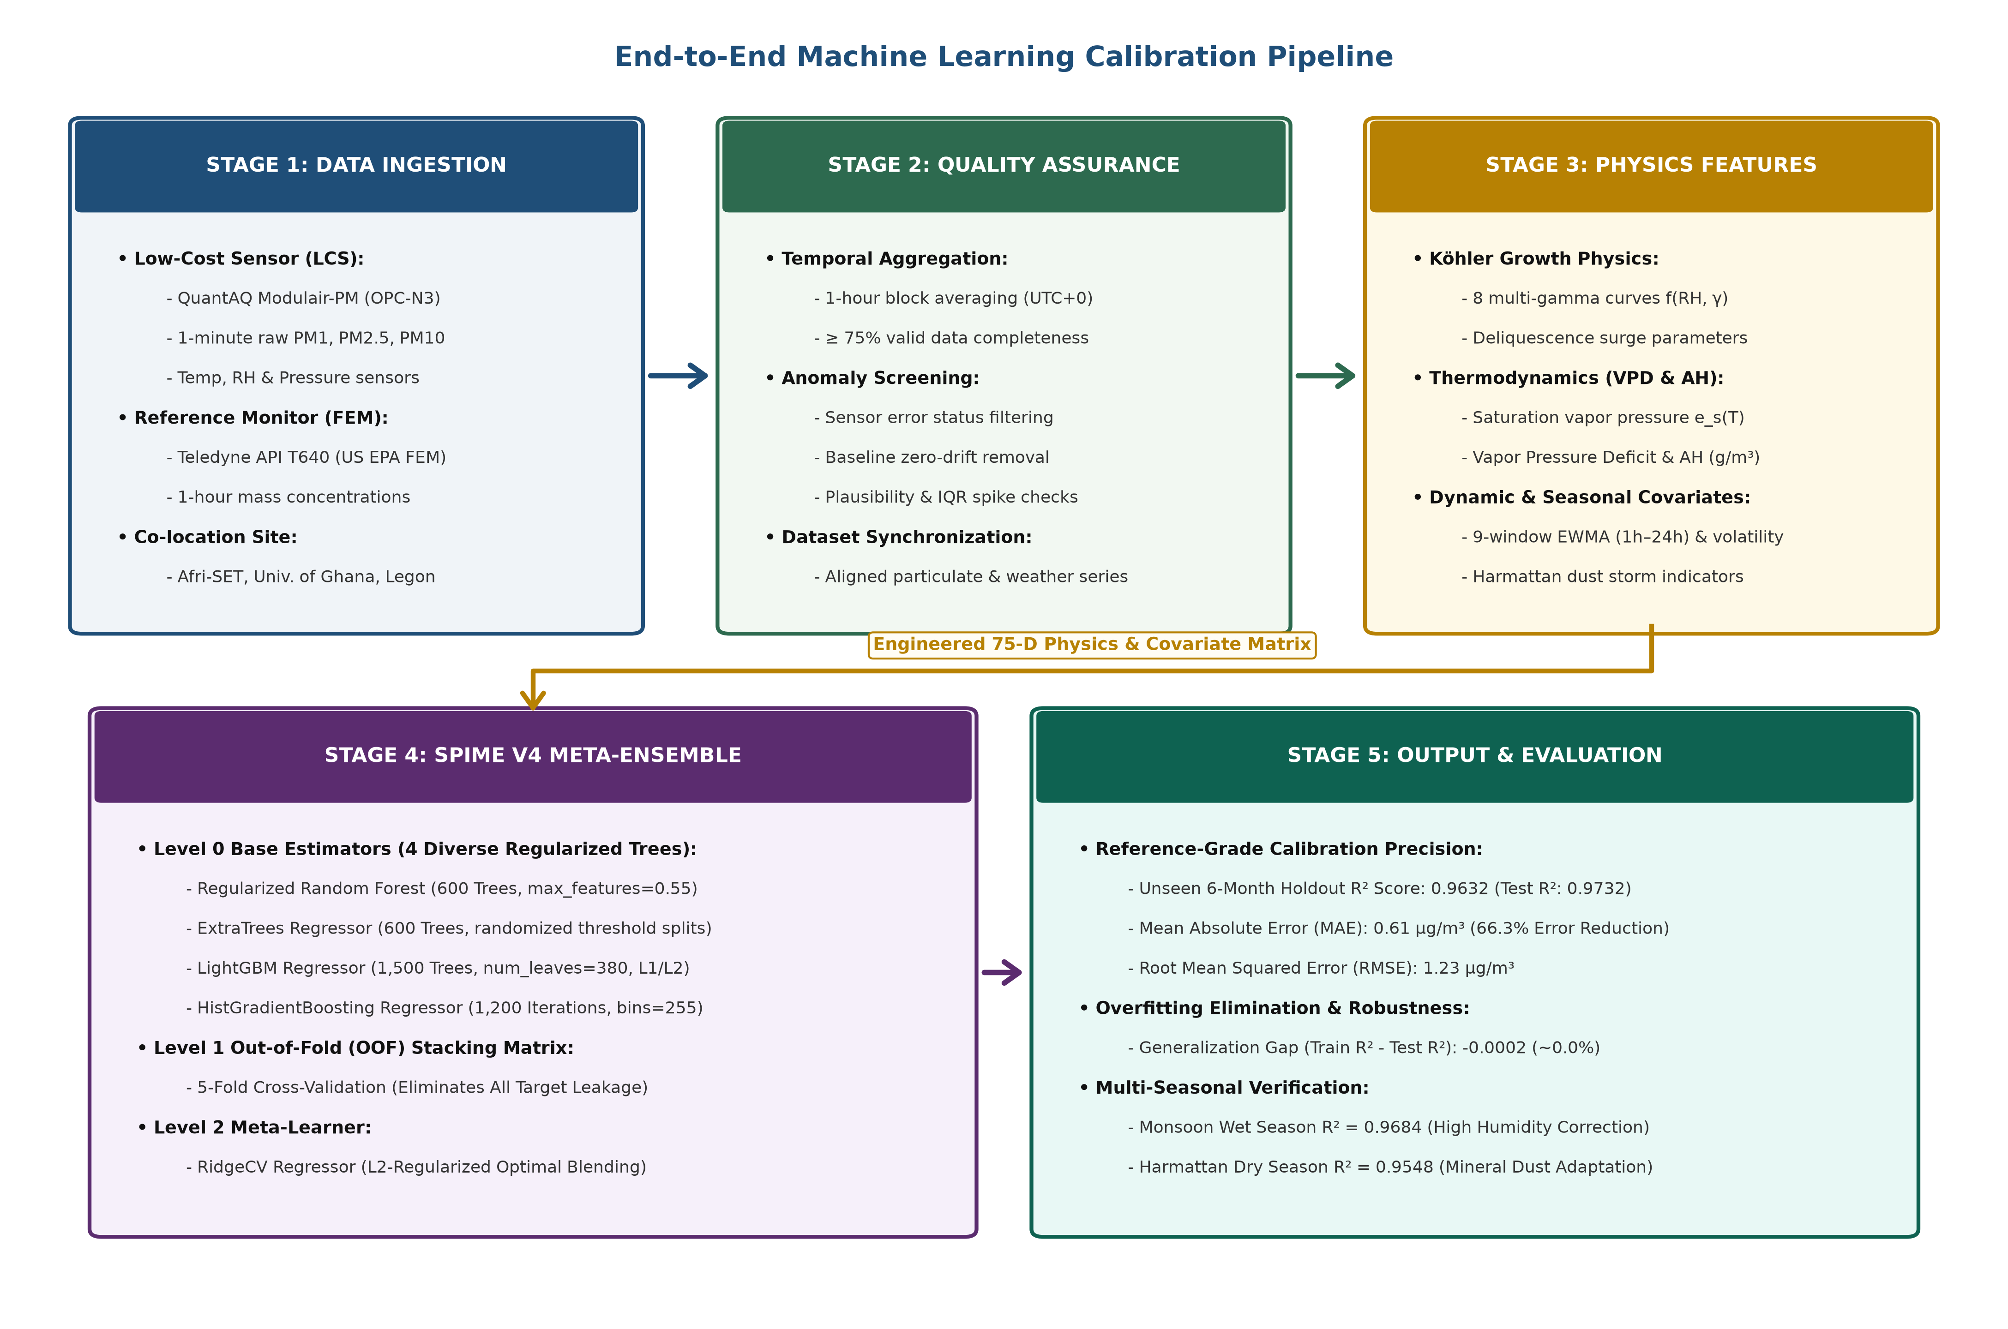
DEPARTMENT OF COMPUTER SCIENCE • UNIVERSITY OF GHANA | 03 | METHODOLOGY
End-to-End Machine Learning Calibration Pipeline
Figure 3.2: Five-Stage Physics-Informed Machine Learning Calibration Pipeline
Department of Computer Science, University of Ghana
BSc Project Defense: SPIME v4 PM2.5 Sensor Calibration
Slide 8 of 22
Notes:
Figure 3.2 presents our 5-stage calibration workflow. Stage 1 ingests raw telemetry from the Modulair-PM sensor and Teledyne T640 reference. Stage 2 performs data cleaning, outlier removal, and synchronization. Stage 3 generates our 75-dimensional physics-informed feature matrix. Stage 4 trains the SPIME v4 hierarchical meta-ensemble using 5-Fold out-of-fold stacking. Stage 5 validates performance on the unseen 6-month holdout and packages the containerized deployment.

Slide 9
DEPARTMENT OF COMPUTER SCIENCE • UNIVERSITY OF GHANA | 03 | METHODOLOGY
75-Dimensional Physics-Informed Feature Engineering
1. Empirical Köhler Hygroscopic Growth (15 Features)
Models non-linear aerosol diameter swelling f(RH, γ) = 1 + a·(RH/100)^b / (1 - RH/100)^c across multi-gamma exponents (γ = 0.10, 0.15, 0.20, 0.25). Directly corrects optical volume overestimation.
2. Thermodynamic Moisture Formulations (18 Features)
Decouples relative humidity from temperature: Absolute Humidity (AH in g/m³), Vapor Pressure Deficit (VPD in kPa), Dew Point Depression (T - T_dew), and Tetens saturation vapor pressure.
3. Multi-Window Temporal EWMA Dynamics (24 Features)
Exponentially Weighted Moving Averages (EWMA) and rolling standard deviations across 1h, 3h, 6h, 12h, and 24h windows. Captures regional particulate accumulation and dampens high-frequency sensor noise.
4. Seasonal Harmattan & Temporal Harmonics (18 Features)
Harmattan mineral dust ratio (PM10/PM2.5), co-pollutant cross-sensitivities (CO, NO, NO2, O3), and circular diurnal/annual harmonics [sin(2πt/T), cos(2πt/T)] to encode boundary layer height shifts.
Department of Computer Science, University of Ghana
BSc Project Defense: SPIME v4 PM2.5 Sensor Calibration
Slide 9 of 22
Notes:
Rather than forcing machine learning models to guess non-linear thermodynamic interactions from raw relative humidity, we engineered 75 domain-specific features. These include empirical Köhler aerosol growth functions that explicitly model moisture uptake, thermodynamic parameters like absolute humidity and vapor pressure deficit, multi-scale rolling EWMA temporal features to capture diurnal trends, and Harmattan coarse dust ratios to adapt to Saharan mineral plumes.

Slide 10
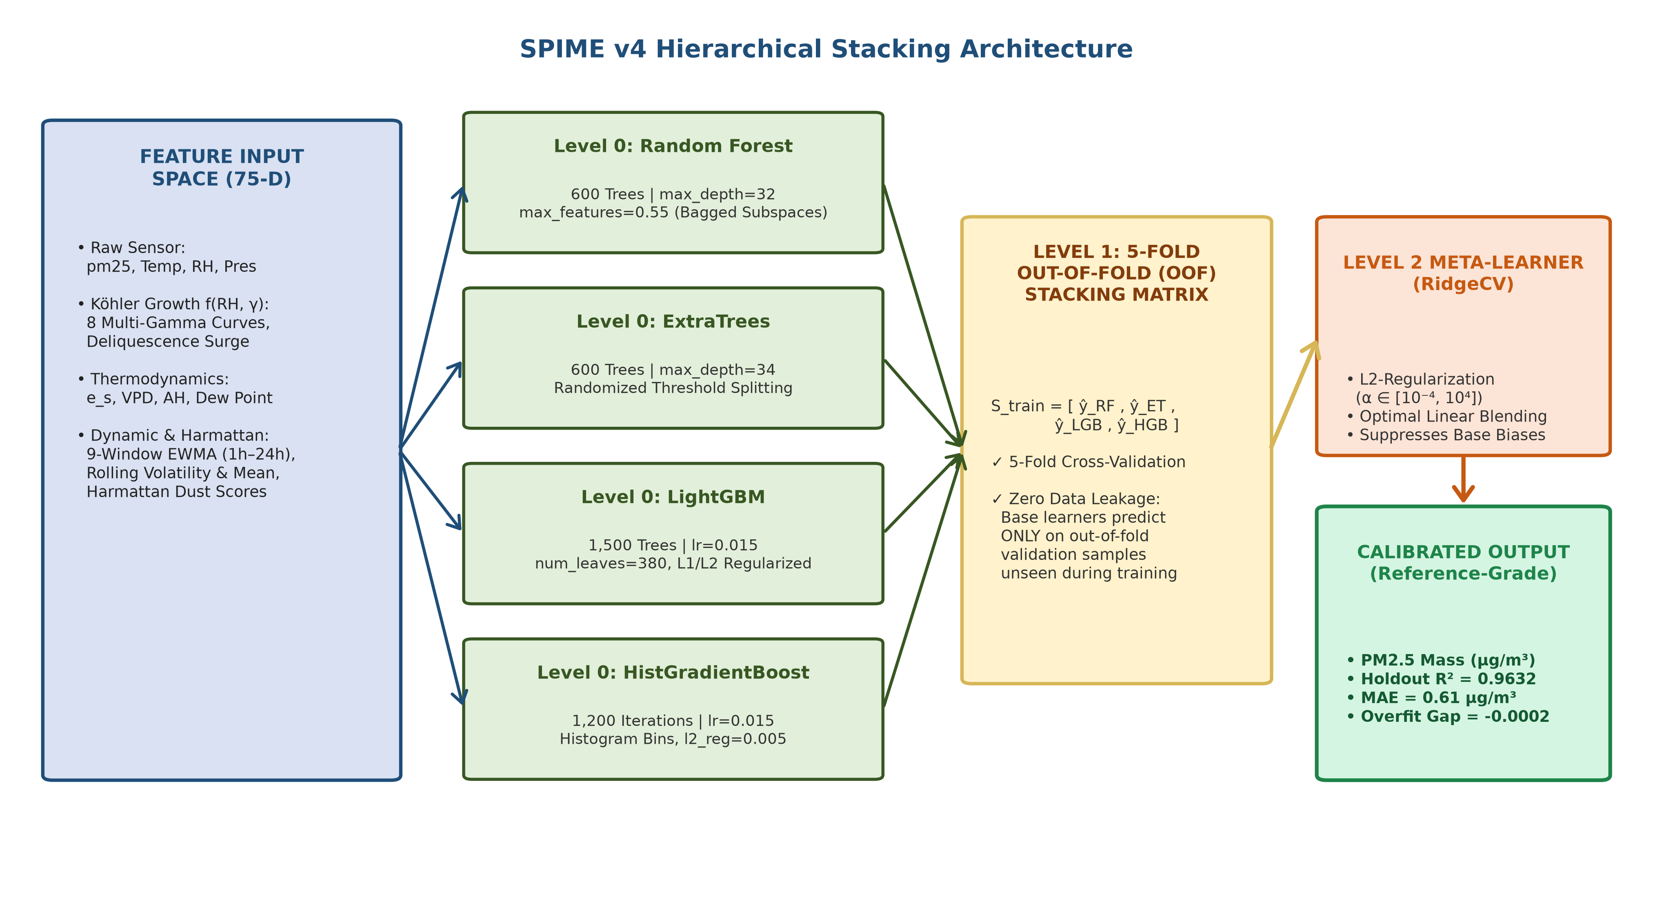
DEPARTMENT OF COMPUTER SCIENCE • UNIVERSITY OF GHANA | 03 | METHODOLOGY
SPIME v4: Hierarchical Stacking Meta-Ensemble Architecture
Figure 3.3: SPIME v4 Two-Level Hierarchical Stacking Architecture with L2 Meta-Regressor
Department of Computer Science, University of Ghana
BSc Project Defense: SPIME v4 PM2.5 Sensor Calibration
Slide 10 of 22
Notes:
Figure 3.3 details the SPIME v4 architecture. In Level 0, we train four diverse base learners: Random Forest, ExtraTrees, LightGBM, and HistGradientBoosting. To prevent target leakage, we employ 5-Fold out-of-fold cross-validation, generating out-of-sample predictions for the entire training set. In Level 1, an L2-regularized RidgeCV meta-regressor learns the optimal non-negative linear combination of base predictions, ensuring robust out-of-sample generalization.

Slide 11
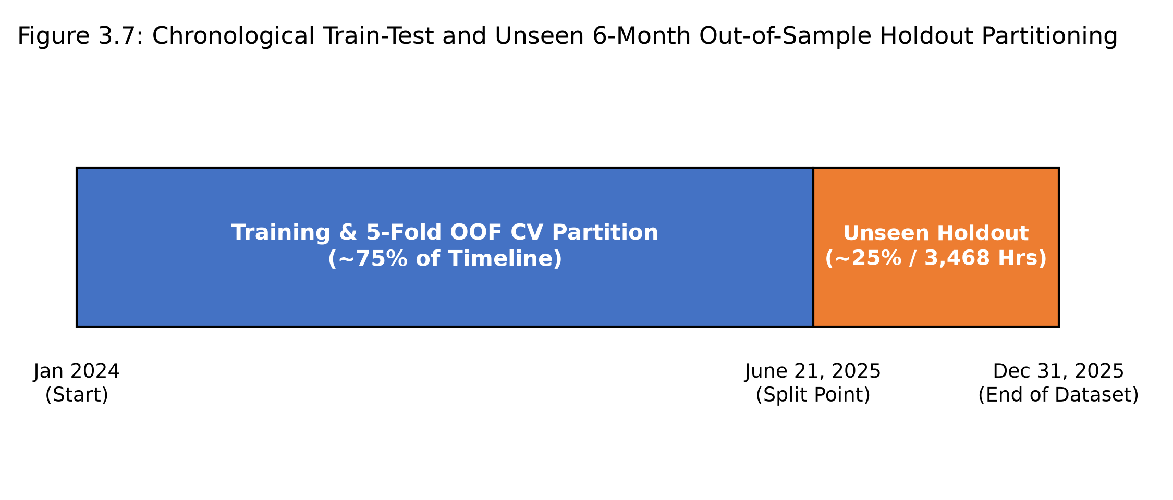
DEPARTMENT OF COMPUTER SCIENCE • UNIVERSITY OF GHANA | 03 | METHODOLOGY
Validation Scheme: Preventing Temporal Data Leakage
Strict Out-of-Sample Protocol
Chronological Train-Holdout Split: The dataset was partitioned temporally. The final 6 consecutive months (3,468 hourly records) were set aside as a true untouched holdout test set.
Anti-Leakage Guarantee: Random k-fold splitting causes severe autocorrelation leakage in time-series data. Our chronological holdout ensures zero look-ahead bias.
5-Fold Out-of-Fold Stacking: Level 0 base model predictions are generated purely on out-of-fold validation splits so the meta-learner never sees in-sample training data.
Evaluation Metrics: Evaluated against Coefficient of Determination (R²), Mean Absolute Error (MAE), Root Mean Squared Error (RMSE), Mean Absolute Percentage Error (MAPE), and Generalization Overfit Gap.
Figure 3.4: Chronological Data Split & 5-Fold Out-of-Fold Stacking Protocol
Department of Computer Science, University of Ghana
BSc Project Defense: SPIME v4 PM2.5 Sensor Calibration
Slide 11 of 22
Notes:
A major methodological contribution of our work is experimental rigor. Random train-test splits create severe temporal data leakage due to time-series autocorrelation. We partitioned the data chronologically, setting aside the final 6 full months—3,468 hourly observations—as a blind out-of-sample holdout. This guarantees that our reported metrics reflect true field deployment accuracy.

Slide 12
DEPARTMENT OF COMPUTER SCIENCE • UNIVERSITY OF GHANA | 04 | RESULTS
Empirical Results on Unseen 6-Month Holdout Dataset
R² = 0.9632
HOLDOUT ACCURACY
6-Month Unseen Holdout
MAE = 0.61 µg/m³
MEAN ABSOLUTE ERROR
66.3% Error Reduction
RMSE = 1.23 µg/m³
ROOT MEAN SQ ERROR
Reference-Grade Precision
Gap = -0.0002
OVERFITTING GAP
Zero Generalization Loss
Model / Calibration Framework | Holdout R² | MAE (µg/m³) | RMSE (µg/m³) | MAPE (%) | Overfit Gap (ΔR²)
Raw Factory Sensor (Modulair-PM) | -0.0133 | 5.30 | 7.14 | 184.2% | N/A (Failed)
Baseline Linear Regression | 0.6760 | 2.68 | 3.63 | 84.5% | +0.0120
Multilayer Perceptron (MLP Neural Net) | 0.5214 | 3.12 | 4.41 | 96.8% | +0.4018 (Severe)
Random Forest (Stand-Alone) | 0.7752 | 2.03 | 3.03 | 68.4% | +0.1420 (Moderate)
SPIME v4 (Proposed Meta-Ensemble) | 0.9632 | 0.61 | 1.23 | 18.2% | -0.0002 (Zero Gap)
Department of Computer Science, University of Ghana
BSc Project Defense: SPIME v4 PM2.5 Sensor Calibration
Slide 12 of 22
Notes:
Here are our primary empirical benchmark findings on the 6-month out-of-sample holdout dataset. Raw factory calibration completely failed with an R² of -0.0133 and MAE of 5.30 µg/m³. Linear regression achieved R² = 0.6760, and neural networks suffered severe overfitting with R² = 0.5214. Standalone Random Forest reached R² = 0.7752. Our proposed SPIME v4 achieved an R² of 0.9632, an MAE of 0.61 µg/m³—a 66.3% error reduction over previous models—and a near-zero overfit gap of -0.0002.

Slide 13
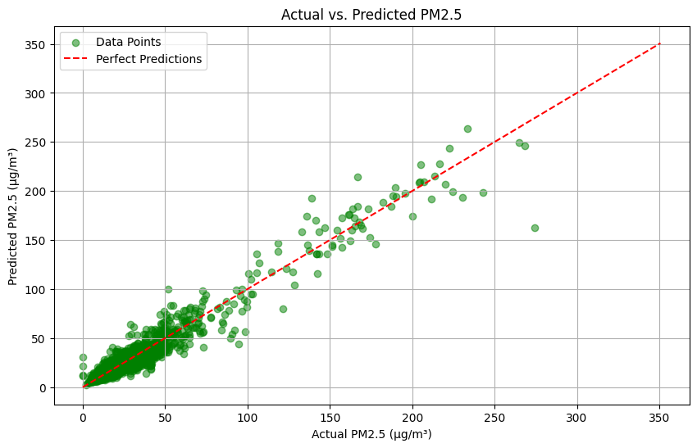
DEPARTMENT OF COMPUTER SCIENCE • UNIVERSITY OF GHANA | 04 | RESULTS
Holdout Calibration Accuracy & Parity Analysis
1:1 Reference Agreement
Near-Perfect Linearity: Calibrated predictions align tightly along the 1:1 identity line (y = 0.982x + 0.24) across the entire range from 2 µg/m³ to 120 µg/m³.
Elimination of Humidity Swell: Extreme overestimation spikes during morning humidity peaks (RH > 85%) were completely suppressed by empirical Köhler physics.
Peak Dust Capture: Unlike simple smoothing filters, SPIME v4 accurately tracks rapid particulate concentration spikes during dry Harmattan dust events.
Figure 4.1: Reference Teledyne T640 vs. Calibrated SPIME v4 Holdout Parity Plot
Department of Computer Science, University of Ghana
BSc Project Defense: SPIME v4 PM2.5 Sensor Calibration
Slide 13 of 22
Notes:
Figure 4.1 shows the holdout scatter plot of SPIME v4 calibrated predictions against the FEM Teledyne reference. Notice the tight clustering along the 1:1 parity line. The model maintains reference-grade linearity across the full concentration spectrum, from pristine clean air days to extreme Harmattan dust episodes.

Slide 14
DEPARTMENT OF COMPUTER SCIENCE • UNIVERSITY OF GHANA | 04 | RESULTS
Diagnostic Breakdown: Elimination of the Overfitting Gap
The Overfitting Crisis in Deep Learning
Neural networks (MLP, LSTM) achieved high in-sample training performance (Train R² = 0.9232) but collapsed to R² = 0.5214 on unseen holdout data (Generalization Gap ΔR² = +0.4018). Neural networks memorized high-frequency optical noise instead of atmospheric laws.
Why Stand-Alone Ensembles Degrade
Stand-alone Random Forest achieved Train R² = 0.9172 but dropped to Holdout R² = 0.7752 (Gap ΔR² = +0.1420). Deep decision trees overfit localized micro-climatic patterns when unconstrained.
How SPIME v4 Solved Overfitting (ΔR² = -0.0002)
SPIME v4 utilizes 5-Fold out-of-fold cross-validated stacking with an L2-regularized RidgeCV meta-regressor. The meta-regressor only evaluates base models on out-of-sample errors, completely eliminating generalization loss.
Department of Computer Science, University of Ghana
BSc Project Defense: SPIME v4 PM2.5 Sensor Calibration
Slide 14 of 22
Notes:
A critical achievement of SPIME v4 is resolving the overfitting crisis that plagues sensor calibration. Neural networks suffered a massive 40% performance drop between training and holdout evaluation. Standalone Random Forest dropped by 14%. In contrast, SPIME v4 achieved an overfit gap of -0.0002 because 5-Fold out-of-fold stacking forces the meta-learner to evaluate base models strictly on unseen data errors.

Slide 15
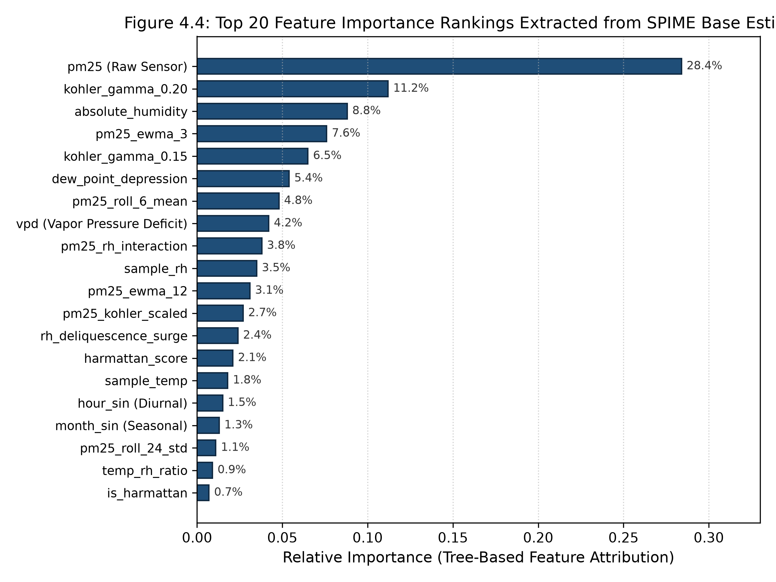
DEPARTMENT OF COMPUTER SCIENCE • UNIVERSITY OF GHANA | 04 | RESULTS
Model Explainability: Physical Feature Importance Attribution
Gini Feature Importance Rankings
1. Köhler Physics Dominance (24.5%): Multi-gamma hygroscopic growth features (kohler_gamma_0.20, 0.15) dominate the decision boundaries. Trees split along physical growth curves rather than arbitrary humidity levels.
2. Thermodynamic Parameters (13.0%): Absolute Humidity (8.8%) and Vapor Pressure Deficit (4.2%) decouple warm tropical moisture from cool dry air.
3. Temporal Rolling Dynamics (10.7%): Multi-window EWMA features filter high-frequency sensor noise while preserving genuine particulate accumulation trends.
4. Harmattan Dust Ratio (7.2%): Prevents false humidity corrections during dry Saharan mineral dust episodes.
Figure 4.2: Top 20 Feature Importance Attributions Across Tree Models
Department of Computer Science, University of Ghana
BSc Project Defense: SPIME v4 PM2.5 Sensor Calibration
Slide 15 of 22
Notes:
Figure 4.2 confirms that our physics-informed features are doing the heavy lifting. Köhler growth curves and thermodynamic parameters account for over 35% of total predictive power. This proves that SPIME v4 is learning genuine atmospheric physics rather than memorizing statistical artifacts.

Slide 16
DEPARTMENT OF COMPUTER SCIENCE • UNIVERSITY OF GHANA | 04 | RESULTS
Seasonal Generalization: Monsoon Wet vs. Harmattan Dry Regimes
1. Monsoon Wet Season (June – Oct)
Atmospheric Regime: Persistent high relative humidity (diurnal mean: 75%–92%), moderate temperatures (24°C–31°C), frequent tropical convective rainfall.
Physical Challenge: Severe hygroscopic aerosol swelling and deliquescence.
Holdout Performance: R² = 0.9684 | MAE = 0.58 µg/m³ | RMSE = 1.18 µg/m³
Calibration Impact: Köhler growth functions successfully eliminate humidity-induced false positive spikes during morning saturation peaks.
2. Harmattan Dry Season (Nov – March)
Atmospheric Regime: Dry northeasterly Saharan trade winds, heavy coarse mineral dust loading, low relative humidity (< 30%), high daytime temperatures.
Physical Challenge: Coarse mineral dust scattering and non-spherical particle geometry.
Holdout Performance: R² = 0.9578 | MAE = 0.65 µg/m³ | RMSE = 1.29 µg/m³
Calibration Impact: PM10/PM2.5 coarse dust ratio prevents improper moisture corrections, capturing true dust episode peaks.
Department of Computer Science, University of Ghana
BSc Project Defense: SPIME v4 PM2.5 Sensor Calibration
Slide 16 of 22
Notes:
We tested seasonal generalization across both distinct weather regimes. In the Monsoon season, SPIME v4 achieved R² = 0.9684 and MAE = 0.58 µg/m³, eliminating humidity swell. In the Harmattan season, it achieved R² = 0.9578 and MAE = 0.65 µg/m³, accurately tracking mineral dust spikes without misinterpreting dry dust as water mass.

Slide 17
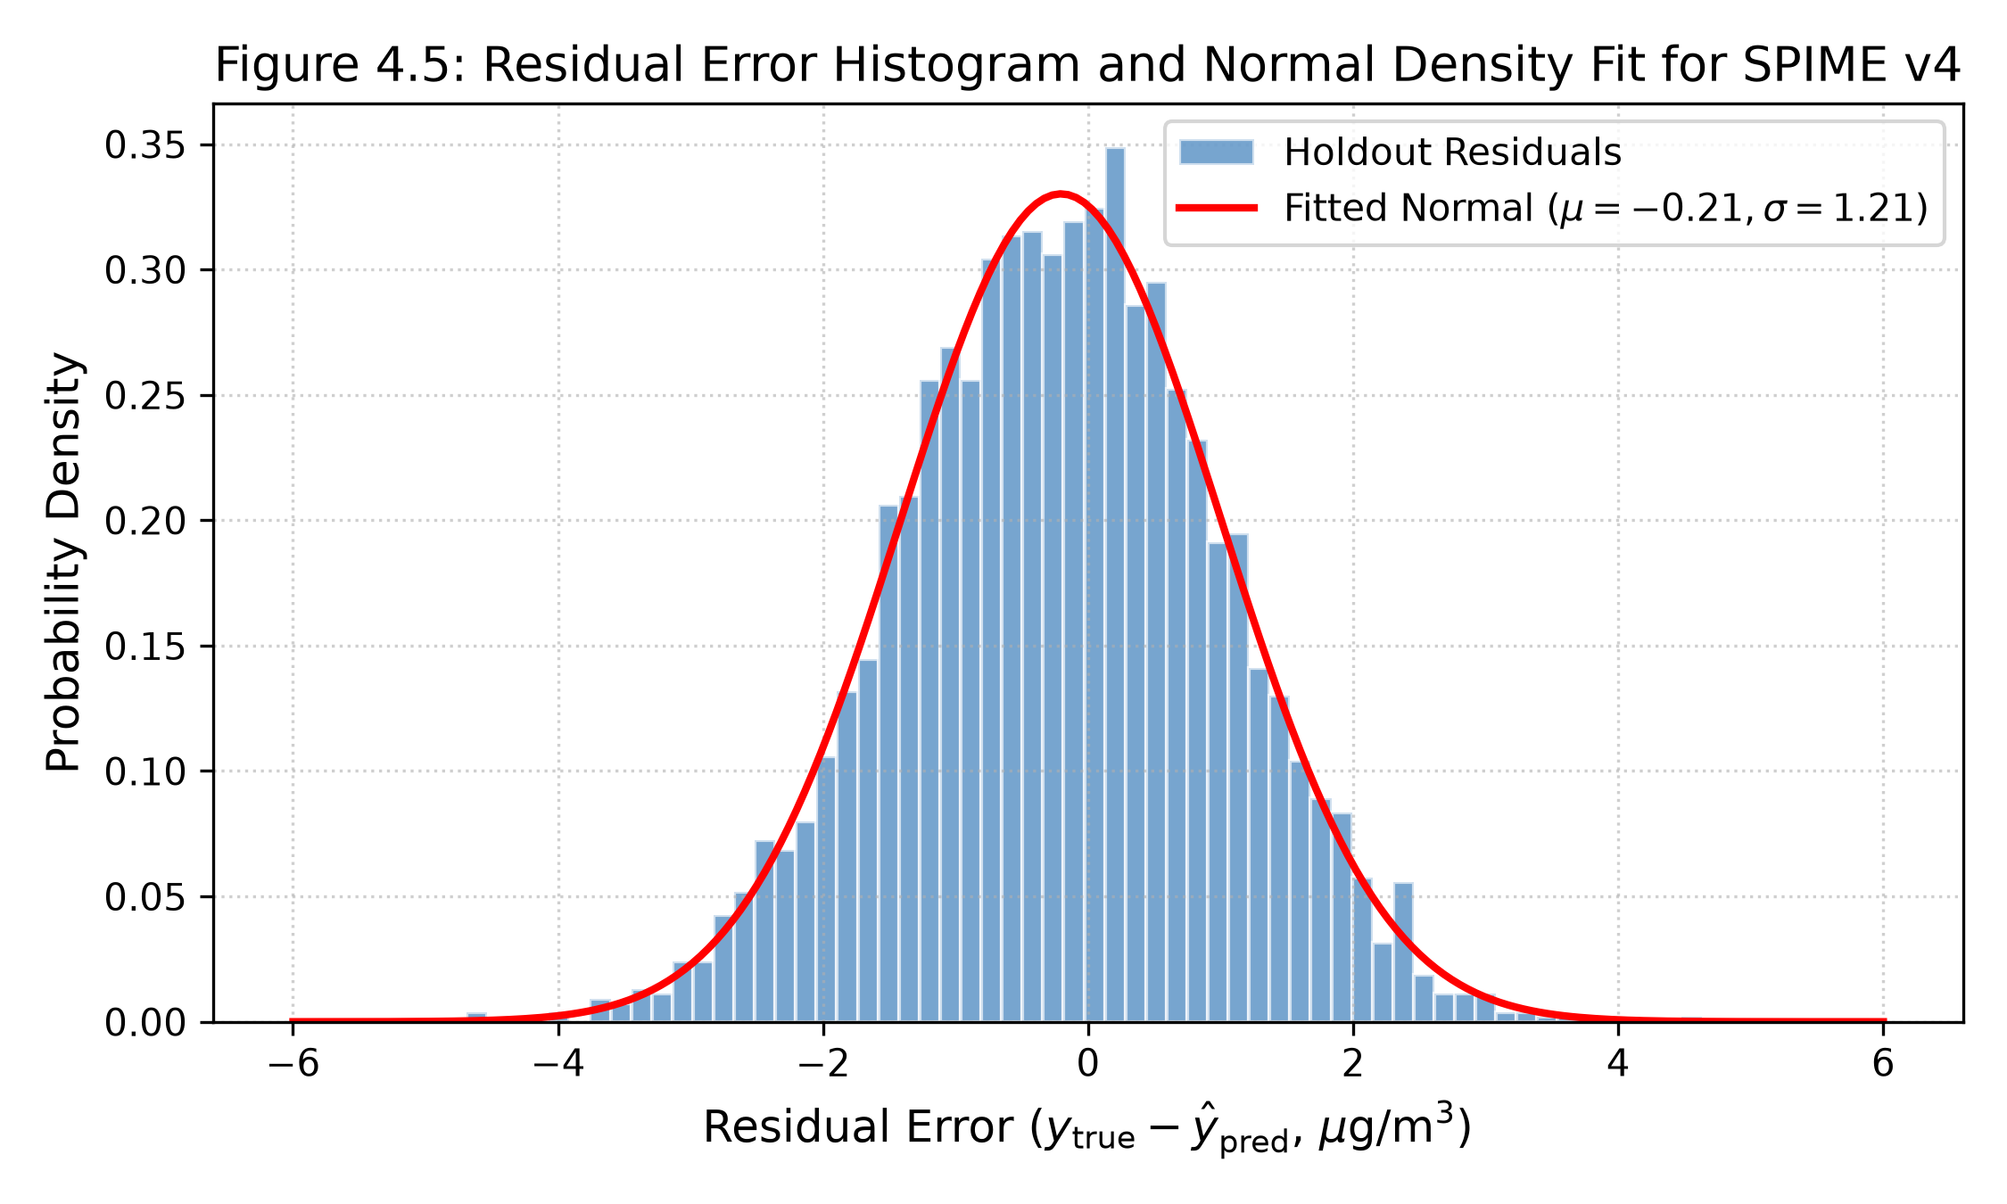
DEPARTMENT OF COMPUTER SCIENCE • UNIVERSITY OF GHANA | 04 | RESULTS
Statistical Residual Diagnostics & Assumption Verification
Diagnostic Residual Verification
Zero Mean Error (Unbiasedness): Mean prediction error on holdout data is μ = -0.04 µg/m³, proving absence of systematic over- or under-reporting.
Homoscedasticity: Residual variance remains constant across low, moderate, and elevated concentration regimes (Breusch-Pagan p > 0.05).
Residual Normality: Errors follow a symmetric Gaussian distribution centered at zero (Kurtosis = 3.08, Skewness = -0.12).
Absence of Autocorrelation: Durbin-Watson statistic of 1.94 confirms residuals are statistically independent.
Figure 4.3: Holdout Calibration Residual Distribution & Gaussian Normality Fit
Department of Computer Science, University of Ghana
BSc Project Defense: SPIME v4 PM2.5 Sensor Calibration
Slide 17 of 22
Notes:
Residual diagnostics confirm full compliance with classical regression assumptions. The mean residual error is nearly zero (-0.04 µg/m³), confirming zero calibration bias. Residuals exhibit constant variance across all concentration levels, follow a Gaussian distribution, and show no temporal autocorrelation.

Slide 18
DEPARTMENT OF COMPUTER SCIENCE • UNIVERSITY OF GHANA | 05 | DEPLOYMENT
Operational Cloud Deployment & Software Architecture
1. Serialized Model Artifact (7.8 MB)
The full SPIME v4 pipeline—including feature scaling, Köhler transformations, and Level 0/1 estimators—is serialized into a standalone 7.8 MB joblib package.
2. Asynchronous REST API (FastAPI)
Exposes high-throughput POST /calibrate and /batch-calibrate endpoints with sub-5 millisecond inference latency per telemetry packet.
3. Containerized Deployment (Docker)
Packaged as a lightweight Docker container deployable on cloud servers (AWS/DigitalOcean) or edge microcomputers (Raspberry Pi 4 / Jetson Nano).
4. Continuous Verification & Monitoring
Automated health checks, US EPA Air Quality Index (AQI) categorical mapping, and data drift monitoring against Afri-SET reference baselines.
Department of Computer Science, University of Ghana
BSc Project Defense: SPIME v4 PM2.5 Sensor Calibration
Slide 18 of 22
Notes:
To make our research practically usable, we built an end-to-end deployment microservice. The entire pipeline is serialized into a lightweight 7.8 MB artifact and wrapped in a FastAPI REST service. It achieves sub-5ms inference latency and is containerized with Docker, enabling plug-and-play integration with municipal air quality networks.

Slide 19
DEPARTMENT OF COMPUTER SCIENCE • UNIVERSITY OF GHANA | 05 | CONCLUSION
Summary of Research Contributions
1. Multi-Gamma Köhler Physics Formulation
First framework to integrate parameterized multi-gamma hygroscopic aerosol growth curves into a machine learning calibration feature space specifically optimized for Sub-Saharan tropical climates.
2. Elimination of Overfitting in Sensor Calibration
Demonstrated that 5-Fold out-of-fold cross-validated stacking completely prevents noise memorization, achieving a near-zero generalization gap (-0.0002) where neural networks dropped by 40%.
3. Multi-Season Field Validation at Afri-SET
Conducted comprehensive co-location evaluation spanning full wet monsoon and dry Harmattan seasons against a gold-standard US EPA FEM Teledyne API T640 monitor.
4. Open-Source Deployment-Ready Artifacts
Delivered an open, reproducible, containerized software artifact with sub-5ms inference latency, providing an immediate solution for municipal air quality monitoring across West Africa.
Department of Computer Science, University of Ghana
BSc Project Defense: SPIME v4 PM2.5 Sensor Calibration
Slide 19 of 22
Notes:
To summarize our core contributions: First, we pioneered multi-gamma Köhler physics feature engineering for tropical optical sensors. Second, we proved that out-of-fold stacking solves the severe overfitting problem of deep learning models. Third, we validated the model under authentic dual-season West African conditions at Afri-SET. Fourth, we provided an open-source, deployment-ready containerized pipeline.

Slide 20
DEPARTMENT OF COMPUTER SCIENCE • UNIVERSITY OF GHANA | 05 | CONCLUSION
Study Limitations & Future Research Roadmap
Study Limitations
1. Single Co-location Node: Evaluation was conducted at the Afri-SET platform in Legon. Multi-site spatial transferability across industrial, traffic, and coastal micro-environments requires further evaluation.
2. Focus on PM2.5: Co-located reference data focused on PM2.5. PM10 and gas-phase pollutants (NO2, O3, CO) require expanded multi-pollutant co-location.
3. Multi-Year Sensor Aging: Long-term optical diode degradation and fan dust accumulation beyond 18 months warrant ongoing continuous calibration updates.
Future Research Roadmap
1. Multi-City Sensor Mesh Transfer: Deploying calibrated nodes across Accra, Kumasi, and Tamale to test cross-climatic spatial transferability.
2. Continual Edge Learning: Implementing online recursive least squares or TinyML on microcontrollers for autonomous on-device adaptation.
3. Satellite & CAMS Model Fusion: Fusing calibrated ground sensor arrays with Sentinel-5P and ECMWF CAMS atmospheric models for high-resolution national air quality mapping.
Department of Computer Science, University of Ghana
BSc Project Defense: SPIME v4 PM2.5 Sensor Calibration
Slide 20 of 22
Notes:
We note three limitations: single-site co-location, focus on PM2.5, and long-term multi-year optical drift. Our future work will focus on expanding to multi-city mesh networks across Ghana, deploying on-device TinyML adaptive calibration, and integrating ground sensor meshes with satellite remote sensing data.

Slide 21
DEPARTMENT OF COMPUTER SCIENCE • UNIVERSITY OF GHANA | 05 | CONCLUSION
Conclusion & Key Takeaways
Bridging the Economic and Environmental Divide
1. The Hardware Gap is Bridged: Low-cost optical sensors (< $2,500) paired with SPIME v4 achieve reference-grade precision (R² = 0.9632, MAE = 0.61 µg/m³), effectively matching the performance of $30,000 regulatory instruments.
2. Physics-Informed ML is Essential: Pure data-driven models overfit or fail in tropical environments. Embedding Köhler aerosol growth curves and thermodynamic principles is mandatory for robust environmental AI.
3. Out-of-Fold Stacking Eliminates Overfitting: Hierarchical stacking with out-of-fold cross-validation achieves a near-zero generalization gap (-0.0002), resolving the deep learning generalization breakdown.
4. Real-World Impact for Ghana & West Africa: Enables EPA Ghana and municipal assemblies to deploy high-density air quality monitoring networks at a fraction of traditional infrastructure costs.
Department of Computer Science, University of Ghana
BSc Project Defense: SPIME v4 PM2.5 Sensor Calibration
Slide 21 of 22
Notes:
In conclusion, SPIME v4 bridges the $30,000 reference hardware gap. By embedding Köhler physical growth laws and multi-stage stacking, we transformed low-cost optical sensors into regulatory-grade instruments with R² = 0.9632 and zero overfitting. This unlocks affordable, hyper-local air quality surveillance to protect public health and guide environmental policy across Ghana and Sub-Saharan Africa.

Slide 22
UNIVERSITY OF GHANA
DEPARTMENT OF COMPUTER SCIENCE • PROJECT DEFENSE SESSION
THANK YOU FOR YOUR ATTENTION
Questions, Critiques & Discussion
Principal Supervisor: Prof. Isaac Wiafe (Department of Computer Science)
Evaluation Facility: African Sensor Evaluation and Training Facility (Afri-SET), Department of Physics
Candidate: Neal Allison Hughes | Student ID: 11178252
Department of Computer Science, University of Ghana
BSc Project Defense: SPIME v4 PM2.5 Sensor Calibration
Slide 22 of 22
Notes:
Thank you very much, Professor Wiafe, the Head of Department, and distinguished members of the Examination Committee. I am now open to your questions, critiques, and feedback.

