Slide 1


[Mohan Wang] [Huiyang Liao] [Qiwei Wang]
Group：27

Slide 2


PART 01 The aims of the analysis
PART 02 Exploratory data analysis
CONTENT
PART 03 Statistical modelling and results
PART 04 Conclusions and extensions

Slide 3

01
The aims of the analysis

Slide 4

The goal of this project is to analyse key factors influencing whether an individual's annual income exceeds $50K and to develop a Generalized Linear Model (GLM) for prediction. Through exploratory data analysis and regression modeling, we aim to quantify the impact of socio-economic characteristics (such as age, education, occupation, working hours, etc.) on income levels, providing data-driven insights for policy-making, business decisions, and personal career planning.

Slide 5
02
Exploratory data analysis

Slide 6
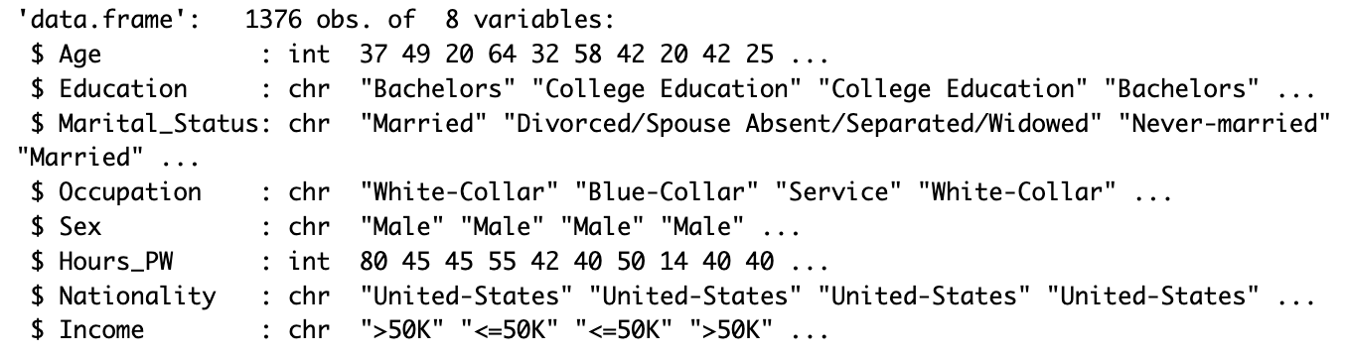
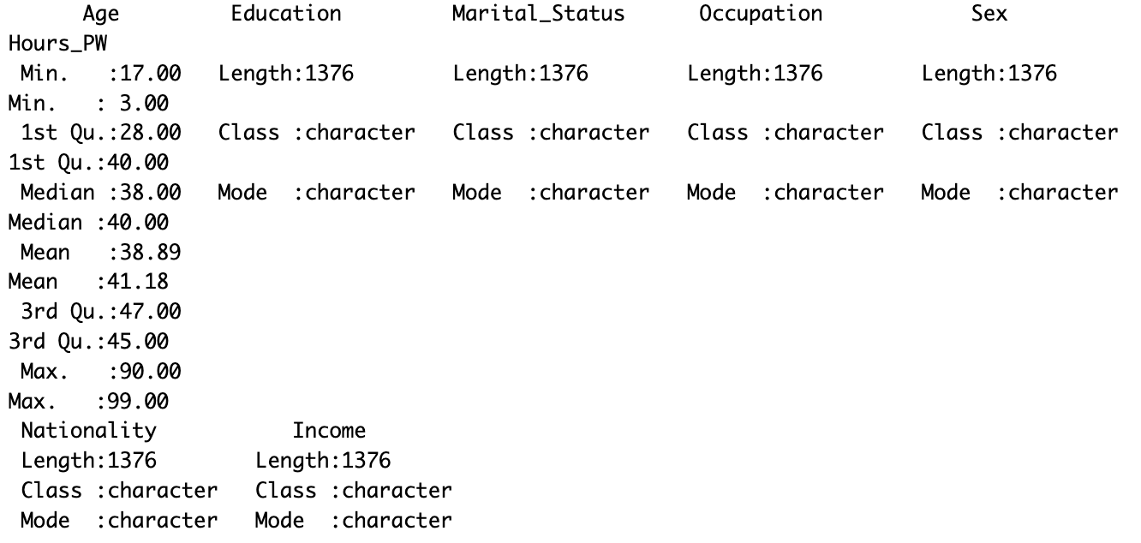
Data Structure
Overview of Variables

Slide 7
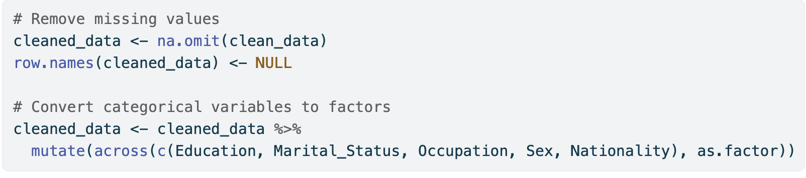
Data Cleaning

Slide 8
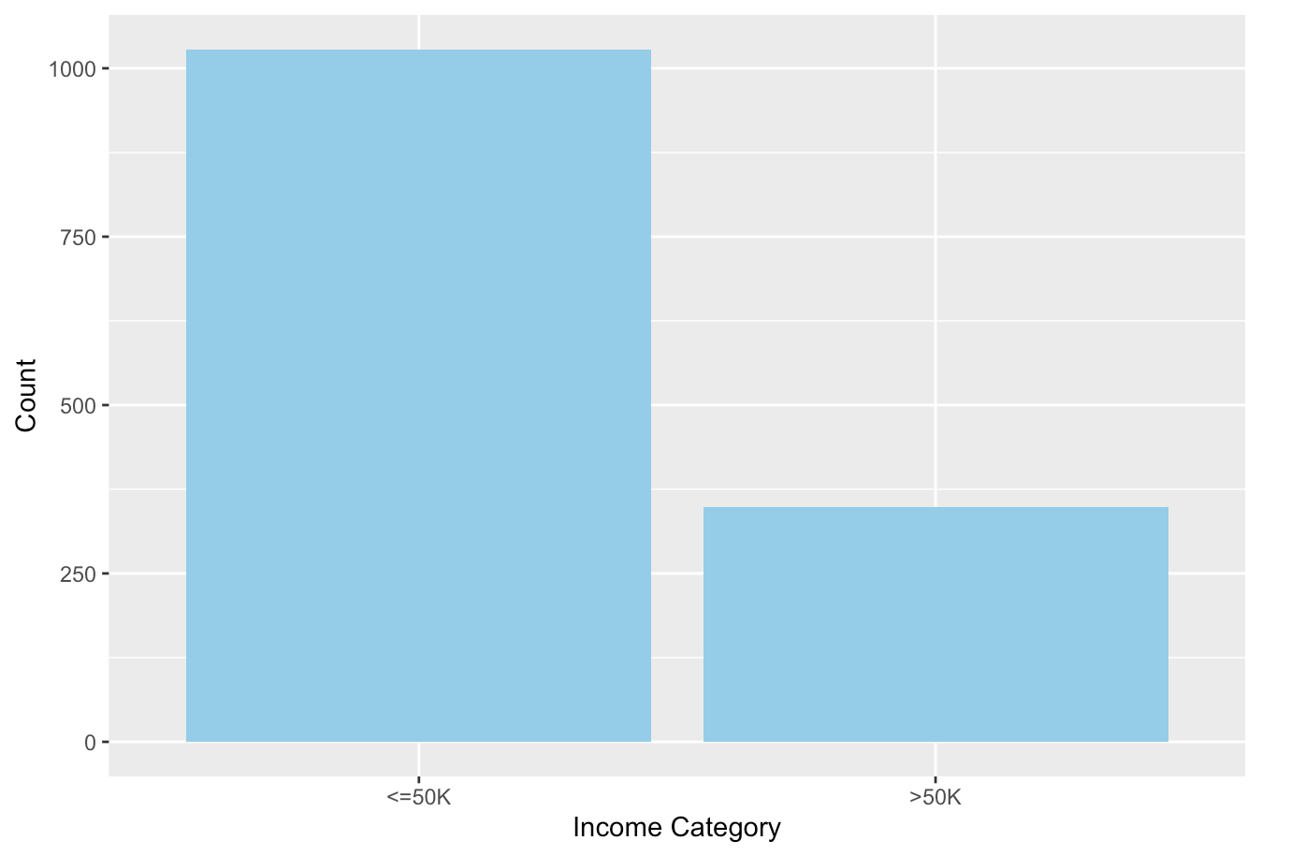
Visualize the income distribution

Slide 9
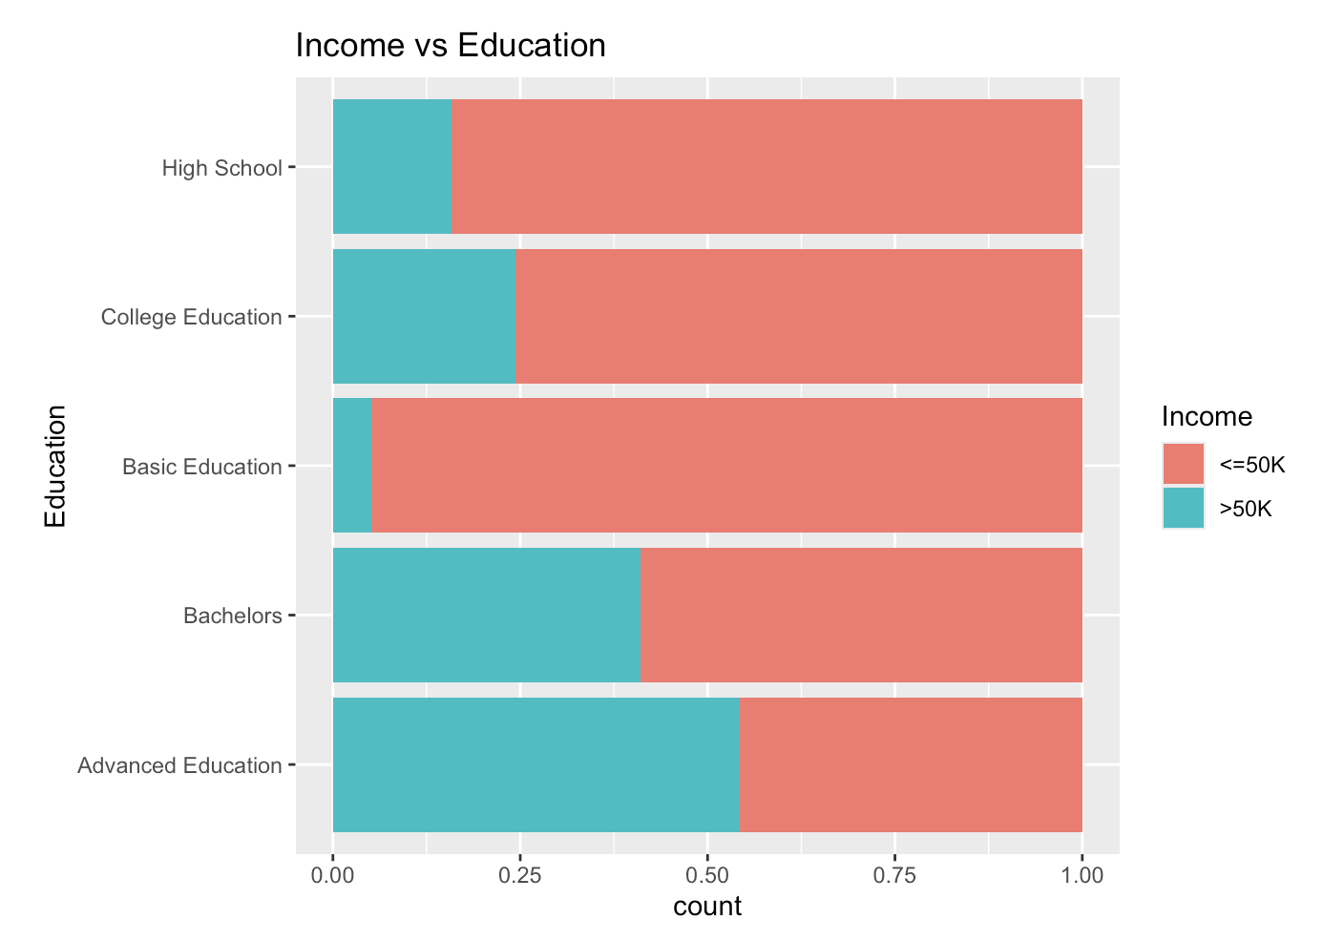
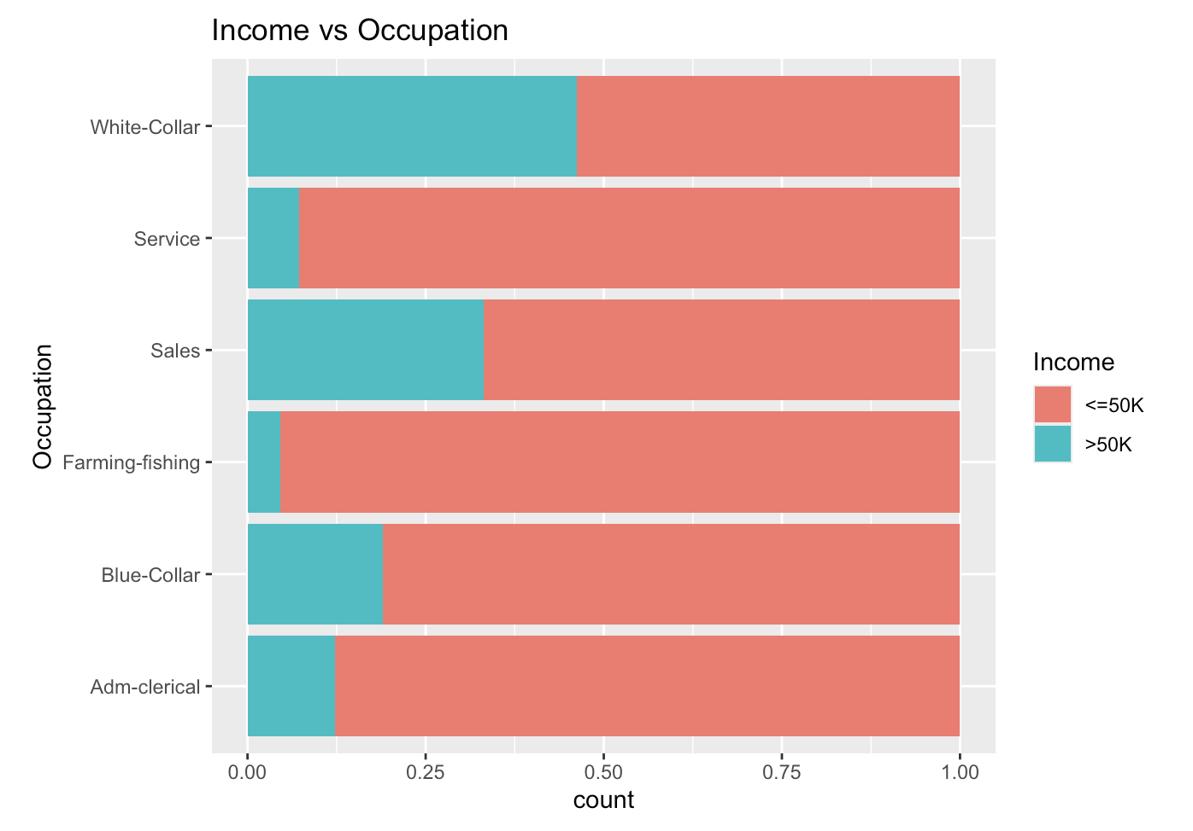
Exploring Categorical Variables' Relationship with Income

Slide 10
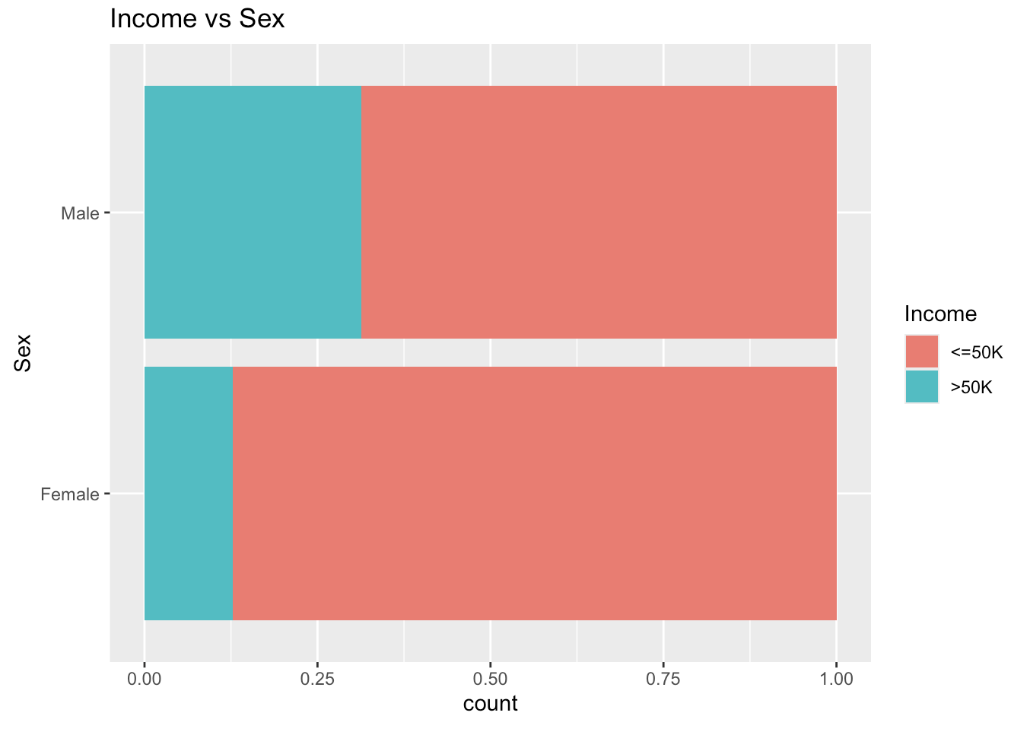
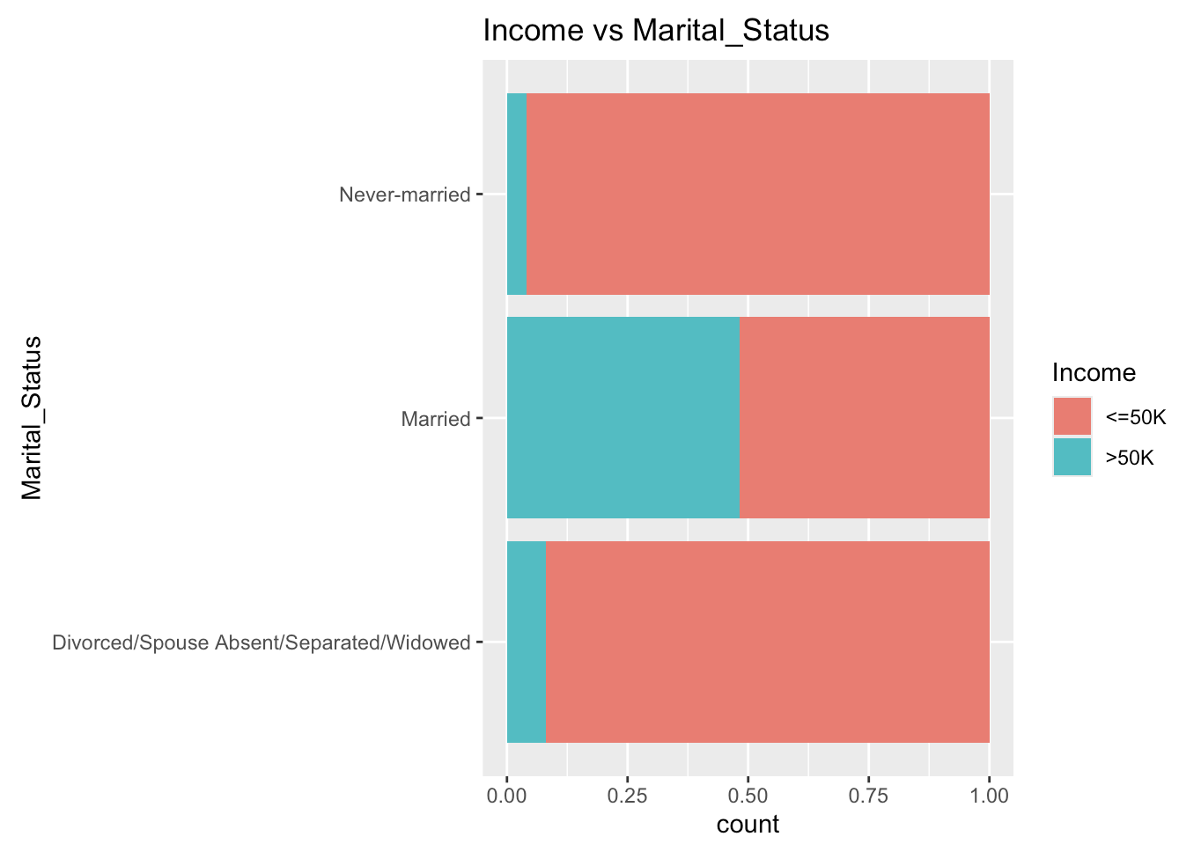

Slide 13
03
Statistical modelling and results

Slide 14

请输入标题
在这里输入您的内容，或者通过复制您的文本，在此框选择复制粘贴，在这里输入您的内容，或者通过复制您的文本，在此框选择复制粘贴

Slide 15
04
Conclusions and extensions

Slide 16



标题

Slide 17
THANKS FOR LISTENING
Group 27

