Slide 1

Angelix: Scalable Multiline Program Patch Synthesis via Symbolic Analysis
Sergey Mechtaev
Jooyong Yi
Abhik Roychoudhury
School of Computing, National University of Singapore, Singapore
Presenter: Xuyang Li, Nanjing University

Slide 2
Automated Program Repair
positive
tests
negative tests
Test suits
buggy program
repair engine
…

Slide 3
Automated Program Repair
positive
tests
negative tests
Test suits
positive
tests
buggy program
repair engine
patched program(s) that
pass all tests

Slide 4
Let’s fit the test suits!
positive
tests
negative tests
Test suits
positive
tests
buggy program
repair engine
patched program(s) that
pass all tests

Slide 5
But not overfit ☹
positive
tests
negative tests
Test suits
positive
tests
buggy program
repair engine
patched program(s) that
pass all tests

Slide 6
A search problem with constraints in nature
Based on buggy program
Extracted from test suits
designed search space
(special mutations
on source AST)

Slide 7
A search problem with constraints in nature
Based on buggy program
Extracted from test suits
On small piece of control flow
designed search space
(special mutations
on source AST)

Slide 8
A search problem with constraints in nature
Based on buggy program
Extracted from test suits
validation
Search strategy
designed search space
(special mutations
on source AST)
Search-Based Algorithm

Slide 9
A search problem with constraints in nature
Based on buggy program
Extracted from test suits
validation
Try to synthesis a program satisfying extracted constraints
Search strategy
Extracted constraints
designed search space
(special mutations
on source AST)
Search-Based Algorithm
Constraint-Based Algorithm

Slide 10
A search problem with constraints in nature
Based on buggy program
Extracted from test suits
Subtleties!
With symbolic execution
validation
Try to synthesis a program satisfying extracted constraints
Search strategy
Extracted constraints
designed search space
(special mutations
on source AST)
designed search space
(special mutations
on source AST)
Search-Based Algorithm
Constraint-Based Algorithm

Slide 11
Repair Criterion
Scalability
Scale to large real-world program
Repairability
Can repair more defect classes
Quality of repairs
less change, not overfit, developer’s sweetheart

Slide 12
Repair Criterion
Scalability
Constraint-based method bad at this
Repairability
Quality of repairs
Constraint-based method good at these

Slide 13
Contribution
High scalability, repairability
Constraint-based automated repair method
that generates
High quality of repairs.

Slide 14
Example: max(x, y)

Slide 15
Example: max(x, y)
if (x > y)
ret = x;
else
ret = y;
return ret;
Source program

Slide 16
Example: max(x, y)
if (x > y)
ret = x;
else
ret = y;
return ret;
if (x < y)
ret = x + 1;
else
ret = y;
return ret;
Source program
Buggy program

Slide 17
Example: max(x, y)
Buggy program
if (x < y)
ret = x + 1;
else
ret = y;
return ret;
Changed control flow and dataflow!

Slide 18
Example: max(x, y)
Buggy program
if (x < y)
ret = x + 1;
else
ret = y;
return ret;
Changed control flow and dataflow!
test id | x | y | Buggy ret | Correct ret
1 | 1 | 2 | 2 | 2
2 | 2 | 1 | 1 | 2

Slide 19
Example: max(x, y)
if (x < y)
ret = x + 1;
else
ret = y;
return ret;
Changed control flow and dataflow!
Path 1
Path 2
test id | x | y | Buggy ret | Correct ret
1 | 1 | 2 | 2 | 2
2 | 2 | 1 | 1 | 2

Slide 20
Example: max(x, y)
if (x < y)
ret = x + 1;
else
ret = y;
return ret;
Changed control flow and dataflow!
Path 1
Path 2
test id | x | y | Buggy ret | Correct ret
1 | 1 | 2 | 2 | 2
2 | 2 | 1 | 1 | 2
Positive test, but wrong control flow
Negative test, wrong control flow

Slide 21
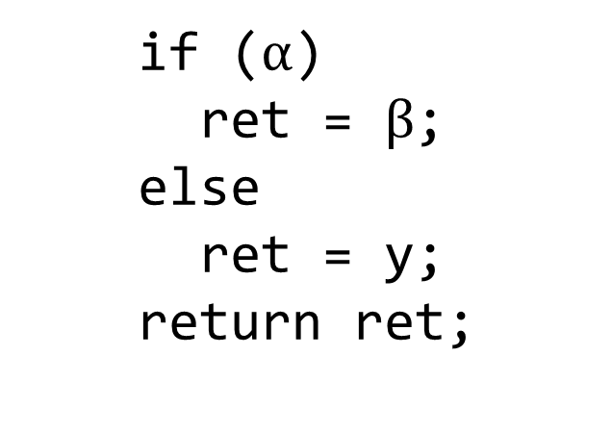
Example: max(x, y)
Let’s extract constraint for each test
if ($α$)
ret = $β$;
else
ret = y;
return ret;
Magically choose suspicious expressions
test id | x | y | Buggy ret | Correct ret
1 | 1 | 2 | 2 | 2
2 | 2 | 1 | 1 | 2

Slide 22
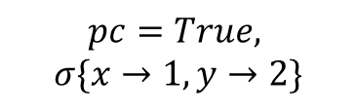
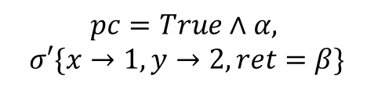
Example: max(x, y)
…Via Symbolic Execution
$$pc=True,$$
$$σ\{x→1, y→2\}$$
if ($α$)
ret = $β$;
else
ret = y;
return ret;
$$pc=True∧α,$$
$$σ′\{x→1, y→2, ret=β\}$$
test id | x | y | Buggy ret | Correct ret
1 | 1 | 2 | 2 | 2
2 | 2 | 1 | 1 | 2

Slide 23
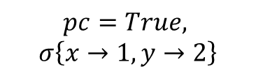

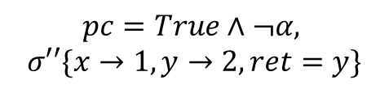
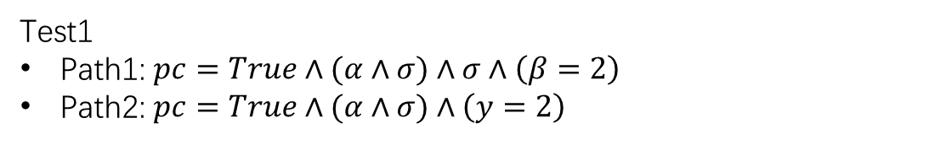
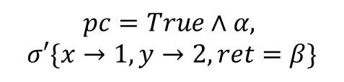
Example: max(x, y)
…Via Symbolic Execution
$$pc=True,$$
$$σ\left\{x→1, y→2\right\}$$
Just record visible variables’ value (at installed symbols)
Test1
Path1: $pc=True∧(α∧σ)∧σ∧\left(β=2\right)$
Path2: $pc=True∧(α∧σ)∧\left(y=2\right)$
if ($α$)
ret = $β$;
else
ret = y;
return ret;
$$pc=True∧α,$$
$$σ′\{x→1, y→2, ret=β\}$$
$$pc=True∧¬α,$$
$$σ′′\{x→1, y→2, ret=y\}$$
Result should match
Standard $pc$ in symbolic execution
test id | x | y | Buggy ret | Correct ret
1 | 1 | 2 | 2 | 2
2 | 2 | 1 | 1 | 2

Slide 24
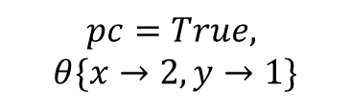

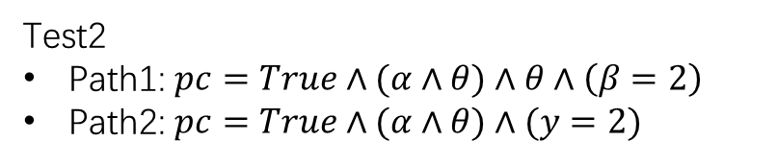
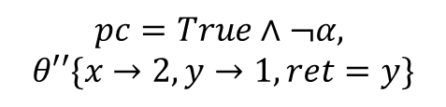
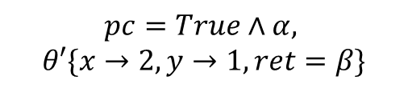
Example: max(x, y)
…Via Symbolic Execution
$$pc=True,$$
$$θ\{x→2, y→1\}$$
Test1
Path1: $pc=True∧(α∧σ)∧σ∧\left(β=2\right)$
Path2: $pc=True∧(α∧σ)∧\left(y=2\right)$
if ($α$)
ret = $β$;
else
ret = y;
return ret;
$$pc=True∧α,$$
$$θ′\{x→2, y→1, ret=β\}$$
Test2
Path1: $pc=True∧(α∧θ)∧θ∧\left(β=2\right)$
Path2: $pc=True∧(α∧θ)∧(y=2)$
$$pc=True∧¬α,$$
$$θ′′\{x→2, y→1, ret=y\}$$
test id | x | y | Buggy ret | Correct ret
1 | 1 | 2 | 2 | 2
2 | 2 | 1 | 1 | 2

Slide 25

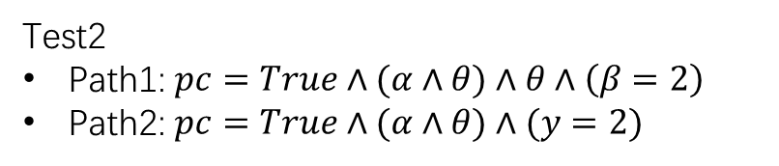
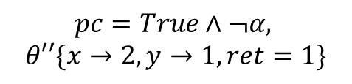
Example: max(x, y)
Must be concrete value!
Extract Constraints: Are there Satisfiable paths?
$$pc=True,$$
$$θ\{x→2, y→1\}$$
Great! We find angelic value!
Test1
Path1: $pc=True∧(α∧σ)∧σ∧\left(β=2\right)$
Path2: $pc=True∧(α∧σ)∧\left(y=2\right)$
if ($α$)
ret = $β$;
else
ret = y;
return ret;
$$pc=True∧α,$$
$$θ′\{x→2, y→1, ret=β\}$$
Test2
Path1: $pc=True∧(α∧θ)∧θ∧\left(β=2\right)$
Path2: $pc=True∧(α∧θ)∧(y=2)$
Let $α=True$ and $β=2$
$$pc=True∧¬α,$$
$$θ′′\{x→2, y→1, ret=1\}$$
UNSAT
test id | x | y | Buggy ret | Correct ret
1 | 1 | 2 | 2 | 2
2 | 2 | 1 | 1 | 2
If both UNSAT, means no possible change for selected suspicious expression can make this test pass. Next attempt.

Slide 26
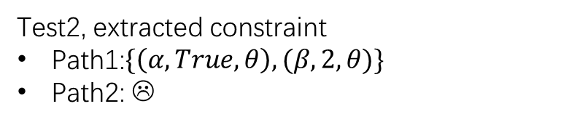
Example: max(x, y)
Extract Constraints: Are there Satisfiable paths?
$$pc=True,$$
$$θ\{x→2, y→1\}$$
Test1
Path1: $pc=True∧(α∧σ)∧σ∧\left(β=2\right)$
Path2: $pc=True∧(α∧σ)∧\left(y=2\right)$
if ($α$)
ret = $β$;
else
ret = y;
return ret;
$$pc=True∧α,$$
$$θ′\{x→2, y→1, ret=β\}$$
Test2, extracted constraint
Path1:$\{\left(α,True,θ\right),(β,2,θ)\}$
Path2: ☹
$$pc=True∧¬α,$$
$$θ′′\{x→2, y→1, ret=1\}$$
test id | x | y | Buggy ret | Correct ret
1 | 1 | 2 | 2 | 2
2 | 2 | 1 | 1 | 2

Slide 27
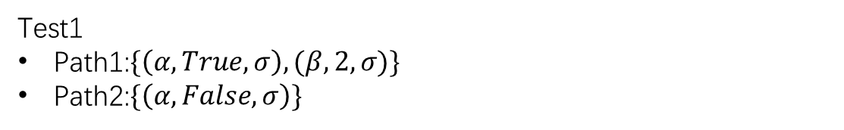
Example: max(x, y)
Forests!
Extract Constraints: Are there Satisfiable paths
—— for all tests?
Angelic Path
Test1
Path1:$\{\left(α,True,σ\right),(β,2,σ)\}$
Path2:$\{\left(α,False,σ\right)\}$
if ($α$)
ret = $β$;
else
ret = y;
return ret;
Angelic forest
Test2, extracted constraint
Path1:$\{\left(α,True,θ\right),(β,2,θ)\}$
Path2: ☹
Extracted constraint for a single test!
test id | x | y | Buggy ret | Correct ret
1 | 1 | 2 | 2 | 2
2 | 2 | 1 | 1 | 2

Slide 28
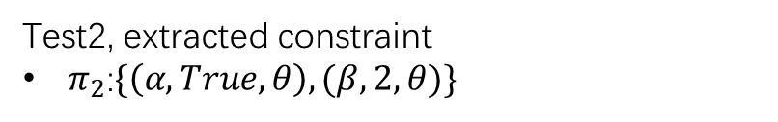

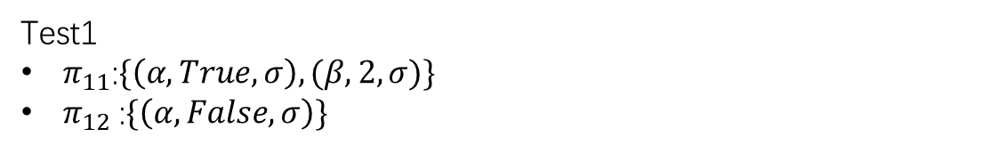
Example: max(x, y)
Forests!
Synthesis expressions on “angelic forests”!
Test1
$π_{11}$:$\{\left(α,True,σ\right),(β,2,σ)\}$
$π_{12}$:$\{\left(α,False,σ\right)\}$
if ($α$)
ret = $β$;
else
ret = y;
return ret;
Test2, extracted constraint
$π_{2}$:$\{\left(α,True,θ\right),(β,2,θ)\}$
Ensure every test will pass.
Find $e_{α},e_{β}$ by SMT solver such that
Hard constraints!
$$\left(\left(⟦e_{α}⟧σ=True∧⟦e_{β}⟧σ=2\right)∨\left(⟦e_{α}⟧σ=False\right)\right)∧\left(⟦e_{α}⟧θ=True∧⟦e_{β}⟧θ=2\right)$$
And with less syntactic change
Soft constraints!

Slide 29
Example: max(x, y)
Forests!
We made successful repair.
Test1
$π_{11}$:$\{\left(α,True,σ\right),(β,2,σ)\}$
$π_{12}$:$\{\left(α,False,σ\right)\}$
if (x > y)
ret = x + 1;
else
ret = y;
return ret;
Test2, extracted constraint
$π_{2}$:$\{\left(α,True,θ\right),(β,2,θ)\}$
Find $e_{α},e_{β}$ by SMT solver such that
Hard constraints!
$$\left(\left(⟦e_{α}⟧σ=True∧⟦e_{β}⟧σ=2\right)∨\left(⟦e_{α}⟧σ=False\right)\right)∧\left(⟦e_{α}⟧θ=True∧⟦e_{β}⟧θ=2\right)$$
And with less syntactic change
Soft constraints!

Slide 30
Whole algorithm
Test suits
Let’s see what did we do…
Iteration
Controlled
Symbolic
Execution
Buggy
program
Symbolize
Symbolized program
Path
conditions
$$pc=True∧(α∧θ)∧θ∧\left(β=2\right)$$
Failed, reattempt
Extract constraints successfully
Patch
Angelix
forests
forest: $\{\left(α,True,θ\right),(β,2,θ)\}$
Synthesis
successfully

Slide 31
Whole algorithm
Test suits
We do something more in practice
Transform, to expose more candidate fault location
Iteration
Controlled
Symbolic
Execution
Buggy
program
Symbolize
Symbolized program
Path
conditions
Failed, reattempt
Extract constraints successfully
- x++
+ if (1) x++
Patch
Angelix
forests
Synthesis
successfully
while (...) {
//...
+ if (0) break;
}

Slide 32
Whole algorithm
Test suits
We do something more in practice
Transform
Iteration
Controlled
Symbolic
Execution
Buggy
program
Symbolize
Symbolized program
Path
conditions
Failed, reattempt
Dynamic
analysis
Extract constraints successfully
Fault
localization
Patch
Angelix
forests
Guide
Synthesis
successfully

Slide 33
Whole algorithm
validate
Validation tests
Selected tests
We do something more in practice
Transform
Iteration
Controlled
Symbolic
Execution
Buggy
program
Symbolize
Symbolized program
Path
conditions
Failed, reattempt
Dynamic
analysis
Extract constraints successfully
Fault
localization
Patch
Angelix
forests
Guide
Synthesis
successfully

Slide 34
Whole algorithm
validate
Validation tests
Selected tests
Transform
Iteration
Controlled
Symbolic
Execution
Buggy
program
Symbolize
Symbolized program
Path
conditions
High scalability
High repairability
High quality of patches
Failed, reattempt
Dynamic
analysis
Extract constraints successfully
Fault
localization
Patch
Angelix
forests
Guide
Synthesis
successfully

Slide 35
Whole algorithm
validate
Validation tests
Incremental
Selected tests
Transform
Iteration
Controlled
Symbolic
Execution
Buggy
program
Symbolize
Symbolized program
Path
conditions
High scalability
High repairability
High quality of patches
Failed, reattempt
Dynamic
analysis
Extract constraints successfully
Fault
localization
Patch
Angelix
forests
Guide
Synthesis
successfully
Examine a controlled piece of control flow graph at a time
Well-designed concise constraint

Slide 36
Whole algorithm
Expose more potential faults
validate
Validation tests
Selected tests
Multiple symbols
Transform
Iteration
Controlled
Symbolic
Execution
Buggy
program
Symbolize
Symbolized program
Path
conditions
High scalability
High repairability
High quality of patches
Failed, reattempt
Dynamic
analysis
Extract constraints successfully
Fault
localization
Patch
Angelix
forests
Guide
Synthesis
successfully
Synthesis
make less change
Well-designed informative constraint

Slide 37
Experiment
Persuasive! Better than old methods.
Shows its repairability, scalability, and better repair quality.
Sadly, we’re not going to cover this…

Slide 38

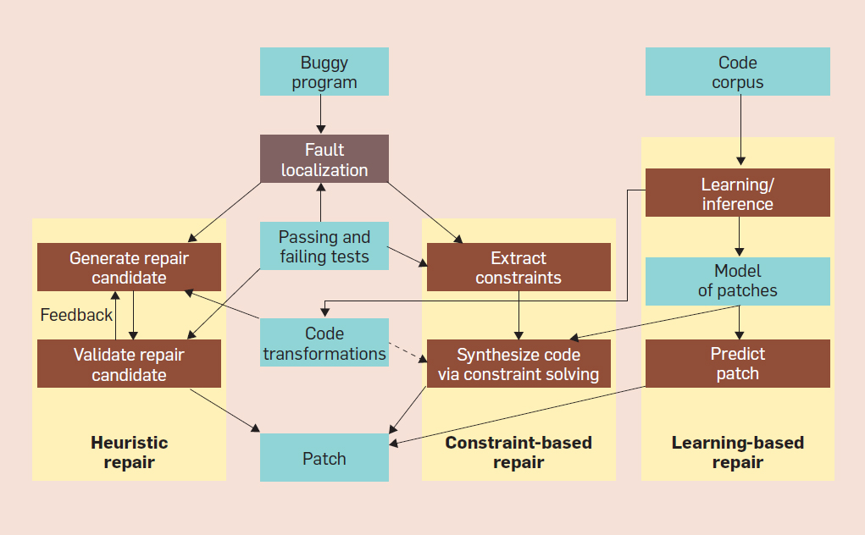
Current progress and prospect
formal
Statistics & heuristic
Hot research field!
Communications of the ACM, December 2019, Vol. 62 No. 12, Pages 56-65

Slide 39
Current progress and prospect
formal
Statistics & heuristic
Fix bug throughout development
Serve as
teaching assistant
& Suggest hints
…
Communications of the ACM, December 2019, Vol. 62 No. 12, Pages 56-65
Notes:
Program is inherently formal. Syntactically and semantically.
But we code writers has something in common.

Slide 40
Current progress and prospect
Programming language
formal
Statistics & heuristic
Human
and
Programmers
Understanding programs written by and for human.
Communications of the ACM, December 2019, Vol. 62 No. 12, Pages 56-65
Notes:
Program is inherently formal. Syntactically and semantically.
But we code writers has something in common.

Slide 41
Current progress and prospect
positive
tests
negative tests
Test suits
positive
tests
buggy program
repair engine
patched program(s) that
pass all tests

Slide 42
Current progress and prospect
Author’s team
positive
tests
negative tests
Test suits
positive
tests
buggy program
repair engine
patched program(s) that
pass all tests
targeting
overfitting problem

Slide 43

Current progress and prospect ☺
No Debugging!
Even No Coding!
positive
tests
negative tests
Natural Language
Or
Formal Specification
buggy program
Auto coder
A VERY correct Program

Slide 44
Angelix and its Contribution
High scalability, repairability
Constraint-based automated repair method
that generates
High quality of repairs.

Slide 45
Appendix
--- a/distance.c
+++ b/distance.c
@@ -16,8 +16,8 @@
else {
dy = y2 - y1;
}
- if (dx < dy) // dx > dy
- ret = dx + 1; // ret = dx
+ if ((dy < dx)) // dx > dy
+ ret = dx; // ret = dx
else
ret = dy;
return ret;

Slide 46
Appendix
// n>100?true:false
int n = input()
int x = 99; // 99->100
if (x>n) // or, x+1>n
return true;
else
return false;
// test1: 50, false
// test2: 100, false
// test3: 101, true
...
int angelic value is stronger than boolean angelic value

Slide 47
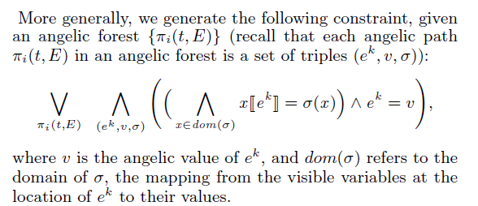
Appendix

Slide 48
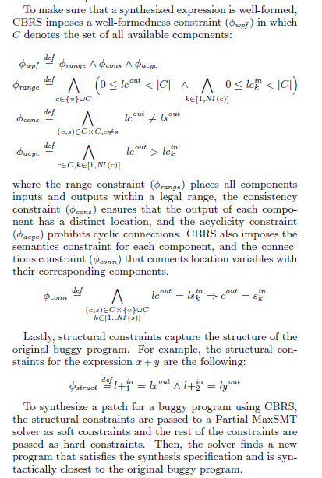
Appendix

