Slide 1
Where Does Depth Go? — Part B
Our experiment: the instrument, the war stories, and the road ahead
Lab seminar · Part B: design, hard lessons, status
Kaho · July 2026
Notes:
Open by collecting answers to Part A's take-home question: 'how would YOU test whether a model represents something it cannot say?' Several will have reinvented probing or oracle injection.

Slide 2
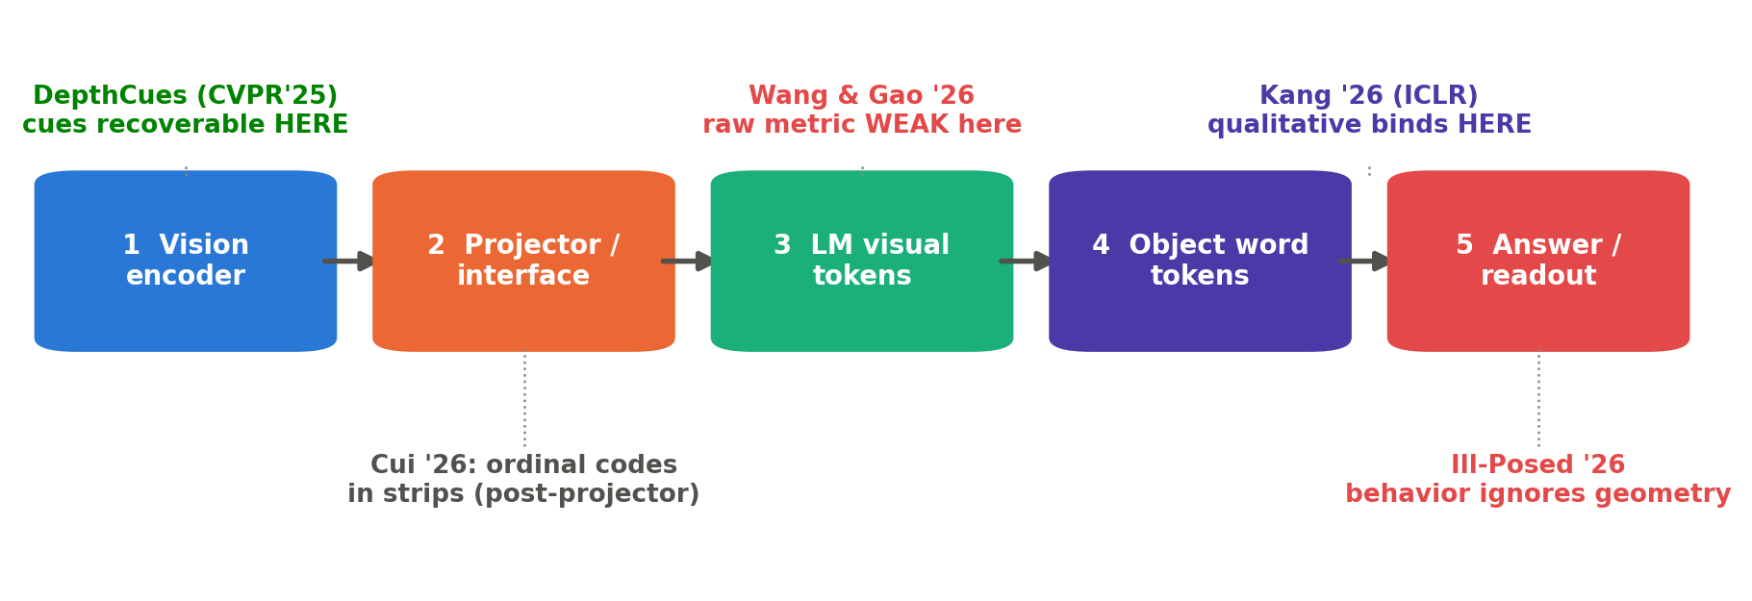
RECAP
Sixty seconds of Part A
Qualitative ≫ quantitative across several recent benchmarks (task formats unmatched — one reason we build a matched battery); accuracy can't identify the mechanism behind either score.
Cue information is recoverable at the encoder (DepthCues) · behavior barely tracks geometry (Ill-Posed) · raw metric weak at LM layers under W&G's protocol · and two 2026 papers motivate COMPETING localization hypotheses — a projector discontinuity (Deccan, categorical occlusion) vs an output-side failure (Anchored, slant, LM-input only). The pattern for controlled DEPTH is unmeasured.
Our aim: a stage-wise, selection-leak-controlled trace (with nuisance baselines on both sides) of object-specific depth across FIVE PRESPECIFIED functional stages — CONTINUOUS depth (z; Δz/ratio) as the probe target, ORDINAL ordering as the behavioral anchor — testing which localization pattern holds at object-word binding sites.
Part A, slides 8–53. Sources: 2411.17385 · 2606.24335 · 2605.07148 · 2601.12626 · 2603.22278 · 2605.20448 · 2606.06714.
B·2
Notes:
Fast. This is a memory refresher, not a re-teach.

Slide 3
ACT 5 · OUR EXPERIMENT
An instrument whose failure modes are explicitly tested
Two design decisions from Act 2, turned into a battery, a probing grid, and a causal endpoint. The instrument is fixed; the conclusion is not — and Act 6 shows why we assume instruments CAN fool us.
B·3

Slide 4
ACT 5 · OUR EXPERIMENT
The design at a glance
DECISION 1 — control the inputs:
a Blender-rendered battery with exact geometry, where depth and its correlated 2D cues vary independently. Rendering enforces exact factorial control and ground-truth geometry at a scale natural data rarely provides.
DECISION 2 — look inside, at five stages:
linear probes over (stage × layer × quantity × axis), then patching + a graded intervention along an independently validated depth-related direction — at the PREREGISTERED primary site (stage 2 vs stage 4 contrast); probe-indicated sites are EXPLORATORY and get confirmed on held-out data (no intervene-where-the-curve-looks-weakest circularity).
And a discipline layer wrapped around both:
every probe ships its nulls; every null ships a positive control; every dataset enters only after item-level inspection; every claimed number carries provenance (config + seed + git hash).
S1 design: research_proposal_spatial_binding.md §2 (project docs); discipline rules: AGENTS.md verification rules 3/7/11/12/13.
B·4
Notes:
Frame: Act 5 = what we designed. Act 6 = why it has this much armor (the armor was bought with real blood).

Slide 5
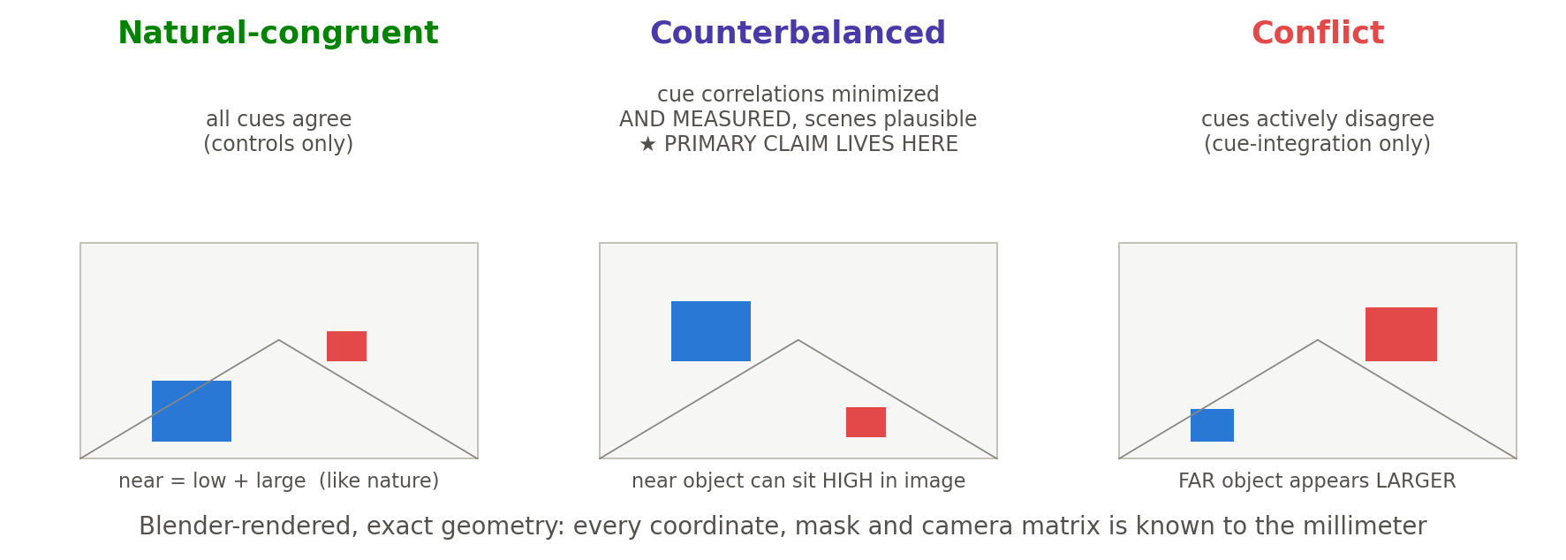
ACT 5 · OUR EXPERIMENT
The stimulus battery: three regimes
The primary localization claim lives in the COUNTERBALANCED regime — plausible scenes with prespecified cue correlations MINIMIZED AND MEASURED (the decorrelation matrix is an acceptance test, not an assumption). That structurally preempts the 'your images are just weird' attack: the headline never rests on bizarre pictures. Conflict images serve cue-integration analyses only.
S1 stimuli §2.2; regime philosophy shared with Why Far Looks Up 2605.30161 (corridor stimuli) and O3-D 2607.01503 (cue-controlled).
B·5
Notes:
Show real rendered pilot images here when M4a lands — swap the sketches for actual renders.

Slide 6
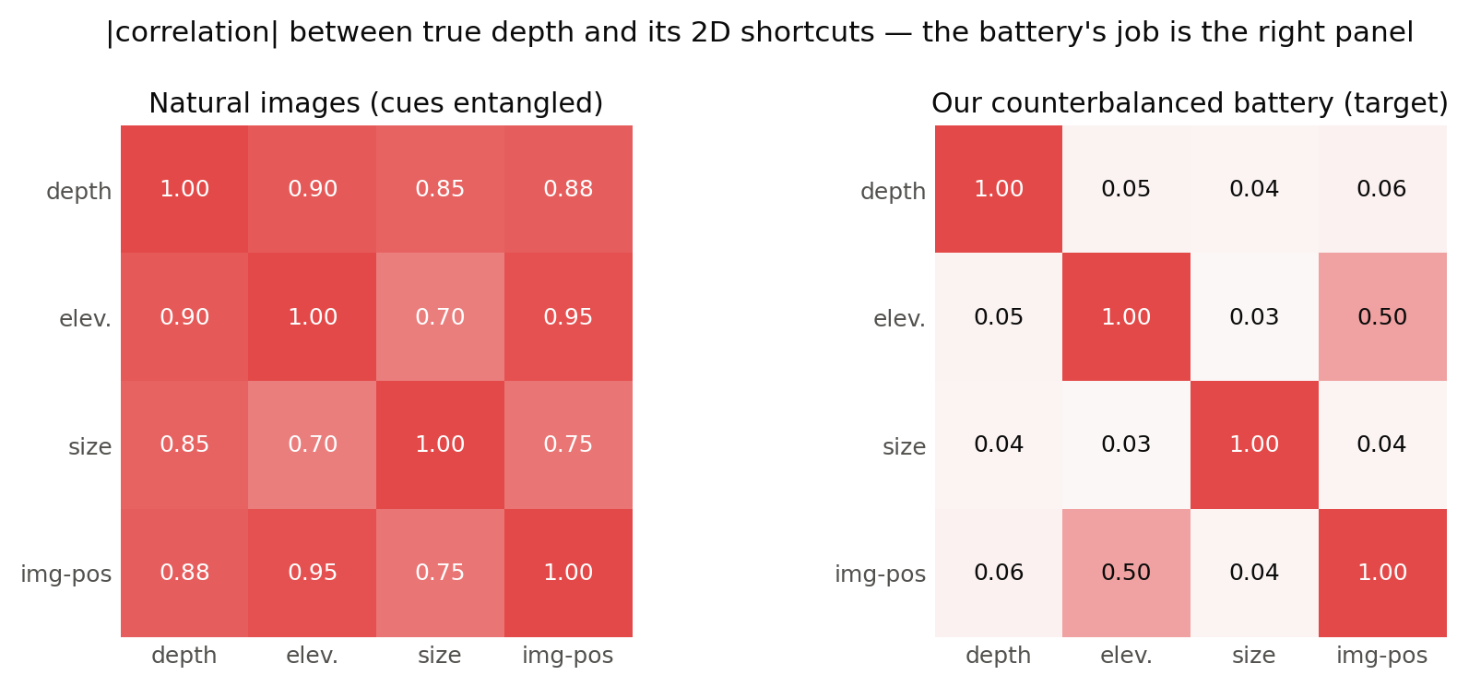
ACT 5 · OUR EXPERIMENT
What the battery must break
Five required decorrelations (each a measured defect of our own v0 — Act 6): continuous lateral positions · camera-pose jitter (disrupts the position leak at the source; the dumb-feature ceiling verifies the residual against the preregistered bound) · independent per-object size jitter (breaks the size↔depth shortcut: v0 depth was 86% predictable from apparent size alone, r=0.93) · textures/distractors/lighting · recalibrated worst-case thresholds.
M4a spec (IMPLEMENTATION_PLAN §4); v0 defect measurements: reports/m3_reproduction.md §2.4 (ours). Right panel = design target, verified by measurement before use.
B·6
Notes:
The right matrix is the ACCEPTANCE TEST, not an assumption — M4a measures it (the decorrelation matrix is an explicit deliverable).

Slide 7
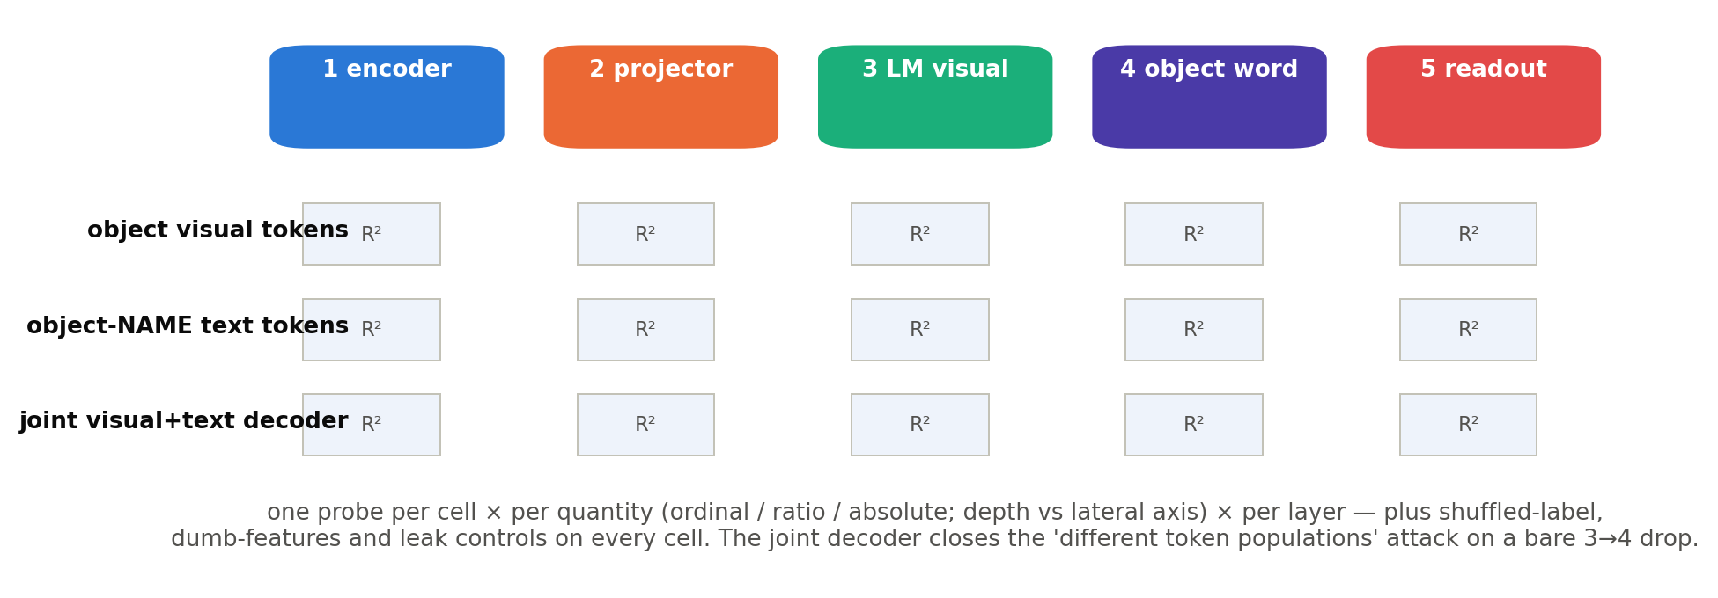
ACT 5 · OUR EXPERIMENT
The probing grid: 5 stages × 3 targets
S1 §2.3. H2a's ordinal-vs-continuous comparison uses MATCHED targets derived from the same depth labels and scenes — equalized probe capacity, sample counts, nuisance controls, ceiling-normalized evaluation. Strip/all-token probing from Cui et al. 2603.22278 v2 (in their setup, object-pooled-only probing underestimated the distributed signal).
B·7
Notes:
Why the object-NAME row matters: it is where Kang localized causal influence on qualitative spatial beliefs. H1 predicts continuous depth becomes much less recoverable exactly there.

Slide 8
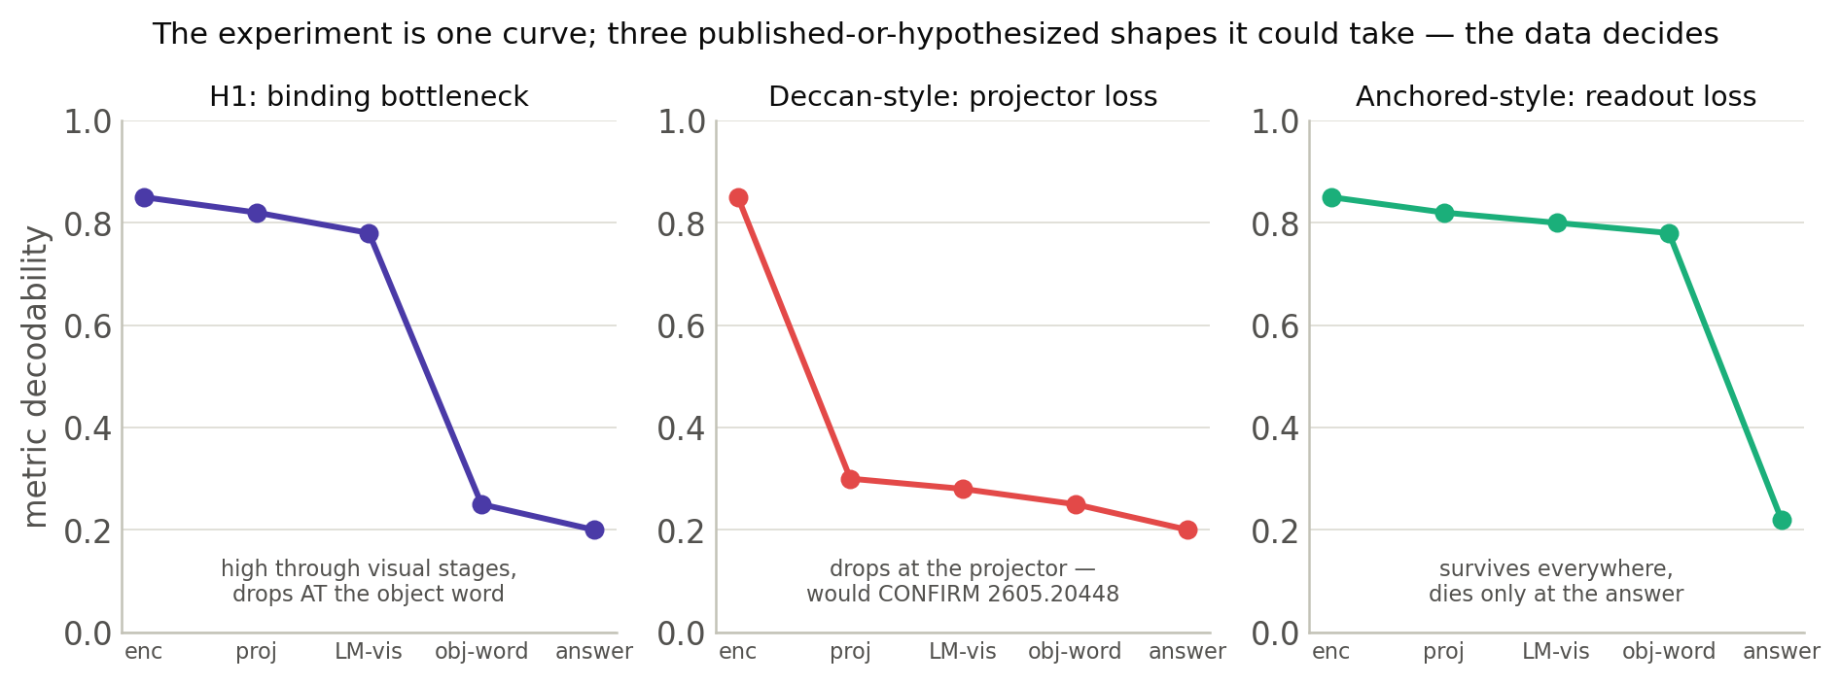
ACT 5 · OUR EXPERIMENT
The central result: a stage-wise profile
Metric decodability across five stages — under MATCHED evaluation (matched-capacity readouts, per-cell CIs, stage-specific dumb baselines; stages are different token populations, so a raw R² line would compare non-equivalent readouts). Left = H1's PROBE-LEVEL signature (a binding claim additionally requires the causal decision rule). Middle = the projector pattern (Deccan). Right = the readout pattern (Anchored). These are three preregistered REFERENCE signatures — mixed, gradual, or nonmonotonic profiles (and different answers for z, Δz, ratio) remain possible; the profile distinguishes among candidates, it does not force one.
H1/H2: ours (S1). Middle shape: 2605.20448; right shape: 2606.06714.
B·8
Notes:
Repeat the mantra: the instrument is fixed, the conclusion is not — every shape is a finding, but only because the gates make the curve trustworthy.

Slide 9
ACT 5 · OUR EXPERIMENT
Probes vs answers, under explicit calibration controls
The obvious attack: 'your probe got training data; the zero-shot model didn't.' Three defenses, built in from day one:
1 — Rank correlations as the COMMON metric: Spearman of probe predictions vs verbalized answers on identical images removes scale calibration — it does not remove the supervision asymmetry; defenses 2–3 characterize (not eliminate) it.
2 — Few-shot-calibrated verbal baseline: demonstrations spanning the probe's label range — acknowledging that in-context calibration is NOT equivalent to supervised probe fitting. If probes still outperform, a probe–verbalization gap remains after these controls (its cause is not yet localized).
3 — Oracle-text condition: feed ground-truth coordinates as TEXT. Correct answers show the LM can solve the downstream reasoning problem on explicit symbolic input — a DOWNSTREAM COMPETENCE CONTROL: it rules out 'the LM cannot compute the relation' — nothing finer (text coordinates may recruit symbolic arithmetic with no multimodal binding at all).
Answer protocol: ORDER-ROBUST ACCURACY — correct under BOTH option orders, with the null defined by PERMUTATION / a paired-response model (responses across orders are not independent — a position-biased model breaks the naive 25%); per-order accuracies + order-effect CI reported; free-response AND ordinal ranking, never MCQ alone.
S1 §2.3(2); two-ordering protocol from Cui et al. 2603.22278 v2; oracle ladder precedent: DISJOINT-3DQA arXiv:2505.24257.
B·9
Notes:
The convergent fact behind defense 3 (from three papers): VLMs can CONSUME resolved coordinates (+18–20 pts) but can't integrate partial cues (+0.5–4). Nobody knows why — mechanistic texture for the discussion.

Slide 10
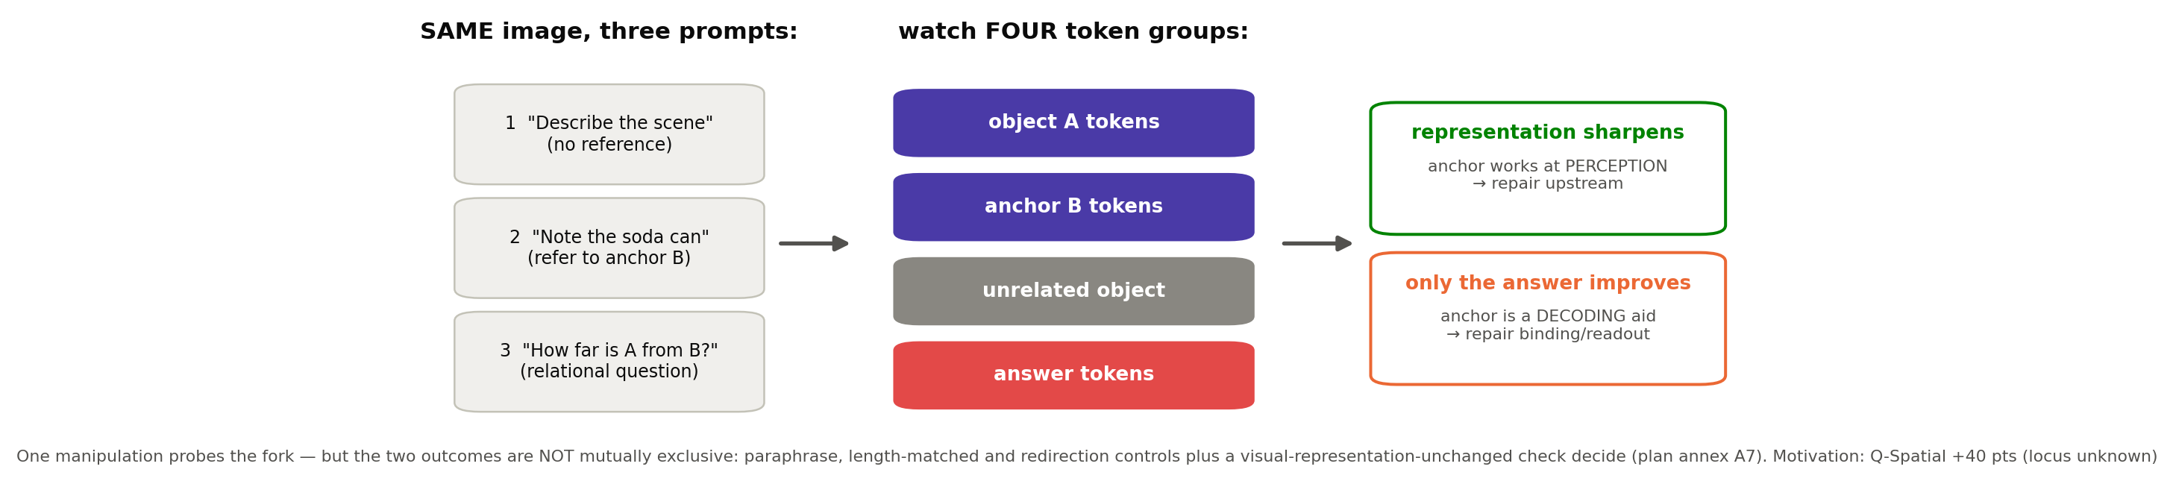
ACT 5 · OUR EXPERIMENT
The anchor experiment — a fork in one manipulation
S1 §2.3(3), promoted to core — the central prompt-conditioned TRANSFER test (binding is licensed only by the full decision rule). Motivation: Q-Spatial Bench arXiv:2409.09788 (+40 pts from a reference-object prompt, locus unknown).
B·10
Notes:
Present honestly: the two outcomes are NOT mutually exclusive (a reference prompt can shift attention, priors, AND strategy at once). The control battery — paraphrases, length-matching, redirection, visual-representation-unchanged — turns it from a perturbation into a fork (plan annex A7).

Slide 11
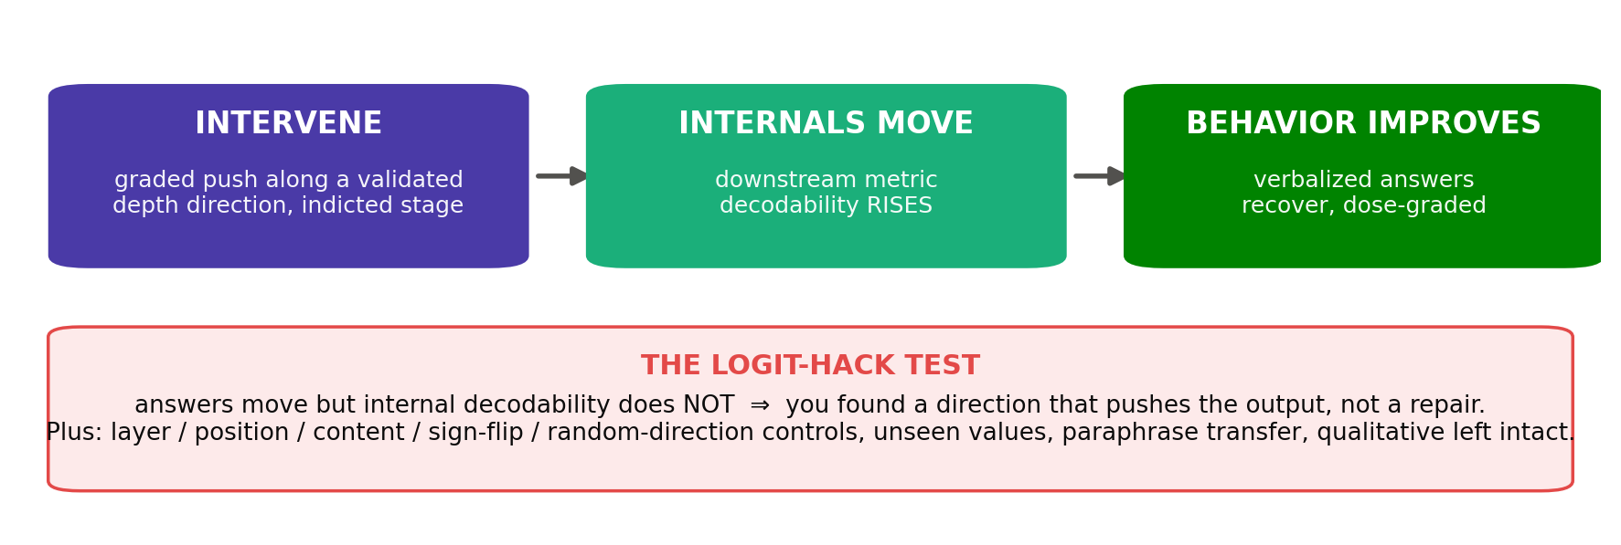
ACT 5 · OUR EXPERIMENT
The causal endpoint: testing repair vs generic steering
S1 §2.5 + M6 spec. 'Depth-direction intervention' = graded push along a VALIDATED depth-related direction/subspace — the exact construction (probe direction / matched-condition difference / low-rank subspace / interchange) is defined before use; they carry different causal interpretations. Vocabulary (usage/necessity/sufficiency): 2607.03358; extends Kang 2601.12626's discrete oracle-ID injection.
B·11
Notes:
The mediation chain provides evidence FAVORING representationally specific repair over direct logit manipulation — with direction/object specificity, held-out generalization, and unrelated-behavior preservation on top. Foil to beat: generic ITI-style steering gives only ~1–2pp (Attention in Space).

Slide 12
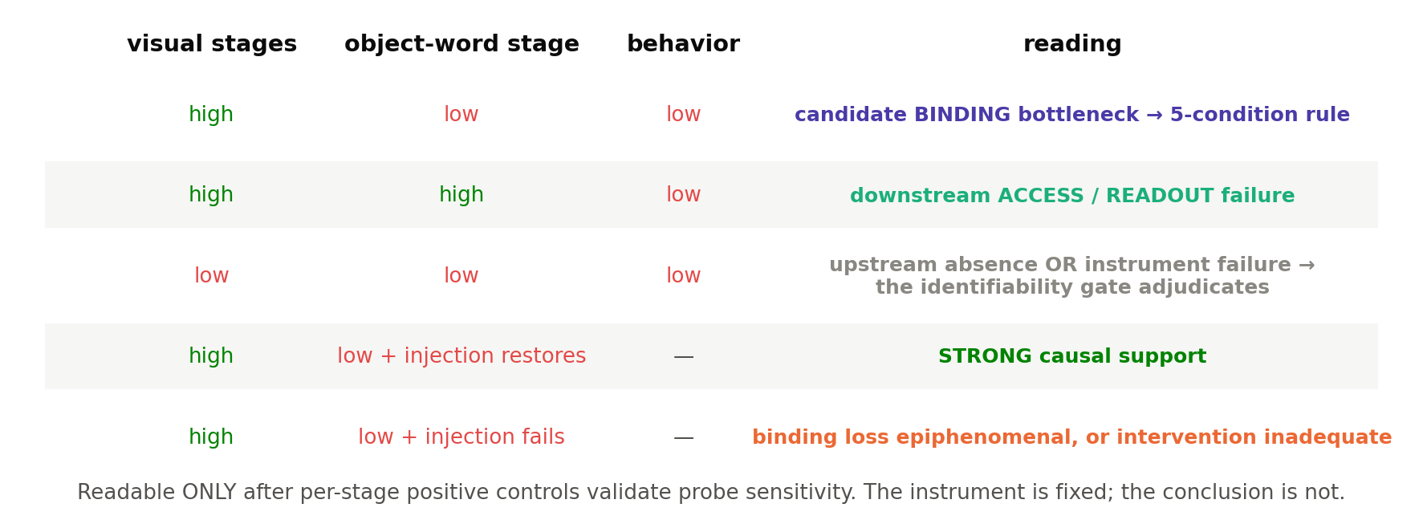
ACT 5 · OUR EXPERIMENT
Reading the result: the outcome matrix
S1 §2.3 outcome matrix (replaces the unfalsifiable 'every outcome is a finding'). Binding claimed only under the 5-condition decision rule (appendix).
B·12
Notes:
If asked for the 5 conditions: visual recoverable + text-token substantially less (matched eval) + qualitative DOES transfer there + causal intervention changes metric answers + object-specific. All five, or no binding claim.

Slide 13
ACT 5 · OUR EXPERIMENT
Two gates before any of it counts
GATE 1 — image-identifiability (M4a, needs NO model):
a supervised pixel model must recover each target FROM THE IMAGES — generalizing across HELD-OUT nuisance factors (objects, poses, textures, cameras, renderer seeds, lighting families, render settings), never only random splits, gated per level (ordinal / continuous ranking / calibrated magnitude; the human spot-check licenses ordinal only). Renderer GT ≠ pixel-inferable GT: if the target is not image-identifiable under the stated assumptions, a low internal result is uninterpretable as model failure — and a high one may reflect priors rather than image evidence.
GATE 2 — instrument validity, five conditions (M4b — reformulated at Design Rev 3):
THREE positive controls decode per stage — semantic; an INJECTED implementation control (known scalar into an independent activation dimension — validates extraction+probing, not detection); and an independently established NATURAL geometric control — neither continuous control is constructed from the probe being validated (a shape control cannot license a continuous-depth null) · label-permutation scores follow the preregistered null distribution; nuisance baselines stay below the acceptance bound · the leak ceiling collapses vs v0 AGAINST PRE-REGISTERED NUMERIC BOUNDS (a relative drop alone is insufficient — 0.94→0.40 would still leak) · generalization across held-out objects/poses/depth ranges · demonstrated dynamic range. ⚠ NOT 'metric must be hard': high metric decodability after all validity checks is a FINDING, not a gate failure — diagnostic checklist, then proceed with the finding.
Split on purpose: gate 1 first makes a later VALIDITY failure more clearly attributable to the measurement pipeline than to missing image evidence. W&G's gradient (semantics ≫ metric) is a benchmark comparison to report — not a go/no-go.
M4a/M4b split: plan §4 (2026-07-15); gate reformulated to validity-only at Design Rev 3 (2026-07-16). Benchmark comparison (not go/no-go): W&G's pattern, x≈chance, z modest, semantics perfect (2605.07148).
B·13
Notes:
This slide is the answer to 'how do you know your nulls mean anything?' — the gates exist so that every downstream number is interpretable.

Slide 14
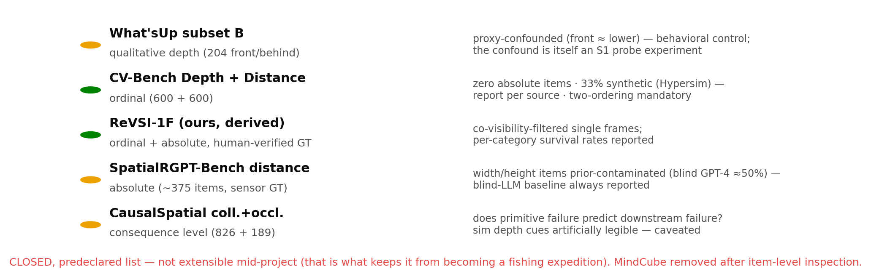
ACT 5 · OUR EXPERIMENT
External validation: a closed, inspected set
Validation layer: S1 §2.6 / plan §2.5(f), all item-level-inspected 2026-07-15. What'sUp 820 items · CV-Bench 1,200 (3D) · CausalSpatial 1,015 used · SpatialRGPT ~375 distance items.
B·14
Notes:
Every caveat on this slide was found by opening the actual files, not reading the papers — What'sUp-B's 204 depth items and MindCube's unsuitability were both invisible from descriptions.

Slide 15
ACT 5 · OUR EXPERIMENT
Models: a deliberately small core
Core = 2 architectures: Qwen2.5-VL-7B (modern, M-RoPE, native-res) + LLaVA-1.5-7B (classic CLIP, fixed-res).
Probe target: CONTINUOUS egocentric depth (z; Δz/ratio secondary) · behavioral anchor: ORDINAL depth · qualitative positive control · five stages · probes with selection-leak + nuisance controls · one intervention.
Expansion to 4–6 models (InternVL, Gemma-3, Qwen2-VL) happens ONLY after the stage-wise pattern stabilizes on two — 'is it one phenomenon or three?' is worth answering, but not before there is a phenomenon.
Architecture caveat carried everywhere: stages are FUNCTIONAL, mapped per-architecture to concrete tensors (projector vs resampler vs tiling are not homologous) — the mapping table is a published config, not code.
Model scope: S1 §2.7 (revised 2026-07-15); functional-stage mapping: plan §3.
B·15
Notes:
If asked 'why not GPT-5/Gemini': closed weights — no activations, no internals, no probes. This science requires open weights.

Slide 16
ACT 6 · WAR STORIES
How measurements lie — live from this project
Everything in Act 5 that looked paranoid was bought with a real failure. Four stories, each with the rule it taught us. This act is the most useful thing in the talk if you ever probe a model.
B·16

Slide 17
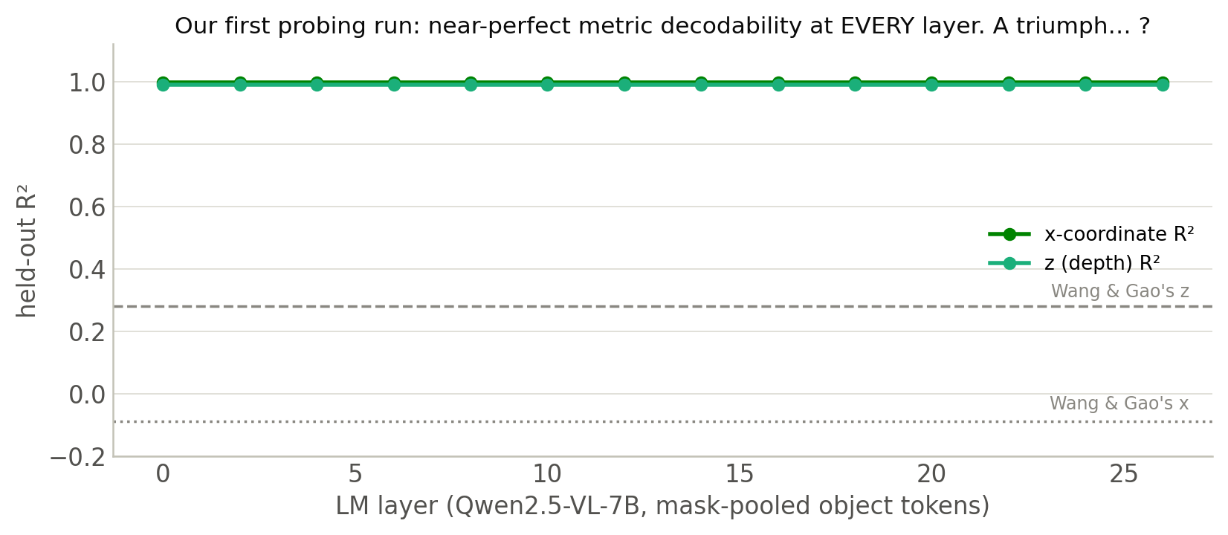
ACT 6 · WAR STORIES
Scene: our first probing run (July 14)
Wang & Gao's REFERENCE PATTERN (our stimuli and extraction differ — pattern comparison, not faithful reproduction): x ≈ chance, z modest (+0.28). We got x = 0.997, z = 0.990 — at EVERY layer, shuffled controls exactly at chance, token registration verified. Question for the room: is this good news?
Ours: reports/m3_reproduction.md (M3.2, Qwen2.5-VL-7B + InternVL3-8B on v0 stimuli). W&G targets: 2605.07148 App. B.
B·17
Notes:
Let them argue. Someone will say 'your model is better' — perfect setup. The controls all PASSED. Everything looked rigorous.

Slide 18
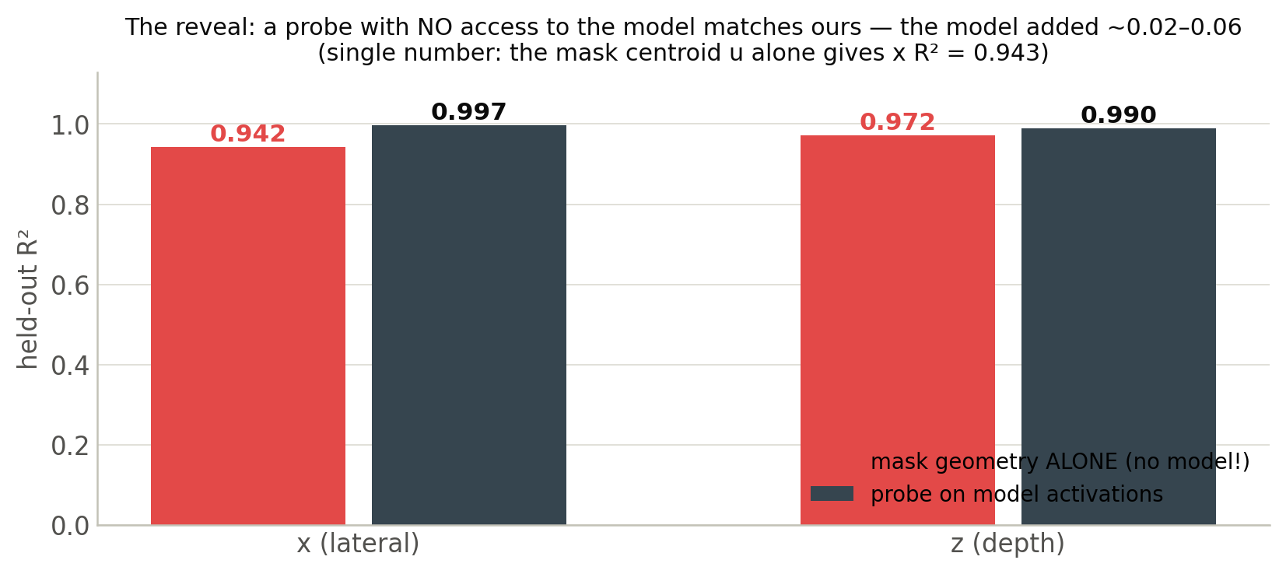
ACT 6 · WAR STORIES
The reveal: most of the score didn't need the model
A probe given ONLY mask geometry — centroid, area, bbox, retinal size, elevation; no activations, no model — scores R² 0.942–0.972. Most of the 0.997 score reflected the selection and stimulus geometry, not learned activation content (raw incremental ≈0.02–0.06, BEFORE matched-capacity and nested-CV analysis).
Ours: reports/m3_reproduction.md §2.4; leak_ceiling.py. Sanity check of the method: it correctly returns CHANCE for colour, which a mask cannot encode.
B·18
Notes:
The number that stings: the model's activations added ~0.02–0.06 over the mask. Everything else was the instrument.

Slide 19
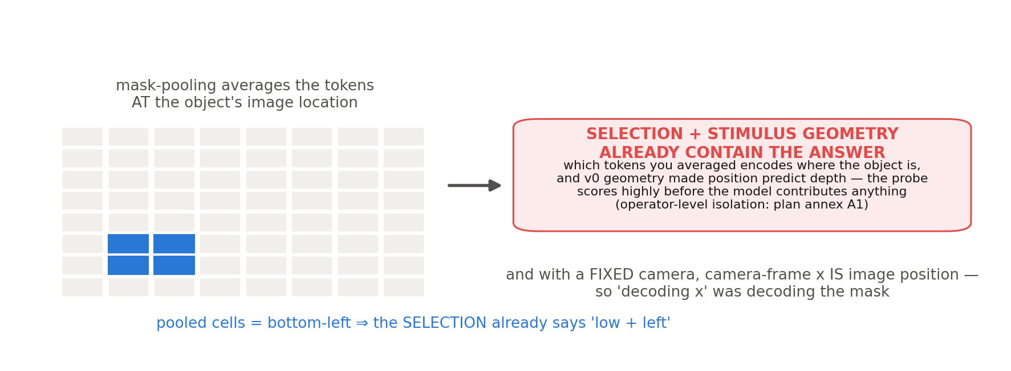
ACT 6 · WAR STORIES
Why: selection + stimulus geometry already contain the answer
The position/selection leak: ours (M3 retro-audit). Generic lineage: control tasks, Hewitt & Liang 2019 arXiv:1909.03368; Belinkov 2022 arXiv:2102.12452.
B·19
Notes:
Deeper point: mask-pooled VISUAL probes inherit the SELECTION leak; TEXT-token probes don't — but text probes have their OWN nuisance predictors (token identity, position, mention order, template role) — 'leak' stays reserved for the selection mechanism; both sides carry baselines; never imply visual=contaminated / text=clean. The visual-high/text-low contrast could be MANUFACTURED by measurement on either side — which is why the leak threatened the core experiment, not a footnote.

Slide 20
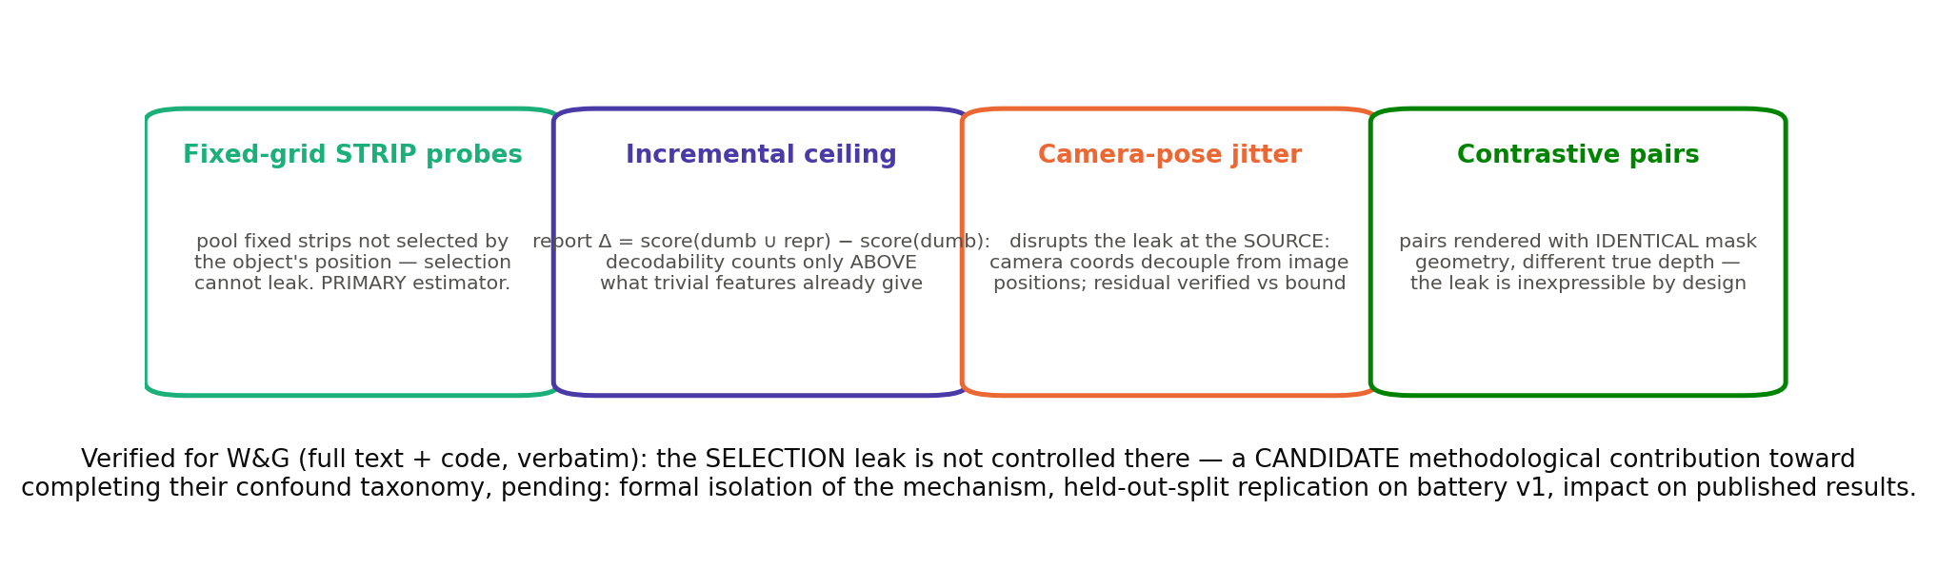
ACT 6 · WAR STORIES
The fix — a candidate contribution
Ours — CANDIDATE status; promotion checklist (all six): 1 baseline reproduces on the ORIGINAL study's split · 2 held-out object/position splits · 3 incremental activation gain quantified · 4 selection mechanism formally isolated · 5 affected published conclusions reassessed · 6 prior work lacks an equivalent control (done for W&G: appendices F–I.4 verbatim + code). Why Far Looks Up's text-delta probe escapes THIS mask-selection leak (deltas cancel it); other nuisance sources remain possible. Lineage: 2605.30161, 2606.13870, Hewitt & Liang 2019.
B·20
Notes:
Career lesson for juniors: the embarrassing bug, chased to the bottom and checked against the field, may become a methods contribution — pending the promotion checklist. Note also: mask geometry is an EXTERNAL/trivial-feature baseline, not 'non-representational' — the mask does represent location; the issue is the signal's provenance (selection, not learned activations).

Slide 21
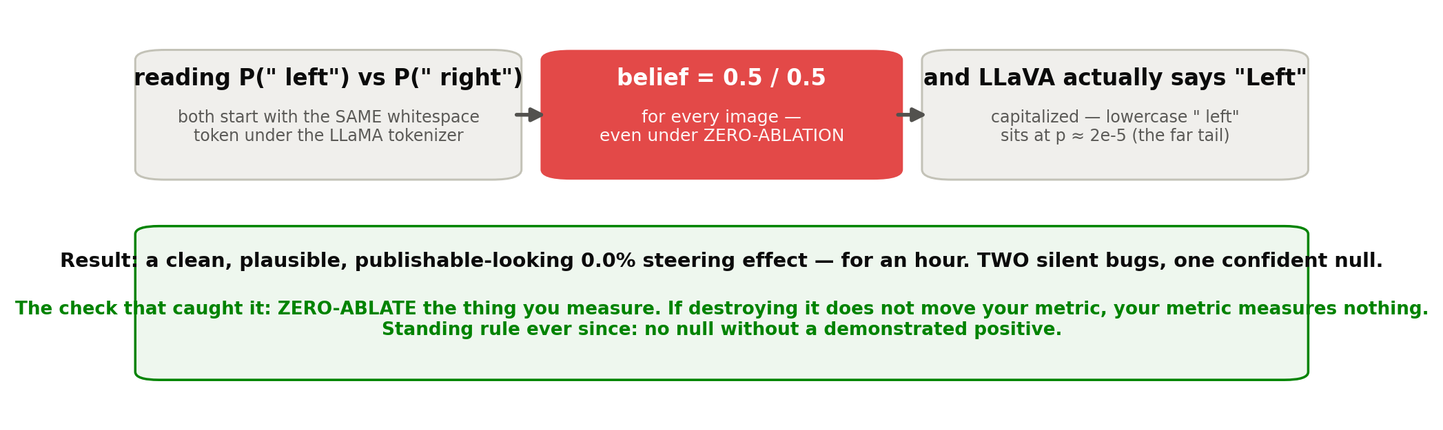
ACT 6 · WAR STORIES
Story 2: the null that measured nothing
Ours: M3 (steering readout bug, LLaVA-1.5 / LLaMA tokenizer). Now AGENTS.md rule 11: no null without a registered positive.
B·21
Notes:
Emphasize the emotional shape: a 0% effect with a plausible story attached FEELS like honest science. Phase 2 is made of nulls — this is the project's most dangerous residual failure mode.

Slide 22
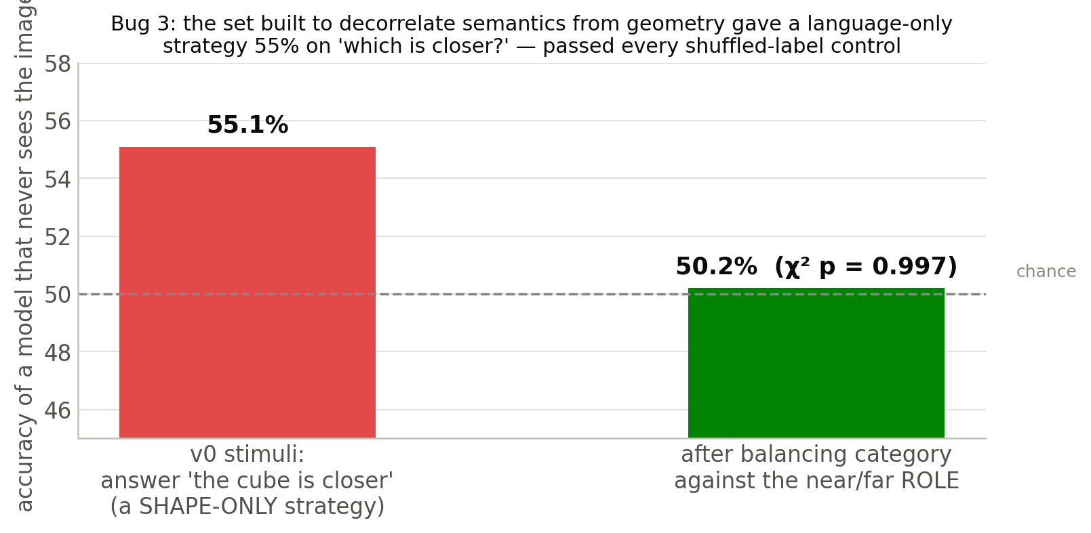
ACT 6 · WAR STORIES
Story 3: the benchmark that answered itself
v0 sampled sphere-near 148/far 182, cube-near 168/far 147 — so 'the cube is closer' won 59.6% of mixed pairs. Rule: balance every factor against the ROLE it could predict, not just its own marginal.
Ours: second retro-audit (2026-07-14). Fix: category+colour drawn as ordered (near,far) pairs, balanced; shape-only strategy 55.1% → 50.2% (χ² p=0.997).
B·22
Notes:
Same failure class as the leak: passed every shuffled-label control, exposed only by an adversarial baseline. Hence: dumb-features baseline on every probe, forever.

Slide 23
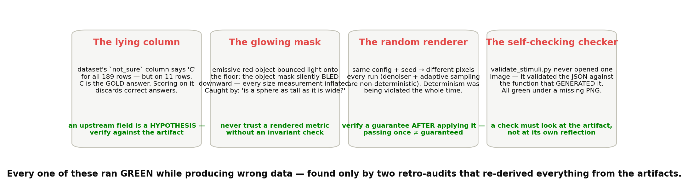
ACT 6 · WAR STORIES
Story 4, quickly: four more silent greens
Ours: retro-audits of M0–M2 (reports/m0_m2_audit.md): 6 code bugs survived closure, 2 producing wrong data; 5 documented constants false. All silent, all green.
B·23
Notes:
The meta-pattern: every bug had the same shape — pipeline runs green while producing wrong data. That's why the audits re-derive everything from artifacts.

Slide 24
ACT 6 · WAR STORIES
What the war bought: the evaluation law
1 · No probe without nuisance-feature baselines + incremental-value analysis
decodability counts only above trivial features — reporting dumb-only, representation-only, combined, and Δ = score(dumb ∪ repr) − score(dumb), under matched regularization + nested CV, with a permutation CI on Δ (Δ alone can be distorted by capacity and suppression effects).
2 · No null without a registered positive
zero-ablate what you measure: if a registered positive intervention does not move the measurement, that measurement is not validated for interpreting nulls.
3 · No dataset without item-level inspection; no design claim without a verification search
descriptions, adapter counts, and upstream fields are hypotheses.
4 · Two threshold rules, never mixed
constructed quantities → worst-case bounds (means failed us: 1.096 vs true 1.158). Sampled quantities → weakest prespecified stratum + CIs, never gate on one noisy item.
5 · An argument that makes your finding follow from a definition is a bug, not an insight
we shipped one for a day ('occlusion carries zero metric content, therefore…') — retracted after external review. If a claim survives every possible null result, it isn't empirical.
AGENTS.md verification rules 7/11/12/13 — each dated to the failure that created it (PROJECT_MEMORY, hard-won lessons).
B·24
Notes:
Rule 5 deserves 2 minutes: the retracted deduction FELT like insight because it was cheap and made the headline follow from a definition. The smell test: a result you cannot lose is a result you cannot earn.

Slide 25
ACT 7 · STATUS & ROAD
Where we are, what's next, and the bigger program
Six days of foundations, two gates ahead, two deadlines in six weeks.
B·25

Slide 26
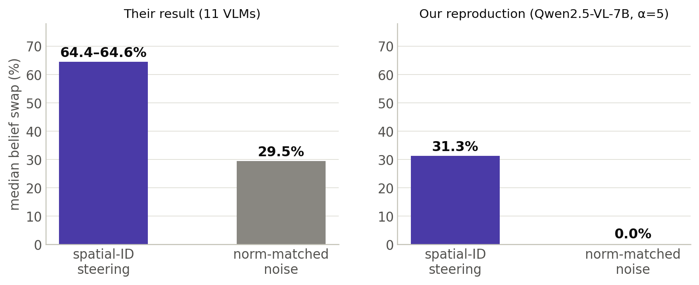
ACT 7 · STATUS
Foundations: M0–M3 in six days
Done:
deterministic scene generator (calibrated, bounce-bug-proofed) · six benchmark adapters, item-audited · Kang: key qualitative signatures partially reproduced (stage/layer pattern; rank-3 reconstruction R²=0.87/0.84; positive direction-vs-noise contrast 31.3% vs 0.0%; monotone dose-response — the absolute swap effect did NOT reproduce) · the position leak found BEFORE it poisoned Phase 2.
Gate decision: GO (advisor review, Jul 14).
The honest wrinkle: their absolute swap rate (64%) does not reproduce. Our above-noise contrast is positive (+43.3 peak vs noise 0%); theirs is +34.9 over a 29.5% noise floor — DESCRIPTIVE comparison only: noise construction, doses and selection differ, so no superiority claim. Reported as-is; nothing tuned.
Ours: reports/m3_reproduction.md; Kang targets: 2601.12626 (64.4–64.6% vs 29.5%; rank-3 R²≥0.85; above-chance +34.9).
B·26
Notes:
The wrinkle is a feature of the talk, not a bug — showing juniors what honest partial reproduction looks like.

Slide 27
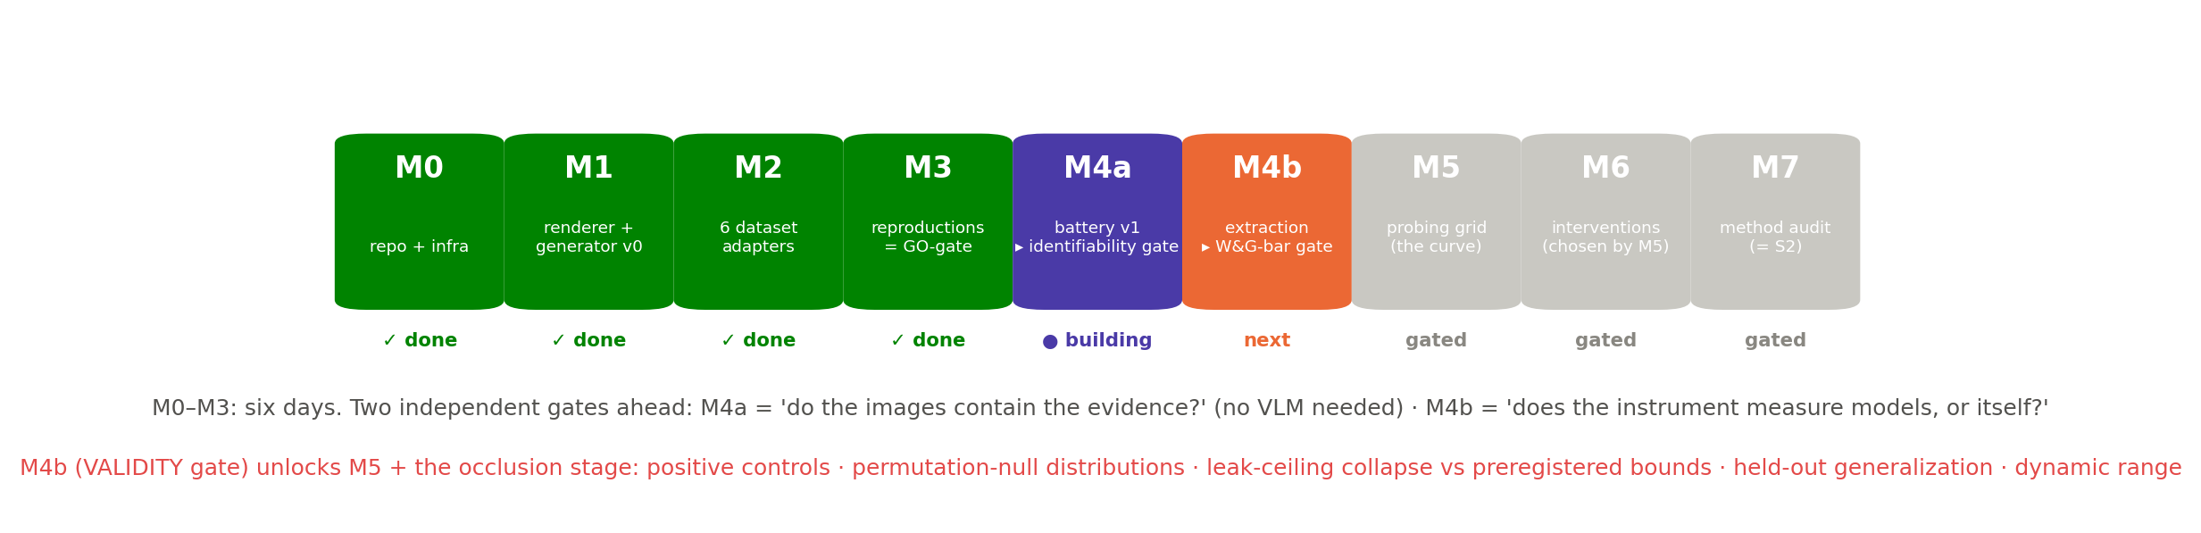
ACT 7 · STATUS
Now: M4a, and the two gates
Milestones + gates: IMPLEMENTATION_PLAN §4 (M4 split 2026-07-15). M4a needs no VLM and no GPU (CPU rendering).
B·27
Notes:
M4a is being implemented right now. Target from the advisor deck: preliminary decodability curves by mid-August.

Slide 28
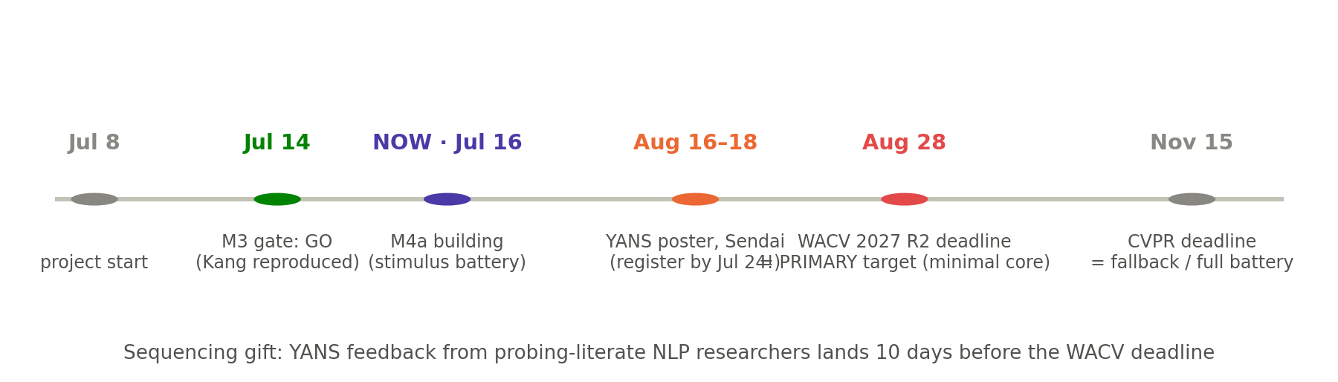
ACT 7 · STATUS
Calendar: six loaded weeks
WACV paper = the MINIMAL CORE only (2 models; depth traced two-level — continuous probe targets, ordinal behavioral tests; the five-stage curve; the leak methodology; the reproduction). Full battery + interventions extend to the CVPR fallback if needed. Scope discipline: do not force a weak submission — gates outrank deadlines.
Venue plan: professor-approved 2026-07-16 (PROJECT_MEMORY). Named scoop risks: Anchored's group (declared LM-internal follow-up) and Deccan AI (declared multi-model follow-up).
B·28
Notes:
If asked why the rush: both rival groups declared follow-ups aimed at adjacent or overlapping territory, and Kang just got an ICLR spotlight on the area.

Slide 29
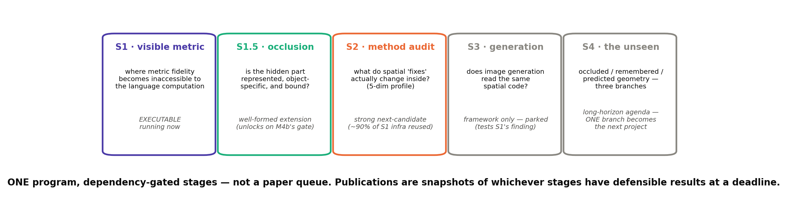
ACT 7 · THE PROGRAM
The bigger program: one question, staged
Program frame: PROJECT_MEMORY (canonical question: how is object-specific spatial state represented, transferred, and causally used — under visible / occluded / absent / hypothetical conditions).
B·29
Notes:
Maturity labels are mandatory — S4 is an agenda, not a queued experiment. Do not let the room read five stages as five promised papers.

Slide 30
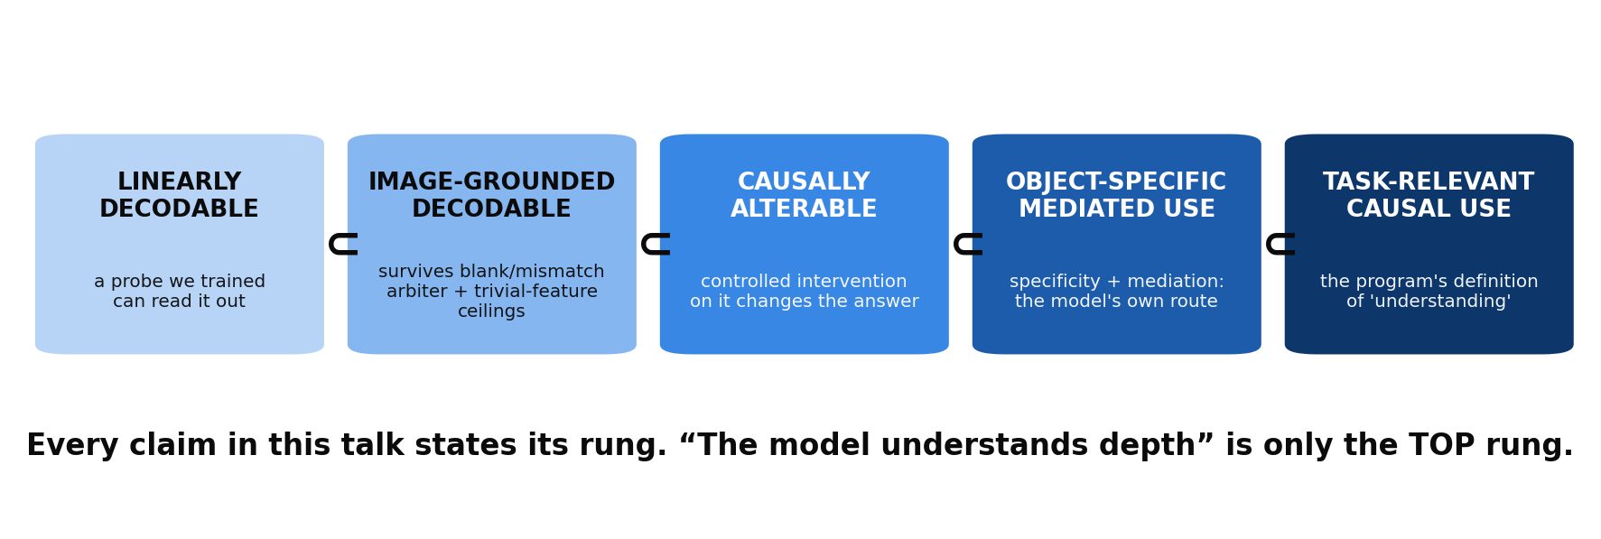
ACT 7 · THE PROGRAM
What we will be allowed to claim
1 LINEARLY DECODABLE → 2 IMAGE-GROUNDED beyond nuisance baselines → 3 CAUSALLY ALTERABLE under controlled intervention (a generic push that moves answers is still rung-3 evidence only if specificity controls pass) → 4 OBJECT-SPECIFIC MEDIATED USE → 5 TASK-RELEVANT natural causal use. No claim borrows a higher rung than its evidence.
Wording discipline, project-wide: metric information 'becomes unavailable or unusable' — never 'is destroyed'. Erased / recoded / detached / ignored / corrupted are five different mechanisms; the design exists to tell them apart.
Evidential ladder: program frame (Part A slide 29). Five-mechanism decomposition: S1 §1.
B·30
Notes:
This slide is the intellectual signature of the project — claims graded by rung, wording that doesn't presuppose the mechanism.

Slide 31
WRAP-UP
Takeaways — and homework
1 · Accuracy cannot explain failure. Priors and single-cue or benchmark strategies can produce correct answers without integrated geometric reasoning; only controlled inputs + internal measurement can tell them apart.
2 · Measurements mislead in their own ways. Every probe needs nuisance baselines + incremental-value analysis; every null needs a positive control — the field's papers (and ours) are only as good as their controls.
3 · The open question is variable-specific. Two 2026 papers motivate competing localization hypotheses (projector vs output-side) from different variables and methods; our five-stage, trivial-feature-controlled trace tests which pattern holds for controlled depth.
Homework (pick one):
design a dumb-features baseline for YOUR current experiment — what trivial feature could be answering for your model? · or: predict which of the three curves (binding / projector / readout) M5 will find, and defend it at the next seminar.
—
B·31
Notes:
Collect curve predictions on a whiteboard with names. When M5's real curve lands, revisit — best seminar-engagement trick available.

Slide 32
APPENDIX
Reference slides
The decision rule in full, the reproduction numbers, dataset details, and a glossary.
B·32

Slide 33
APPENDIX
The five-condition binding decision rule
Claim a binding bottleneck ONLY when ALL FIVE hold:
1 — metric information has SIGNIFICANT INCREMENTAL recoverability from object-associated visual representations, beyond prespecified selection and nuisance features, under matched nested evaluation;
2 — it is SUBSTANTIALLY LESS recoverable from that object's TEXT tokens, under matched evaluation;
3 — qualitative spatial-ID influence is detectable at those same text-token sites (a validated Kang-style positive control);
4 — a HELD-OUT, depth-specific intervention at the candidate transfer layer changes the relevant internal depth readout AND the corresponding object-specific answer (mediation inside the rule, not beside it);
5 — effects are OBJECT-SPECIFIC, operationalized by reference redirection: renaming/re-referencing the object redirects the effect; intervening on the non-target object does not reproduce it; the effect follows the REFERRED object, not a fixed token position or answer option.
Failing any one ⇒ report the pattern, do not name it 'binding'.
S1 §2.3 decision rule (research_proposal_spatial_binding.md).
B·33

Slide 34
APPENDIX
M3 reproduction: the numbers
Kang reproduction (reimplemented from the paper; their repo is unlicensed):
mirror-swap patching profile: image patches early → object-word tokens middle (LLaVA peaks 0.31–0.34 at L12–14; Qwen at L16) → text late — the qualitative stage/layer pattern reproduces (no preregistered similarity metric, so not stated as 'exact').
rank-3 R²: 0.87 (LLaVA-1.5-7B) / 0.84 (Qwen2.5-VL-7B) vs paper ≥0.85.
steering at α=5: 31.3% belief swap vs 0.0% norm-matched noise; dose-response 10→23→31→43% (α=1→10), noise 0% at every dose.
does NOT reproduce: absolute swap rate (19–31% vs ~64%). Above-noise contrasts: ours +31.3/+43.3 over a 0% floor; theirs +34.9 over 29.5% — descriptive, not directly comparable (noise construction/doses/selection differ). Confidence explanation tested and REJECTED (noise flips 0/23 even at conf 0.90–0.99; r=+0.03). The gap remains unexplained and is reported as such.
W&G pattern (M3.2): x=0.997 / z=0.990 on v0 — the FAIL that exposed the stimuli (Act 6).
Ours: reports/m3_reproduction.md. Paper targets: 2601.12626, 2605.07148.
B·34

Slide 35
APPENDIX
Glossary
binding — the prompt-conditioned transfer making object-specific visual information causally available at the language-token positions that refer to and answer about that object (our operational definition; ≠ Cui et al.'s 'spatial variable binding' = ordinal ordering-IDs).
leak ceiling / dumb-features baseline — probe score achievable from trivial EXTERNAL features (mask geometry, shape, colour, cue values; the mask does represent location — the point is the signal's provenance is selection/annotation, not learned activations); a representation claim requires significant incremental value beyond the baseline under matched-capacity evaluation — dumb-only, representation-only, combined, and incremental results all reported.
selection leak — mask-pooling picks tokens BY the object's position, so the pooling choice itself encodes the answer.
identifiability gate — proof that the images contain the evidence (supervised pixel model + human check) before any stage-level null is interpreted.
mediation — intervention → internal decodability rises → behavior improves; answers moving alone = logit hack.
ordinal / ratio / absolute — which is closer / how many times farther / how many meters. Ordinal is often constrained by monocular evidence; ratio requires geometric assumptions (calibration, support plane); absolute additionally requires a scale prior. Our battery supplies these conditions by construction; the identifiability gate verifies them.
two-ordering protocol — every MCQ asked in both option orders; kills option-position priors.
Definitions: S1 design docs; Cui et al. 2603.22278 v2 (terminology boundary).
B·35

