Slide 1
Where Does Depth Go?
Tracing metric spatial information inside vision-language models
Lab seminar · Part A: the problem, the tools, and what the field knows
Kaho · July 2026
Notes:
Promise: by the end of Part A you can read any mechanistic-interpretability paper about VLMs. Part B (next time): our own experiment design and early results.

Slide 2
ACT 0 · THE MACHINE
What a vision-language model actually is
10 minutes of anatomy — everything later in this talk points at one of five places inside this machine.
2

Slide 3
ACT 0 · THE MACHINE
What a VLM does
Input: an image + a text question. Output: text.
Examples you have used: GPT-5, Gemini, Qwen-VL, LLaVA — 'describe this photo', 'read this receipt', 'which object is closer?'
Under the hood it is a language model that has been given eyes: the image is converted into vectors the language model can process in the same sequence as its text tokens.
This talk is about one question type on which current VLM behavior is UNRELIABLE — especially when continuous depth magnitude is required — and finding WHERE inside the model the failure arises.
Background slide — no external claims.
3
Notes:
Keep it light. Ask who has used a VLM. The key phrase to plant: 'the image becomes tokens'.

Slide 4
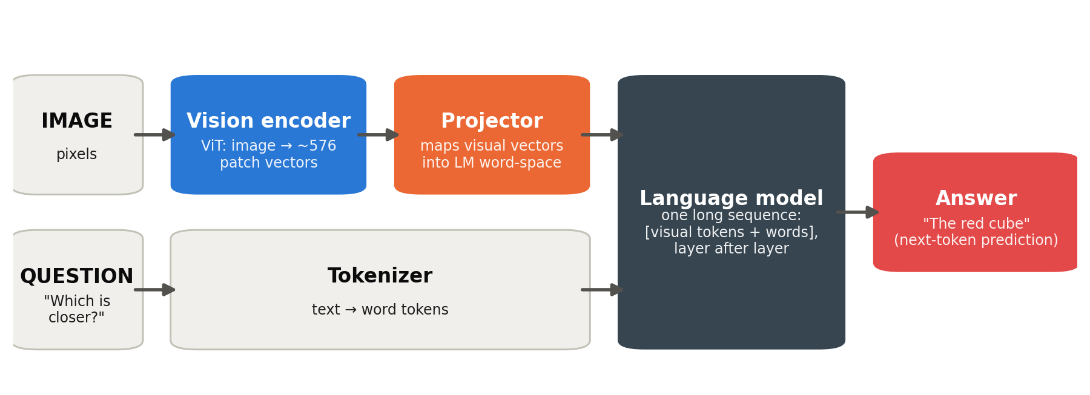
ACT 0 · THE MACHINE
Anatomy: three parts, one sequence
Vision encoder (a ViT): image → a few hundred 'patch vectors'.
Projector: a small network that maps those vectors into the LM's word-vector space.
Language model: reads [visual tokens + question tokens] as ONE sequence and writes the answer. ⚠ This is a FUNCTIONAL abstraction — real VLMs bridge with projectors, mergers, resamplers, tiling, or token compression (why Part B maps stages per-architecture).
Architecture: LLaVA-style VLMs (Liu et al. 2023, arXiv:2304.08485); the same broad functional decomposition applies to Qwen2.5-VL, InternVL, Gemma-3 — their concrete bridging modules differ.
4
Notes:
THIS DIAGRAM IS THE MAP FOR THE WHOLE TALK. Every later figure is this pipeline with annotations. Spend time here.

Slide 5
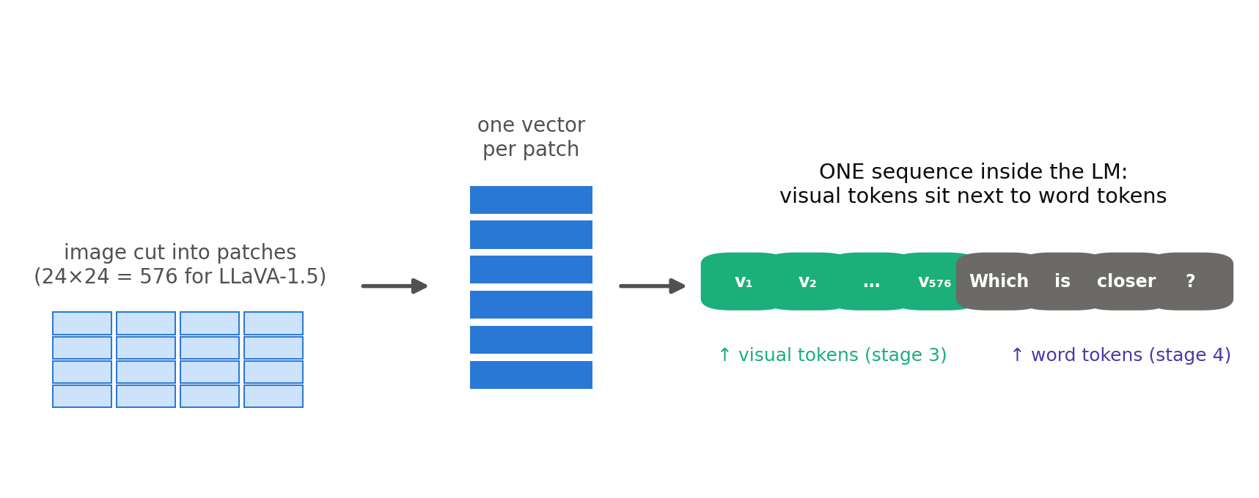
ACT 0 · THE MACHINE
What 'visual tokens' are
The LM does not see pixels. In LLaVA-1.5 it sees 576 vectors, each initially corresponding roughly to one image patch; other architectures merge, tile, or compress visual regions. All sit in the same sequence as the words.
Consequence: any spatial answer must ultimately be supported by information carried by — or reconstructed from — these visual representations.
Token counts: LLaVA-1.5 (arXiv:2310.03744), 576 tokens at 336px; Qwen2.5-VL uses native-resolution variable counts.
5
Notes:
Rookie checkpoint: 'the model reads the image like extra words'.

Slide 6
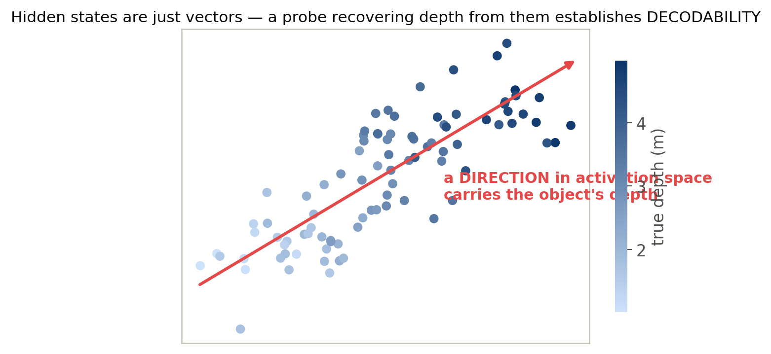
ACT 0 · THE MACHINE
What a 'representation' is
Every token, at every layer, is a vector (thousands of numbers).
A minimal OPERATIONAL test for a depth-related representation: can depth be recovered from those vectors? That alone establishes DECODABILITY — not that the model itself reads or uses it (the distinction Act 3 formalizes).
Toy picture: each dot is one hidden state; color = the object's true depth; the red arrow is a direction that carries it — the SIMPLEST case: depth may instead occupy a low-dimensional subspace or be nonlinearly recoverable.
This is exactly what a 'linear probe' will test in Act 3.
Toy illustration (synthetic data, ours). Linear-representation background: Belinkov 2022, arXiv:2102.12452.
6
Notes:
For the weakest listeners: vectors = lists of numbers; direction = weighted combination. Appendix has a slower version.

Slide 7
ACT 0 · THE MACHINE
How the model answers: next-token prediction
The LM predicts one token at a time: P(next word | everything so far).
The FIRST answer token is predicted from the final prompt-position hidden state through the vocabulary head; longer answers are generated autoregressively — one new hidden state per generated token.
So an answer can fail in two very different ways:
the needed information never reached the late layers, OR
it is there, but the answer-writing computation does not use it.
Keep that split in mind — it is the entire theme of this research.
Standard autoregressive LM decoding — background.
7
Notes:
Plant the represented-vs-used distinction here, casually. It returns as the 'evidential ladder'.

Slide 8
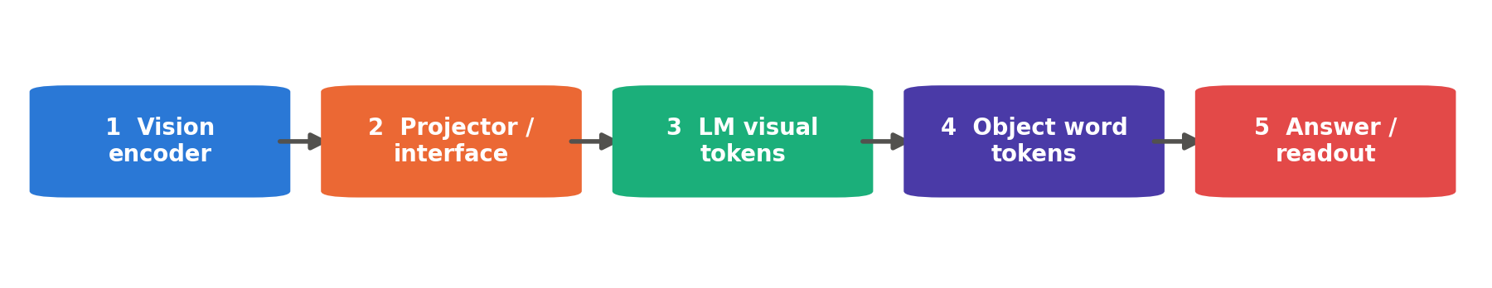
ACT 0 · THE MACHINE
Checkpoint — you now know enough
We will name FIVE functional stages along this pipeline (colors stay fixed all talk).
Stage 4 is subtle: the hidden states of the words that NAME an object ('the cube'). We use 'binding' for the PROCESS by which a particular visual object's information becomes associated with those token positions — establishing that it happened takes causal evidence (Act 3).
Everything from here on is one question: how far along this chain does DEPTH survive?
Five functional stages: our formulation (S1 design); binding-site concept from Kang et al., ICLR 2026, arXiv:2601.12626.
8
Notes:
The five colors are now installed. Quiz the room: point at a stage, ask what it is.

Slide 9
ACT 1 · THE PHENOMENON
Strong on spatial relations, weak on spatial quantities
One concrete failure, then the numbers that show the behavioral pattern is systematic. Whether the models CAN'T measure internally is the open question, not the premise.
9

Slide 10
ACT 1 · THE PHENOMENON
One image, two questions
Q1 "Is the cup to the left of the ball?"
Q2 "Which is closer?" (ORDINAL)
"How much closer?" (CONTINUOUS)
✓ correct, confidently — models are near ceiling on this type
✗ ordinal: variable — often answerable under familiar cue correlations. Continuous magnitude: much weaker, with systematic errors.
QUALITATIVE
QUANTITATIVE — ordinal vs continuous, kept distinct all talk
Same image. Same model. The colors green/orange mean qualitative/quantitative for the rest of the talk.
Illustrative synthesis ACROSS studies — not a matched benchmark comparison: MindEdit-Bench arXiv:2607.00491; ReVSI arXiv:2604.24300; Kang et al. arXiv:2601.12626 (qualitative near ceiling).
10
Notes:
Live-demo option: run Qwen2.5-VL on one of our rendered stimuli here. GT is exact, so the failure is undeniable.

Slide 11
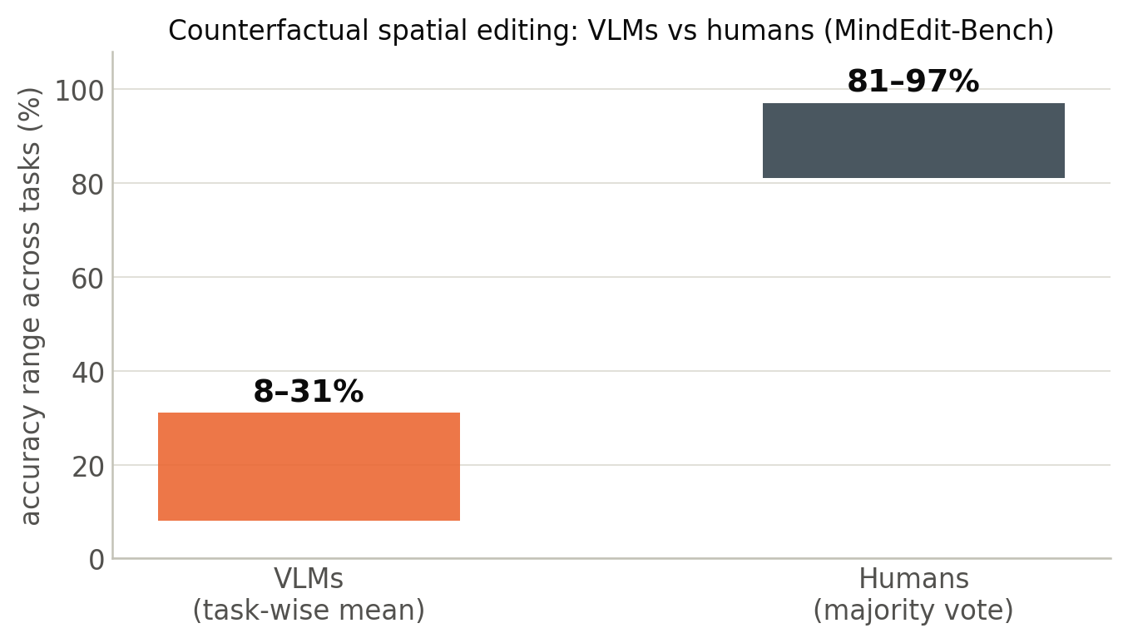
ACT 1 · THE PHENOMENON
It is systematic: models vs humans
Counterfactual spatial editing tasks ('if the chair moved 1m left, what would be behind it?'):
8–31%
task-wise mean VLM accuracy
81–97%
human majority-vote accuracy, same items
MindEdit-Bench, arXiv:2607.00491 — 120 privately captured indoor scenes (contamination control), 3-photo smartphone triplets.
11
Notes:
Stress 'privately captured': the images cannot be in training data. Scope carefully: MindEdit tasks bundle mental transformation, correspondence, scene updating AND depth — they show severe failure on metric/counterfactual spatial tasks; that metric precision is ONE component is OUR hypothesis, not the benchmark's finding.

Slide 12
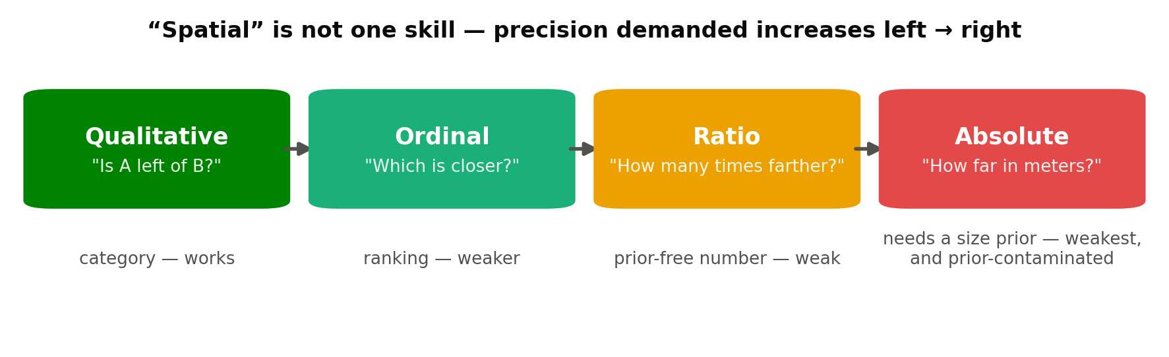
ACT 1 · THE PHENOMENON
'Spatial' is four different demands
What one image permits is CONDITIONAL: ordinal depth is often constrained by monocular evidence; ratio depth needs geometric assumptions (calibration, support plane); absolute scale additionally needs a size prior. Our battery supplies these conditions by construction — and verifies them (identifiability gate, Part B).
Recent results are broadly CONSISTENT with a precision-related difficulty gradient — but current benchmarks differ in format, scoring, and priors, so the ladder is not yet cleanly isolated. (One reason our battery exists: matched scenes, matched formats, all four levels.)
Taxonomy: our formulation (S1 design). Absolute-scale prior-contamination: ReVSI, arXiv:2604.24300.
12
Notes:
This taxonomy is ours and structures the whole project — every question and probe target maps to exactly one level.

Slide 13
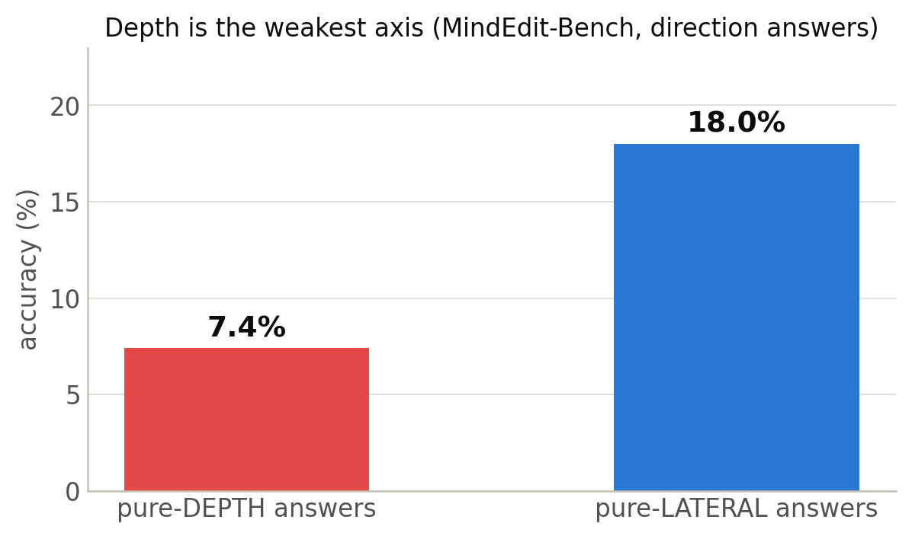
ACT 1 · THE PHENOMENON
In this benchmark, depth is the weakest axis
Same benchmark, direction answers split by axis: left/right (lateral) vs near/far (depth).
Depth-only answers: 7.4%. Lateral-only: 18.0%.
And errors are structured: wrong answers land in the ADJACENT 45° compass bin at 1.7× the random rate; 180° reversals at only 0.6×.
The ERROR DISTRIBUTION retains coarse directional structure even when depth-axis answers are poor — a behavioral observation that motivates internal analysis (it cannot itself localize what is represented).
MindEdit-Bench, arXiv:2607.00491, §5.3.
13
Notes:
Caveat to mention verbally (from our deep-read): their depth ground truth comes from a monocular-depth pipeline, so some of the 7.4% could be label noise — one reason our stimuli use exact rendered geometry.

Slide 14
ACT 1 · THE PHENOMENON
Why anyone should care
Robotics / embodied AI: 'reach behind the mug' requires metric geometry, not adjectives — but this motivation is SECONDARY for us.
Text-to-image systems also show spatial-instruction failures — whether they share the same internal mechanism is unknown — and their evaluation relies on VLM judges whose own spatial ability is unproven.
The scientific reason is primary: the qualitative–metric asymmetry is documented across several recent benchmarks but not mechanistically explained. It is a clean, open 'why' about the most widely deployed model family in the world.
Asymmetry documented across MindEdit-Bench 2607.00491, ReVSI 2604.24300, SD-VLM 2509.17664, Spatial Blindspot 2601.09954.
14
Notes:
One slide only, on purpose — this program is about the representational question, not the robot.

Slide 15
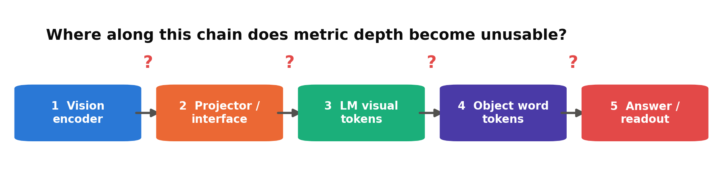
ACT 1 · THE PHENOMENON
So: WHY does metric fail?
Three hypotheses a reasonable person would offer:
1. 'It cannot SEE depth' — the visual system never extracts it.
2. 'It cannot SAY numbers' — the info is inside, the verbal output mangles it.
3. 'Something in between' — it is extracted, then becomes unusable somewhere along the pipeline.
These are candidate failure LOCI, not mutually exclusive global explanations — a real model may exhibit all three, varying by cue, quantity, and architecture. Spoiler: existing evidence makes complete cue blindness unlikely (1), and makes a purely final-verbalization account unlikely FOR TESTED QUALITATIVE relations (2) — neither result resolves continuous metric depth, which is where the open question lives.
Evidence against 1: DepthCues arXiv:2411.17385. Against 2 (for qualitative): Kang et al. arXiv:2601.12626. The middle: this talk.
15
Notes:
Ask the room to vote 1/2/3 before revealing. Their intuitions become the outline of Act 4.

Slide 16
ACT 2 · THE LIMITS OF ACCURACY
The same score can come from different mechanisms
Accuracy answers 'did the output match the label' — it cannot identify the mechanism that produced the answer. Two families of evidence, and why they force us to look inside.
16

Slide 17
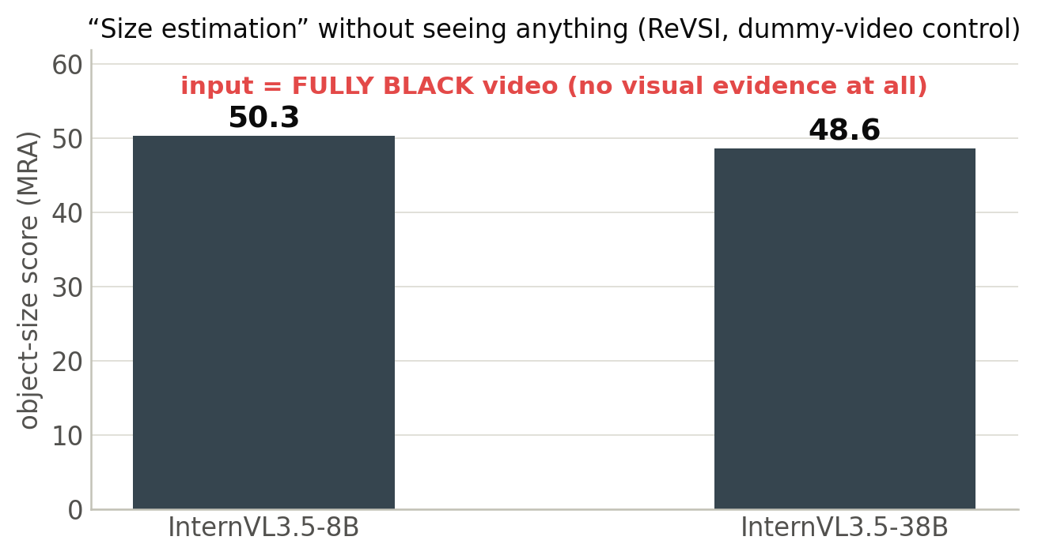
ACT 2 · THE LIMITS OF ACCURACY
Exhibit A: high scores with NO image
ReVSI's dummy-video control: replace the entire video with black frames, ask the same object-size questions.
Scores barely move — much of the score is available WITHOUT visual evidence, via linguistic, category, or benchmark priors.
Same study: fine-tuned 'spatial' models score 0.0–0.9% on dummy videos — unlike the base models, these systems depend strongly on the visual input under this benchmark.
And VSI-Bench counting: answering '2' every time scores 62%.
ReVSI, arXiv:2604.24300 — Table 6 (InternVL3.5-8B: 50.3, -38B: 48.6 MRA, black videos); Table 5 (Spatial-MLLM); Fig. 5 (62%).
17
Notes:
Let the black-video number land in silence. This is the literature's clearest demonstration that accuracy answers a different question than 'did the model perceive'.

Slide 18
ACT 2 · THE LIMITS OF ACCURACY
What a 'prior' is
A mug is ~9 cm tall. A door is ~2 m. Chairs sit near tables. The model has read the internet: it KNOWS these without looking.
Priors are not cheating — humans use them too. The problem is for MEASUREMENT: a benchmark score cannot tell prior from perception.
Direct evidence that substantial performance is available from language-side priors alone: a text-only frontier LLM — no image input at all — beats every open VLM on in-the-wild metric size questions.
So 'the model estimated the size' often means 'the model recognized the object and recalled its typical size'.
Text-only-LLM result: Ill-Posed by Design, arXiv:2606.24335 (331 tape-measured in-the-wild queries, 70 photos).
18
Notes:
The tape-measure detail is worth saying out loud — they physically measured objects to get GT that priors can't have memorized.

Slide 19
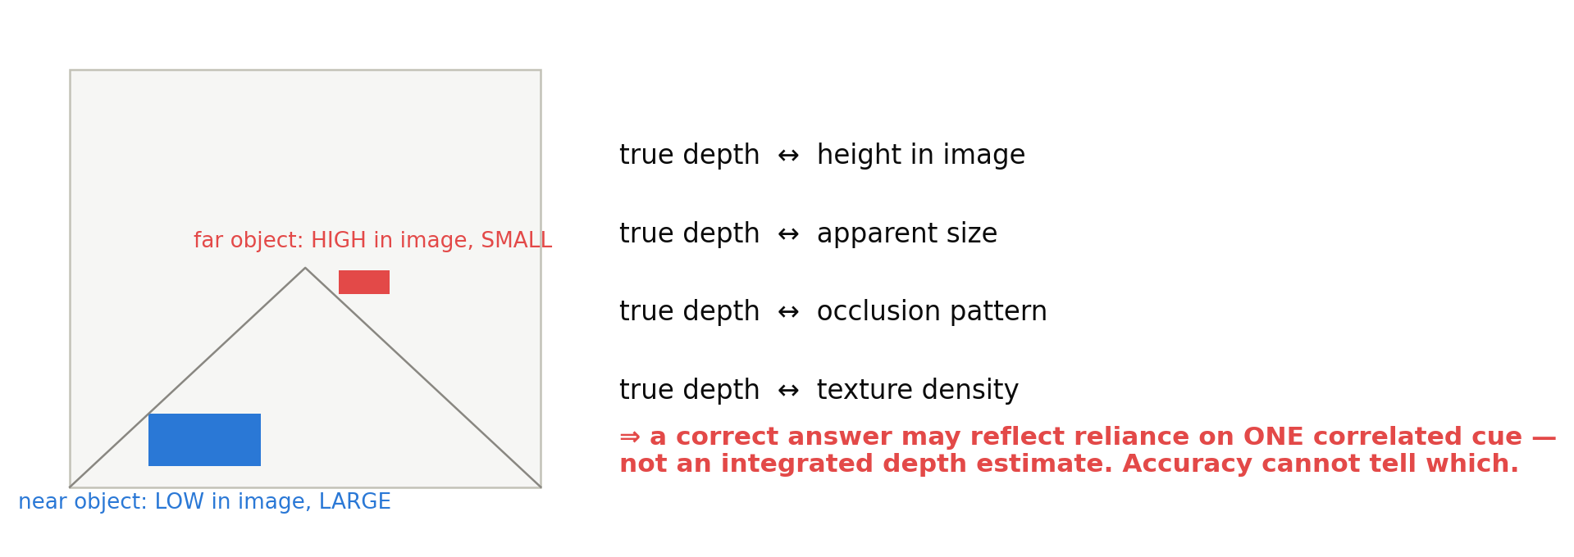
ACT 2 · THE LIMITS OF ACCURACY
Exhibit B: natural images leak the answer
Cue-correlation problem: Wang & Gao arXiv:2605.07148 (z-shortcut); Why Far Looks Up arXiv:2605.30161 (vertical–distance entanglement); DepthCues arXiv:2411.17385 (cue inventory).
19
Notes:
In photos, 'far' objects are higher, smaller, occluded, denser-textured. Careful wording: these cues ARE the legitimate evidence monocular depth is inferred from — the risk is that a benchmark can be solved by ONE correlated cue without cue integration or generalization under decorrelation.

Slide 20
ACT 2 · THE LIMITS OF ACCURACY
A shortcut caught red-handed
Front/behind questions can be answered by IMAGE HEIGHT: on a tabletop, 'in front' ≈ 'lower in the picture'.
Kang et al. found internal directions CONSISTENT with this height-proxy strategy: LLaVA's 'front/behind' directions are nearly identical to its 'above/below' directions (above≈front, below≈behind).
Why Far Looks Up: vertical position and distance are ENTANGLED in VLM representation space — an axis-specific defect (the horizontal axis is clean).
So a correct front/behind answer is not, BY ITSELF, evidence of an integrated depth representation.
Kang et al., arXiv:2601.12626 §4.1/Fig.7 (LLaVA-1.5-7B); Why Far Looks Up, arXiv:2605.30161 (VD-entanglement, axis-specific).
20
Notes:
This is why our validation set What'sUp-B (front/behind) is labeled 'proxy-confounded' — the confound is itself an experiment for our probes.

Slide 21
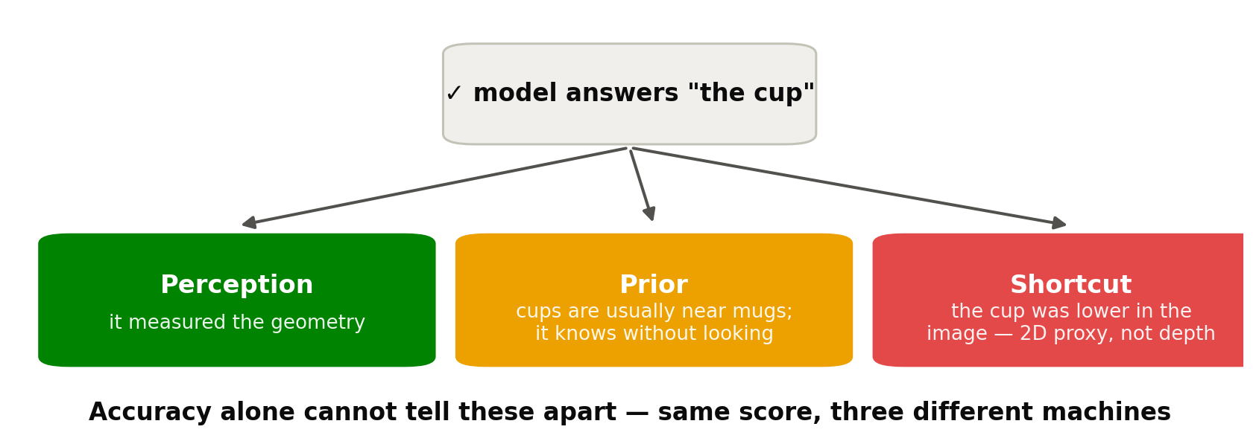
ACT 2 · THE LIMITS OF ACCURACY
Right and wrong answers each have three stories
Wrong answers split into LATENT candidate explanations: not recoverable at earlier stages / recoverable but not transferred or used / used but distorted during answer generation. Accuracy sees none of this structure.
Decomposition: our framing (S1). Anchored arXiv:2606.06714 is evidence CONSISTENT WITH a decodable-but-not-faithfully-expressed case (LM interior unmeasured) — Act 4.
21
Notes:
This slide IS the motivation for interpretability. Next act: the tools that can tell these stories apart.

Slide 22
ACT 2 · THE LIMITS OF ACCURACY
Therefore: two design decisions
1 — Control the inputs.
Render synthetic scenes with EXACT geometry where depth, image height, and apparent size vary independently — so no prespecified single cue should predict the target above the preregistered threshold (verified, not assumed). (Rendering enforces exact factorial control and ground-truth geometry at a scale natural data rarely provides.)
2 — Look inside.
Measure what each stage of the pipeline knows, with probes and causal interventions — so prior reliance, single-cue prediction, and grounded geometric processing become empirically DISTINGUISHABLE under explicit controls (not perfectly identifiable — distinguishable).
Design rationale: our S1; controlled-stimulus philosophy shared with Why Far Looks Up 2605.30161, O3-D 2607.01503, Anchored 2606.06714.
22
Notes:
Act 3 = decision 2's toolbox. Act 5 (Part B) = decision 1's stimuli.

Slide 23
ACT 3 · THE INSTRUMENTS
Mechanistic interpretability 101
What it means to open the model — the common methods, what each can and cannot conclude, and which ones this project uses.
23

Slide 24
ACT 3 · THE INSTRUMENTS
What mechanistic interpretability is
Behavioral evaluation treats the model as a black box: inputs in, answers out, accuracy computed.
Mechanistic interpretability opens the box: it studies the INTERNAL activations and computations — what information is recoverable where, and which interventions alter behavior.
The promise for us: the three explanations of Act 2 (perception / prior / shortcut) make DIFFERENT predictions about internals, even when they produce the same answer.
The danger (also for us): internal measurements can lie in their own ways — every method below comes with its failure mode.
Survey background: Belinkov 2022, arXiv:2102.12452 (probing); Hewitt & Liang 2019, arXiv:1909.03368 (control tasks).
24
Notes:
Frame it as microscopy for neural nets. And set expectations: the methods are simple — linear regression and copy-paste of vectors.

Slide 25
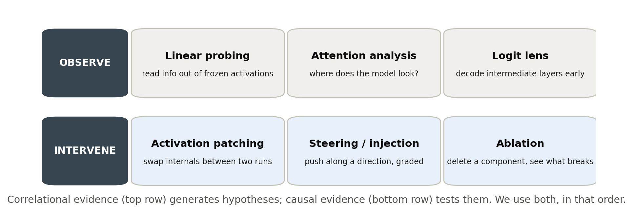
ACT 3 · THE INSTRUMENTS
The toolbox at a glance
Method taxonomy: standard practice; see Belinkov 2022 (probing), and Kang et al. 2601.12626 / Cui et al. 2603.22278 for patching+steering in VLMs.
25
Notes:
Observe→hypothesize, intervene→test. We'll do the top-left and both bottom-left cells in detail; the rest get honorable mentions.

Slide 26
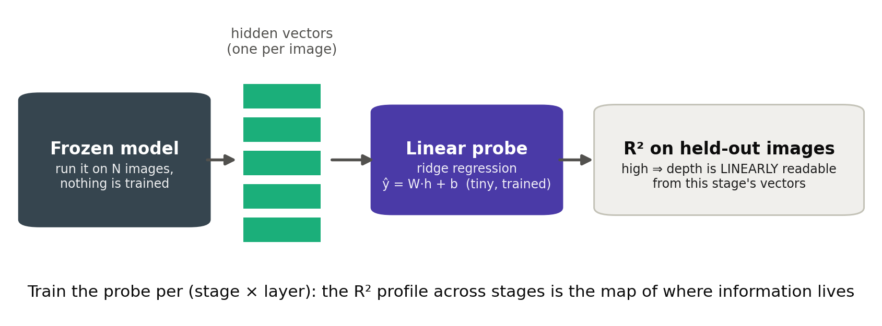
ACT 3 · THE INSTRUMENTS
Tool 1 — Linear probing
Why LINEAR: a held-out linear probe shows the target is LINEARLY RECOVERABLE from that representation, under our sampling and controls — the weakest evidential tier, and the one comparable to prior work. 'Accessible to the model' needs more (the ladder, ahead).
Probing methodology: Belinkov 2022, arXiv:2102.12452. Applied to VLM geometry: Wang & Gao 2605.07148; Anchored 2606.06714.
26
Notes:
Walk through slowly: freeze model, collect vectors, ridge regression, held-out R². The whole project's Figure 1 is 'this, at five stages'.

Slide 27
ACT 3 · THE INSTRUMENTS
What a probe does NOT tell you
Probe success ≠ the model uses it.
The probe is OUR readout, not the model's. Information can be decodable by us and ignored by the answer computation.
Probe success ≠ the info is even about the image!
A probe can read dataset regularities or trivially available features. Extreme case: 'decodability' that survives replacing the image with a blank — then it was prior, not grounding.
Probe failure ≠ absence.
Maybe the info is there non-linearly, or your probe/site choice is wrong. A null needs a demonstration that the instrument CAN register a positive.
Decodable ≠ grounded (blank-image arbiter): arXiv:2606.31257. Control tasks: Hewitt & Liang 2019, arXiv:1909.03368. Mirage behavior: arXiv:2606.13870.
27
Notes:
These three warnings are load-bearing for our design — each becomes a mandatory control in Part B.

Slide 28
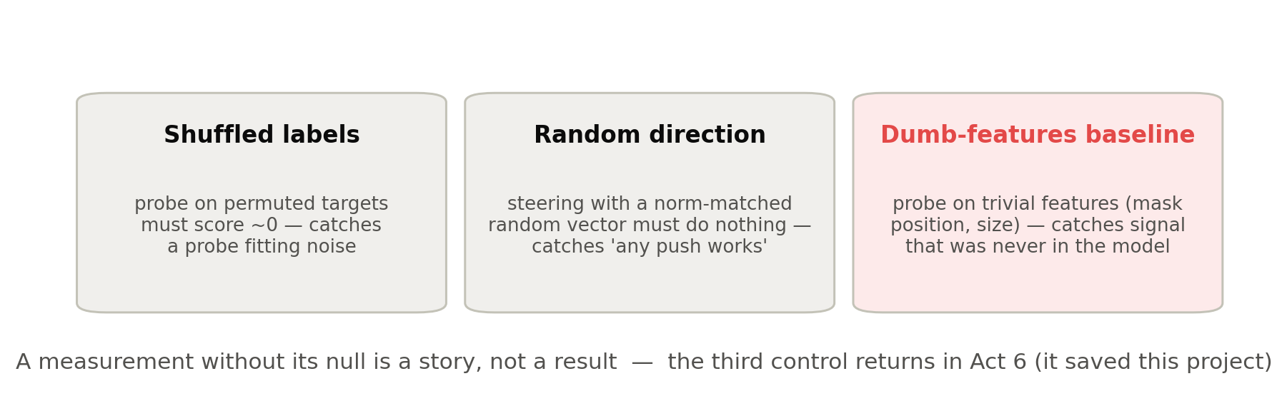
ACT 3 · THE INSTRUMENTS
Controls: every measurement ships its null
Shuffled labels / selectivity: Hewitt & Liang 2019, arXiv:1909.03368. Random-direction nulls: Cui et al. 2603.22278. Nuisance-feature baseline + incremental-value analysis: ours (Act 6 in Part B).
28
Notes:
Foreshadow: the third control was invented in this project after a near-disaster. Detective story in Part B.

Slide 29
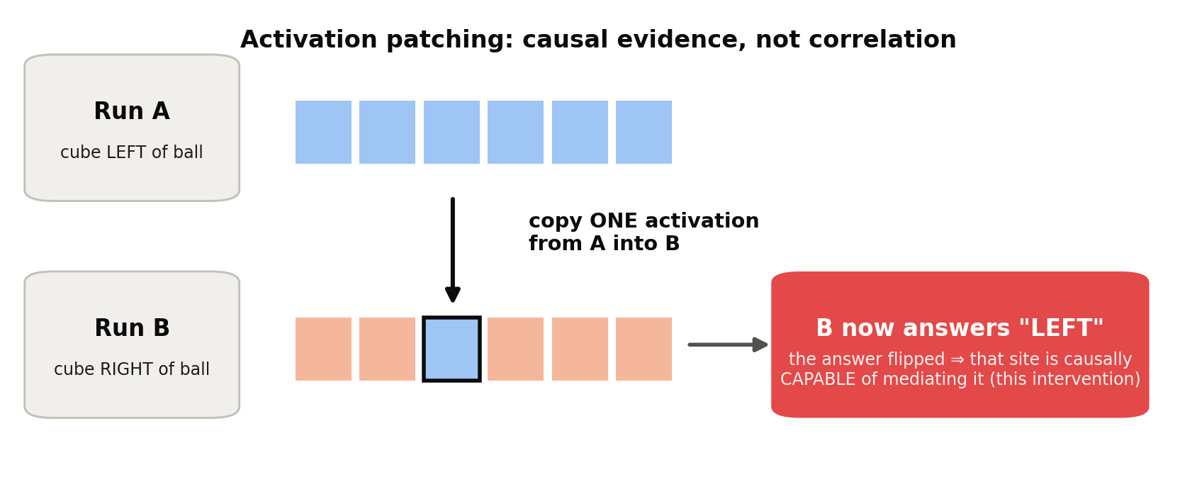
ACT 3 · THE INSTRUMENTS
Tool 2 — Activation patching
Patching in VLMs: Kang et al. 2601.12626 (mirror-swap); Cui et al. 2603.22278 (interchange interventions); Deccan 2605.20448 (causal tracing).
29
Notes:
Contrast with probing (stated carefully): probing shows the target is linearly recoverable BY US; patching shows the site is causally CAPABLE of mediating the behavior under this intervention. Natural-use claims need specificity + mediation on top. Different rungs of the ladder.

Slide 30
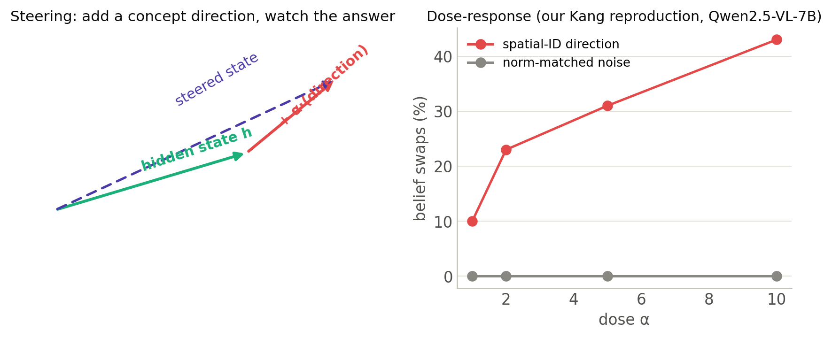
ACT 3 · THE INSTRUMENTS
Tool 3 — Steering (and why dose-response matters)
A monotone dose curve with a flat noise control is much harder to fake than a single 'it flipped' anecdote — provided the intervention stays in-distribution and passes norm-matched random-direction and semantic-specificity controls.
Steering: Kang et al. 2601.12626. Dose-response curve shown: our M3 reproduction (Qwen2.5-VL-7B: 10/23/31/43% at α=1/2/5/10; noise 0% at every dose).
30
Notes:
The right panel is OUR data — first appearance of our own results in the talk. Note the noise line: flat zero at every dose. 'In-distribution' cannot be proven, only stress-tested: we test for GROSS distribution shift via norm, neighborhood/distribution, and unrelated-behavior checks — these bound, not establish, in-distribution status.

Slide 31
ACT 3 · THE INSTRUMENTS
Honorable mentions (know they exist)
Attention analysis:
where the answer token 'looks'. In VLM spatial reasoning: attention is misallocated by linguistic familiarity (AdaptVis), and spatial heads are sparse (<1%), and ablating the identified head set substantially reduces performance on the tested tasks.
Logit lens:
decode intermediate layers with the final classifier — cheap map of when the answer forms.
Ablation:
zero a component and watch behavior. A CHANGE supports causal relevance; a NULL does not prove absence — redundant or distributed pathways compensate (Cui's LM backup mechanism is a live example). Separate, and ours: zero-ablate what you MEASURE, to prove the metric itself is responsive.
Sparse autoencoders:
unsupervised feature discovery — powerful, out of scope here.
AdaptVis: arXiv:2503.01773 (ICML 2025). Sparse spatial heads: Attention in Space, arXiv:2603.20662. SAEs for vision: arXiv:2605.24946.
31
Notes:
Keep to 90 seconds. The zero-ablation honesty check returns in Part B war stories.

Slide 32
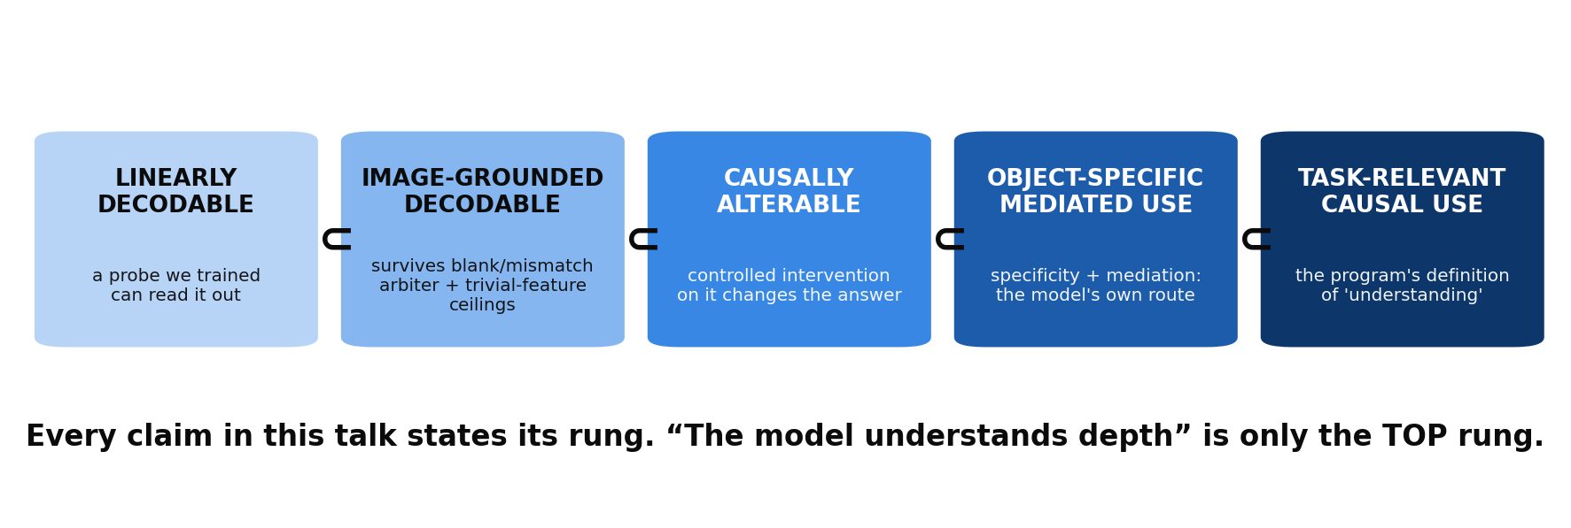
ACT 3 · THE INSTRUMENTS
The grading scale: the evidential ladder
Ladder (five rungs): our program frame. The decodable/grounded gap is empirical — arXiv:2606.31257; the decodable/used gap — Anchored, arXiv:2606.06714.
32
Notes:
THE most important slide of Act 3. Every paper in Act 4 gets graded on this ladder; so will our own claims.

Slide 33
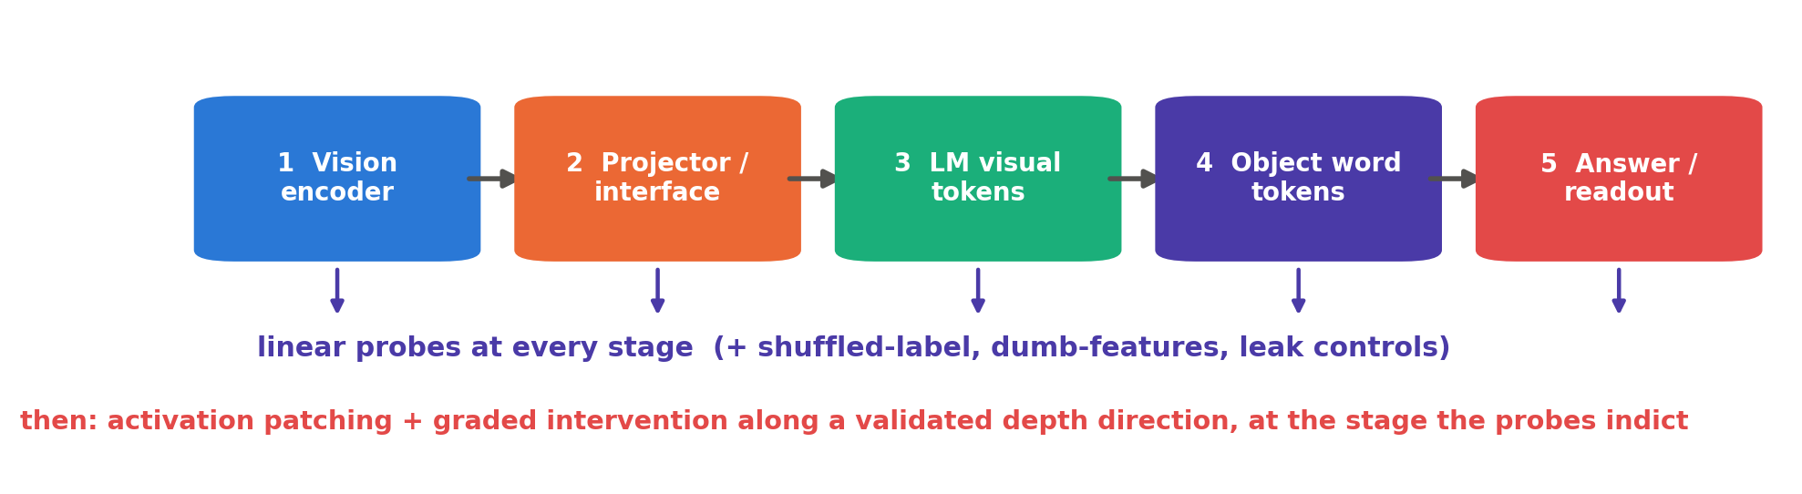
ACT 3 · THE INSTRUMENTS
What THIS project uses
Probes at all five stages (the decodability curve) → the correlational map.
Patching + a graded intervention along an INDEPENDENTLY validated depth-related direction, at the preregistered primary site → the causal test.
Every probe with shuffled-label + dumb-features + leak controls; every null with a positive control.
Our S1 design (research_proposal_spatial_binding.md §2.3, §2.5).
33
Notes:
Checkpoint: probe = linearly recoverable by us; patch/steer = causally capable under our intervention; ladder = what we may claim. Now the literature.

Slide 34
ACT 4 · WHAT THE FIELD KNOWS
Five anchor papers and two competing localization hypotheses
Each paper gets the time it deserves. Watch the pipeline diagram — every paper measures a different part of it, and none measures all of it.
34

Slide 35
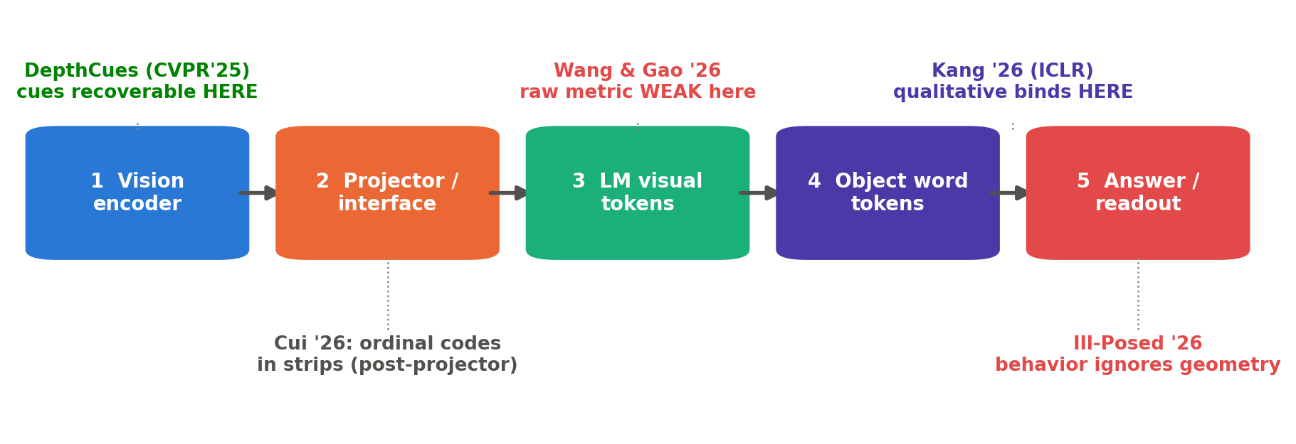
ACT 4 · THE LITERATURE
The map: who measured what, where
Two ENDPOINT results (green/red at the ends) + three constraints in the middle. Hold this map — each paper now gets its own slides.
DepthCues 2411.17385 · Wang & Gao 2605.07148 · Kang 2601.12626 · Cui 2603.22278 · Ill-Posed 2606.24335.
35
Notes:
Narrative: start at the ends (easiest to grasp), then the middle, then the two papers whose interpretations motivate different localization hypotheses.

Slide 36
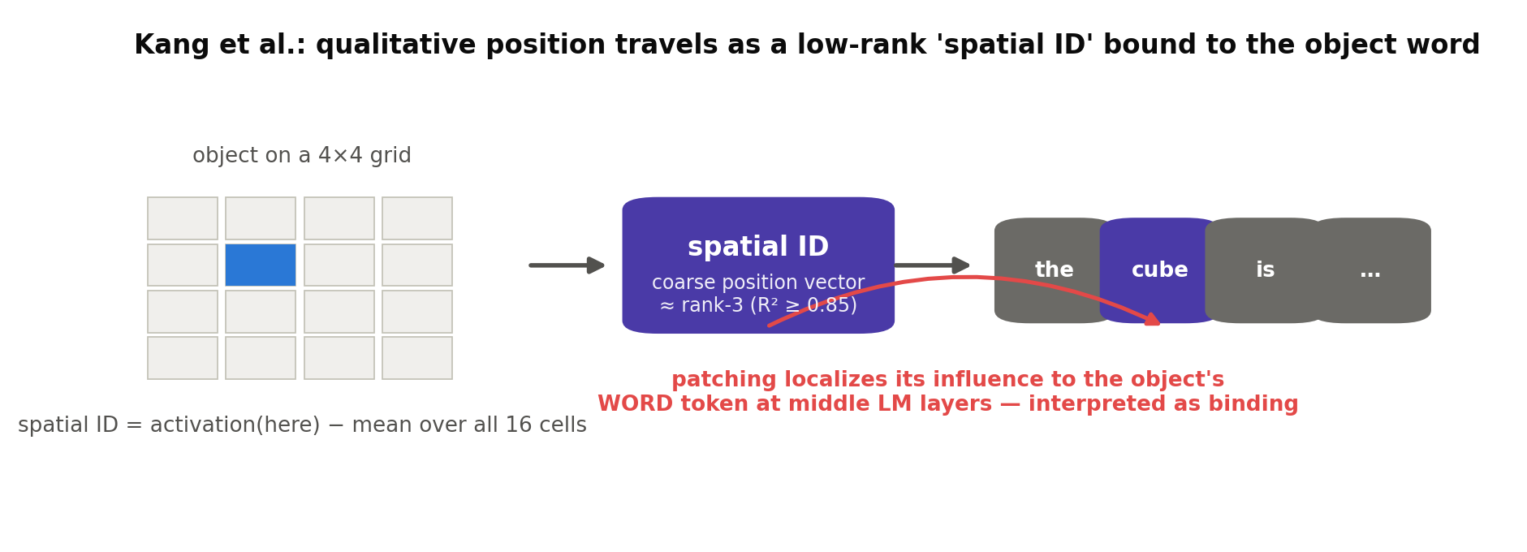
ACT 4 · KANG ET AL. (CALTECH, ICLR 2026)
Anchor 1 · Kang et al. — the setup
Question: HOW does a VLM answer 'is A left of B?' — what internal object carries the relation?
Method: place two objects on a 4×4 grid (controlled synthetic scenes); compute each position's 'spatial ID' = that position's activation minus the mean over all 16 cells.
Scale: 11 VLMs up to 14B — LLaVA, LLaMA-3.2V, Qwen2/2.5-VL, Gemma, InternVL…
Then: patch and steer those IDs to test them CAUSALLY.
Kang, Chen, Gkioxari, Perona — arXiv:2601.12626, ICLR 2026. Code: github.com/Raphoo/linear-mech-vlms. Paper Fig.1: arxiv.org/html/2601.12626v1/images/realistic_no_fm_full_process_with_grids_v2.drawio.png
36
Notes:
PASTE PAPER FIG 1 here if desired (URL in citation). Mean-centering intuition: 'what changes when only position changes'.

Slide 37
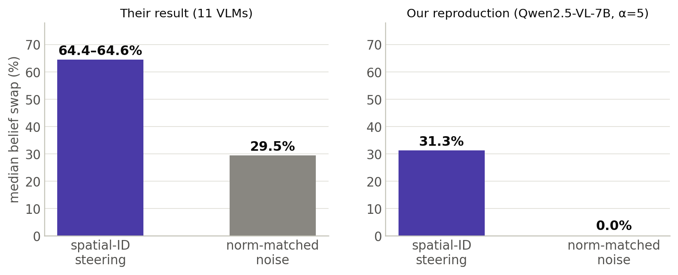
ACT 4 · KANG ET AL. (CALTECH, ICLR 2026)
Kang et al. — what they found
Spatial IDs are LOW-RANK:
rank-3 linear fit of the encoder's positional encodings explains them (R² 0.854–0.903).
Patching localizes their influence to the object's WORD token
at a narrow band of middle LM layers (image early, object-word middle, text late) — which they INTERPRET as binding.
Steering them flips beliefs:
median 64.4–64.6% vs 29.5% noise. Ours reproduces a positive target-direction vs matched-noise contrast (31.3% vs 0.0%).
arXiv:2601.12626 — Fig.2 (64.4%) / §3 text (64.6%) / App. Table 2 (rank-3 R²). Our reproduction: reports/m3_reproduction.md.
37
Notes:
Note the honest wrinkle: our absolute swap rate is lower; our noise floor is 0% vs their 29.5%. Our intervention shows a positive signal-to-noise contrast, but its magnitude is NOT directly comparable with theirs — doses, noise construction, and selection differ. Nothing was tuned.

Slide 38
ACT 4 · KANG ET AL. (CALTECH, ICLR 2026)
Kang et al. — the two facts we build on
Fact 1 — internal IDs track qualitative answer correctness (their protocol).
Wrong verbal answers co-occur with wrong internal IDs (LLaVA & LLaMA, Mann-Whitney): when the model said the wrong side, the internals were already wrong — arguing, FOR THE TESTED MODELS AND TASKS, against a purely final-verbalization explanation. (Scope: their models, stimuli, relation set — not a universal law.)
Fact 2 — nothing metric was ever tested.
No continuous distance, no depth, no trained probes. Their own loose end: LLaVA's front/behind collapses onto above/below — whether metric depth is latently present is flagged open.
And their experimental supervision and evaluation are DISCRETIZED to a 4×4 grid (IDs ≈ rank-3 under it) — the internal channel could still carry finer structure. Whether continuous precision survives at these sites is exactly our question — they never ask it.
arXiv:2601.12626 §4.1–4.2. ⚠ wording: rank-3 ≠ 'incapable of precision' — 3 continuous dims can carry arbitrary precision; the discretized supervision MOTIVATES H2 without supporting or proving it (compatible with ordinal-only AND continuous-sampled codes).
38
Notes:
The wording warning is deliberate — we retracted a 'rank-3 therefore incapable' argument once. State it as an open empirical question.

Slide 39
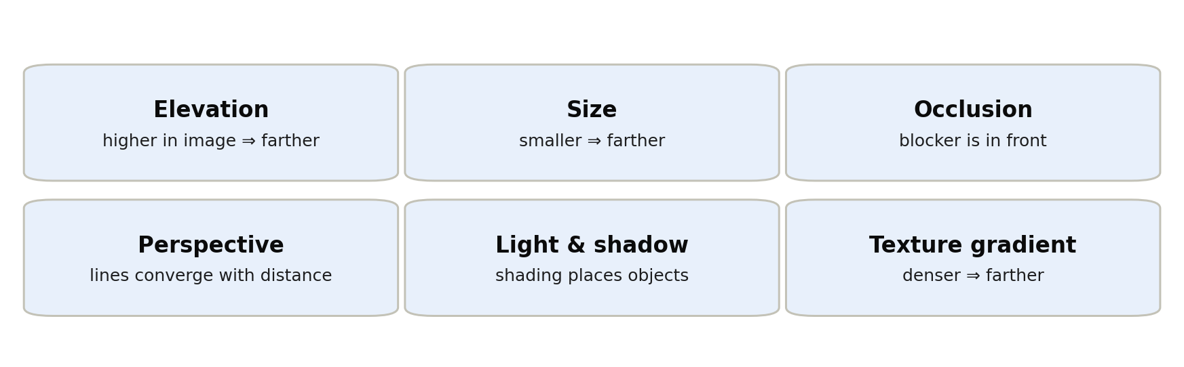
ACT 4 · DEPTHCUES (CVPR 2025)
Anchor 2 · DepthCues — the input endpoint
The six monocular cues humans use for depth — psychology's inventory, turned into six probing tasks over VISION ENCODERS.
DepthCues, arXiv:2411.17385 (CVPR 2025) — elevation, light & shadow, occlusion, perspective, size, texture gradient; 20 pre-trained vision models.
39
Notes:
Bridge from Act 2: the same cues that can become correlated predictors in natural benchmarks are, here, the measurement target at the encoder.

Slide 40
ACT 4 · DEPTHCUES (CVPR 2025)
DepthCues — result, stated carefully
Result: all six depth cues are DECODABLE from modern vision encoders (20 models: DINOv2, CLIP, StableDiffusion, DepthAnything…), and cue-probing performance correlates with depth-estimation quality.
⚠ Precision matters — bottom rung of the ladder:
this shows depth-RELATED information is RECOVERABLE from encoders by a trained probe. It does not show 'the metric signal exists' there in usable form, and says nothing about the VLM pipeline after the encoder.
Related: metric depth IS extractable from VLMs after fine-tuning (DepthLM) — but fine-tuning can CREATE or reorganize a representation, so this constrains 'absent' claims only weakly.
⇒ INPUT ENDPOINT, weak form: complete cue blindness is unlikely — but this does NOT establish an integrated or metric depth representation, nor anything past the encoder.
arXiv:2411.17385 (no single headline correlation coefficient is given — stated qualitatively, per the paper). DepthLM: ICLR 2026 (metric depth via fine-tuned prompt/head).
40
Notes:
This 'recoverable ≠ present-in-usable-form' discipline is why our design has an image-identifiability gate before any encoder claim.

Slide 41
ACT 4 · WANG & GAO (PITT, 2026)
Anchor 3 · Wang & Gao — probing the LM side
Question: is 3D scene geometry present in the LM's hidden states?
Data: SynSpat3D — 1,000 fully synthetic scenes with exact geometry (5,000 video-question pairs). Synthetic gives exact ground truth and ENABLES controlling priors — it does not eliminate shortcuts automatically (our Act 6 war stories are the proof).
Method: trained probes on MASK-POOLED object tokens (average the visual tokens under each object's mask) at LM decoder layers.
Models: Qwen2.5-VL-7B, InternVL3-8B.
Targets: object x/z coordinates, pairwise 3D distance, and — as the control — object SHAPE.
Wang & Gao, arXiv:2605.07148. Paper Fig.2 (pipeline): arxiv.org/html/2605.07148v1/x2.png
41
Notes:
'Mask-pooled' will matter enormously in Part B (the position leak lives exactly there). Plant the term now, neutrally.

Slide 42
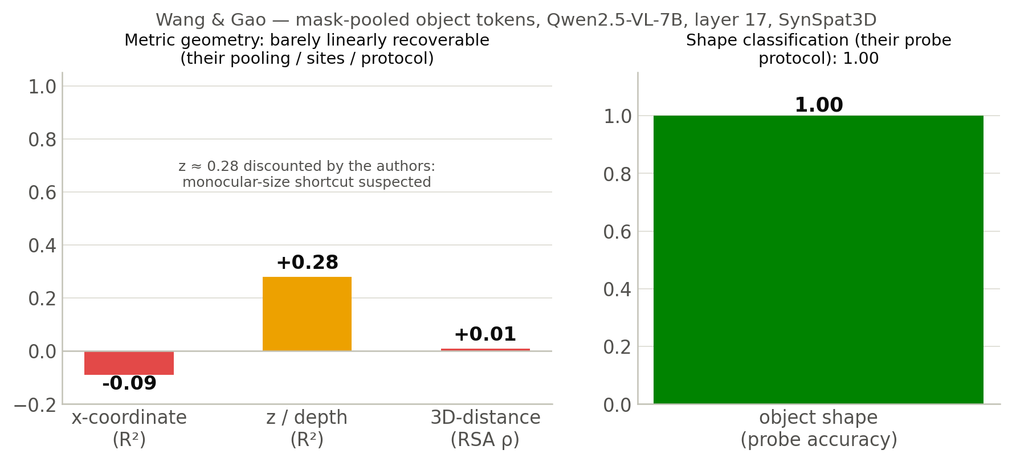
ACT 4 · WANG & GAO (PITT, 2026)
Wang & Gao — the numbers
Shape classification under their probe protocol: 1.00. Metric geometry: barely LINEARLY recoverable — under their pooling, sites and protocol (x is WORSE than predicting the mean). The z≈0.28 they themselves discount as a size-shortcut suspect.
arXiv:2605.07148, App. B (Qwen2.5-VL-7B, L17): x R²=−0.09±0.01, z R²=+0.28±0.02, distance RSA ρ=+0.01±0.01, shape acc=1.00. ⚠ their Fig.4 prints '+0.09' for x; the appendix confirms negative.
42
Notes:
Challenges hypothesis 2's naive form — under their pooling, sites and protocol. A probe null never rules out nonlinear, distributed, or differently-sited information (Act 6 shows instrument caveats cut both ways). Also note: shape 1.00 is ACCURACY (classifier), not R².

Slide 43
ACT 4 · WANG & GAO (PITT, 2026)
Wang & Gao — what survives, what's open
What remains detectable: relative-neighborhood structure.
After projecting out the identity/semantic subspace, a relative-neighborhood structure is statistically detectable at middle layers under their analysis (Dirichlet energy vs a 1,000-permutation null) — detectable-under-this-analysis, not 'the model keeps a topology it uses'.
And a topology-inspired regularizer improves downstream performance: Dirichlet-energy LoRA, 500 steps, transfers zero-shot (+6.3 VSI-Bench, +7.0 MindCube on Qwen vs naive LoRA) — improvement, not proof that the detected structure is the causal mediator.
What's left open — three things we take:
metric-vs-topology never dissociated (rank order recovered, faithful distance never tested) · only LM layers probed — encoder and projector untouched · steering shown only on the PROBE readout (90% sign-correct), never on the verbalized answer.
arXiv:2605.07148 — Fig.7 (Dirichlet), Table 1 (LoRA), App. C (54/60=90.0% sign-correct; v⊥ 48.3%≈chance).
43
Notes:
Framing for our claim: theirs is ONE region of the pipeline. The x=−0.09 is the reading at LM layers — where it became weak is unmeasured. Localizing that is the question our protocol is designed to test.

Slide 44
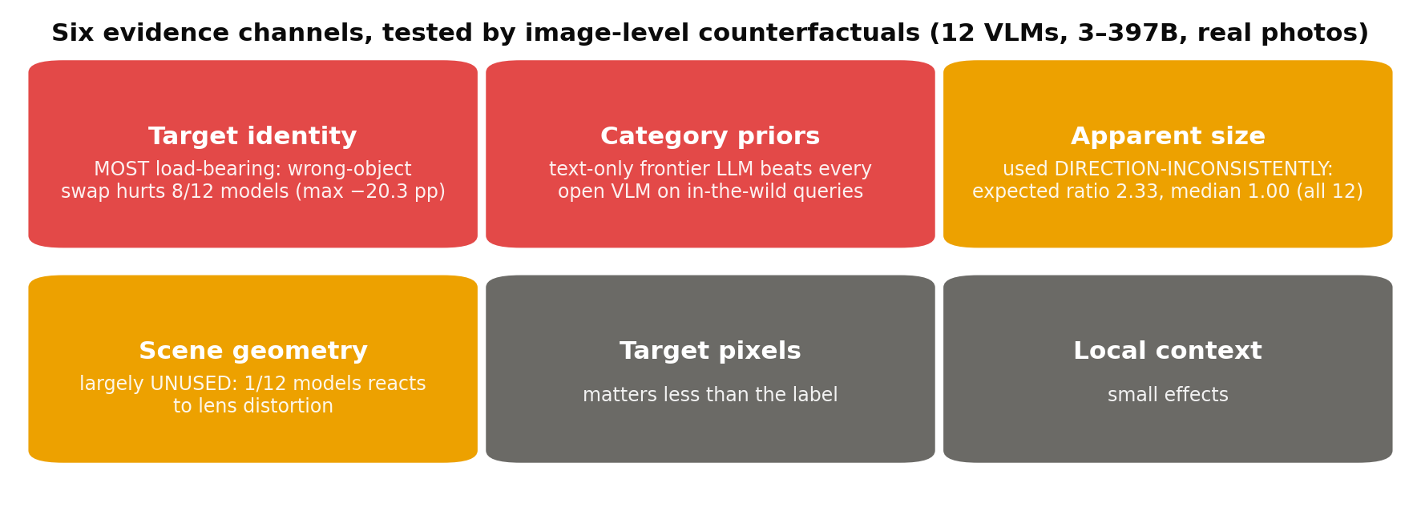
ACT 4 · ILL-POSED BY DESIGN (2026)
Anchor 4 · Ill-Posed by Design — the output endpoint
arXiv:2606.24335 — Metric VQA: 10,813 queries; 331 tape-measured in-the-wild queries / 70 photos; 12 open VLMs (3–397B). Paper Fig.1: arxiv.org/html/2606.24335v1/_page_1_Figure_2.jpeg
44
Notes:
Method in one line: edit ONE evidence channel in a real photo (swap the object, distort geometry, resize) and watch the metric answer. Behavioral counterfactuals — no internals.

Slide 45
ACT 4 · ILL-POSED BY DESIGN (2026)
Ill-Posed by Design — the two conclusions
1 — Behaviorally, metric answers are 'category-level priors with selective visual modulation'.
Identity dominates (wrong-object swap hurts 8/12 models, up to −20.3 pp); apparent size is used without a consistent direction (expected ratio 2.33, observed median 1.00 — every model); geometry is nearly untouched (1/12 reacts to lens distortion).
2 — In the tested LoRA setups, training did not demonstrably install geometry.
LoRA fine-tuning learns the task (+2 to +12 pp) WITHOUT gaining apparent-size or perspective sensitivity — consistent with sharpened priors rather than new measurement (their setups; not a law about all training).
⇒ OUTPUT ENDPOINT: under their perturbations, outputs show weak sensitivity to scene geometry. Together with DepthCues this is an UNRESOLVED CONTRAST — cue information decodable at encoders, weak geometric sensitivity at outputs — and none of the studies reviewed here directly links the two observations. That link is the open question.
arXiv:2606.24335, §6 + LoRA experiments (Qwen2.5-VL-3B +11.6, LLaVA-v1.6 +9.9, Qwen2.5-VL-7B +2.1 pp).
45
Notes:
The LoRA result also previews our S2 stage (method audit): fixes that improve scores without touching the mechanism.

Slide 46
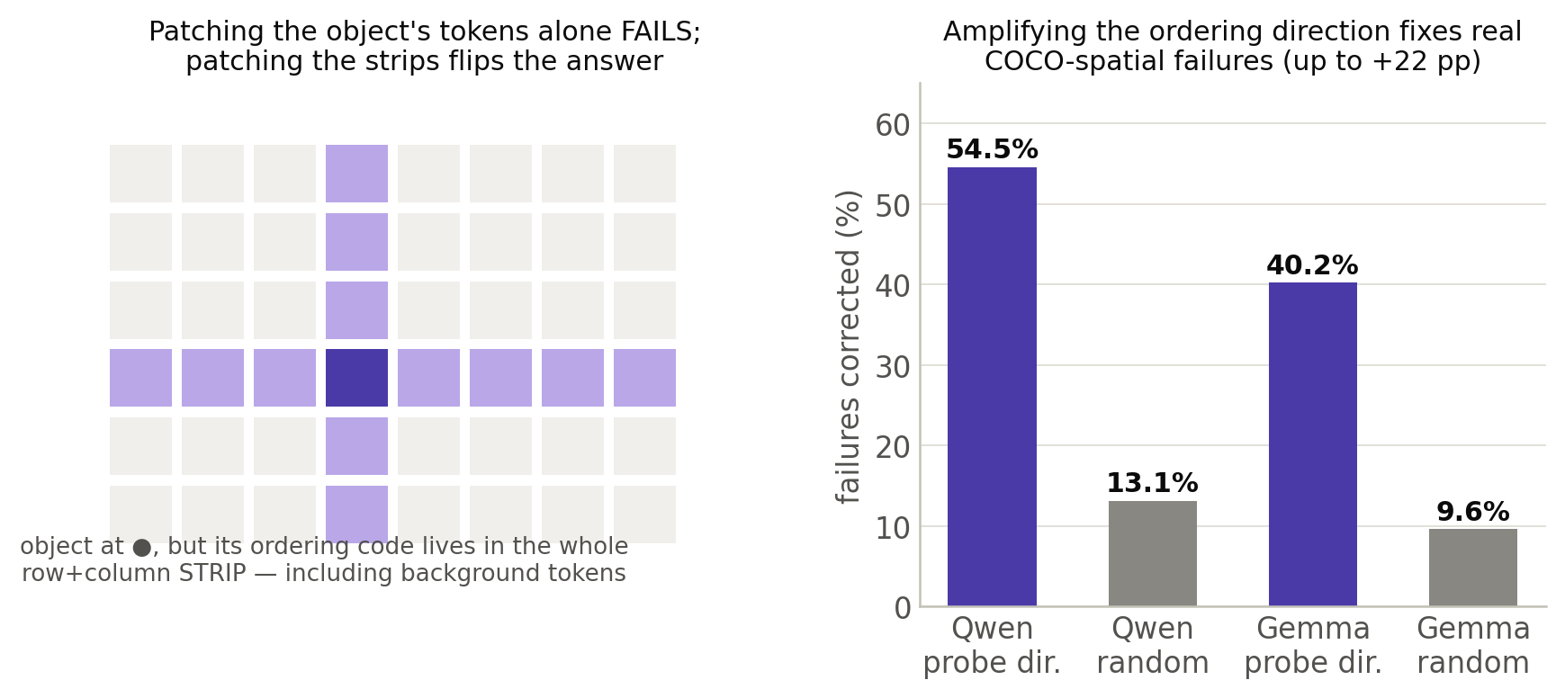
ACT 4 · CUI ET AL. (BAU & TORRALBA GROUPS, 2026)
Anchor 5 · Cui et al. — where the ordinal code lives
Cui et al., arXiv:2603.22278 v2 — COCO-spatial: 2,687 natural images; correction 54.5%/40.2% vs random 13.1%/9.6% (Qwen/Gemma), up to +22 pp; both option orders evaluated. Code/data: spatial.baulab.info
46
Notes:
Two surprises: (1) the code is DISTRIBUTED — background strips carry it, object tokens alone don't; (2) amplifying the probe direction corrects a substantial subset of errors on natural images.

Slide 47
ACT 4 · CUI ET AL. (BAU & TORRALBA GROUPS, 2026)
Cui et al. — what we adopt, where we differ
Adopted into our methodology (their standards are the field's best):
probe strips/all tokens, not just object-pooled (in their setup, object-only probing underestimated the distributed signal) · evaluate under both option orders · random-direction nulls for any steering.
Terminology landmine:
their 'spatial variable binding' = ordinal ordering-IDs inside the LM. OUR 'binding' = the vision→object-word-token transfer step (Kang's sense). Same word, different mechanisms — we cite them as the ordinal counterpart.
What they never measure: anything METRIC, site-wise decomposition (post-projector only), object-word text-token sites, probe-vs-verbalization.
arXiv:2603.22278 v2, §5.2–5.3, App. A.3.
47
Notes:
Also: they found an LM-side BACKUP mechanism that partially reconstructs ordering when the vision-derived signal is ablated — redundancy exists for ordinal; unknown for metric.

Slide 48
ACT 4 · SYNTHESIS
Assembling the map: a pincer, and a hole
IN: depth-related CUE information is recoverable in vision encoders (DepthCues). OUT: tested VLM outputs show weak sensitivity to controlled geometric evidence (Ill-Posed). ⚠ The relationship between those two observations is UNMEASURED — that is the point. MIDDLE: raw metric weak at LM layers under W&G's protocol; qualitative and ordinal relations have PARTIALLY CHARACTERIZED internal mechanisms (Kang, Cui).
The studies reviewed here do not provide a full-chain trace of a controlled continuous depth variable — where it becomes less recoverable, and whether or where it becomes causally unavailable, is unmeasured.
Synthesis: ours. Sources as per previous slides.
48
Notes:
Pause here. If the audience holds one slide from Act 4, it's this one.

Slide 49
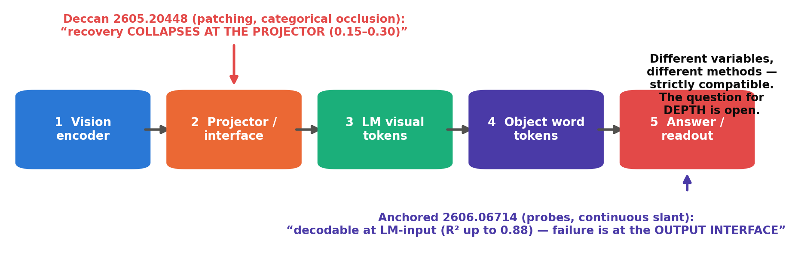
ACT 4 · TWO LOCALIZATION HYPOTHESES
…then two papers motivated opposite localization hypotheses
Deccan AI, arXiv:2605.20448 (May 2026) · Anchored Not Graded, arXiv:2606.06714 (June 2026).
49
Notes:
Careful framing (Design Rev 3): the two RESULTS are strictly compatible — different variables, methods, models. It is their INTERPRETATIONS that point at opposite ends. Say 'competing localization hypotheses', never 'they contradict each other'.

Slide 50
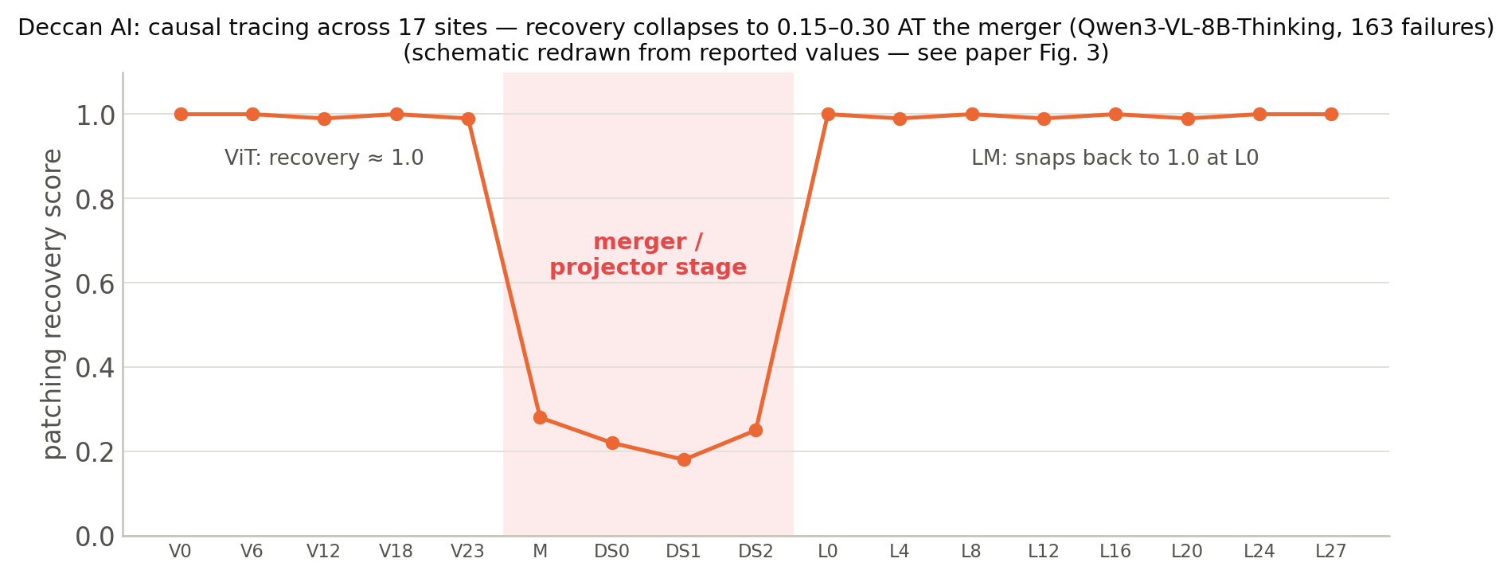
ACT 4 · TWO LOCALIZATION HYPOTHESES
Deccan: a recovery discontinuity at the projector
Causal tracing (patching) at 17 sites, occlusion counterfactuals, Qwen3-VL-8B-Thinking, 3,034 human-curated samples: recovery ≈1.0 through the ViT, drops to 0.15–0.30 across the merger/projector, snaps back at LM L0. The snap-back shows clean downstream activations restore behavior under patching — not what remains naturally encoded in the corrupted run. A causal-recovery discontinuity under their protocol, for a CATEGORICAL variable.
arXiv:2605.20448 — §6, Fig.3 (redrawn; original: arxiv.org/html/2605.20448v1/figures/fig_causal_tracing.png). Also: the depth-relevant region receives <5% of visual attention.
50
Notes:
Their variable is CATEGORICAL (occlusion present/absent), their method is patching. Keep those qualifiers — they matter for reconciling with the next slide.

Slide 51
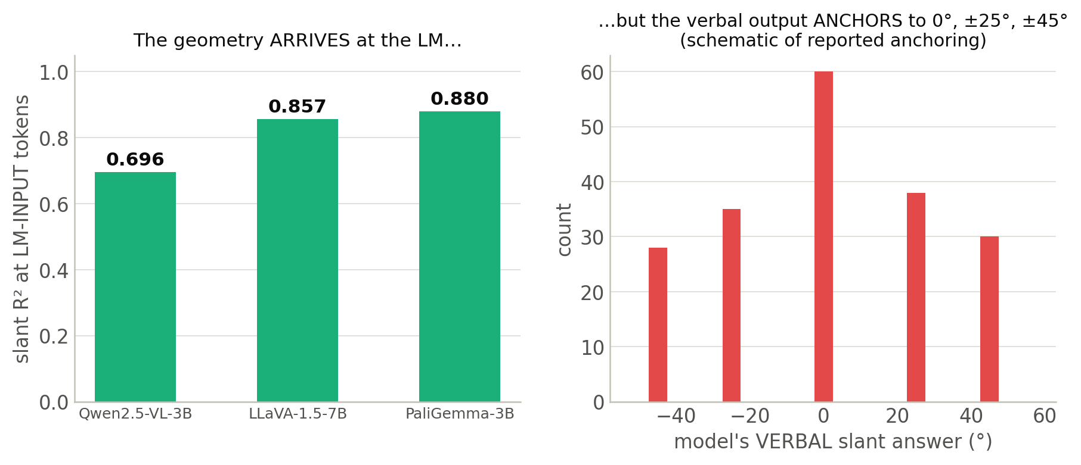
ACT 4 · TWO LOCALIZATION HYPOTHESES
Anchored: decodable at LM-input; the LM interior unmeasured
Continuous surface slant, factorial synthetic stimuli (10 slant × 10 FOV × 2 curvature), 4 VLMs: slant is decodable at LM-INPUT visual tokens (R² 0.696–0.880) while the verbal answer anchors to a few canned values. THEIR interpretation: a representation-to-output interface failure — but the LM computation itself is unmeasured (their declared future work), so the failure location inside the LM is unresolved.
arXiv:2606.06714 v2 — R² 0.696 (Qwen2.5-VL-3B) / 0.857 (LLaVA-1.5-7B) / 0.880 (PaliGemma-3B); anchoring to 0°, ±25°, ±45°. Right panel: schematic of reported anchoring.
51
Notes:
Their variable IS continuous (like ours) but they stop at LM-input: exactly where Deccan says everything recovers. The two papers barely overlap in what they measured — which is why both can exist.

Slide 52
ACT 4 · TWO LOCALIZATION HYPOTHESES
What the two results do — and do not — establish
They measured different things — the results are strictly COMPATIBLE:
Deccan: CATEGORICAL variable (occlusion), PATCHING method, sites through the LM. Anchored: CONTINUOUS variable (slant), PROBING method, stops at LM-input.
And neither has:
a controlled continuous METRIC variable (depth/distance) · probes at object-word BINDING sites · selection-leak-controlled probing (Part B: mask-pooled probes can read position from the pooling itself) · the full chain in one design.
Together they pose a variable-specific localization question not answered by the studies reviewed here: does controlled continuous DEPTH follow a projector-, binding-, or readout-bottleneck pattern?
Comparison: ours, from both papers' methods sections (2605.20448 §6; 2606.06714 §4–5).
52
Notes:
Design Rev 3 framing: their INTERPRETATIONS compete; their results don't strictly conflict. We test which localization pattern holds for controlled depth — attribute interpretations to their authors; never assert a published contradiction.

Slide 53
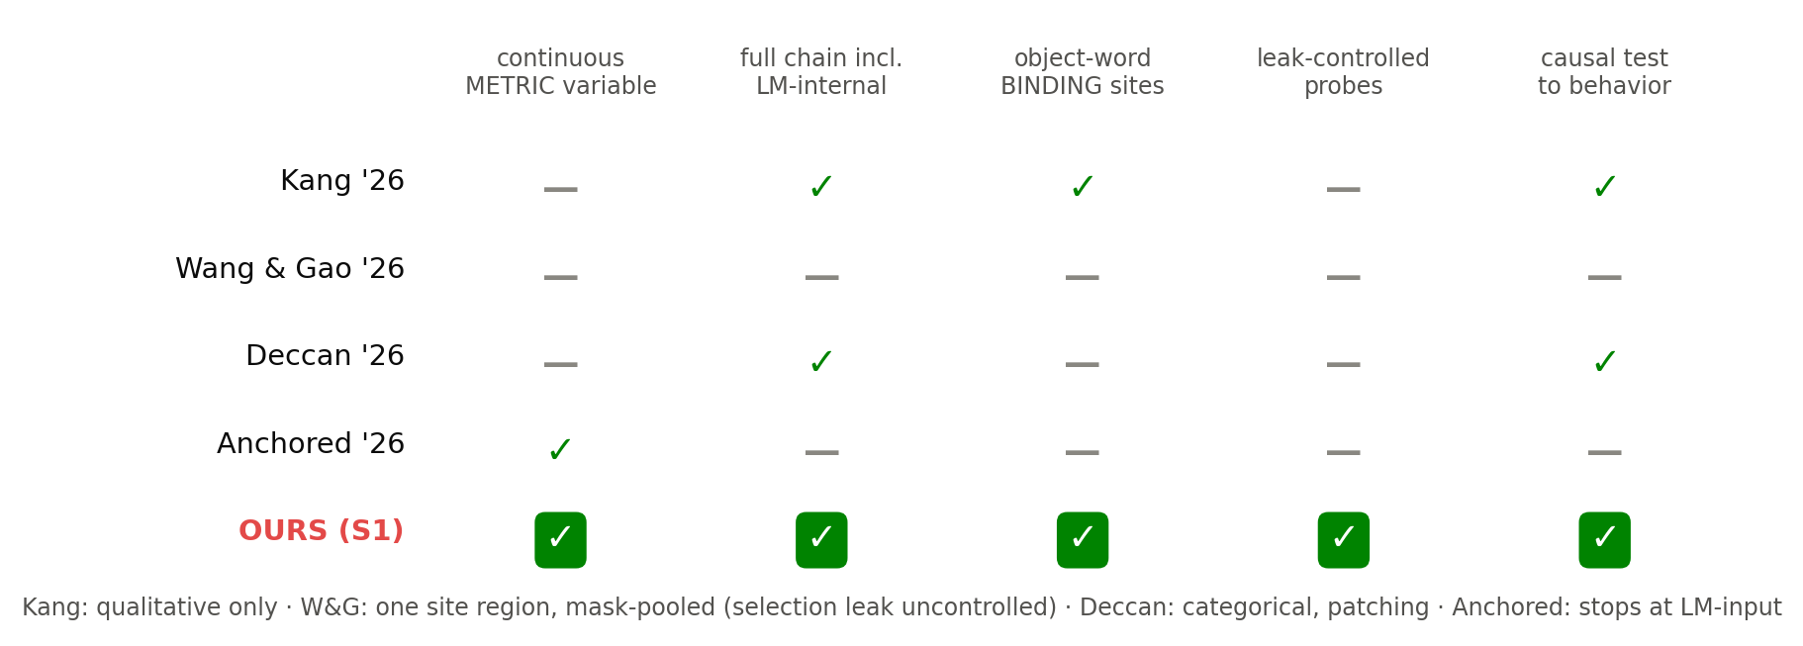
ACT 4 · THE GAP
The gap, as a checklist
Rows from each paper's methods: 2601.12626 · 2605.07148 · 2605.20448 · 2606.06714. Our row = S1 design (Part B).
53
Notes:
Claim, pre-result form (Design Rev 3): a stage-wise, trivial-feature-controlled protocol for tracing object-specific depth — CONTINUOUS depth as probe target, ORDINAL ordering as behavioral anchor — across the functional chain including object-word sites, testing which localization pattern holds. 'First' waits for results + a fresh sweep.

Slide 54
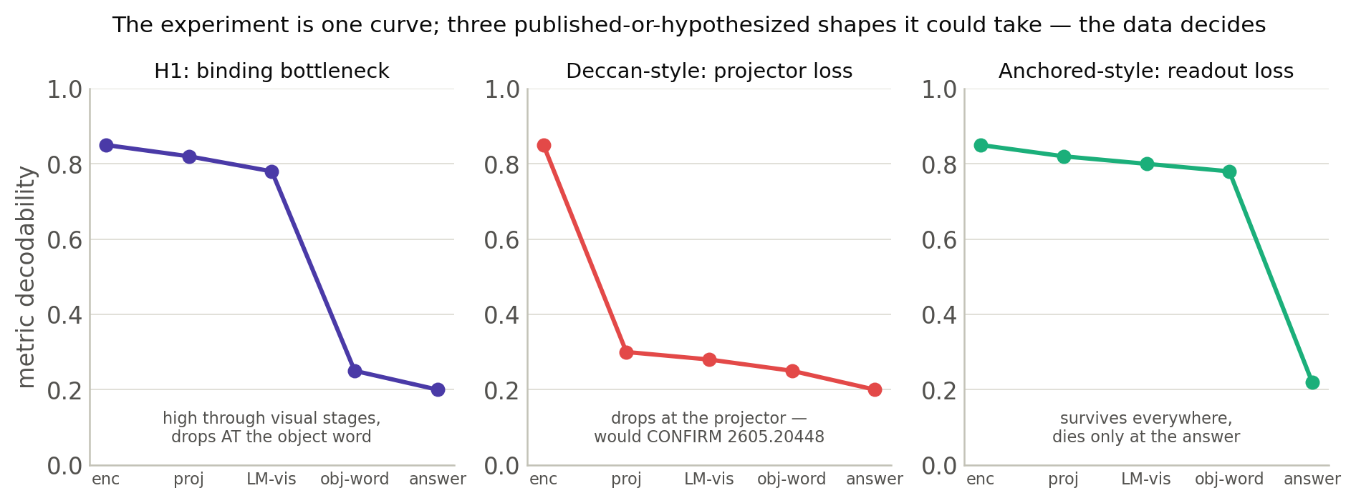
ACT 4 · OUR HYPOTHESES
Our bet: H1 and H2 — and the curve that decides
H1 — WHERE: continuous depth declines at object-word sites (probe-level; the causal half is tested separately). H2a — representational SELECTIVITY of that decline: ordinal survives there while continuous drops (extends H1, not independent of it; difficulty-matched comparison required). H2b — causal selectivity: continuous interventions show weaker object-specific mediation than ordinal ones. One location claim, two selectivity claims layered on it. Stated as bets — the instrument is fixed, the conclusion is not.
H1/H2: our S1 hypotheses. Curve shapes: left = H1; middle = the pattern 2605.20448 reports (categorical occlusion, patching); right = the pattern 2606.06714 suggests (slant, probes to LM-input only).
54
Notes:
Wording discipline: 'becomes unavailable or unusable', never 'destroyed' — erased / recoded / detached / ignored / corrupted are five different mechanisms and the design distinguishes them.

Slide 55
WRAP-UP
End of Part A — what Part B covers
You can now read this literature:
you know the machine (5 stages), the phenomenon (qualitative ≫ metric), why benchmarks can't explain it (priors + single-cue reliance), the tools (probe / patch / steer + ladder), and the state of the art (two endpoints, one open localization question).
Part B — our experiment:
the synthetic stimulus battery that decorrelates the cues · the five-stage probing grid with its controls · the war stories (how our own first instrument lied to us, and the position leak we found in the field's method) · current status and timeline.
One question to take home: how would YOU test whether a model represents something it cannot say?
—
55
Notes:
Collect their answers to the take-home question at the start of Part B — several will have reinvented probing or oracle injection, which is the best possible setup.

