Slide 1
Designing a Controlled Spatial Dataset for Tracing Metric Spatial Information in VLMs
From M1 v0 to the M4a stimulus battery
Research aim: locate where continuous metric depth remains encoded, becomes inaccessible, or is not used Dataset aim: make the image evidence valid, identifiable, and not explainable by trivial shortcuts
Prepared from repo state and pilot renders in /data3/hugin/vsr/stimuli · July 2026

Slide 2
OVERVIEW
Deck Flow
The dataset design is the load-bearing bridge between the research question and model probing.
Research purpose
Plan
Prior work
Dataset design
Where does metric depth fail in the VLM chain?
M1 -> M3 -> M4a -> M5/M6
Kang spatial IDs; Wang & Gao latent topology
v0 audit -> M4a controlled regimes
The central point: M4a is not just image generation. It is construction of a measurement instrument.

Slide 3
RESEARCH
Research Purpose
Trace continuous metric spatial information through the VLM computation chain.
Question: where does metric spatial information become unavailable, inaccessible, causally inert, or unused?
Qualitative / ordinal anchor: left/right, front/behind, nearer/farther.
Metric probe target: continuous depth z, depth ratio, lateral/world position.
Causal question: if we change the representation, does the answer move?
The project does not assume metric information is “destroyed.”
It separates encoding, accessibility, alterability, and natural use.
This requires stimuli whose ground truth and visual evidence are both valid.

Slide 4
RESEARCH
Why Accuracy Is Not Enough
A model can answer a spatial question without using metric spatial representation.
Mask / bbox geometry
Scene cue shortcuts
Prompt / answer artifacts
centroid, area, height, object extent
apparent size, elevation, category priors
option order, tokenization, wording
A high probe score only counts as representation evidence if it beats prespecified nuisance baselines and holds under held-out factors.
This is why the deck focuses on dataset design before model results.

Slide 5
RESEARCH
Functional Chain to Be Tested
M5/M6 will only be meaningful after M4a clears the stimulus gate.
Image
Vision encoder
VL interface
Early multimodal LM
Object-word tokens
Answer/readout
Verbal answer
At each stage: is continuous depth decodable above nuisance baselines?
At language-bound stages: is the information object-specific, not just globally present?
At intervention stages: does changing the depth-related representation change belief/readout?

Slide 6
PLAN
Project Plan Around Dataset Construction
M1 and M3 determine what M4a must fix.
M1
Minimal renderer + v0 stimuli
Build the first controlled image/annotation pipeline.
M3
Reproduction / audit
Use prior-work methods to test whether v0 is a usable substrate.
M4a
Stimulus battery v1
Redesign stimuli so evidence is valid and shortcuts are measured.
M4b
Activation cache
Extract five-stage representations only after M4a passes.
M5/M6
Probe + intervene
Locate and test causal use of metric depth.
Current status: M4a is still in progress; full M4b extraction is locked until the stimulus gate passes.

Slide 7
PRIOR WORK
Prior Work 1: Kang et al. Spatial IDs
A causal object-word intervention framework for spatial beliefs.
Claim: object locations are linearly bound into object-word activations as spatial IDs.
Pipeline: Objaverse renders -> 4x4 grid -> object-word activations -> spatial-ID extraction.
Intervention: add/subtract mirror spatial-ID directions and measure left/right belief swap.
Paper headline: spatial-ID steering ~64.4% noise ~29.5% above-chance influence 43.6%
Our M3.1: qualitative mechanism reproduced; absolute effect size did not. This supports the existence of a spatial-ID-like mechanism but does not locate continuous metric depth.
Source: Kang et al., arXiv:2601.12626.

Slide 8
PRIOR WORK
Prior Work 2: Wang & Gao Latent Spatial Topology
A probing and regularization study of spatial topology in VLM latent space.
SynSpat3D: synthetic scenes with independently sampled shape, color, size, and 3D position.
Default probing corpus: 1,000 Free6DoF scenes, 16 frames each, 5 questions per scene.
Object representation: mask-driven, coverage-weighted pooling over visual tokens.
Targets: color, shape, x-coordinate, z-coordinate, and 3D-distance topology.
Reported Qwen L17 pattern: color 0.51 ± 0.02 shape 1.00 ± 0.00 x R² -0.09 ± 0.01 z R² +0.28 ± 0.02 3D-distance RSA +0.01 ± 0.01
Their story: non-geometric semantics dominate; 3D topology is weak but can be shaped by a Dirichlet-energy regularizer.
Source: Wang & Gao, arXiv:2605.07148.

Slide 9
PRIOR WORK
Why Our M3.2 Was an Audit, Not a Strict Reproduction
The original SynSpat3D distribution and our M1 v0 were fundamentally different.
Wang & Gao SynSpat3D
Our M1 v0
Multi-object scenes: appendix default 3-8 objects.
16-frame egocentric rendering.
Free6DoF random camera paths.
Shape/color/size/position sampled independently.
Designed for latent scene topology / cognitive-map analysis.
Two target objects only.
Single image.
Fixed camera.
Congruent cues only.
Fixed lateral offset and shared size multiplier.
Correct interpretation: M3.2 used Wang & Gao-style probing to audit v0; it did not reproduce their full dataset.

Slide 10
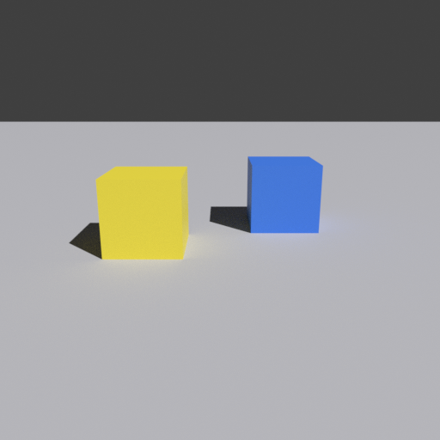
M1 V0
M1 v0 Dataset: What It Was For
A minimal renderer and geometry-validation substrate, not the final science dataset.
500 images at 512x512, rendered with Blender/Cycles CPU.
Objects: cube, sphere, cylinder.
Two target objects on a ground plane; no distractors.
Fixed camera; fixed lateral offset; congruent depth/size/elevation cues.
Outputs: RGB image, masks, bboxes, retinal size, 3D positions, depth, pair relations.
v0 example: fixed side + congruent cues
v0_congruent_00000 near: yellow_cube z=4.12, h=108px far: blue_cube z=4.88, h=89px regime: congruent; distractors=0
Key config: lateral_offset = 0.7 depth_gaps = [0.5, 1.0, 1.5] shared size multiplier = [0.9, 1.0, 1.1]

Slide 11
M1 V0
What v0 Validated, and What It Could Not Validate
M1 was an engineering success; M3 showed it was not a valid metric-probing instrument.
Validated
Not validated
M3 finding
renderer, annotations, masks, projection checks, config-driven generation
whether metric targets were non-trivial and shortcut-resistant
the pipeline could run correctly while the dataset measured the wrong thing
The lesson: a stimulus set is not accepted because images were rendered. It is accepted only when its outputs satisfy the invariants needed for the scientific claim.

Slide 12
M3 AUDIT
v0 Problem 1: Lateral x Was a Side Label
The target did not behave like a continuous metric coordinate.
v0 lateral position: object A: x ≈ -0.7 object B: x ≈ +0.7
A probe could classify left-vs-right rather than estimate a continuous coordinate.
Mask-pooled tokens are selected by image location, so the selected token set already carries side information.
High x R² on v0 is therefore not evidence of a metric spatial representation.
v0: fixed left/right placement
v0_congruent_00000 near: yellow_cube z=4.12, h=108px far: blue_cube z=4.88, h=89px regime: congruent; distractors=0

Slide 13
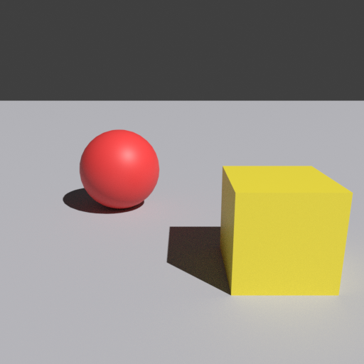
M3 AUDIT
v0 Problem 2: Depth z Was Overdetermined by Apparent Size
Congruent cues made the depth target too easy.
In a pinhole camera, retinal size is tied to physical size divided by depth.
v0 used shared size multipliers, so near/far apparent size tracked depth strongly.
This makes z-depth decodable from image geometry without needing VLM representations.
v0: near object visibly larger
Measured in M3 report: depth correlated with size_m / retinal_size_px mask geometry alone predicted z near ceiling
v0_congruent_00496 near: yellow_cube z=2.66, h=183px far: red_sphere z=4.01, h=111px regime: congruent; distractors=0

Slide 14
M3 AUDIT
v0 Problem 3: Mask Pooling Leaked Position
The measurement procedure can carry the answer before the model contributes anything.
object mask -> select visual tokens at object location -> average features -> train probe
The token indices selected by the mask already encode where the object is in the image.
On v0, mask centroid and bbox geometry alone predicted x and z extremely well.
Therefore activation decodability must be reported above nuisance-feature baselines.
M3 v0 leak ceiling: mask geometry alone -> x R² ≈ 0.942, z R² ≈ 0.972. Mask-pooled activations added only a small increment for x/z.

Slide 15
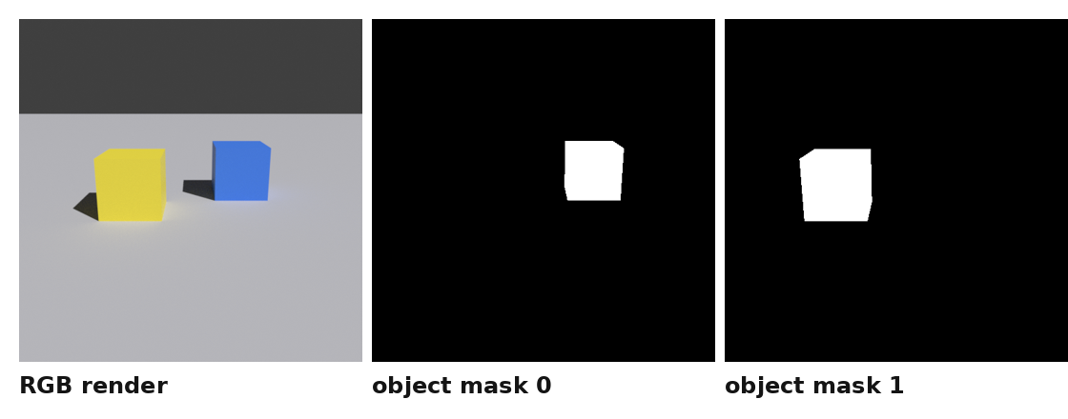
DATASET
Each Rendered Item Is More Than a PNG
The annotation and masks are part of the measurement instrument.
RGB image: what the VLM sees.
Visible object masks: define target regions and validate bboxes/areas.
Geometry annotations: 3D position, camera coordinates, depth, pair relations.
Factors: regime, depth gap, category pairing, size condition, camera jitter, distractor count.
Validation rule: check the output invariant, not just whether the render script ran.

Slide 16
M4A
M4a Goal: Build a Valid Measurement Instrument
The stimulus must contain metric evidence without making the answer trivial.
M4a target: image-identifiable metric relations + decorrelated nuisance features + validated geometry.
Identifiable
Not shortcut-solved
Traceable
The image must contain enough evidence for the target variable.
No single trivial feature should carry the main claim.
Every result ties back to config, seed, commit, and annotation.

Slide 17
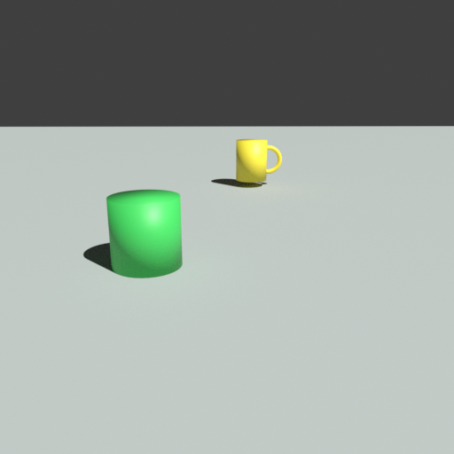
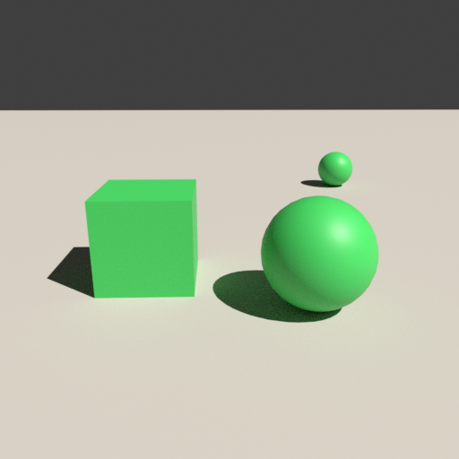
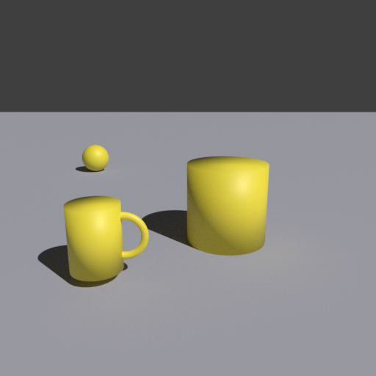
M4A
M4a Uses Three Regimes
Each regime answers a different experimental question.
Natural-congruent: all cues agree
Counterbalanced: shortcut cues decorrelated
Conflict: cues intentionally disagree
m4a_v1_natural_congruent_pilot_00000 near: green_cylinder z=4.13, h=100px far: yellow_mug z=8.01, h=49px regime: natural_congruent; distractors=0
m4a_v1_counterbalanced_pilot_j2_00049 near: green_sphere z=3.03, h=130px far: green_cube z=3.50, h=133px regime: counterbalanced; distractors=1
m4a_v1_conflict_pilot_00037 near: yellow_mug z=2.93, h=116px far: yellow_cylinder z=3.72, h=135px regime: conflict; distractors=1

Slide 18
M4A
Regime 1: Natural-Congruent
A control/reference arm where depth cues agree.
Purpose: all-cues-agree reference for ordinal and ratio behavior.
Current intended generator: 400 images.
Final category set: cube, cylinder, mug, sphere.
Size condition: congruent; elevation condition: congruent.
0-1 distractors.
Pilot visual example
m4a_v1_natural_congruent_pilot_00000 near: green_cylinder z=4.13, h=100px far: yellow_mug z=8.01, h=49px regime: natural_congruent; distractors=0
Important caveat: shown pilot image is pre-final; final natural-congruent design restricts categories to a symmetric 4-set.

Slide 19
M4A
Why Natural-Congruent Became a 4-Category Set
Six categories made area congruence infeasible without reintroducing pairing confounds.
Six-category natural-congruent: required worst-case area ratio ≈ 1.7661 design available max ≈ 1.4737
Bottle/chair create worst-case silhouette-area constraints when they are near.
Per-pair floors would make category pairing predict the realized depth ratio.
Restricting the generator to a symmetric 4-set preserves role balance and keeps one uniform floor.
Adopted final natural-congruent generator: {cube, cylinder, mug, sphere}. Counterbalanced and conflict still use all six categories.

Slide 20
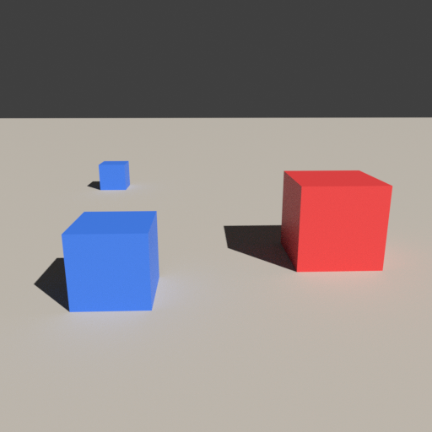
M4A
Regime 2: Counterbalanced
The primary regime for metric localization claims.
Intended scale: 900 images.
Six categories: cube, sphere, cylinder, chair, mug, bottle.
Independent size jitter.
Counterbalanced elevation cue.
0-2 distractors.
Far appears as large as near
Equal retinal size despite depth gap
m4a_v1_counterbalanced_pilot_j2_00049 near: green_sphere z=3.03, h=130px far: green_cube z=3.50, h=133px regime: counterbalanced; distractors=1
m4a_v1_counterbalanced_pilot_j2_00020 near: blue_cube z=2.88, h=120px far: red_cube z=3.55, h=120px regime: counterbalanced; distractors=1
Question: can the model represent depth when simple cues no longer agree?

Slide 21
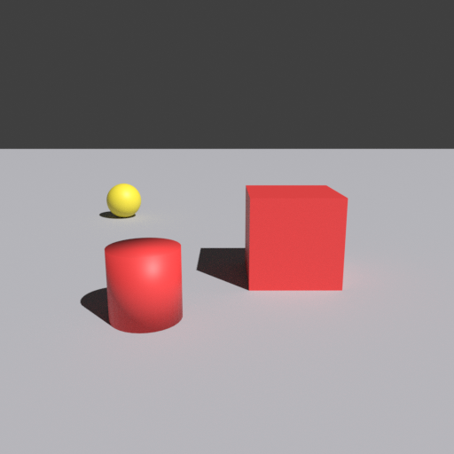
M4A
Regime 3: Conflict
Cue-integration analysis: true depth versus apparent size.
Intended scale: 900 images.
Six categories.
Near size multiplier: 0.78-0.94.
Far size multiplier: 1.12-1.30.
Far object may look as large or larger.
Far object looks larger
Far cube has larger retinal height
m4a_v1_conflict_pilot_00037 near: yellow_mug z=2.93, h=116px far: yellow_cylinder z=3.72, h=135px regime: conflict; distractors=1
m4a_v1_conflict_pilot_00030 near: red_cylinder z=3.25, h=108px far: red_cube z=4.14, h=119px regime: conflict; distractors=1
Question: which cue does the model follow?

Slide 22
M4A
What the Main Config Factors Do Visually
Each setting manipulates a cue that could otherwise carry the answer.
depth_gaps
How far apart the target objects are in depth
difficulty of near/far judgment
lateral_range
How far left/right targets appear
continuous position instead of side label
camera jitter
Viewpoint height, translation, pitch, yaw
breaks fixed image-position mapping
size_condition
Physical size relation between near/far
controls apparent-size cue
elevation_condition
Vertical image-position relation
controls ground-plane depth cue
distractors
Extra non-target objects
tests object-specific reference/binding

Slide 23
M4A
Depth Gap and Lateral Range
M4a turns categorical-looking variables into graded variables.
v0: lateral_offset = 0.7 depth_gaps = [0.5, 1.0, 1.5]
M4a: lateral_range = [0.3, 0.85] depth_gaps = [0.45, ..., 1.95]
v0 x behaved like left/right classification.
v0 depth cues were too congruent and easy.
M4a samples graded lateral positions.
Depth gaps span easier and harder cases.

Slide 24
M4A
Camera Jitter
The same 3D relation should not always map to the same 2D pattern.
height: ±0.16 m pos_x: ±0.3 m pos_y: ±0.2 m pitch: ±3° yaw: ±4°
Fixed camera makes image location a strong proxy for world location.
Jitter weakens the direct mapping between 2D position and 3D target.
This is especially important for lateral-position probes.
Design tension: stronger camera motion improves decorrelation but makes clean placement harder. This is why placement margins and validation are load-bearing.

Slide 25
M4A
Size Condition
The most direct manipulation of the apparent-size shortcut.
congruent
independent_jitter
conflict_far_larger
Near usually looks larger; all-cues-agree control.
Physical size varies independently of depth; main regime.
Far object deliberately larger; cue conflict.
M3 lesson: without this manipulation, z-depth can be read from retinal size instead of model representation.

Slide 26
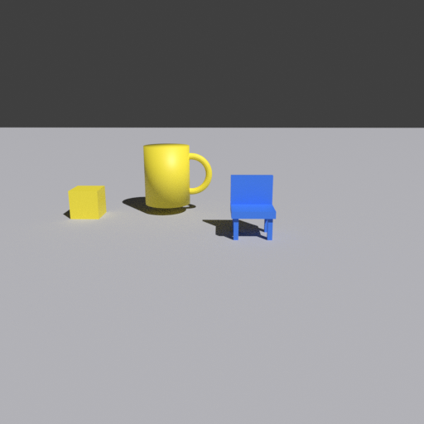
M4A
Distractors, Lighting, and Background
Nuisance variation prevents the dataset from being a two-object toy world.
Distractors force the system to bind the right object reference, not just solve a two-object layout.
Ground colors and sun energy/direction vary to reduce fixed render artifacts.
Final nuisance coverage is still part of the M4a gate: texture families, renderer seeds, and render/AA settings remain open decisions.
Counterbalanced + distractor
m4a_v1_counterbalanced_pilot_j2_00005 near: blue_chair z=4.73, h=79px far: yellow_mug z=5.77, h=78px regime: counterbalanced; distractors=1

Slide 27
M4A
The R Problem
R is the natural-congruent depth-ratio safety factor.
R = minimum required far_depth / near_depth for natural-congruent size cues to remain valid under worst-case category, size, depth, and camera settings
Near object must be closer in geometry and supported by projected size/area cues.
Some far categories can have larger silhouettes than some near categories.
Therefore the ratio floor must be derived from worst-case extrema, not averages.
Intuition: a near mug versus a far cube can violate “near looks larger” unless the far object is sufficiently farther away.

Slide 28
M4A
Current R Status
The latest cumulative ledger raised R and kept it unratified.
pass 0: R = 1.2072 pass 1: R = 1.2060 pass 2: R = 1.2026 cumulative union: R = 1.2092
Per-pass R appeared to fall because non-nested grids forgot earlier extrema.
Unioning all extrema revealed a higher lower bound.
Violations cluster at the deep end of the near-depth band, with minimum multiplier and maximum pitch.
Next pass should grid each role-specific depth range rather than the union range.
Status: R is not ratified. No full battery render or M4b extraction should consume it yet.

Slide 29
M4A
M4a Current Experimental Settings
The gate-scale configs are already defined, but the battery is not finalized.
natural-congruent N = 400 4 categories size: congruent elevation: congruent distractors: 0-1 role: control/reference
counterbalanced N = 900 6 categories size: independent jitter elevation: counterbalanced distractors: 0-2 role: primary localization
conflict N = 900 6 categories far object larger elevation: congruent distractors: 0-1 role: cue integration
Shared: 512x512, Cycles CPU, camera jitter, lateral range [0.3, 0.85], depth gaps up to 1.95, target margins.

Slide 30
STATUS
What Remains Unresolved Before M4a Acceptance
These are blocking items, not cosmetic cleanup.
R ratification: pass 3 role-specific depth refinement and fresh targeted verification.
Gate-scale render: full configured dataset has not been rendered as accepted battery.
Determinism: byte-compare verification still required for the final outputs.
Image-identifiability gate: final battery must pass held-out-factor checks.
Nuisance coverage: texture families, lighting families, renderer seeds, and render settings remain open gate decisions.
Human/contact-sheet inspection: useful for ordinal sanity only, not calibrated metric validity.
M4b remains locked: no activation cache, five-stage extraction, or lm_ans readout until M4a passes.
Rule: validate the output, not the fact that the pipeline ran.

Slide 31
STATUS
Why This Is Not Overengineering
Every major failure so far was a green pipeline producing the wrong scientific object.
v0 x
v0 z
looked like metric x; was mostly side label
looked like depth decoding; was apparent-size shortcut
mask pooling
metadata
looked like representation; selected token location leaked position
looked reproducible; dirty-tree provenance was false
The dataset is the experiment. If it is wrong, the later probing and intervention results will be uninterpretable.

Slide 32
Takeaway
M1 proved we could render controlled geometry. M3 proved the first rendered set was not a valid metric-probing instrument. M4a redesigns the dataset so M5/M6 can ask where metric spatial information is encoded, bound, and used.
The contribution depends on turning rendered images into a validated measurement instrument.
Pilot examples included for explanation only; final M4a battery awaits R ratification and gate-scale validation.

