Slide 1



AutoDebias: Learning to Debias for Recommendation
Jiawei Chen, Hande Dong, Yang Qiu, Xiangnan He,
Xin Xin, Liang Chen, Guli Lin, Keping Yang
cjwustc@ustc.edu.cn
Notes:
Hello, everyone, I am Jiawei chen from the university of science and technology of china. It’s my honor to introduce our new work “AutoDebias: Learning to Debias for Recommendation”.

Slide 2

Outline
Background
Bias Issue in Recommender System
Recent debiasing strategies
Proposed Method: AutoDebias
A uniform learning framework for various biases
Experiments
Conclusion and Future Work
Notes:
My presentation is organized with four parts. We first introduce bias issue in recommendation and review recent debiasing methods.
We then detail the proposed method, autodebias, a universal and adaptive solutions for recommendation debiasing.
After that, we will validate our autodebias with experiments.
Finally, we make a summary of our work and position some future directions.

Slide 3


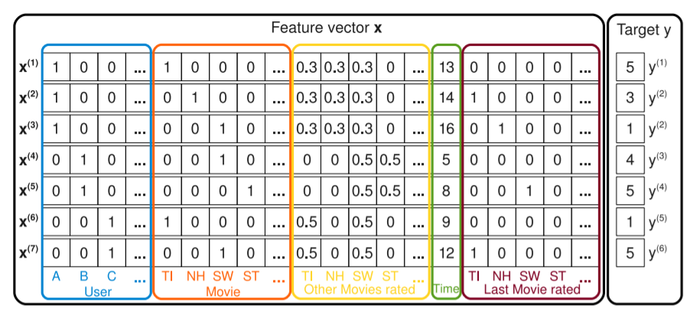
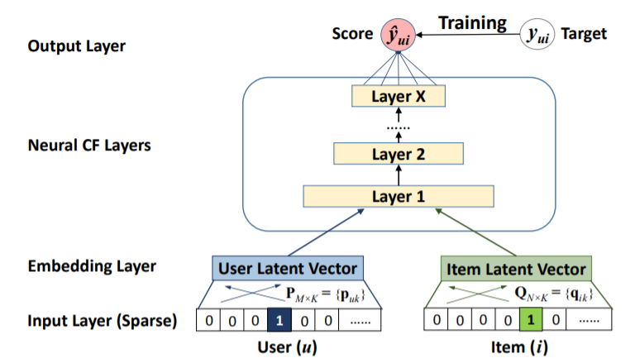
Mainstream Models: Fitting Historical Data
Minimizing the difference between historical feedback and model prediction
Predicted Score
History feedback
3 | 2 | 1 | 4
2 | 2 | 3 | 5
2 | 4 | 5 | 5
3 |  | 1
2 | 3 |  | 5
2 |  | 5
Collaborative filtering
- Matrix factorization & factorization machines
Factorization Machines
Deep learning approaches
- Neural factorization machines & graph neural networks
Neural Collaborative Filtering
2
Neural Graph Collaborative Filtering
Notes:
Recent years have witnessed various effective recommendation methods, such as matrix factorization, deep learning-based methods or graph-based methods. They are developed to better fit user historical data such that it can make a precise prediction of user future decisions.
However, although these methods exhibit powerful fitting ability, their performance may suffer in real-world RS, as the collected feedback data is often full of biases.

Slide 4
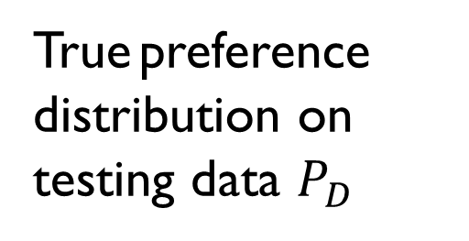
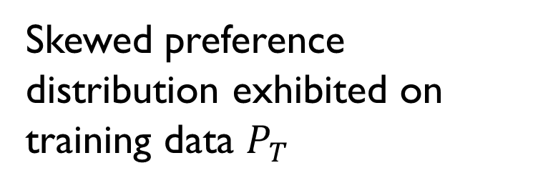
Bias is Common in RS
The data is observational rather than experimental.
Affected by user self-selection (selection bias), exposure mechanism of the system (exposure bias), public opinion(conformity bias), and the display position (position bias).
True preference
distribution on testing data $P_{D}$
Biases
Skewed preference
distribution exhibited on training data $P_{T}$
Training data deviates from reflecting user true preference.
Blindly fitting user history behavior data would yield unexpected results.
Notes:
In practice, the data is collected based on our observation rather than experiments, and the data is often affected by many factors not just based on our preference, for example, the data is affected by exposure mechanism of the system (which we usually call it as exposure bias) [34, 47], also it would be affected by public opinions (as user behavior usually conform to the major group) [25, 29]. It will be also affected by the user-self-selection or the display position (position bias) [22, 23]. These biases make the data deviate from reflecting user true preference.
As such, blindly fitting user history data without considering inherent bias would result in many serious problem, such as making skewed prediction, affect recommendation accuracy; and amplifying long-tail effect, hurt user’s experience.
As such, the importance of developing debiasing strategy can be not be over-emphasized.

Slide 5
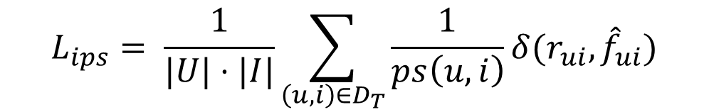
Existing Debiasing Strategy: Part 1
Biases
Test data distribution
Training data distribution
Inverse Propensity Score (IPS):
adjust data distribution by sample reweighting:
Data Imputation:
assigns pseudo-labels for missing data
IPS
$$L_{ips}= \frac{1}{|U|⋅|I|}\sum_{\left(u,i\right)∈D_{T}}{\frac{1}{ps\left(u,i\right)}}δ(r_{ui},{\hat{f}}_{ui})$$
$$L_{IM}= \frac{1}{|U|⋅|I|}(\sum_{\left(u,i\right)∈D_{T}}{δ(r_{ui},{\hat{f}}_{ui})}+\sum_{\left(u,i\right)∉D_{T}}{δ(m_{ui},{\hat{f}}_{ui}))}$$
Schnabel, Tobias, et al. "Recommendations as treatments: Debiasing learning and evaluation." international conference on machine learning. PMLR, 2016.
H. Steck, “Training and testing of recommender systems on data missing not at random,” in KDD, 2010, pp. 713–722.
Notes:
To deal with problem, there are a surge of publications on recommendation debiasing. Most of which can be classified into four types. The first type is inverse propensity score, which adjust data distribution by sample reweighting. In other word, as we can see from this figure, it aims at reweighting the contribution of each instance such that the training data distribution is consistent with the test distribution.
The second type is data imputation, it would give pseudo-labels for missing data to address selection bias.

Slide 6
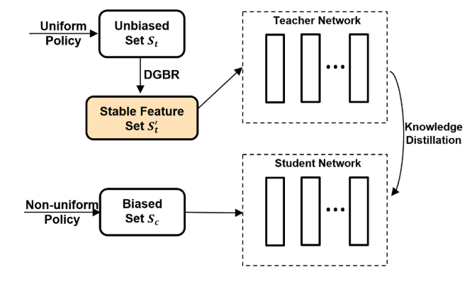
Existing Debiasing Strategy: Part 2
Generative Modeling:
assumes the generation process of data and reduces the biases accordingly.
Knowledge Distillation:
trains a separate teacher model on the uniform data to guide the normal model training
J. M. Hern´andez-Lobato, N. Houlsby, and Z. Ghahramani, “Probabilistic matrix factorization with non-random missing data.” in ICML, 2014, pp. 1512–1520.
Liu, Dugang, et al. "A general knowledge distillation framework for counterfactual recommendation via uniform data.” In SIGIR 2020.
Notes:
The third type of methods is generative modeling. This kinds of method will assume the generative process of data and infer the effect of user true preference based on the graphical model.
The fourth type of method is knowledge distillation. This kinds of method would train a separate teacher model on the uniform data and transfer the model’s knowledge to the normal training of the recommendation model on biased data.

Slide 7

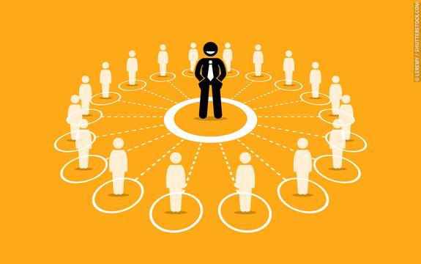

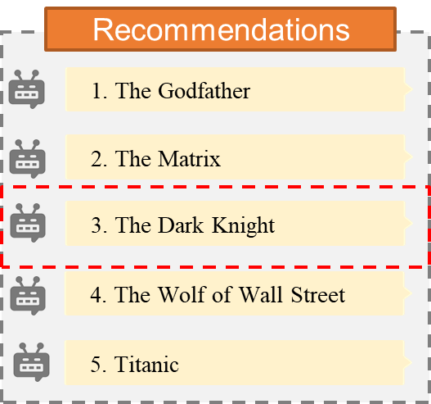



Shortcomings of Existing Debiasing Strategy
Lack of Universality: These methods are designed for addressing one or two biases of a specific scenario.
Lack of Adaptivity: The effectiveness of these methods depends on proper debiasing configurations.
How to develop a universal solution that accounts for multiple biases and choose proper debiasing strategy?
Notes:
Although these methods achieve great success in some scenarios, we argue two limitations of them.
The first is that they methods lack universality [ˌjuːnɪvɜːˈsælɪti]. These methods are designed for addressing one or two biases of a specific scenario, e.g., IPS for selection bias [39], exposure graphical model for the exposure bias [12]. But, when facing real data that commonly contains multiple types of biases, these methods will fall short.
The second is that they lack adapativity. The effectiveness of these methods is guaranteed only when the debiasing configurations kənˌfɪgjʊˈreɪʃənz (e.g., pseudolabels,
propensity scores, or data-generating process) are properly specified. However, obtaining such proper configurations is quite difficult, requiring domain expertise that thoroughly [ˈθɜːrəli] understands the biases in the data and how they affect the model.
Although knowledge distillation is potential to address these limitations, we argue that directly training a large teacher model on a small uniform data is inefficient, which will suffer from high variance. Also it lacks theoretical guarantees, and the inherent mechanism of how teacher model
offsets the bias is not entirely [ɪnˈtaɪəli] understood.
Considering the shortcomings of existing work, we believe it would be necessary to develop a universal debiasing solution that can accounts for multiple biases and free human effort to find optimal configurations.

Slide 8
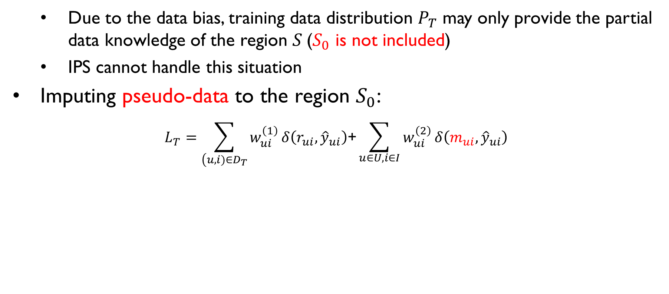
AutoDebias: A Universal Learning Framework
Just leveraging propensity score is insufficient:
: Training data
: Imputed data
Due to the data bias, training data distribution $P_{T}$ may only provide the partial data knowledge of the region $S$($S_{0}$ is not included)
IPS cannot handle this situation
Imputing pseudo-data to the region $S_{0}$:
$$L_{T}=\sum_{\left(u,i)∈D_{T}\right.}{w_{ui}^{\left(1\right)}}δ\left(r_{ui},{\hat{y}}_{ui}\right)\text{+}\sum_{u∈U,i∈I}{w_{ui}^{\left(2\right)}}δ\left(m_{ui},{\hat{y}}_{ui}\right)$$
Notes:
To achieve this goal, we propose autodebias, a universal learning framework to address various biases. We first show why ips is insufficient and how our method completes it.
Let S denotes the support of the test data distribution, in other word, the region that the test data distribution covers. The training data distribution would separate S into two parts. S1 denotes the region that the training data distribution covers, S0 denotes the region that the training distribution does not cover. We know that the training data would only provide the data knowledge of the region S1, while leave the region S0 blank. Of cause, just learning a model with data from S1 will suffer especially when S1 and S0 exhibits rather different patterns. Even IPS can not address this problem.
To deal with this problem, beyond IPS, we further Imputing pseudo-data to the blank region $S_{0}$ and gives a new universal debiasing learning objective function, where W(1), w(2) and m are the hyper-parameters. W(1) and w(2) are the data weights of the real sample and the pseudo-data, m are the imputed labels. With such objective function, the model can be learned in an unbiased manner, If these hyperparameters can be proper specified.

Slide 9

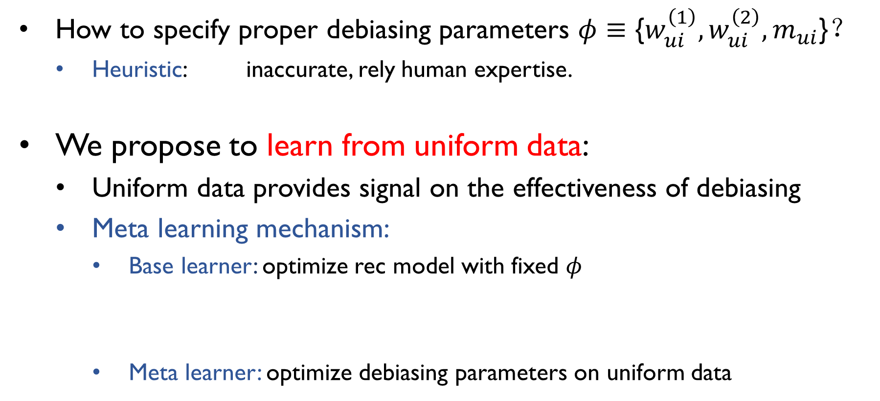
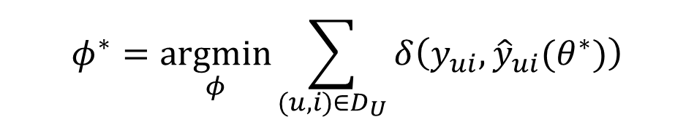
AutoDebias: Adaptive learning algorithm
How to specify proper debiasing parameters $φ≡\text{\{}w_{ui}^{\left(1\right)},w_{ui}^{\left(2\right)},m_{ui}\text{\}}$？
Heuristic: inaccurate, rely human expertise.
We propose to learn from uniform data:
Uniform data provides signal on the effectiveness of debiasing
Meta learning mechanism:
Base learner: optimize rec model with fixed $φ$
Meta learner: optimize debiasing parameters on uniform data
$$θ^{∗}(φ)=\underset{θ}{argmin}\sum_{(u,i)∈D_{T}}{w_{ui}^{(1)}}δ\left(y_{ui},{\hat{y}}_{ui}(θ)\right)+\sum_{u∈U,i∈I}{w_{ui}^{(2)}}δ\left(m_{ui},{\hat{y}}_{ui}(θ)\right)$$
$$φ^{∗}=\underset{φ}{argmin}\sum_{(u,i)∈D_{U}}{δ\left(y_{ui},{\hat{y}}_{ui}(θ^{∗})\right)}$$
Notes:
To support adaptivity, now the question lies on how to find the proper debiasing parameters. Recent works mainly rely on heuristical deisign. Which is usually inaccurate [ɪnˈækjərət] and relys on human expertise.
To deal with this problem, we propose to learn from the uniform data. We know that uniform data provide an important signal on the effectiveness of debiasing. We make full use of this evidence and optimize debiasing parameters towards better recommendation performance on the uniform data. We leverage meta learning algorithm to achieve this goal. It contains two processes: the inner base learner, which optimizes the basic recommendation model with current debiasing parameters. The outer meta learner, which test the current learned recommendation model on the uniform data and optimize debiasing parameters towards better performance on the uniform data.

Slide 10
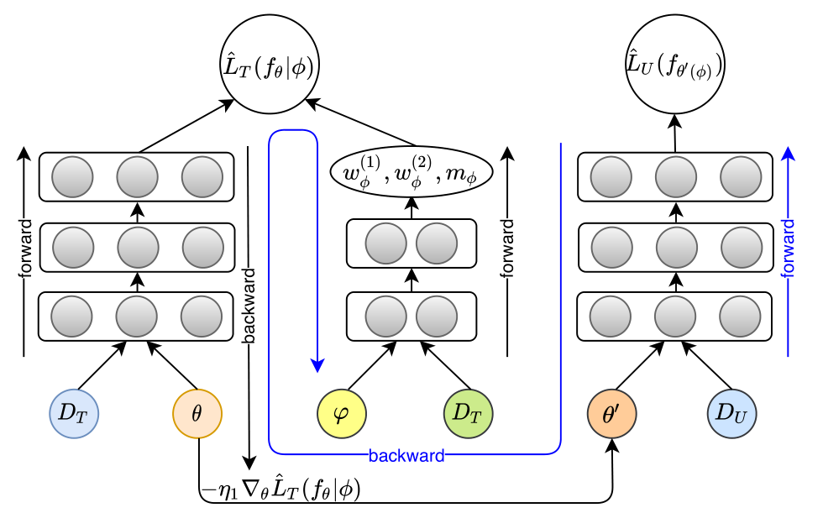

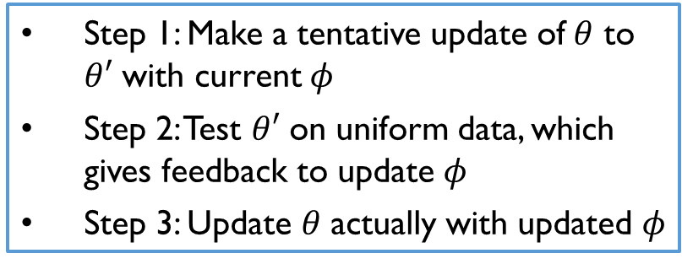
Work#1: AutoDebias: Method
Two challenges:
Overfitting: small uniform data but many debiasing parameters $φ$
Solution: Introduce a small meta model to generate $φ$, e.g., linear model
Inefficiency: obtaining optimal$φ$ involves nested loops of optimization
Solution: Update recsys model and debiasing parameters alternately in a loop
$$w_{ui}^{\left(1\right)}=exp\left(φ_{1}^{T}\left[x_{u}°x_{i}°e_{y_{ui}}\right]\right), w_{ui}^{\left(2\right)}=exp\left(φ_{2}^{T}\left[x_{u}°x_{i}°e_{O_{ui}}\right]\right), m_{ui}=σ\left(φ_{3}^{T}\left[e_{y_{ui}}°e_{O_{ui}}\right]\right)$$
Step 1: Make a tentative update of$θ$ to $θ′$ with current $φ$
Step 2: Test $θ′$ on uniform data, which gives feedback to update$φ$
Step 3: Update 𝜃 actually with updated $φ$
Notes:
We also need to address two challenges [ˈtʃælɪndʒ] ：
the one is that uniform data is often collected in a small scale but there are many debiasing parameters need to be optimized. The model would easily suffer from over-fitting. To tackle this challenge, we introduce a small meta model for example the linear model to generate debiasing parameters.
The second is that obtaining [əbˈteɪnɪŋ] optimal$φ$ involves nested loops of optimization. We need get optimal recommendation model then we make a step of updating debiasing parameters. The learning process is inefficient. To deal with this problem, we consider to update the two learners alternately ɔːltərneɪtly in a loop.
Overall, the learning process is presented as follow:
Theta prime
Actually ˈæktʃuəli

Slide 11
Work#1: AutoDebias: Experiments
Evaluate AutoDebias on two Yahoo!R3 and Coat (random exposure)
Methods | On Yahoo!R3 |  | On Coat
 | AUC | NDCG@5 | AUC | NDCG@5
MF(biased) | 0.727 | 0.550 | 0.747 | 0.500
MF(uniform) | 0.573 | 0.449 | 0.580 | 0.358
MF(combine) | 0.730 | 0.554 | 0.750 | 0.504
IPS | 0.723 | 0.549 | 0.759 | 0.509
DR | 0.723 | 0.552 | 0.765 | 0.521
CausE | 0.731 | 0.551 | 0.762 | 0.500
KD-Label | 0.740 | 0.580 | 0.748 | 0.504
AutoDebias-w1 | 0.733 | 0.573 | 0.762 | 0.510
AutoDebias | 0.741 | 0.645 | 0.766 | 0.522
AutoDebias outperforms state-of-the-arts methods
AutoDebias>AutoDebias-w1: Introducing imputation strategy is effectiveness
AutoDebias-w1>IPS: learning debiasing parameters from uniform data is superior over heuristic design
Notes:
Now, let’s see our experimental results. We evulate autodebias on two famous dataset yahoo and coat, which contains uniform data with random exposure policy as we can see, .
Autodebias-w1 is a special case of autodebias where we just use weighting strategy but do not use imputation. This result validate the effectiveness of imputing pseudo-labels.
[suːˈpɪriər]

Slide 12
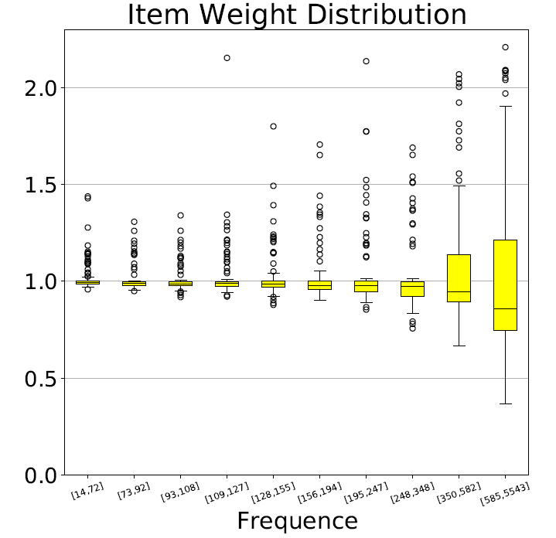
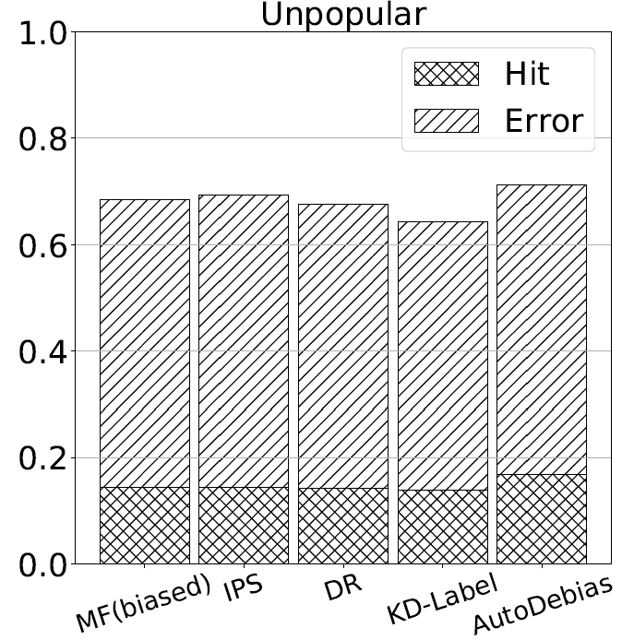
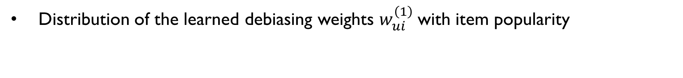
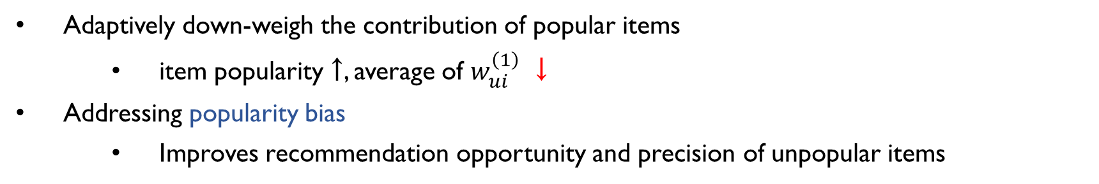
Work#1: AutoDebias: Experiments
Distribution of the learned debiasing weights $w_{ui}^{\left(1\right)}$with item popularity
Adaptively down-weigh the contribution of popular items
item popularity ↑, average of $w_{ui}^{\left(1\right)}$ ↓
Addressing popularity bias
Improves recommendation opportunity and precision of unpopular items
Notes:
Also, we present the distribution of the learned w1 with item popoularity. As we can see, our method would learn different weights for different instances. Generally speaking, the larger item popularity is , the samller the averge value of w(1) exhibits. This result validates the adaptivity of autodebias, which can adaptively downweight the contribution of the popular items. Addressing popularity bias.
It can be also seen from the recommendation results. Our method improves the recommendation opportunity and precision of unpopular items.

Slide 13
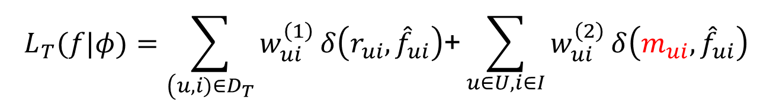
Conclusion
Importance to eliminate biases
Data-driven methods cannot handle biases
Limitations of exist methods: lacking university and adaptivity
Universal debiasing objective function:
Meta-learning algorithm for automatic debiasing:
optimize debiasing parameters on uniform data
Future Work
Explore more sophisticate meta model
Biases is dynamic instead of static
$$L_{T}(f|φ)=\sum_{\left(u,i)∈D_{T}\right.}{w_{ui}^{\left(1\right)}}δ\left(r_{ui},{\hat{f}}_{ui}\right)\text{+}\sum_{u∈U,i∈I}{w_{ui}^{\left(2\right)}}δ\left(m_{ui},{\hat{f}}_{ui}\right)$$
Notes:
Finally, lets make a conclusion the envision some furture directions.
In this work, we first discuss the importance to eliminates biases. After that, we review existing methods and summarisze the two limitations of them: lacking university and adaptivity. We then give a universal debiasing objective function and develop a meta-learning based algorithm to learn the optimal debiasing parameters. Our experiments show our atuodebias outperforms state-of-the-arts.
One interesting direction for future work is to explore more advanced meta model, which could capture more complex patterns
and potentially achieve better performance than linear meta model. Also, note that in real-world biases are usually dynamic rather than
static. it will be valuable to explore how bias evolves with the time and develop a universal solutions for dynamic biases.

Slide 14

Thank you!
cjwustc@ustc.edu.cn
Notes:
Thank you. If you have any question, please feel free to contact us.

Slide 15
Existing Debiasing Strategy: Part 2
Generative Modeling:
assumes the generation process of data and reduces the biases accordingly.
Knowledge Distillation:
trains a separate teacher model on the uniform data to guide the normal model training
J. M. Hern´andez-Lobato, N. Houlsby, and Z. Ghahramani, “Probabilistic matrix factorization with non-random missing data.” in ICML, 2014, pp. 1512–1520.
Liu, Dugang, et al. "A general knowledge distillation framework for counterfactual recommendation via uniform data.” In SIGIR 2020.
Notes:
The third type of methods is generative modeling. This kinds of method will assume the generative process of data and infer the effect of user true preference based on the graphical model.
The fourth type of method is knowledge distillation. This kinds of method would train a separate teacher model on the uniform data and transfer the model’s knowledge to the normal training of the recommendation model on biased data.

