Slide 1
Spotiflop ALgoRithm

Slide 2

SUMMARY
K-nearest neighbor
Random Forest Classifier
Support Vector Machine
Comparisons
2

Slide 3
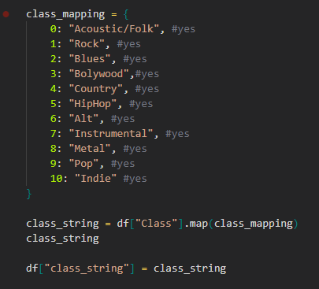
MAPPING SONGS BY GENRE

Slide 4

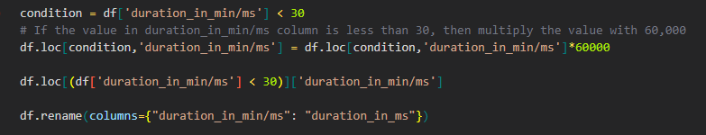
DATA WRANGLING

Slide 5
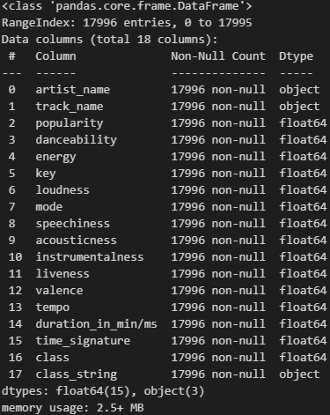
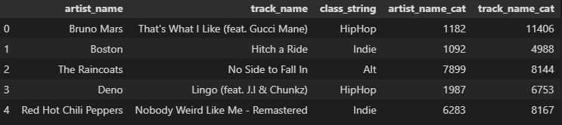
CATEGORIZATION
DATA TYPE

Slide 6
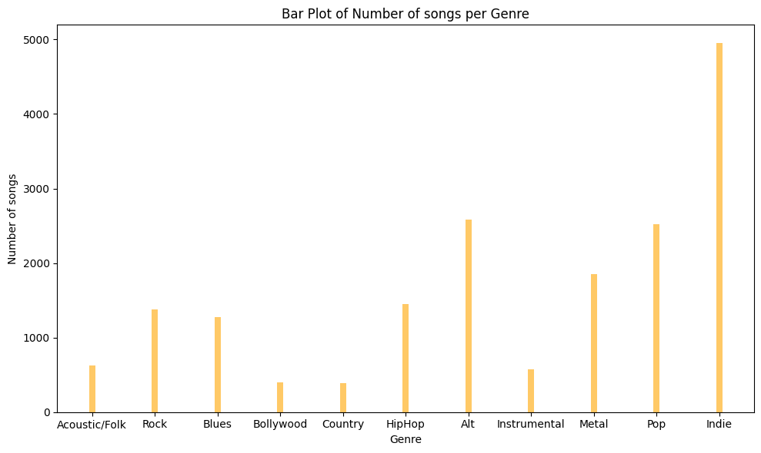
Number of song per genre

Slide 7
K-nearest neighbor
Classification
Data proximity
7

Slide 8
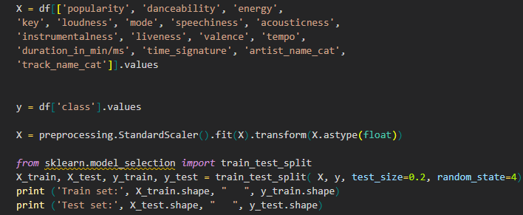
Splitting train and test

Slide 9
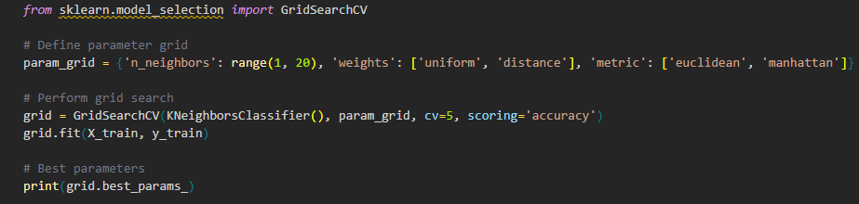
Which distance ?

Slide 10
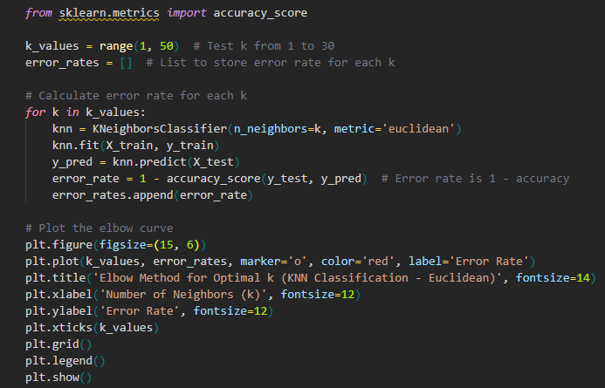
Euclidean Distance

Slide 11
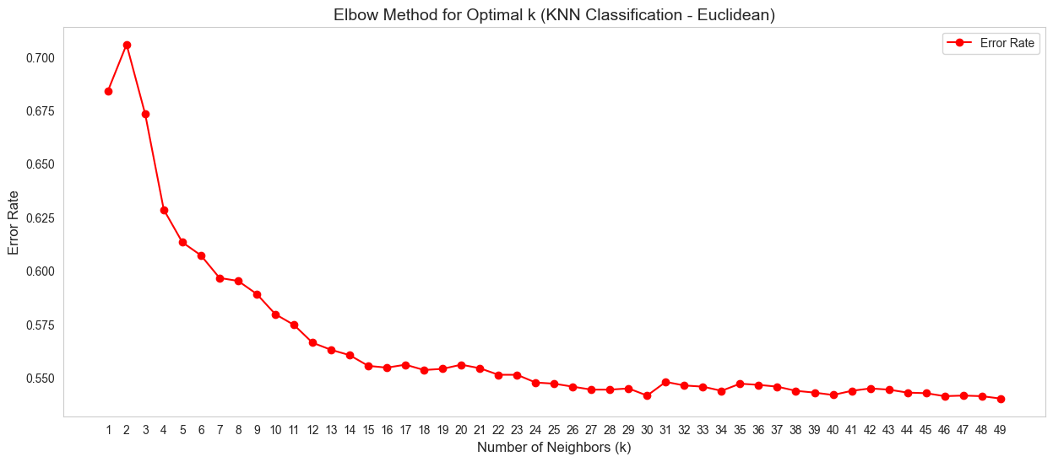
Distances
Euclidean

Slide 12
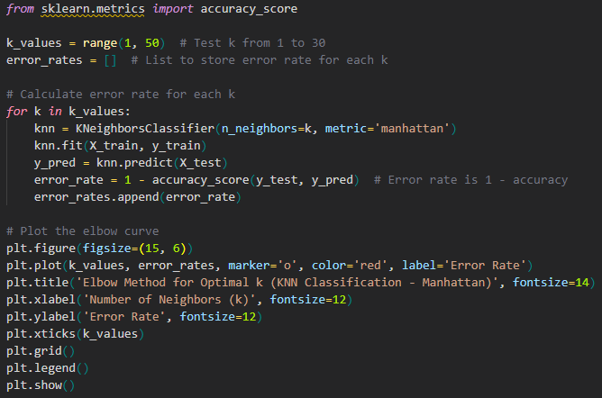
MANHATTAN Distance

Slide 13
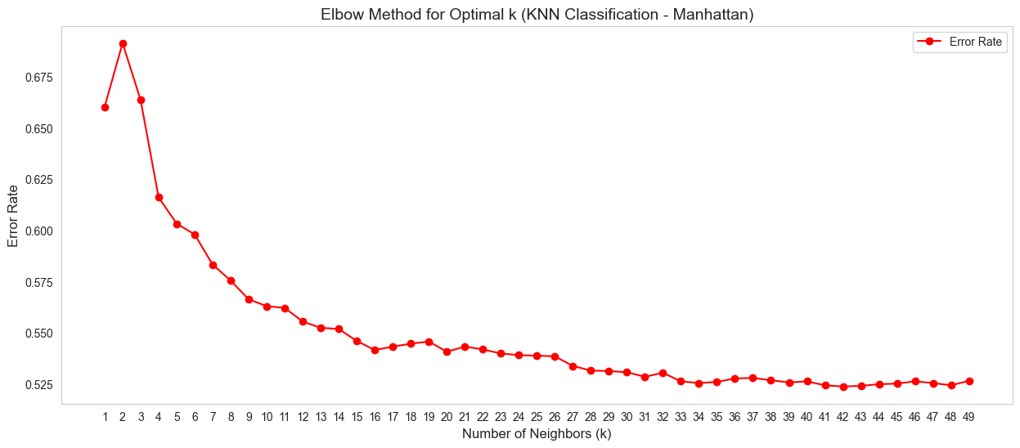
Distances
Manhattan

Slide 14
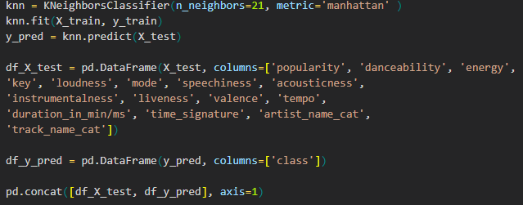
KNN algorithm

Slide 15
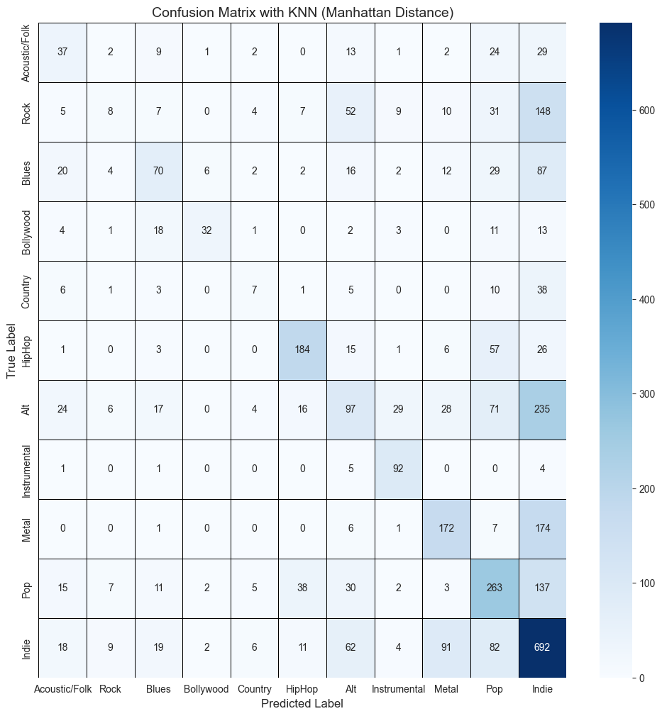
CONFUSION MATRIX
Indie’s issue ?

Slide 16
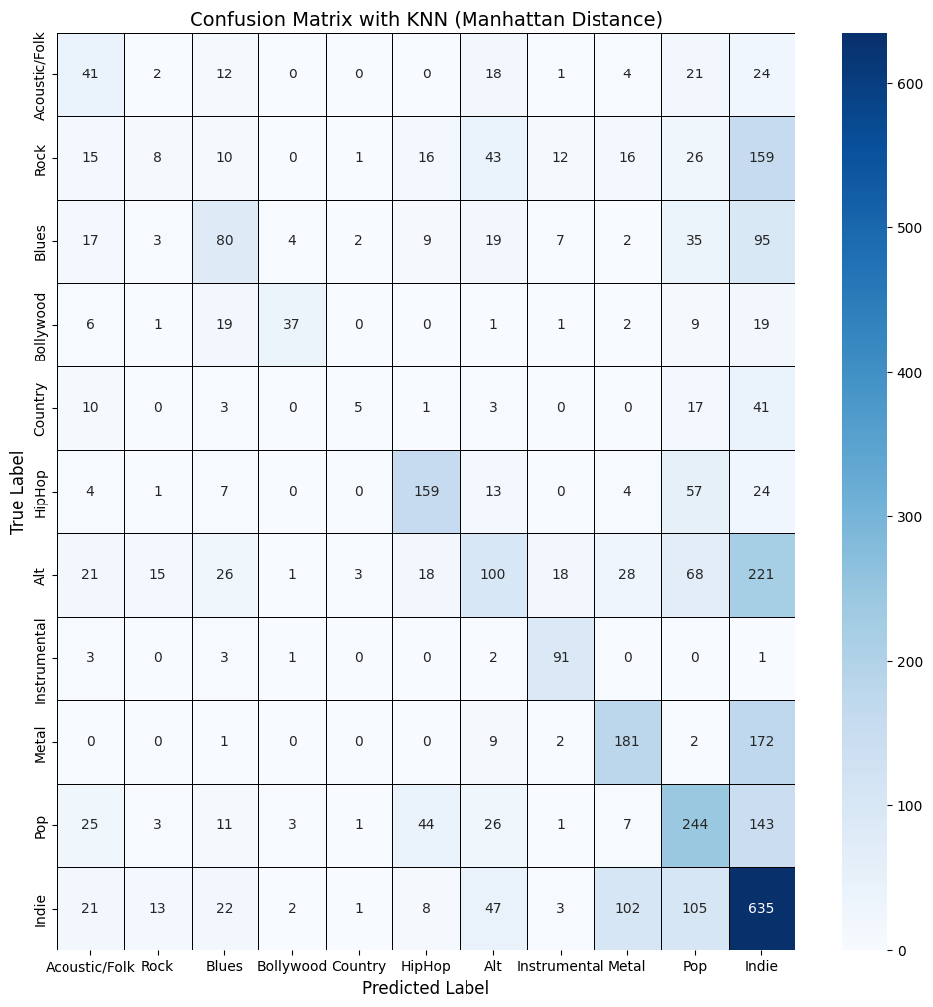
CONFUSION MATRIX

Slide 17
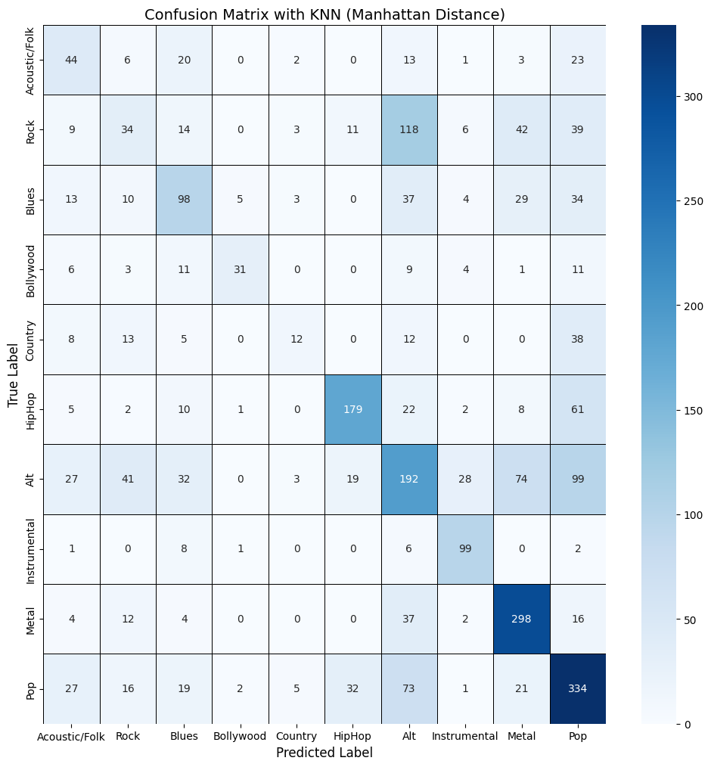
CONFUSION MATRIX
Removing Indie ?

Slide 18
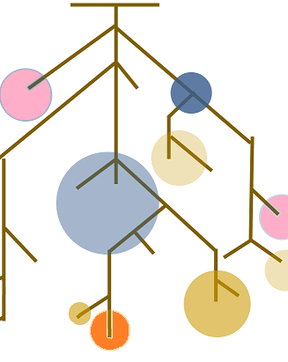
Random forest classifier
Group of Decision Trees
Randomness
Vote
RandomForestClassifier() from sklearn
Notes:
Random forest is an ensemble learning method that combines multiple decision trees to make predictions.
Each tree is trained on a random subset of the data.
The final prediction is made by aggregating the predictions of all trees just like an election.

Slide 19
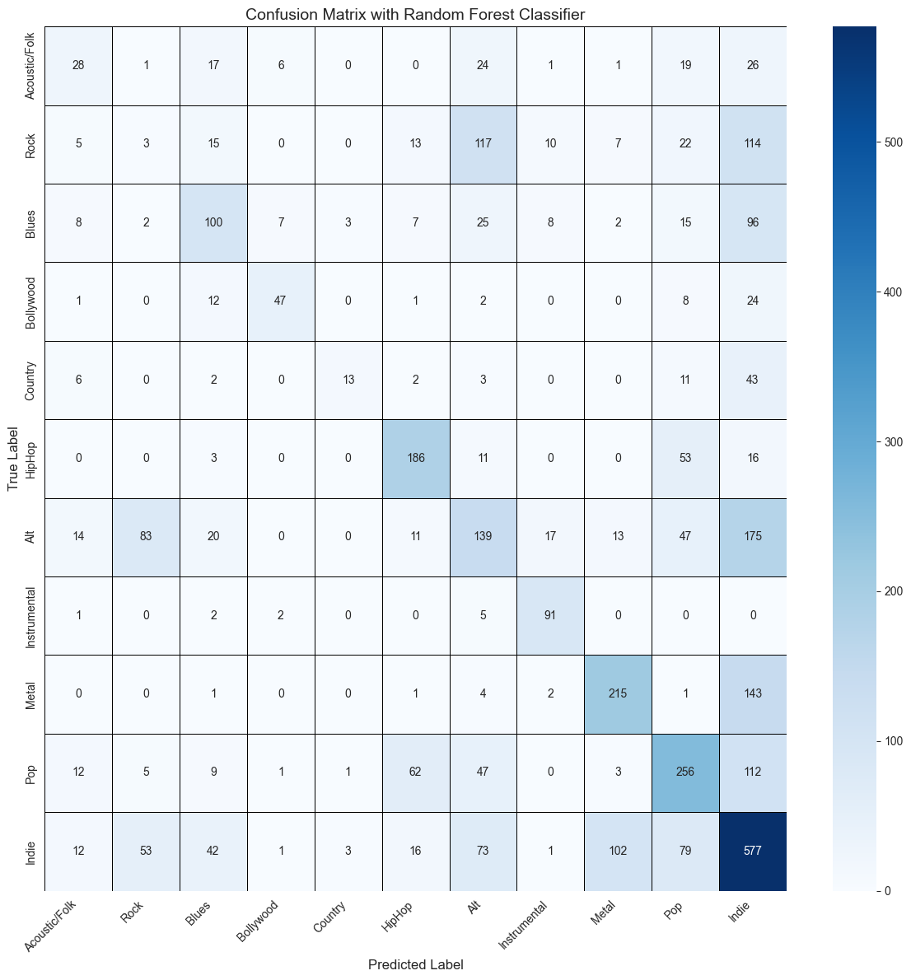
Confusion Matrix
Indie concentration
Good classes
Bad classes
Notes:
Good classes : Bollywood, Hip-Hop & Instrumental
Bad classes : Rock, Blues, Country & Alt

Slide 20
Support Vector Machine
Find best boundaries
Support Vector
Complex Data
Svm() from sklearn
20
Notes:
SVM aims to find the best boundaries that separates different classes in the data & maximize the distance between the closest points of each class.
The data points that are closest to theses boundaries are called support vectors
This algorithm can handle complex data using a method called “kernel tricks” (se renseigner pour question orienté après)

Slide 21
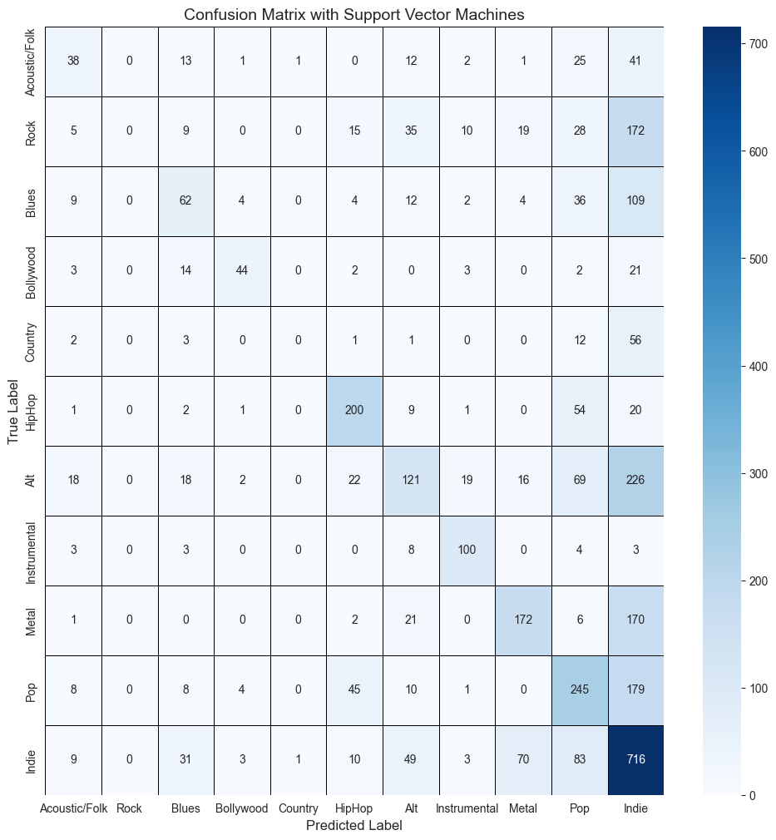
Confusion Matrix
Same pattern :
Indie
Bollywood, Hip-Hop & Instrumental
Rock, Blues, Country & Alt

Slide 22

Comparisons
Precision
Recall
Specificity
F1-score

Slide 23
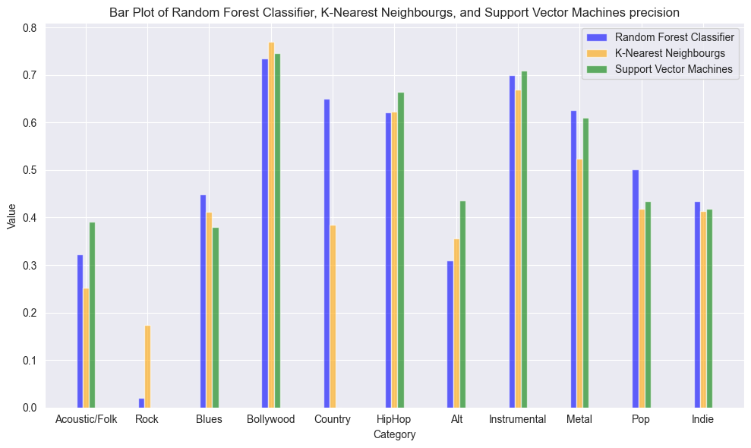
Precision
Notes:
It explains how many of the correctly predicted cases actually turned out to be positive.

Slide 24
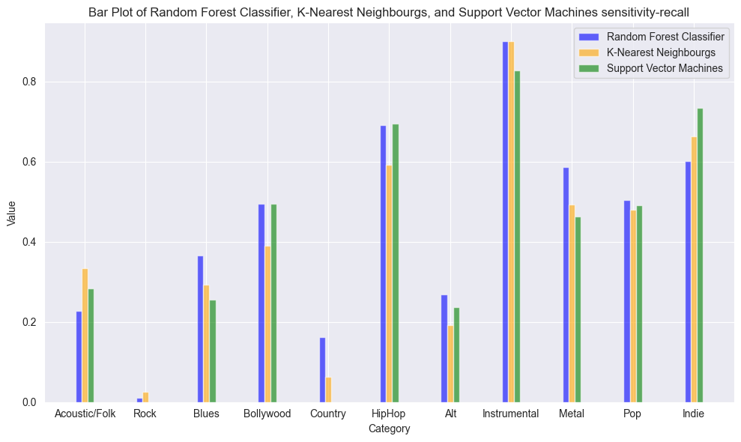
Recall
Notes:
It explains how many of the actual positive cases we were able to predict correctly with our model.

Slide 25
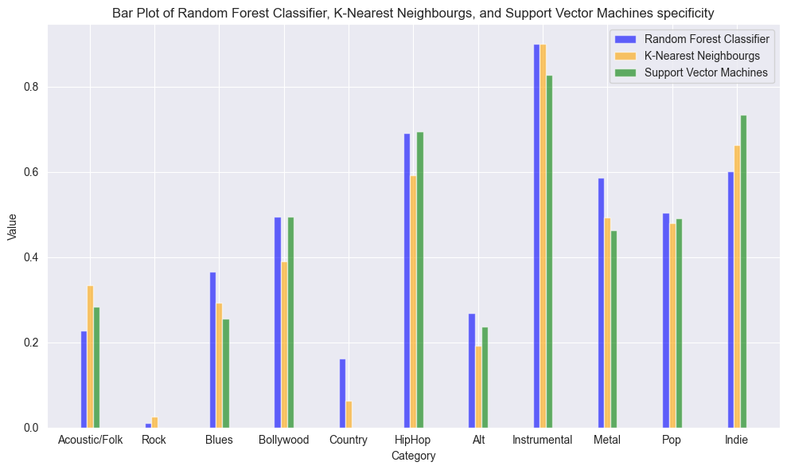
Specificity
Notes:
Proportion of actual negatives correctly predicted negative

Slide 26
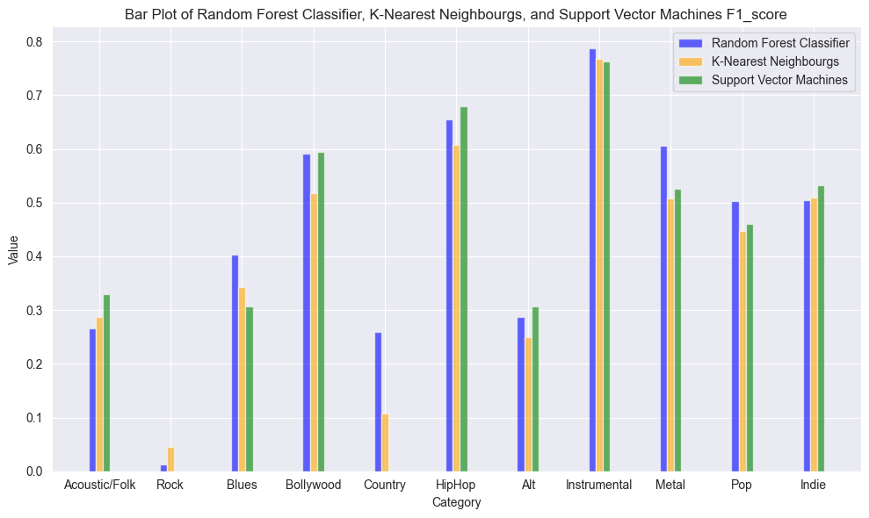
F1-Score
Notes:
F1 Score is the harmonic mean of precision and recall

Slide 27
Conclusion
Notes:
Random Forest Classifier

