Slide 1
Spotiflop ALgoRithm

Slide 2

SUMMARY
K-nearest neighbor
Random Forest Classifier
Support Vector Machine
Comparisons
2

Slide 3
K-nearest neighbor
Classification
Data proximity
3

Slide 4
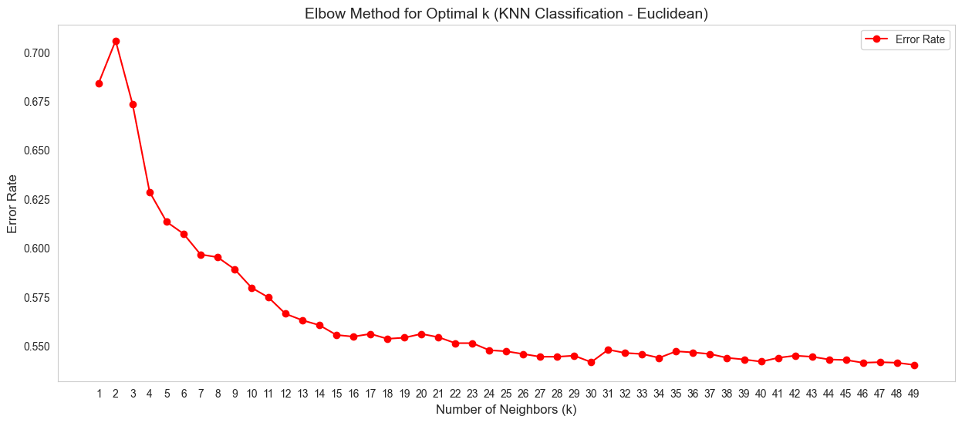
Distances
Euclidean

Slide 5
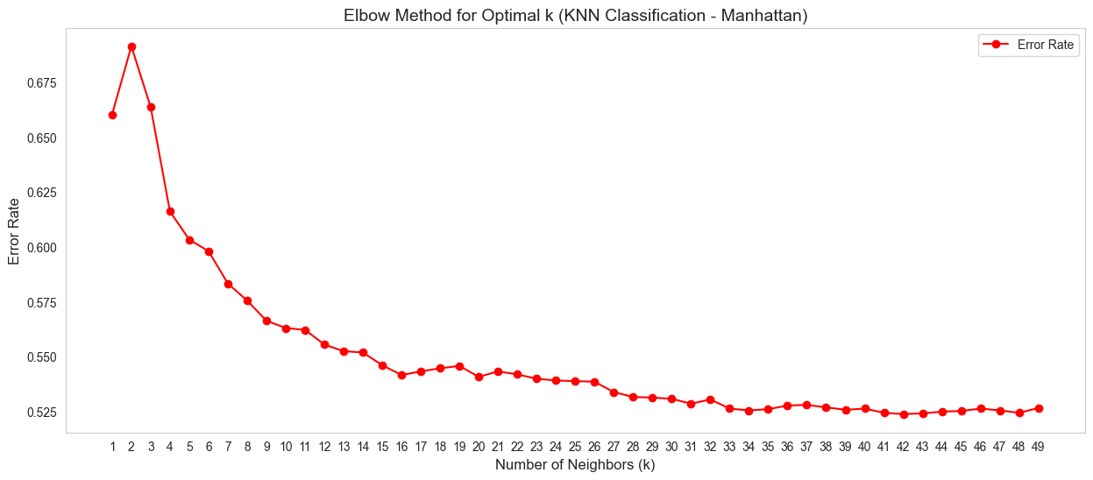
Distances
Manhattan

Slide 6
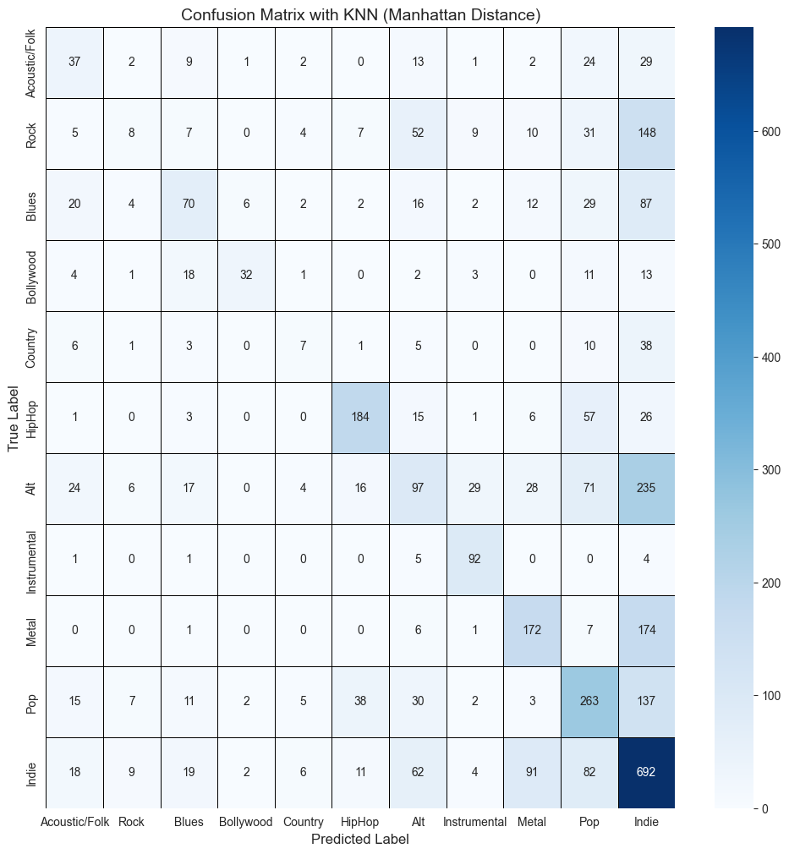
CONFUSION MATRIX

Slide 7
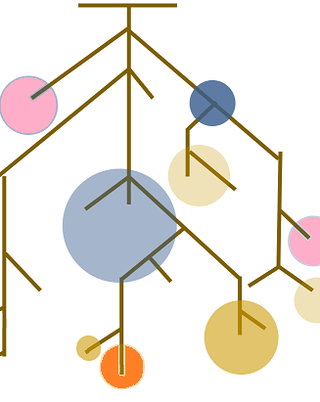
Random forest classifier
Group of Decision Trees
Randomness
Vote
Notes:
Random forest is an ensemble learning method that combines multiple decision trees to make predictions.
Each tree is trained on a random subset of the data.
The final prediction is made by aggregating the predictions of all trees just like an election.

Slide 8
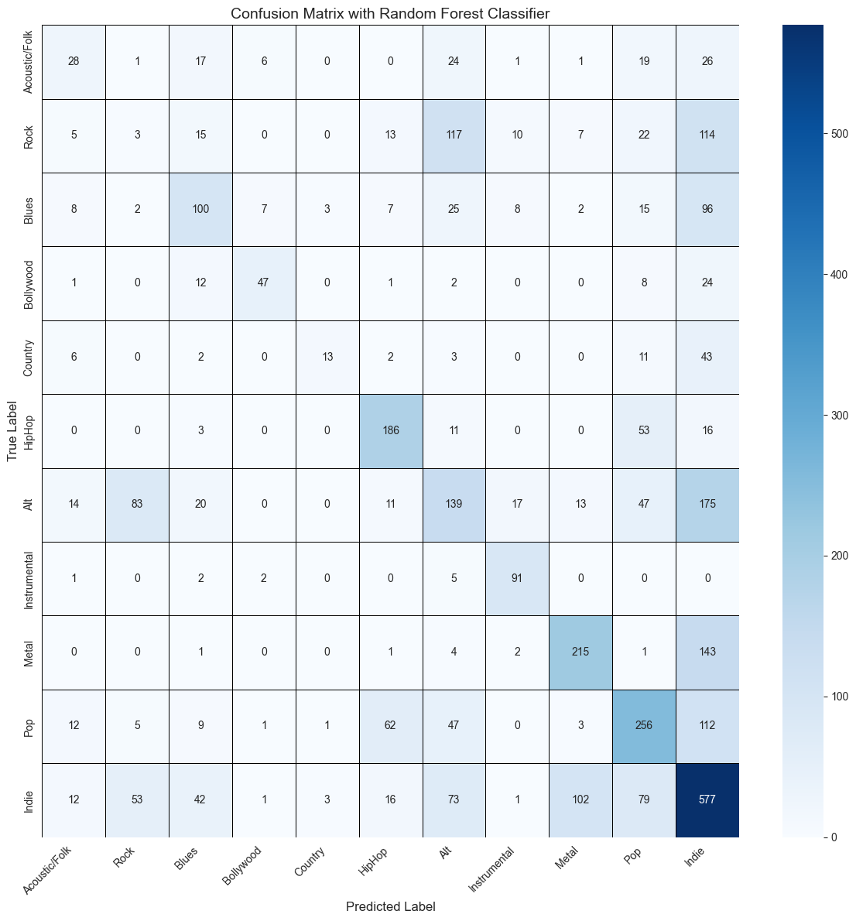
Confusion Matrix
Indie concentration
Good classes
Bad classes
Notes:
Good classes : Bollywood, Hip-Hop & Instrumental
Bad classes : Rock, Blues, Country & Alt

Slide 9
Support Vector Machine
Find best boundaries
Support Vector
Complex Data
9
Notes:
SVM aims to find the best boundaries that separates different classes in the data & maximize the distance between the closest points of each class.
The data points that are closest to theses boundaries are called support vectors
This algorithm can handle complex data using a method called “kernel tricks” (se renseigner pour question orienté après)

Slide 10
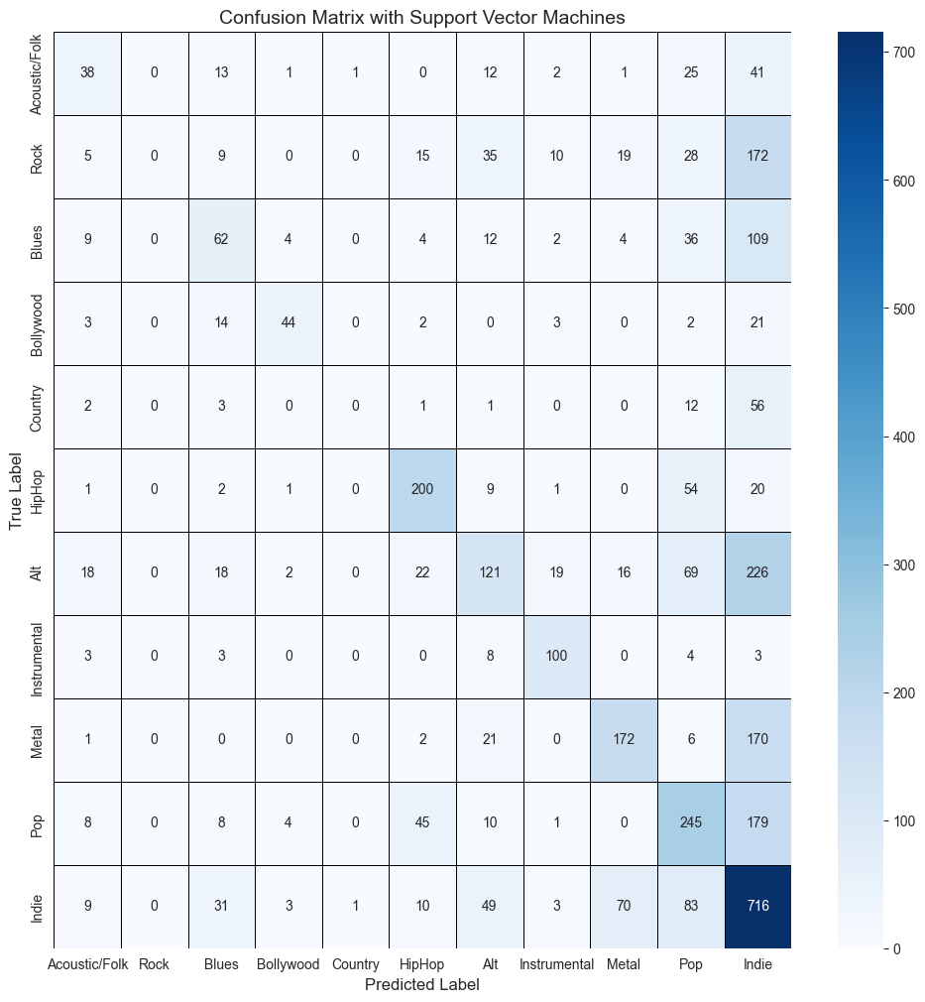
Confusion Matrix
Same pattern :
Indie
Bollywood, Hip-Hop & Instrumental
Rock, Blues, Country & Alt

Slide 11

Comparisons
Precision
Recall
Specificity
F1-score

Slide 12
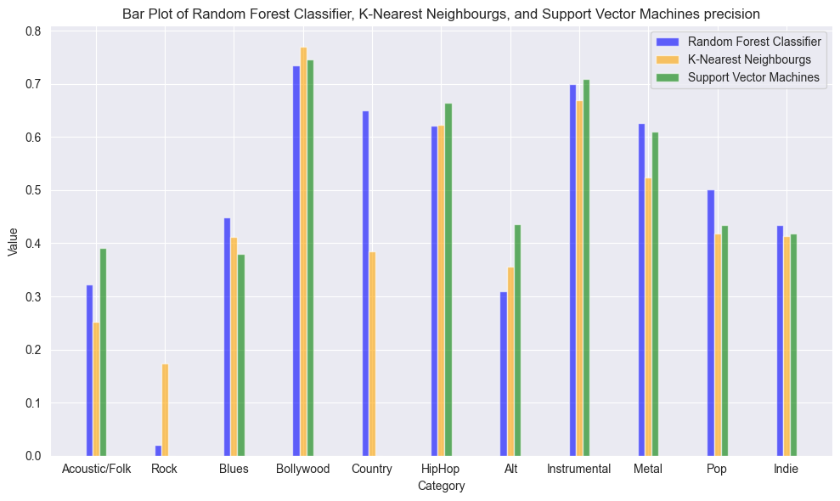
Precision

Slide 13
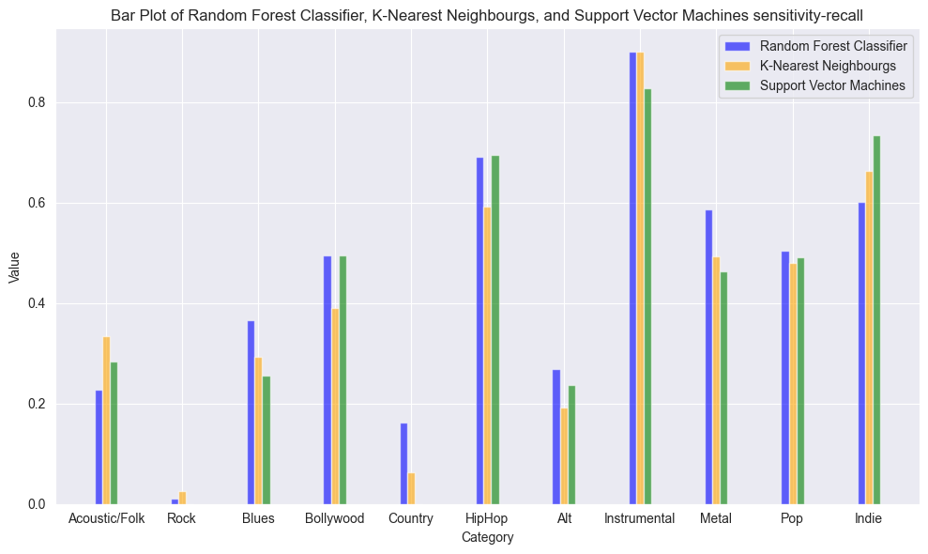
Recall

Slide 14
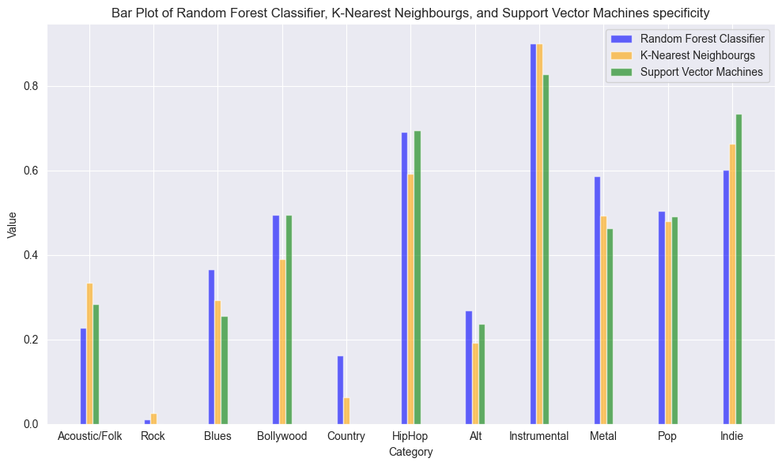
Specificity

Slide 15
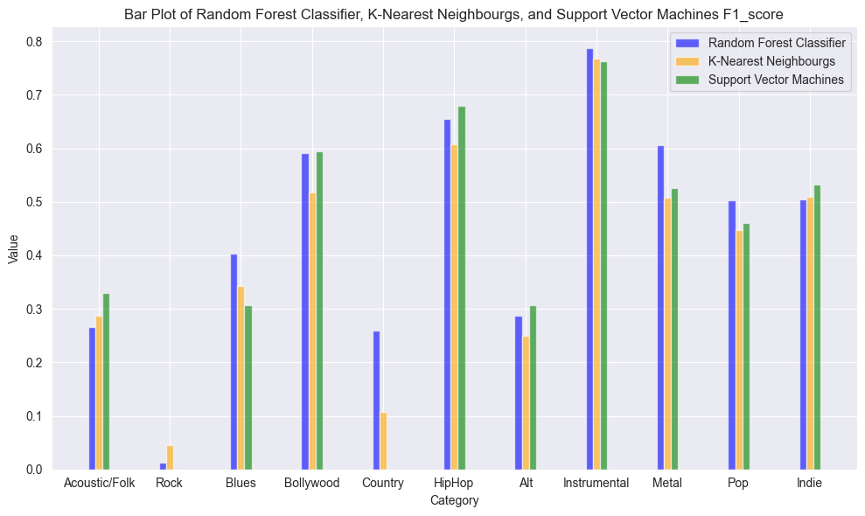
F1-Score

Slide 16
Conclusion

