Slide 1
Spotiflop ALgoRithm

Slide 2

SUMMARY
K-nearest neighbor
Random Forest Classifier
Support Vector Machine
Comparisons
2

Slide 3
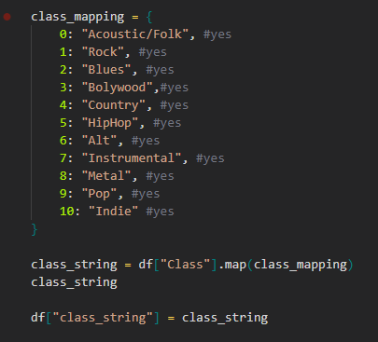
MAPPING SONGS BY GENRE

Slide 4
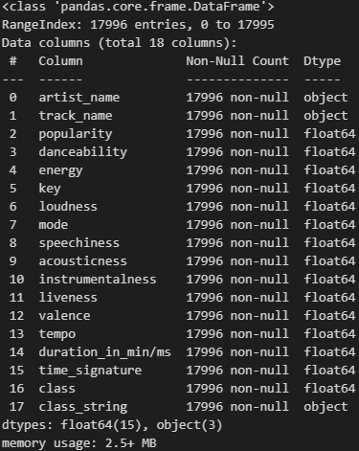
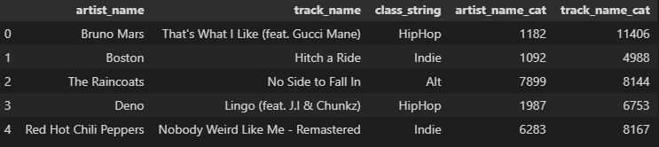
CATEGORIZATION
DATA TYPE

Slide 5

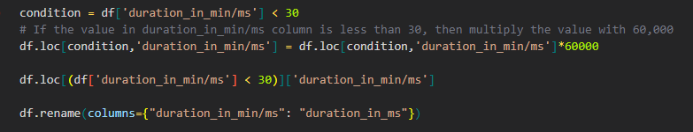
DATA WRANGLING

Slide 6
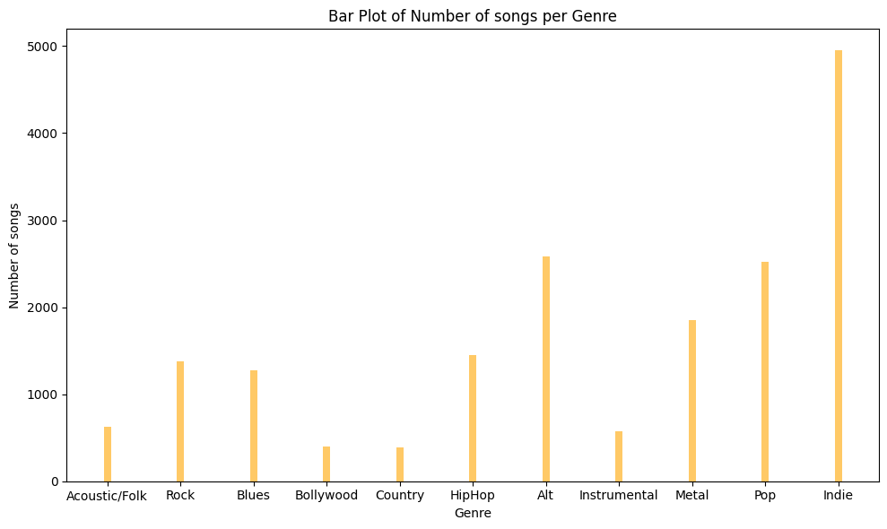
Number of song per genre

Slide 7
K-nearest neighbor
Classification
Data proximity
7

Slide 8
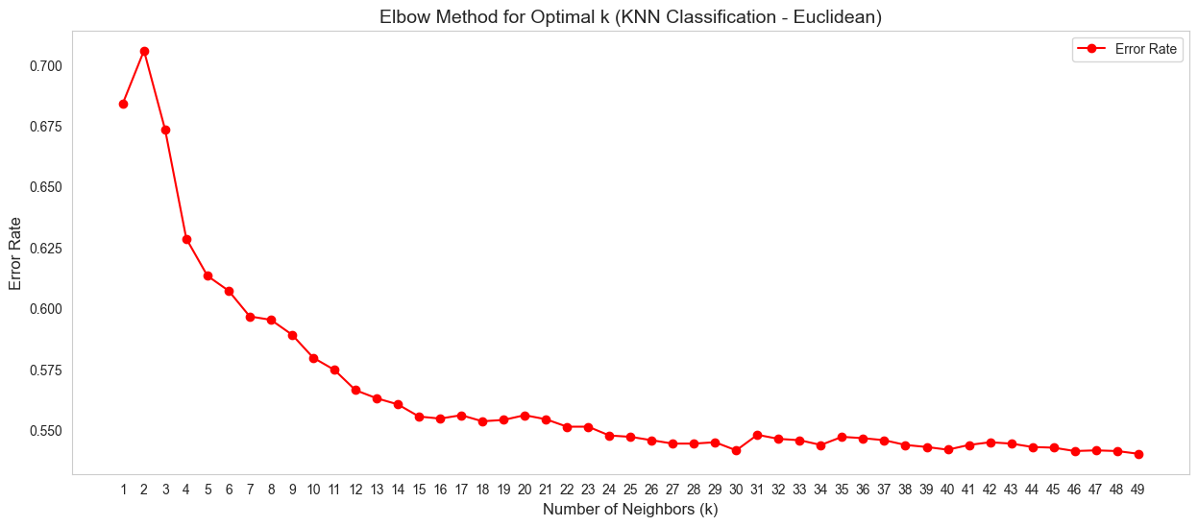
Distances
Euclidean

Slide 9
Distances
Euclidean

Slide 10
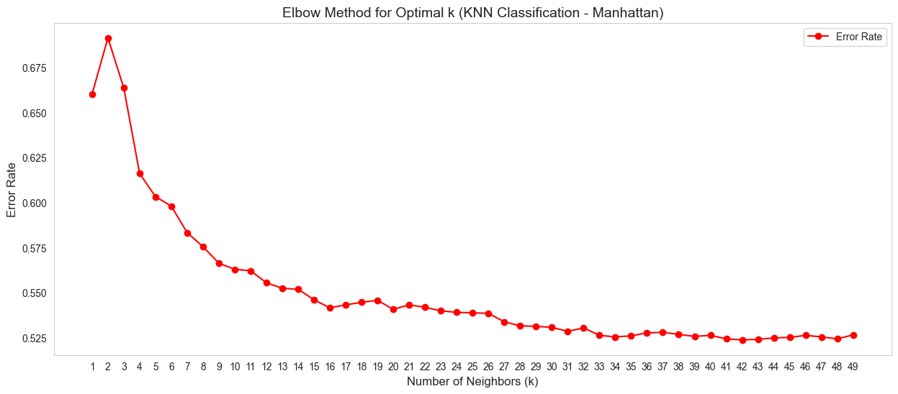
Distances
Manhattan

Slide 11
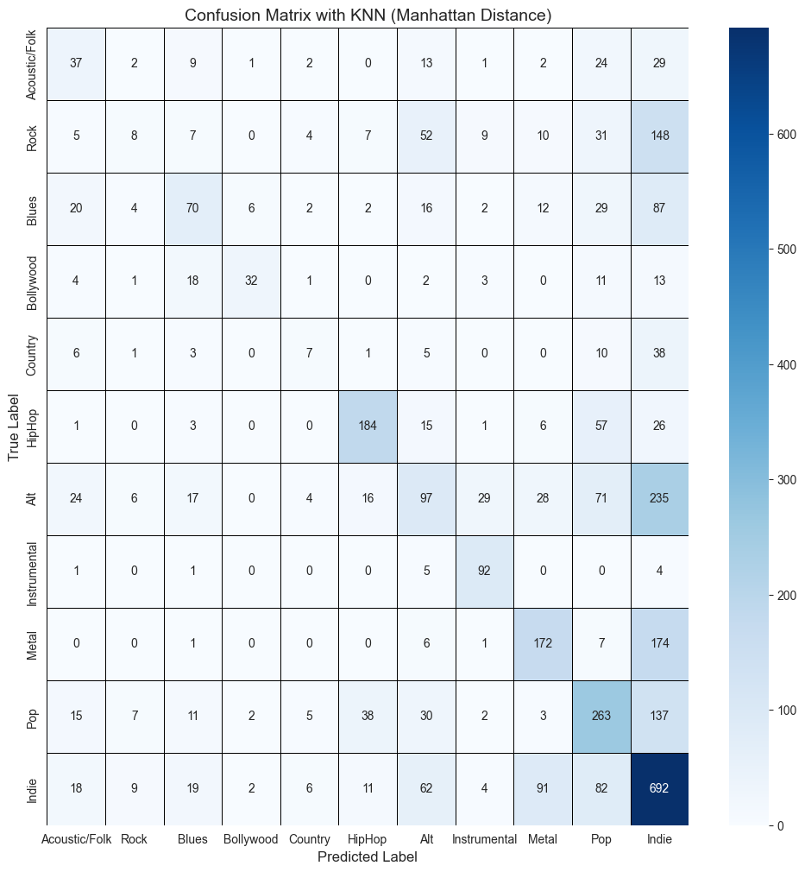
CONFUSION MATRIX

Slide 12
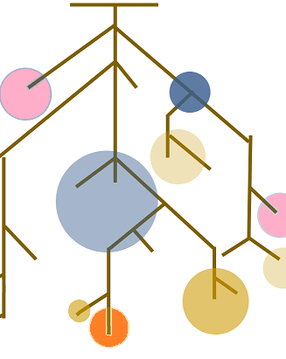
Random forest classifier
Group of Decision Trees
Randomness
Vote
Notes:
Random forest is an ensemble learning method that combines multiple decision trees to make predictions.
Each tree is trained on a random subset of the data.
The final prediction is made by aggregating the predictions of all trees just like an election.

Slide 13
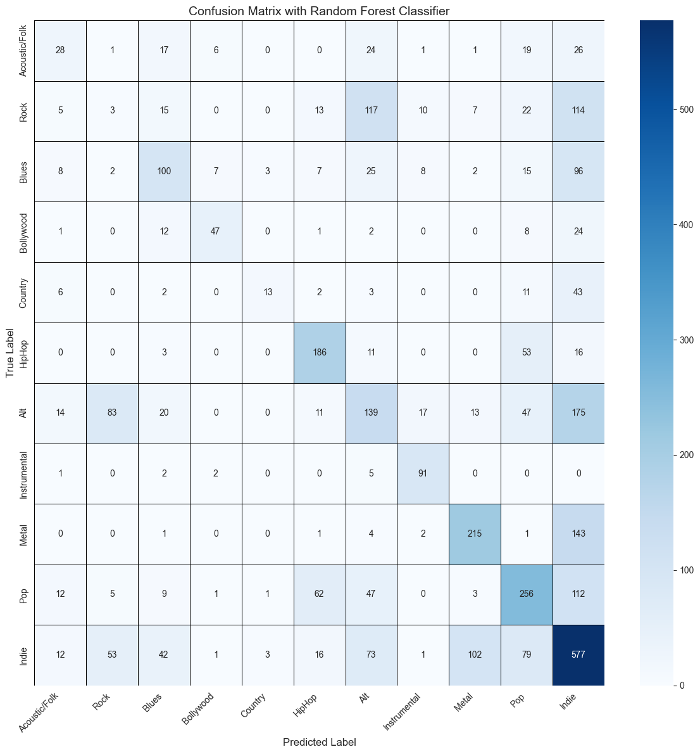
Confusion Matrix
Indie concentration
Good classes
Bad classes
Notes:
Good classes : Bollywood, Hip-Hop & Instrumental
Bad classes : Rock, Blues, Country & Alt

Slide 14
Support Vector Machine
Find best boundaries
Support Vector
Complex Data
14
Notes:
SVM aims to find the best boundaries that separates different classes in the data & maximize the distance between the closest points of each class.
The data points that are closest to theses boundaries are called support vectors
This algorithm can handle complex data using a method called “kernel tricks” (se renseigner pour question orienté après)

Slide 15
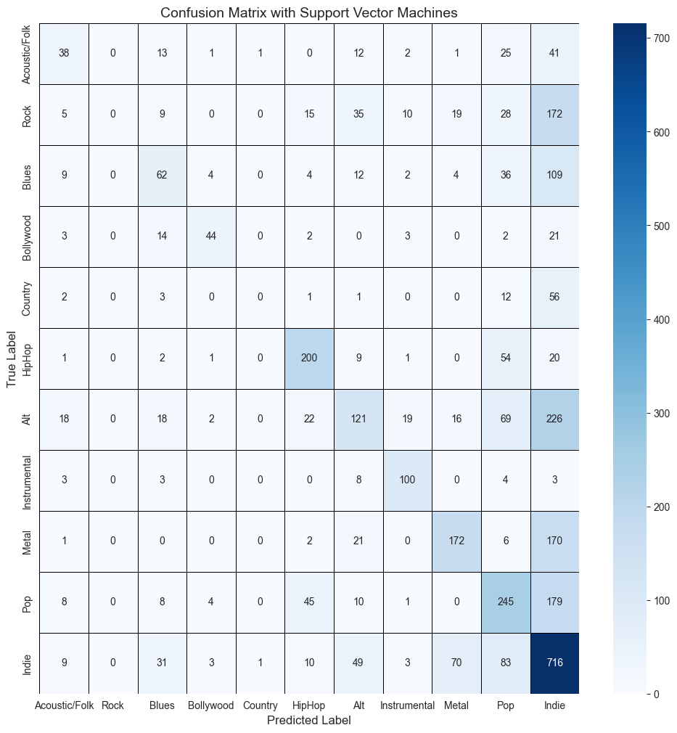
Confusion Matrix
Same pattern :
Indie
Bollywood, Hip-Hop & Instrumental
Rock, Blues, Country & Alt

Slide 16

Comparisons
Precision
Recall
Specificity
F1-score

Slide 17
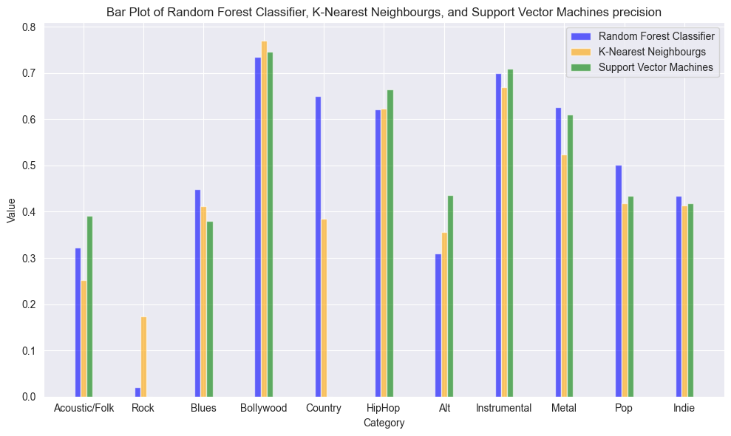
Precision

Slide 18
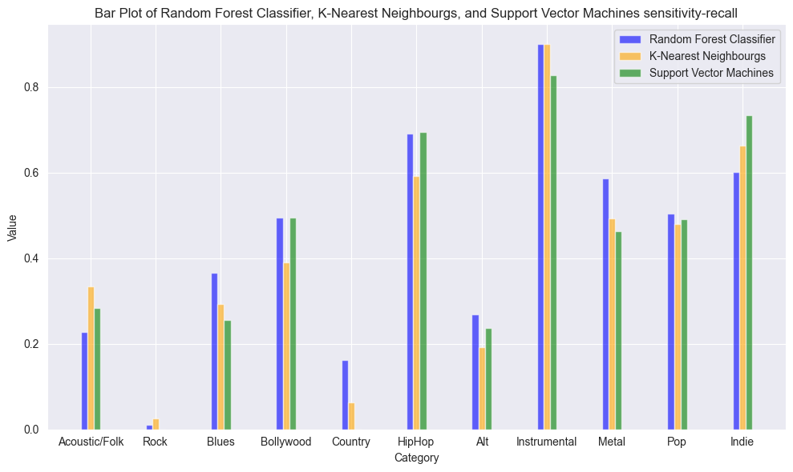
Recall

Slide 19
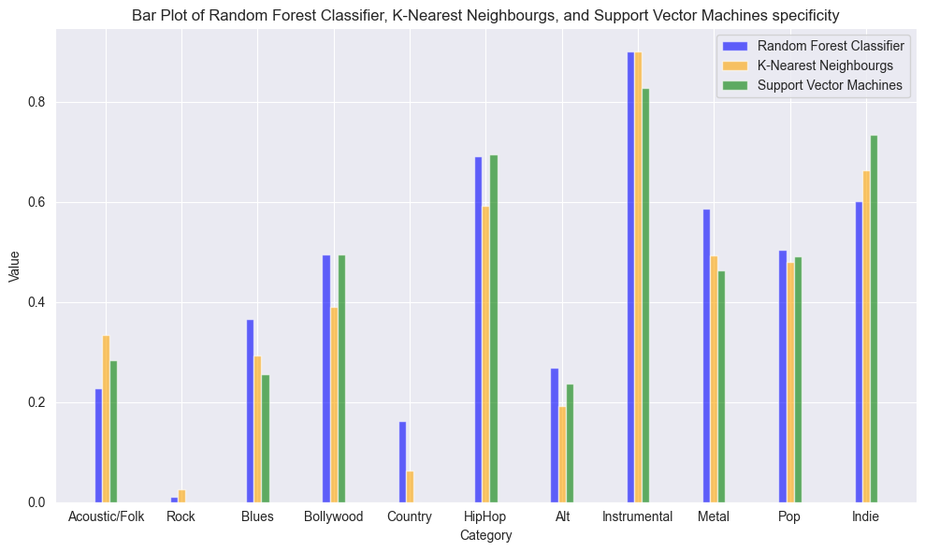
Specificity

Slide 20
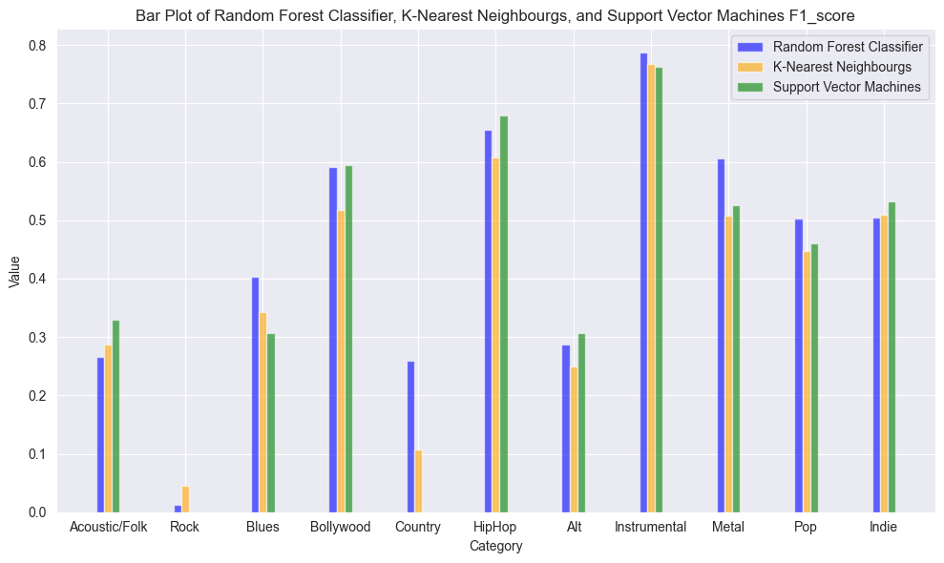
F1-Score

Slide 21
Conclusion

