Slide 1

COOP
Data-Driven Insights
for Coop Sverige
Channel behavior · Sustainability · Customer segmentation · Discount economics
Data Analyst Case Interview | 2 months of receipt data, 2 stores | April–May 2020

Slide 2

AGENDA
What we'll cover
01
Channel Behavior
How do offline, online, and omni-channel customers shop — and what sets them apart?
02
Sustainability
How and why do categories differ, and what can Coop do to be more sustainable?
03
Customer Segmentation
What actually differentiates our customer groups, and how should Coop act on it?
04
Discount Economics
What does discount spend actually cost us, and what's a converted customer worth?
COOP SVERIGE — DATA ANALYST CASE
1

Slide 3
DATA & METHODOLOGY
What we're working with
• 1.6M receipt line items, 2 stores (A & B), 2020-04-01 to 2020-05-31
• ~20,500 households, ~90,900 receipts — IDs anonymized per GDPR, item names replaced with a category hierarchy
• "profit" throughout = lineItemAmountExclVat − lineItemCostExclVat (Coop's margin, VAT excluded)
• All SEK figures in this deck are shown as a monthly run-rate (2-month sample ÷ 2), not cumulative 2-month totals — a straight-line average, not a seasonality-adjusted forecast
• Where facts were missing, we made explicit assumptions rather than guessing silently — each is called out on the slide it affects
⚠ DATA CAVEAT The accompanying case_data_description.xlsx reports ~2x today's row/receipt/customer counts (3.2M rows vs. our actual 1.6M). The file itself is complete and un-truncated (matches the zip archive byte-for-byte) — this looks like a documentation mismatch, not missing data. Treat our numbers, not the xlsx's, as ground truth.
COOP SVERIGE — DATA ANALYST CASE
2

Slide 4
01
Channel Behavior
How do offline-, online-, and omni-channel customers shop — and what sets them apart?

Slide 5
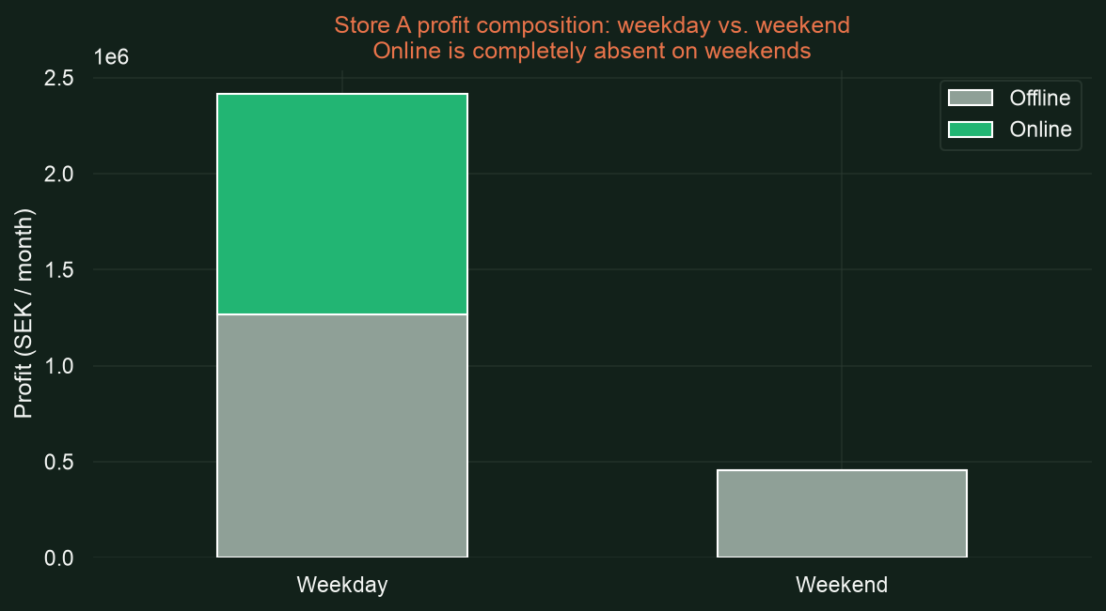
CHANNEL BEHAVIOR
Online exists at Store A only — and never on weekends
• Store B has zero online transactions — always has, structurally
• Even at Store A, online purchasing is exactly zero on every single weekend day in the 2-month window
• Verified directly: all 18 weekend dates in the file show 0 online transactions, while offline sales continue normally (10K–19K/day)
• This looks like an operational limit (no weekend online fulfillment), not a demand problem
COOP SVERIGE — DATA ANALYST CASE
3

Slide 6
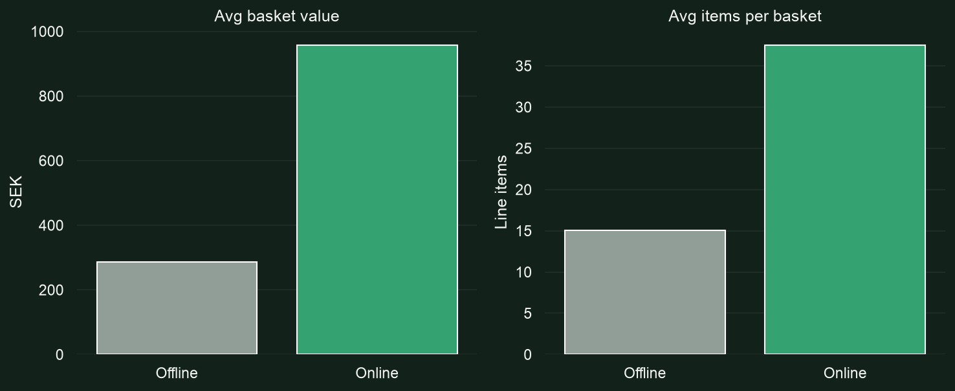
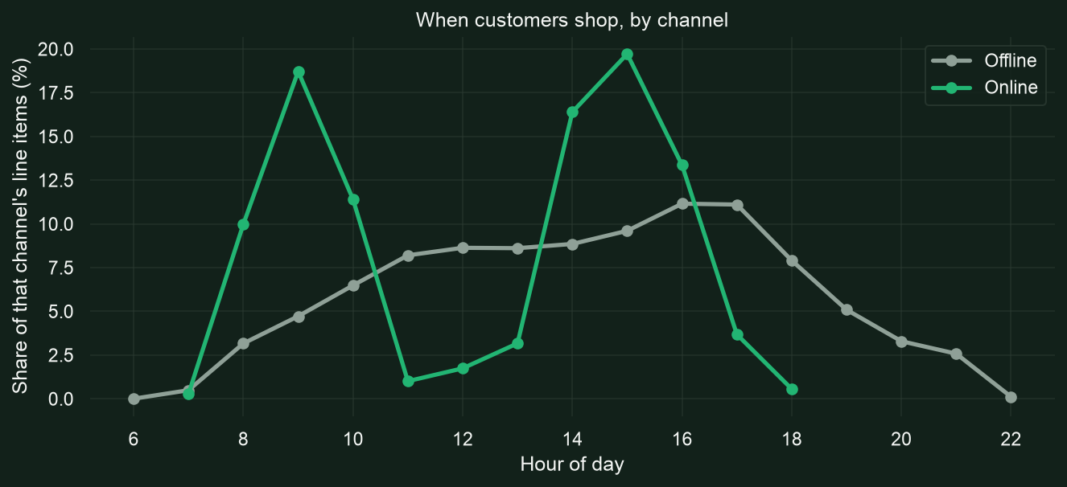
CHANNEL BEHAVIOR
Online shoppers buy more, and buy ahead of meals
• Online baskets are larger in both value and item count — consistent with planned, bulk-style shopping
• Online orders cluster around ~9am and ~3pm — before meal times, suggesting forward-planning rather than impulse purchases
COOP SVERIGE — DATA ANALYST CASE
4

Slide 7
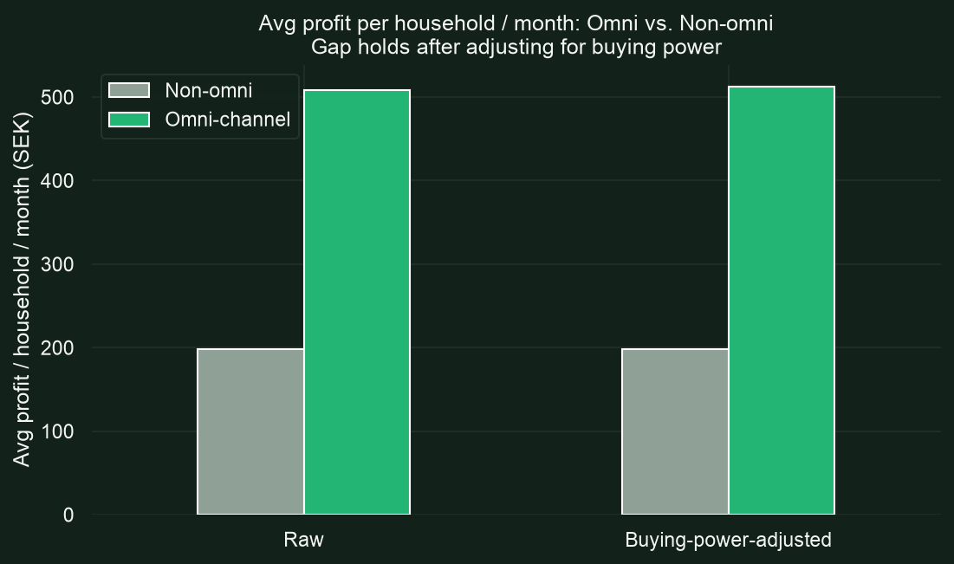
CHANNEL BEHAVIOR
Omni-channel households are ~2.6x more profitable
2.56x
Raw profit multiplier
(omni vs. non-omni)
2.59x
After adjusting for
buying power
• Stress-tested against the obvious confound — buying power — and the gap barely moved
• This is a real behavioral/engagement signal, not just "omni customers are richer households"
• But only ~0.55% of households are omni today — and part of that low rate is structural: Store-B-only shoppers can never qualify, since online doesn't exist there
COOP SVERIGE — DATA ANALYST CASE
5

Slide 8
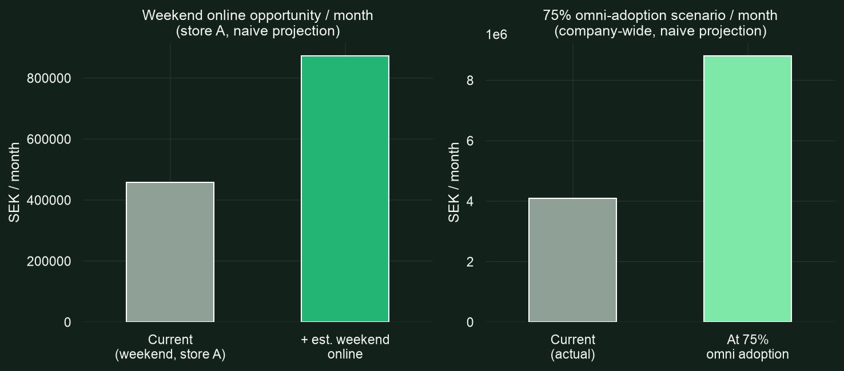
CHANNEL BEHAVIOR
Sizing the opportunity
⚠ DATA CAVEAT Both figures are naive, directional projections, not forecasts. They assume weekend/converted shoppers would behave like today's existing weekday/omni shoppers — ignoring fulfillment costs, cannibalization, and the small, self-selected size of today's omni sample (113 households). Use as "size of the prize," not a committed number.
COOP SVERIGE — DATA ANALYST CASE
6

Slide 9
CHANNEL BEHAVIOR — RECOMMENDED ACTIONS
What Coop should do
• Test weekend online fulfillment at Store A — the weekday economics already work (online ≈ 91% of offline profit); the naive estimate is +415K SEK/month if weekends matched weekday performance
• Investigate extending online to Store B — even a partial rollout closes a purely structural gap that's currently suppressing the omni-channel rate
• Build a dedicated retention play for existing omni-channel households — they're proven ~2.5x more valuable; protect and grow this group before chasing broad conversion
• Re-baseline the omni-channel rate against Store-A-eligible households only when reporting it internally — the raw company-wide number understates true adoption where the option exists
COOP SVERIGE — DATA ANALYST CASE
7

Slide 10
02
Sustainability
How and why do categories differ, and what actions can Coop take to be more sustainable?

Slide 11
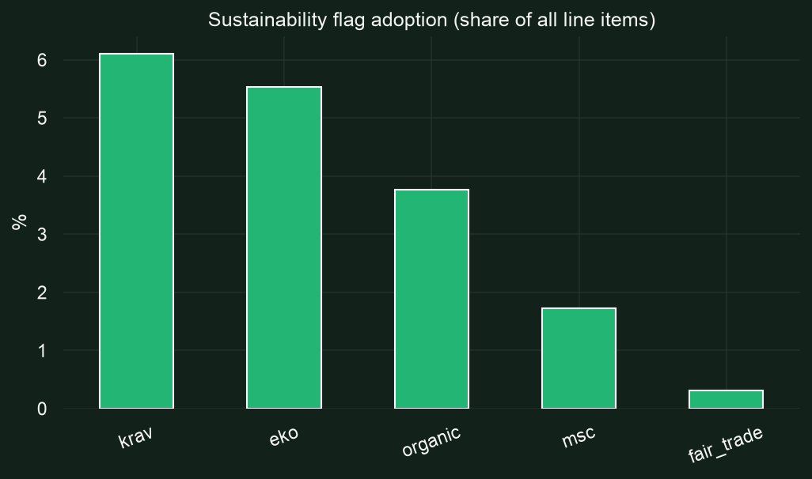
SUSTAINABILITY
Baseline adoption is low — and one flag under-counts it
• krav 6.1%, eko 5.5%, organic 3.8%, msc 1.7%, fair_trade 0.3% of all line items
• no_lactose (22.7%) is excluded from "sustainability" — it's a dietary/allergen label, not an environmental one
⚠ DATA CAVEAT Only 34.5% of KRAV-flagged items are also flagged organic — but KRAV certification requires meeting organic standards as a floor, so KRAV items ARE organic in substance regardless. The `organic` flag alone understates true coverage — use organic-OR-krav instead. This isn't cosmetic: it changes which categories have a real supply gap (next slide).
COOP SVERIGE — DATA ANALYST CASE
8

Slide 12
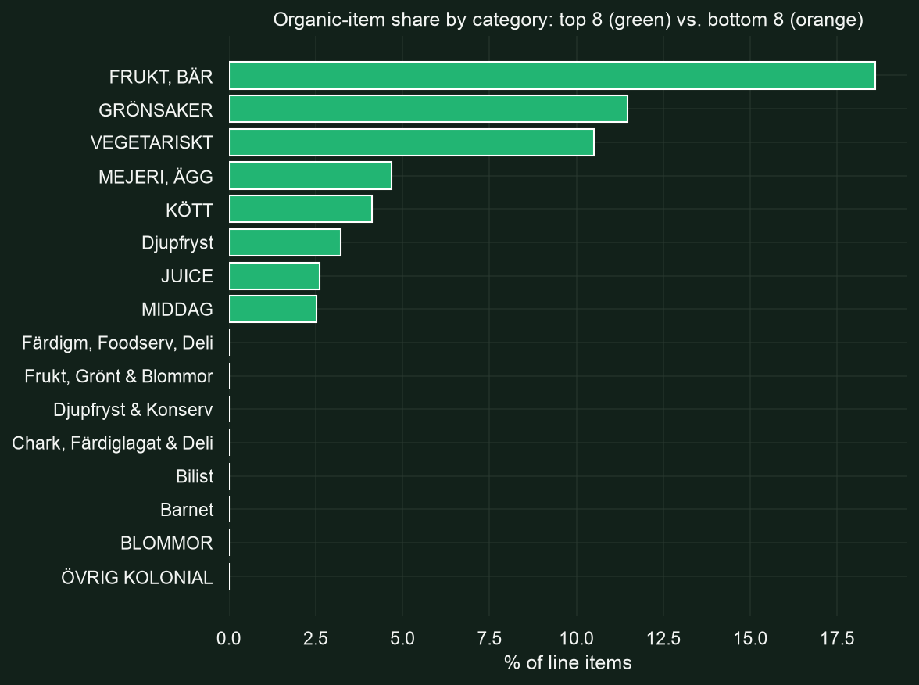
SUSTAINABILITY
Sustainability lives almost entirely in fresh produce
• Fruit & berries (18.6%), vegetables (11.5%), and vegetarian (10.5%) lead — organic certification is most established for raw produce
• Meat sits surprisingly low (4.1% on the organic flag alone) — worth re-checking with KRAV included before treating it as a confirmed gap
• Packaged/pantry goods are near-zero — processed goods essentially have no organic presence in the assortment at all
COOP SVERIGE — DATA ANALYST CASE
9

Slide 13
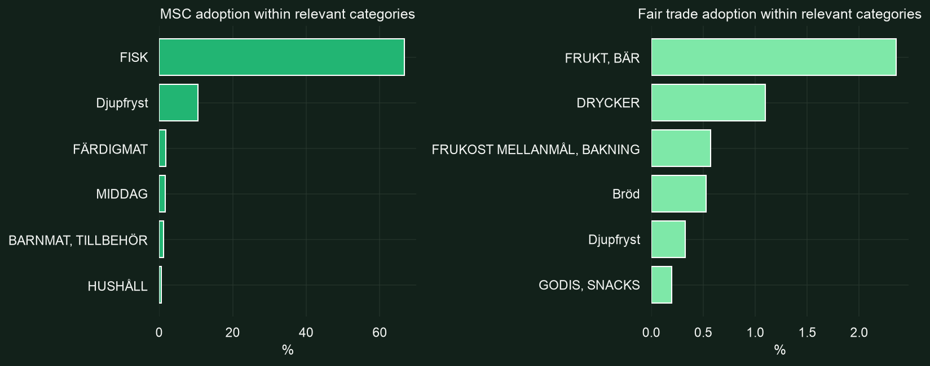
SUSTAINABILITY
MSC and fair trade only make sense in their own categories
• MSC (sustainable seafood) is concentrated exactly where expected: 66.6% of fish items carry it
• fair_trade peaks much lower even in its best categories (~2.4%) — realistically limited to a narrow slice like coffee, chocolate, bananas
COOP SVERIGE — DATA ANALYST CASE
10

Slide 14
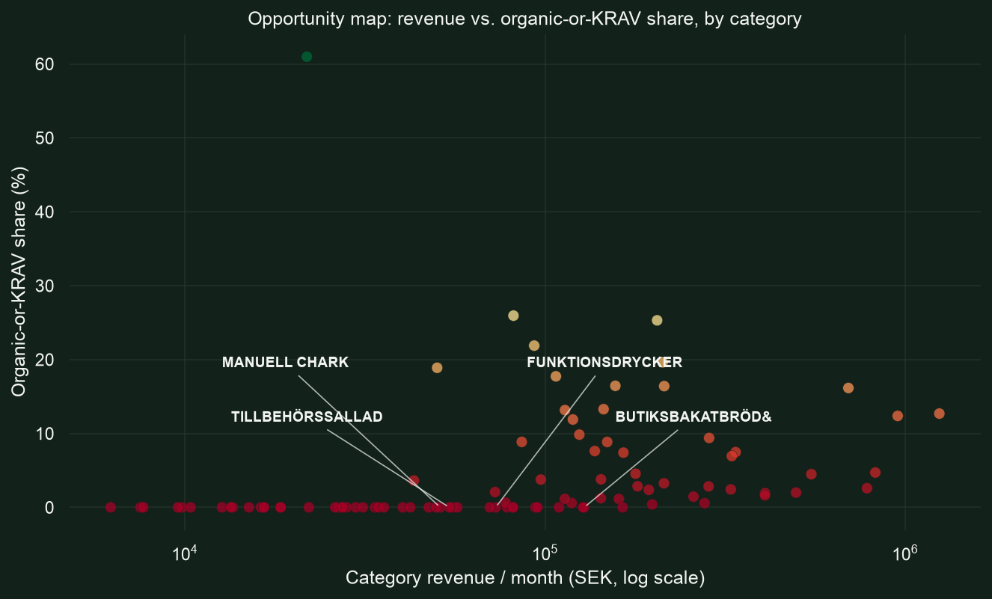
SUSTAINABILITY
The biggest opportunity is supply, not demand
• Corrected lens: organic-OR-krav, not organic alone — cheese and frozen fish looked like gaps under organic alone, but both already have real KRAV coverage
• The genuine gaps: in-store bread (~128K SEK/month), functional drinks (~73K), salad sides (~54K), and deli-counter meats (~51K) — all at 0% organic-or-krav
• These are real assortment gaps Coop controls directly, not a customer demand problem
COOP SVERIGE — DATA ANALYST CASE
11

Slide 15
SUSTAINABILITY — RECOMMENDED ACTIONS
What Coop should do
• Close the assortment gap in the REAL zero-coverage categories — in-store bread, functional drinks, salad sides, deli-counter meats — not cheese or frozen fish, which already have KRAV coverage
• Fix the organic flag's under-tagging for KRAV items internally — it quietly understates Coop's true organic-equivalent assortment everywhere, not just in the categories flagged here
• Investigate whether meat still under-indexes once KRAV coverage is accounted for, before treating it as a confirmed gap
• Promote MSC in fish, don't fix it — adoption is already strong (66.6%); this is a visibility/marketing play, not a supply gap
COOP SVERIGE — DATA ANALYST CASE
12

Slide 16
03
Customer Segmentation
What's the difference between our customer groups, and how should Coop act on that?

Slide 17
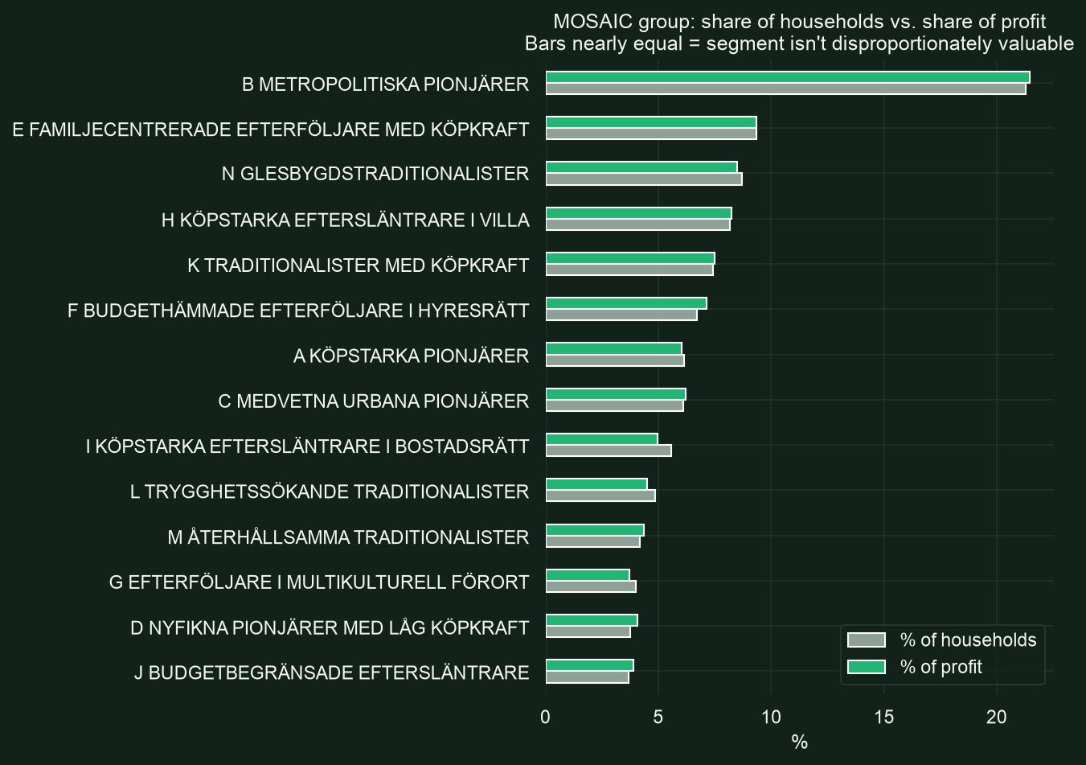
CUSTOMER SEGMENTATION
Demographic segments barely predict value
• Every MOSAIC lifestyle segment's profit share tracks its household share almost exactly
• Avg profit per household/month ranges only 178–216 SEK across all 14 segments — a narrow band, not a meaningful split
• MOSAIC group does NOT identify Coop's most valuable customers
COOP SVERIGE — DATA ANALYST CASE
13

Slide 18
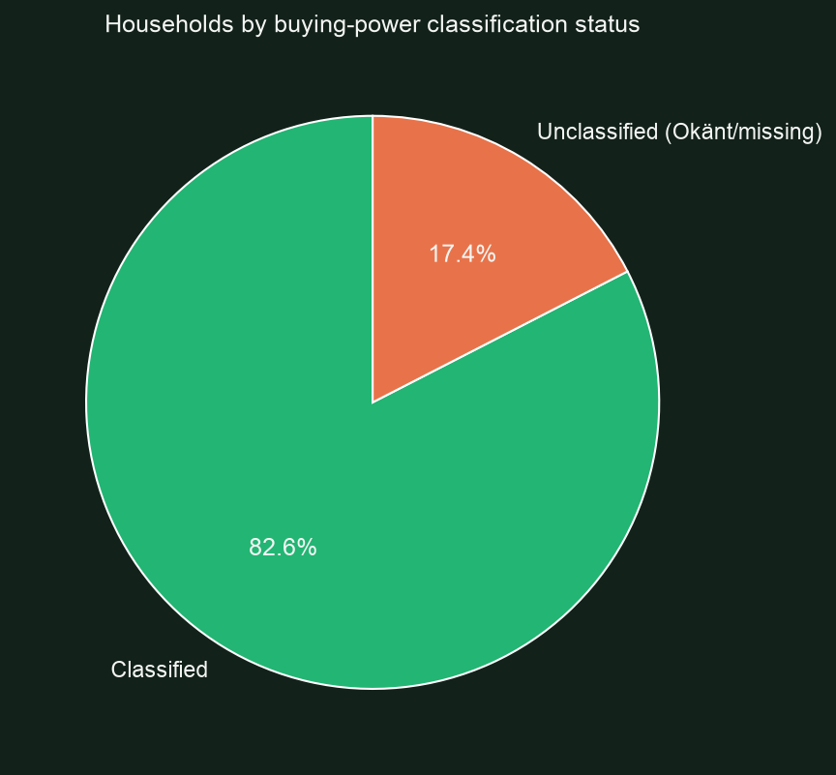
CUSTOMER SEGMENTATION
Buying-power class doesn't track spend — and much of it is unclassified
• LAG_KOPKRAFT (low buying power) households average 208 SEK profit/month — MORE than MYCKET_HOG_KOPKRAFT (very high buying power) households at 201 SEK/month
• An externally-assigned "purchasing power" label does not predict actual spend at Coop
⚠ DATA CAVEAT 17.4% of households (worth ~18% of profit) have no usable buying-power classification at all (Okänt or missing) — over 30x the equivalent gap in MOSAIC group. Nearly 1 in 5 households isn't represented if this field is used for targeting.
COOP SVERIGE — DATA ANALYST CASE
14

Slide 19
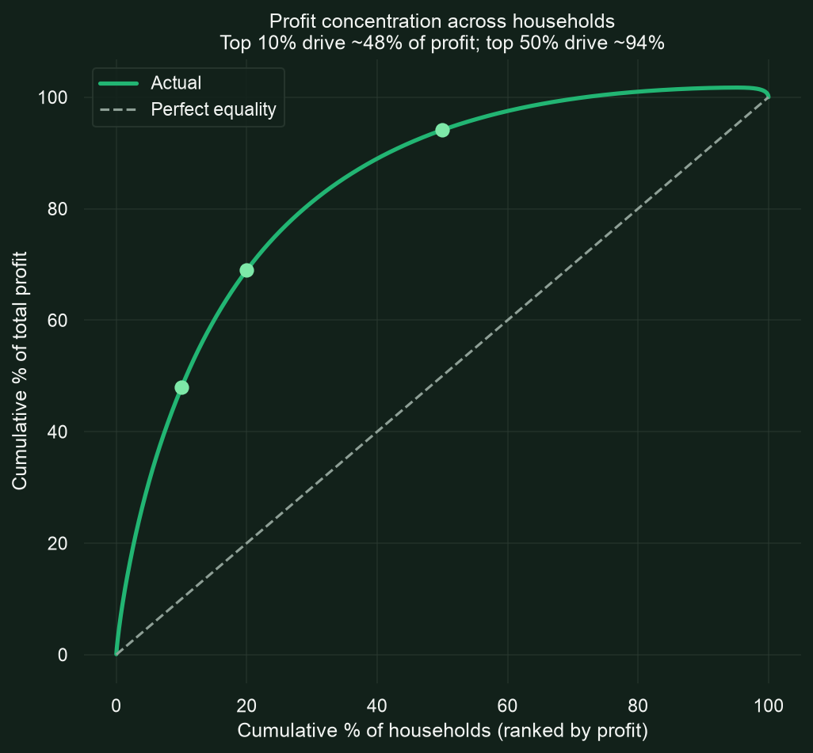
CUSTOMER SEGMENTATION
What actually predicts value: plain behavioral concentration
47.9%
of profit from the
top 10% of households
94.1%
of profit from the
top 50% of households
• Half of Coop's customer base contributes almost nothing (5.9% of profit) over this window
• A simple "heavy vs. light shopper" behavioral split captures far more than either demographic label
COOP SVERIGE — DATA ANALYST CASE
15

Slide 20
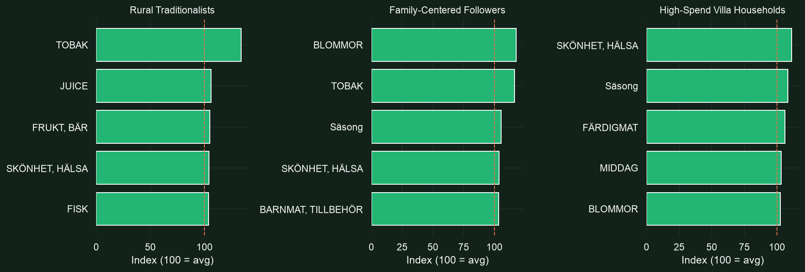
CUSTOMER SEGMENTATION
MOSAIC does show what segments buy — just not how much
Index = segment's spend-share in a category ÷ overall spend-share × 100 (100 = average)
COOP SVERIGE — DATA ANALYST CASE
16

Slide 21
CUSTOMER SEGMENTATION — RECOMMENDED ACTIONS
What Coop should do
• Stop leading with MOSAIC or buying-power class for value-based targeting — neither meaningfully separates high- from low-value households
• Build a simple behavioral (RFM-style) segment instead — the top 10-20% of households by actual spend deserve a dedicated retention/loyalty program
• Use MOSAIC for assortment and marketing, not value targeting — the category-affinity signal is real and actionable (e.g. tobacco/juice for rural traditionalists, beauty/health for high-spending villa households)
• Investigate the top 10% of households directly — demographic labels don't explain their value, so a behavioral deep-dive will be more useful than further demographic slicing
COOP SVERIGE — DATA ANALYST CASE
17

Slide 22
04
Discount Economics
What does discount spend actually cost us, and what's a converted customer worth?

Slide 23
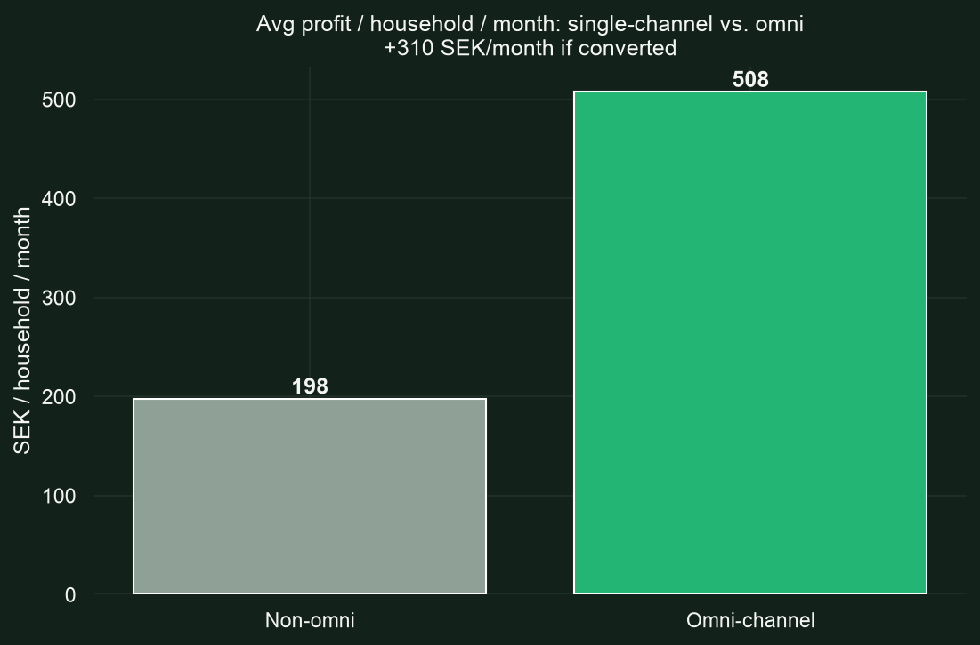
DISCOUNT ECONOMICS
Discounts cost little to offer — a converted customer is worth real money
• The marginal cost of OFFERING a discount is close to zero — no fixed spend; Coop only pays out when a customer actually redeems it, unlike advertising or headcount, which cost money regardless of results
• The real cost only shows up on redemption — quantified next: ~1.25M SEK/month, ~30.6% of gross margin (see Q4.5)
• Converting one single-channel household to omni-channel is worth +310 SEK/month in incremental profit — a real, ongoing prize per customer, not a one-off
⚠ DATA CAVEAT Our own Q4.2 analysis found the raw discount-usage-to-omni-channel correlation mostly disappears once controlling for visit frequency as a confound. This is the value AT STAKE if a conversion nudge succeeds — not proof that discounts alone cause it. Given the near-zero cost of testing, a controlled pilot (targeted discount to a matched sample, held against a control group) is the cheap way to find out.
COOP SVERIGE — DATA ANALYST CASE
18

Slide 24
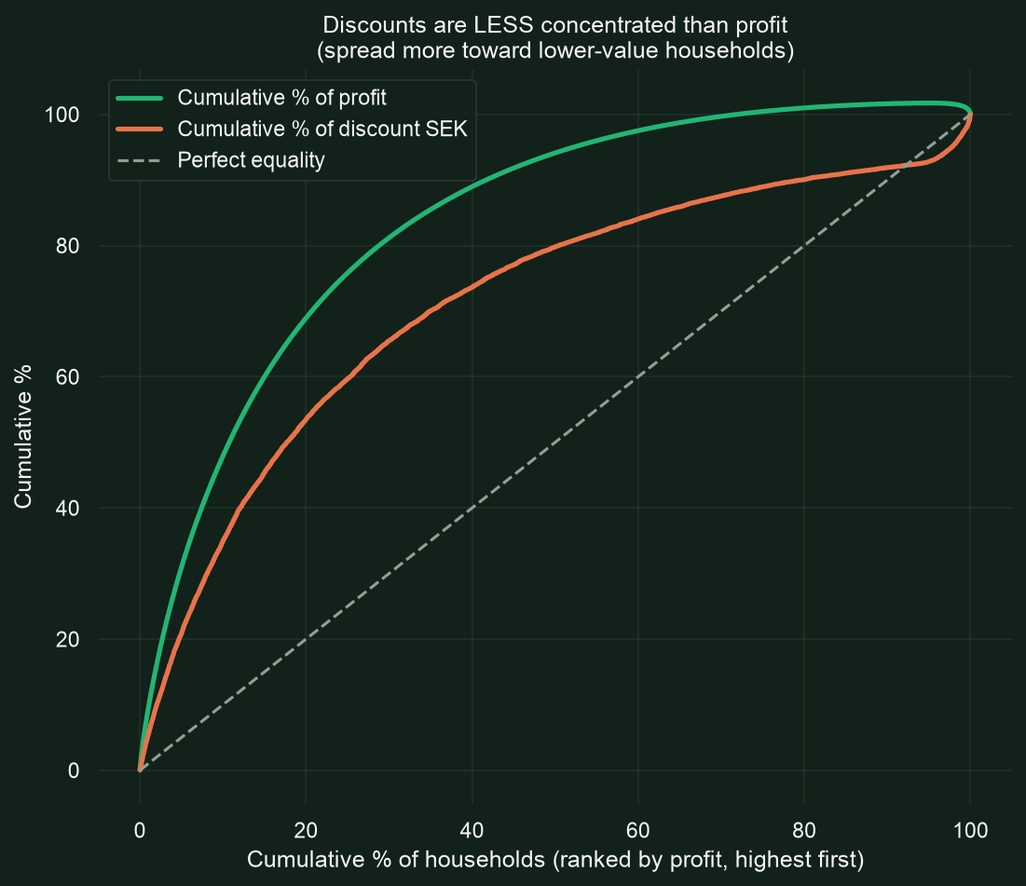
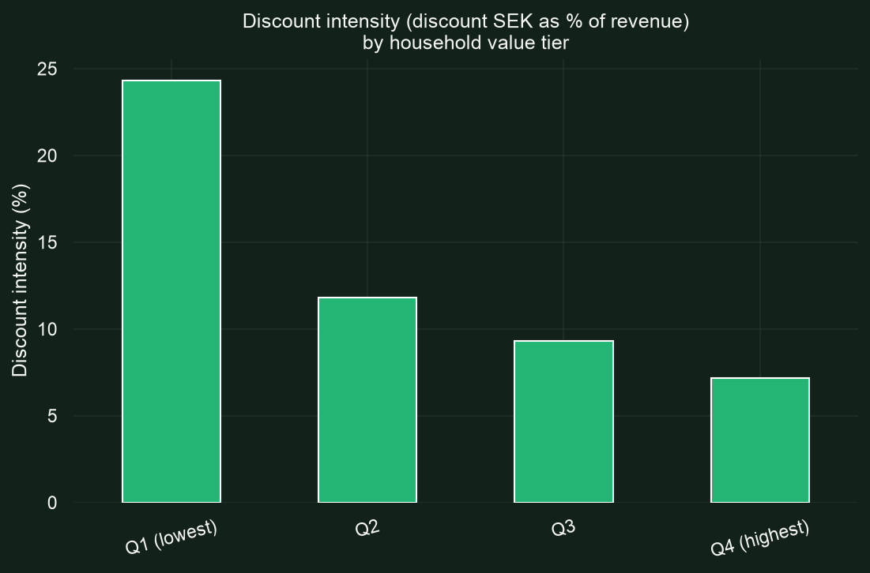
DISCOUNT ECONOMICS
Discount spend already skews toward lower-value customers
• Top 10% of households (by profit) drive 47.9% of profit but receive only 35.0% of discount SEK — discounts are LESS concentrated than value, not more
• Discount intensity (discount SEK as % of revenue) drops cleanly from 24.3% for the lowest-value quartile to 7.2% for the highest — the deepest discounting already goes to marginal customers, not top spenders
COOP SVERIGE — DATA ANALYST CASE
19

Slide 25
DISCOUNT ECONOMICS — RECOMMENDED ACTIONS
What Coop should do
• Run a controlled pilot: offer a targeted cross-channel discount to a matched sample of single-channel customers, held against a control group — near-zero cost to test, ~310 SEK/month upside per household if it works
• Don't rebalance the existing discount budget toward top-tier customers — today's allocation already skews toward marginal/lower-value households, which is directionally efficient as an acquisition/retention tool, not wasted spend
• Track discount ROI by household value tier going forward, not just in aggregate — turns an 8.5%-of-revenue cost center into a measurable, tunable lever instead of a blanket policy
• Reuse this same near-zero-cost mechanism for Q4.3's finding — target low-margin-anchored "loyal" customers with a discount nudging them toward a higher-margin substitute, not just channel conversion
COOP SVERIGE — DATA ANALYST CASE
20

Slide 26
SYNTHESIS
The throughline across all four questions
• Channel behavior (01): omni-channel households are worth ~2.6x more profit/month, and that holds even after adjusting for buying power — real behavioral value, not just wealthier customers. The biggest blocker is self-inflicted: no weekend online, no Store-B online.
• Sustainability (02): the gap is supply, not demand — in-store bread, functional drinks, salad sides, and deli-counter meats have zero organic-or-KRAV options today. The organic flag itself under-counts real coverage (KRAV implies organic) and is worth fixing before it drives further decisions.
• Customer segmentation (03): behavior beats demographics — MOSAIC and buying-power class barely predict value, but plain spend concentration does: the top 10% of households drive ~48% of profit.
• Discount economics (04): discount spend already skews toward marginal customers, not wasted on the loyal ones — and since offering a discount costs almost nothing until redeemed, it's a cheap lever worth testing further (e.g. nudging single-channel customers toward omni).
COOP SVERIGE — DATA ANALYST CASE
21

Slide 27
Tack!
Questions & discussion

